Slide 1
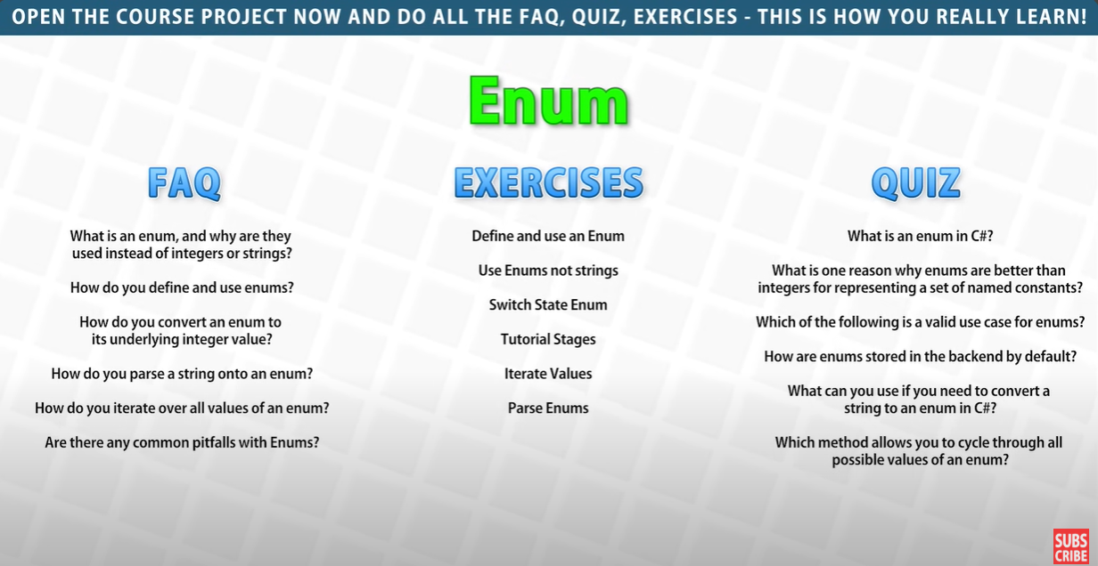
Notes:
When you use enums, the code becomes self-documenting because you work with descriptive names instead of arbitrary numbers. This reduces the cognitive load for anyone reading or maintaining the code since the purpose of each value is clear.
enum Season { Spring, Summer, Autumn, Winter } Season currentSeason = Season.Autumn; if (currentSeason == Season.Spring) { Console.WriteLine("Spring"); } else if (currentSeason == Season.Summer) { Console.WriteLine("Summer"); } else if (currentSeason == Season.Autumn) { Console.WriteLine("Autumn"); } else if (currentSeason == Season.Winter) { Console.WriteLine("Winter"); }
Here, Season.Autumn is immediately clear as a specific named value. There's no need to guess or refer to documentation to understand what it represents.
Enums in C# are best suited for scenarios where you need to represent a fixed set of related constants with meaningful names. Here are the most common valid use cases for enums:
In the backend, enums in C# are stored as their underlying integer values by default. When you define an enum, each enumerator (enum member) is associated with a constant integer value, starting from 0 unless specified otherwise.

Slide 2
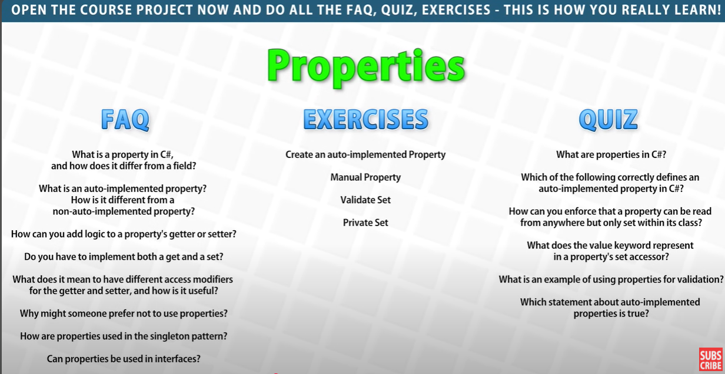
Notes:
How can you enforce that a property can be read from anywhere but only set within it's class
To enforce that a property can be read from anywhere but only set within its class, you can use different access modifiers for the get and set accessors. Specifically, make the set accessor private while keeping the get accessor public.
what does the value keyword represent in a property's set accessor
In C#, the value keyword in a property's set accessor represents the value that is being assigned to the property when it is set.
When you define a property with a set accessor, the value keyword acts as a placeholder for the data passed to the property. This value can then be assigned to a backing field or used in logic within the set block.
public class Person
{
private string _name;
public string Name
{
get { return _name; }
set { _name = value; } // 'value' represents the data being assigned to Name
}
}
var person = new Person();
person.Name = "John"; // 'value' is now "John" inside the 'set' accessor
Console.WriteLine(person.Name); // Output: John
What is an example of using properties for validation
public class Person
{
private string _name;
private int _age;
// Property with validation for 'Name'
public string Name
{
get { return _name; }
set
{
if (string.IsNullOrWhiteSpace(value))
throw new ArgumentException("Name cannot be empty or whitespace.");
_name = value; // Valid value assignment
}
}
// Property with validation for 'Age'
public int Age
{
get { return _age; }
set
{
if (value < 0 || value > 120)
throw new ArgumentOutOfRangeException("Age must be between 0 and 120.");
_age = value; // Valid value assignment
}
}
}
Which statement about auto-implemented properties is true
Auto-implemented properties are a shorthand way of defining properties without explicitly defining a backing field. The compiler automatically creates a private, anonymous backing field for you.
can properties be use in interface
public interface IPerson
{
string Name { get; set; }
int Age { get; }
}
public class Person : IPerson
{
public string Name { get; set; }
public int Age { get; private set; }
public Person(string name, int age)
{
Name = name;
Age = age;
}
}
No explicit backing field required: The compiler creates it automatically.
Simple and concise: Ideal for cases where no additional logic is needed in the getter or setter.
Can still control accessibility: You can use access modifiers on the get or set parts of the property to control how they can be accessed or modified.

Slide 3
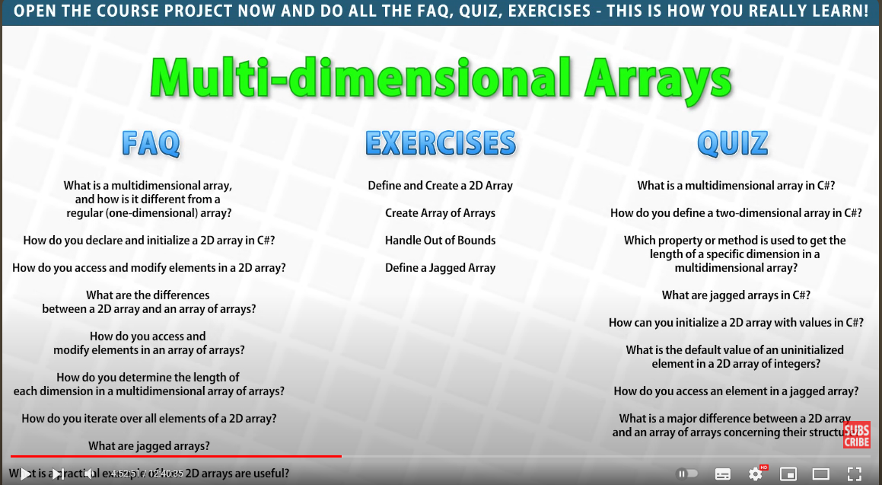

Slide 4
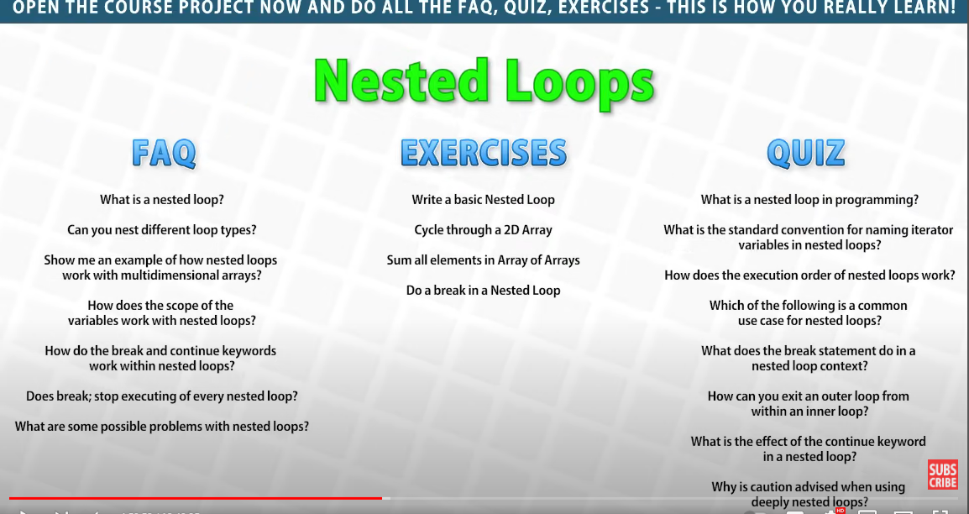

Slide 5
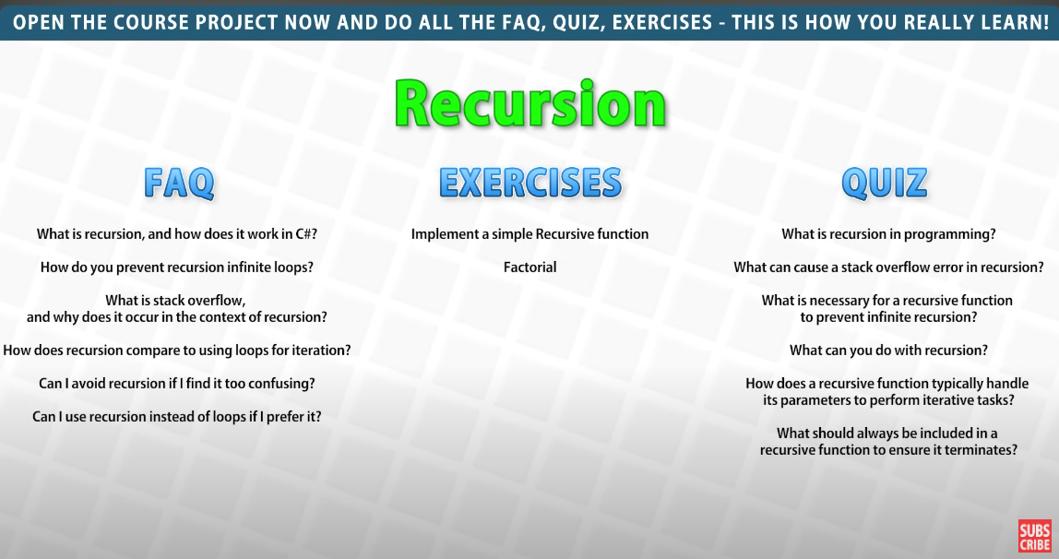
Notes:
What is stack overflow and why does it occur in the context of recursion
In the context of recursion, every recursive function call pushes a new frame (containing function parameters, return address, and local variables) onto the call stack. If the recursion is too deep or if the base case is missing or improperly implemented, the stack becomes full, leading to a stack overflow.

Slide 6
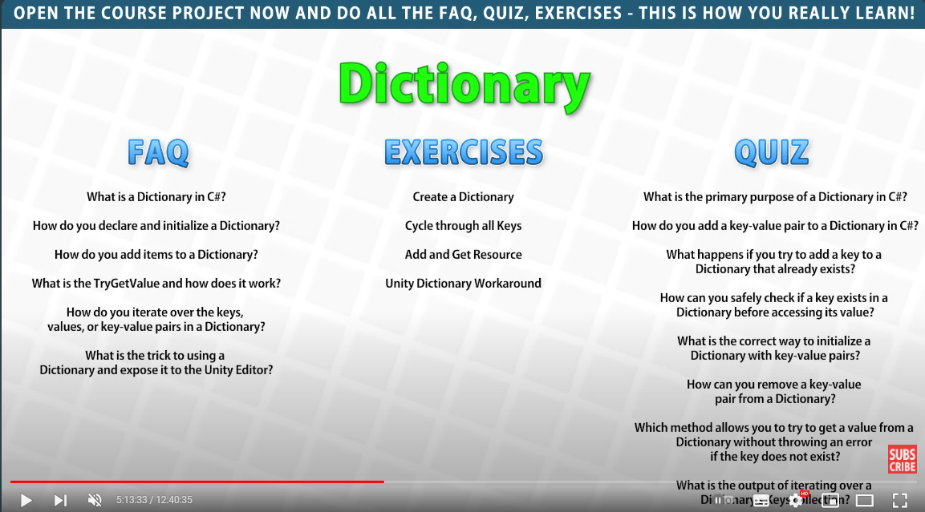

Slide 7
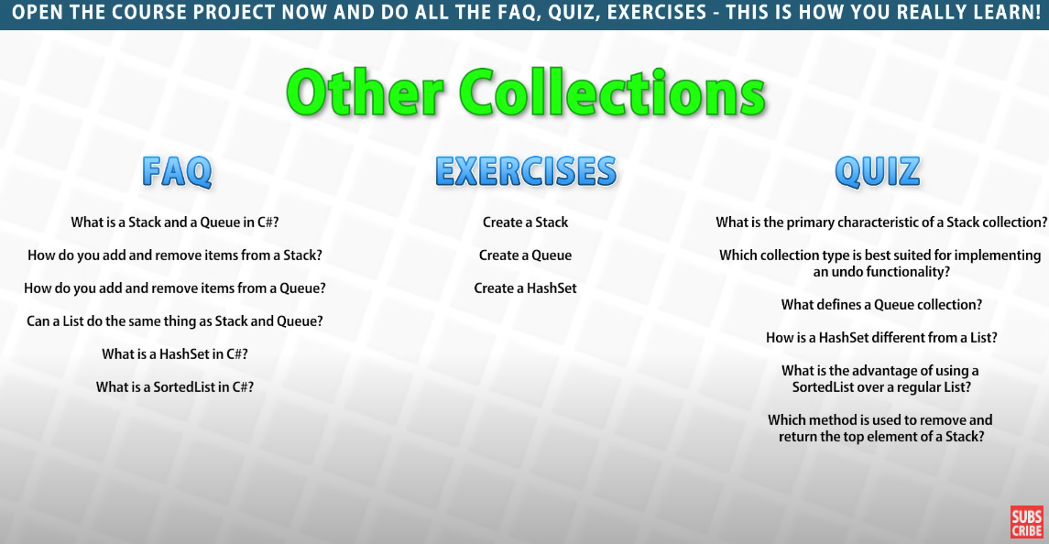

Slide 8
