Slide 1

Word-Level Auto Text Generator Using RNN-LSTM
Sarthak Kaushik
Nov 30, 2021
SCS 3546 Deep Learning
University of Toronto

Slide 2
Introduction
Objective of this project is to autogenerate text given a "word" or a "sequence of words" and the number of words to be generated.
Three different variations of RNN-LSTM models are used to evaluate the impact of RNN-LSTM architectures on the level of text generation.
There are two general methods that are widely used for auto text generation.
Character level auto generator
Word level auto generator

Slide 3
Methodology
Text Pre-Processing
Dataset - "Alice in Wonderland" from the Project Gutenberg™
Build and Train Network(s)
Colab-GPU based Notebook
Generate Text Given Seed Text and length of sequence
Compare the output from the three models

Slide 4
Text Pre-Processing
Remove the header and footer from text files
Remove punctuations
Tokenize words in text
Ignore Words from “vocab” that are less frequent in corpus
Create Sentences of fixed length (ignore sentences that have ignored words”)
For vocab - Maintain a dictionary for word-> index and index->word

Slide 5
Build & Train Model
Three Models
Base Model – 1 Layer Bidirectional LSTM
Based Model with Dropout = 0.2
Stacked LSTM Models

Slide 6
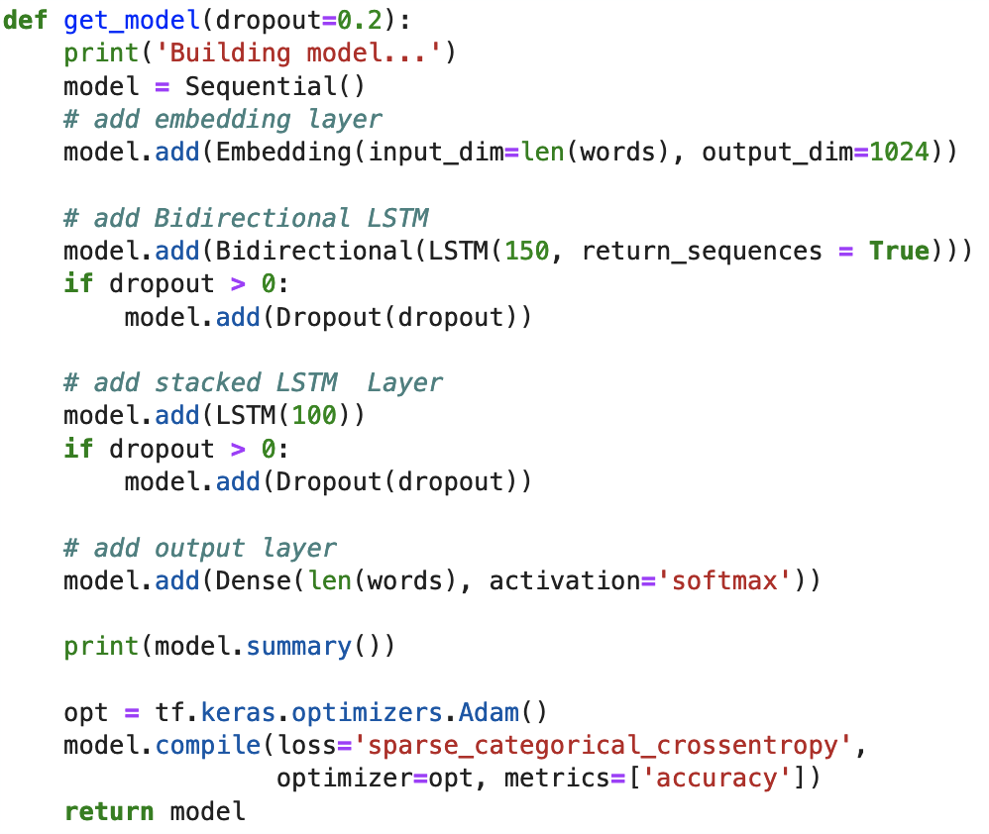
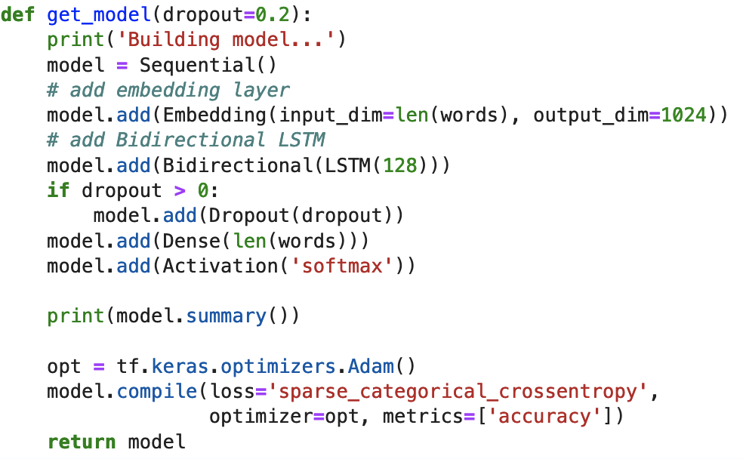
RNN-LSTM Models
Base Model (with Dropout)
Stacked LSTM Model without dropout

Slide 7
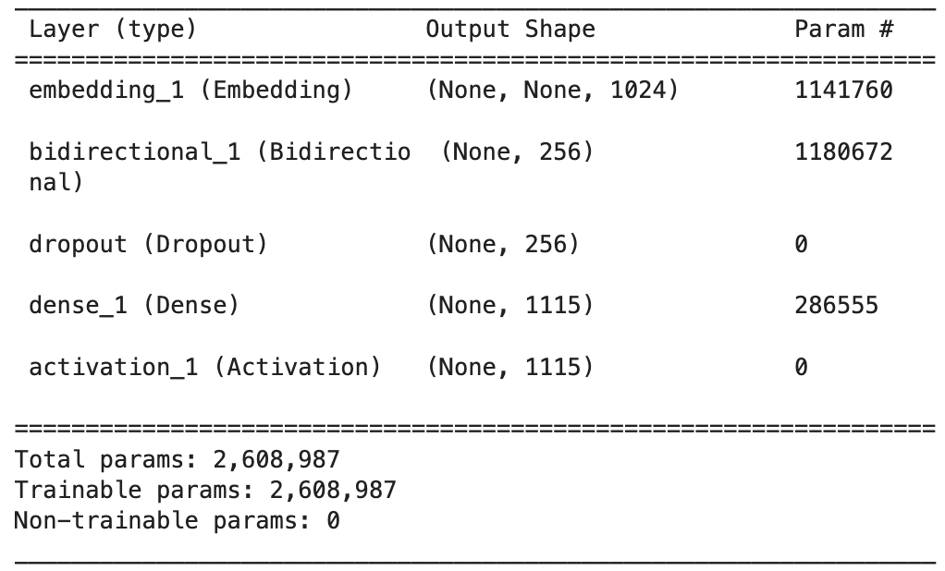
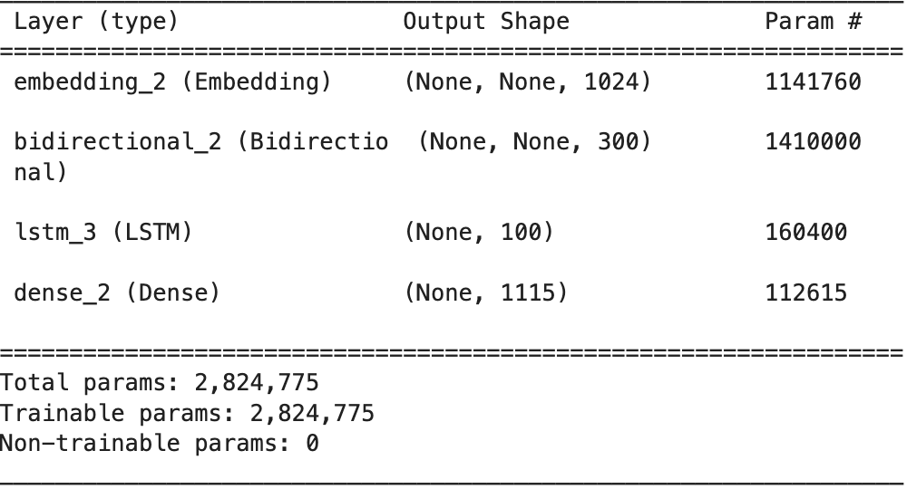
RNN-LSTM Layers
Base Model (with Dropout)
Stacked LSTM Model without dropout

Slide 8
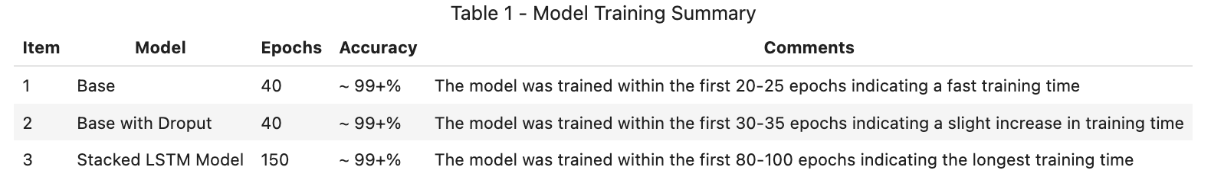
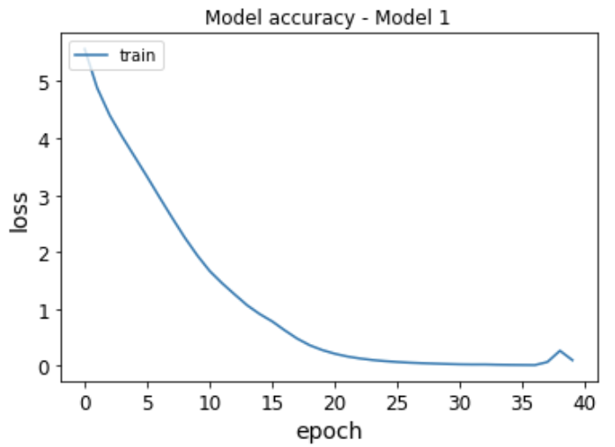
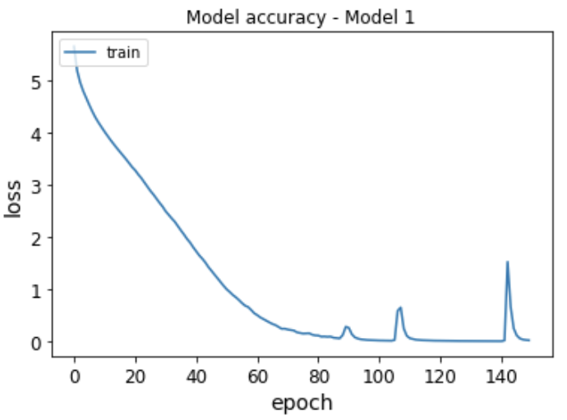
Results and Discussions
Loss- Model 1
Loss- Model 2
Loss- Model 3

Slide 9
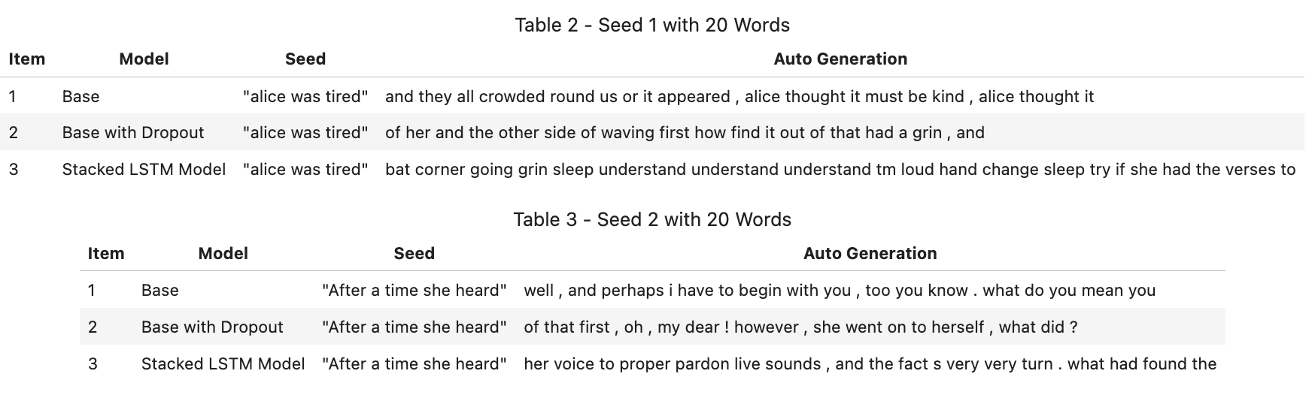
Auto Text Generator

Slide 10
Future Work
Future work on this would be to train these three models on other applications -
Tweets - Train data on a particular celebrity twitter dataset and generate tweets
Create Dialogues for a chat-bot
Compare the word-level vs character-level text generation
Tune the hyperparameters of the model
Drop out
add Batch Normalization
See how the auto-generated text varies with epochs

