Slide 1
Agents that finish the job.
Many agents in parallel. One screen to steer them.
Simon Irengard-Gullstrand · October 2026
Notes:
Today: how I run AI coding at scale without it running away from me. The pitfalls, the layered setup that answers them, and what it buys us as a team.

Slide 2






Left alone, agents go wrong in six ways.
Endless fix loops
Snowballing context
One model for everything
The same failing idea, retried for an hour.
Every early token is paid for again on each turn.
Opus skimming logs. Haiku reviewing money code.
Confidently wrong
Agents in the dark
Unseen pushes
Green tests that test nothing.
Five terminals. Which one is stuck?
Code leaves before anyone looks.
Notes:
Everyone who has used Claude Code or Copilot agents for real work has hit these. Everything that follows answers one of these six.

Slide 3
Six layers. Each with one job.
Podium
The control room A live dashboard and CLI over the whole run.
Shell
orchestrate-deep-plans Epics to stories, built in parallel.
Planner
deep-plan One feature from recon to a merged PR.
Leaf skills
Swappable one by one grilling, tdd, deep-qa, create-deep-pr.
Runtime
Under every spawn Paseo or Agent, model tiers, a contract.
RTK
Under every command Trims output before the model reads it.
Notes:
Top to bottom: Podium is where I watch and steer. orchestrate-deep-plans plans a feature and fans out stories. deep-plan runs one feature end to end, and deep-app-plan sits above it for a whole new app. Leaf skills are small and swappable. The runtime decides how each agent is spawned and on which model: the subagent protocol, Paseo or Claude Code agents, Haiku/Sonnet/Opus, and a contract of commands that must pass. RTK sits under every shell command.

Slide 4
Many agents in parallel. One plan.
Wave 1
Wave 2
Wave 3
S1 Invite API
S5 Audit log
Orchestrator
plans, dispatches, lands
S2 Email sender
S8 Onboarding
Merged
S6 Invite page
S3 Billing math
S9 End-to-end
S7 Migration
Sonnet builds
S4 Settings UI
Opus where it matters
10
7 min
4.2 days
stories building at once
Stories that share no files run side by side.
median story, dispatch to merge
Each agent works in its own worktree and branch.
for a 14-milestone app
Skåne Spa, planned and steered from Podium.
Notes:
This is the core idea. The orchestrator breaks a milestone into stories, works out which ones depend on each other or touch the same files, and dispatches every story that is ready at once, each to its own agent in its own git worktree. Most build on Sonnet; stories touching money, dates, auth or migrations get Opus. When a wave lands, the next one starts. Podium shows all of it live, so speed doesn't cost you control. Numbers are from my Skåne Spa run: up to 10 stories building at once, a median of about 7 minutes from dispatch to merge per story.

Slide 5
A run, from plan to retro.
P0
P1
P2
P3
P4
P5
Adopt
Plan
Breakdown
Build
Handback
Retro
Picks up earlier plans
Epics and decisions first
Stories and their models
One agent per story
Gate, verify and land
Only after friction
Inside every milestone
R
recon
0
grill
0.5
UI mock
1
architecture
2
spec
3
TDD + gate
4
verify
5–6
land
Each step ends on a checkpoint, so a fresh context can pick up where the last one stopped.
Notes:
The orchestrator owns P0 to P5; P3 is where the parallelism happens, and P4 runs in a fresh Opus subagent. Inside each milestone, deep-plan walks the same steps every time. The ledger stays under 60 lines, so a phase can restart in a clean context instead of dragging a huge one along.

Slide 6
The suite as a layer cake.
P0 Adopt
P1 Plan
P2 Breakdown
P3 Build
P4 Handback
P5 Retro
Shell
orchestrate-deep-plans
Podium CLI and extension · human modes · two milestones at once · epic decisions before the milestone cut
Planner
deep-plan
Reads earlier plan history
deep-plan: recon, grill, mock, architecture, spec
Splits tasks into stories
Parallel story agents replace the serial build
deep-plan: gate, verify, land
A fresh subagent reads the milestone's friction
Leaf skills
swappable one by one
Explore
grilling
research
prototype
domain-modeling
codebase-design
—
tdd in every story prompt
deep-qa
code-review
security-review
diagnosing-bugs
create-deep-pr
retro rules
podium tokens
podium finding
Runtime
under every spawn
subagent protocol · Paseo or Agent · Opus for critical work, Sonnet for the rest · a contract of commands per repo
Notes:
The same suite drawn as a layer cake: phases left to right, layers top to bottom. The shell owns the run and Podium. The planner/lander is the per-feature skill; only its plan and land halves are used, because P3 swaps its serial build for parallel story agents. Leaf skills are swappable one by one. The runtime sits under every spawn. A layer only calls the one beneath it, which is what makes each part replaceable.

Slide 7
Built on ideas that work.
grilling · Matt Pocock
Grill before you build
A spec brief with numbered assumptions you confirm before any code.
wayfinder · Matt Pocock
Map decisions, then build
Questions spanning milestones are settled first; work too big gets re-cut.
epic-breakdown-advisor · Dean Peters
Thin vertical slices
Milestones cut with Humanizing Work's splitting patterns and a Valuable check.
prototype · Matt Pocock
Prototype to decide
A clickable mock is signed off before a single story is built.
tdd · Matt Pocock
Red, green, refactor
One commit per green slice, and a contract that must pass.
code-review · Matt Pocock
Review on two axes
Standards and spec reviewed by parallel subagents at every gate.
codebase-design · after John Ousterhout
Deep modules
Interfaces are pinned before stories split, so agents don't collide.
retro · Matt Pocock
Learn from every run
Friction becomes findings, and findings become next week's fixes.
writing-for-agents · Matt Pocock
Checkable instructions
Every step ends on a completion criterion an agent can verify.
Notes:
The suite is mostly good ideas from other people, wired together and enforced. Matt Pocock's skills (github.com/mattpocock/skills): grilling, wayfinder, prototype, tdd, code-review, codebase-design, retro and writing-for-agents. Dean Peters' epic-breakdown-advisor (github.com/deanpeters/Product-Manager-Skills), built on Richard Lawrence and Peter Green's Humanizing Work guide to splitting user stories, shaped how epics are cut into milestones, including its rule that a slice that isn't valuable shouldn't be split off. Deep modules come from John Ousterhout's A Philosophy of Software Design. What the suite adds is the orchestration: these run in a fixed order, in parallel where they can, with Podium showing all of it.

Slide 8
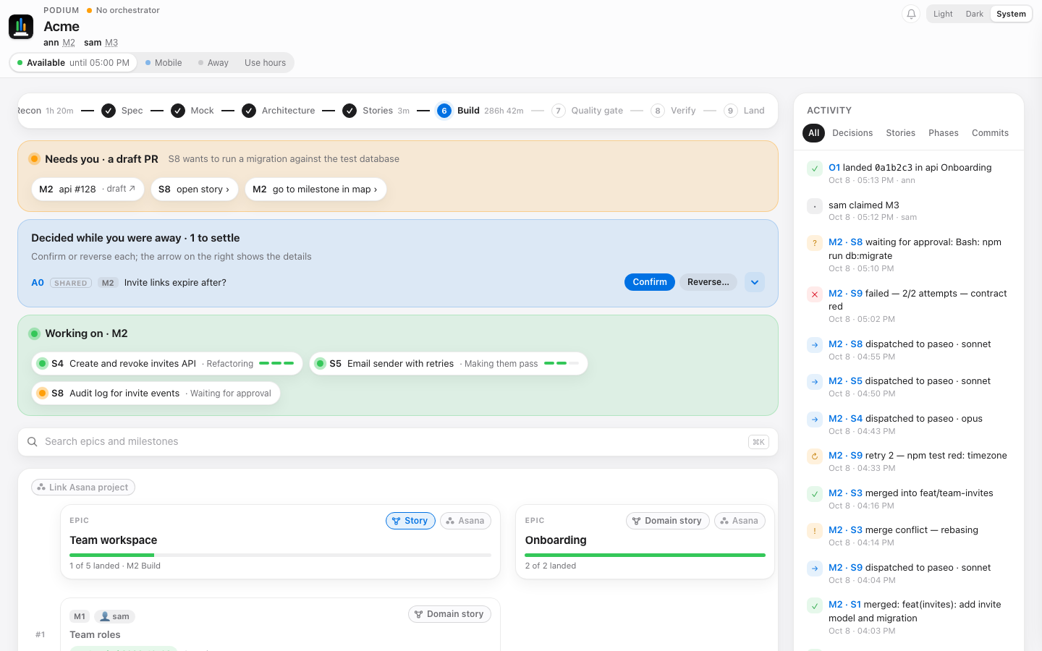
See every agent. Steer from one screen.
Needs you
A draft PR or a story waiting for your approval.
Decided while away
Assumptions the run made. Confirm or reverse.
Working now
Every story agent and what it is doing.
Two Macs, one run
State syncs through a git ref. Each claims milestones.
Notes:
The Podium on a sample run. Orange: things that need me. Blue: decisions the run made while I was away. Green: stories being built right now. On the right the activity feed shows each dispatch with its model, retries and failures. It's plain JSON and a CLI, Python standard library only, with 438 tests.

Slide 9
Nothing loops forever.
3
2
2
tries per failure
attempts per story
rounds of gate churn
Then it stops and reports.
Then it blocks dependants and asks.
Then the verify loop stops and reports.
8
6
1h
lines per subagent reply
open decisions per epic
idle and Podium stops
Or one: COMMITTED or FAILED.
Settled before the build starts.
No one around, nothing running.
Notes:
The direct answer to the infinite loop. Verify retries start from the last green commit each time. A failed story blocks the stories that depend on it. When a cap is hit, a human decides, which is cheaper than an agent burning an afternoon.

Slide 10
The right model for every job.
Opus
Sonnet
Haiku
Recon, security pass,
screenshot checks
Story builders,
background drafts
Review gates, bug diagnosis,
money, dates, auth
And a small context. Every spawn names its model, late phases start fresh, briefs share a cache prefix.
Notes:
An unnamed spawn inherits the session model, usually Opus, so the subagent protocol makes every spawn pick deliberately. Context matters because the orchestrator re-reads its whole context every turn; files over 300 lines get targeted reads only.

Slide 11
RTK shrinks what the model reads.
−71%
output on ls -la. −48% on git log.
Tests show only failures. Truncated output tells the model how to get the rest. Already-tight output, like a single diff, barely shrinks.
Notes:
RTK is a CLI proxy: the agent runs commands as usual and RTK condenses the output before it reaches the context. I measured these on the podium-dashboard repo. The saving compounds, because every token in the context is re-read on later turns.

Slide 12















Quality is gated, not hoped for.
Grill
Mock
TDD
Gate
Verify
PR
You
Assumptions confirmed
UI signed off first
Red, green, commit
Opus review, contract
deep-qa on the real app
Agent, Copilot, shots
Push preview first
Eight QA lenses. A verdict, never a silent skip.
Defects
static
Spec
static
Design
static
Security
static
Contract
running app
Journeys
running app
Accessibility
running app
Performance
running app
Notes:
Seven gates between an idea and a push. The grill forces assumptions into the open before code exists, as a spec brief you confirm. TDD stops vacuous tests. deep-qa only reports: pass, fixable or blocked, and a lens that can't run is reported, never dropped. The last gate is always a human.

Slide 13




You stay in charge. Even while away.
Nothing leaves without a yes
Away mode keeps work moving
Caps hand control back
Shared runs can't run code
Every push starts with a preview you see. PRs open as drafts.
Agents log their assumptions. You confirm or reverse each.
A story failing twice stops and asks you.
A pull never executes anything. Commands are approved by digest.
Notes:
Autonomy without losing control. The agents keep going while I'm in meetings, but every irreversible step, and every guess they made, comes back to me.

Slide 14
It gets better every week.
1
1
Retro
A milestone with friction turns retries, failures and denied prompts into findings.
2
Gather
Findings sync per run. Colleagues share patterns, never transcripts.
Every
week
4
2
3
Improve
Problems seen in two runs get up to five drafted, tested fixes.
4
Approve
You ship what you like. Fixes that saved no tokens get reverted.
3
Notes:
The setup learns from its own friction. The retro looks for repeated mistakes and repeated work that wastes tokens; podium tokens mines session logs for oversized output and repeated commands. /deep-improve runs as a weekly schedule with nobody watching; it asks nothing, drafts fixes on local branches and writes a report. Nothing ships without my approval.

Slide 15
What it has shipped so far.
86
99%
milestones landed
of 413 agent-built stories
Across six projects, each through the same gates.
Landed on the first dispatch. None hit the retry cap.
1,092
4.2
review findings before merge
days for Skåne Spa
Raised by the gates; 74% fixed before landing, the rest skipped with a reason.
14 milestones, up to 10 stories in parallel, about $2.50 of model time per story.
Measured from Podium runs and Claude session logs. There is no same-feature build without the setup, so no “X× faster” claim.
Notes:
Real numbers from my own runs, not a benchmark. 86 milestones landed across six projects, mostly side projects like Skåne Spa, plus one shared work run. 99% means no re-dispatch was needed; an agent may still iterate inside its one attempt. The 1,092 findings are mostly standards and spec findings, not all bugs. Skåne Spa cost about $244 at list price, $170 of it the Opus orchestrator. What I can't claim: a speed-up versus working without it, fewer escaped bugs, or fewer tokens. The model mix lowers cost per token only modestly, about 5% on a whole run, because the orchestrator stays on Opus. That's the next thing to improve.

Slide 16
What you get.
Parallel speed
Up to 10 agents building at once, each on the model its job needs.
Control you can see
Plan, steer and approve from one screen. Every loop capped.
Quality by default
Gates from grill to push, not a review at the end.
Compounding gains
This week's friction is next week's fix.
github.com/warriv93/podium-dashboard · github.com/warriv93/deep-skills
Notes:
The four things to take away: parallel agents for speed, Podium for control, gates for quality, and a weekly pass that improves the suite itself. To try it: install Podium from github.com/warriv93/podium-dashboard and the skills with deep-skills' install.sh, then start with /deep-plan on one feature. Questions?

