Slide 1
BRAIN MAPPER | PROGRESS PRESENTATION
A Cognitive-Aware Learning Analytics Framework Using Large Language Models and Knowledge Tracing
Integrating 6-Dimensional LLM Cognitive Skill Extraction, CA-KT Modeling, and Offline LAN Assessment
RESEARCH TEAM (DEPARTMENT OF DATA SCIENCE)
• L. Waruna Lakshan Silva (Team Leader)
• K.A.A. Dilshan
• K.A. Pramudi Biyonika Himaranshi
• Tharindu Kothlawala
SUPERVISION & INSTITUTION
• Miss. Risuni Siyara (Dept. of Software Engineering)
• Dr. Chameera De Silva (Dept. of Data Science)
SLTC Research University, Ingiriya Road, Meepe, Sri Lanka

Slide 2
01 | INTRODUCTION
Project Overview & Problem Statement
Project Overview
Problem Definition
• Context: In Sri Lankan schools, exam marks are mainly used for grading, leaving rich question-level answer script insights underutilized.
• Brain Mapper Vision: A Cognitive-Aware Learning Analytics Framework combining Large Language Models (LLMs) and Knowledge Tracing (KT).
• Core Mechanism: Automatically scores 6 cognitive skills per question and integrates them with student response histories for accurate prediction & explainable learner profiles.
• Real-World Delivery: Paired with an offline LAN Digital Examination Platform to capture Grade 10–11 responses without internet access.
• Black-Box KT: Traditional KT (DKT, qDKT, QKT) models correctness and concept IDs but ignores underlying cognitive processes.
• Assessment Blind Spots: Educators cannot tell why a student struggles (e.g., weak Working Memory vs. Logical Reasoning) or align exam difficulty.
• Manual Bottleneck: Expert cognitive tagging (Q-matrix / CDM) is slow, subjective, and impossible to scale to thousands of questions.
• Data & Connectivity Gap: Paper scripts are returned and lost by students; rural/school labs lack reliable internet for online testing.
Research Questions
• RQ1 (Prediction): Does incorporating LLM-derived cognitive skill requirements into KT improve student performance prediction over traditional KT baselines?
• RQ2 (Explainability): Can Cognitive-Aware KT provide more explainable insights into student cognitive strengths and weaknesses than traditional KT?
• RQ3 (Skill Influence): Which cognitive skills exert the greatest influence on student performance prediction within the proposed framework?
Brain Mapper | Cognitive-Aware Learning Analytics Framework | SLTC Research University
2 / 14

Slide 3
01 | INTRODUCTION
Aims, Research Objectives & Scope
PRIMARY AIM: Develop a Cognitive-Aware Learning Analytics Framework using LLMs and Knowledge Tracing to improve student performance prediction and deliver explainable insights into learner cognitive behavior.
RO1: Cognitive Skill Extraction
RO2: Cognitive-Aware KT Model
RO3: Empirical & Expert Validation
Identify and represent 6 cognitive skill requirements per question (Attention, Working Memory, Logical Reasoning, Language Processing, Critical Thinking, Metacognition) on a 0–3 scale using multimodal LLMs.
Design and train CA-KT integrating question cognitive demand vectors with sequential student interaction histories to model evolving knowledge & cognitive mastery states.
Benchmark prediction accuracy (AUC, Accuracy, RMSE) against DKT, qDKT, and QIKT/QKT baselines, and validate explainable learner profiles alongside an offline LAN exam platform.
Research Scope
Expected Outcomes
• Focus: Prediction modeling & explainable cognitive analytics (not automated grading decisions).
• Ethics: De-identified data only; LLMs support educators rather than replacing judgment.
• Deliverables: Trained CA-KT model, 6-skill cognitive dataset, explainable profiler, and benchmark report.
• Deployment: Offline LAN MCQ examination platform ready for Phase 2 school data collection.
Brain Mapper | Cognitive-Aware Learning Analytics Framework | SLTC Research University
3 / 14

Slide 4
02 | PROGRESS
Current Progress & Completed Milestones (Aug – Nov 2026)
7,652 / 7,652
Questions Annotated
100% DeepSeek Multimodal (0–3)
5.55M
Student Interactions
18,066 Students (XES3G5M)
6 / 6 Models
Full-Dataset Trained
DKT, qDKT, QIKT & 3x CAKT
30 / 30 Tests
All Automated Checks Pass
22 Python + 8 Node.js Tests
Milestone / Component | Timeline | Status | Key Achievement
1. School Data Collection Attempt | Aug 4 – Aug 18 | Deferred to Phase 2 | Identified answer-script loss bottleneck; built LAN platform for Phase 2
2. XES3G5M + ExRec Data Curation | Aug 19 – Aug 26 | Completed (100%) | 7,652 Qs (2,214 visual + 2,459 PNGs), 5,549,184 events, zero leakage
3. Zero-Cost DeepSeek Extension | Sep 11 – Nov 11 | Completed (100%) | Chrome MV3 + Bridge Server annotated all 7,652 Qs at $0 API cost
4. Multi-LLM Cross-Validation | Nov 9 – Present | In Progress (12/500) | Gemini Web extension (Port 8767) built; 500-Q Gemini Pro run started
5. Baselines & New CA-KT Training | Nov 11 – Nov 12 | Completed (100%) | Trained DKT, qDKT, QIKT, Normal/Cluster/New CAKT; New CAKT ranks #1
6. Offline LAN Exam App (BrainMapper) | Nov 1 – Nov 12 | Phases 1–3 Built | Home, Roster, Quiz Builder (MCQ), QR Monitor & Student Exam Portal live
Brain Mapper | Cognitive-Aware Learning Analytics Framework | SLTC Research University
4 / 14

Slide 5
03 | RELATED WORK
Literature Summary & Identified Research Gap
Model / Family | Core Mechanism | Strength | Limitation Addressed by Brain Mapper
BKT (Corbett & Anderson) | Hidden Markov / Probabilistic | Interpretable single-skill mastery | Assumes independent skills; weak on complex items
DKT (Piech et al., 2015) | LSTM Recurrent Neural Net | Captures long sequential history | Concept-level only; opaque hidden states
DKVMN & SAKT (2017–19) | Memory Nets / Self-Attention | Models concept relations & attention | No question-specific difficulty or cognitive load
AKT (Ghosh et al., 2020) | Monotonic Attention + Rasch | Rasch embeds reduce overfitting | Lacks cognitive process profiling
qDKT (Sonkar et al., 2020) | Question-Centric LSTM + Graph | Distinguishes questions within KCs | Suffers on sparse/new question IDs
QIKT / QKT (Chen / Shen '23) | Question-Centric + IRT + Quiz | Strong AUC (72.7–85.4 across sets) | No explicit cognitive skill demands
IRT / NCD (Wang et al., '20) | Cognitive Diagnosis Models | Models mastery vs. difficulty | Relies on costly manual expert Q-matrices
Key Research Gap & Brain Mapper Contribution
• Gap: Existing KT models (DKT, qDKT, QIKT) rely on binary responses and curriculum concepts without explicit cognitive demands, while CDMs depend on manual expert Q-matrices.
• Our Contribution: Automate 6-skill multimodal cognitive estimation via LLMs and fuse it with Rasch-decomposed, cluster-aware KT (CA-KT) + explainable learner profiling.
Brain Mapper | Cognitive-Aware Learning Analytics Framework | SLTC Research University
5 / 14

Slide 6
04 | METHODOLOGY
Dataset Curation & 6-Skill Multimodal Cognitive Extraction
Benchmark Dataset: XES3G5M + ExRec
Six-Dimensional Cognitive Skill Taxonomy (0–3 Scale)
• Origin: AI4ED / TAL Education Group (NeurIPS) + ExRec English translations (Özyurt et al.).
• Scale: 18,066 students, 5,549,184 interactions, 7,652 math questions (seq. length 200–913).
• Multimodal: 2,214 image-dependent problems with 2,459 geometry diagram PNGs.
• Leakage Prevention: Excluded overlapping test windows; isolated answer keys from LLM prompts.
1. Attention: Selective focus on key elements, visual diagram parsing, filtering extraneous distractors.
2. Working Memory: Retaining and manipulating intermediate steps, variables, and multi-clause constraints.
3. Logical Reasoning: Step-by-step deductive/inductive reasoning, geometric proofs, and pattern discovery.
Zero-Cost LLM Annotation & Validation
4. Language Processing: Decoding domain-specific math phrasing, dense wording, and conditional statements.
• Scale: 0 = Not Required, 1 = Low, 2 = Moderate, 3 = High Requirement (+ confidence & rationale).
• Pipeline: Chrome MV3 Extension + Python Bridge injects question text & attaches PNGs via File/DataTransfer API into DeepSeek Web.
• Cross-Validation: Separate Gemini Web extension (Port 8767) tests 500 text-only Qs for inter-LLM agreement without manual human labeling.
5. Critical Thinking: Evaluating alternative pathways, testing edge/boundary cases, and counterexamples.
6. Metacognition: Strategy planning, error self-monitoring, constraint verification, and reflection.
Brain Mapper | Cognitive-Aware Learning Analytics Framework | SLTC Research University
6 / 14

Slide 7
04 | METHODOLOGY
Cognitive-Aware Knowledge Tracing (New CA-KT) & Evaluation
1. Rasch + Cognitive Item
2. 64 Cognitive Clusters
3. Causal Window-200
4. Cognitive-IRT Output
Decomposes each item into shared concept + cognitive base plus scalar question variation μ_q to prevent ID memorization.
K-Means clusters 865 sparse concepts by cognitive demand signatures into 64 dense cognitive concept groups.
LSTM knowledge acquisition + AKT-style monotonic time-decayed causal attention bounded to recent 200 steps.
Predicts correctness via Ability (θ) − Difficulty (β) × Discrimination (α) + interpretable 6-skill mastery ψ_t ∈ (0,1)^6.
Dual Evaluation Protocol (PyTorch, Seed 42, 8 Epochs)
Offline LAN Exam Platform (Phase 2 Deployment)
• Standard Benchmark Split: Official XES3G5M split: 14,453 train/val students (folds 0–4) tested on 3,613 completely unseen students (1.10M interactions).
• Per-Class Classroom Mode: Simulates real schools: 2,000-student base pre-training fine-tuned on 5 separate 40-student classes (70% past / 10% val / 20% future quizzes).
• Metrics: ROC-AUC (primary), Binary Accuracy, and RMSE across DKT, qDKT, QIKT, and 3 CA-KT variants.
• Purpose: Enables internet-free Grade 10–11 school quizzes to collect clean MCQ response streams for Phase 2 customization.
• Security & Integrity: Mandatory unique Student IDs (#ST-xxxx), stripped answer keys in /api/currentQuiz, reload-safe session drafts.
• Zero-Friction Join: Host runs Express + Electron server; students scan QR code over local Wi-Fi / hotspot.
Brain Mapper | Cognitive-Aware Learning Analytics Framework | SLTC Research University
7 / 14

Slide 8
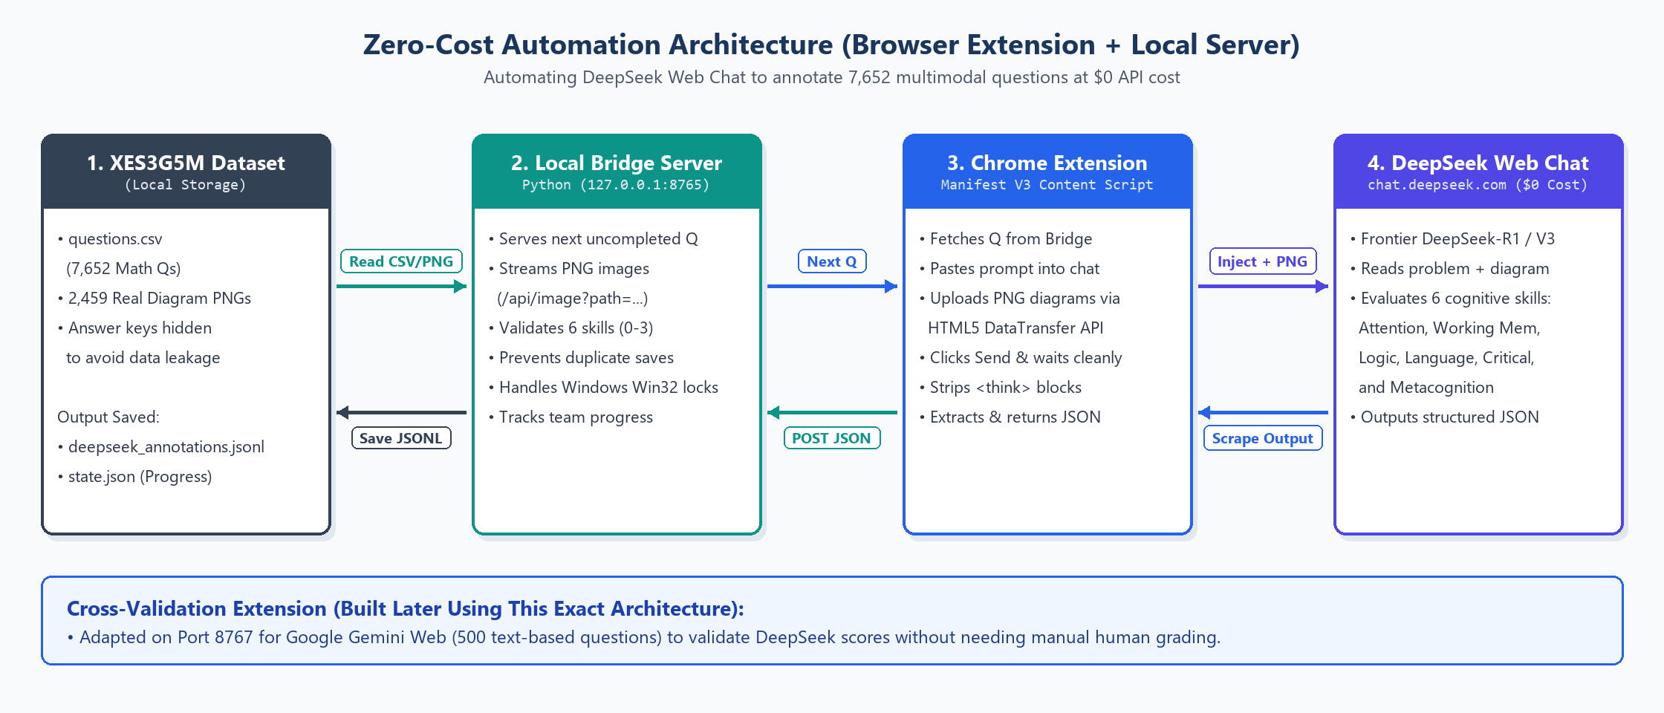
05 | SYSTEM ARCHITECTURE
End-to-End Pipeline & Zero-Cost LLM Annotation Architecture
End-to-End Data Flow
Zero-Cost Multimodal Chrome Extension & Python Bridge
• 1. Question Input: 7,652 XES3G5M math problems (+ 2,459 PNGs) or educator-authored MCQs.
• 2. LLM Cognitive Tagging: DeepSeek Chrome Extension + Python Bridge generates 0–3 demand vectors with atomic disk sync.
• 3. Feature Fusion: Merges 6D cognitive vectors with student sequential correctness & 64 concept clusters.
• 4. New CA-KT Engine: Predicts per-question success probability & updates 6-skill learner mastery ψ_t.
• 5. BrainMapper App: Delivers offline LAN exams & surfaces pre-quiz forecasts + explainable cognitive radar profiles.
Brain Mapper | Cognitive-Aware Learning Analytics Framework | SLTC Research University
8 / 14

Slide 9
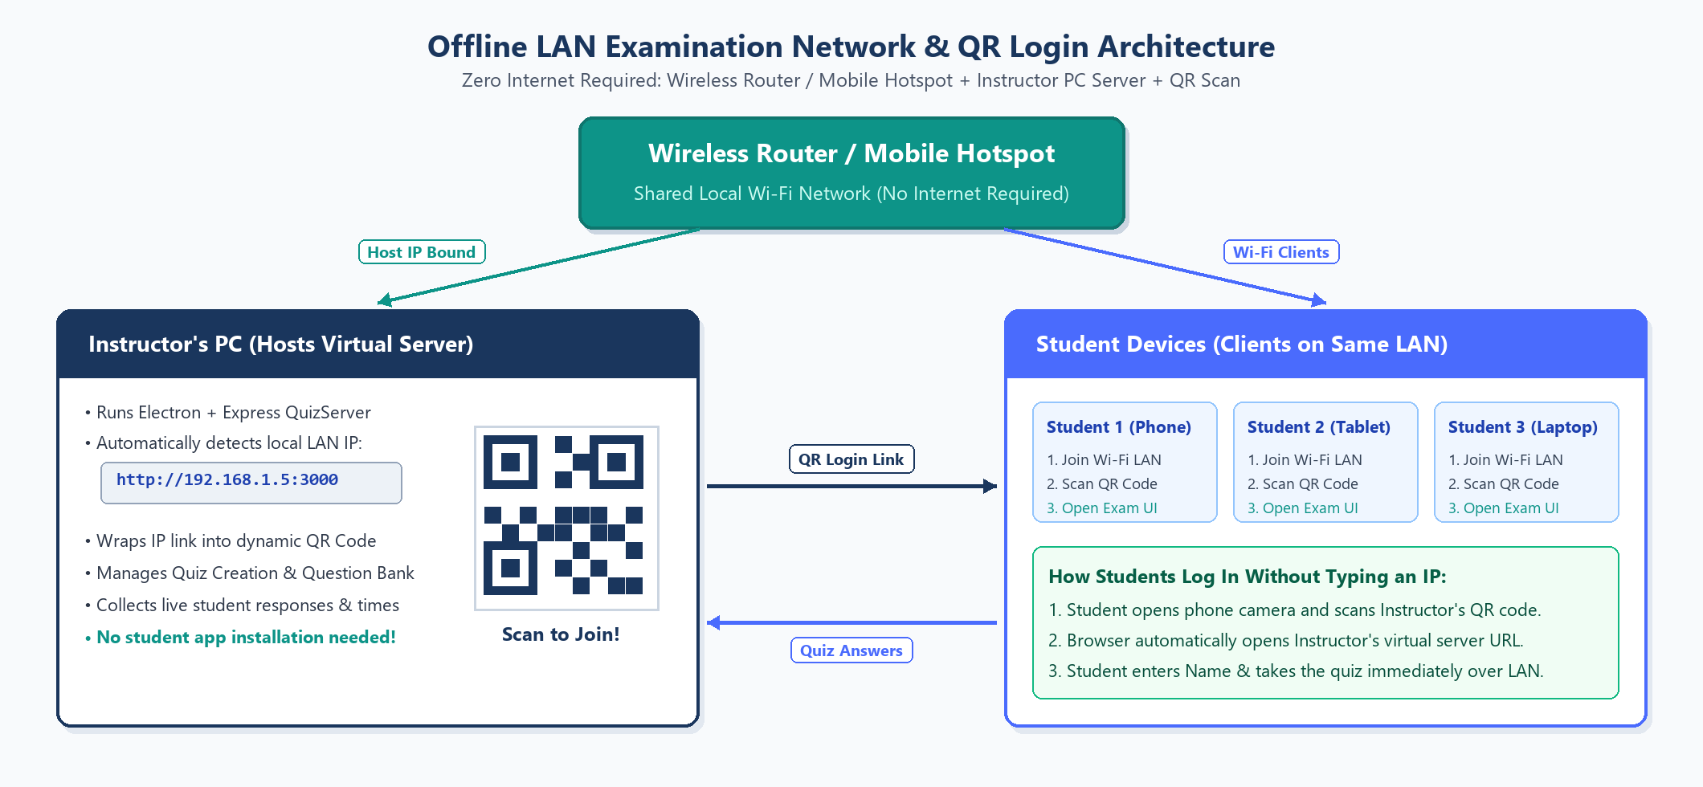
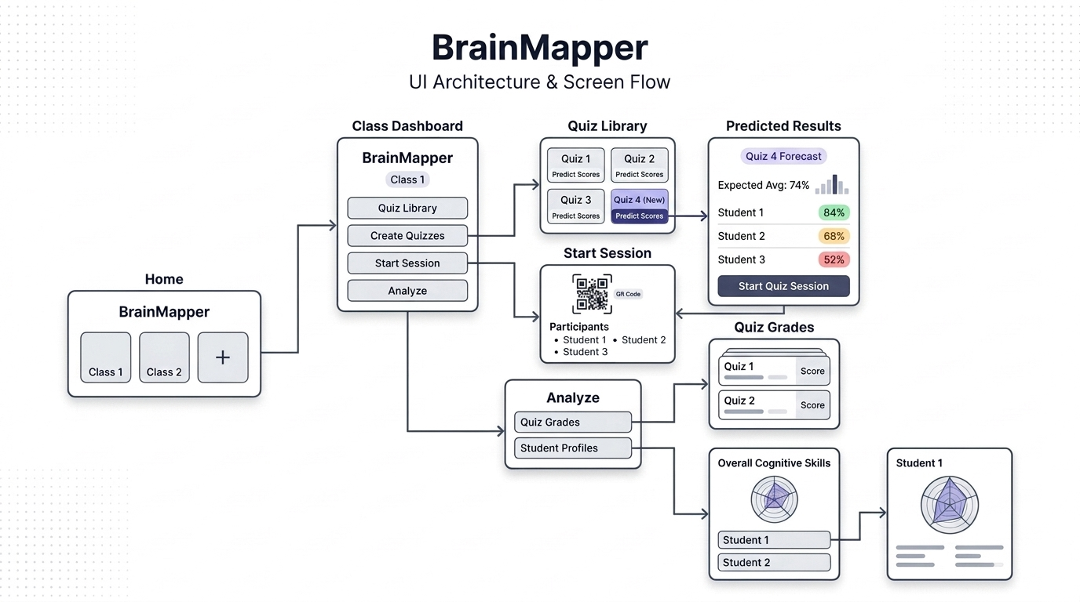
05 | SYSTEM ARCHITECTURE
Offline LAN Network, QR Login & BrainMapper UI Architecture
Offline LAN Examination & QR Login Network
Figma UI Architecture & Implemented Interfaces
Implemented Phases 1–3: Home & Student Roster (#ST-xxxx), Class Dashboard, MCQ Quiz Library & Builder, Live QR Session Monitor (SSE), and Reload-Safe Student Exam Portal (/exam). Phase 4 (Analyze & Live Prediction UI) scheduled next.
Brain Mapper | Cognitive-Aware Learning Analytics Framework | SLTC Research University
9 / 14

Slide 10
06 | PRELIMINARY RESULTS
Full-Dataset Benchmark Results (7,652 Qs / 5.55M Interactions)
Model | Standard Test AUC | Standard Acc | Standard RMSE | Per-Class Scratch AUC | Per-Class Base AUC | Per-Class Cust. AUC | Per-Class Cust. RMSE
DKT (Baseline) | 0.7743 | 81.51% | 0.3659 | 0.5156 | 0.7087 | 0.7085 | 0.3950
qDKT (Baseline) | 0.8026 | 82.27% | 0.3568 | 0.4976 | 0.7201 | 0.7206 | 0.3959
QIKT (Baseline) | 0.8108 | 82.49% | 0.3540 | 0.5790 | 0.7594 | 0.7572 | 0.3769
Normal CAKT | 0.8117 | 82.52% | 0.3537 | 0.6115 | 0.7540 | 0.7518 | 0.3804
CAKT + Clusters Only | 0.8117 | 82.47% | 0.3539 | 0.6067 | 0.7607 | 0.7604 | 0.3753
New CAKT (Proposed) | 0.8119 | 82.51% | 0.3536 | 0.6196 | 0.7657 | 0.7640 | 0.3737
Key Empirical Findings
• #1 Across All Splits: New CAKT achieves highest AUC (0.8119 Standard, 0.7640 Per-Class) and lowest RMSE.
• Small-Class Gains: On 40-student classes from scratch, New CAKT reaches 0.6196 AUC (+12.2% over qDKT, +4.06% over QIKT).
• Clusters + Rasch Synergy: 64 cognitive concept clusters + Rasch item decomposition prevent ID overfitting.
Brain Mapper | Cognitive-Aware Learning Analytics Framework | SLTC Research University
10 / 14

Slide 11
06 | PRELIMINARY RESULTS
7,652-Question Cognitive Distribution & Cross-Validation
Multi-LLM Cross-Validation (DeepSeek vs. Gemini)
• Methodology: 500 text-only questions sampled for blind re-annotation via Gemini Web Extension (Port 8767).
• Gemini Pro Run Active: 12 / 500 paired questions evaluated so far (within-1-point agreement: 83.3%–100.0% across the 6 skills).
• Next Step: Complete remaining 488 Gemini Pro annotations to finalize Cohen's weighted κ & Pearson r validation.
Explainable Learner Profiling (CA-KT)
• Latent Mastery Vector: CA-KT outputs interpretable 6-skill mastery ψ_t ∈ (0,1)^6 alongside IRT θ, β, and α.
• Educator Value: Separates content knowledge gaps from cognitive bottlenecks (e.g., Working Memory overload).
Corpus Telemetry (7,652 Questions)
• Mean Model Confidence: 0.91 across 7,652 questions; 100% schema-validated (0–3 integers).
• Cognitive Profile: Math problems demand highest Logical Reasoning (2.46) & Working Memory (2.30).
Brain Mapper | Cognitive-Aware Learning Analytics Framework | SLTC Research University
11 / 14

Slide 12
07 | CHALLENGES & SOLUTIONS
Technical & Operational Challenges Solved
Area | Challenge Encountered | Implemented Solution & Impact
School Data Collection | Answer scripts returned to students were lost; insufficient continuous term-test histories. | Adopted XES3G5M benchmark (18,066 students) for Phase 1 & built offline LAN Exam platform for Phase 2.
LLM API Cost & Quotas | GPT-4o vision (~$35–$55) exceeded budget; free Gemini/Groq APIs hit 500 RPD / TPM caps. | Built zero-cost Chrome MV3 Extension + Python Bridge for DeepSeek Web Chat ($0 cost, 7,652/7,652 done).
Multimodal & DOM Reliability | 2,214 questions needed PNGs; DeepSeek-R1 emitted <think> blocks & caused duplicate/stale reads. | Automated File/DataTransfer image upload, <think> stripping, anti-stale DOM guards & atomic os.fsync.
Multi-Member Collaboration | Windows OneDrive file locks (WinError 32) & git file conflicts during parallel annotation. | Added retry-safe atomic writes + clean team git workflows across Waruna, Pramudi, Dilshan & Tharindu.
KT Question Memorization | Standard models overfit to 7,652 question IDs & 865 sparse concepts on small 40-student classes. | Introduced Rasch item decomposition + 64 K-Means cognitive concept clusters + 200-step causal window.
Exam Security Offline | Need zero-internet exam delivery without leaking answers or breaking on browser refresh. | Local Express/QR LAN server strips answer keys, enforces #ST-xxxx IDs & restores drafts on reload.
Brain Mapper | Cognitive-Aware Learning Analytics Framework | SLTC Research University
12 / 14

Slide 13
08 | FUTURE WORK
Remaining Plan & 12-Month Schedule Alignment
1. Inference & Explainability
2. BrainMapper Phase 4 & ML Sync
3. Cross-Validation & School Data
4. Expert Validation & Thesis
Months 7–8
Months 8–9
Months 9–10
Months 11–12
Implement production Python modules in src/brain_mapper/inference & explainability to compute live per-student cognitive mastery ψ_t and RQ3 skill attribution.
Replace 'Work in progress' stubs in Predicted Results & Analyze screens with live New CA-KT pre-quiz forecasts, Quiz Grades, and 6-axis cognitive radar charts.
Finish 500-question Gemini Pro cross-validation and deploy the offline LAN platform in partner Sri Lankan Grade 10–11 classrooms (Phase 2 real cohort).
Conduct educational expert evaluation of explainable learner profiles (RQ2), finalize comparative analysis, and complete the final dissertation.
Phase / Activity (12-Month Proposal Timeplan) | M1–M3 | M4–M6 | M7–M9 | M10–M12
Literature Review, Refined Proposal & XES3G5M Curation | Completed | — | — | —
6-Skill Taxonomy, LLM Cost Study & Zero-Cost DeepSeek Annotation (7,652 Qs) | — | Completed | — | —
CA-KT & Baseline Modeling (DKT, qDKT, QIKT) + BrainMapper Phases 1–3 | — | Completed | — | —
Inference/Explainability, Phase 4 UI, Gemini Pro Check & Phase 2 School Trials | — | — | Active / Next | —
Expert Explainability Validation, Final Thesis & Presentation | — | — | — | Scheduled
Brain Mapper | Cognitive-Aware Learning Analytics Framework | SLTC Research University
13 / 14

Slide 14
09 | CONCLUSION
Summary, Contributions & Q&A
Key Conclusions
Limitations & Mitigation
• Cognitive-Aware Framework Validated: Successfully fused 6-dimensional LLM cognitive annotations with sequential Knowledge Tracing across 7,652 math items and 5.55M events.
• Superior Predictive Accuracy: New CA-KT outperforms DKT, qDKT, and QIKT on both Standard unseen-student (0.8119 AUC) and Per-Class small-cohort customization (0.7640 AUC).
• Zero-Cost Scalable Pipeline: Browser-bridge automation eliminated API cost barriers while ensuring strict schema & multimodal diagram coverage.
• Deployment-Ready Ecosystem: Offline LAN Exam Platform (Phases 1–3) establishes a secure pipeline for Phase 2 Grade 10–11 school data collection.
• LLM Subjectivity: Mitigated via strict 0–3 rubric, confidence logging, and ongoing 500-question Gemini Pro cross-validation.
• Benchmark vs. Local Curriculum: XES3G5M models generalized math tracing; Phase 2 LAN school trials will calibrate to Sri Lankan Grade 10–11 cohorts.
• Pending Live UI Wiring: Inference & explainability endpoints are the immediate next engineering step to activate Predicted Results & Analyze screens.
Thank You! Questions & Discussion
Team Brain Mapper | L.W.L. Silva, K.A.A. Dilshan, K.A.P.B. Himaranshi, T. Kothlawala | SLTC Research University
Brain Mapper | Cognitive-Aware Learning Analytics Framework | SLTC Research University
14 / 14

