Slide 1
BRAIN MAPPER | RESEARCH PROGRESS
A Cognitive-Aware Learning Analytics Framework
Using LLMs and Knowledge Tracing
Cognitive Skill Demand Extraction • CA-KT Performance Prediction • Offline LAN Delivery
Research Team: L.W.L. Silva (Leader), K.A.A. Dilshan, K.A.P.B. Himaranshi, T. Kothlawala
Supervisors: Miss. Risuni Siyara & Dr. Chameera De Silva
Department of Data Science | SLTC Research University, Sri Lanka

Slide 2
01 • INTRODUCTION
The Problem & The Brain Mapper Solution
⚠️ The Problem
💡 Our Solution
🎯 Practical Impact
• School exams only yield aggregate marks (e.g., 62%). Question-level diagnostic data is lost.
• Traditional Knowledge Tracing (DKT, qDKT) is a black box, treating items as opaque IDs.
• Teachers cannot diagnose why a student struggles (working memory, logic, or language?).
• Manual expert Q-matrix tagging is too expensive and cannot scale to large question banks.
• Automate cognitive skill scoring (0–3 scale) using Multimodal LLMs.
• Evaluate 6 skills: Attention, Working Memory, Logical Reasoning, Language, Critical Thinking, Metacognition.
• Design Cognitive-Aware KT (CA-KT) to fuse cognitive vectors with sequential student responses.
• Generate actionable cognitive radar profiles for teachers.
• Accurate Performance Prediction before and during exams.
• Explainable Learner Diagnostics: reveals student cognitive strengths and weak spots.
• Zero-Internet LAN Exam Platform for seamless deployment in Sri Lankan schools.
• Zero ongoing LLM API subscription costs for schools.
Brain Mapper | SLTC Research University
2 / 11

Slide 3
01 • INTRODUCTION
Research Aim & Three Core Objectives
PRIMARY RESEARCH AIM
Develop a Cognitive-Aware Learning Analytics Framework using LLMs and Knowledge Tracing to improve student performance prediction and deliver explainable insights into learner cognitive behavior.
🔍 RO1: Cognitive Extraction
🧠 RO2: CA-KT Modeling
📊 RO3: Empirical Validation
• Define a 6-skill cognitive rubric (0–3 scale).
• Use multimodal LLMs to score math questions & geometry diagrams automatically.
• Achieve automated, consistent question annotation.
• Design Cognitive-Aware KT (CA-KT).
• Combine student interaction sequences with 6D cognitive requirement vectors.
• Track evolving cognitive mastery over time.
• Benchmark against DKT, qDKT, and QIKT.
• Evaluate on unseen students & small classes.
• Deploy an offline LAN exam system for real school validation.
Brain Mapper | SLTC Research University
3 / 11

Slide 4
02 • PROGRESS
What We Have Accomplished So Far
7,652
Questions Annotated
100% Complete via Custom Extension
5.55M
Interactions
18,066 Students (XES3G5M Benchmark)
6 Models
Trained & Tested
DKT, qDKT, QIKT + 3x CA-KT Variants
30 / 30
Automated Tests
22 Python Tests + 8 Node Server Tests
Completed Milestones
Active & Deployment Work
• Curated XES3G5M + ExRec English benchmark (7,652 Qs, 2,459 diagram PNGs).
• Developed browser extension to annotate all 7,652 questions on a 0–3 cognitive scale.
• Fully trained all baseline & CA-KT models on the full dataset; New CA-KT ranks #1.
• Multi-LLM cross-validation running (500 text questions re-annotated with Gemini Pro).
• Built BrainMapper offline LAN exam server (QR code login, student portal).
• Ready for Phase 2 real Grade 10–11 school classroom deployment.
Brain Mapper | SLTC Research University
4 / 11

Slide 5
03 • RELATED WORK
Comparison With Existing Approaches
Traditional KT Models
Cognitive Diagnosis Models
Brain Mapper (Proposed)
• Models: DKT (2015), SAKT (2019), qDKT (2020), QIKT (2023).
• Approach: Track concept IDs and 0/1 correctness using RNNs / Attention.
• Limitation: Treats questions as black boxes. Cannot explain student cognitive difficulties.
• Models: Item Response Theory (IRT), Neural Cognitive Diagnosis (NCD).
• Approach: Estimate student mastery and question difficulty parameters.
• Limitation: Requires expensive manual Q-matrix tagging by human experts. Cannot scale.
• Bridges the Gap: Uses Multimodal LLMs to extract cognitive skills automatically.
• Cognitive-Aware KT: Fuses 6 cognitive demands with sequence modeling.
• Advantage: High accuracy + interpretable cognitive diagnostics with zero manual tagging.
THE CORE RESEARCH GAP: Existing KT models know THAT a student failed a question, but not WHY. Cognitive models know why, but require costly human experts. Brain Mapper uses LLMs to bridge this gap automatically.
Brain Mapper | SLTC Research University
5 / 11

Slide 6
04 • METHODOLOGY
Dataset Curation & 6-Skill Cognitive Extraction
📁 Dataset & Automated Annotation
🧩 The 6 Cognitive Skills (0–3 Scale)
• Benchmark: XES3G5M + ExRec English dataset (18,066 students, 5.55M interactions).
• Multimodal: 7,652 questions including 2,214 visual geometry items with 2,459 diagram PNGs.
• Automated Extension: Developed custom browser extension to programmatically inject questions and diagram PNGs for LLM cognitive scoring.
• Complete Coverage: 100% of questions annotated (0–3 integer scale) with zero manual tagging.
• Attention (1.87 avg): Focus on key details; visual diagram parsing.
• Working Memory (2.30 avg): Holding intermediate steps & formulas.
• Logical Reasoning (2.46 avg): Step-by-step deductive math proofs.
• Language Processing (1.41 avg): Understanding dense word problems.
• Critical Thinking (0.91 avg): Checking alternative options & edge cases.
• Metacognition (0.16 avg): Strategy planning & error self-checking.
Brain Mapper | SLTC Research University
6 / 11

Slide 7
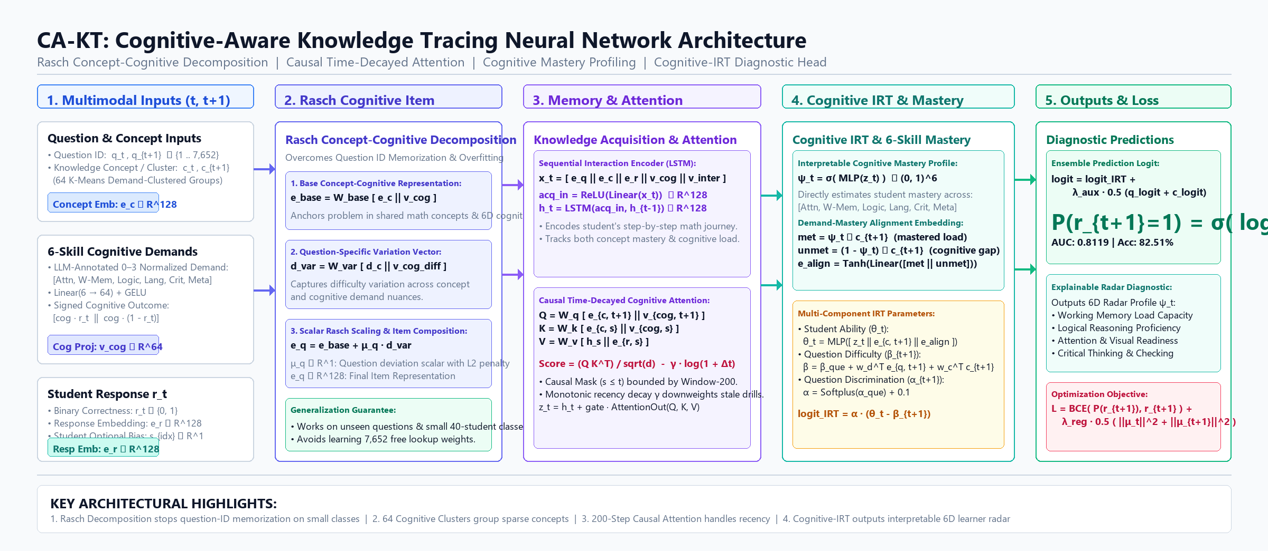
05 • SYSTEM ARCHITECTURE
CA-KT Neural Network Architecture
Core Innovations
• Rasch Decomposition:
e_q = e_base + μ_q · d_var
stops question-ID memorization.
• 64 Cognitive Clusters:
groups 865 sparse concepts by cognitive requirement signatures.
• Causal Attention:
monotonic recency decay bounded to 200 interaction steps.
• Cognitive IRT Head:
outputs student ability (θ), difficulty (β), and 6D mastery (ψ_t).
Brain Mapper | SLTC Research University
7 / 11

Slide 8
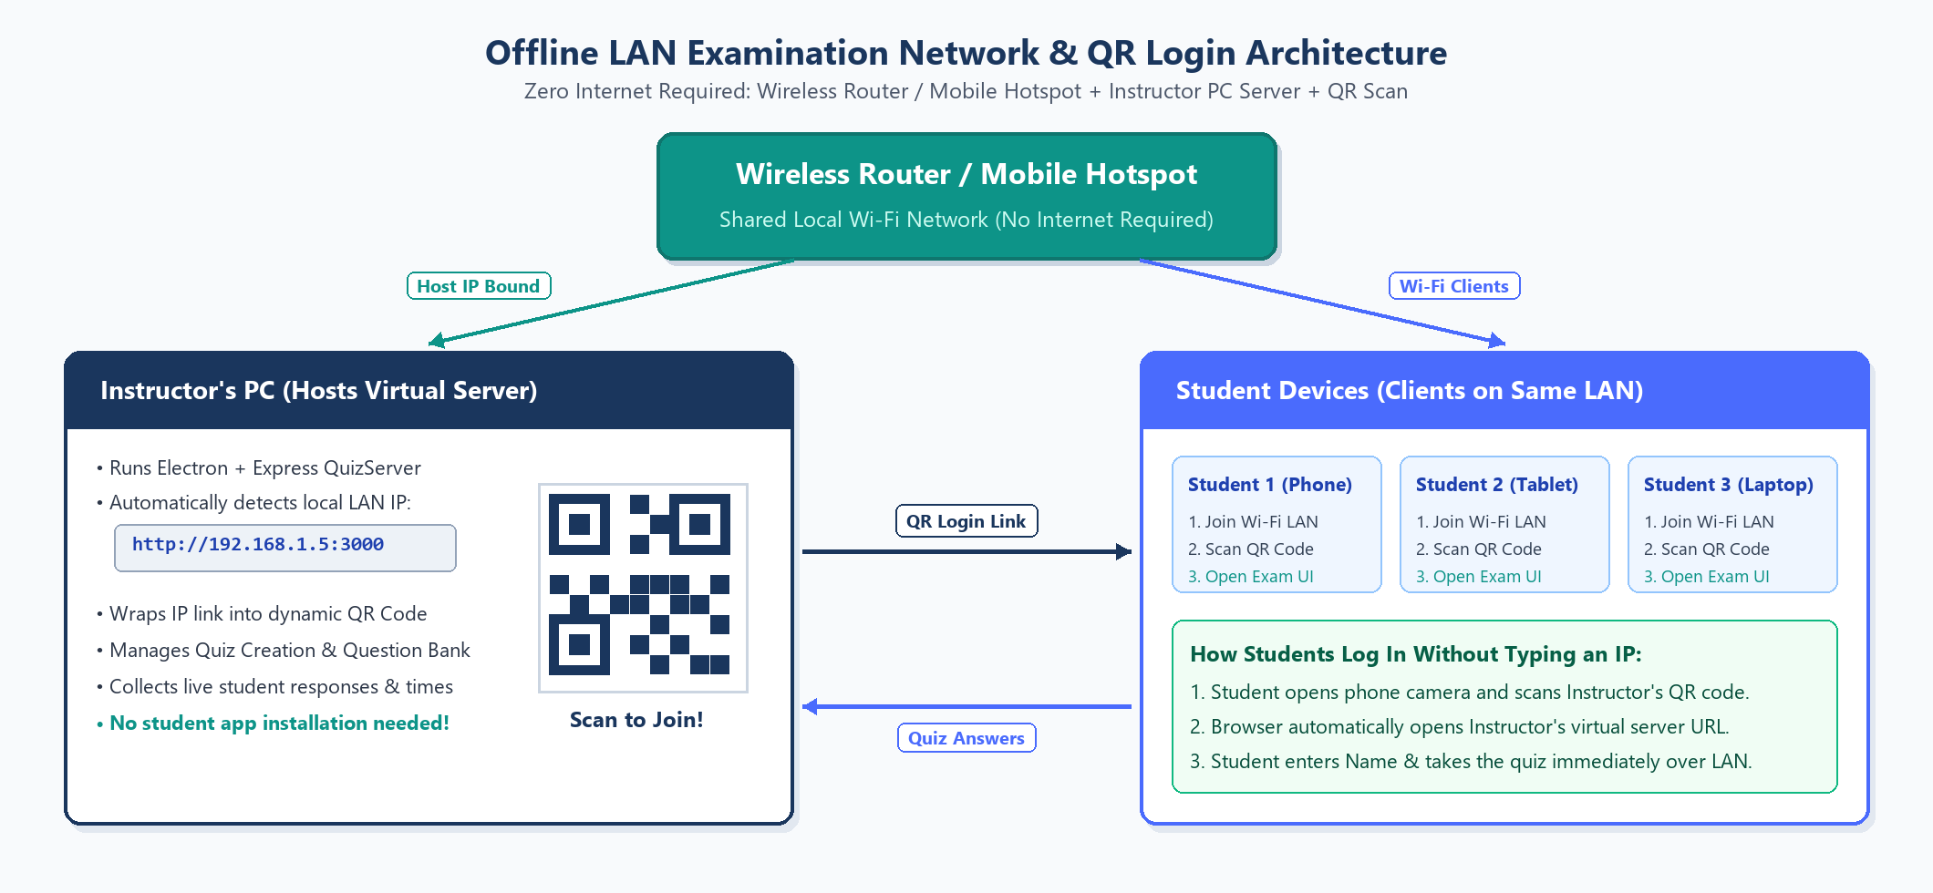
05 • SYSTEM ARCHITECTURE
Offline LAN Examination & Analytics Platform
Built for Sri Lankan Classrooms
• Zero Internet Needed: Runs over local Wi-Fi router or phone hotspot.
• QR Code Login: Students scan QR code with phone camera to join exam.
• Unique Student IDs: Uses #ST-xxxx IDs; binds to class roster automatically.
• Exam Integrity: Strips answer keys from student network responses.
• Crash & Reload Proof: Saves auto-drafts every 3 seconds to prevent lost work.
Brain Mapper | SLTC Research University
8 / 11

Slide 9
06 • PRELIMINARY RESULTS
New CA-KT Achieves State-of-the-Art Accuracy
Key Findings
• #1 in Accuracy: New CA-KT achieves 0.8119 AUC on unseen students, beating DKT, qDKT, and QIKT.
• Solves Small-Class Problem: On small 40-student classes from scratch, CA-KT gets 0.6196 (+12.2% over qDKT).
• Highest Fine-Tuned Score: Fine-tuning base weights on a class's history yields 0.7640 AUC (80.88% accuracy).
• Rasch + Clusters: Proves that cognitive clustering prevents models from overfitting on small data.
Brain Mapper | SLTC Research University
9 / 11

Slide 10
07 • CHALLENGES & SOLUTIONS
Major Obstacles & How We Solved Them
📁 1. School Data Loss
💰 2. High API Costs
⚡ 3. Small Class Overfitting
• Challenge: Schools hand answer scripts back to students, who lose them. Insufficient past data.
• Solution: Adopted the 18,066-student XES3G5M benchmark for Phase 1.
• Long-term Fix: Built the offline LAN platform to collect Phase 2 school data digitally.
• Challenge: Commercial LLM APIs (GPT-4o vision) cost $35–$55, and free tiers hit strict daily limits.
• Solution: Built our own Chrome Extension for DeepSeek Web chat.
• Result: 100% of all 7,652 questions annotated at $0 total API cost.
• Challenge: Training KT on 40 students causes models to memorize question IDs and fail.
• Solution: Rasch item decomposition + 64 K-Means cognitive concept clusters.
• Result: Reached 0.6196 AUC from scratch (+12.2% over qDKT).
Brain Mapper | SLTC Research University
10 / 11

Slide 11
08 & 09 • FUTURE WORK & CONCLUSION
Next Steps & Final Summary
🚀 Future Work (Months 7–12)
🏆 Conclusion
• Connect Model to UI: Wire New CA-KT checkpoints into the BrainMapper web app for real-time predictions.
• Finish Cross-Validation: Complete 500-question Gemini Pro validation on port 8767.
• Classroom Pilot: Conduct Phase 2 offline exams in partner Sri Lankan Grade 10–11 classrooms.
• Expert Evaluation: Validate cognitive radar profiles with mathematics lecturers and teachers.
• Concept Proven: Incorporating cognitive skill demands significantly improves Knowledge Tracing accuracy.
• New CA-KT Ranks #1: Outperforms DKT, qDKT, and QIKT across both standard and per-class splits.
• Zero-Cost Pipeline: Demonstrated that large-scale educational annotation can be achieved with $0 API budget.
• Classroom-Ready: Offline LAN platform ensures practical deployment in real schools.
Thank You! Questions & Discussion
Team Brain Mapper | SLTC Research University
Brain Mapper | SLTC Research University
11 / 11

