Slide 1

Retail Sales Case Study and Model Deployment
Detailed Presentation of Tasks Performed By Akhil Nair

Slide 2

Project Overview
This project aims to analyze customer behavior and responses to marketing campaigns for a retail giant.
The dataset includes demographics, purchase behavior, and campaign response data.
The goal is to derive insights and build a predictive model to enhance marketing strategies.

Slide 3
Objectives
1. Perform data quality checks and cleaning.
2. Conduct exploratory data analysis (EDA) to uncover patterns and relationships.
3. Engineer features for model building.
4. Build and evaluate predictive models.
5. Deploy the best model and analyze its performance.

Slide 4
Data Preparation: Data Loading
Loaded data from three files: demographics.txt, campaign.json, and behaviour.json.
Ensured data is properly structured and ready for analysis.

Slide 5
Data Preparation: Data Cleaning
Performed necessary cleaning tasks:
- Handled missing values
- Removed duplicates
- Standardized formats
Ensured data quality for accurate analysis.

Slide 6
Data Preparation: Data Integration
Integrated data from the three sources into a consolidated dataset.
Ensured consistent and complete information for each customer.

Slide 7
Exploratory Data Analysis: Univariate Analysis
Analyzed individual variables to understand their distributions.
Identified key characteristics and patterns within the data.

Slide 8
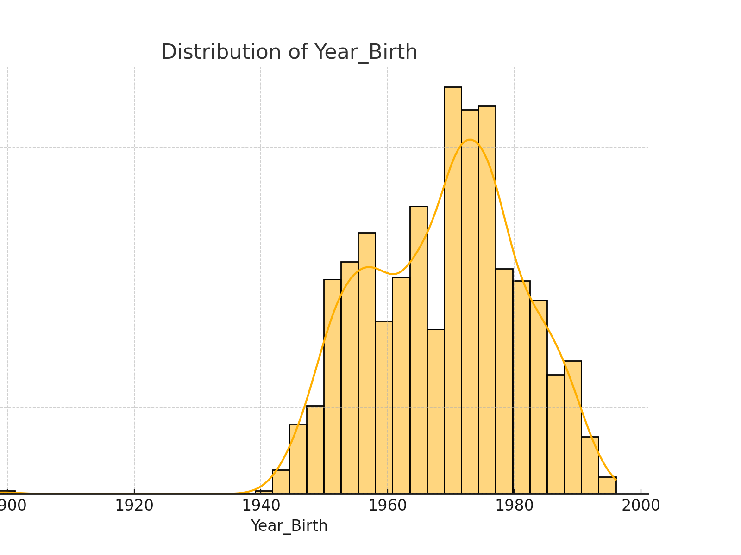
Distribution of Year_Birth

Slide 9
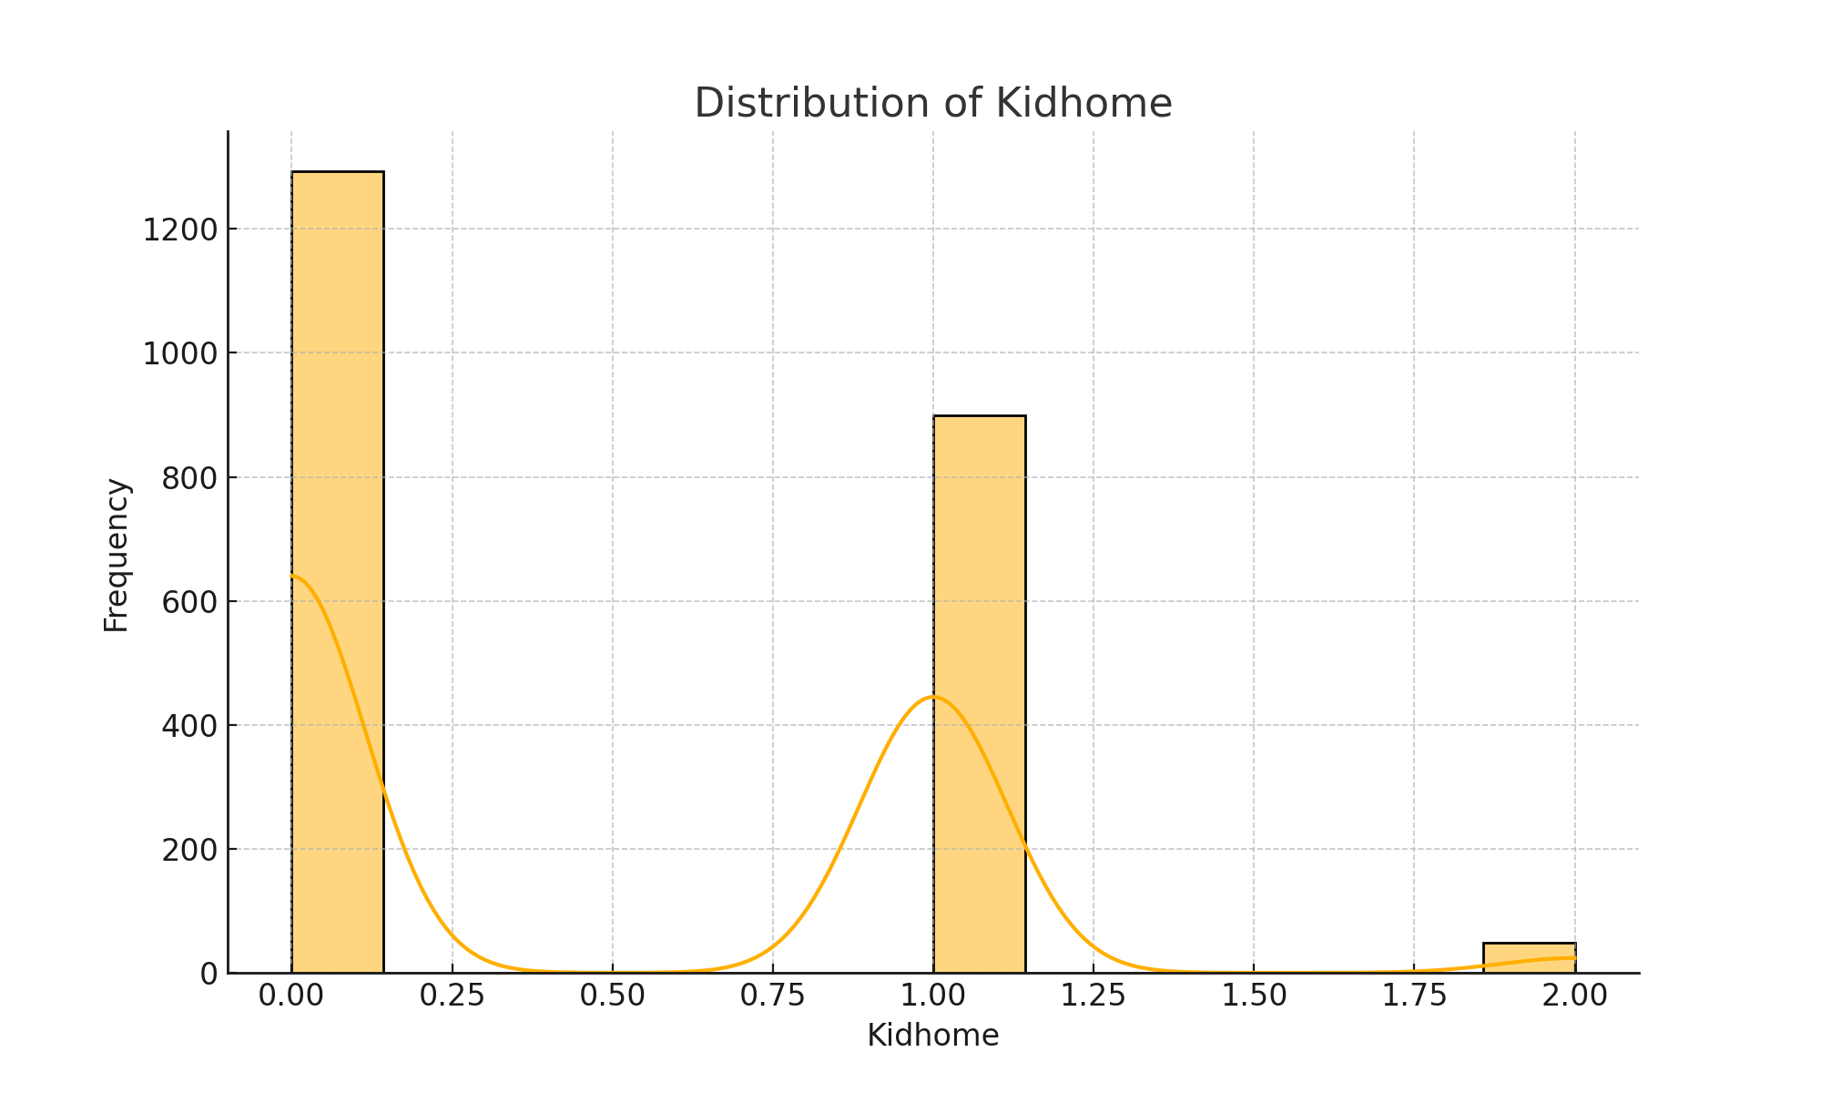
Distribution of Kidhome

Slide 10
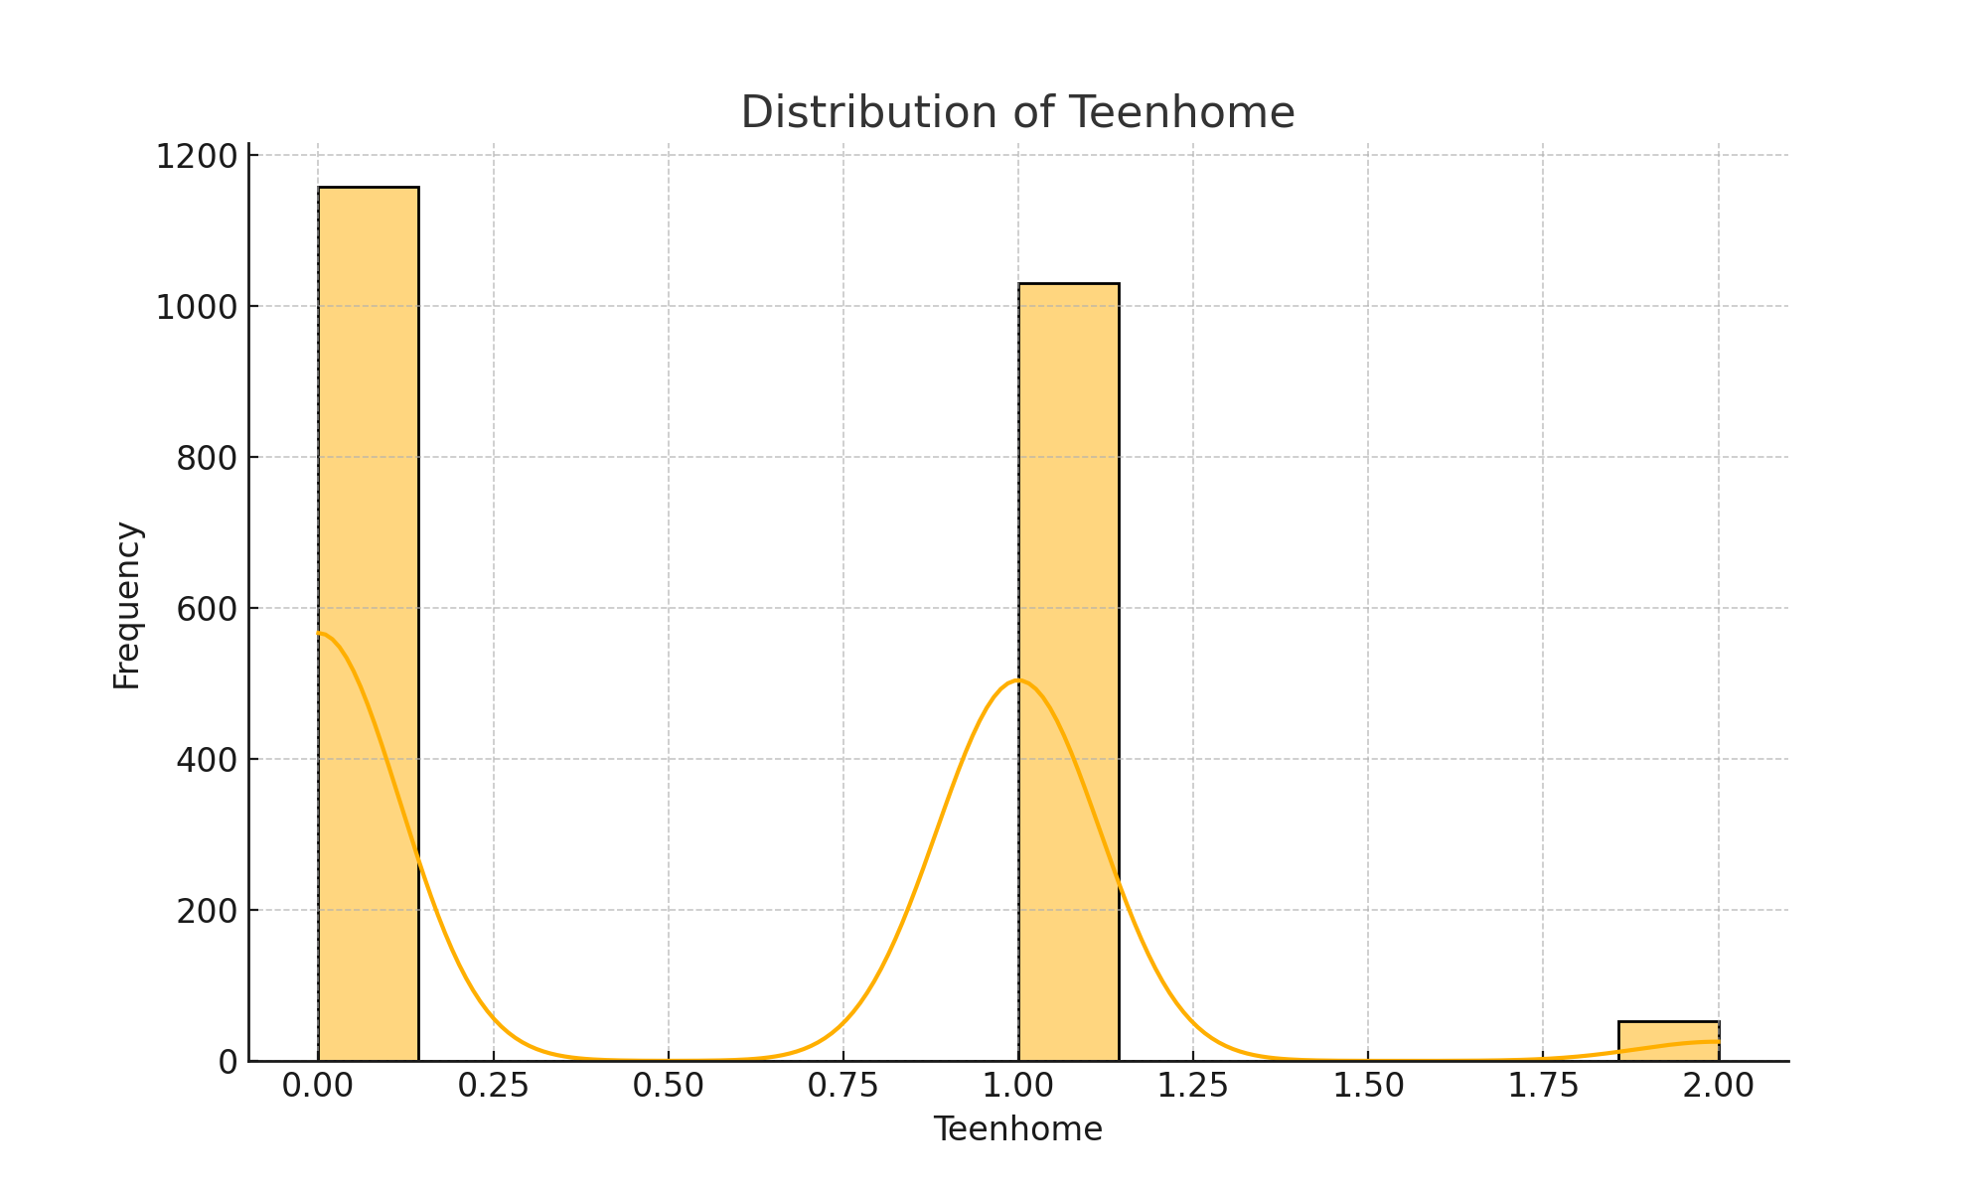
Distribution of Teenhome

Slide 11
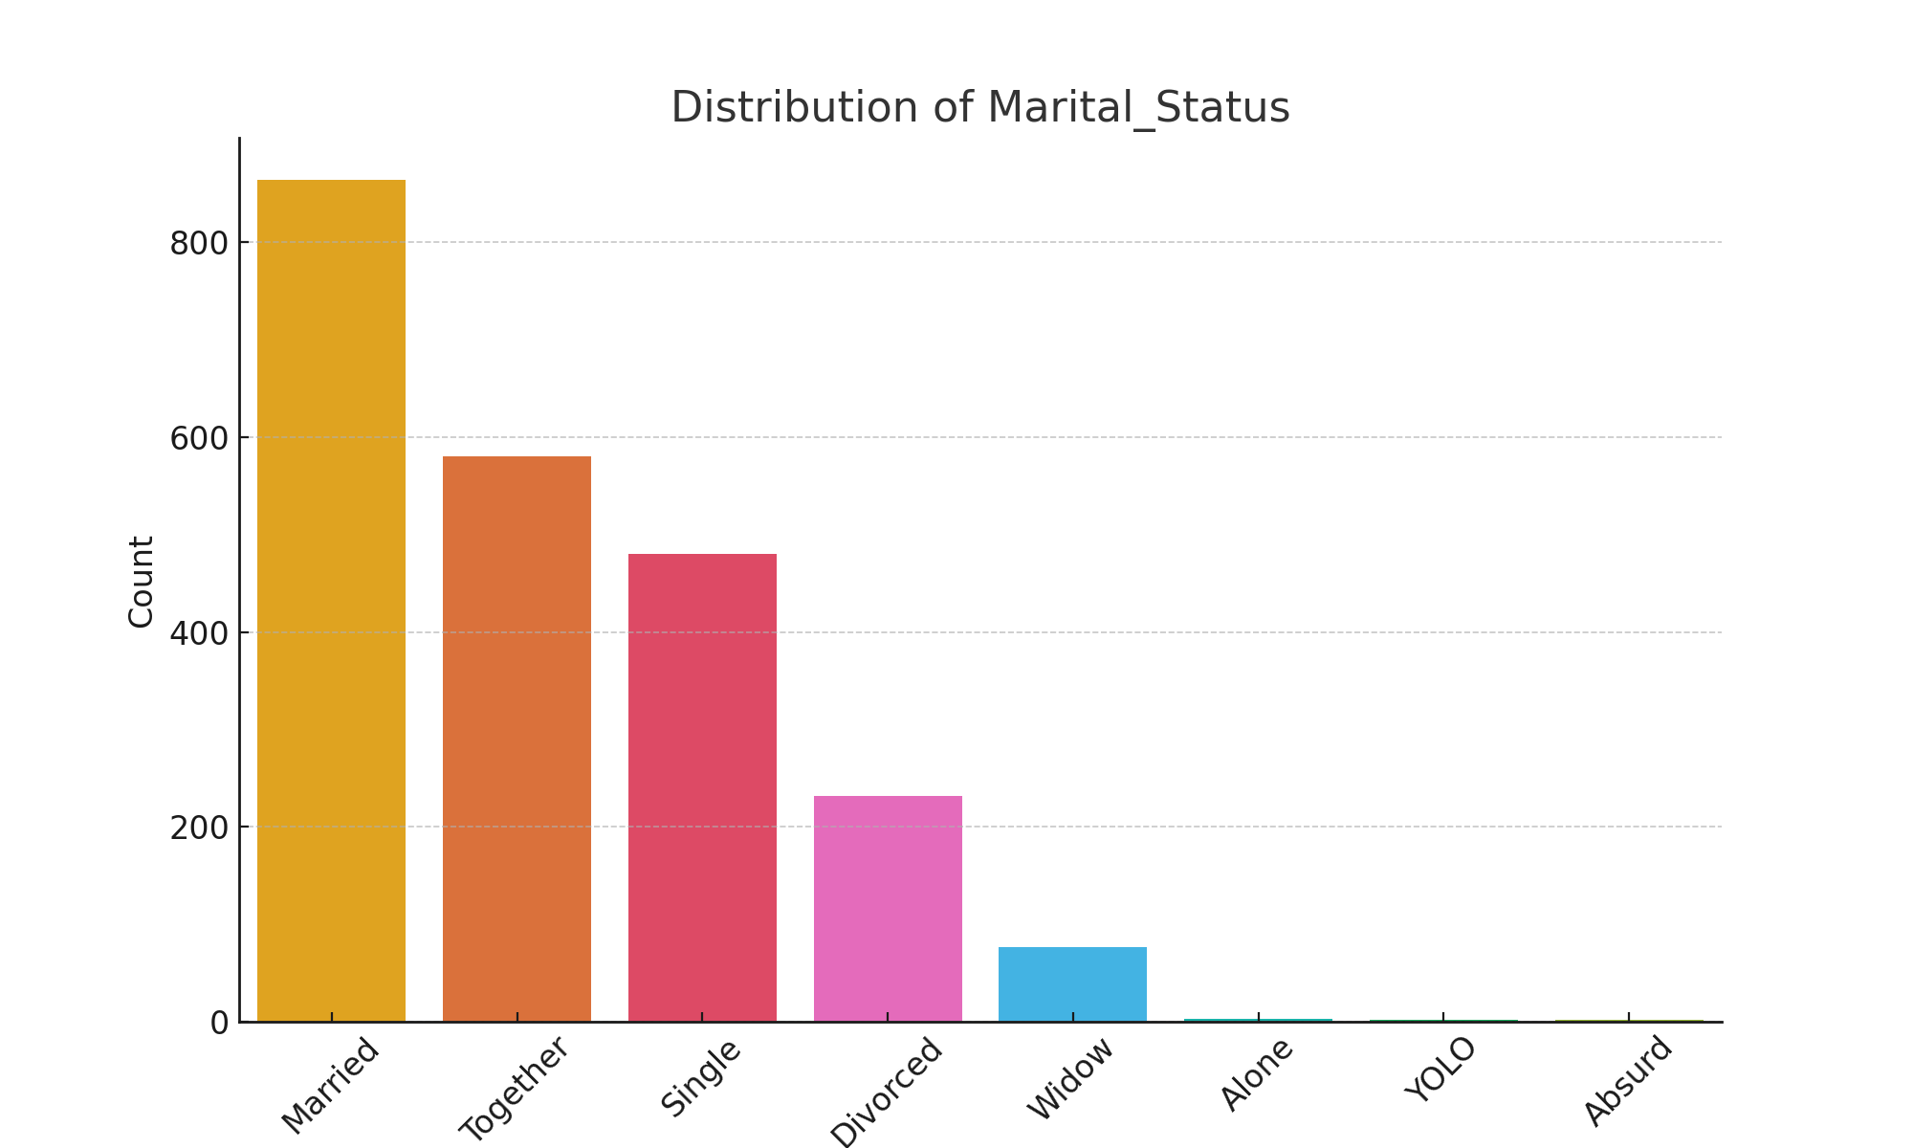
Distribution of Marital_Status

Slide 12
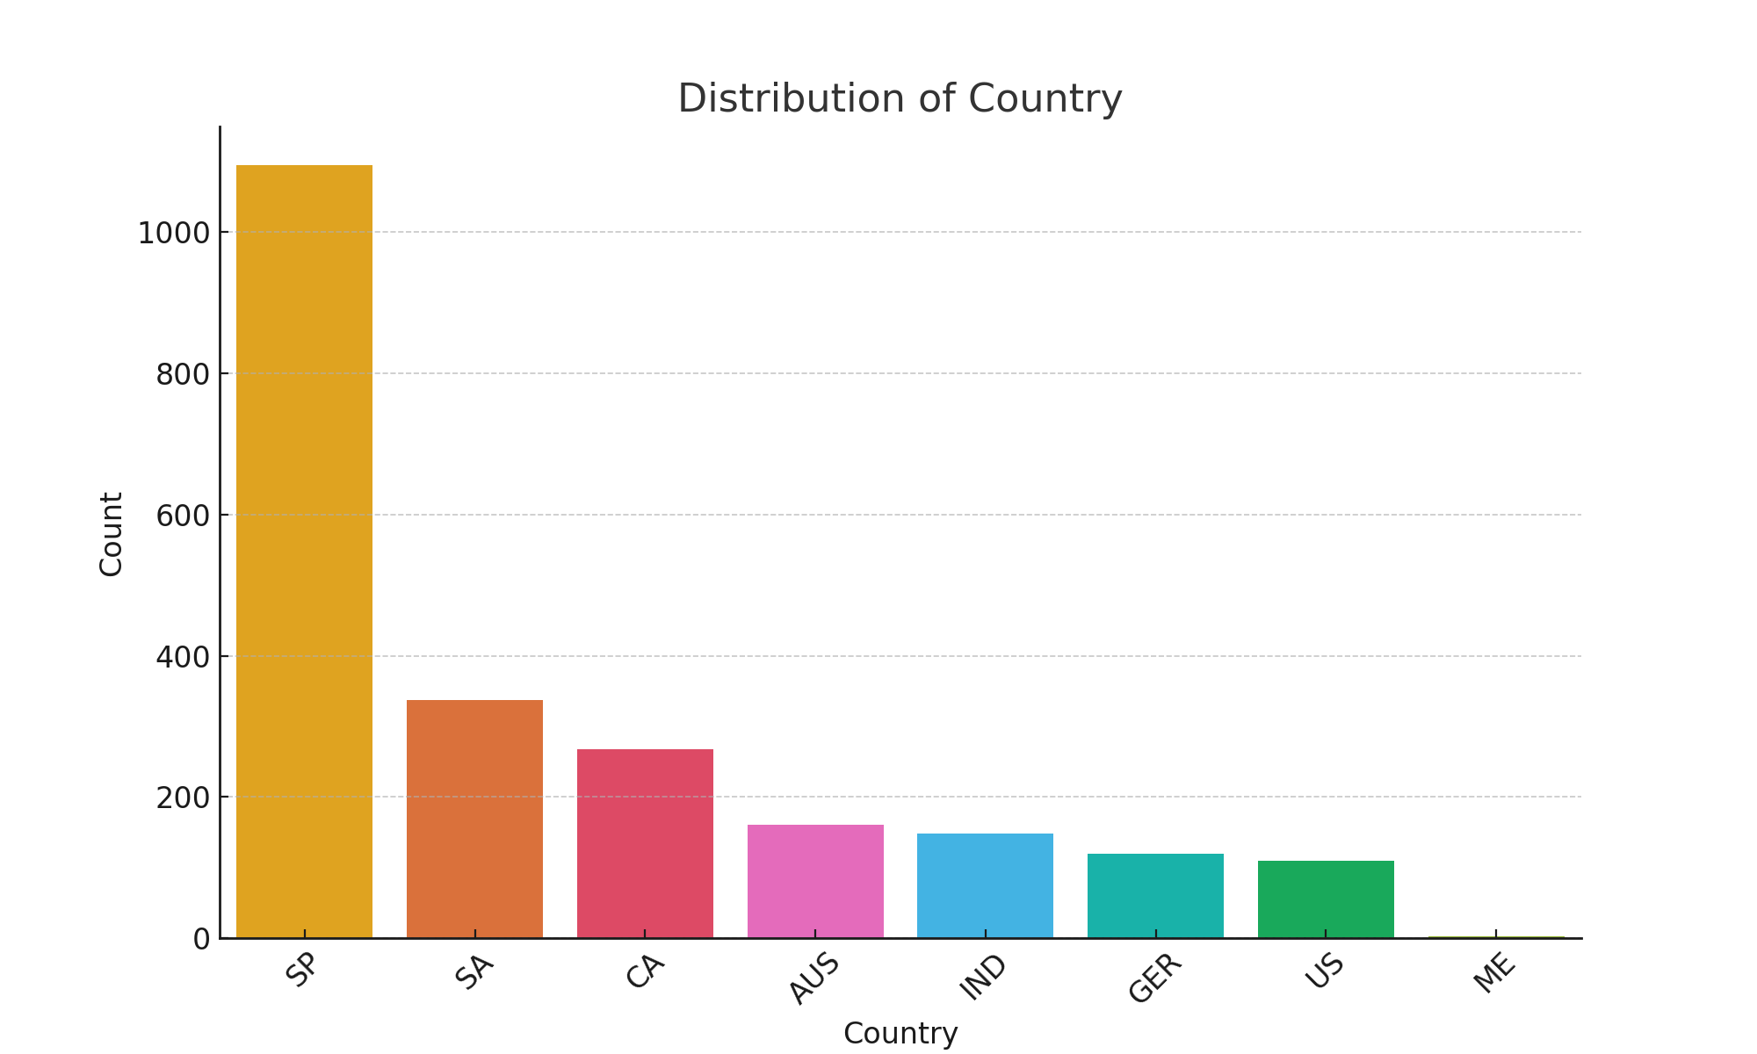
Distribution of Country

Slide 13

Exploratory Data Analysis: Bivariate Analysis
Examined relationships between pairs of variables.
Explored correlations and potential interactions.

Slide 14
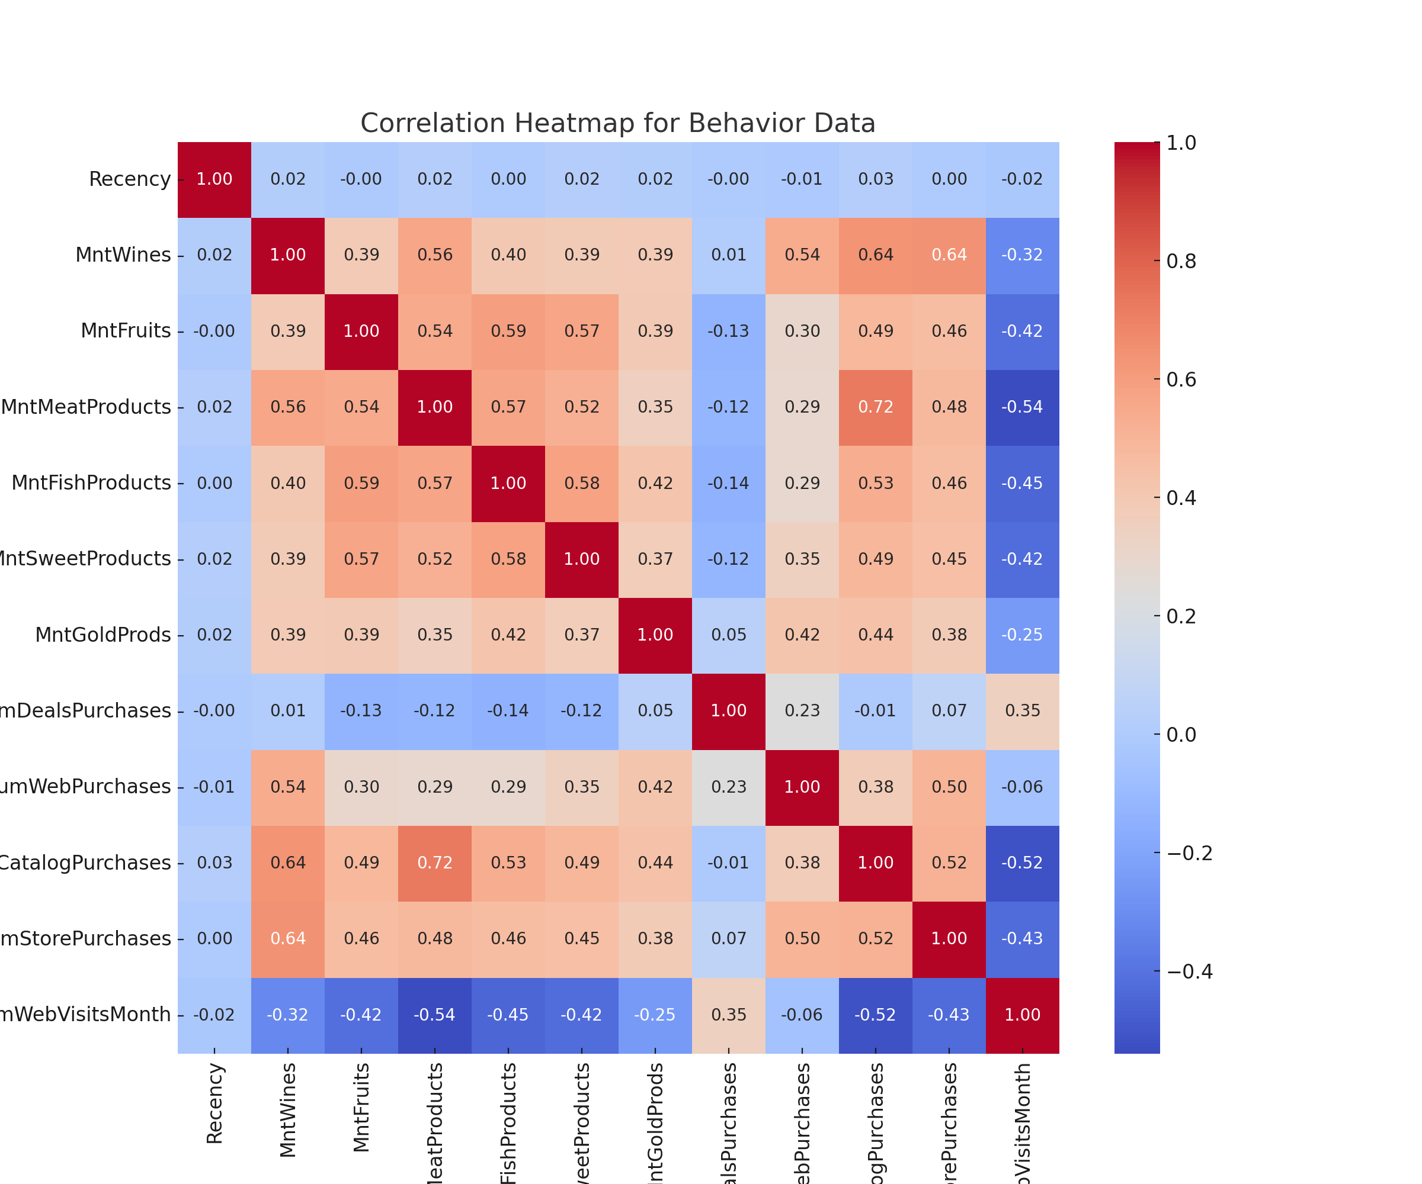
Correlation Heatmap for Behavior Data

Slide 15
Exploratory Data Analysis: Multivariate Analysis
Analyzed multiple variables simultaneously to uncover complex patterns.
Identified key drivers of customer behavior and campaign responses.

Slide 16
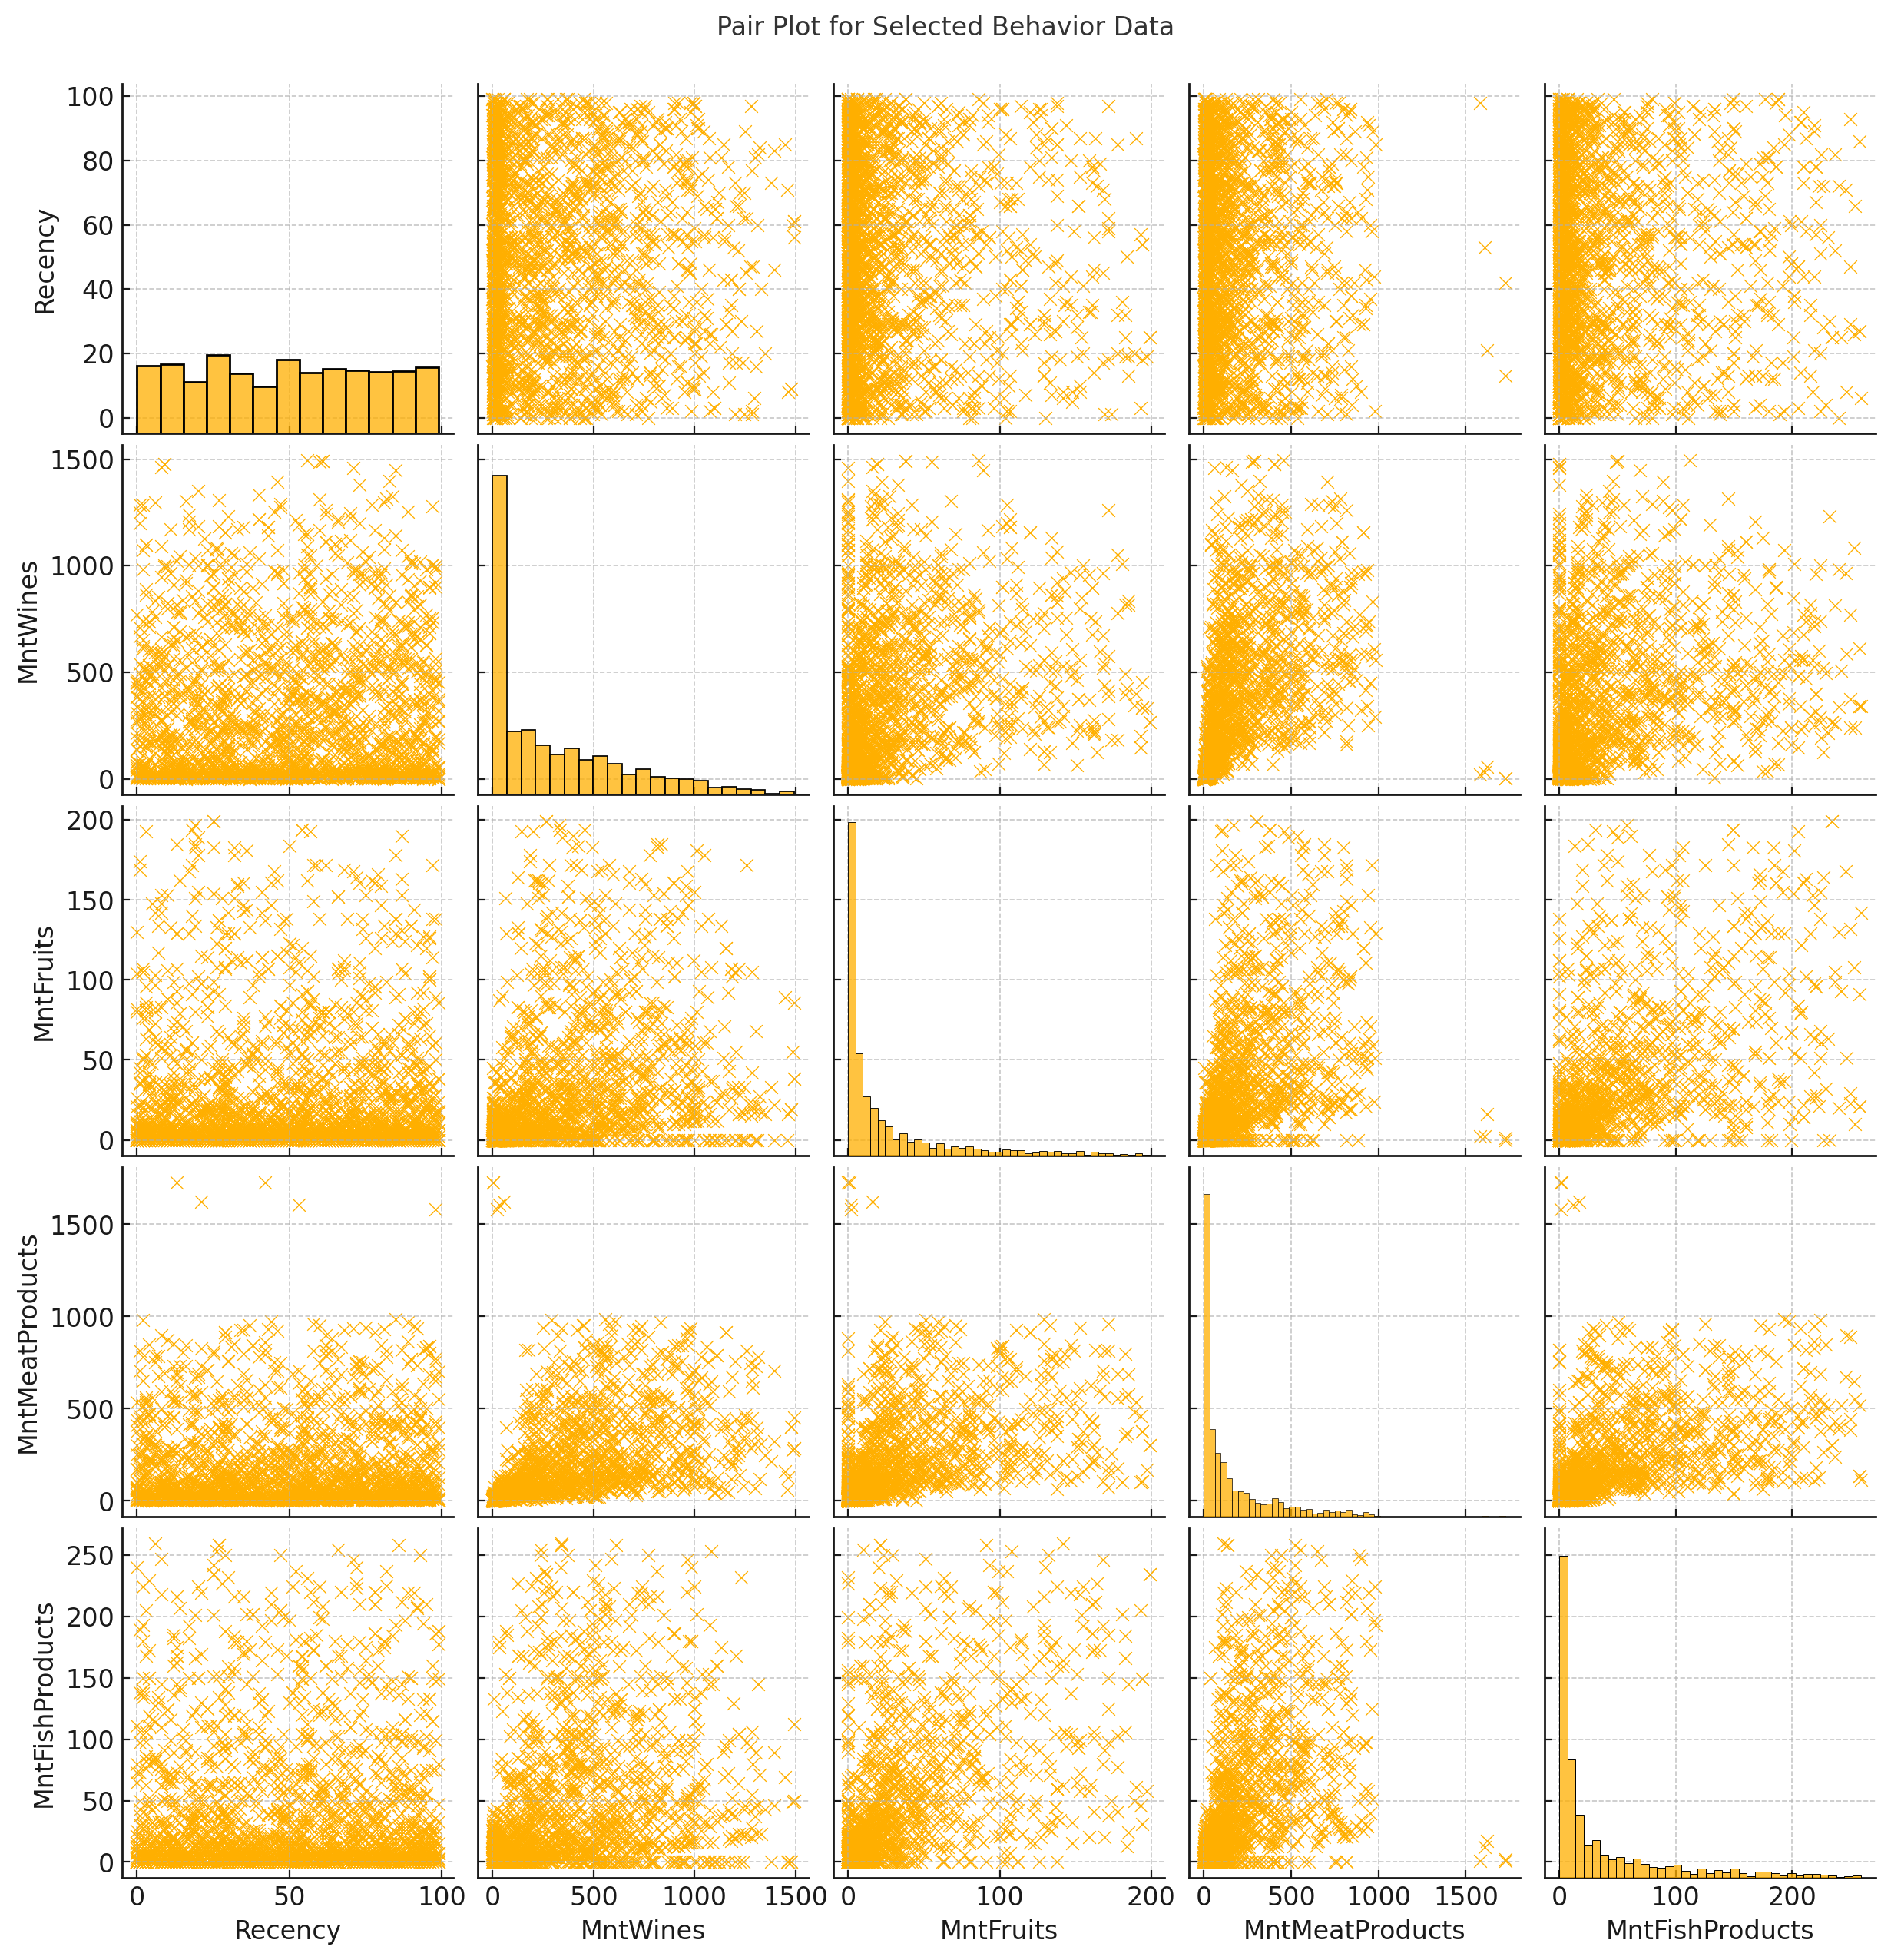
Pair Plot for Selected Behavior Data

Slide 17

Key Findings from EDA
1. Income distribution shows high variability with potential outliers.
2. Majority of customers are educated and married.
3. Positive correlation between different spending categories.
4. Recency negatively correlated with amount spent.
5. Funnel analysis shows decreasing acceptance rates for successive campaigns.

Slide 18
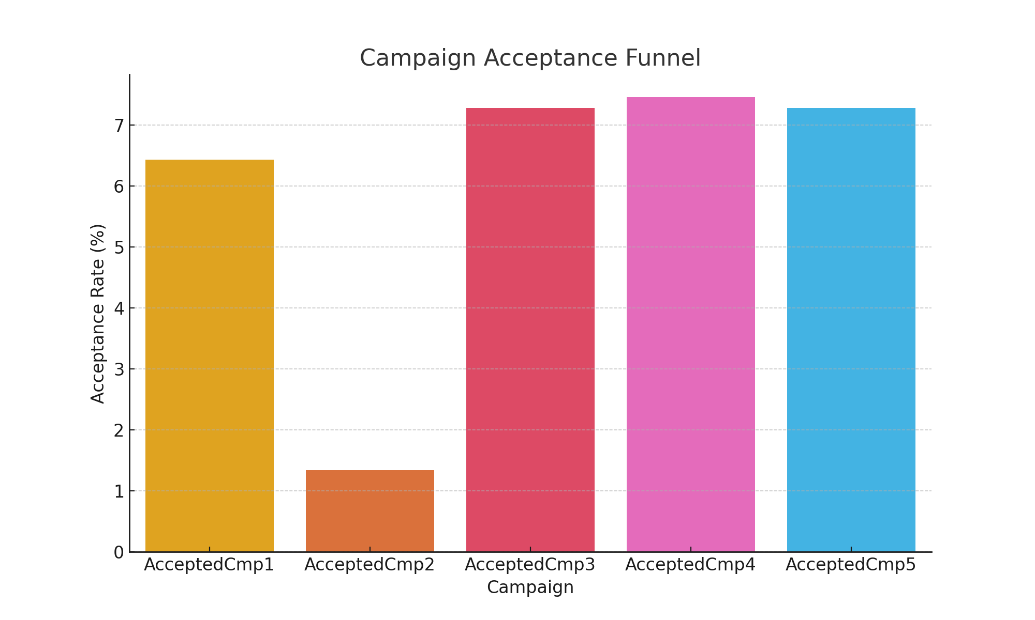
Campaign Acceptance Funnel

Slide 19
Feature Engineering: Feature Creation
Created new features to enhance model performance.
Derived meaningful attributes from existing data.

Slide 20
Feature Engineering: Feature Selection
Selected the most relevant features for model building.
Ensured optimal input variables to improve model accuracy.

Slide 21
Model Building: Model Selection
Explored various machine learning algorithms.
Selected the best model based on performance metrics and business requirements.

Slide 22
Model Training
Feature and Target Selection:
Selected relevant features and target variable (Response).
Convert Categorical Variables:
Converted categorical variables to dummy variables.
Split Data:
Split the data into training and testing sets.
Train Models:
Trained both Logistic Regression and Random Forest models.
Evaluate Models:
Evaluated the models using classification metrics.
Save the Best Model:
Saved the Random Forest model as it performed better, along with the imputer.

Slide 23
Model Evaluation - Logistic Regression
## Model Evaluation - Logistic Regression
**Performance Metrics:**
- Precision, Recall, F1-Score, Accuracy
- Confusion Matrix
**Classification Report:**
| Class | Precision | Recall | F1-Score | Support |
|-------|-----------|--------|----------|---------|
| 0 | 0.84 | 0.89 | 0.86 | 668 |
| 1 | 0.65 | 0.54 | 0.59 | 232 |
**Confusion Matrix:**
| | Predicted 0 | Predicted 1 |
|-------|--------------|-------------|
| Actual 0 | 595 | 73 |
| Actual 1 | 106 | 126 |

Slide 24
Model Evaluation - Random Forest
## Model Evaluation - Random Forest
**Performance Metrics:**
- Precision, Recall, F1-Score, Accuracy
- Confusion Matrix
**Classification Report:**
| Class | Precision | Recall | F1-Score | Support |
|-------|-----------|--------|----------|---------|
| 0 | 0.87 | 0.91 | 0.89 | 668 |
| 1 | 0.72 | 0.62 | 0.67 | 232 |
**Confusion Matrix:**
| | Predicted 0 | Predicted 1 |
|-------|--------------|-------------|
| Actual 0 | 609 | 59 |
| Actual 1 | 89 | 143 |

Slide 25
Model Preference
Model Preference:
We chose the Random Forest model because it outperformed the Logistic Regression model across all key metrics:
Higher accuracy: 0.83 compared to 0.79
Better precision and recall for both classes
Higher F1-score

Slide 26

Outcomes and Inferences
Model Performance:
The Random Forest model performed better than the Logistic Regression model, with an accuracy of 83% and better precision, recall, and F1-scores.
Feature Importance:
Features like Income, MntMeatProducts, MntWines, and Recency were found to be significant in predicting customer response.
Model Deployment:
The model was successfully deployed using Flask, providing a user-friendly interface for predictions.

Slide 27
Conclusions
Effective Predictive Model:
The Random Forest model proved to be a reliable and accurate predictive model for determining customer responses to marketing campaigns.
Significant Features:
Key features influencing customer response include Income, amount spent on meat and wine products, and recency of purchases.
User-Friendly Deployment:
Deploying the model using Flask makes it accessible and easy to use, allowing for real-time predictions based on customer data.

Slide 28
Recommendations
Target High-Income Customers:
Focus marketing efforts on high-income customers as they are more likely to respond positively to campaigns.
Emphasize Frequent Buyers:
Prioritize customers with high recency and those who frequently purchase meat and wine products.
Personalized Campaigns:
Use the model to create personalized marketing campaigns based on significant features to improve response rates.
Monitor and Update Model:
Continuously monitor model performance and update it with new data to maintain accuracy and relevance.

Slide 29
Thank-You

