Slide 1

Introduction to Android Development
Warwick Hunter

Slide 2
History
1.0 – Very basic tools, predates HTC G1 (Dream)
1.5 – Big improvements, first usable version
1.6 – More improvements, widespread adoption
2.0 – Breaking API changes in some areas, bugs
2.1 – Nice and stable
2.2 – JIT introduced
2.3 – Spiffier widgets, exchange support
2.3.3/4 – Added NFC and accessory API
3.0 – Big visual improvements, tablet support
3.1 – Sundry improvements

Slide 3
Developing
Tools
Java SDK download – Mac, Linux, Windows
Eclipse plugin – 3.5, 3.6, 3.7
Emulator in the SDK or any Android phone
NDK – Native development kit available, but don't assume all phones are ARM.

Slide 4
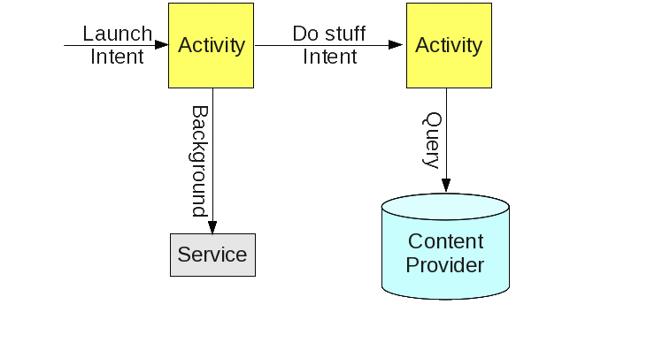
Anatomy of an App

Slide 5
Development Pieces
AndroidManifest.xml
register activities and services
declare permissions required
Resources – res area (all I18N)
layout : screen and widget layouts
drawable : images
values : strings, arrays
raw : audio and anything else
Gen
R.java : Auto-generated identifiers of all the above

