Slide 1
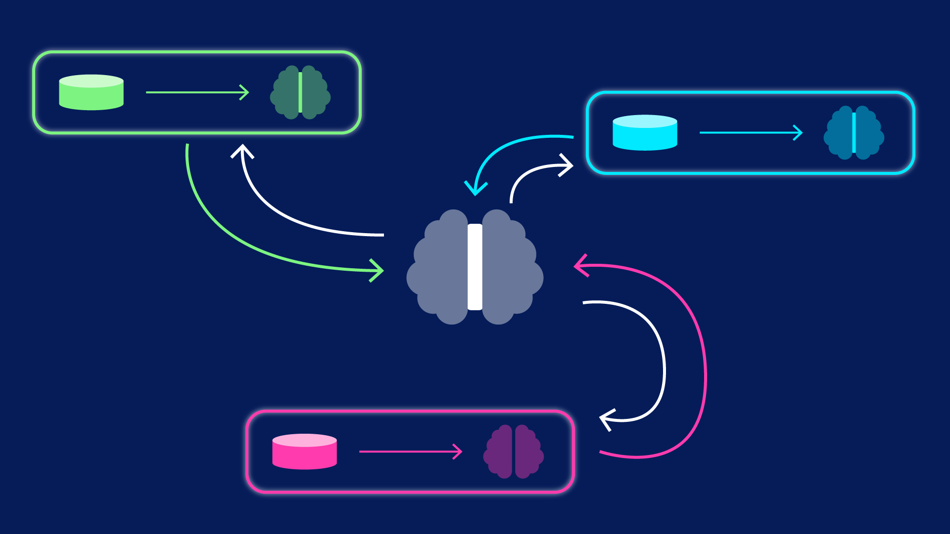
Threats to Federated Learning: A Survey
Wasae Qureshi
Notes:
References: https://gab41.lab41.org/membership-inference-attacks-on-neural-networks-c9dee3db67da

Slide 2
The Paper
Threats to Federated Learning: A Survey
Lingjuan Lyu, Han Yu, Qiang Yang
Link to survey paper: https://arxiv.org/pdf/2003.02133.pdf
Notes:
References: https://arxiv.org/pdf/2003.02133.pdf

Slide 3
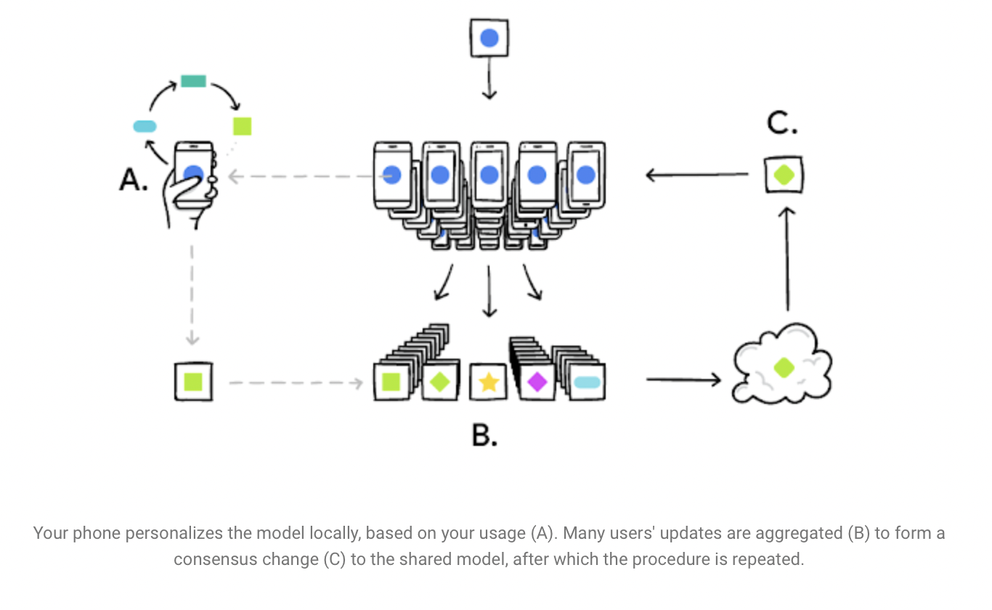
What is Federated Learning?
Tackling issue with privacy
Centralized global model
This is deployed to individual users (like you and me) device
Trained on the data on the device
Updates sent back to the global model
Training data stays with the user
Secure and accurate models
Notes:
References: https://ai.googleblog.com/2017/04/federated-learning-collaborative.html

Slide 4
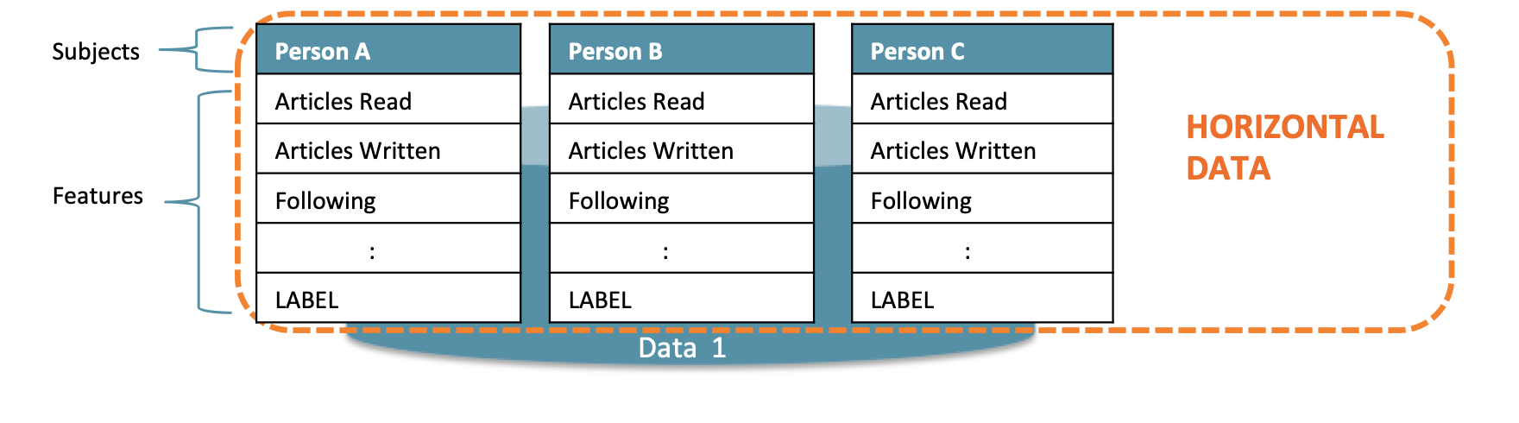
Types of Federated Learning
Horizontal Federated Learning (HFL)
Consistent set of features
Types of HFL’s
H2C - HFL for customers
H2B - HFL for businesses
Notes:
References:
https://blog.openmined.org/federated-learning-types/
https://arxiv.org/pdf/2003.02133.pdf

Slide 5
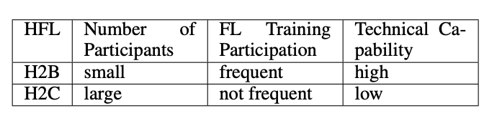
Types of Federated Learning (continued…)
H2B
Low participants, frequently selected.
High technical capability and significant computational power
H2C
Lot’s of participants, not frequently selected
Low technical capability
Example of this is Google Board (used for typing)
Difference in number of participants and technical ability
Technical ability is a good indicator on whether malicious attacker will attack)

Slide 6
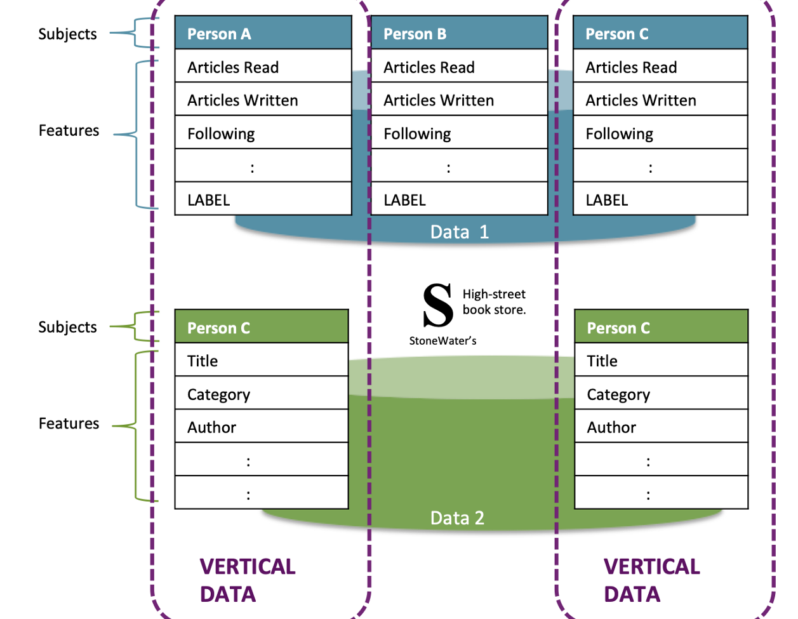

Types of Federated Learning (continued…)
Vertically Federated Learning (VFL)
Not consistent set of features…
Federated Transfer Learning (FTL)
Little overlap between sample space and feature space
Not many case studies on this available
Notes:
References: https://blog.openmined.org/federated-learning-types/
https://en.wiktionary.org/wiki/question_mark

Slide 7
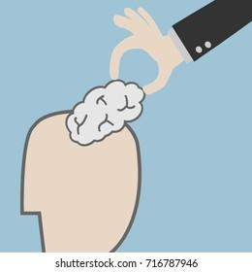
Threats to Federated Learning?
Data is never shared between the servers
But during the training process (model updates the global model) can reveal sensitive information.
Original gradient can be used to reveal info about original data
Notes:
References: https://www.shutterstock.com/image-vector/hands-stealing-idea-brain-716787946

Slide 8
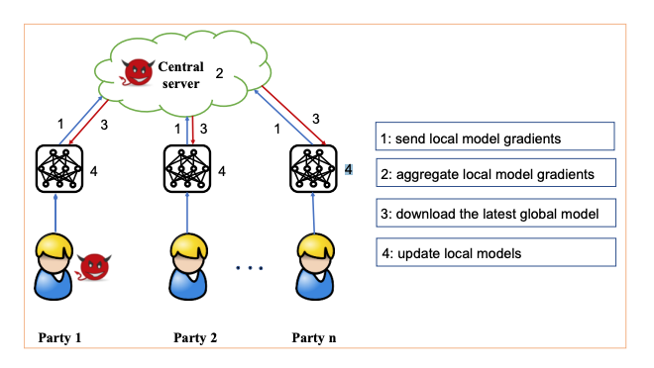
Threats to Federated Learning? (continued…)
Federated Learning design has vulnerabilities with the:
server
Tamper with training process
Change params
individual participants
Change params that are uploaded to the server.

Slide 9
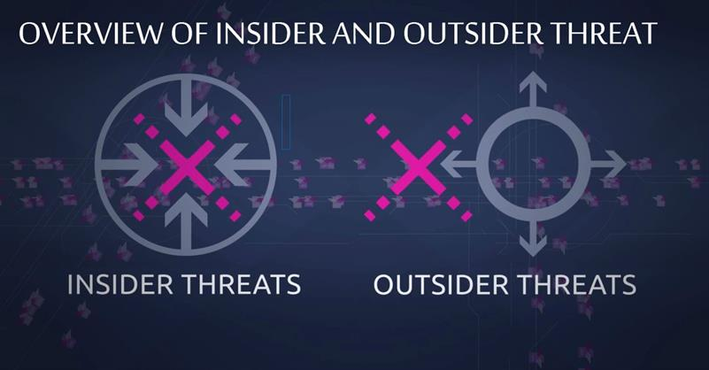
Threat Models - Types of attacks
Insider vs Outsider
Insider can attacker server and participants (stronger)
Outsider typically are eavesdropping
Focus on insider attacks
Single attack
Model to miss-classify
Byzantine attack
Tailor outputs to have similar distribution to correct model
Sybil attack
Use previously compromised accounts or simulate dummy accounts to make powerful attack
Semi-honest vs Malicious
Semi-honest are only observing
Malicious are attacking
Notes:
References:
https://resources.infosecinstitute.com/topic/insider-vs-outsider-threats-identify-and-prevent/

Slide 10
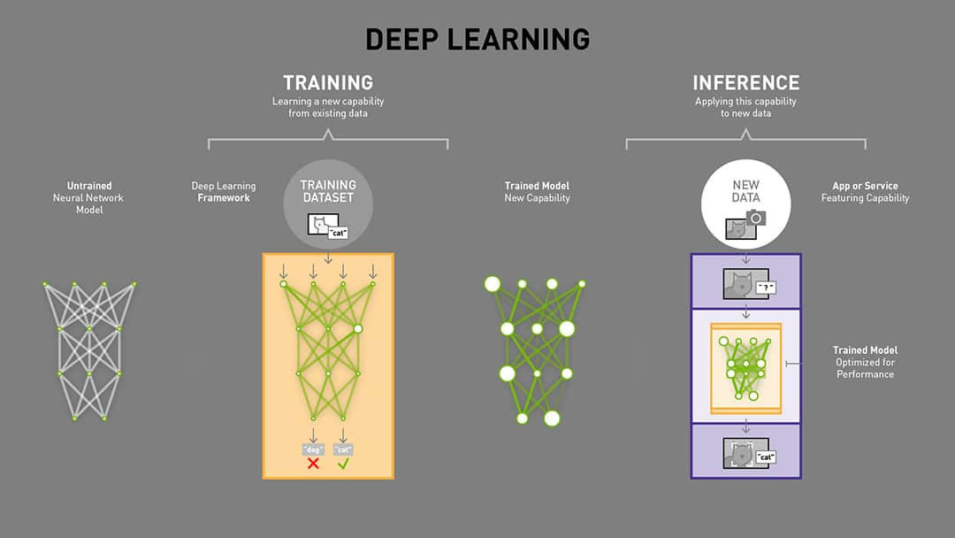
Training phase vs Inference phase
Training phase
Learn, influence, or damage the model
Poison attacks
Data integrity
Learning process
Inference phase
No model interference
Give incorrect predictions
Exploit the model
Notes:
Reference: https://blogs.nvidia.com/blog/2016/08/22/difference-deep-learning-training-inference-ai/

Slide 11
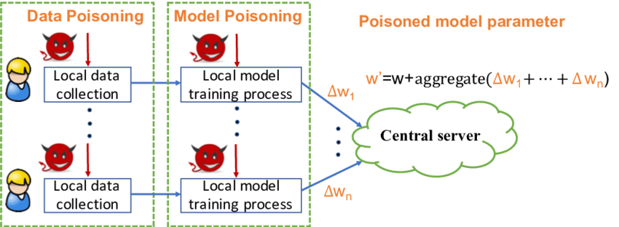
Poison Attacks
Random attacks
Aim to reduce accuracy
Targeted attacks
Influence the outcome and benefit
More difficult to execute
Data or model poisoning
Main purpose to change the behavior of the model

Slide 12
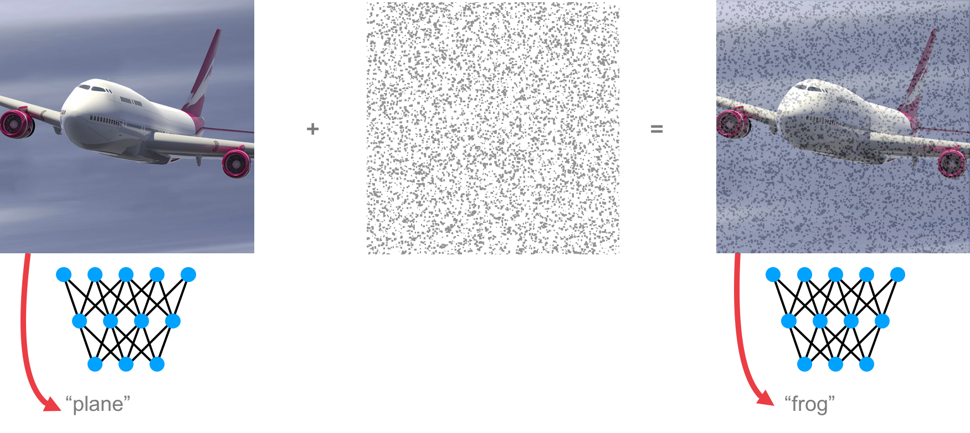
Data Poisoning
Clean-label attacks
Introducing misclassified data
Can’t change existing labels in training data as it is certified
Dirty-label attacks
Label-flipping
Changing labels from one class to another
1 to 7, now it will think a 1 is 7 when making a prediction
Backdoor poisoning
Features are modified instead to blunder predictions
Data can’t be certified, otherwise these attacks are not possible.

Slide 13
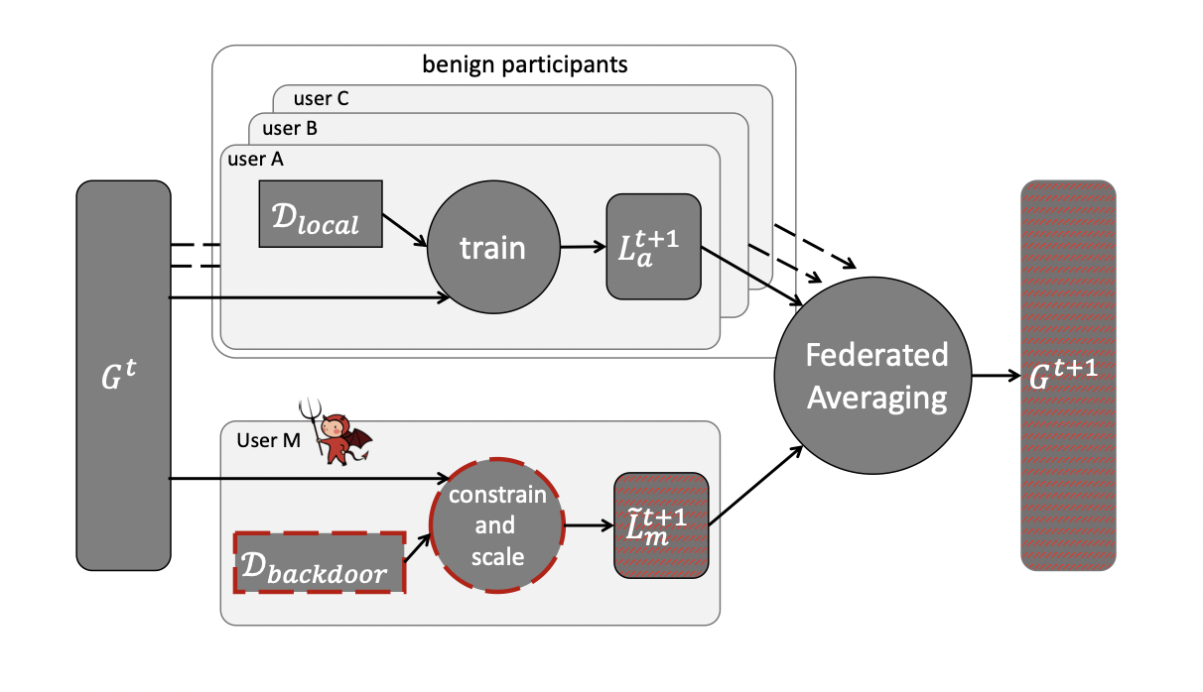
Model Poisoning
Attack the updates of the local model on user device before sending them to global model
Need access to user device
Train model with poisoned data
Not exactly the same as data poisoning
Not messing with the existing data, just the learning process of the model
Notes:
Reference: https://arxiv.org/pdf/1807.00459.pdf

Slide 14
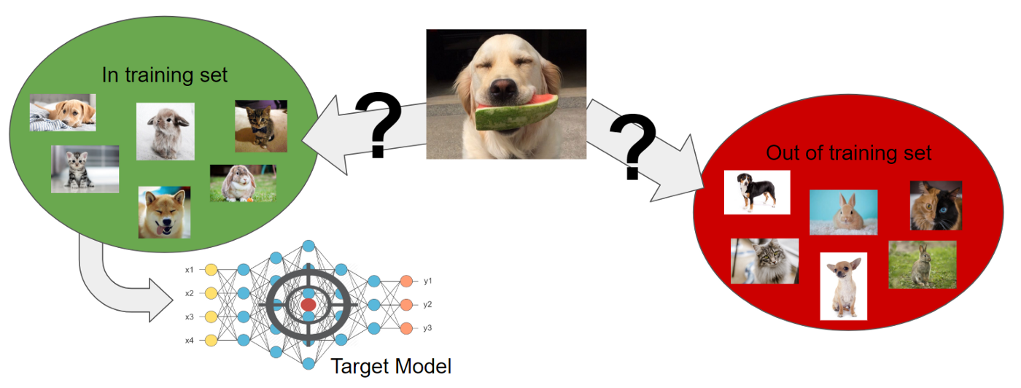
Inference Attacks (not to be confused with Inference Phase)
Information attackers can get from the training phase
Gradients are key here
Malicious attackers can use the gradients models generate and use to get significant amount of information of the user
In some cases the whole original data
Notes:
Reference: https://gab41.lab41.org/membership-inference-attacks-on-neural-networks-c9dee3db67da

Slide 15
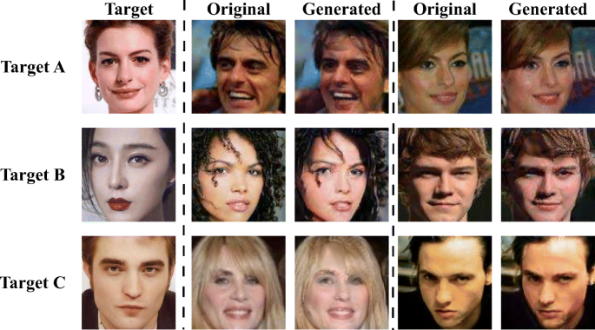
Inferring Class Representatives
Train a GAN model to generate similar samples of targeted training data
Which ultimately was suppose to be private
Not original data however
Similar distribution
Pretty effective if the model had trained on one specific user
Pretty unlikely but regardless this is a privacy leak
Notes:
Reference: https://link.springer.com/article/10.1007/s11042-020-09604-z

Slide 16

Inferring Properties and Membership
Using an individual data point, attackers can figure out if it was used in the training of a model
Passive attack
Observe model updates and changes to the parameters
Active attack
Aggressively try to gain more information from the user
Notes:
Reference: https://gab41.lab41.org/membership-inference-attacks-on-neural-networks-c9dee3db67da

Slide 17
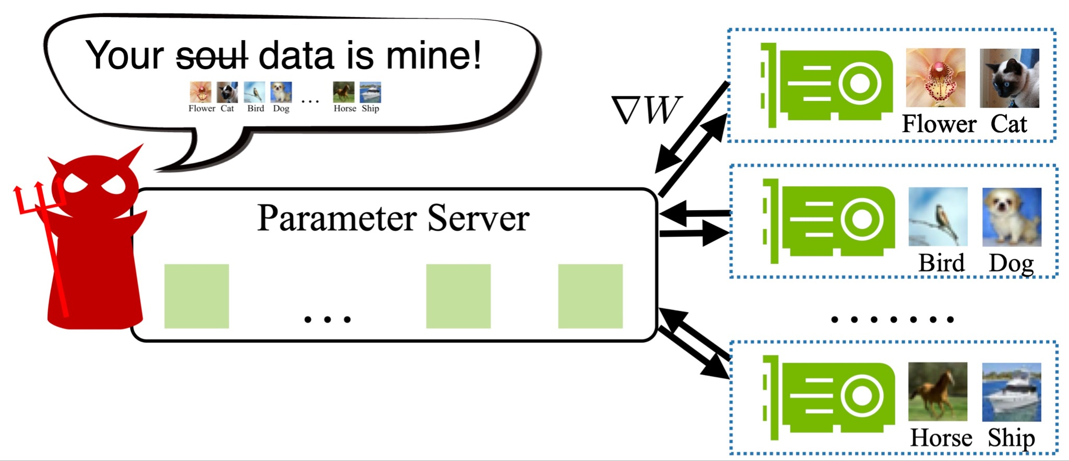
Inferring Training Inputs and Labels
Two papers Deep Leakage From Gradients and Improved Deep Leakage From Gradients
Presented a model that can gain the original data from the training dataset from the model
Just in a couple of iterations this can be done
Most powerful attack than before
Notes:
Reference: https://hanlab.mit.edu/projects/dlg

Slide 18

What is the future?
Do we need to do model updates?
Share less sensitive information. Share only predictions
Implementing new or with existing architectures
Decentralizing federated learning
Differential privacy
Describing patterns while withholding information about individuals
Checking the network for attackers
Notes:
Reference: https://www.heartland.org/news-opinion/news/the-future-is-bright-at-heartland
https://en.wikipedia.org/wiki/Differential_privacy

Slide 19
Thank You!

