Slide 1
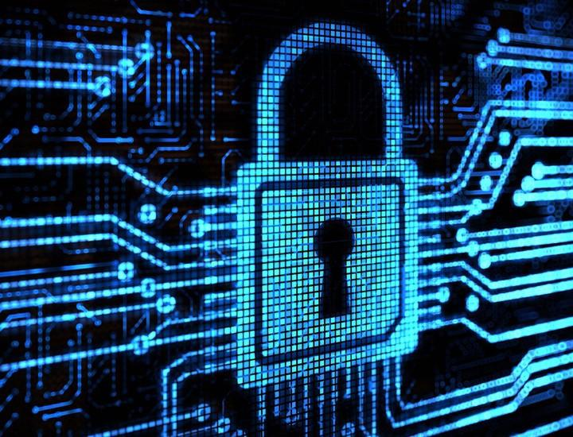
When Machine Learning Meets Privacy: A Survey and Outlook
Wasae Qureshi
Notes:
References: https://joeyandbluewhale.github.io/project/mlprivacy/

Slide 2
The Paper
When Machine Learning Meets Privacy: A Survey and Outlook
Bo Liu, Ming Ding, Sina Shaham, Wenny Rahayu, Farhad Farokhi, Zihuai Lin
Link to survey paper: https://arxiv.org/pdf/2011.11819.pdf
Notes:
References: https://arxiv.org/pdf/2011.11819.pdf

Slide 3

Privacy?
Emerging issue in the past decade with the rise in data volume.
Security measures are being added, but attackers are getting clever.
How bad is it?
Notes:
References: https://blog.google/technology/safety-security/data-privacy-day-seven-ways-we-protect-your-privacy/
https://arxiv.org/pdf/2011.11819.pdf

Slide 4
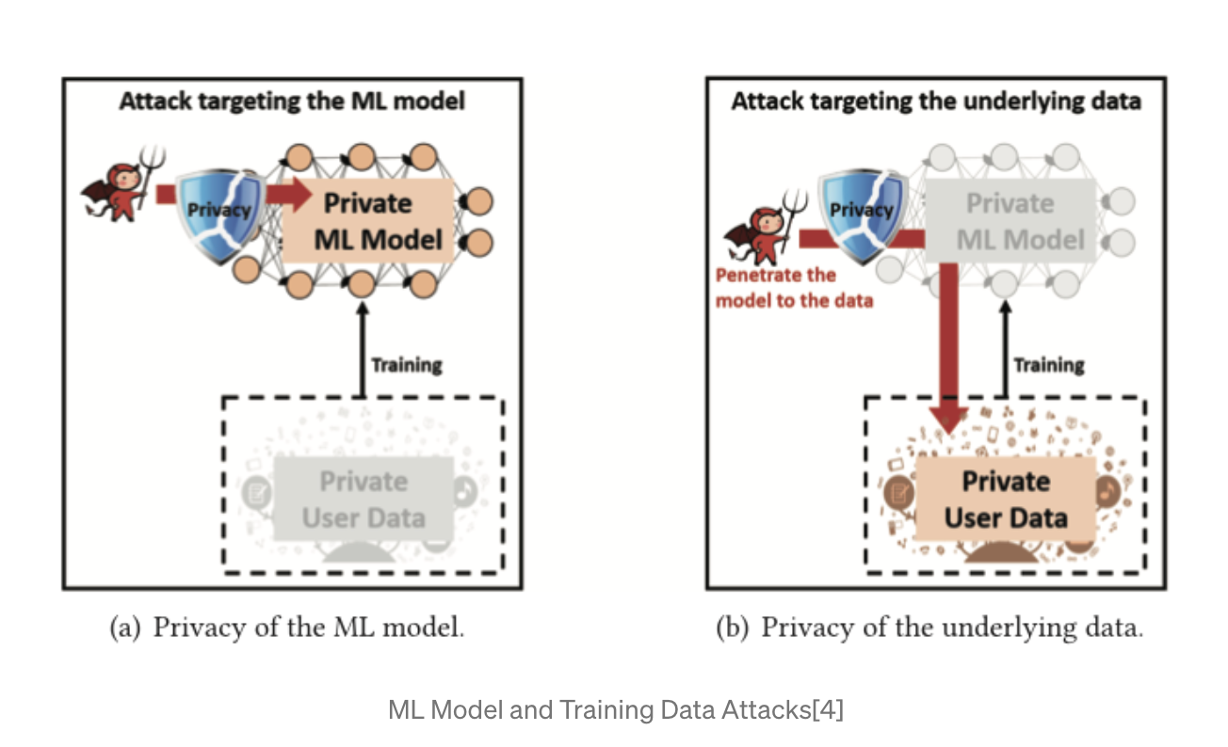
Private Machine Learning
Doesn’t mean creating in secrecy.
Current attacks and prevention methods against ML
Training data/Model
White-box/Black-box attacks
Notes:
References:
https://arxiv.org/pdf/2011.11819.pdf

Slide 5
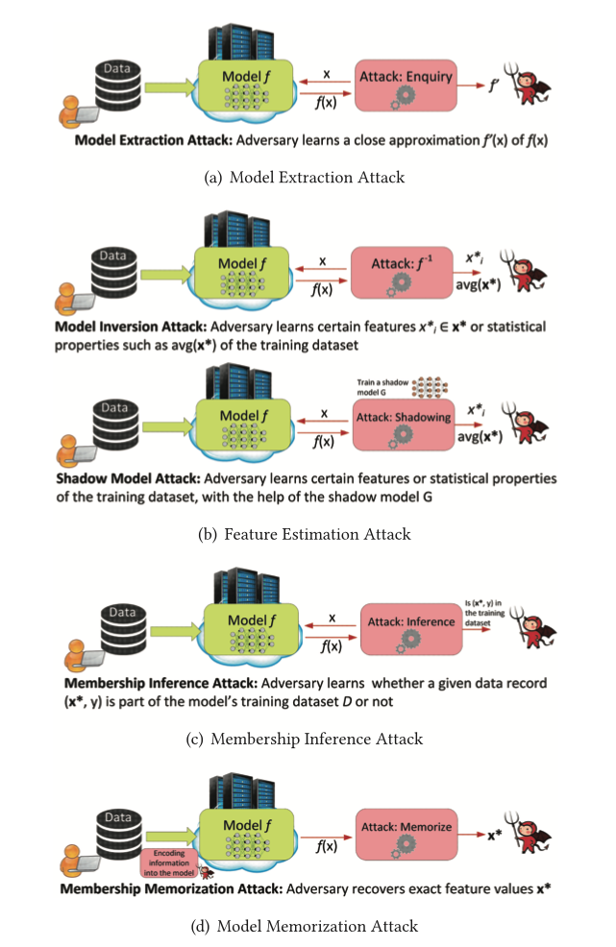
Types of Private Machine Learning Attacks
Model Extraction Attack
Feature Estimation Attack
Inversion Attack
Shadow Attack
Membership Inference Attack
Model Memorization Attack
Notes:
Reference: https://arxiv.org/pdf/2011.11819.pdf

Slide 6

Defense Mechanisms?
Encrypting the data
Obfuscation, jumbling up the the data but making is still known to the model
Aggregation
Federated learning
Notes:
References: https://www.agileit.com/news/data-encryption-methods-secure-cloud/
https://arxiv.org/pdf/2011.11819.pdf

Slide 7
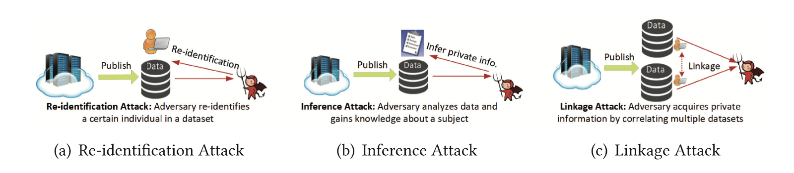
Machine Learning Aided Privacy Protection
Notes:
References: https://arxiv.org/pdf/2011.11819.pdf

Slide 8
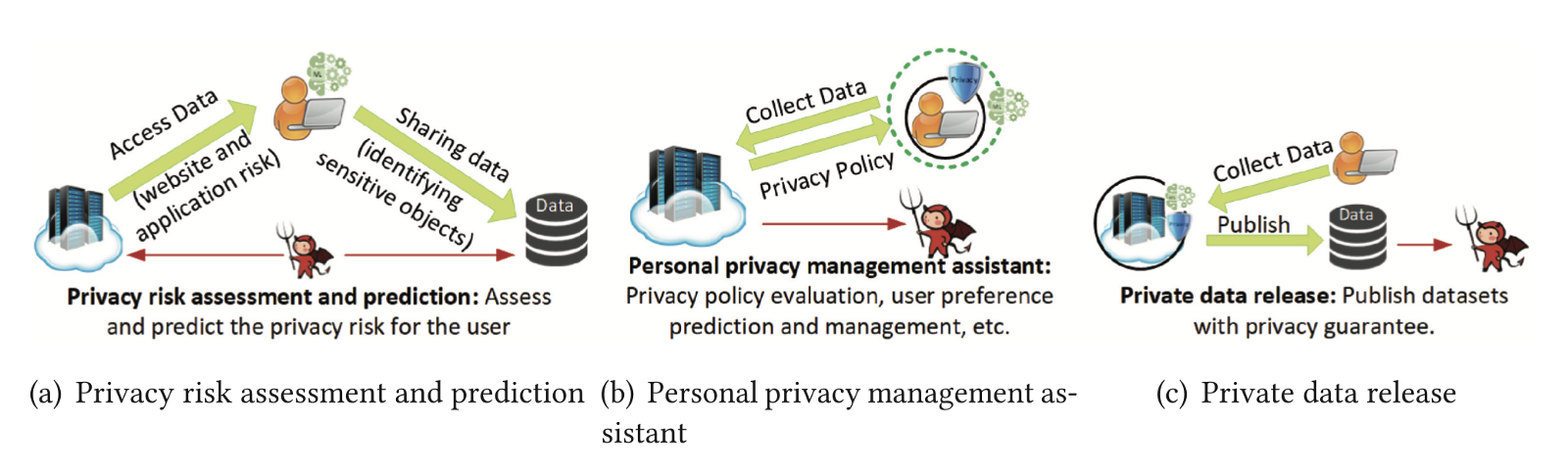
Types of Privacy Protection
Notes:
References: https://arxiv.org/pdf/2011.11819.pdf

Slide 9
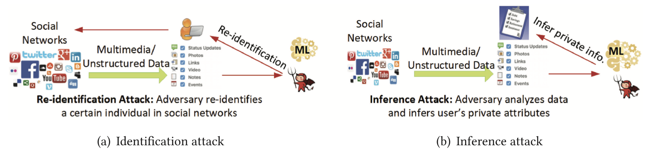
Machine Learning-based Privacy Attacks and Corresponding Protection Schemes
Notes:
References:
https://arxiv.org/pdf/2011.11819.pdf

Slide 10
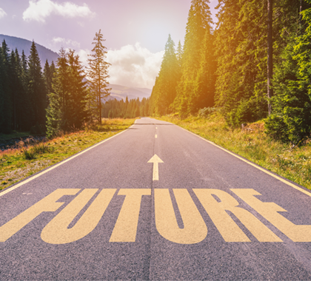
What is the future?
Attackers will always find new ways to attack and researchers will always find ways to protect ourselves against them.
Noise, obfuscation, encryption
GANS
Notes:
Reference: https://www.heartland.org/news-opinion/news/the-future-is-bright-at-heartland
https://arxiv.org/pdf/2011.11819.pdf

Slide 11
Thank You!

