Slide 1

Agile Presentation
Wasan Alabed
CS250 Software Development Lifecycles

Slide 2
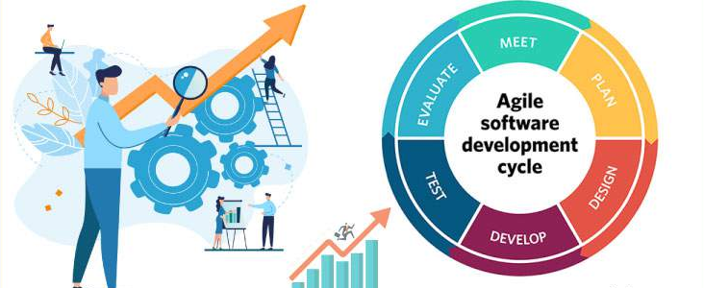
Agile Software Development Cycle

Slide 3

Scrum Team
Client
Product Owner
The Scrum Master: makes sure the Scrum team follows its values and works well together.
The product owner is responsible for communicating user needs to the development team, using user input to create a product backlog of important requirements.
The development team creates and delivers product additions. They handle the design, development, and testing of these new features.
Scrum Master
Tester
Developer

Slide 4
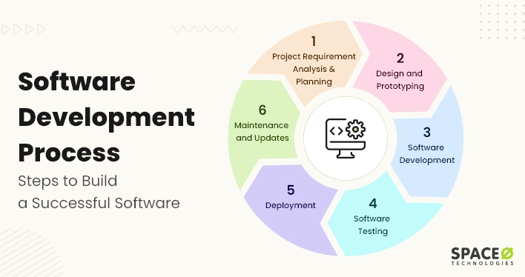
Software Development Life Cycle phases
Requirement analysis and resource planning: To plan software development, align it with goals, analyze tasks, allocate resources, and create a justifiable budget.
Design and prototype to define the complete workflow: Define the software workflow, guide designers, and address issues early to save time and resources.
Software development: Understanding requirements and design is crucial before coding software. Our skilled team knows how to develop products that meet project-specific requirements.
Software testing: Our team responsible for quality assurance tests software to find and fix any issues that may affect its performance, ease of use, and reliability.
Software deployment: Software is deployed once it's been coded, tested, and approved for functionality and stability
Maintaining and updating software: Software development is ongoing and requires regular monitoring and updates to keep up with technology and user needs.

Slide 5
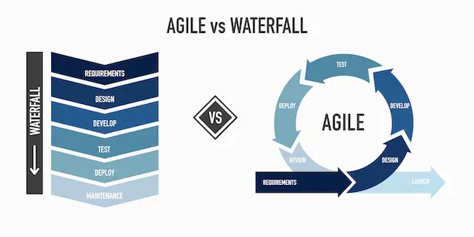
When it comes to agile development, taking an incremental approach can help you make progress without needing a complete list of requirements right from the start. It's possible to explore and develop features as you go along, taking user feedback into account to guide your decision-making. By using a flexible and iterative approach like Scrum or Agile Modeling, you can involve users throughout the development process to ensure that you're meeting their needs and making continuous improvements.
The waterfall model is a process where software development stages are done one after the other, with some testing and feedback in between. But because it's inflexible, big companies and government agencies need a lot of documentation on what's needed and what's involved before starting a project. Once development starts, there's not much room for changes.

Slide 6
an agile approach Factors
The SNHU Travel project can benefit from using an agile approach. This approach allows for quick adjustments to changing requirements and helps teams stay flexible and adapt accordingly. Involving stakeholders in the agile approach and getting feedback from them can lead to a successful outcome. With its focus on delivering a high-quality travel experience for users, an agile approach can help teams stay focused on the big picture and make smart decisions that drive the project forward. Overall, choosing an agile approach can ensure the success of the SNHU Travel project.

Slide 7

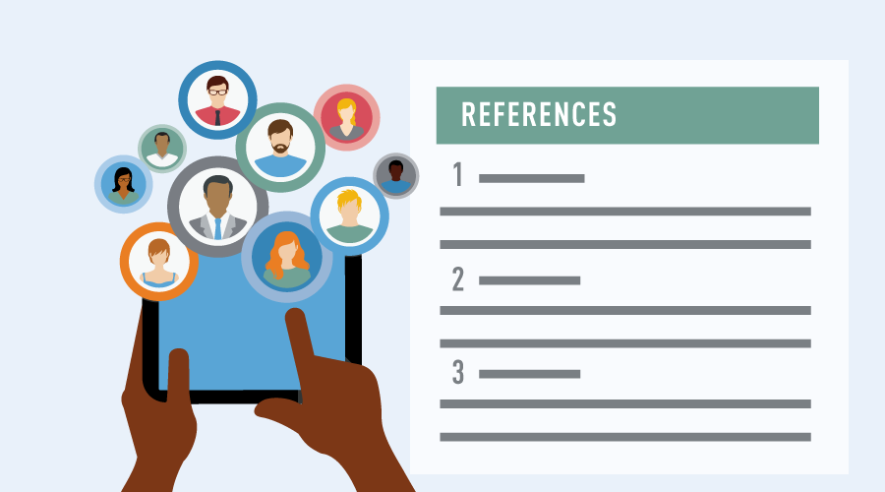
References
1. Patel, B., & Written by Bhaval PatelBhaval Patel is a Director (Operations) at Space-O Technologies. He has 20+ years of experience helping startups and enterprises with custom software solutions to drive maximum results. Under his leadership. (2023, May 9). 6 stages of Agile Software Development Process: Visual Guide. Homepage. https://www.spaceotechnologies.com/blog/software-development-process/
2. Tyagi, N. (n.d.). What is Agile Software Development?: Agile Software Development Life cycle. What is Agile Software Development? | Agile Software Development Life Cycle. https://www.analyticssteps.com/blogs/what-agile-software-development
3. Benefits of Agile Change Management. CrossCountry Consulting. (2023, February 7). https://www.crosscountry-consulting.com/insights/blog/benefits-of-agile-change-management/

