Slide 1
Storyboards
BudgetApp
SWDV 661
Wasan Yotchai
March 16, 2025

Slide 2
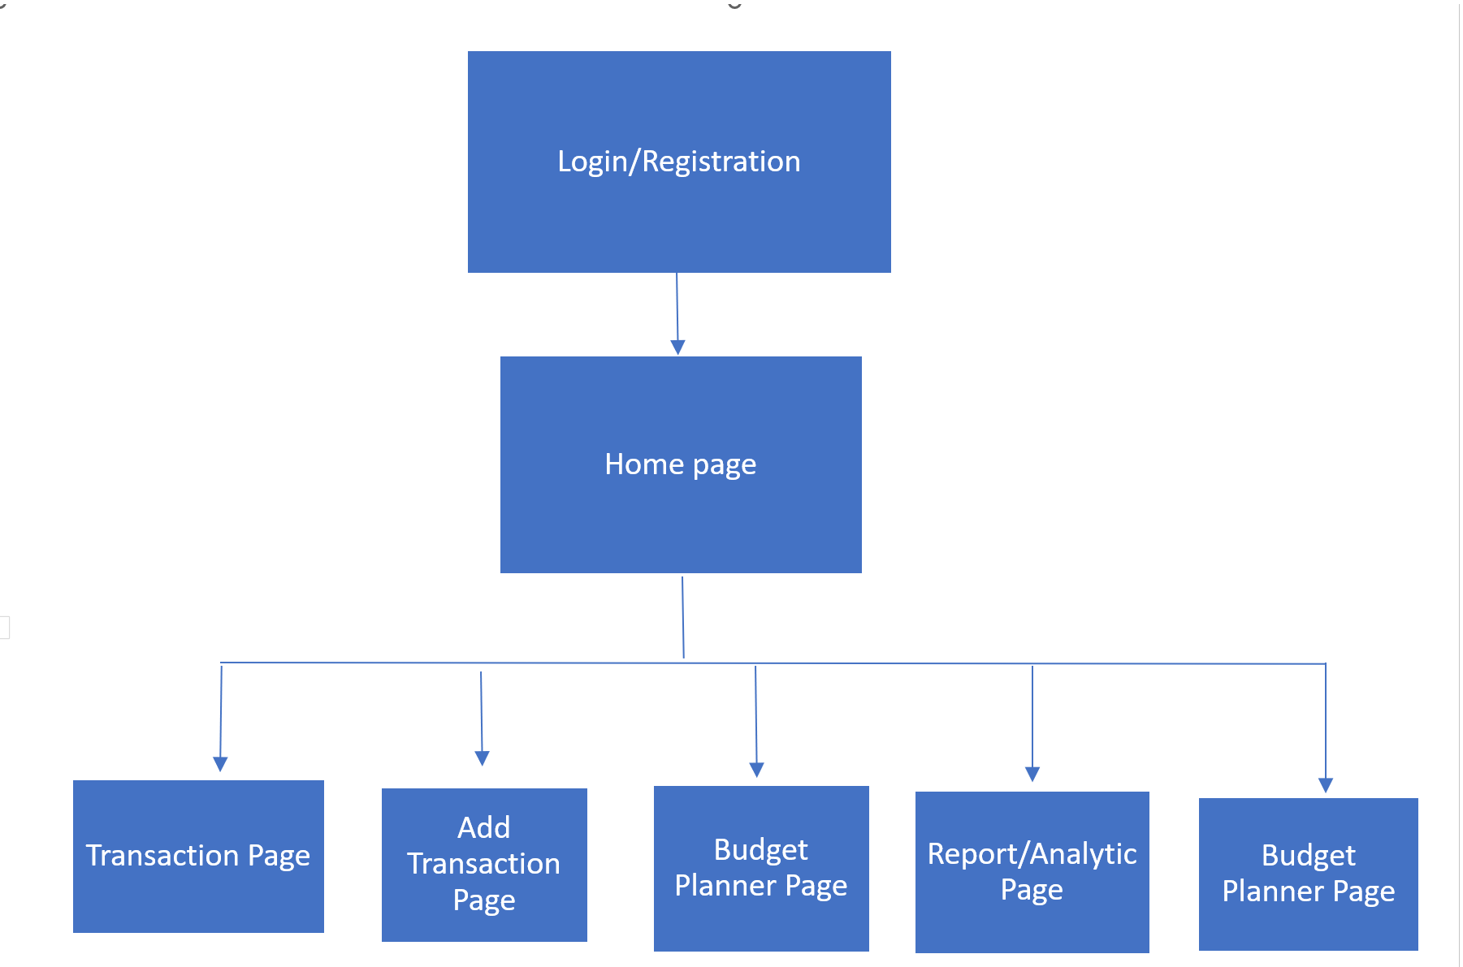
Rough storyboard:

Slide 3
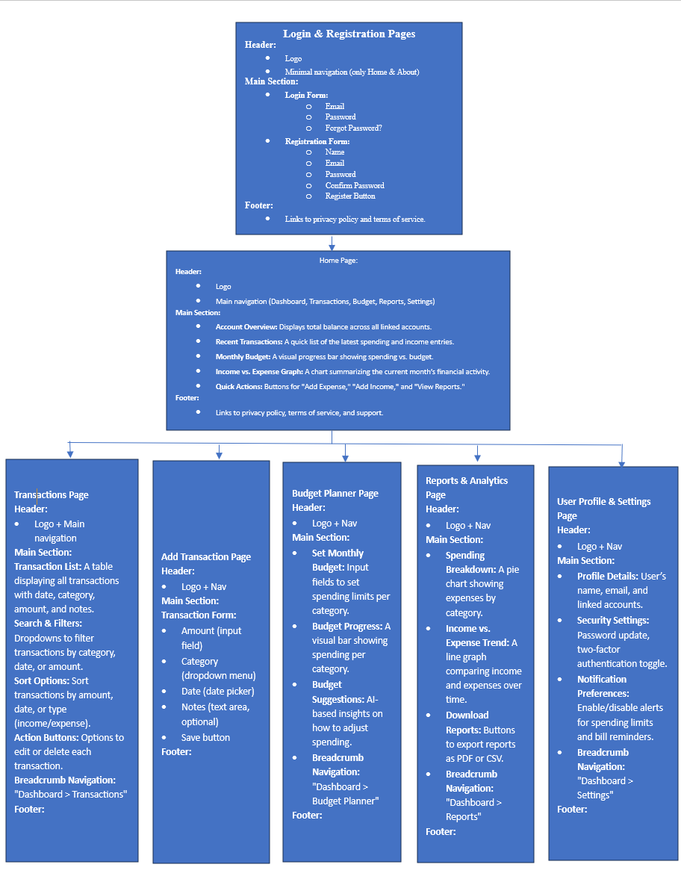

Slide 4
Details:

Slide 5
Login & Registration Pages
Header:
Logo
Minimal navigation (only Home & About)
Main Section:
Login Form:
Email
Password
Forgot Password?
Registration Form:
Name
Email
Password
Confirm Password
Register Button
Footer:
Links to privacy policy and terms of service.

Slide 6
Home (Dashboard) Page
Header:
Logo
Main navigation (Dashboard, Transactions, Budget, Reports, Settings)
Main Section:
Account Overview: Displays total balance across all linked accounts.
Recent Transactions: A quick list of the latest spending and income entries.
Monthly Budget: A visual progress bar showing spending vs. budget.
Income vs. Expense Graph: A chart summarizing the current month’s financial activity.
Quick Actions: Buttons for "Add Expense," "Add Income," and "View Reports."
Footer:
Links to privacy policy, terms of service, and support.

Slide 7
Transactions Page
Header:
Logo
Main navigation
Main Section:
Transaction List: A table displaying all transactions with date, category, amount, and notes.
Search & Filters: Dropdowns to filter transactions by category, date, or amount.
Sort Options: Sort transactions by amount, date, or type (income/expense).
Action Buttons: Options to edit or delete each transaction.
Footer:
Links to FAQs and customer support.

Slide 8
Add Transaction Page
Header:
Logo + Main navigation + Breadcrumb Nav ("Dashboard > Transactions > Add Transaction")
Main Section:
Transaction Form:
Amount (input field)
Category (dropdown menu)
Date (date picker)
Notes (text area, optional)
Save/submit button
Footer:
Links to support and FAQs.

Slide 9
Budget Planner Page
Header:
Logo
Main navigation
Main Section:
Set Monthly Budget: Input fields to set spending limits per category.
Budget Progress: A visual bar showing spending per category.
Budget Suggestions: AI-based insights on how to adjust spending.
Footer:
Links to financial tips and budgeting help.

Slide 10
Reports & Analytics Page
Header:
Logo
Main navigation
Main Section:
Spending Breakdown: A pie chart showing expenses by category.
Income vs. Expense Trend: A line graph comparing income and expenses over time.
Download Reports: Buttons to export reports as PDF or CSV.
Breadcrumb Navigation: "Dashboard > Reports"
Footer:
Links to support and data privacy policy.

Slide 11
User Profile & Settings Page
Header:
Logo
Main navigation
Main Section:
Profile Details: User’s name, email, and linked accounts.
Security Settings: Password update, two-factor authentication toggle.
Notification Preferences: Enable/disable alerts for spending limits and bill reminders.
Breadcrumb Navigation: "Dashboard > Settings"
Footer:
Links to help center and FAQs.

