Slide 1
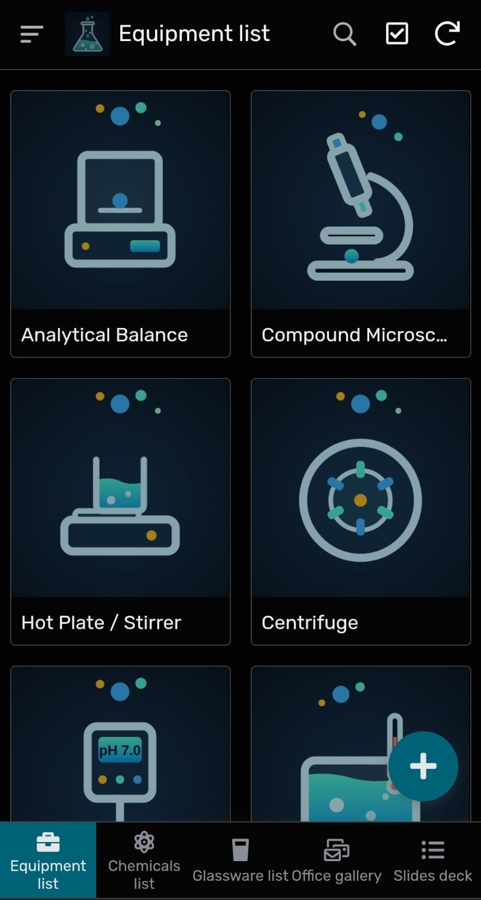

Store IT
Phone screenshot of the app
Know where every lab item is before you step into the storeroom.
Cristina G., Wasani C., Amber G. | CMPS3141 HCI

