Slide 1
Data Structures
Chapter 2: Arrays

Slide 2
§ 2.1 ADT and C++ Class類別
Four components部份/元件 in a C++ Class
  class name 類別名稱
  data members 資料成員: the data that make up 組成 the class
  member functions 成員函式: the set of operations運算 that may be applied應用 to the objects物件 of class
  levels of program access 程式存取之層次: public公開的, protected保護的 and private私有的
height高
(x, y)
width寬

Slide 3
Rectangle.h – Definition of Rectangle Class
#ifndef RECTANGLE_H
#define RECTANGLE_H
class Rectangle // <- class name: Rectangle
{
public:
// 4 member functions
Rectangle(); // <- constructor 建構子
~Rectangle(); // <- destructor 解構子
int GetHeight();
int GetWidth();
private:
// 4 data members
int xLow, yLow, height, width;
// (xLow, yLow) is the bottom left corner
};
#endif
height
(x, y)
width

Slide 4
Rectangle.cpp – Operation Implementation
#include <Rectangle.h>
int Rectangle::GetHeight() {return height;}
int Rectangle::GetWidth() {return width;}
ADT: Abstraction Data Type 抽象資料型態
  Rectangle.h: object representation 物件表示
  (or class definition 類別定義)
  Rectangle.cpp: operation implementation 運算實作

Slide 5
Example: rect.cpp
#include <iostream> // NOTE: partial部份的 code程式碼
class Rectangle
{
friend ostream& operator<< (ostream& os, Rectangle& r);
public:
Rectangle(int x = 0, int y = 0, int height = 0, int
width = 0) : x1(x), y1(y), h(height), w(width)
{ }
int operator==(const Rectangle& s) {/* TODO:... */}
private:
int x1, y1, h, w;
};
ostream& operator<<(ostream& os, Rectangle& r)
{/* TODO:... */}
void main()
{
Rectangle r(1,1,3,4); // call constructor
Rectangle s;
Rectangle t(1,1,3,4);
if (r == r) cout << 1 << endl; // use overloaded "=="
if (r == t) cout << 2 << endl;
cout << r; // use overloaded "<<"
}

Slide 6
Constructor 建構子
Constructor: the name of the function
is identical完全相同 to its class name
class Rectangle
{
public:
Rectangle(int x = 0, int y = 0, int height = 0, int
width = 0) : x1(x), y1(y), h(height), w(width)
{ }
private:
int x1, y1, h, w;
};
void main()
{
Rectangle r(1,1,3,4); // call constructor
Rectangle s;
Rectangle t(1,1,3,4);
}

Slide 7
Operator Overloading 運算子多載 for ==
#include <iostream> // NOTE: partial code
class Rectangle
{
public:
int operator==(const Rectangle& s) // overload多載 "=="
{
if (this == &s) return 1;
else if ( (x1 == s.x1) && (y1 == s.y1) &&
(h == s.h) && (w == s.w) ) return 1;
return 0;
}
private:
int x1, y1, h, w;
};
void main()
{
Rectangle r(1,1,3,4); // call constructor
Rectangle t(1,1,3,4);
if (r == r) cout << 1 << endl; // use overloaded "=="
if (r == t) cout << 2 << endl;
cout << r; // use overloaded "<<"
}

Slide 8
Operator Overloading for <<
#include <iostream> // NOTE: partial code
class Rectangle
{
friend ostream& operator<< (ostream& os, Rectangle& r);
public:
/* ... */
private:
int x1, y1, h, w;
};
ostream& operator<<(ostream& os, Rectangle& r)
{
os << "Position is: " << r.x1 << " "; // r.x1 ?
os << r.y1 << endl;
os << "Height is: " << r.h << endl;
os << "Width is: " << r.w << endl;
return os;
}
void main()
{
Rectangle r(1,1,3,4); // call constructor
Rectangle t(1,1,3,4);
cout << r; // use overloaded "<<"
}

Slide 9
§ 2.2 ADT of Array陣列
Array Objects物件:
  A set of pairs配對 <index, value> where for each value值 of index索引 there is a value from the set item. IndexSet is a finite有限的 ordered有次序的 set of one or more dimensions維度, for example {0,…,n−1} for one dimension 一維,
  {(0,0), (0,1),(0,2),(1,0),(1,1),…,(2,2)} for two dimensions 二維.
class GeneralArray{
public:
GeneralArray(int j, RangeList list, float initValue = defaultValue);
// create a j-dimensional array
float Retrieve(index i);
// return the mapping value of index i
void Store(index i, float x);
// change the value of index i to x
}

Slide 10
1-dimentional Array in C/C++
// array declaration 陣列宣告
int iarr[10];
float farr[7];
//array declaration with default預設 initial初始 values
int iarr[5] = {0};
float farr[5] = {0.0};
char carr[5] = {'\0'};
bool barr[5] = {false};
// array declaration with different initial values
int iarr[5] = {7, 2, -1, 4, 3};
double darr[5] = {0.2, 0.1, 0.4, 0.3, 0.2};
char carr[5] = {'B', 'A', 'C', 'C', 'D'};
bool barr[5] = {true, false, true, false, true};
// #include <stdbool.h> in C99
darr[i] darr[2]=?
index i | 0 | 1 | 2 | 3 | 4
value | 0.2 | 0.1 | 0.4 | 0.3 | 0.2

Slide 11
2-dimentional Array in C/C++
char A[3][4]; // row-major 列主序
  logical邏輯的 structure physical物理的 structure結構
0
1
2
3
A[0][0]
0
A[0][1]
1
A[0][2]
2
A[0][3]
A[1][0]
A[2][1]
A[1][1]
A[1][2]
A[1][3]
Mapping:
A[i][j] = A[0][0] + i×4 + j
A[2][0]

Slide 12
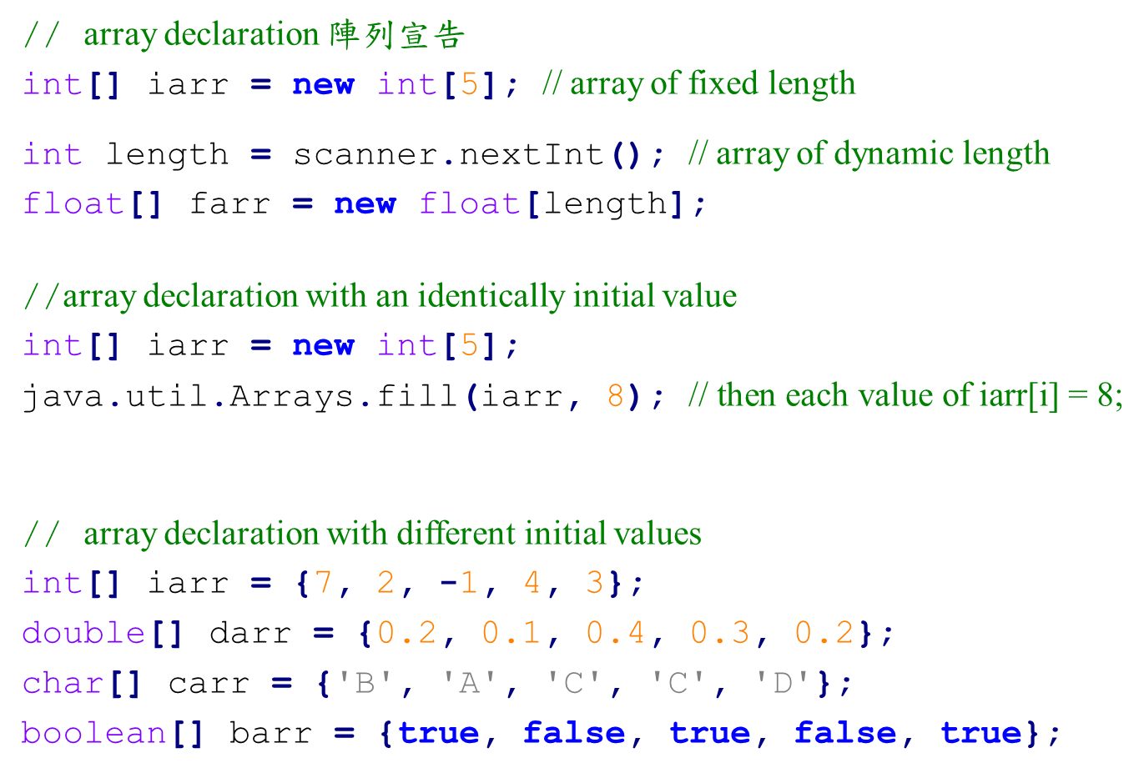
1-dimentional Array in Java
darr
index i | 0 | 1 | 2 | 3 | 4
value | 0.2 | 0.1 | 0.4 | 0.3 | 0.2
darr.length

Slide 13
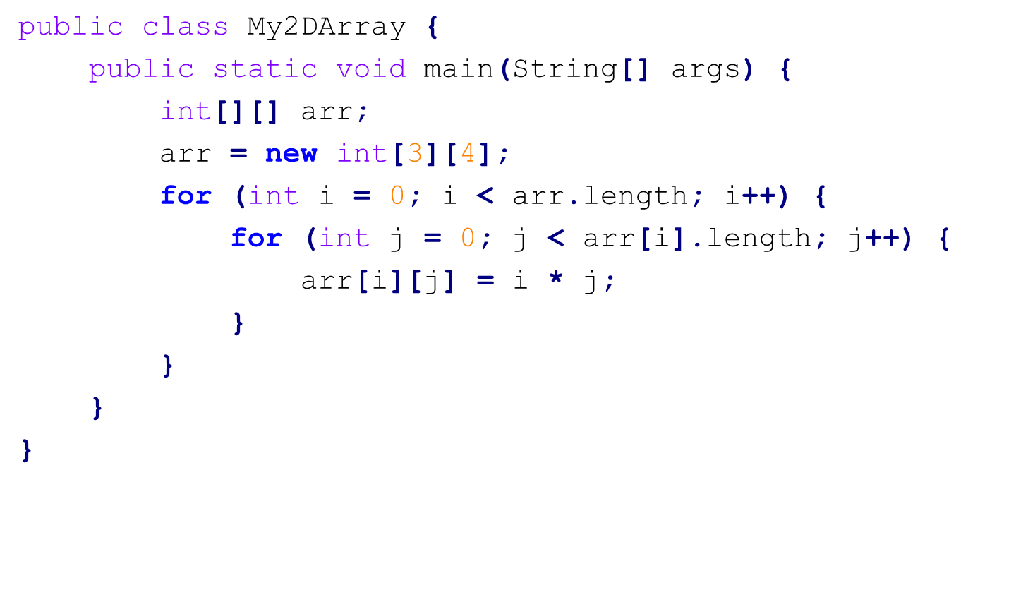
2-dimentional Array in Java
arr[0][2]
arr[0]
reference參考/參照
arr
arr[1]
arr.length
arr[2]
Java: 一維陣列

Slide 14
§ 2.3 Linear List 線性串列 / Ordered List 有序串列
L = (e₀, e₁, e₂, e₃, …, e_{n−1})
List size = n
Relationships關係
e₀ is the zero’th (or front) element元素/要素/成份
e_{i} is the ith element, 0 ≤ i ≤ n − 1
e_{n−1} is the last element
e_{i} immediately直接地 precedes在…之前 e_{i+1},
0 ≤ i < n − 1

Slide 15
Linear List Examples
Days of Week(ENG) = (Sun, Mon, Tue, Wed, Thr, Fri, Sat)
Days of Week(JPN) = (日, 月, 火, 水, 木, 金, 土)
Building Floors = (B1, 1F, 2F, 3F, 4F) @USA
// Basement/Floor
(B1, GF (ground地面 floor), 1F, 2F, 3F) @UK
Quizzes小考 in MyClass = (quiz1, quiz2, quiz3)
Months = (Jan, Feb, Mar, Apr, …, Nov, Dec)

Slide 16
Linear List Operations操作/運算
L = (Jan, Feb, Mar, Apr, …, Nov, Dec)
Length(L) = 12
Retrieve(theIndex i) //檢索,擷取
  Retrieve(2)=Mar, Retrieve(12)= error!
Indexof(theElement e)
  Indexof(Feb) = 1, Indexof(Sunday) = −1
Delete(theIndex i) //刪除
Insert(theIndex i, theElement e) //新增
Modify(theIndex i, theElement e) //修改
// query: 查詢
Notes:
Strictly speaking, nondecreasing order: 2, 2, 3, 6, 8, 8, 10.

Slide 17
Polynomial多項式
f(x) = x⁸ − 10x⁵ + 3x³ + 1.5
4 terms項/條: x⁸, −10x⁵, 3x³, 1.5
Coefficients係數: 1, −10, 3, 1.5
Non-negative integer exponents指數/冪:
8, 5, 3, 0
NOTE: g(x) = x² − 4/x + 7x^{3/2}
Question: Is g(x) a polynomial? Why?
http://en.wikipedia.org/wiki/Polynomial

Slide 18
Polynomial Addition加法/Multiplication乘法
f(x) = x⁸ − 10x⁵ + 3x³ + 1.5
g(x) = 3x³ + 2x − 4
f(x) = x⁸ − 10x⁵ + 3x³ + 1.5
g(x) = 3x³ + 2x − 4
f(x) + g(x) = x⁸ − 10x⁵ + 6x³ + 2x − 2.5
a(x) + b(x) = Σ(a_{i}+b_{i})x^{i}
a(x) ⋅ b(x) = Σ(a_{i}x^{i} ⋅ Σ(b_{j}x^{j}))

Slide 19
Polynomial Representation表示法 1
class Polynomial{
private:
int degree; // degree度/等級 ≤ MaxDegree
float coef [MaxDegree + 1];
};
f(x) = x⁸ − 10x⁵ + 3x³ + 1.5
0 | 1 | 2 | 3 | 4 | 5 | 6 | 7 | 8 | 9 | 10 | 11 | 12 | …
1.5 | 0 | 0 | 3 | 0 | -10 | 0 | 0 | 1 | 0 | 0 | 0 | 0 | 0...

Slide 20
Polynomial Representation 2
class Polynomial{
private:
int degree;
float *coef;
public:
Polynomial::Polynomial(int d) {
degree = d;
coef = new float [degree+1];
}
};
f(x) = x⁸ − 10x⁵ + 3x³ + 1.5
0 | 1 | 2 | 3 | 4 | 5 | 6 | 7 | 8 | 9 | 10 | 11 | 12 | …
1.5 | 0 | 0 | 3 | 0 | -10 | 0 | 0 | 1 | 0 | 0 | 0 | 0 | 0...

Slide 21
Polynomial Representation 3
a(x) = 2x¹⁰⁰⁰ +1
class Polynomial; // forward declaration 前向宣告
class Term {
friend Polynomial;
private:
float coef; // coefficient 係數
int exp; // exponent 次方,乘冪
};
// data members of Polynomial
private:
Term *termArray;
int capacity;
int terms;

Slide 22
Polynomial Addition
Add the following two polynomials: (See Prog. 2.8)
  a(x) = 2x¹⁰⁰⁰ + 1
  b(x) = x⁴ + 10x³ + 3x² + 1
0
1
2
0
1
2
3
4
a_coef
2
2
1
b_coef
4
1
10
3
1
a_exp
1000
0
b_exp
4
3
2
0
0
1
2
3
4
5
c_coef
5
2
1
10
3
2
O(m + n)
c_exp
1000
4
3
2
0

Slide 23
Appending添加 New Term (Program 2.9)
Add the following two polynomials:
  a(x) = 2x¹⁰⁰⁰ + 1
  b(x) = x⁴ + 10x³ + 3x² + 1
0
1
2
0
1
2
3
4
a_coef
2
2
1
b_coef
4
1
10
3
1
a_exp
1000
0
b_exp
4
3
2
0
0
1
2
3
4
5
6
7
8
Doubling array size when necessary
O(m + n)
c_coef
5
2
1
10
3
2
c_exp
1000
4
3
2
0

Slide 24
Time Complexity for
Polynomial Addition
c(x) = a(x) + b(x)
Suppose that
  m: the number of non-zero terms in a(x)
  n: the number of non-zero terms in b(x)
Time complexity for polynomial addition O(m+n)
  Why Program 2.9 (doubling the array size for c(x)) does not increase the order of time complexity?

Slide 25
§ 2.4 Sparse Matrices 稀疏矩陣
Matrix➔ table of values
0 0 3 0 4
0 0 5 7 0
0 0 0 0 0
0 2 6 0 0
4 × 5 matrix (4 by 5)
4 rows 列
5 columns 行
20 elements 元素
6 nonzero elements
row 0
row 1
row 2
row 3
column 3

Slide 26
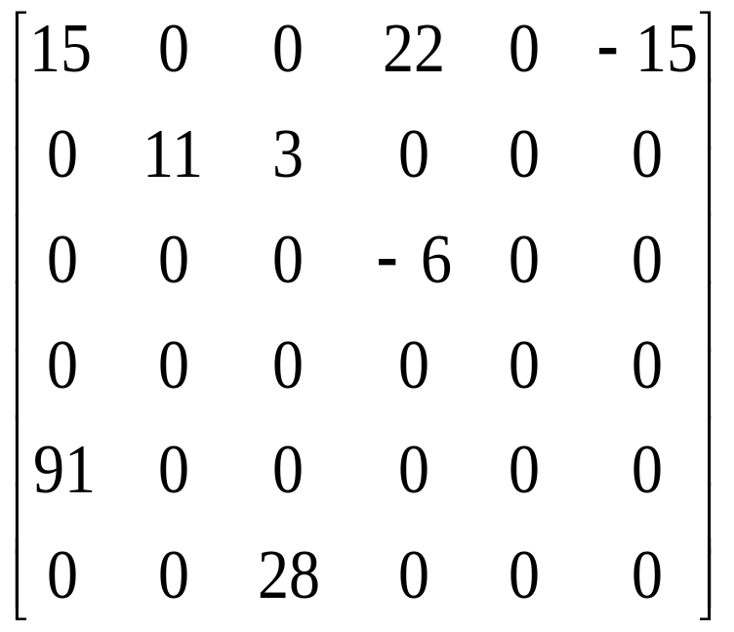
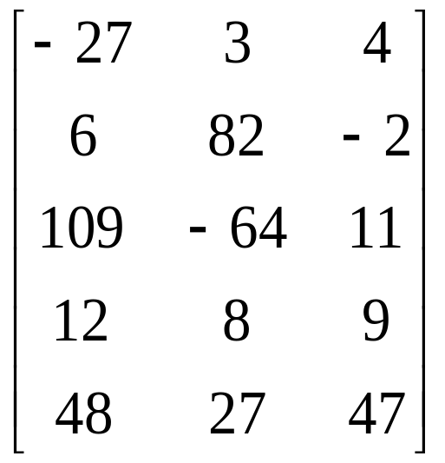
Sparse Matrices

Slide 27
Sparse Matrix Representation
Use a triple三元組: (row, column, value)
  (1, 3, 7)
Store triples row by row
  (0, 2, 3), (0, 4, 4), (1, 2, 5), (1, 3, 7), …
For all triples within a row, their column indices are in ascending遞增的 order
Must know the numbers of rows and columns and the number of nonzero elements
0 0 3 0 4
0 0 5 7 0
0 0 0 0 0
0 2 6 0 0

Slide 28
Linear List Example
0 0 0 0 0 0
0 0 0 3 0 4
0 0 0 5 7 0
0 0 0 0 0 0
0 0 2 6 0 0
Representation 1:
singleLinearList =
row 1 1 2 2 4 4
column 3 5 3 4 2 3
value 3 4 5 7 2 6
Representation 2:
One linear list per每 row
row0 = [ ]
row1 = [(3, 3), (5, 4)]
row2 = [(3, 5), (4, 7)]
row3 = [ ]
row4 = [(2, 2), (3, 6)]
Notes:
The single linear list has 6 elements. Each list element is a triple (row, column, value).

Slide 29
Single Linear List for a Matrix
Class SparseMatrix
  Array smArray of triples of type MatrixTerm
    int row, col, value // for a triple (row, col, value)
  int rows, // number of rows in this matrix
  cols, // number of columns in this matrix
  terms, // number of nonzero elements in this matrix
  capacity; // size of smArray
Size of smArray generally通常 is not predictable可預測的 at time of initialization
  Start with some default capacity/size (e.g. 10)
  Increase capacity as needed

Slide 30
Approximate近似的 Memory Requirements需求
500
Suppose假定 that
  500 × 500 matrix
  1994 nonzero elements
  4 bytes per element
2D array 500 × 500 × 4 =1 million bytes
=1,000,000 bytes
Class SparseMatrix 3 × 1994 × 4 + 4 × 4
= 23,944 bytes
. .. . .. . . . .
. .. . . .. . . . .
. .. . .. . . . .. .. . .. . . . . .. .. .. . .. . . . . .. . .. . .. . . . . .. . .. . .. . .. . . . .. .. . .. . .. . ... . . . . .. .. .. .
500

Slide 31
Sparse Matrix Representation (Cont.)
class SparseMatrix; // forward declaration
class MatrixTerm {
friend class SparseMatrix
private:
int row, col, value;
};
In class SparseMatrix:
private:
int Rows, Cols, Terms;
MatrixTerm smArray[MaxTerms];

Slide 32
Matrix Transpose 矩陣轉置
0 0 0 0 0 0
0 0 0 3 0 4
0 0 0 5 7 0
0 0 0 0 0 0
0 0 2 6 0 0
0 0 0 0 0
0 0 0 0 0
0 0 0 0 2
0 3 5 0 6
0 0 7 0 0
0 4 0 0 0
M =
M^{T}=
row 1 1 2 2 4 4
column 3 5 3 4 2 3
value 3 4 5 7 2 6
2 3 3 3 4 5
4 1 2 4 2 1
2 3 5 6 7 4

Slide 33
Matrix Transpose
Intuitive直覺的 way:
  for (each row i)
  take element (i, j, value) and store儲存 it in (j, i, value)
More efficient有效率的 way: O(terms × columns)
  for (all elements in column j)
  place放置 element (i, j, value) in position (j, i, value)
O(mn)
row 1 1 2 2 4 4
column 3 5 3 4 2 3
value 3 4 5 7 2 6
3 5 3 4 2 3
1 1 2 2 4 4
3 4 5 7 2 6

Slide 34
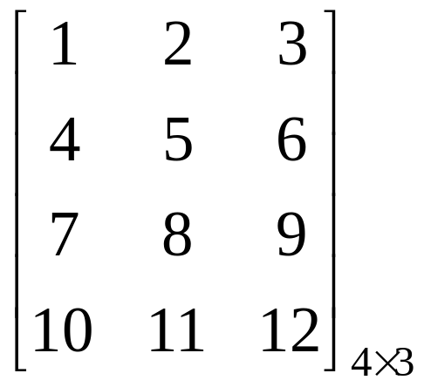
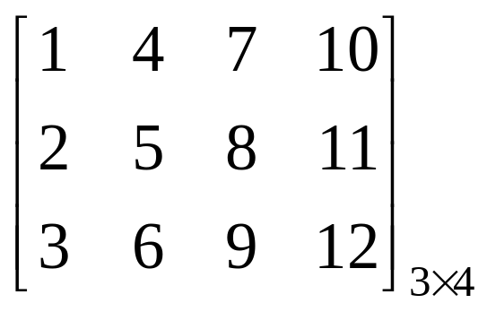
Matrix Transpose in a 2-D Array
    for (i = 0; i < rows; i++ )
    for (j = 0; j < columns; j++ )
    b[j][i] = a[i][j];
a =
b =
Time Complexity: O(rows × columns)

Slide 35
Transposing a Matrix (Program 2.10)
SparseMatrix SparseMatrix::Transpose()
// return the transpose of a (*this)
{
SparseMatrix b;
b.Rows = Cols; // rows in b = columns in a
b.Cols = Rows; // columns in b = rows in a
b.Terms = Terms; // terms in b = terms in a
if (Terms > 0) // nonzero matrix
{
int CurrentB = 0;
for (int c = 0; c < Cols; c++) // transpose by columns
for (int i = 0; i < Terms; i++)
// find elements in column c
if (smArray[i].col == c) {
b.smArray[CurrentB].row = c;
b.smArray[CurrentB].col = smArray[i].row;
b.smArray[CurrentB].value = smArray[i].value;
CurrentB++;
}
} // end of if (Terms > 0)
} // end of transpose
O(terms × columns)
or
O(rows × columns × columns)
if terms = O(rows × columns)

Slide 36
Transposing a Matrix
The O(terms × columns) time =>
O(rows × columns²)
when terms is the order (等級) of rows × columns
A better transpose function (Program 2.11)
  Compute how many terms in each columns of matrix a before transposing to matrix b.
  Determine where is the starting point of each row for matrix b.
  Move each term from a to b.
O(terms × columns)
O(terms + columns)

Slide 37
Faster Matrix Transpose
0 0 0 0 0 0
0 0 0 3 0 4
0 0 0 5 7 0
0 0 0 0 0 0
0 0 2 6 0 0
0 0 0 0 0
0 0 0 0 0
0 0 0 0 2
0 3 5 0 6
0 0 7 0 0
0 4 0 0 0
Step 1: #nonzero in each row of transpose
= #nonzero in each column of
original matrix
= [0, 0, 1, 3, 1, 1]
Step2: Start point of each row of transpose
= sum of size of preceding rows of
transpose
= [0, 0, 0, 1, 4, 5]
Step 3: Move elements, left to right, from
original list to transpose list
row 1 1 2 2 4 4
column 3 5 3 4 2 3
value 3 4 5 7 2 6
[0, 0, 1, 3, 1, 1]

Slide 38
Faster Matrix Transpose
0 0 0 0 0 0
0 0 0 3 0 4
0 0 0 5 7 0
0 0 0 0 0 0
0 0 2 6 0 0
0 0 0 0 0
0 0 0 0 0
0 0 0 0 2
0 3 5 0 6
0 0 7 0 0
0 4 0 0 0
row 1 1 2 2 4 4
column 3 5 3 4 2 3
value 3 4 5 7 2 6
rowStart =
[0, 0, 0, 1, 4, 5]
- 3 - - - -
- 1 - - - -
- 3 - - - -
- 3 - - - 5
- 1 - - - 1
- 3 - - - 4
- 3 3 - - 5
- 1 2 - - 1
- 3 5 - - 4
rowStart =
[0, 0, 0, 2, 4, 5]
i = 0
rowStart =
[0, 0, 0, 2, 4, 6]
i = 1
rowStart =
[0, 0, 0, 3, 4, 6]
i = 2

Slide 39
Faster Matrix Transpose
row 1 1 2 2 4 4
column 3 5 3 4 2 3
value 3 4 5 7 2 6
Step 1: #nonzero in each row of transpose
= #nonzero in each column of
original matrix
= [0, 0, 1, 3, 1, 1] O(terms+columns)
Step2: Start point of each row of transpose
= sum of size of preceding rows of
transpose
= [0, 0, 0, 1, 4, 5] O(columns)
Step 3: Move elements, left to right, from
original list to transpose list O(terms)
Total time complexity: O(terms + columns)
O(rows ×columns) if terms = O(rows × columns)

Slide 40
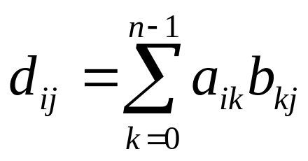
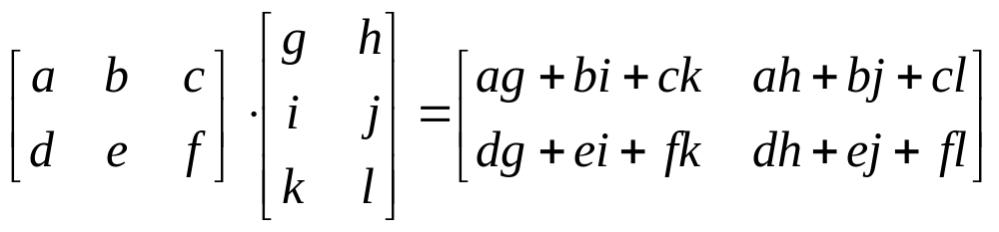
Matrix Multiplication
Given two matrices A and B, where A is m × n and B is n × p, the product乘積 matrix D has dimension m × p. In matrix D, each element D[i][j] = d_{ij} by the following formula:
where 0 ≤ i < m and 0 ≤ j < p.

Slide 41
Matrix Multiplication Example (1)
0 0 0 0 0 0
0 0 0 3 0 4
0 0 0 5 7 0
0 0 0 0 0 0
0 0 2 6 0 0
0 0 0 0 0
0 0 0 0 0
0 0 0 0 2
0 3 5 0 6
0 0 7 0 0
0 4 0 0 0
A=M_{5×6}=
B=M^{T}_{6×5}=
0 0 0 0 0
0 25 15 0 18
0 15 74 0 30
0 0 0 0 0
0 18 30 0 40
AB=(MM^{T})_{5×5}=

Slide 42
Matrix Multiplication Example (2)
A = M_{5×6} =
row 1 1 2 2 4 4
column 3 5 3 4 2 3
value 3 4 5 7 2 6
B^{T} = (M^{T})^{T} =
row 1 1 2 2 4 4
column 3 5 3 4 2 3
value 3 4 5 7 2 6
AB = (MM^{T})_{5×5}=
row 1 1 1 2 2 2 4 4 4
column 1 2 4 1 2 4 1 2 4
value 25 15 18 15 74 30 18 30 40
Time complexity: O(b.cols × a.terms + a.rows × b.terms)

Slide 43
§ 2.5 Representation of Arrays
Multidimensional多維度的 arrays are usually implemented實作 by one dimensional array via經由 either row major order or column major order
Example: One dimensional array 一維陣列
α
α+1
α+2
α+3
α+4
α+5
α+6
α+7
α+8
α+9
α+10
α+11
A[0]
A[1]
A[2]
A[3]
A[4]
A[5]
A[6]
A[7]
A[8]
A[9]
A[10]
A[11]

Slide 44
Two Dimensional (2D, 2-D, 2-d) Array
The elements of a 2-dimensional array A in C/C++ is declared宣告 as:
int A[3][4]; // in C/C++
or
int[][] A = new int[3][4]; // in Java
A[0][0] A[0][1] A[0][2] A[0][3]
A[1][0] A[1][1] A[1][2] A[1][3]
A[2][0] A[2][1] A[2][2] A[2][3]
0
1
2
3
0
1
2
A[2][1]

Slide 45
Row-Major列主序 Mapping對映
Example: 3 × 4 array
  a b c d
  e f g h
  i j k l
Convert it into 1D array y by collecting elements by rows
Within a row, elements are collected收集 from left to right
Rows are collected from top to bottom
We get y = {a, b, c, d, e, f, g, h, i, j, k, l}
轉換
row 0
row 1
row 2
…
row i
Notes:
Used in Pascal and Fortran for example.

Slide 46
Column-Major行主序 Mapping
  a b c d
  e f g h
  i j k l
Convert it into 1D array y by collecting elements by columns
Within a column, elements are collected from top to bottom
Columns are collected from left to right
We get y = {a, e, i, b, f, j, c, g, k, d, h, l}
col 0
col 1
col 2
…
col i

Slide 47
Matrix 矩陣
Table of values
It has rows and columns, but numbering begins at 1 rather than 而不是 0 (in an array)
a b c d row 1
e f g h row 2
i j k l row 3
Use notation x(i, j) rather than x[i][j]
We may use a 2D array to represent表示 a matrix.

Slide 48
Row Major Order 列主序
Lexicographical order (字典排序): also known as (a.k.a 別名) lexicographic, lexical order, dictionary order, alphabetical order or lexicographic(-al) product
Col 0
Col 1
Col 2
Col u₂ - 1
Row 0
X
X
X
X
Row 1
X
X
X
X
Row u₁ - 1
X
X
X
X
u₂ elements
u₂ elements
Row 0
Row 1
Row i
Row u₁ − 1
i × u₂ elements

Slide 49
Memory Mapping (from 2D to 1D)
char A[3][4]; // in row-major order
logical structure physical structure
0
1
2
3
A[0][0]
0
A[0][1]
1
A[0][2]
2
A[0][3]
A[1][0]
A[2][1]
A[1][1]
A[1][2]
A[1][3]
Mapping function:
A[i][j] = A[0][0] + i ×4+ j
A[2][0]
A[2][1]

Slide 50
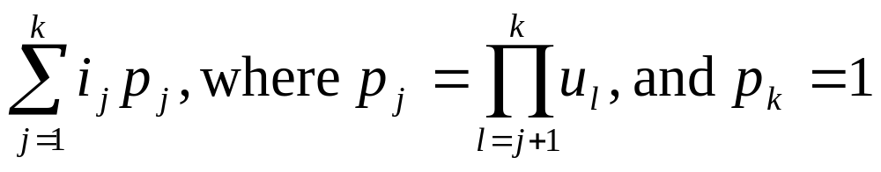
Memory Mapping (Row Major Order)
α: the start address 起始位置 of array A
  refer to 與…關聯 A[0], A[0][0], A[0][0][0], etc.等(…)
2D to 1D
  A[u₁][u₂]
  A[i][j] = α + i × u₂ + j
3D to 1D
  A[u₁][u₂][u₃]
  A[i][j][k] = α + i × u₂ × u₃ + j × u₃ + k
k-D to 1D
  A[u₁][u₂][u₃]…[u_{k}]
  A[i₁] [i₂]…[i_{k}] = α +

Slide 51
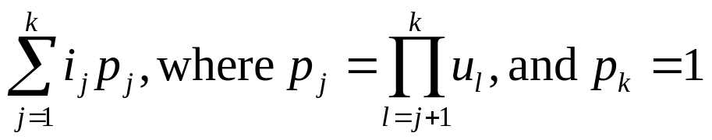
Memory Mapping (Row Major Order)
α: the start address of array A
  refer to A[0], A[0][0], A[0][0][0], etc.
β: the memory size for storing each element
  char: 1 byte ⇒ β=1
  int: 4 bytes ⇒ β=4
2D to 1D
  A[u₁][u₂]
  A[i][j] = α + (i×u₂ + j) × β
k-D to 1D
  A[u₁][u₂][u₃]…[u_{k}]
  A[i₁] [i₂]…[i_{k}] = α + β ×
Greek alphabet the CORRECT pronunciation

Slide 52
Given an C/C++ array a[10][20] for storing char data, and suppose that the start address is a[0][0] = 50.
(1) What is the address of a[7][13] in row-major order.
(2) What is the address of a[7][13] in column-major order.
Solution:
row major=50+(7*20+13)*1=203
column major=50+(13*10+7)*1=187

Slide 53
Given an C/C++ array a[3][4][6][8] for storing int data, and suppose that the start address is a[0][0][0][0] = 1000.
(1) What is the address of a[2][1][4][5] in row-major order.
(2) What is the address of a[2][1][4][5] in column-major order.
Solution:
row major=1000+(2*4*6*8+1*6*8+4*8+5)*4=2876
column major=1000+(5*6*4*3+4*4*3+1*3+2)*4=2652

Slide 54
§ 2.6 String 字串
Usually string is represented as a character array
General一般的/普遍的 string operations include包含 comparison比較, string concatenation連接, copy, insertion, string matching匹配/比對, printing, etc.
A character array:
H
e
l
l
o
W
o
r
l
d
\0

Slide 55
String in C
String function in C: #include <string.h>
  strcat, strncat 字串連接
  strcmp, strncmp 字串比較
  strcpy, strncpy 字串複製
  strlen 字串長度
  strchr, strrchr 尋找某字元出現位置
  strstr 尋找某字串出現位置
  strtok 切割字串
  …
#include <cstring> // in C++ for using string.h of C

Slide 56
String Matching 字串比對 Problem
Given a text string T of length n and a pattern string P of length m, the exact string matching problem 完整字串比對問題 is to find all occurrences出現 of P in T.
E.g. T=“agcttgcta” P=“gct”
1 5
Applications應用:
  Searching keywords in a file (Text Editor)
  Searching engines (Google)
  Database searching (GenBank)
More string matching algorithms (with source codes 原始碼):
http://www-igm.univ-mlv.fr/~lecroq/string/

Slide 57
String Terminologies 專有名詞/術語
S=“agcttgcta”
|S|=9, length長度 or size大小 of S
Substring子字串: S_{i,j} = S_{i}S_{i+1}…S_{j}
  S_{1,3}=“gct”, S_{0,4}=“agctt” agcttgcta
Subsequence子序列 of S: deleting zero or more characters from S agcttgcta
  “act” and “gctt” are subsquences of S.
Prefix字首/前綴 of S: S_{0,k}
  “agct” is a prefix of S. agcttgcta
Suffix字尾/後綴 of S: S_{h,|S|−1}
  “cta” is a suffix of S. agcttgcta

Slide 58
Fast Matching Example
Suppose there exists a string S and a pattern樣本/樣板/模式 P = abcabcacab, let’s try to match pattern P in string S.
Knuth-Morris-Pratt (KMP) algorithm: O(|S|+|P|)
i 0 1 2 3 4 5 6 7 8 9
P a b c a b c a c a b
f -1 -1 -1 0 1 2 3 -1 0 1
S = - a b ? ? ? . . . . ?
P = a b c a b c a c a b
a b c a b c a c a b
S = - a b c a ? ? . . . ?
P = a b c a b c a c a b
a b c a b c a c a b
a bcabcacab
abcabcacab
ab cabcacab
abcabcacab
abc abcacab
abcabcacab
abca bcacab
a bcabcacab
abcab cacab
ab cabcacab
abcabc acab
abc abcacab
abcabca cab
abca bcacab

