Slide 1
Data Structures
Chapter 1: Basic Concepts

Slide 2
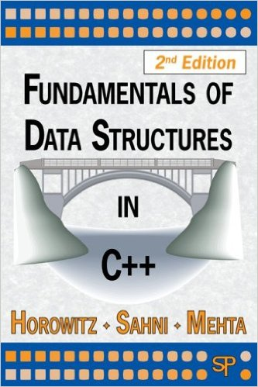

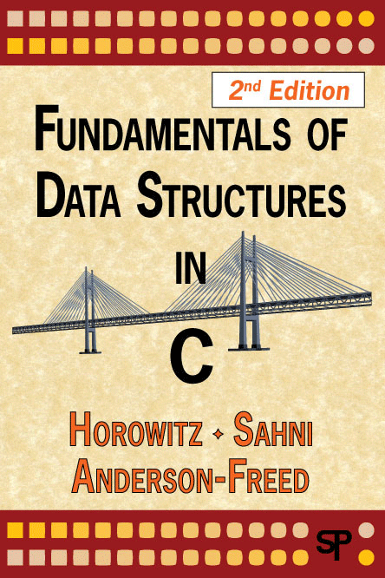
Teaching Resources資源
Textbook: Fundamentals of Data Structures in C++, 2/e
  By Ellis Horowitz, Sartaj Sahni, Dinesh P. Mehta
    Fundamentals of Data Structures
    Fundamentals of Data Structures in Pascal
    Fundamentals of Data Structures in C
  http://inside.mines.edu/~dmehta/FDS_CPP/
    PowerPoint Slides for Lectures
    Source Code in C++

Slide 3
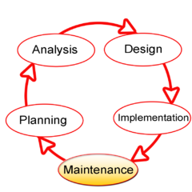
§1.1 System Life Cycle (1)
Requirements需求
Analysis分析
Design設計
Refinement and Coding
  改良與編碼
Verification驗證
cf. SDLC: Systems development life-cycle
  系統發展生命週期
  cf. short for the Latin: confer, meaning "compare"
Systems development life cycle @wikipedia by Dzonatas

Slide 4
System Life Cycle (2)
Requirements需求
  A set of specifications規格
  Describe描述 the information we are given給予/給定的
  The results we have to produce產生/產出
Analysis分析
  Break the problem down into 分解成 manageable pieces
  Bottom-up approach方法
    No master plan, loosely鬆散的 connected連結/連接
  Top-down approach
    A high-level plan, preferred首選的/喜歡的 for
    complex複雜的 software systems
Input
Output

Slide 5
System Life Cycle (3)
Design設計
  The creation of abstract data types (ADT)
  The operations運算 performed執行 on data objects物件
  Both are language語言 independent獨立/無關
Refinement and coding 改良與編碼(程式設計)(link)
  Data object’s representation表示法 can determine決定 the efficiency效率 of the algorithms演算法.
Verification
  Correctness proofs 正確性證明
  Testing測試
  Error removal 錯誤移除
Notes:
台灣下一個十年 就從學Coding開始
https://www.watchinese.com/article/2014/17511
自學程式設計學習資源懶人包
https://www.happycoder.org/2017/01/27/learning-coding-programming-tutorial-and-resource/
想要自學程式？七個自學程式設計正確的觀念和心態
https://www.happycoder.org/2019/01/28/how-to-learn-coding-and-computer-programming/

Slide 6
From C to C++
C++ tutorial for C users
  http://www.ericbrasseur.org/cppcen.html
C/C++之指標 (pointer)，參考 (reference)
觀念整理與常見問題
  https://dotblogs.com.tw/brian/2012/10/18/77588
C/C++ - 常見 C 語言觀念題目總整理
（適合考試和面試）
  https://mropengate.blogspot.com/2017/08/cc-c.html

Slide 7
§1.5 Algorithm Specification規格/敘述
Algorithm演算法: A finite set 有限集合 of instructions指令 that accomplishes完成 a particular特定的 task工作/任務 and satisfy滿足 the following以下的 criteria標準:
  Input輸入: Zero or more quantities are externally外部 supplied提供
  Output輸出: At least one至少一個 quantity數量 is produced
  Definiteness明確性: Each step步驟 must be precisely準確地 defined定義
  Finiteness有限性: Terminates終止 after a number of steps
  Effectiveness有效性: Every instruction指令 must be basic enough to be carried out執行/實行 by a person using only pencil and pen

Slide 8
Algorithm vs. Program程式
vs., VS., V., versus: 對決、對抗、訴訟
In computational theory, a program does not have to satisfy the finiteness.
e.g. 例 Operation System 作業系統 (OS)
  e.g. short for the Latin: exempli gratia, meaning "for example/instance"
  Input: Zero or more quantities are externally supplied
  Output: At least one quantity is produced
  Definiteness: Each step must be precisely defined
  (Finiteness: Terminates after a number of steps)
  Effectiveness: Every instruction must be basic enough to be carried out by a person using only pencil and pen

Slide 9
Sorting排序
Rearrange重新排列 a[0], a[1], …, a[n − 1] into ascending遞增/上升 order順序
When done, a[0] ≤ a[1] ≤ … ≤ a[n − 1]
e.g. 8, 6, 9, 4, 3 => 3, 4, 6, 8, 9
nondecreasing非遞減 order: 2, 2, 3, 6, 8, 8, 10
  descending遞減/下降
  increasing遞增; nonincreasing非遞增
  decreasing遞減; nondecreasing非遞減
Note: 變數使用斜體字；數字與標點符號不用斜體

Slide 10
Sorting Methods
Insertion Sort 插入排序法
Bubble Sort 氣泡排序法
Selection Sort 選擇排序法
Counting Sort 計數排序法
Shaker Sort 搖晃排序法
Shell Sort 謝爾排序法/希爾排序法
Heap Sort 堆積排序法
Merge Sort 合併排序法
Quick Sort 快速排序法

Slide 11
Comparison比較 of Sorting Methods
 | Best case | Average case | Worst case | Extra space | Stable
Brute force | O(nr) | O(nr) | O(nr) | O(n) | Y
Selection sort | O(n²) | O(n²) | O(n²) | O(1) | N
Bubble sort | O(n) | O(n²) | O(n²) | O(1) | Y
Gnome sort | O(n) | O(n²) | O(n²) | O(1) | Y
Insertion sort | O(n) | O(n²) | O(n²) | O(1) | Y
Shell sort | O(n²) | O(n²) | O(n²) | O(1) | N
Merge sort | O(n log n) | O(n log n) | O(n log n) | O(n) | Y
Quick sort | O(n log n) | O(n log n) | O(n²) | O(n) | N
Heap sort | O(n log n) | O(n log n) | O(n log n) | O(1) | N
Counting sort | O(n + r) | O(n + r) | O(n + r) | O(r) | Y
Bucket sort | O(n + b + ?) | O(n + b + ?) | O(n + b + ?) | O(b) | N
Radix sort | O(nd) | O(nd) | O(nd) | O(d) | Y
http://www.csie.ntnu.edu.tw/~u91029/SequenceManipulation.html
https://en.wikipedia.org/wiki/Sorting_algorithm

Slide 12
Insertion插入 of an Element元素 (1)
Given給定 a sorted已排序的 list串列 / sequence序列, insert插入 a new element元素
Given: 3, 6, 9, 14
Insert: 5
Result: 3, 5, 6, 9, 14

Slide 13
Insertion of an Element (2)
Given 3, 6, 9, 14 (, ) and insert 5
Compare比較 new element (5) and last one (14)
Shift轉移/移動 14 right 3, 6, 9, _, 14
Shift 9 right 3, 6, _, 9, 14
Shift 6 right 3, _, 6, 9, 14
Insert 5 3, 5, 6, 9, 14

Slide 14
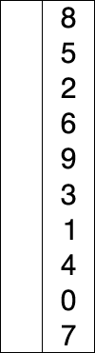
Selection Sort 選擇排序法(1)
Example 1.2 [Selection sort]
Sort a collection of一堆 n ≥ 1 integers整數.
  From those integers that are currently目前 unsorted未排序, find the smallest最小的 and place放置 it next in the sorted list.
for (int i = 0; i < n ; i++)
{
/* Examine檢查 a[i] to a[n-1] and
suppose假設 the smallest integer
is at a[j]; */
// Interchange交換 a[i] and a[j];
}
Selection_sort @ wikipedia, by en:Joestape89
k
j
a[0] a[i] a[n−1]

Slide 15
Selection Sort (2)
void SelectionSort(int *a, const int n)
{ // sort the n integers a[0] to a[n−1] into non-decreasing order
for ( int i = 0; i < n; i++)
{
int j = i;// then find the smallest integer in a[i] to a[n−1]
for (int k = i+1; k < n; k++)
if (a[k] < a[j]) j = k;
// swap(a[i], a[j]); swap交換
int temp = a[i]; a[i] = a[j]; a[j] = temp;
}
}
k
j
a[0] a[i] a[n−1]

Slide 16
Binary Search 二元搜尋 (1)
Algorithm for binary searching on an sorted list
while (there are more integers to check)
{
middle = (left + right) / 2;
if (searchNum < list[middle])
right = middle – 1;
else if (searchNum > list[middle])
left = middle + 1;
else return middle;
}
e.g. 2, 3, 5, 7, 11, 13, 17, 19, 23, 29, 31, 37, 41, 43, 47, 53, 59

Slide 17
Binary Search (2)
int BinarySearch (int *a, int x, const int n)
// Search the sorted array a[0], ..., a[n-1] for x
{
for (int left = 0, right = n - 1; left <= right;)
{ // while more elements
int middle = (left + right)/2;
switch (compare (x, a[middle]))
{ //see next slide
case '>': left = middle + 1; break; // x > a[middle]
case '<': right = middle - 1; break; // x < a[middle]
case '=': return middle; // x == a[middle]
} // end of switch
} // end of for
return -1; // not found
} // end of BinarySearch

Slide 18
compare (x, a[middle])
  Comparison比較 of two integers
  Function函式
    char compare (int x, int y)
    { /* compare x and y, return –1 for less than, o for equal, 1 for greater */
    if (x > y) return '>';
    else if (x < y) return '<';
    else return '=';
    }
  Macro巨集
#define compare(x, y) ((x) < (y)) ? '<' : ((x) == (y)) ? '=' : '>')

Slide 19
Recursive遞迴 Algorithms
Recursive functions函數/函式
Direct recursion 直接遞迴
  Functions call themselves before they are done完成
  foo() {...; foo(); ...;}
Indirect recursion 間接遞迴
  Functions call other functions that again invoke呼叫 the calling function
  foo() {…; bar();} bar() {…; lol();}
  lol() {…; foo();}
Terminating condition 終止條件: When satisfied, the function directly直接 computes計算 the output without calling itself

Slide 20
Recursion for BinarySearch
int BinarySearch (int *a, int x, const int left, const int right)
//Search the sorted array a[left], ..., a[right] for x
{
if (left <= right)
{
int middle = (left + right)/2;
switch (compare (x, a[middle]))
{
// x > a[middle]
case '>': return BinarySearch(a, x, middle+1, right);
// x < a[middle]
case '<': return BinarySearch(a, x, left, middle-1);
// x == a[middle]
case '=': return middle;
} // end of switch
} // end of if
return -1;// not found
}// end of BinarySearch

Slide 21
Recursive Permutation排列 Generator產生器
Example: Print out 印出 all possible可能的 permutations of {a, b, c, d}
  We can construct建構 the set of permutations by printing
    a followed接著/跟隨 by all permutations of (b, c, d)
    b followed by all permutations of (a, c, d)
    c followed by all permutations of (a, b, d)
    d followed by all permutations of (a, b, c)
  A hint提示 for recursion
    w followed by all permutations of (x, y, z)

Slide 22
#include <iostream>
void permutations (char *a, const int k, const int m)
//Generate產生 all the permutations of a[k], ..., a[m]
{
if (k == m) { //Output permutation
for (int i = 0; i <= m; i++) cout << a[i] << " ";
cout << endl;
}
else { //a[k], ..., a[m] has more than one permutation
for (int i = k; i <= m; i++)
{
swap(a[k], a[i]);
permutations(a, k+1, m);
swap(a[k], a[i]);
}
} // end of else
} // end of perm

Slide 23
Permutation – main() of perm.cpp
void main()
{
char b[10];
b[0] = 'a'; b[1] = 'b'; b[2] = 'c'; b[3] = 'd';
b[4] = 'e'; b[5] = 'f'; b[6] = 'g';
permutations(b,0,3);
cout << endl;
}

Slide 24
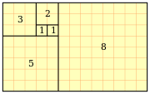
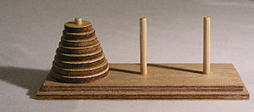

Others Recursion Algorithms
Fibonacci numbers 費氏數列
Towers of Hanoi 河內塔
Ackerman’s function
  阿克曼函數
  A(m,n) =
    n + 1, if m == 0;
    A(m − 1,1), if n == 0;
    A(m − 1,A(m, n − 1)), otherwise.
by User:克勞棣
by User:Evanherk
by André Karwath

Slide 25
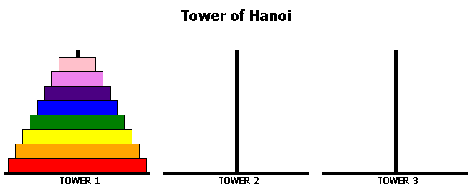
Towers of Hanoi
http://www.dynamicdrive.com/dynamicindex12/towerhanoi.htm

Slide 26
Towers of Hanoi/Brahma
4
3
2
1
A
B
C
64 gold disks to be moved from tower A to tower C
Each tower operates運作 as a stack堆疊
You cannot place放置 big disk on top of a smaller one

Slide 27
1
1
A
B
C
A
A
B
C
A
n > 0 gold disks to be moved from A to C using B
(1) move top n−1 disks from A to B using C
(2) move top disk from A to C
1
1
A
B
C
A
A
B
C
A
moves(n) = 0 when n = 0
moves(n) = 2*moves(n−1) + 1 = 2^{n}−1 when n > 0
(3) move top n−1 disks from B to C using A

Slide 28
§1.3 Abstraction抽象化 Data資料 Type型態
Data Type 資料型態
  A data type is a collection收集/聚集 of objects 物件 and a set of operations運算 that act on 影響到 those objects
Abstraction Data Type (ADT)
  Specification規格 of the objects and the operations is separated from 分離 the representation表示法 of the objects and the implementation實作 of the operations
  Implementation-independent 與實作無關
  Language-independent 與程式語言種類無關
  Interface界面: a reference type 參考型態 in Java

Slide 29
Please write out the recursive formula for each following sequence序列/數列:
(1) 1, 1, 2, 3, 5, 8, 13, 21, …
(2) 1, 2, 4, 8, 16, 32, 64, …
(3) 1, 2, 2, 3, 4, 6, 9, 14, 22, 35, ….

Slide 30
ADT of NaturalNumber 自然數
ADT NaturalNumber
objects: An ordered有序的 subrange子範圍 of the integers starting at zero and ending at the maximum integer (MAXINT) on the computer
functions: for all x, y ∈NaturalNumber, true, false ∈ Boolean and where +, −, <, ==, and = are the usual integer operations
  Nat_Num Zero() ::= 0
  Boolean IsZero(x) ::=if (x == 0) return true
  else return false
  Equal(x,y) :: == if (x == y) return true
  else return false
  Successor :: == …
  Add(x, y) :: == if (x + y <= MAXINT) Add = x + y
  else Add = MAXINT
  Subtract(x,y) :: == …
end NaturalNumber

Slide 31
§1.7 The Criteria標準 to Judge評判 a Program
Does it meet滿足 the original specification 原始規格 of the task 任務?
Does it work工作/運作 correctly正確地?
Is there documentation文件 that describes描述 how to use it and how it works?
Effectively有效率地 use functions函數 to create 建立 logical units 邏輯單元?
Is the code程式碼 readable易讀的/易懂的?
Effectively use primary and secondary storage儲存體?
Is the running time 執行時間 acceptable可接受的?

Slide 32
Performance效能 Analysis分析
Space complexity 空間複雜度
  The amount量/數量 of memory 記憶體 that
  a program needs to run執行 to completion完成/結束
Time complexity 時間複雜度
  The amount of computational time 計算時間 that
  a program needs to run to completion

Slide 33
Space Complexity (1)
Fixed part 固定部份
  Independent無關的/獨立的 of the characteristics特徵 (e.g. number數量, size大小/規模) of the inputs and outputs
    Instruction space 指令(程式碼)空間
    Space for simple簡單的 variables變數, constants常數
    Fixed-size component variables 結構變數
Variable part 變動部份
  Component variables whose size is dependent有關的 on the particular特定的 problem問題 instance實例
  Using recursive functions

Slide 34
Space Complexity (2)
S(P): The space requirement需求 of any program P
  S(P) = c + S_{P}(I)
  c: Fixed Part
  S_{P}(I): Variable Part
  I: Instance characteristics
  e.g. S_{abc}(I) = 0
  float abc(float a, float b, float c)
  {
  return a + b + b*c + (a +b – c)/(a + b) + 4.0 ;
  }

Slide 35
Space Complexity Examples (1)
float sum(float *a, int n) // C & C++
{
float s = 0;
int i;
for (i = 0; i < n; i++)
s += a[i];
return s;
}
public static float sum(float[] a) // Java
{
float s = 0;
int i;
for (i = 0; i < n; i++)
s += a[i];
return s;
}
  In Pascal, it copies the array and S_{sum}(n) = n.
  In C/C++/Java, it does not copy the array and S_{sum}(n) = 0.

Slide 36
Space Complexity Examples (2)
float rsum(float *a, const int n)
{
if (n <= 0) return 0; //terminating condition
else return (rsum(a, n-1) + a[n-1]);
}
It will run n times recursion (n+1 times)
Space needed in a recursion in stack (12 bytes)
  float *a: 4 bytes
  const int n: 4 bytes
  return address: 4 bytes
S_{rsum}(n)=12n

Slide 37
Time Complexity
The time T(P) of program P
  Compile time 編譯時間
    Independent to the instance characteristics
  Run (or execution執行) time (T_{P}) 執行時間
Obtain得到 an exact精確的 formula公式 of T_{P} is not easy
  The true value of T_{P}(n) for any given n can be obtained only experimentally用實驗方法
Program step 程式步驟
  A syntactically語句上 or semantically語義上 meaningful有意義的 segment區段 of a program

Slide 38
Program Step – One Step
a = 4;
c = b + 30;
return a + b * c + (a+b-c) / (a+b) + 4.0;

Slide 39
Time Complexity Example (1)
float sum (float *a, int n) { /* #(count) = 2n + 3*/
float s = 0 ;
int i;
count++ ;
for (i = 0; i< n; i++)
{
count++ ; /* for the for loop */
s += a[i] ;
count++ ; /* for the assignment*/
}
count++ ; /* for the last time of for */
count++ ; /* for return ; */
return s ;
}

Slide 40
Time Complexity Example (2)
float rsum (float *a, int n) { /* 2n+2 */
count++ ; /* for if conditional */
if (n <= 0) {
count++ ; /* for return */
return 0 ;
}
else {
count++ ; /* for return */
return (rsum(a, n-1) + a[n-1]) ;
}
}
// 2 + t_{rsum}(n – 1)

Slide 41
Time Complexity Example (3)
2 + t_{rsum} (n – 1) steps, n > 0.
t_{rsum}(n) = 2 + t_{rsum} (n − 1) // recursive function
= 2 + 2 + t_{rsum} (n – 2)
= 2 * 2 + t_{rsum} (n − 2)
= 2 * 3 + t_{rsum} (n − 3)
.
.
= 2n + t_{rsum}(0) = 2n + 2
terminating condition 終止條件

Slide 42
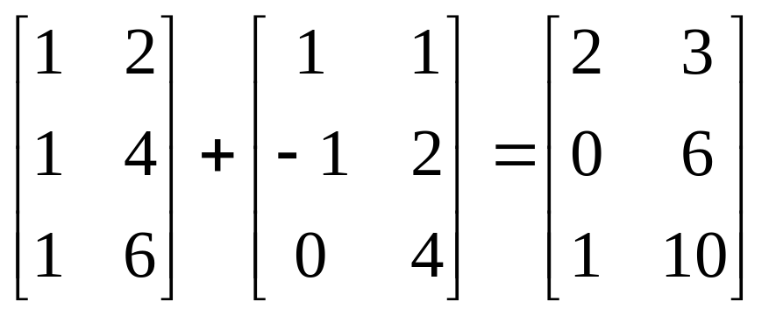
Example: Matrix Addition (1)
0 1
0 1
0 1
0
1
2
rows = ___
row列
cols = ___
column行
void add(int a[][MAX_SIZE], b[][MAX_SIZE], c[][MAX_SIZE], int rows, int cols)
{
int i, j;
for (i = 0; i < rows; i++)
for (j = 0; j < cols; j++)
c[i][j] = a[i][j] + b[i][j];
}

Slide 43
Example: Matrix Addition (2)
void add(int a[][MAX_SIZE], b[][MAX_SIZE], c[][MAX_SIZE], int rows, int cols)
{
int i, j;
for (i = 0; i < rows; i++) {
count++; /* for i-for-loop */
for (j = 0; j < cols; j++) {
count++; /* for j-for-loop */
c[i][j] = a[i][j] + b[i][j];
count++; /* for assignment */
}
count++; /* last time of j-for-loop */
}
count++; /* last time of i-for-loop */
}

Slide 44
Summary摘要/總結 of Step
The number of steps is itself a function of the instance實例 characteristics特徵.
Any specific特定的 instance may have several好幾個 characteristics.
We need to know exactly which characteristics of the problem instance are to be used.
A step is any computation unit that is independent of the characteristics.

Slide 45
Step Table 步驟表 of Matrix Addition
void add (float **a, float **b, float **c, int m, int n)
{ // Line 1
for (int i = 0; i < m; i++)
for (int j = 0; j < n; j++)
c[i][j] = a[i][j] + b[i][j];
} // Line 5
Line | Steps per每個 execution執行 | Frequency次數/頻率 | Total全部的 steps
1 | 0 | 1 | 0
2 | 1 | m+1 | m+1
3 | 1 | m(n+1) | mn+m
4 | 1 | mn | mn
5 | 0 | 1 | 0
 | Total number of steps |  | 2mn+2m+1

Slide 46
Asymptotic漸進的/趨近的 Notation 符號
Motivation動機 to determine決定/確定 step counts
  Compare比較 the time complexities of two programs that compute the same function
  Predict預測 the growth增長 in run time as the instance characteristics change
Example: Binary search
  Successful成功的 search
  Unsuccessful不成功的 search
Asymptotic notation
  Determine the exact 確切的/準確的 step count is very difficult 困難的

Slide 47
Three Kinds種類 of Step Counts
Best-case 最佳狀況
  The minimum最小的/最少的 number of steps that can be executed for the given 給定的 parameters 參數
Worst-case 最差狀況
  The maximum最大的/最多的 number of steps that can be executed for the given parameters
Average-case 平均狀況
  The average number of steps that can be executed with the given parameters

Slide 48
Big O
Definition [Big “O”]: iff: if and only if, ⇔
  f(n) = O(g(n)) iff there exist 存在 positive 正值的constants 常數 c and n₀ such that 使得 f(n) ≤ c⋅g(n) for all n ≥ n₀
  Upper bound 上界 on f(n)
  O(1): a constant常數
  f(n) = O(g(n)) to be informative有意義的, g(n) should be as small a function of n as one can come up with for which f(n) = O(g(n)) is true

Slide 49
Example of Big “O”
3n + 2 = O(n)
  f(n) = 3n + 2, g(n) = n, c = 4, n₀ = 2
  f(n) ≤ c g(n), for all n ≥ n₀
  3n+2 ≤ 4n, for all n ≥ 2
10n² + 4n + 2 = O(n²)
  f(n) = 10n² + 4n + 2, g(n) = n², c = 11, n₀ = 5
  10n² + 4n + 2 ≤ 11n², for n ≥ 5

Slide 50
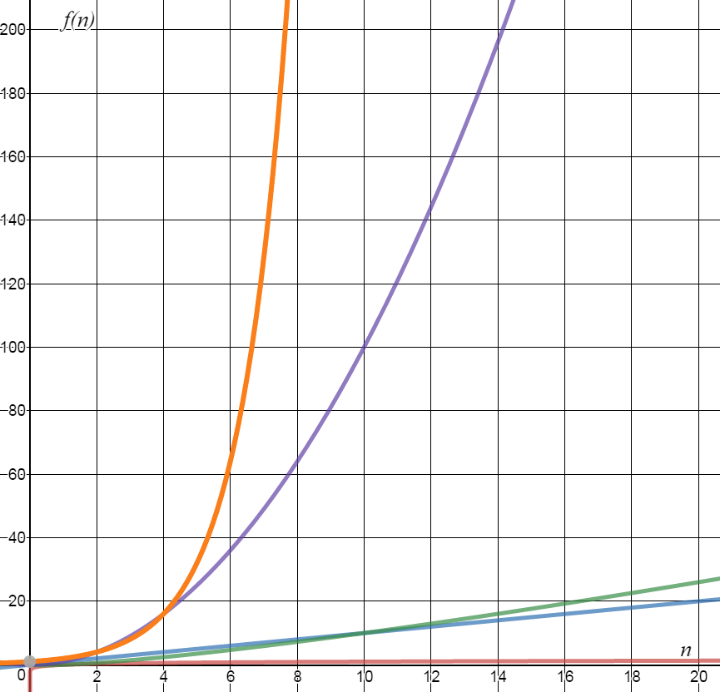
Common of Big O
O(1): constant 常數的
O(log n): logarithmic 對數的
O(n): linear 線性的
O(n log n): log linear 對數線性的
O(n²): quadratic 二次方的
O(n³): cubic 三次方的
O(2^{n}): exponential 指數的
O(n!): factorial 階乘的
https://www.desmos.com/calculator

Slide 51
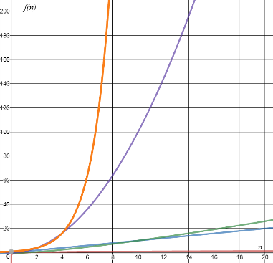
Values of Functions
log n | n | n log n | n² | n³ | 2^{n}
0 | 1 | 0 | 1 | 1 | 2
1 | 2 | 2 | 4 | 8 | 4
2 | 4 | 8 | 16 | 64 | 16
3 | 8 | 24 | 64 | 512 | 256
4 | 16 | 64 | 256 | 4,096 | 65,536
5 | 32 | 160 | 1,024 | 32,768 | 4,294,967,296

Slide 52
Omega Ω
Definition [Omega]
  f(n) = Ω(g(n)) iff there exist positive constants c and n₀ such that f(n) ≥ cg(n) for all n ≥ n₀
  The function g(n) is only a lower bound 下界 on f(n)
  f(n) = Ω(g(n)) to be informative, g(n) should be as large a function of n as one can come up with for which f(n) = Ω(g(n)) is true

Slide 53
Examples of Omega Ω
3n + 2 = Ω(n)
  f(n) = 3n + 2, g(n) = n, c = 3, n₀ = 1
  f(n) ≥ c g(n), for all n ≥ 1
  3n + 2 ≥ 3n, for all n ≥ 1
10n² + 4n + 2 = Ω(n²)
  f(n) = 10n² + 4n + 2, g(n) = n², c = 1, n₀ = 1
  10n² + 4n + 2 ≥ n², for all n ≥ 1

Slide 54
Theta Θ
Definition [Theta]:
  f(n) = Θ(g(n)) iff there exist positive constants c₁, c₂ and n₀ such that c₁g(n) ≤ f(n) ≤ c₂g(n) for all n ≥ n₀
Lower bound 下界 and upper bound 上界 on f(n)
The theta Θ notation is more precise精確的 than both “big oh” and omega notations
  Ω(1) ← Ω(n log n) ← Θ(n log n) → O(n log n) → O(n²)

Slide 55
Examples of Theta
3n + 2 = Θ(n) as 3n + 2 ≥ 3n for all n ≥ 2, and 3n+2 ≤ 4n for all n ≥ 2
10n² + 4n + 2 = Θ(n²)
6*2^{n} + n² = Θ(2^{n})
10n² + 4n + 2 ≠ Θ(1)

Slide 56
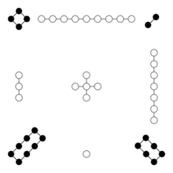
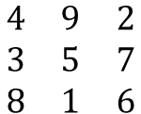
Real實際的 Cases案例 of Theta
Asymptotic complexity of matrix addition 矩陣加法
  Θ(rows * cols)
Asymptotic complexity of binary search 二元搜尋
  worst case: Θ(log n)
  best case: Θ(1) e.g. 2, 3, 5, 7, 11, 13, 17, 19, 23, 29, 31, 37, 41, 43, 47, 53, 59
Asymptotic complexity of permutation 排列
  Θ(n (n!)) 1234, 1243, 1324, 1342, 1423, 1432, 2134, 2143, …
Asymptotic complexity of magic square 魔方陣,幻方
  Θ(n²)

Slide 57
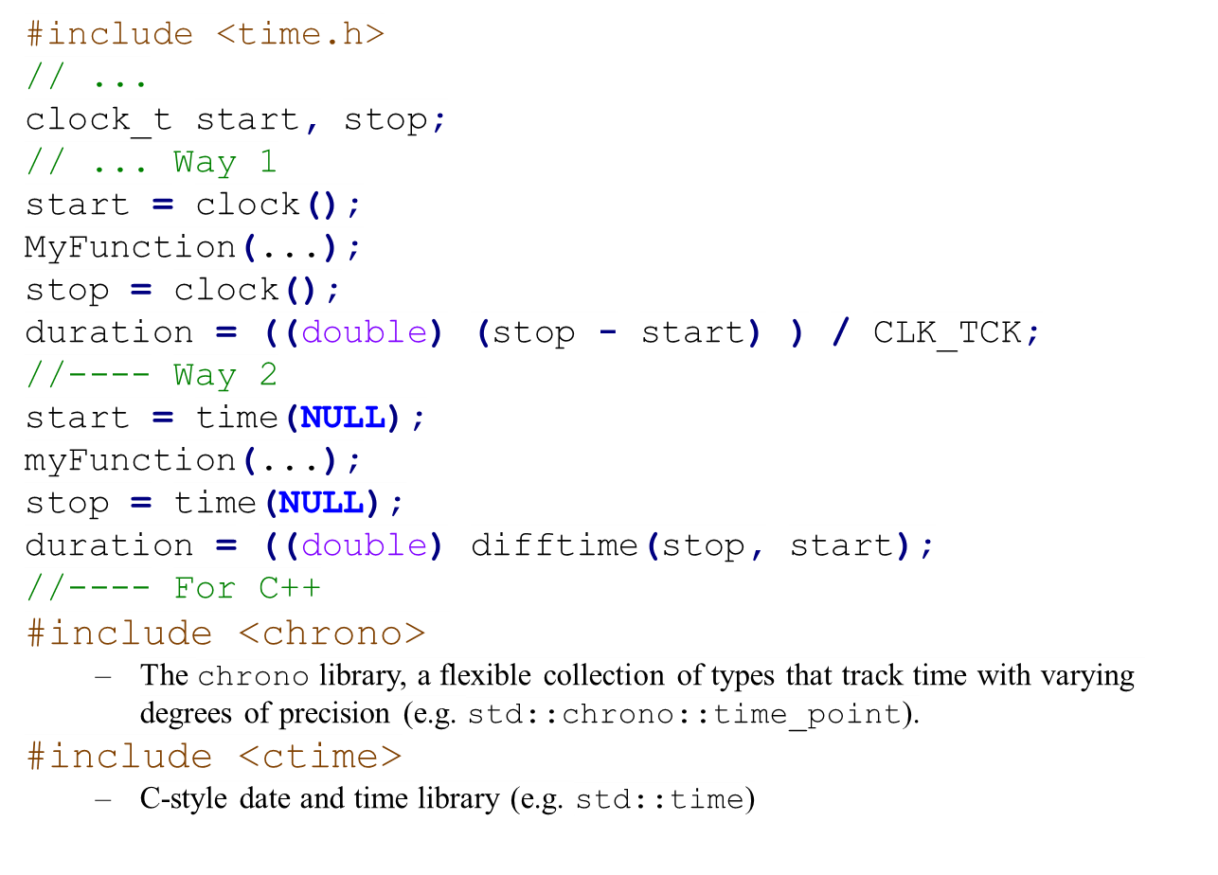
Time Measurement in C/C++

Slide 58
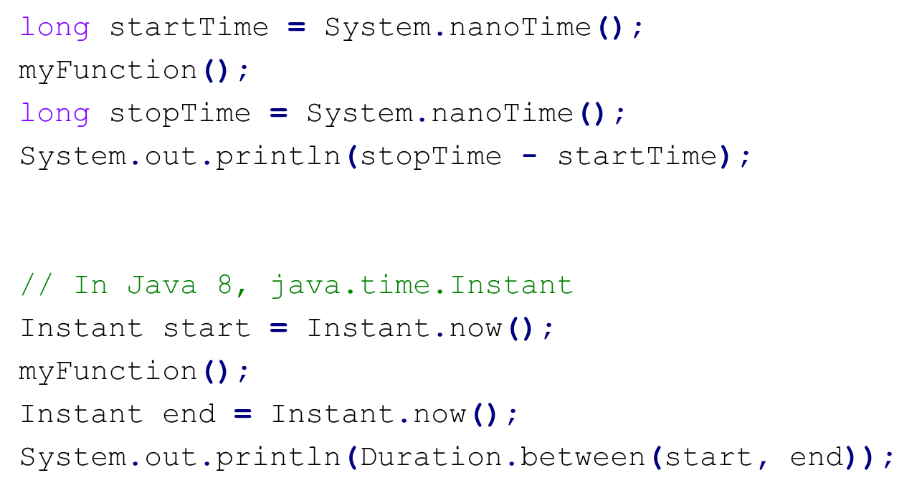
Time Measurement in Java

