Slide 1
IONIC
Hybrid Mobile Application Framework

Slide 2
DAY 2
CRUD USING FIREBASE

Slide 3
Outline
Introduction
CRUD Operation
FIREBASE
FIREBASE
Create new application
Installing dependencies
Create database
Setup credential
Building CRUD App
Create
Read
Update
Delete

Slide 4
Introduction
CRUD Operation
Create, Read, Update, Delete
FIREBASE
Firebase is mobile and web application development platform.
Real-time database
Firebase Cloud Messaging
Firebase Hosting
Firebase Storage

Slide 5
FIREBASE
Create new application
Installing dependencies
Create database
Setup credential

Slide 6
WHAT WE WILL CREATE?

Slide 7
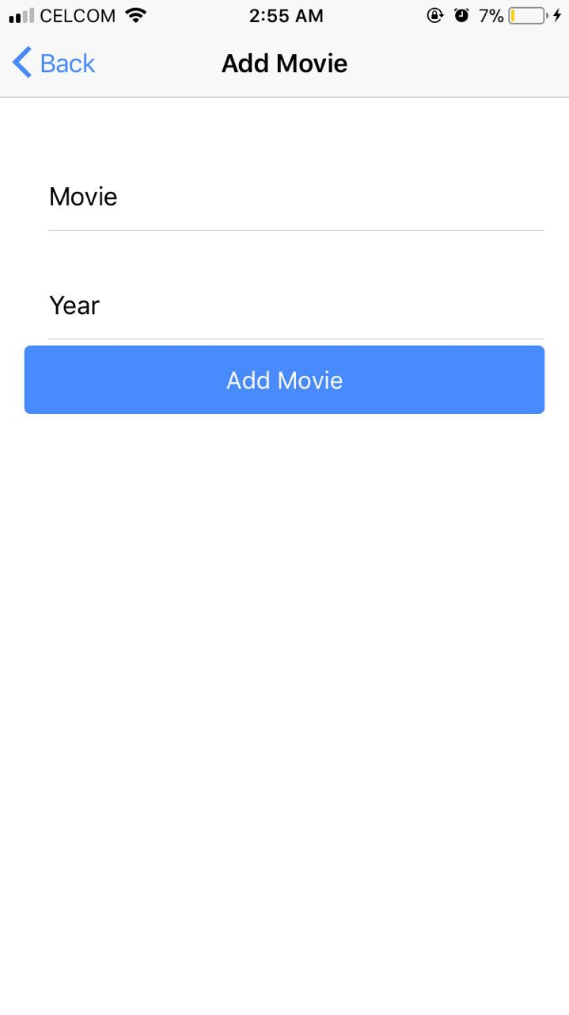
CREATE PROCESS

Slide 8

READ PROCESS

Slide 9
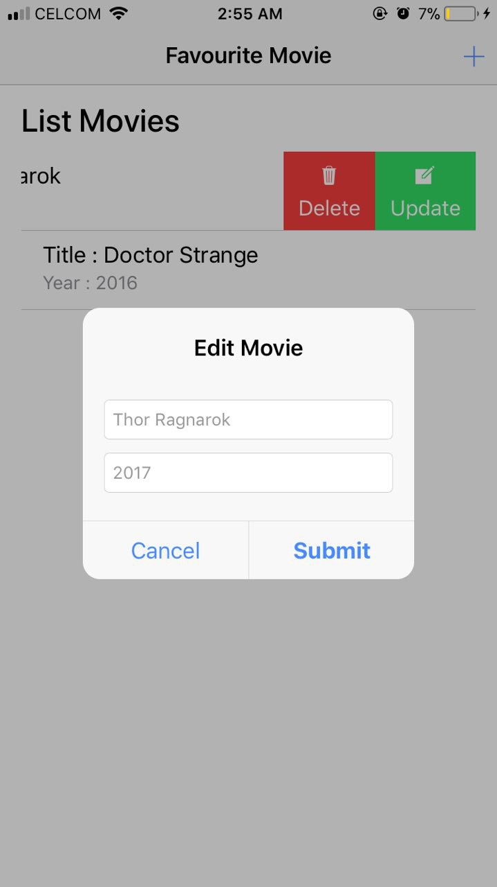
UPDATE PROCESS

Slide 10
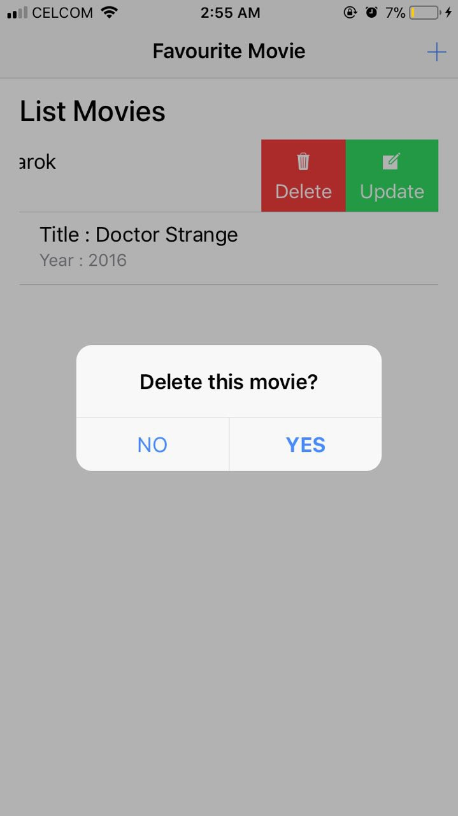
DELETE PROCESS

Slide 11
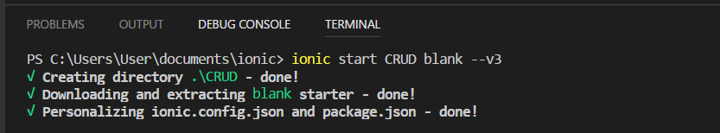
Create new application
C:\Users\Username\Documents\ionic>ionic start CRUD blank –v3

Slide 12
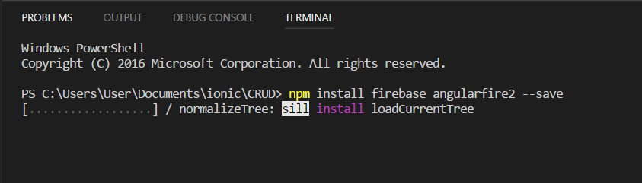
Installing Dependencies
npm install firebase angularfire2 --save

Slide 13
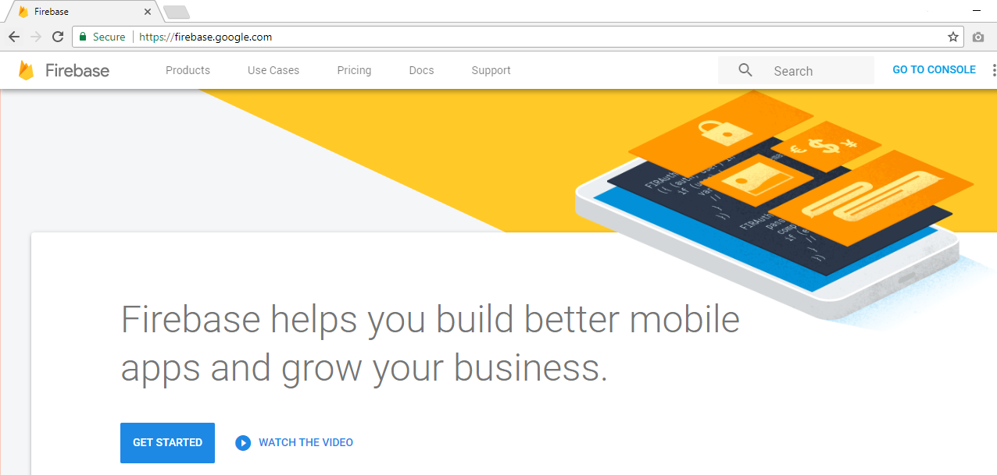
Create account Firebase
https://firebase.google.com
Firebase console

Slide 14
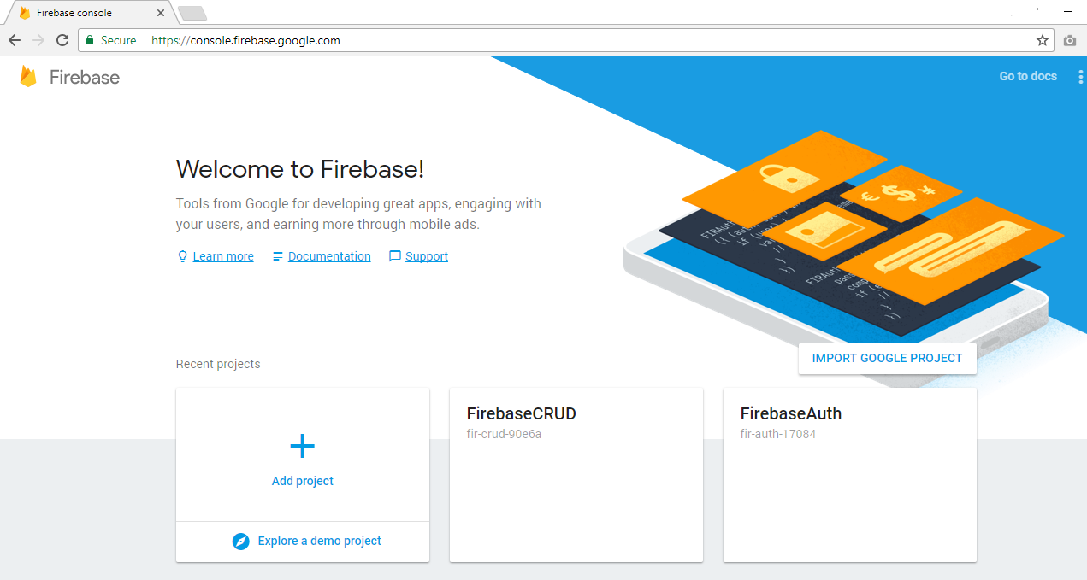
Firebase Console
https://console.firebase.google.com
Create database

Slide 15
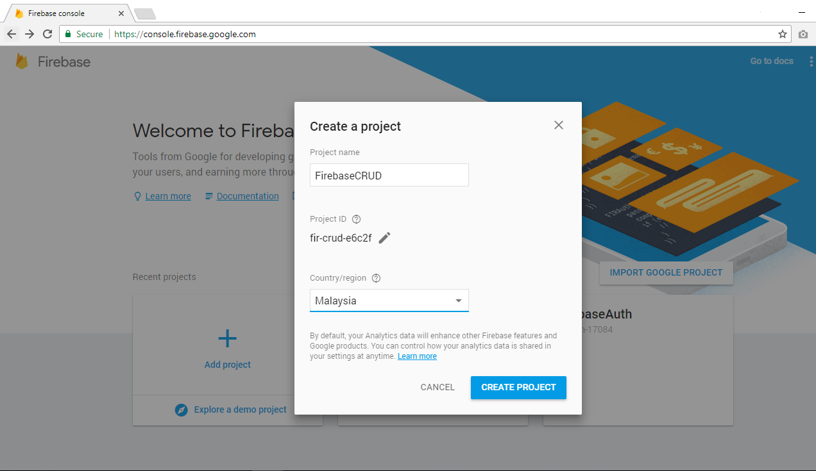
Create new database

Slide 16
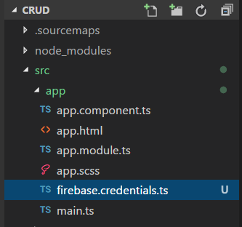
Setup Firebase Credentials
Create ‘firebase.credentials.ts’ file in folder app

Slide 17
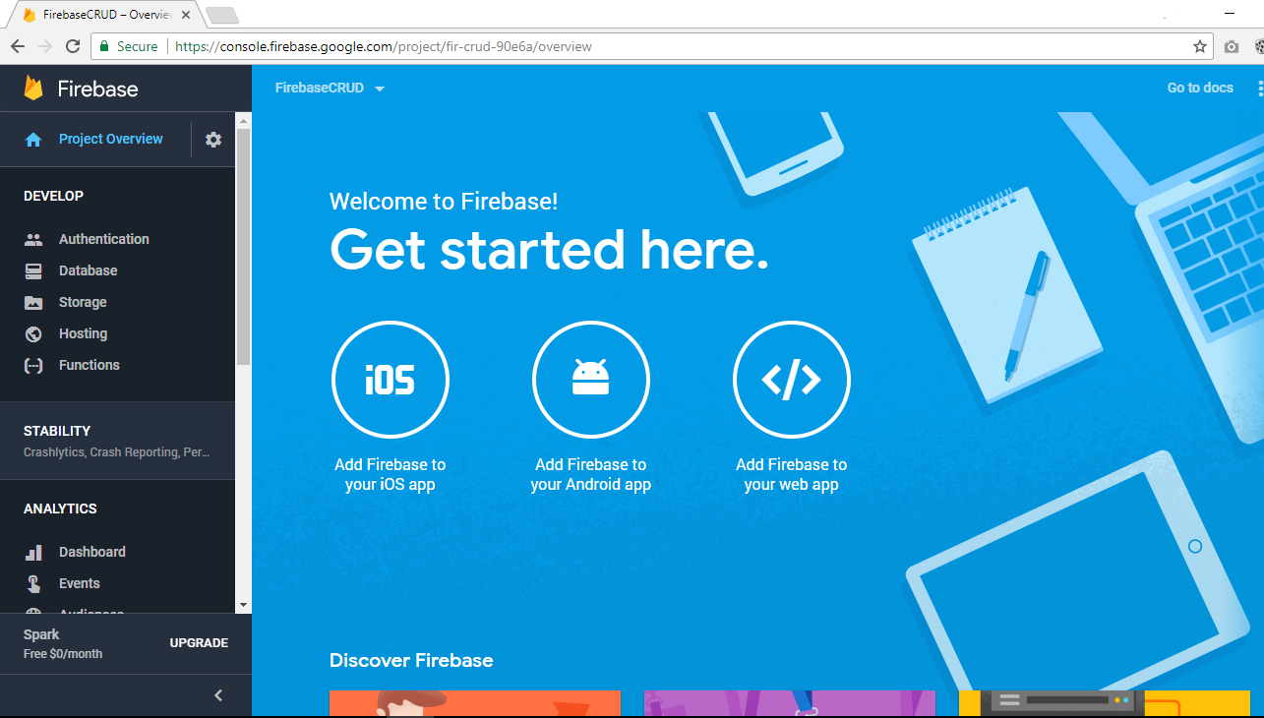
Firebase Control Panel
Click here!

Slide 18
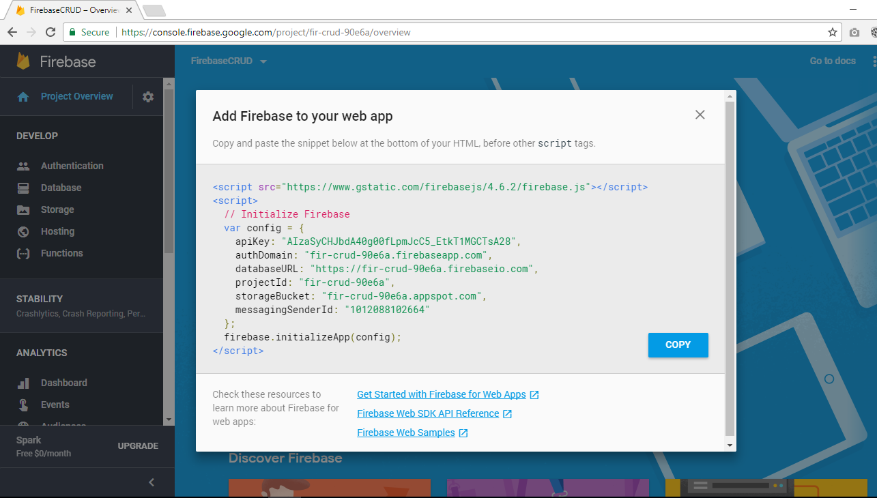
Firebase Configuration
Copy

Slide 19
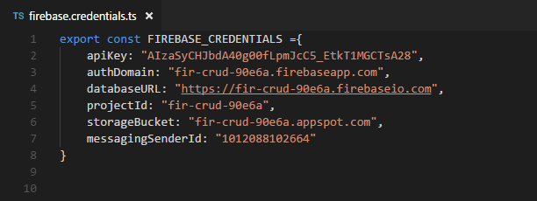
Setup credential

Slide 20
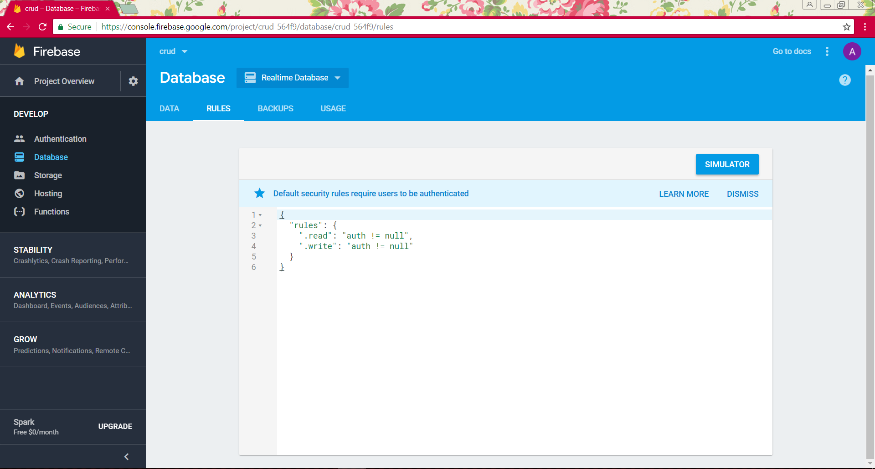
Edit rules
Click ‘Rules’
Edit rules

Slide 21
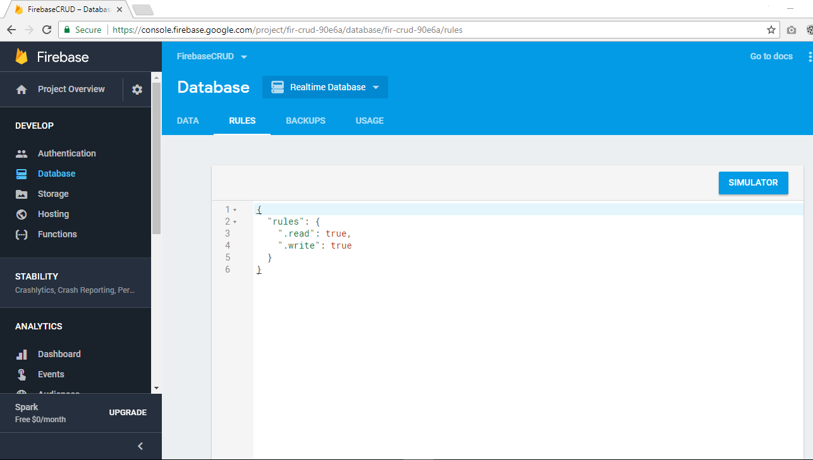
Change rules

Slide 22
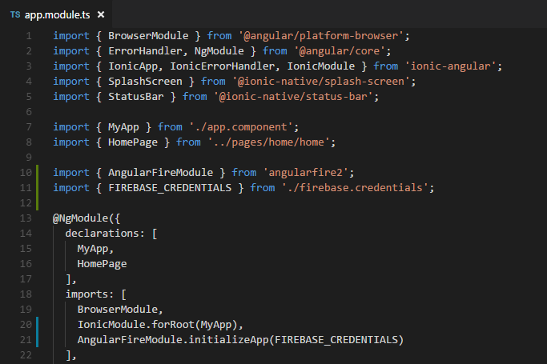
Setup Firebase Credentials
Import module firebase and credentials file into file “app.module.ts”

Slide 23
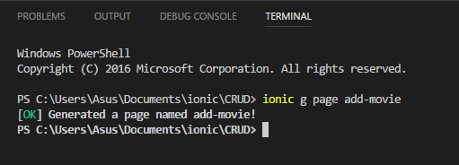
Create new file
ionic g page add-movie

Slide 24
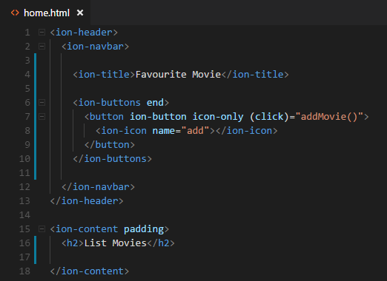
Edit file home.html

Slide 25
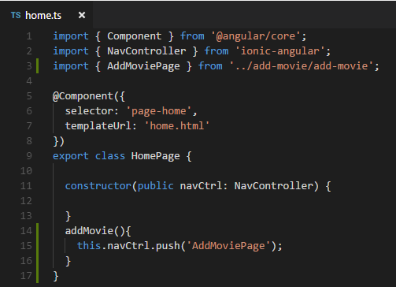
Edit file home.ts

Slide 26
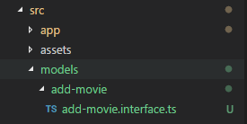
Create folder ‘models’ in folder ‘src’

Slide 27
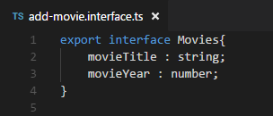
Code file add-movie.interface.ts

Slide 28
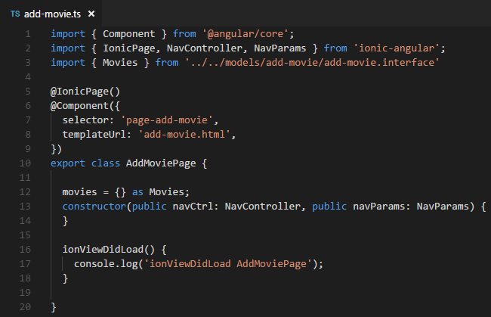
Import file “add-movie.interface.ts” into file “add-movie.ts”

Slide 29
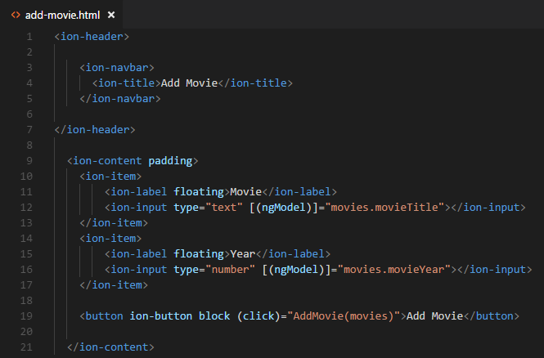
Declare variable for the input field in file “add-movie.html”

Slide 30
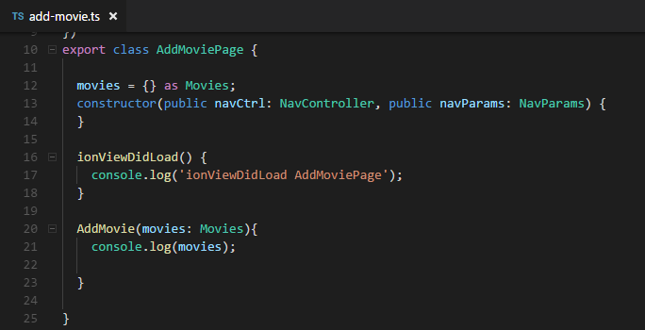
16. Add function “AddMovie()” in file “add-movie.ts”

Slide 31
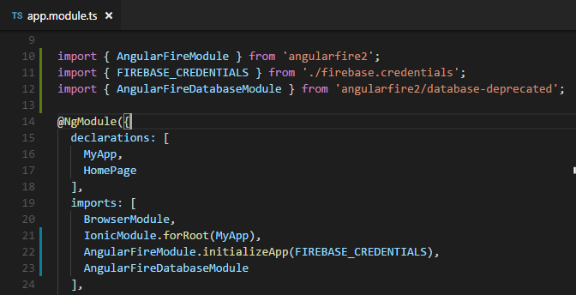
Import Angular database module into file “app.module.ts”

Slide 32
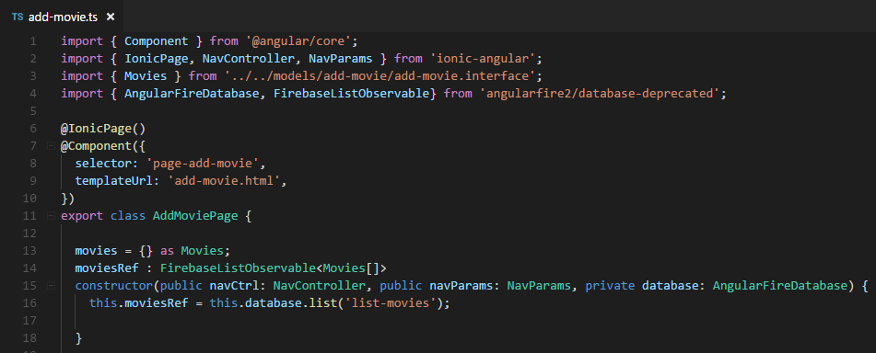
Import Angular database module into file “add-movie.ts”

Slide 33
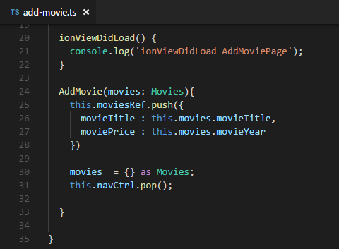
Add process insert data (Create operation)

Slide 34
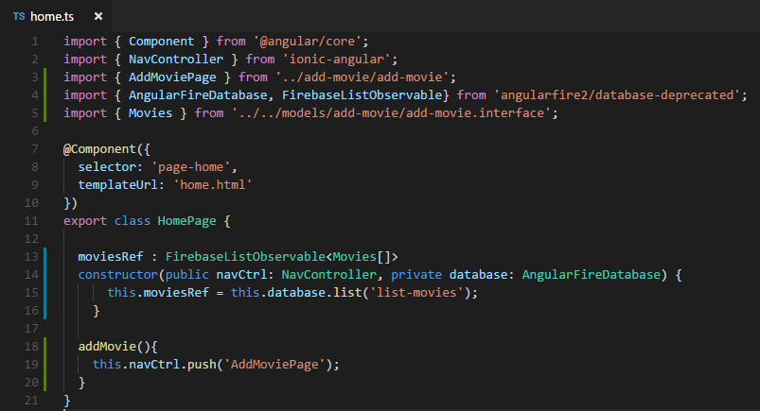
Import Angular database module into file “home.ts”

Slide 35
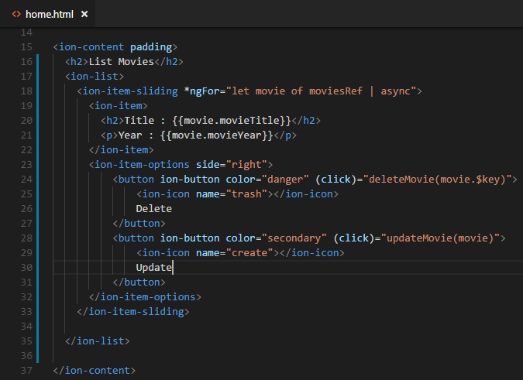
Display list of movies in ‘home.html’ (Read operation)

Slide 36
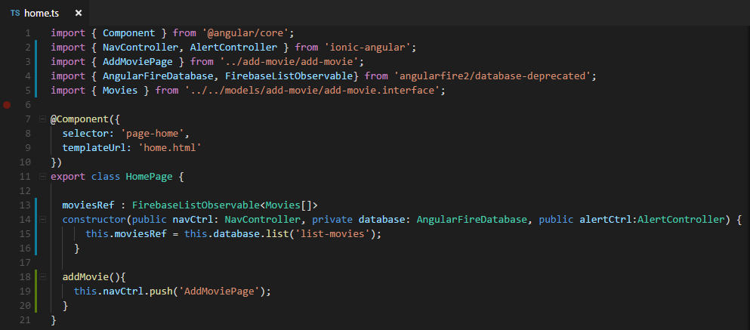
Import Alert Controller into file “home.ts”

Slide 37
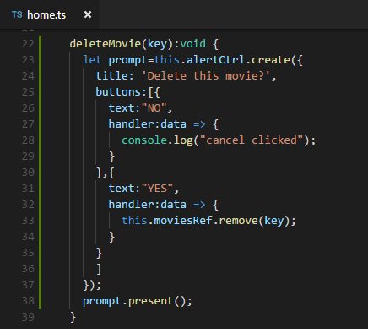
Delete function in ‘home.ts’ (Delete operation)

Slide 38
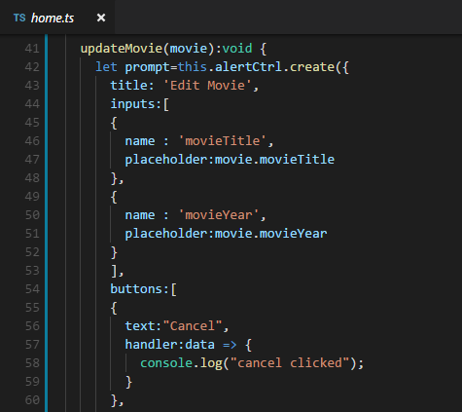
Update function in ‘home.ts’ (Update operation)

Slide 39
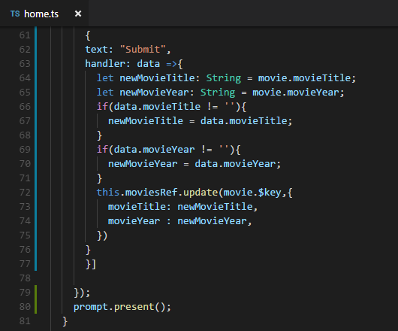
Update function in ‘home.ts’ (cont.)

Slide 40
Done !!!

Slide 41
Exercise
Create one page to display list of employee
Attribute :
Name
Email
HP Number
Date of birth
Position

Slide 42
Thank You !!

