Slide 1
IONIC
Hybrid Mobile Application Framework

Slide 2
DAY 1
INTRODUCTION

Slide 3
Outline
Introduction
Installation
Building first ionic application
References

Slide 4
Introduction
Hybrid Application
What is Apache Cordova
What is Angular JS
What is Ionic

Slide 5
Hybrid Application
Platform independent
IOS, Android & Windows
HTML5, CSS3 & JS
Limited performance
Quick Development
Direct access to native APIs with Cordova

Slide 6
What is Apache Cordova
Apache Cordova is a platform for building native mobile application using HTML, CSS & JavaScript
https://cordova.apache.org/

Slide 7
What is Angular JS
Angular JS is a structural framework for dynamic web application
https://angularjs.org/

Slide 8
What is Ionic
An open source framework for developing hybrid mobile application with Angular JS, Sass & Cordova
https://ionicframework.com/

Slide 9
Installation
Node.js
Visual Studio Code
Android Studio
Git - https://git-scm.com/downloads

Slide 10
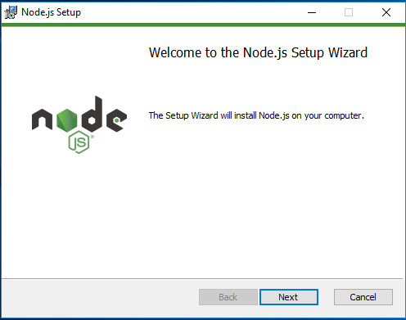
Node.js

Slide 11
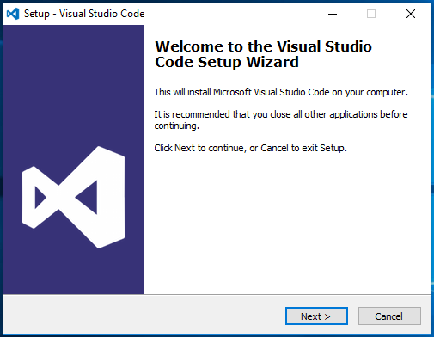
Visual Studio Code

Slide 12
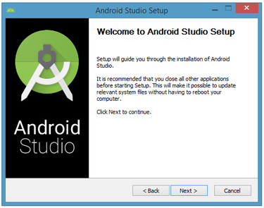
Android Studio

Slide 13
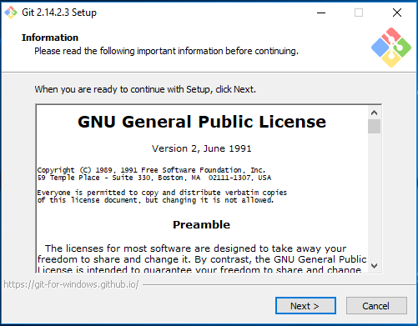
Git

Slide 14
Building First Ionic Application
Create folder “ionic” at Documents
Open VSCode
Open integrated terminal
Ionic installation
Change directory file
Ionic Template
Ionic Build Outline

Slide 15
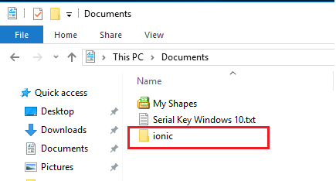
Create folder “ionic” at Documents

Slide 16
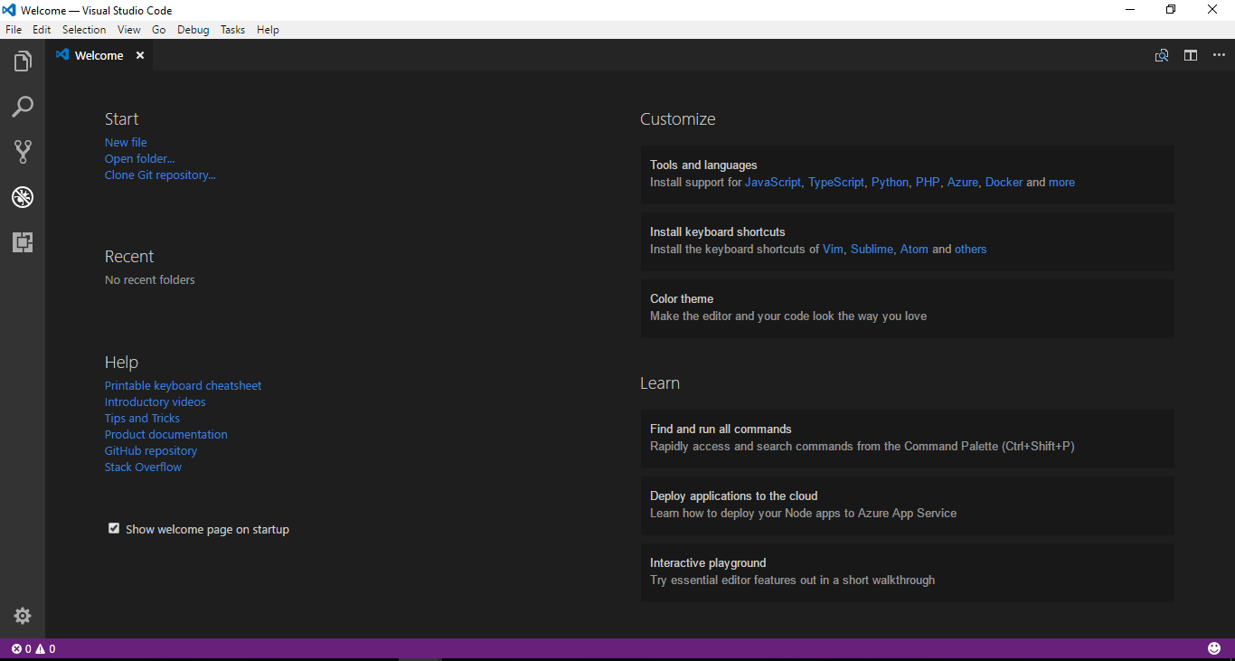
Open VSCode

Slide 17
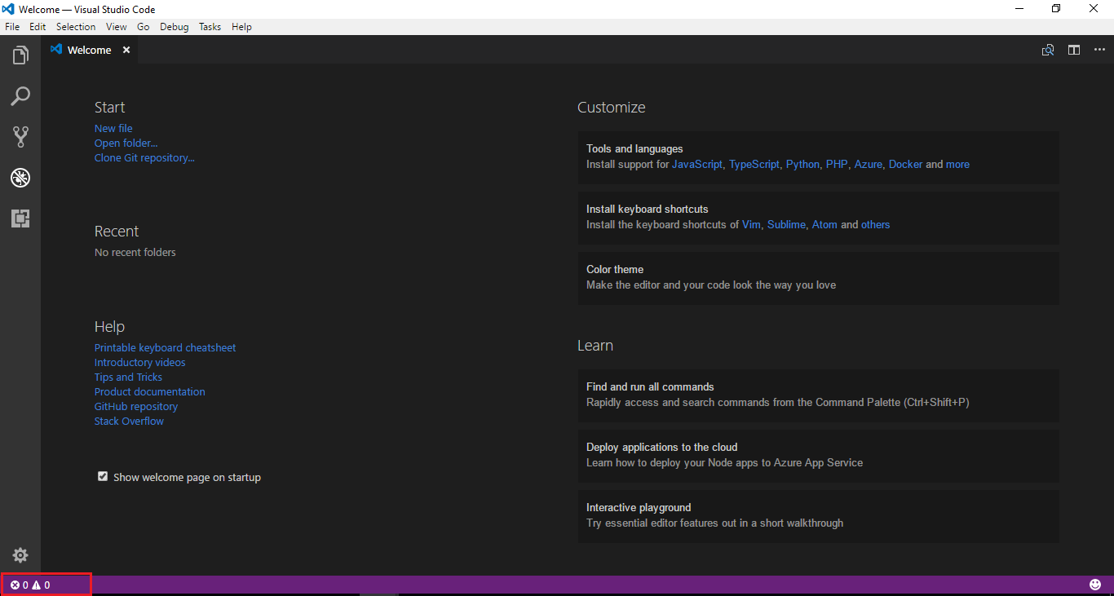
Open integrated terminal
Click here !

Slide 18
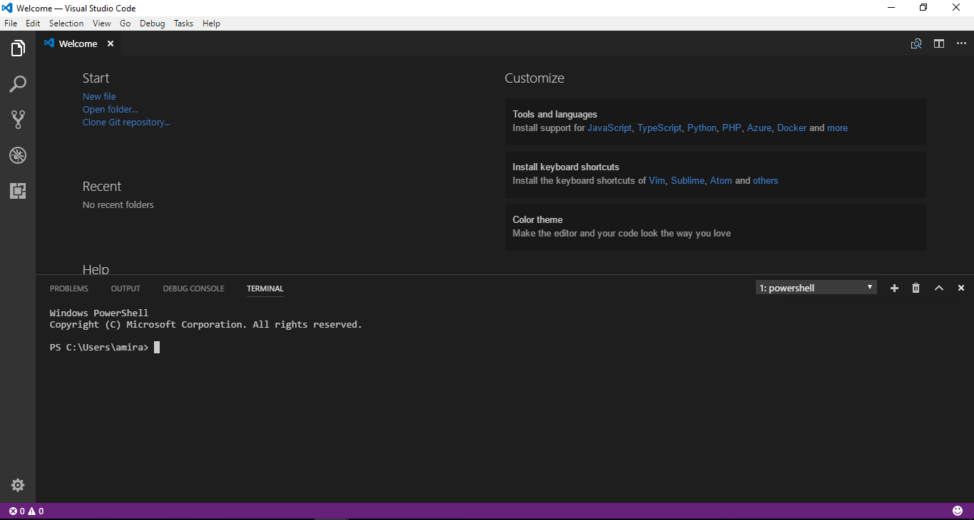
Integrated Terminal

Slide 19
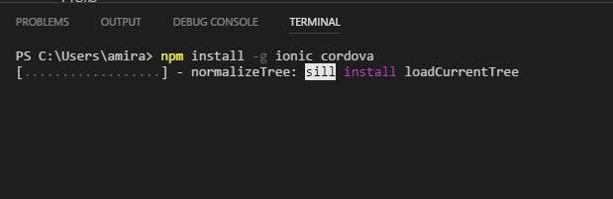
Ionic installation
C:\Users\Username>npm install -g ionic cordova

Slide 20
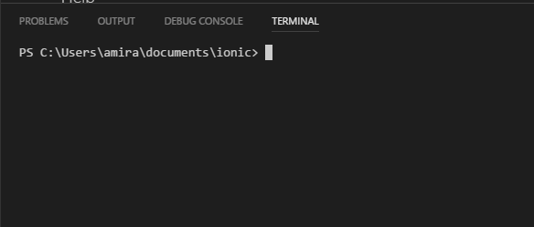
Change directory file
C:\Users\Username\Documents>cd ionic
C:\Users\Username\Documents\ionic>

Slide 21
Ionic Template
Blank App
Tab App
Menu App
C:\Users\Username\Documents\ionic>ionic start “app-name” blank --v3
C:\Users\Username\Documents\ionic>ionic start “app-name” tabs --v3
C:\Users\Username\Documents\ionic>ionic start “app-name” sidemenu --v3

Slide 22
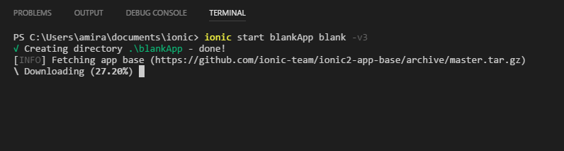
Blank App Template

Slide 23
Start Run Apps
C:\Users\Username\Documents\ionic>cd “app-name”
C:\Users\Username\Documents\ionic\app-name>ionic serve
C:\Users\Username\Documents\ionic\app-name>ionic serve -l

Slide 24
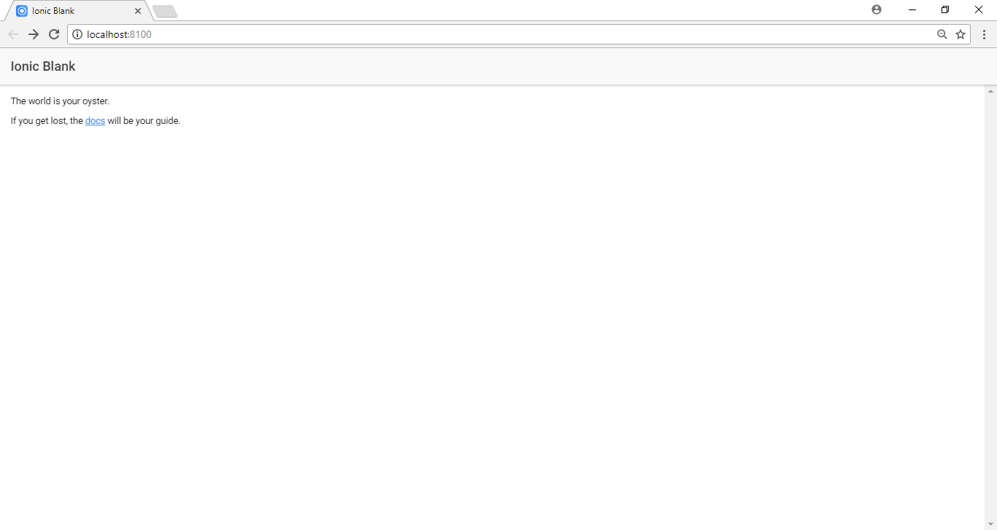
Ionic serve

Slide 25
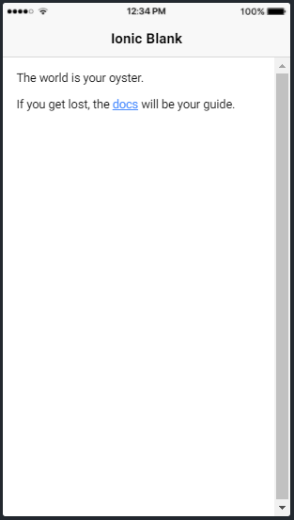
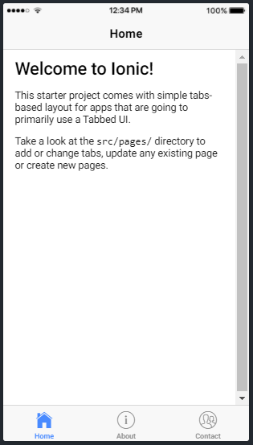
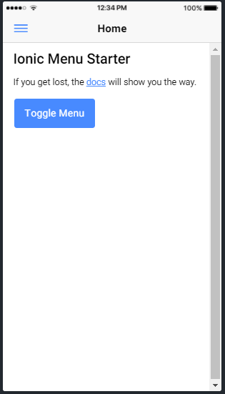
Ionic serve -l

Slide 26
Ionic Build Outline
Basic Card
Header Card
List Card
Icon
Image
Button
Add new page
Redirect to new page
View App using ionic DevApp

Slide 27
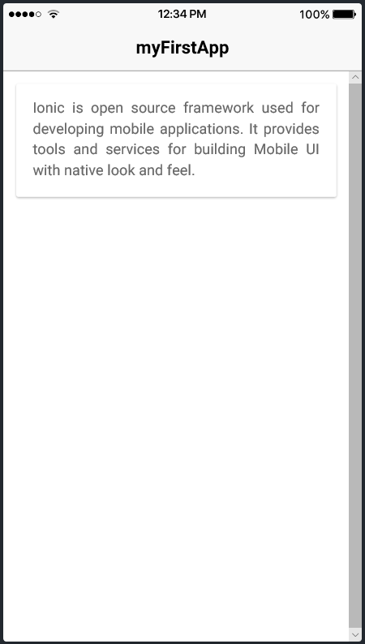
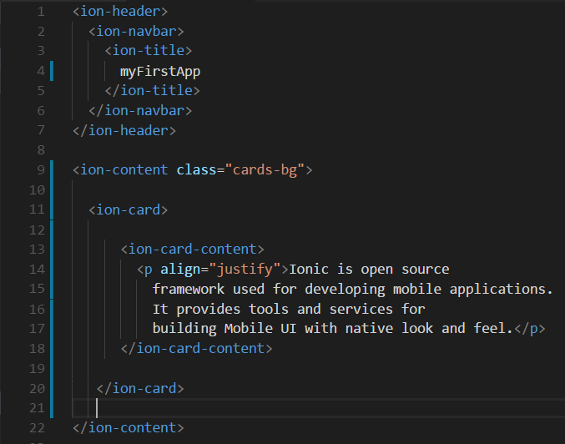
Basic Card

Slide 28
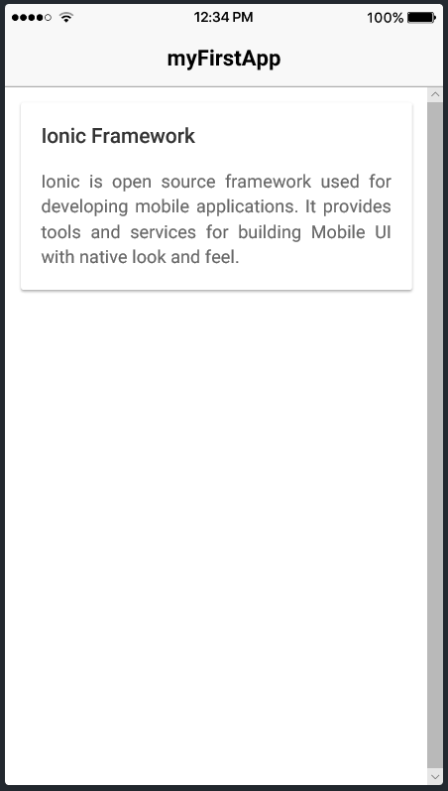
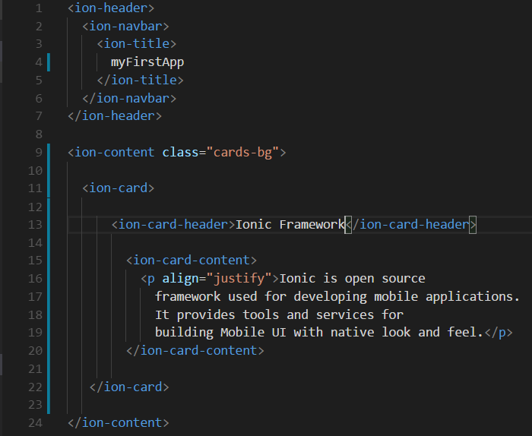
Header Card

Slide 29
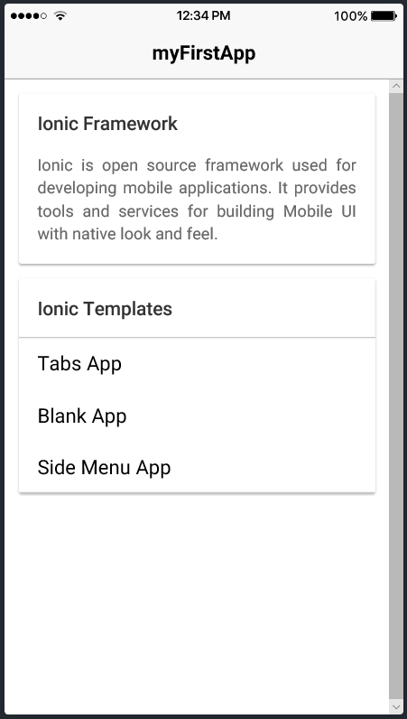
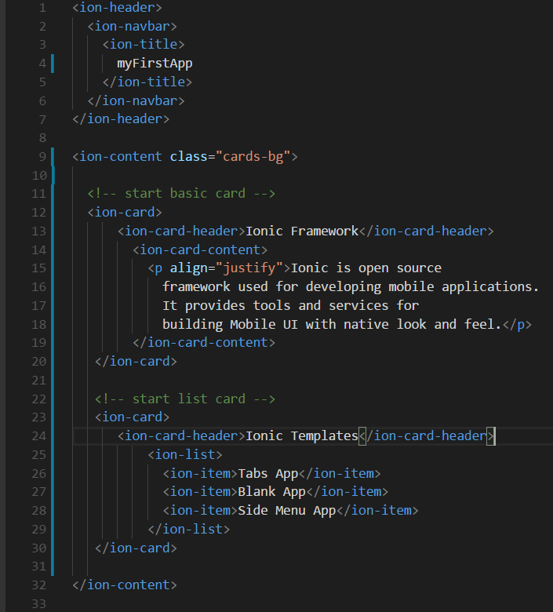
List Card

Slide 30
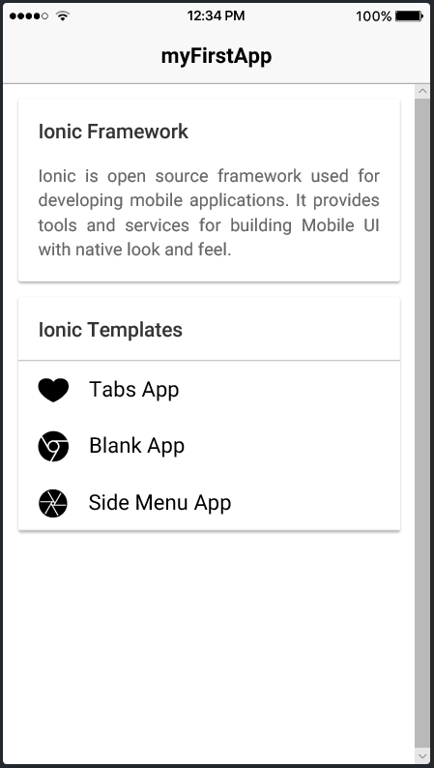
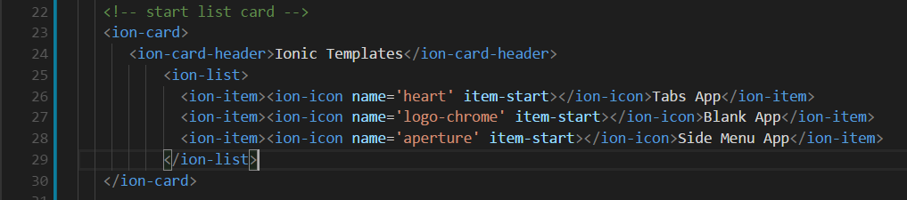
Icon
https://ionicframework.com/docs/ionicons/

Slide 31
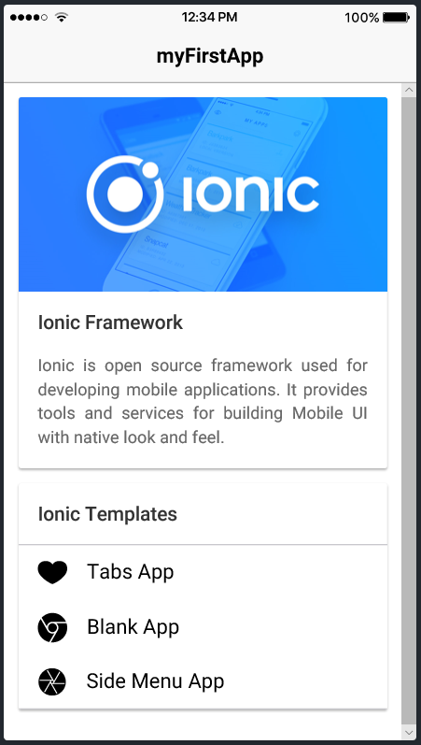
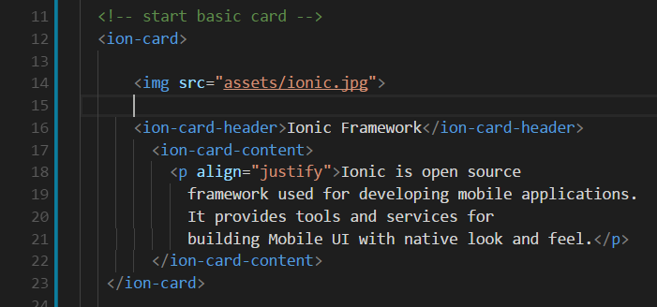
Image
C:\Users\User\Documents\ionic\myFirstApp\src\assets

Slide 32
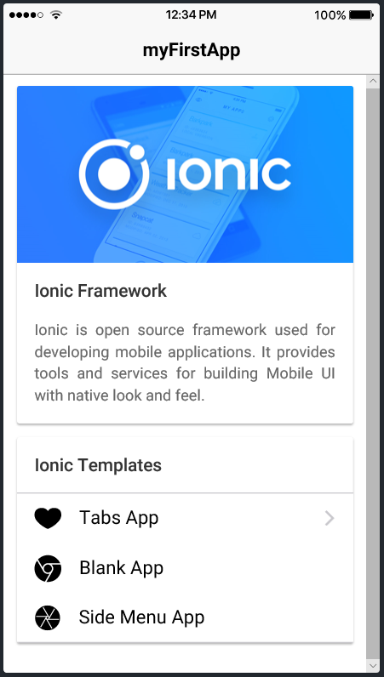
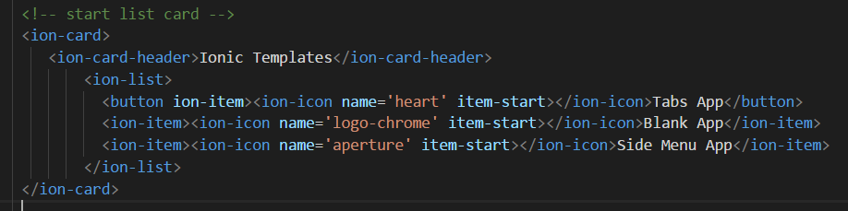
Button
https://ionicframework.com/docs/components/#buttons

Slide 33
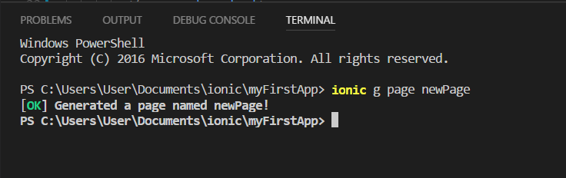
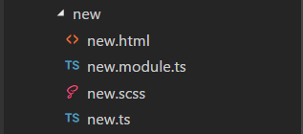
Add New Page
C:\Users\Username\Documents\ionic\myFirstApp>ionic g page <new-name-page>

Slide 34
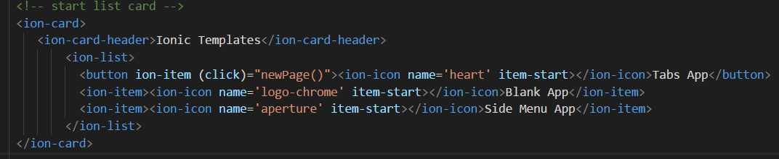
Redirect to New Page
Add link function
<button ion-item (click)="newPage()"><ion-icon name='heart' item-start></ion-icon>Tabs App</button>

Slide 35
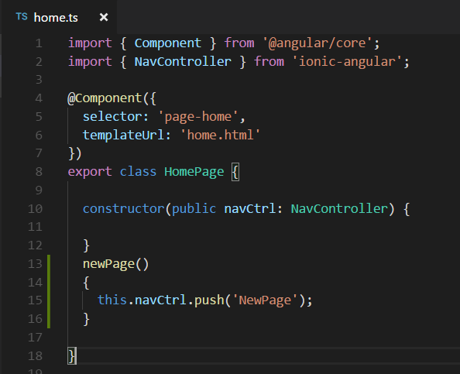
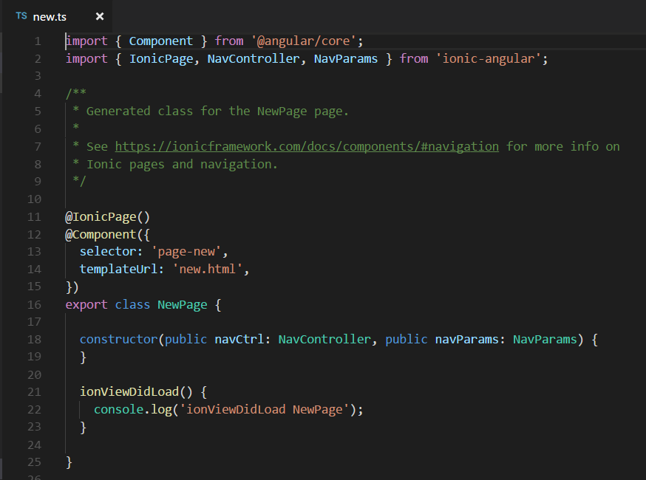
Redirect to New Page
Create function at home.ts
newPage()

Slide 36
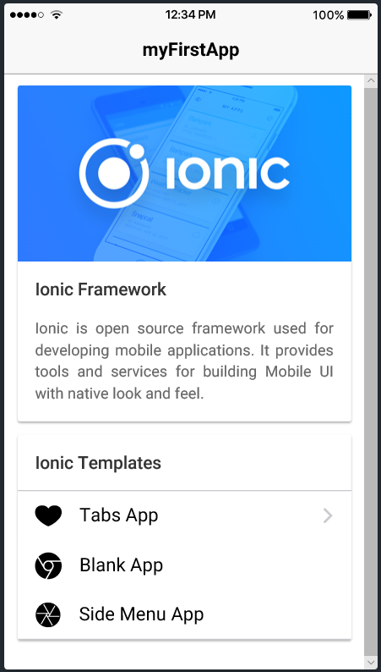
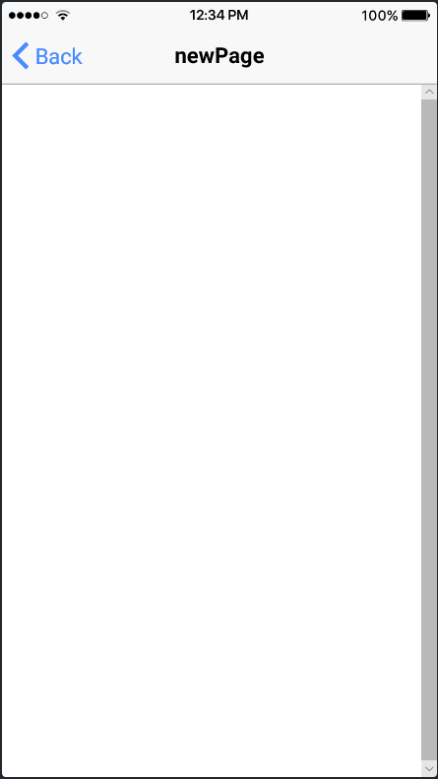
Redirect to New Page
Click here

Slide 37
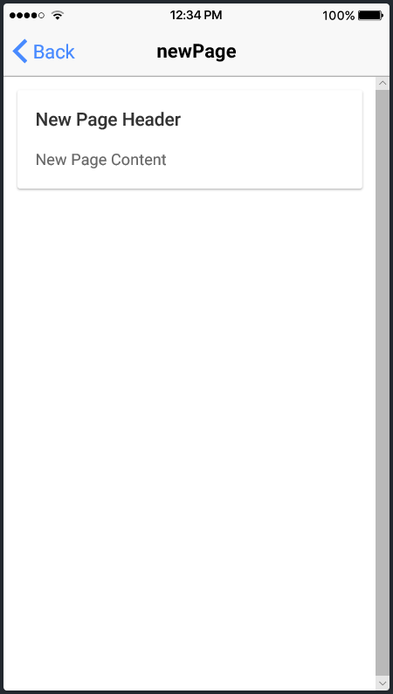
Edit New Page

Slide 38
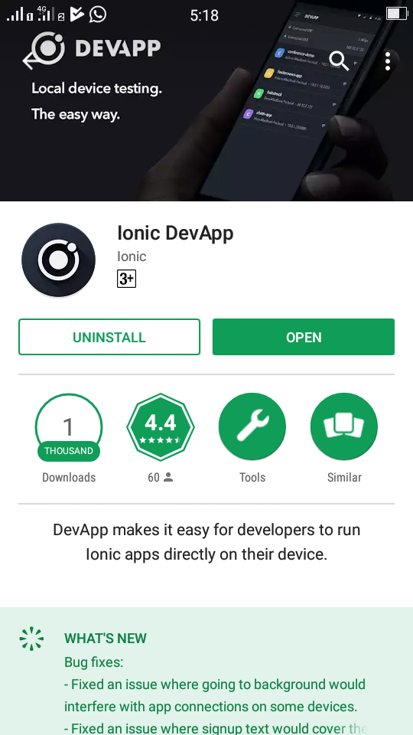
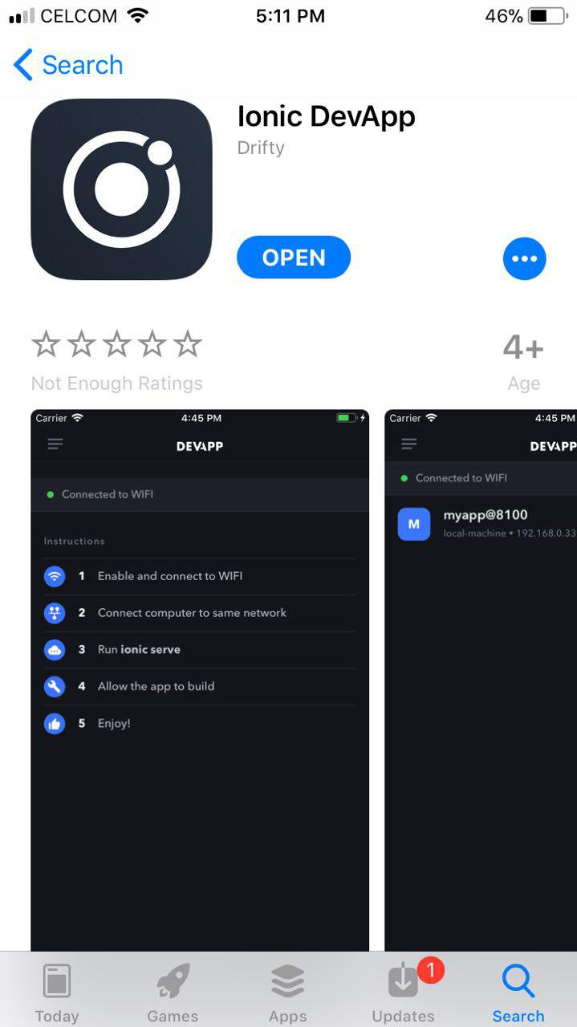
View App using ionic DevApp

Slide 39
Ionic DevApp
Start DevApp
Connect with the same network
Run command: ionic serve

Slide 40
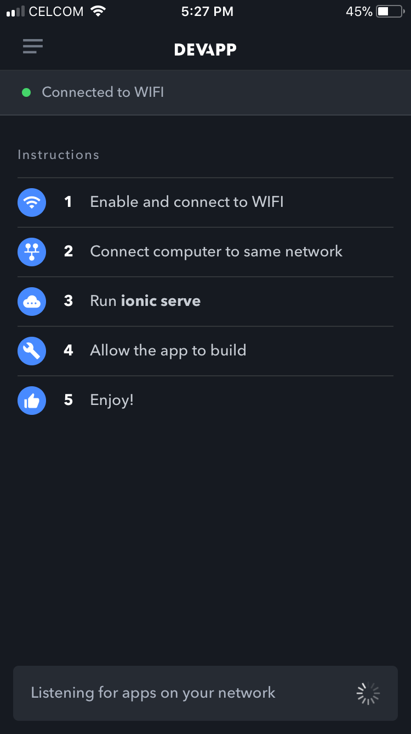
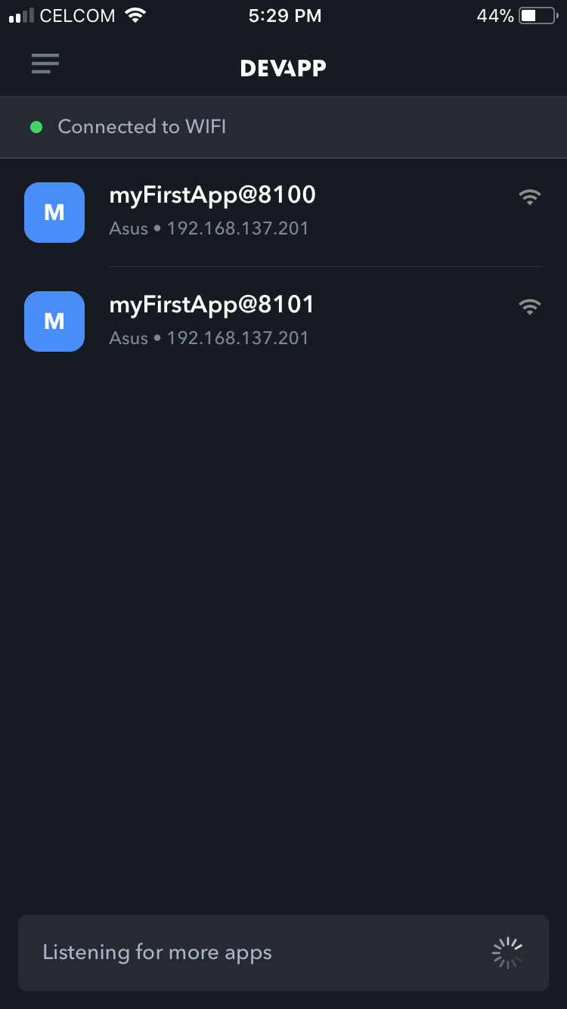
Ionic DevApp

Slide 41
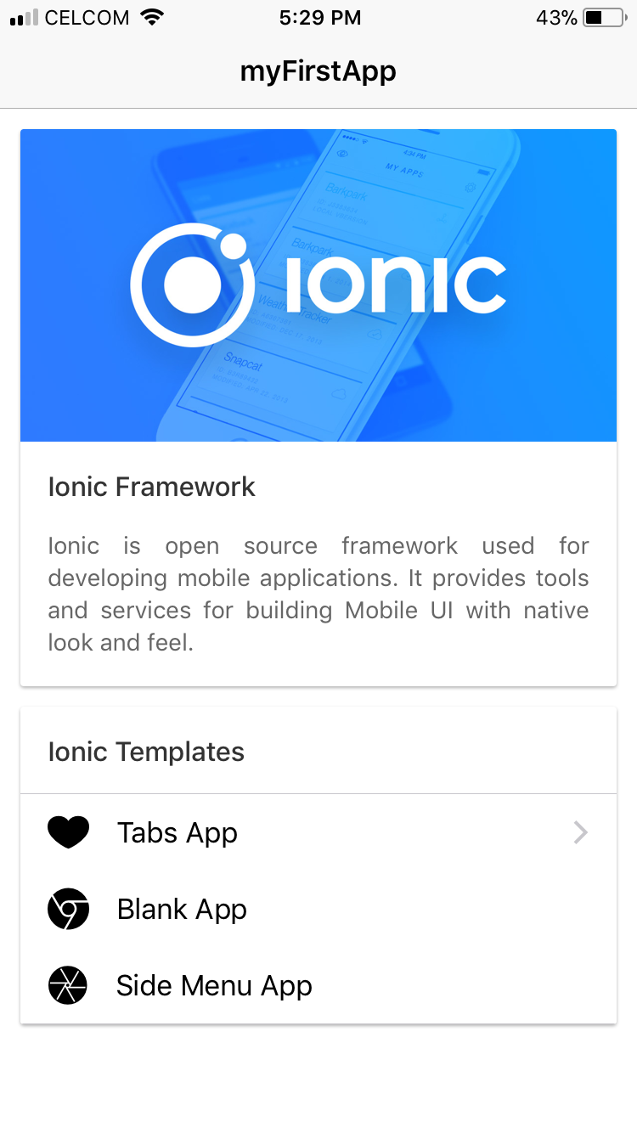

Ionic DevApp

Slide 42
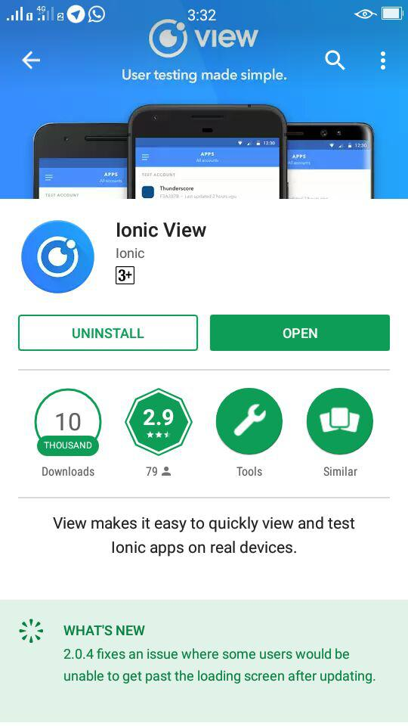
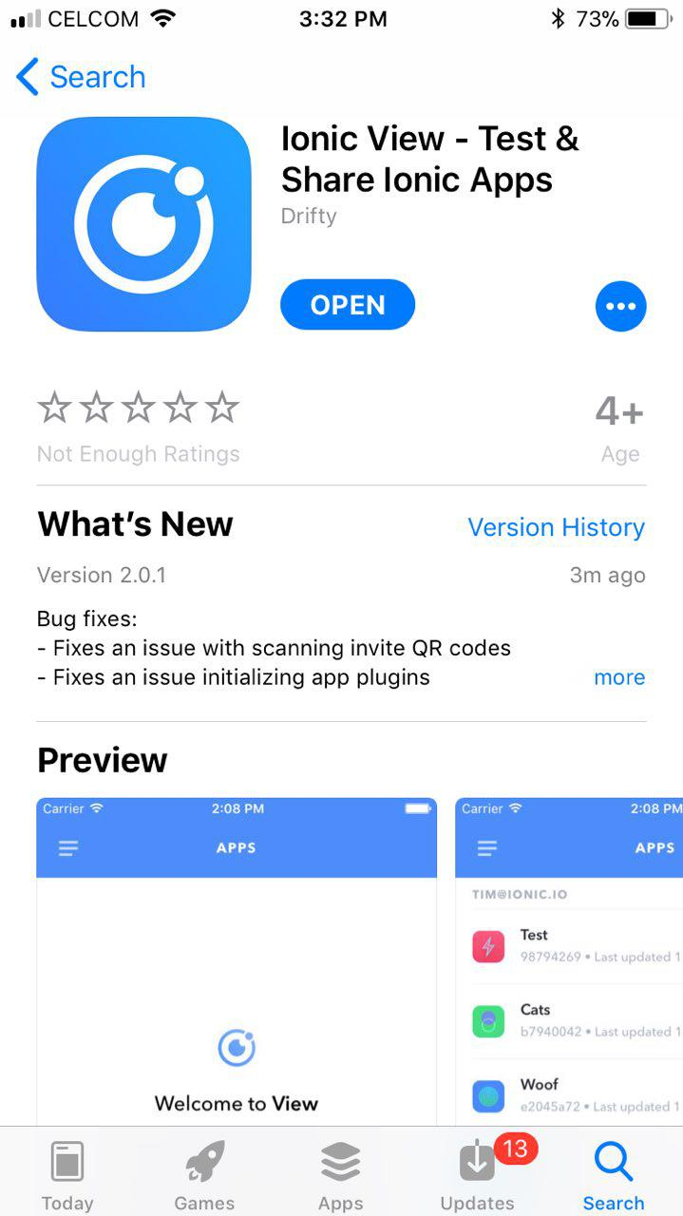
View App using Ionic View

Slide 43
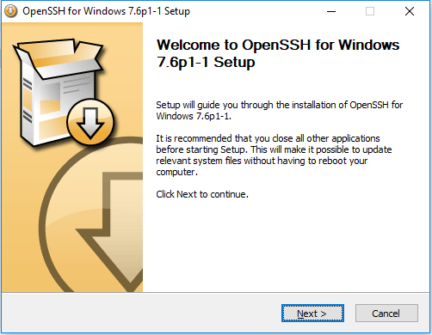
Ionic View – OpenSSH Installation
Download OpenSSH - https://www.mls-software.com/opensshd.html
Install OpenSSH

Slide 44
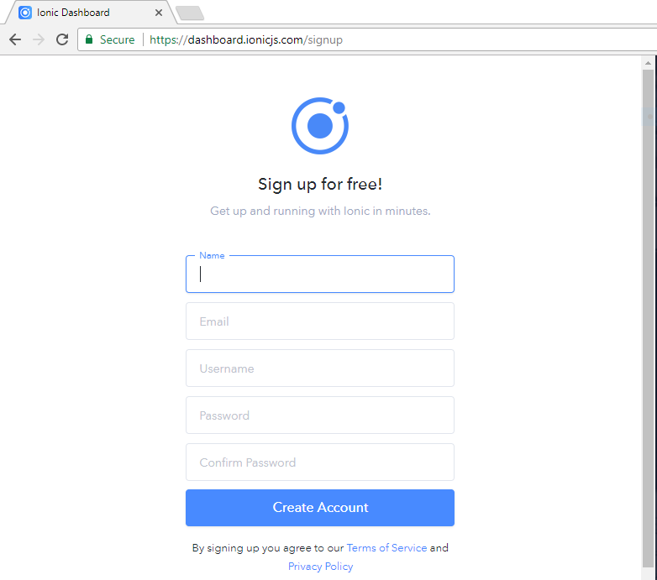
Ionic View – Create IONIC account
https://dashboard.ionicjs.com/signup

Slide 45
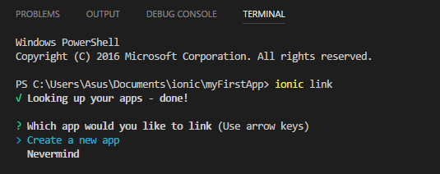
Command Line - ionic link
C:\Users\Username\Documents\AppName>ionic link
Choose “Create a new app”

Slide 46
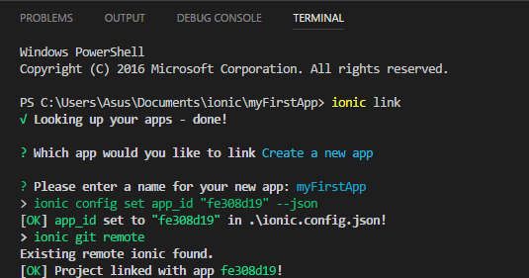
Command Line – ionic link (cont.)
Enter “app-name” (eg: myFirstApp)

Slide 47
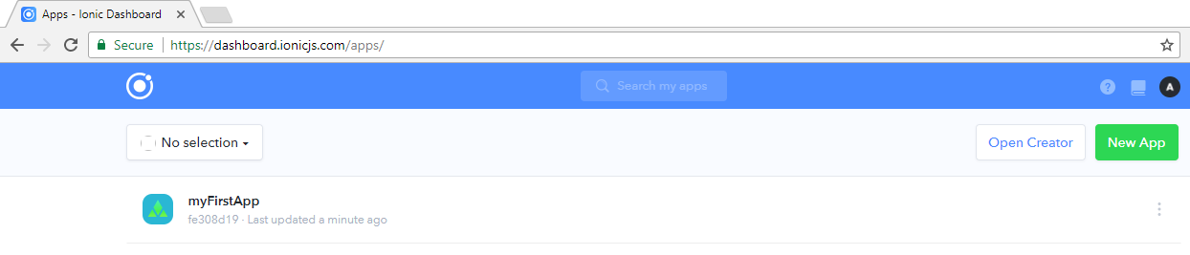
Ionic View – Login IONIC account
https://dashboard.ionicjs.com/login

Slide 48
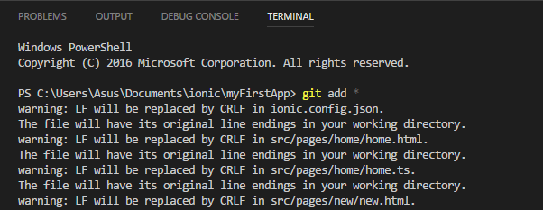
Command Line – git add *
C:\Users\Username\Documents\AppName>git add *

Slide 49
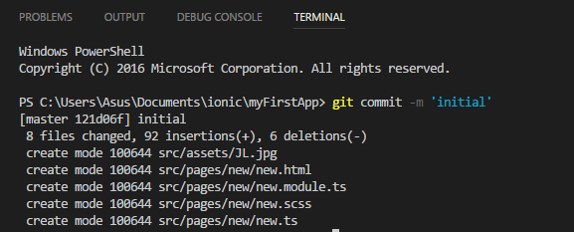
Command Line – git commit –m ‘initial’
C:\Users\Username\Documents\AppName>git commit –m ‘initial’

Slide 50
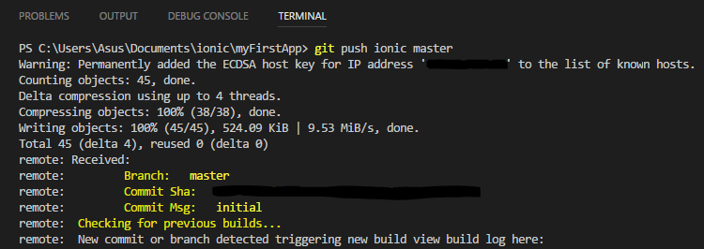
Command Line – git push ionic master
C:\Users\Username\Documents\AppName>git push ionic master

Slide 51

Ionic View – View App @ IONIC Dashboard

Slide 52


Ionic View

Slide 53
Done !!!

Slide 54
Exercise
Design static page for your cv / resume profile
Template: blank page
Information
Bio: name, email, contact number, social link
Education
Career Profile
Experiences
Skills

Slide 55
References
https://ionicframework.com/docs/
https://cordova.apache.org/
https://angularjs.org/
https://ionicframework.com/
https://market.ionic.io/

Slide 56
Thank You !!

