Slide 1
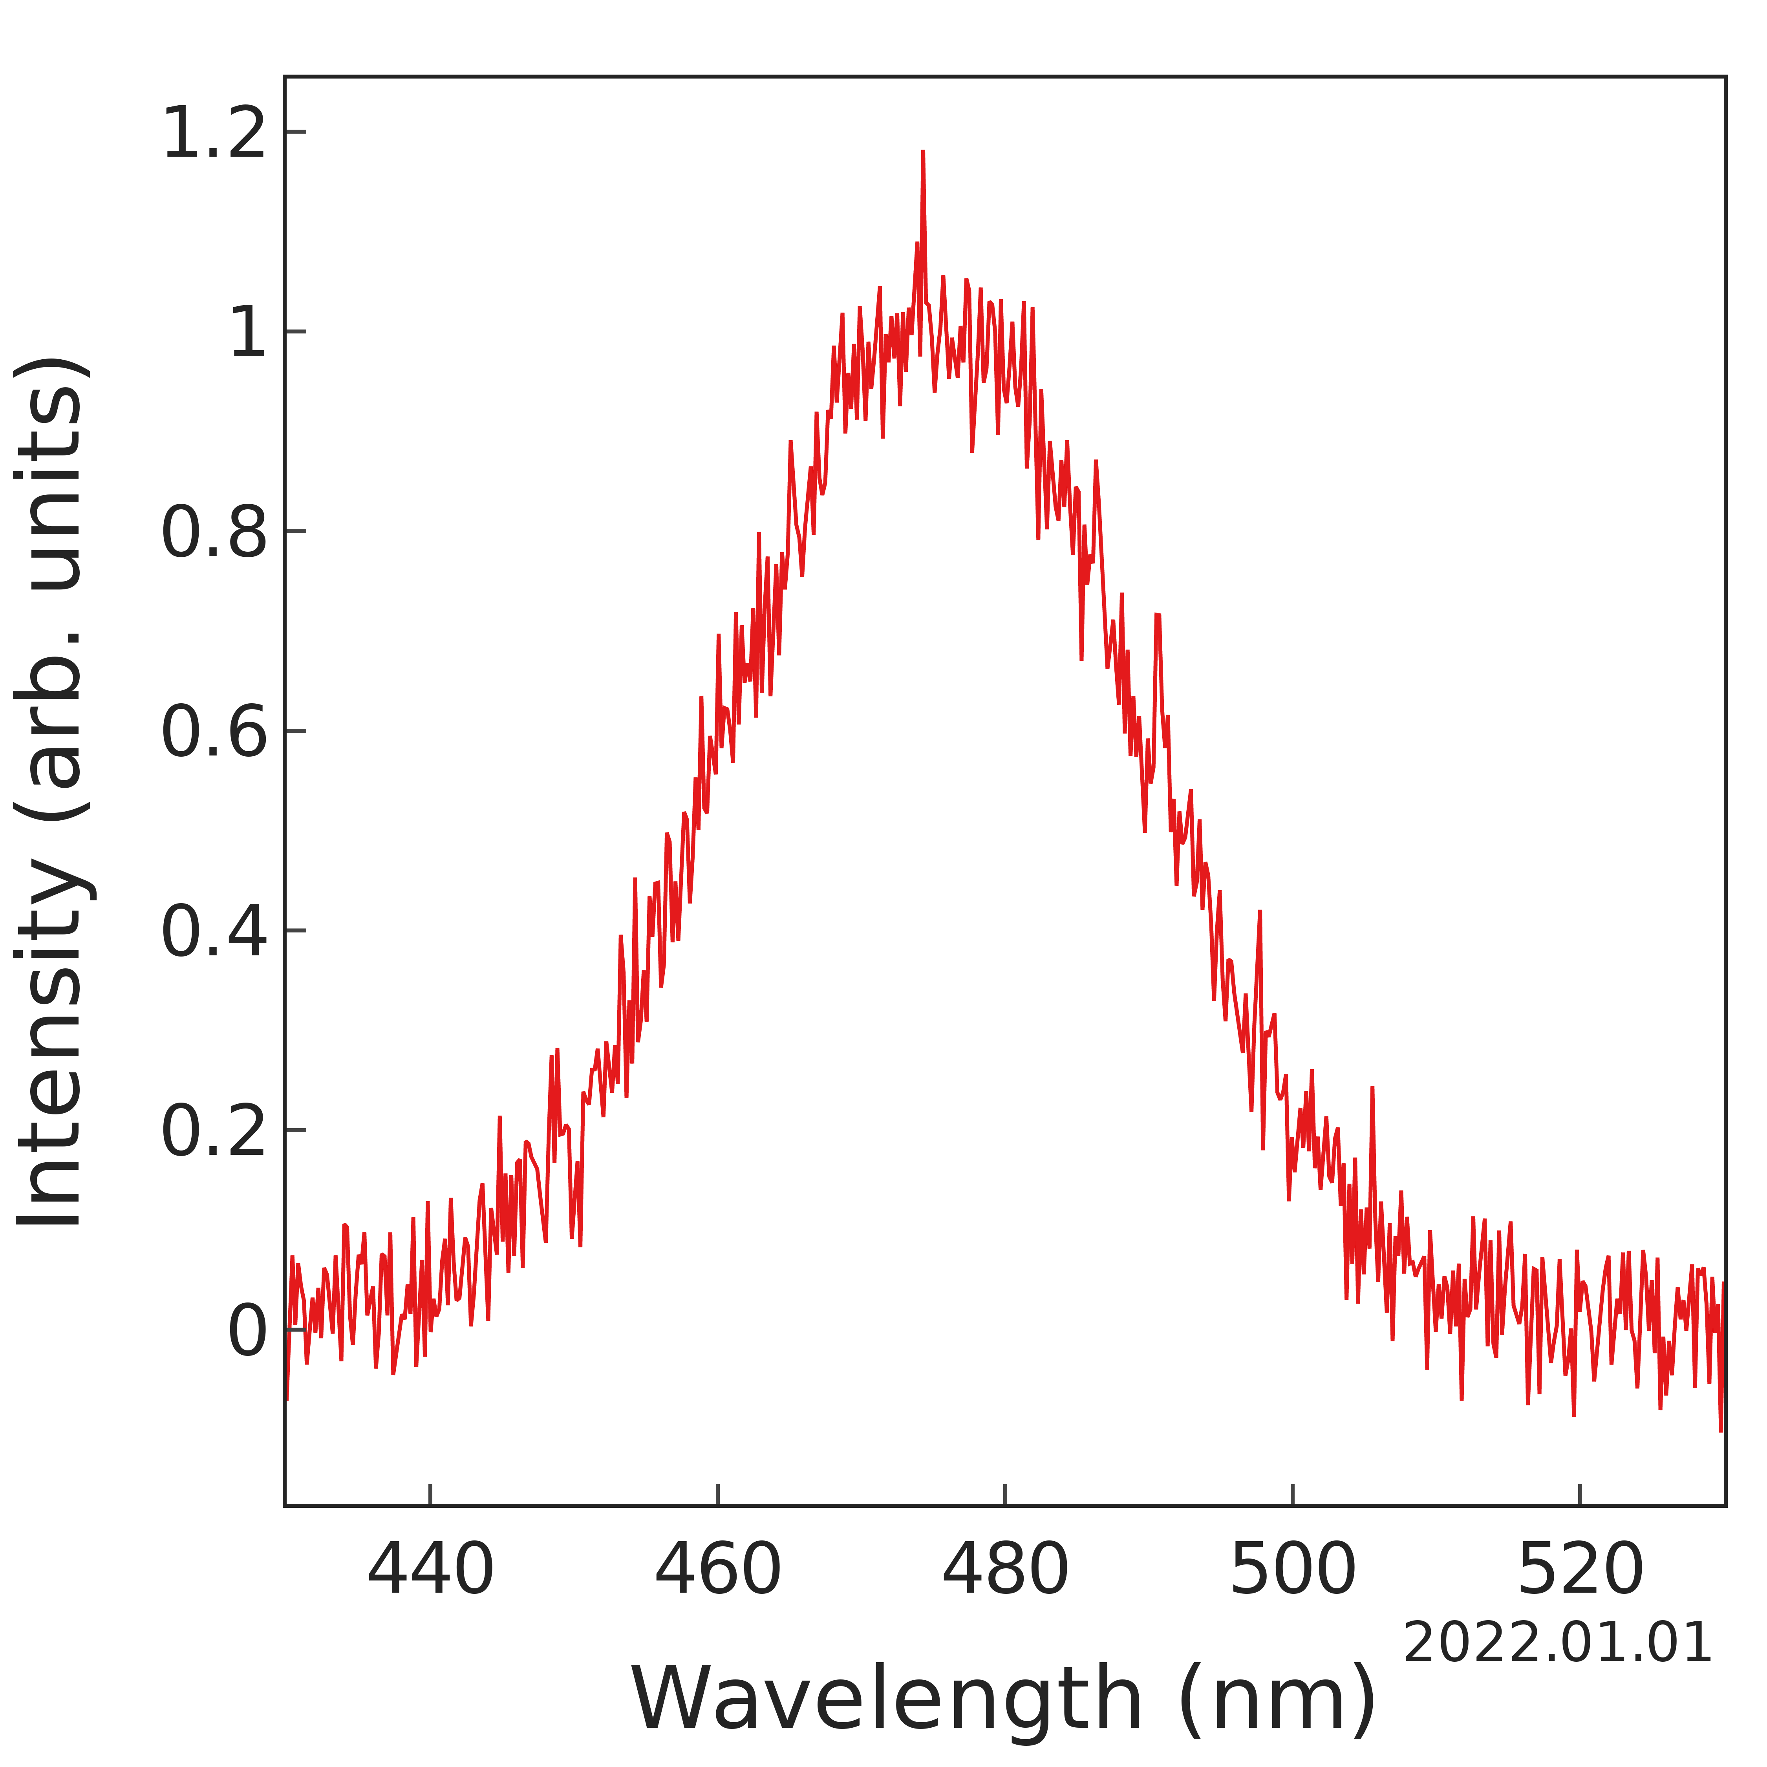
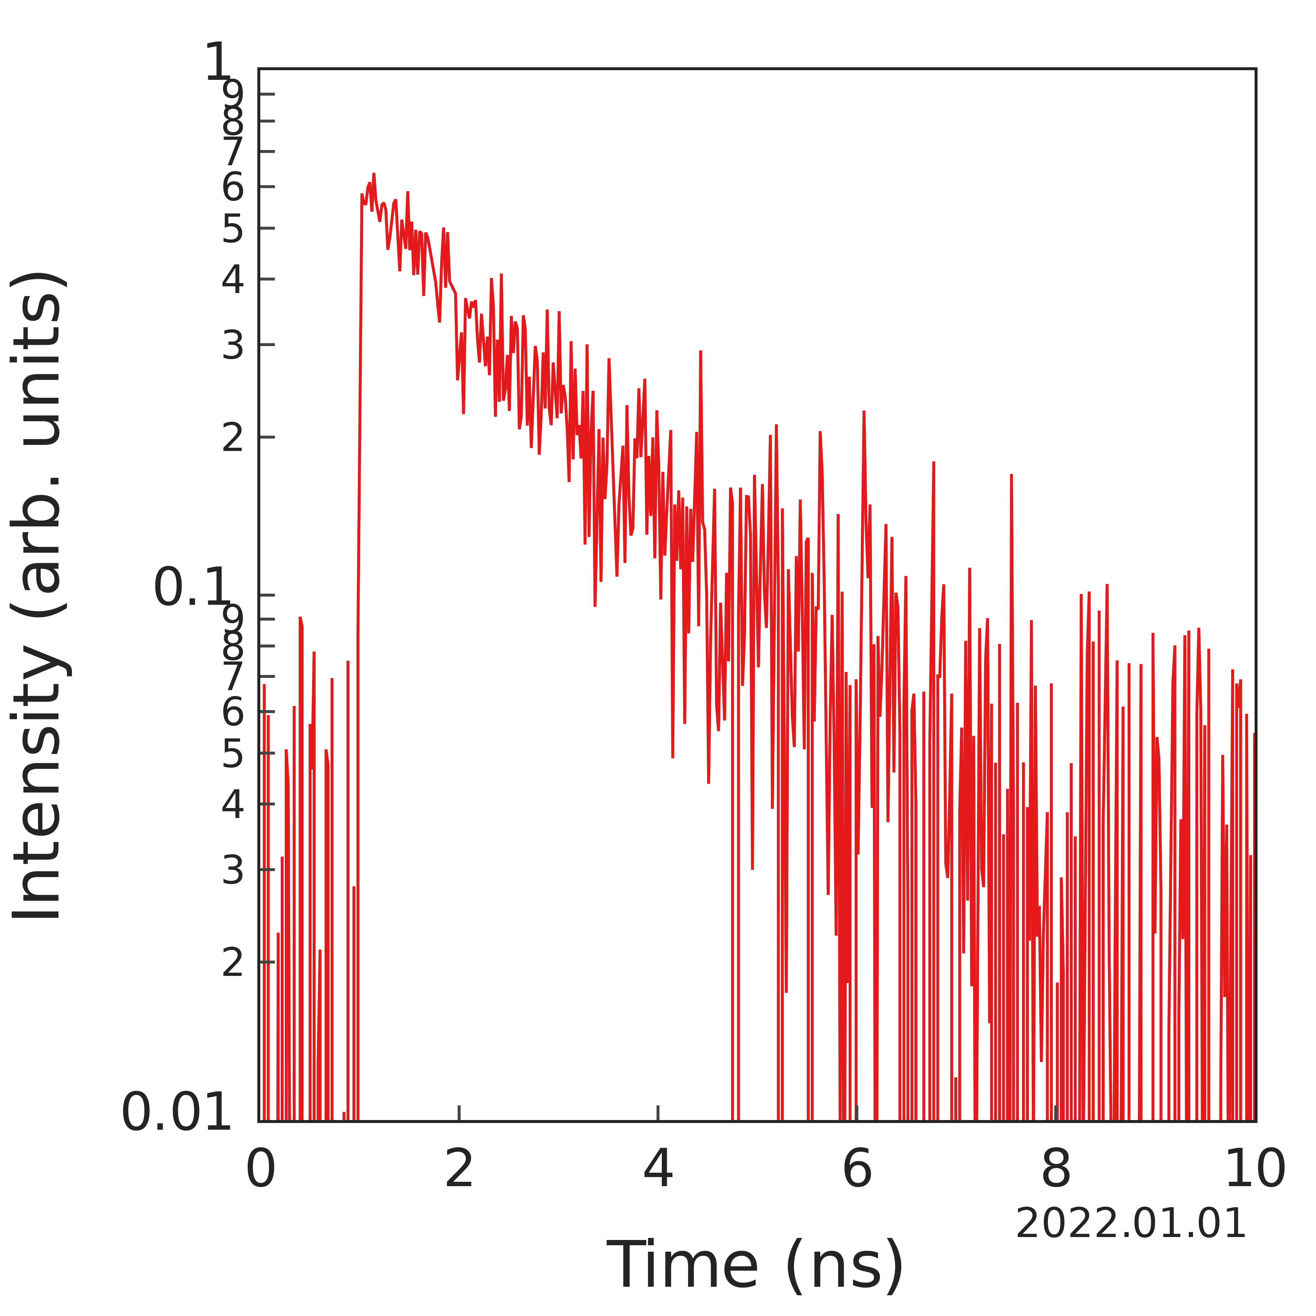
Sample name is here
Excitation wavelength : 470 nm
Excitation power : 1 mW
Time range : 10 ns
Center wavelength : 475 nm
FWHM : 40 nm
Frame : 10000
a : b = 58 : 42
τ₁ = 1.2 ns
τ₂ = 3.6 ns

