Slide 1

Linear Regression
Predicting Continuous Values — The Math Behind the Best-Fit Line
AI & ML FOUNDATIONS
1

Slide 2









What We're Covering Today
What is Regression, and how it differs from classification
Linear Regression — the problem statement & best-fit line
The Cost Function — measuring how wrong the line is
Gradient Descent — finding the minimum error
Repeat & Convergence Theorem, and the Learning Rate
Multiple Linear Regression & the Hyperplane
Model Evaluation — R² and Adjusted R²
Overfitting vs. Underfitting — bias & variance
Ridge & Lasso Regression — regularization
Building it for real with scikit-learn
Introduction to Machine Learning · 2
2

Slide 3
PART 1
What Is Regression?
Predicting a number, not a category
3

Slide 4
What Is Regression?
Regression is a supervised learning task where the model predicts a continuous numeric value, instead of a category.
Ask 'how much?' or 'how many?' and it's usually regression — price, temperature, salary, distance.
This is the key difference from classification, which predicts a label (Yes/No, Spam/Not Spam) instead of a number.
Linear Regression is the simplest and most fundamental regression algorithm — the natural starting point for ML.
Regression →
numbers
Classification →
categories
Introduction to Machine Learning · 4
4

Slide 5
PART 2
Linear Regression
Fitting the best straight line through your data
5

Slide 6

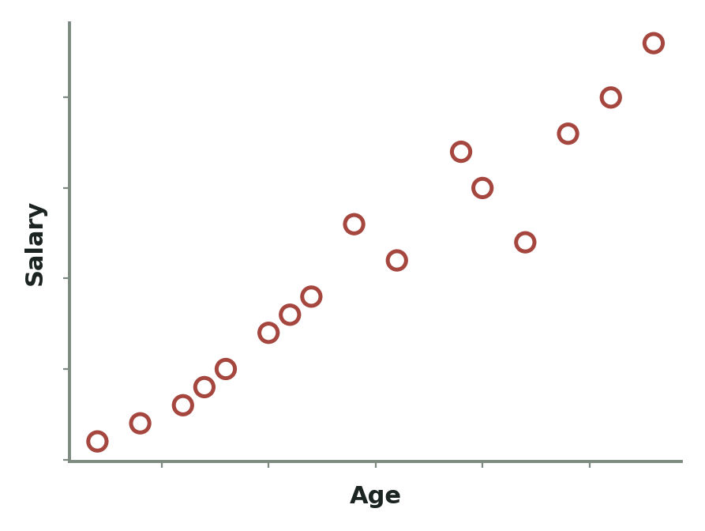
The Problem Statement
Say we have a dataset of Age and Salary for a group of employees.
Age is the input (feature) — what we already know about a person.
Salary is the output (target) — what we want to predict for someone new.
Plotting Age (x-axis) against Salary (y-axis) gives a scatter of points that roughly trends upward.
The goal: find a line that best represents that trend, so we can predict Salary for any Age.
Raw data: each point is one employee's Age and Salary
Introduction to Machine Learning · 6
6

Slide 7

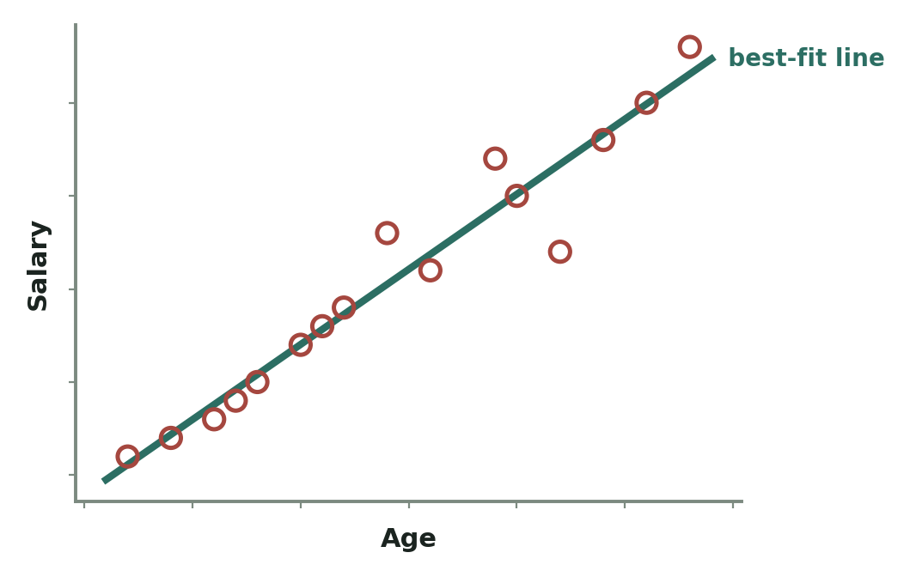
The Best-Fit Line
Among every possible line we could draw through the scatter plot, we want the one that lies closest to all the points overall.
This is called the best-fit line (or regression line).
It won't pass through every point exactly — real data is noisy — but it captures the overall trend.
Once we have this line, we can plug in any new Age and read off a predicted Salary.
The line that sits closest to every point overall
Introduction to Machine Learning · 7
7

Slide 8
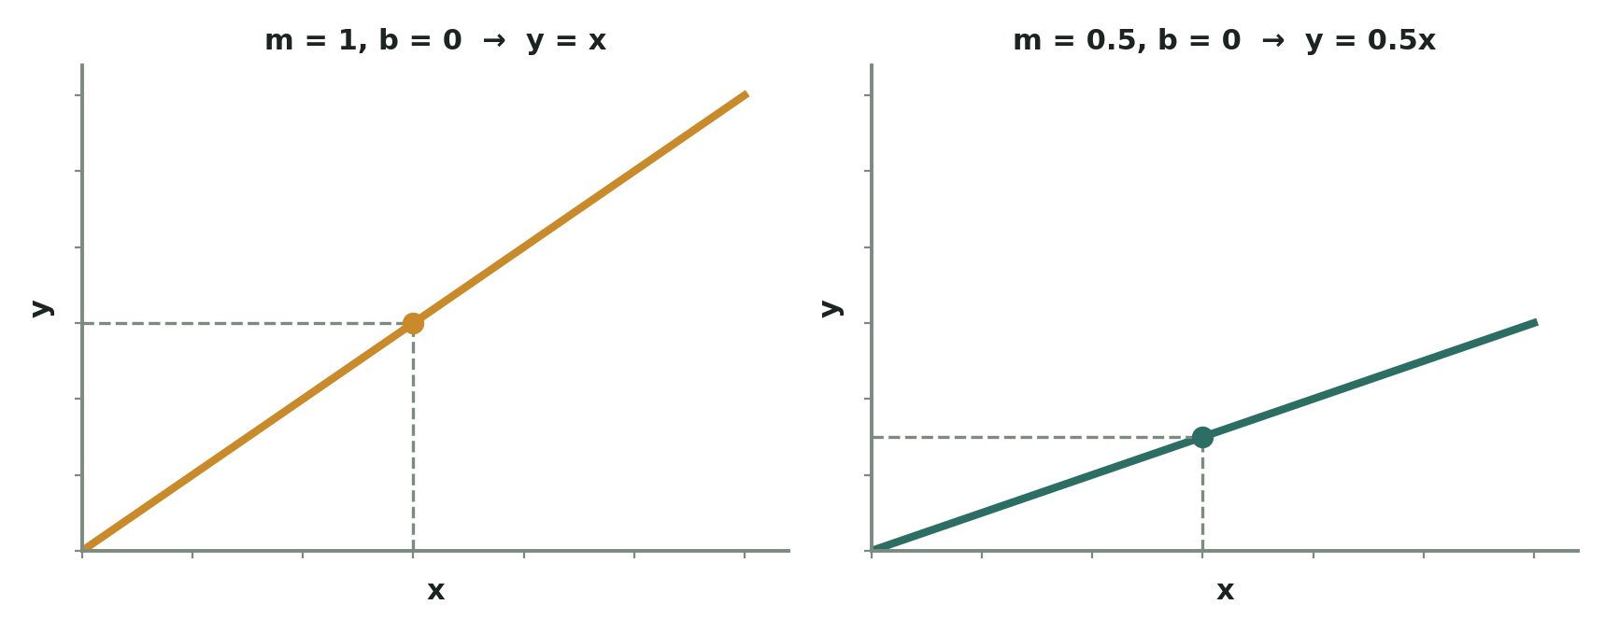
The Equation of a Line: y = mx + b
Every straight line can be written as y = mx + b — the same equation from school algebra. m is the slope — how steeply the line rises for each step along x. b is the intercept — the value of y when x = 0, where the line crosses the y-axis. x is the data point you plug in, and y is the resulting prediction.
Same line, two different slopes — m controls the steepness, b shifts it up or down
8
Introduction to Machine Learning · 8

Slide 9

Worked Example: Reading the Line
With slope m = 1 and intercept b = 0, the line is simply y = x.
With slope m = 0.5 and intercept b = 0, every prediction is scaled down by half.
# y = mx + b
# Case 1: m = 1, b = 0
x = 1.5
y = 1 * x + 0 # y = 1.5
# Case 2: m = 0.5, b = 0
x = 1.5
y = 0.5 * x + 0 # y = 0.75
# Changing m and b reshapes the line —
# this is exactly what "training" tunes
Introduction to Machine Learning · 9
9

Slide 10
The ML Notation: hθ(x)
In ML, we usually write the line as hθ(x) = θ0 + θ1·x instead of y = mx + b — same idea, different symbols.
θ0 (theta-zero) is the intercept — same role as b.
θ1 (theta-one) is the slope — same role as m.
h stands for hypothesis — the model's current best guess function.
Training a Linear Regression model literally means finding the perfect values of θ0 and θ1.
Goal: find the
best θ0 and θ1
Introduction to Machine Learning · 10
10

Slide 11
PART 3
The Cost Function
How do we know if a line is good or bad?
11

Slide 12

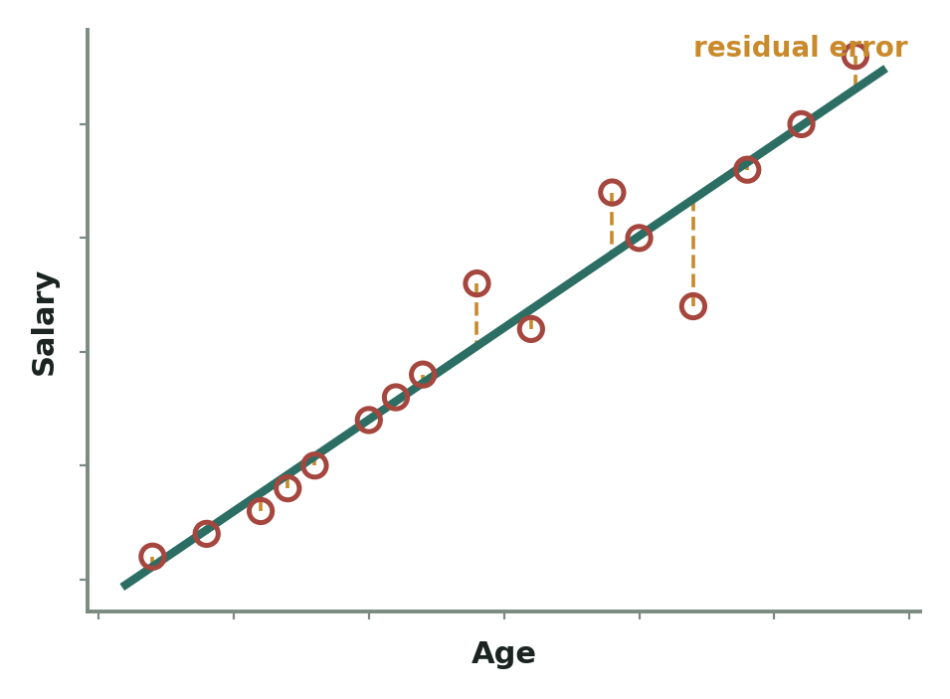
Residual Error
For every data point, the residual error is the gap between the actual value and what the line predicted.
Some points sit above the line, some below — the residual can be positive or negative.
A good line keeps these gaps small overall, across every point in the dataset.
A bad line has large residuals — its predictions are consistently far from reality.
The dashed segments are residuals — the vertical gap at each point
Introduction to Machine Learning · 12
12

Slide 13
The Cost Function J(θ0, θ1) — In Depth
IN PLAIN WORDS: For every point, check how far off the line's guess was, square that miss (so it's always positive and big misses hurt more), add up all those squared misses, then divide by the count so it's a fair average error.
m
J(θ0,θ1) = Σ 1/(2m) · (h(x_i) − y_i)²
i=1
h(x_i) = θ0 + θ1·x_i (the line's guess)
WHAT EACH SYMBOL MEANS
m
Total number of training examples (rows) you have.
Σ
"Sum this up" — repeat for every single point, then add the results together.
h(x_i)
The line's predicted value for point i — plug x_i into y = mx + b.
y_i
The actual, real value for point i from your dataset.
( )²
Squaring: makes misses positive, and punishes big misses much harder than small ones.
1/(2m)
Averages the total error — the '2' just cancels out neatly later in the calculus.
Smaller J = a better-fitting line. Training the model is just repeatedly adjusting θ0 and θ1 to make J as small as possible.
Introduction to Machine Learning · 13
13

Slide 14
PART 4
Gradient Descent
The algorithm that finds the minimum-error line
14

Slide 15
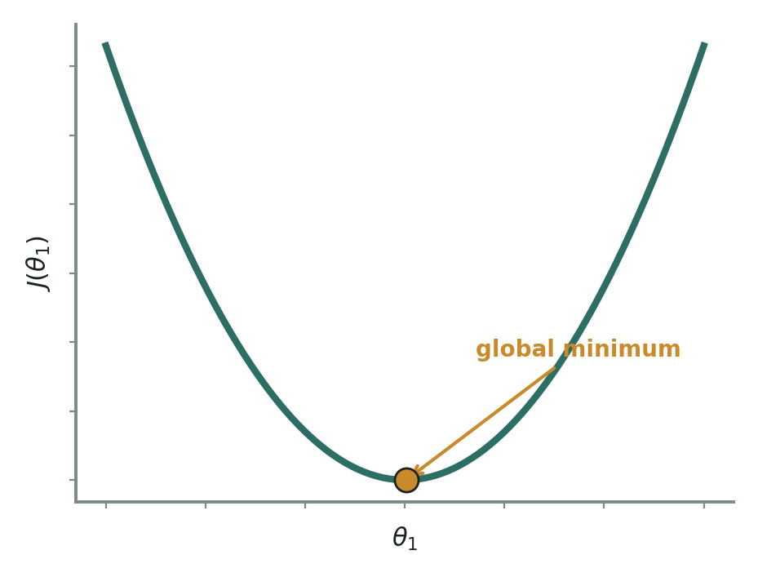
What Is Gradient Descent?
Gradient Descent is the optimization algorithm that searches for the θ0 and θ1 that minimize the cost function J.
Picture plotting J against θ1 — it forms a bowl-shaped (convex) curve.
The lowest point of that bowl is the global minimum — the setting of θ1 with the smallest possible error.
Gradient descent starts at some random point on the curve and takes repeated small steps downhill toward that minimum.
J(θ1) forms a convex bowl — the bottom is the global minimum
Introduction to Machine Learning · 15
15

Slide 16
Worked Example: Evaluating a Few θ Values
Take a tiny dataset: (1,1), (2,2), (3,3) — a perfect line y = x.
Try a few candidate slopes and see how the cost function J reacts.
# Data: {(1,1), (2,2), (3,3)}, θ0 = 0
# θ1 = 1 -> predictions: 1, 2, 3 (perfect match)
# J(θ1=1) = 0 <- global minimum
# θ1 = 0.5 -> predictions: 0.5, 1, 1.5
# J(θ1=0.5) ≈ 0.58
# θ1 = 0 -> predictions: 0, 0, 0
# J(θ1=0) ≈ 2.33
# Plotting J against θ1 traces a bowl —
# and θ1 = 1 sits right at the bottom
Introduction to Machine Learning · 16
16

Slide 17
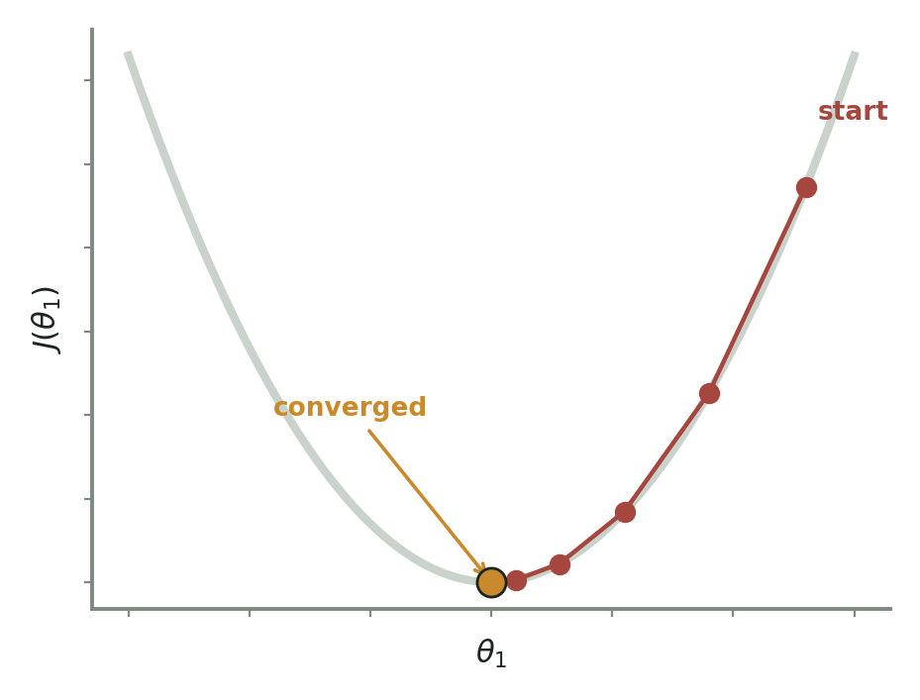
Watching Gradient Descent Converge
Starting from a random θ1 far from the answer, each step moves closer to the bottom of the bowl.
Steps are naturally larger when far from the minimum, and shrink automatically as it gets close.
Once the steps stop making meaningful progress, the algorithm has converged on θ1 = 1 — the global minimum for this dataset.
Each red dot is one gradient descent iteration, walking downhill
Introduction to Machine Learning · 17
17

Slide 18
The Gradient Descent Update Rule — In Depth
IN PLAIN WORDS: To take one step downhill, nudge each θ a little in whichever direction makes J smaller — the learning rate α controls how big that nudge is, and the slope (derivative) tells you which direction is 'downhill' from where you're standing.
repeat until convergence {
θj := θj − α · ∂/∂θj J(θ0, θ1)
} (update θ0 and θ1 simultaneously)
WHAT EACH SYMBOL MEANS
:=
"Gets updated to" — replace the old θj with this new value.
θj
Whichever parameter you're updating — θ0 or θ1.
α
Learning rate — how big a step to take. Small = slow but safe; too big = overshoots.
∂/∂θj J
The slope of the cost curve at your current θj — which way is downhill, and how steep.
Why subtract? If the slope is positive (curve rising to the right), subtracting moves θj left — downhill. If the slope is negative, subtracting a negative moves θj right — still downhill either way.
Introduction to Machine Learning · 18
18

Slide 19
Repeat & Convergence Theorem
At each step, gradient descent nudges θ0 and θ1 slightly in the direction that reduces J the fastest.
It repeats this update over and over — that's the 'Repeat' part of the convergence theorem.
Convergence means the steps get smaller and smaller as you approach the minimum, until J stops meaningfully decreasing.
At that point, the algorithm has found (or nearly found) the optimal θ0 and θ1.
Repeat until
J stops
decreasing
Introduction to Machine Learning · 19
19

Slide 20
The Learning Rate (α)
The learning rate α controls how big each step downhill is.
Too small an α — the model learns correctly but painfully slowly, taking many iterations.
Too large an α — the steps overshoot the minimum and the algorithm can bounce around or even diverge.
Picking a good α is one of the first 'tuning knobs' you learn to adjust in any ML model.
α too big →
overshoots
α too small →
too slow
Introduction to Machine Learning · 20
20

Slide 21
PART 5
Multiple Linear Regression
When more than one feature drives the prediction
21

Slide 22

Multiple Linear Regression — In Depth
IN PLAIN WORDS: Instead of one input driving the prediction, now every feature gets its own weight (θ). The prediction is just the intercept plus each feature multiplied by how much it matters — all added together.
Simple: h(θ) = θ0 + θ1·x1
Multiple: h(θ) = θ0 + θ1·x1 + θ2·x2 + θ3·x3
+ ... + θn·xn
WHAT EACH SYMBOL MEANS
θ0
The intercept — the baseline prediction when every feature is 0.
x1, x2…xn
Each individual feature — e.g. Age, Location, Years of Experience.
θ1, θ2…θn
Each feature's own weight — how much that feature pushes the prediction up or down.
n
The total number of features being used.
Example: predicting Salary from Age, Location, and Experience — each feature gets multiplied by its own θ, then everything is summed into one prediction.
Introduction to Machine Learning · 22
22

Slide 23
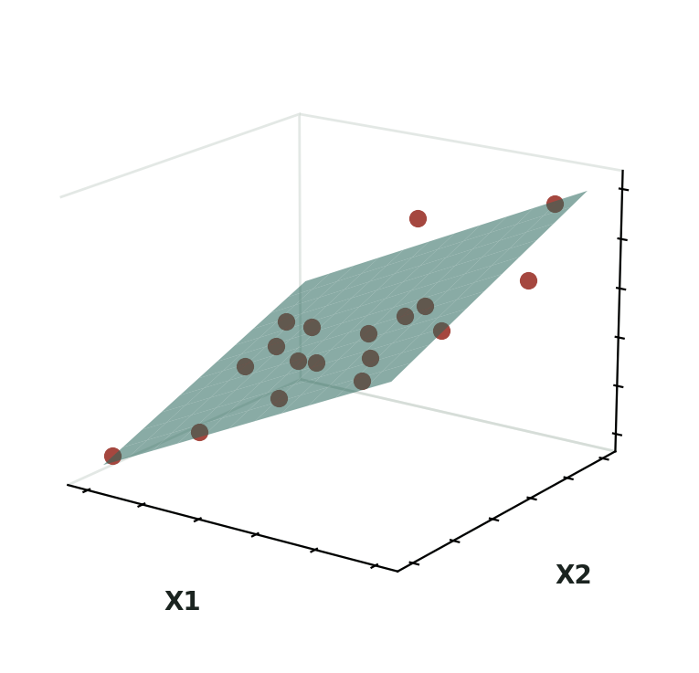
The Hyperplane
With one feature, the best fit is a line. With two features, it becomes a flat plane cutting through 3D space.
With three or more features, it's called a hyperplane — the same idea generalized to higher dimensions we can't directly visualize.
Each axis (x1, x2, x3…) represents one feature, and the hyperplane still tries to sit as close as possible to every data point.
The math scales up cleanly — same cost function, same gradient descent, just more θ parameters to solve for.
Two features (X1, X2) predicting Y — a flat plane instead of a line
Introduction to Machine Learning · 23
23

Slide 24
PART 6
Evaluating the Model
Is this line actually any good?
24

Slide 25
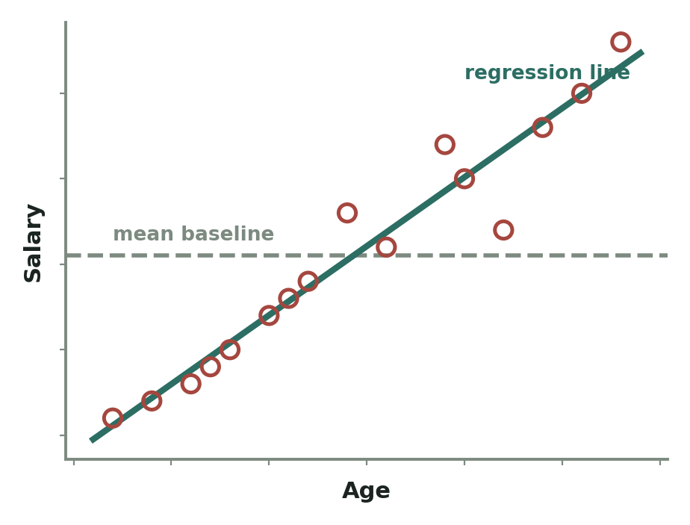
R² — The Coefficient of Determination
R² measures how much of the variation in the output is explained by the model, compared to just guessing the average every time.
The result is always a decimal, usually shown as a percentage — e.g. 0.86 means 86%.
Higher R² generally means a better fit, but it isn't the whole story — see the next slide.
R² compares the model's line against just predicting the mean every time
Introduction to Machine Learning · 25
25

Slide 26
The R² Formula — In Depth
IN PLAIN WORDS: Compare how wrong your model's line is (the residuals) against how wrong you'd be if you just guessed the average every single time. If your model barely beats the average, R² is near 0. If it nails every point, R² is near 1.
Sum of Squared Residuals
R² = 1 − ─────────────────────────
Sum of Squared Total
Σ (y_i − ŷ_i)²
= 1 − ───────────────
Σ (y_i − ȳ)²
WHAT EACH SYMBOL MEANS
y_i
The actual, real value for point i.
ŷ_i
("y-hat") — your model's predicted value for point i.
ȳ
("y-bar") — the plain average of all actual y values, ignoring the model entirely.
Numerator
How wrong your model's predictions are, squared and summed.
Denominator
How wrong just guessing the average would be — the baseline to beat.
R² = 89% means your model explains 89% of the ups and downs in the data — only 11% is left as unexplained error.
Introduction to Machine Learning · 26
26

Slide 27
The Adjusted R² Formula — In Depth
IN PLAIN WORDS: Plain R² can be tricked — it goes up (or stays flat) every time you add ANY feature, even a useless one. Adjusted R² fixes this by charging a small 'entry fee' per feature, so it only rises if that feature genuinely earns its keep.
(1 − R²)(n − 1)
Adj R² = 1 − ──────────────────
n − p − 1
WHAT EACH SYMBOL MEANS
R²
The plain R² score you already calculated for this model.
n
Number of rows (samples/observations) in your dataset.
p
Number of features (predictor columns) the model is using.
n − p − 1
Shrinks as you add features — this is literally the 'fee' for each new column.
Example: adding a weak 'sleep hours' feature — R² rises 81%→88%→89%, but Adjusted R² goes 79%→89%→86%. That drop is the tell that the last feature wasn't worth adding.
Introduction to Machine Learning · 27
27

Slide 28
PART 7
Overfitting vs. Underfitting
The two ways a model can go wrong
28

Slide 29
Overfitting vs. Underfitting
Overfitting
Underfitting
Model memorizes training data too closely
Training performance: excellent
Testing performance: poor
Low bias, high variance
Fix: simplify the model, get more data, regularize
Model is too simple to capture the pattern
Training performance: poor
Testing performance: also poor
High bias, high variance
Fix: add features, use a more complex model
Introduction to Machine Learning · 29
29

Slide 30
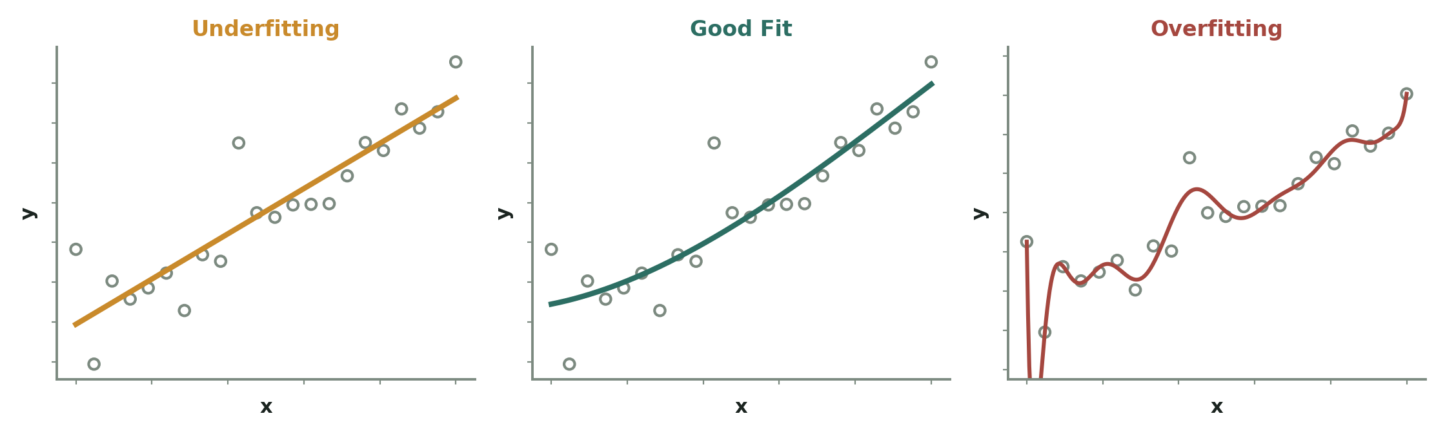
What Overfitting & Underfitting Actually Look Like
Underfitting — a straight line forced onto curved data; it misses the pattern in both training and test data alike.
Good Fit — a smooth curve that follows the true trend without chasing every bit of noise.
Overfitting — a wiggly curve that hits nearly every training point exactly, but that wiggle won't generalize to new data.
Same data, three different model complexities
Introduction to Machine Learning · 30
30

Slide 31



Reading Train vs. Test Accuracy
Model M1
Model M2
Model M3
Train: 92%
Test: 64%
→ Overfitting
Train: 92%
Test: 90%
→ Perfect fit
(low bias, low variance)
Train: 68%
Test: 64%
→ Underfitting
Introduction to Machine Learning · 31
31

Slide 32
PART 8
Ridge & Lasso Regression
Taming overfitting by penalizing complexity
32

Slide 33
The Ridge Regression Formula — In Depth
IN PLAIN WORDS: Take the normal cost function (average squared error) and tack on an extra penalty that grows if any slope (θ) gets too large. To keep the total cost low, the model is forced to keep its θ values small and reasonable — instead of stretching to fit every last wiggle in the training data.
m
J(θ) = Σ 1/(2m) · (h(x_i) − y_i)² + λ · (θ1)²
i=1
\_______________________________/ \__________/
usual prediction error the new penalty
WHAT EACH SYMBOL MEANS
λ
("lambda") — how strong the penalty is. λ = 0 → plain Linear Regression. Bigger λ → smaller, more conservative θ.
(θ1)²
Squaring the slope — same trick as before, always positive, and big slopes get punished hard.
Left term
The same MSE cost function you already know — how wrong the predictions are.
Right term
The 'complexity tax' — added purely to discourage relying too heavily on any one feature.
Lasso uses the exact same idea, but penalizes |θ1| (absolute value) instead of (θ1)² — that small change is what lets Lasso shrink some coefficients all the way to zero.
Introduction to Machine Learning · 33
33

Slide 34
Ridge vs. Lasso — What's the Difference?
Ridge (L2)
Lasso (L1)
Cost = MSE + λ · (slope)²
Shrinks all coefficients toward zero
Rarely sets any coefficient to exactly zero
Good when most features matter a little
Cost = MSE + λ · |slope|
Can shrink weak coefficients to exactly zero
Effectively performs feature selection
Good when only a few features truly matter
Introduction to Machine Learning · 34
34

Slide 35
Try It Yourself — Practice Tasks
Use any small numeric dataset (e.g. house prices, salary data) and work through these with scikit-learn
1
Load the dataset and split it: X_train, X_test, y_train, y_test
5
Calculate R² using model.score() or r2_score()
2
Fit a LinearRegression() model on the training data
6
Add a second feature and watch R² vs Adjusted R² diverge
3
Print the learned coefficients (θ) and intercept
7
Compare train vs test accuracy to check for over/underfitting
4
Predict on X_test and compare against y_test
8
Try Ridge() and Lasso() and compare their coefficients
Introduction to Machine Learning · 35
35

Slide 36
RECAP
Linear Regression is a straight line, fit by shrinking a cost
function with gradient descent — everything else refines that idea.
Next session: Logistic Regression — predicting categories instead of numbers
36

