Slide 1
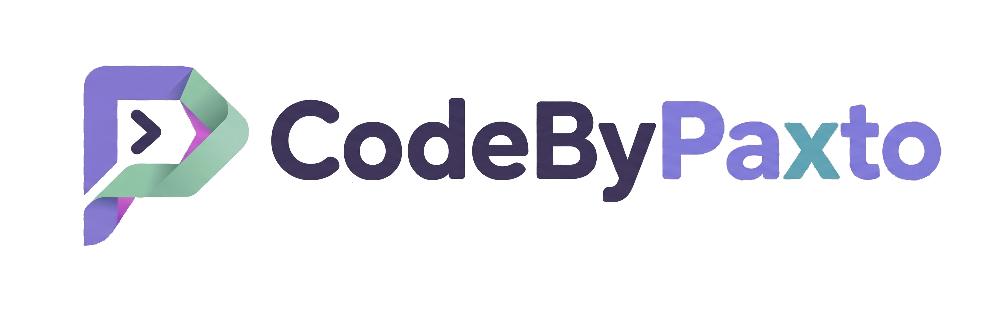
SESSION 16 · AI & ML PLAYGROUND
Why Mathematics?
The Language Behind Every Model, Every Dataset, Every Decision
CodeByPaxto: The AI & ML Playground
Hafiz Waseem Ahmed (Paxto)
01

Slide 2
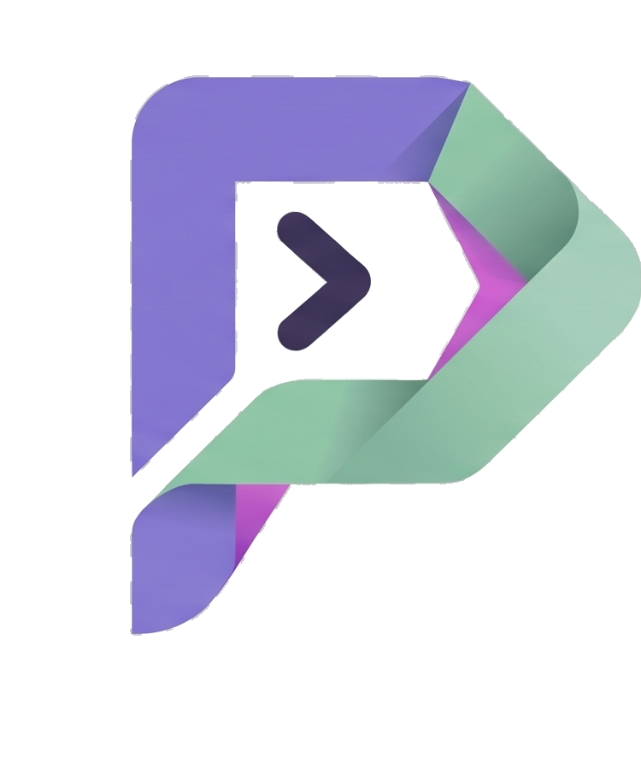
What We're Covering Today
What mathematics actually is — and why it isn't what you think
1
Why Gauss called mathematics "the Queen of all Sciences"
2
Math you already use, without ever calling it "math"
3
Where statistics, probability, linear algebra, and calculus each fit in AI & data science
4
Real systems you use daily, and the math quietly running underneath them
5
What this course will — and deliberately won't — ask of you
6
The road ahead — a preview of every math session still to come
7
CodeByPaxto · AI & ML Playground · Hafiz Waseem Ahmed (Paxto)
02

Slide 3
What Is Mathematics, Really?
Mathematics is not fundamentally about numbers — it's a language for describing patterns, relationships, and change, precisely enough that a computer can act on them.
"The average customer spends more on weekends" is a pattern. Math is simply how you state that precisely enough to test it, measure it, and build something on top of it.
Every field that deals with patterns eventually needs this language — physics, economics, biology, and yes, artificial intelligence and data science.
You've been doing informal versions of this your entire life — this phase of the course is about formalizing instincts you already have.
💬
A language,
not a
subject
CodeByPaxto · AI & ML Playground · Hafiz Waseem Ahmed (Paxto)
03

Slide 4
A FAMOUS LINE
“Mathematics is the Queen of all Sciences.”
— Carl Friedrich Gauss, one of history's greatest mathematicians, 1856
04

Slide 5
Why “Queen,” Not “King”?
On a chessboard, the king can only ever move one square at a time — technically the most important piece, but genuinely limited in reach.
The queen moves any number of squares, in every direction — rows, columns, and diagonals alike. She isn't just important; she's the single most powerful, most versatile piece on the board.
Gauss's choice of "queen" over "king" was deliberate — mathematics doesn't just sit at the top of one field. It reaches into every field, in every direction, with no limit on distance.
Physics, biology, economics, art, medicine, music, computer science — mathematics moves into all of them, often quietly, whether the people working in those fields notice it or not.
♛
The most
powerful piece
on the board
CodeByPaxto · AI & ML Playground · Hafiz Waseem Ahmed (Paxto)
05

Slide 6
Why the Queen — Not the King
The King
The Queen
♚
♛
Moves one square — its reach barely extends past itself.
Moves any distance, in every direction — rows, columns, AND diagonals.
Mathematics moves like the queen, not the king: it doesn't stay confined to one small corner of knowledge. It reaches into biology, art, medicine, economics, and computer science alike — in every direction, as far as it needs to.
CodeByPaxto · AI & ML Playground · Hafiz Waseem Ahmed (Paxto)
06

Slide 7
Math Hiding in Plain Sight, Across Every Field
Biology
Art
Music
Economics
Population growth models, genetics ratios, and the statistics behind every clinical trial.
The golden ratio and symmetry have quietly guided composition for thousands of years.
Musical scales and harmony are built on precise mathematical frequency ratios.
Markets, forecasting, and risk are modeled almost entirely through statistics and probability.
CodeByPaxto · AI & ML Playground · Hafiz Waseem Ahmed (Paxto)
07

Slide 8
You Don't Need to Be a “Math Person”
"Math person" is a myth — it usually just means someone who's had more repetition with the notation, not someone with a fundamentally different brain.
This course will never ask you to prove a theorem, derive a formula from scratch, or memorize a page of equations — that's not the goal here.
The goal is intuition: knowing what a concept means, when to reach for it, and what a tool is actually doing when your code calls it.
If you can already read a bar chart and say "that one's bigger," you already have more mathematical instinct than you're giving yourself credit for.
❓
Intuition
over
proofs
CodeByPaxto · AI & ML Playground · Hafiz Waseem Ahmed (Paxto)
08

Slide 9
Math You Already Do, Without Realizing
Budgeting
Judging Risk
Spotting Trends
Comparing prices, calculating a discount, splitting a bill — arithmetic and percentages, already automatic.
“It probably won't rain today” is an informal probability estimate, built from experience.
Noticing your electricity bill “has been going up lately” is you doing statistics, casually.
CodeByPaxto · AI & ML Playground · Hafiz Waseem Ahmed (Paxto)
09

Slide 10
From Raw Data to a Working Model
→
→
→
→
Raw Data
Statistics &
Probability
Linear
Algebra
Calculus
Working
Model
Numbers, text, images — unorganized
Understand it, trust it, handle uncertainty
Represent it, compute with it
Learn from it, improve over time
Predicts, classifies, recommends
Every arrow in this diagram is a phase of this course — you're about to spend the next several sessions building exactly this pipeline, one skill at a time.
CodeByPaxto · AI & ML Playground · Hafiz Waseem Ahmed (Paxto)
10

Slide 11
Statistics & Probability — Making Sense of Data
Statistics describes what your data actually looks like — what's typical, what's unusual, and how spread out things really are.
Probability handles what statistics alone can't — uncertainty. Will this customer churn? How confident are we in this result? Is this difference real, or just noise?
Every model evaluation metric you'll ever compute — accuracy, confidence, error margins — is statistics and probability wearing a machine learning costume.
This is also, on its own, the exact toolkit used in academic and scientific research — hypothesis testing, confidence intervals, and the tests you'll learn later aren't just for AI.
🎲
Understand it,
and trust
it (or not)
import statistics
scores = [72, 85, 90, 61, 78, 95, 88]
average = statistics.mean(scores)
spread = statistics.variance(scores)
print("Average:", average, "| Spread:", spread)
# statistics ships with Python — no install needed
CodeByPaxto · AI & ML Playground · Hafiz Waseem Ahmed (Paxto)
11

Slide 12
Linear Algebra — How Data and Models Are Represented
Every row in a dataset — a customer, an image, a sentence — is, underneath, just a list of numbers. Linear algebra is the study of exactly that: lists and grids of numbers, and what you can do with them.
A NumPy array, a Pandas DataFrame, and every layer of a neural network are all built directly on linear algebra's core objects: vectors and matrices.
This is genuinely the most immediately useful math in this entire phase — you'll be using it within days, the moment NumPy shows up.
Even a single idea — the dot product — quietly powers recommendation systems, similarity search, and the core computation inside every neural network.
▦
The shape
data actually
takes
import numpy as np
user_taste = np.array([5, 1, 3]) # action, romance, comedy
movie_genre = np.array([4, 0, 2])
similarity = np.dot(user_taste, movie_genre)
print("Similarity score:", similarity)
# NumPy gets its own full session soon — this is a preview
CodeByPaxto · AI & ML Playground · Hafiz Waseem Ahmed (Paxto)
12

Slide 13
Calculus — How Models Actually Learn
When you hear a model was "trained," calculus is what that word is actually describing — a process of gradually reducing error, step by step.
Calculus, at its core, is the study of change — and "how do I change my model's settings to make its predictions a little less wrong" is exactly a calculus question.
You won't need this until much later in the course — it only really clicks once there's an actual model to train, so we're deliberately saving it for that exact moment.
For now, just know it exists, and know its job: calculus is the part of math that lets a model improve itself, automatically, without you hand-tuning it.
∑
The engine
behind
“training”
# A sneak peek — plain Python, no libraries needed
def error(x): return (x - 4) ** 2 # how "wrong" a guess is
x = 0.0
for _ in range(5):
slope = (error(x + 0.001) - error(x)) / 0.001
x -= 0.1 * slope # nudge x to reduce the error
print("x is creeping toward 4:", round(x, 2))
CodeByPaxto · AI & ML Playground · Hafiz Waseem Ahmed (Paxto)
13

Slide 14
Real Systems, and the Math Quietly Running Underneath
Recommendations
Spam Filters
Medical Diagnosis
Self-Driving Cars
Netflix and Spotify suggestions run on similarity math — linear algebra's dot product, at massive scale.
Deciding “spam or not” from the words in an email is a probability calculation — Bayes' Theorem, specifically.
AI-assisted diagnosis tools report a confidence level — a direct, practical use of statistics and probability.
Reading the road and updating driving decisions in real time leans on calculus — constant, rapid adjustment.
CodeByPaxto · AI & ML Playground · Hafiz Waseem Ahmed (Paxto)
14

Slide 15
Intuition First — What This Course Will (and Won't) Do
✓ What We WILL Do
✕ What We WON'T Do
Build real intuition for what each concept means and why it matters
Show you exactly when to reach for which tool, in real, practical situations
Cover the handful of formulas that are genuinely worth knowing by heart
Connect every concept directly to code, data, and models you'll actually build
Derive formulas from first principles, or prove theorems
Drill long hand-calculations that a library computes instantly
Cover every edge case or every advanced variant of a technique
Expect any prior math background beyond what next session will cover
CodeByPaxto · AI & ML Playground · Hafiz Waseem Ahmed (Paxto)
15

Slide 16
The Road Ahead — Every Math Session Still to Come
Session 17 — Math Prerequisites: percentages, ratios, roots, powers, logs, and reading notation
Session 18 — Descriptive Statistics: describing what your data actually looks like
Session 19 — Probability: reasoning about uncertainty, and Bayes' Theorem
Session 20 — Inferential Statistics I: confidence, hypothesis testing, and p-values
Session 21 — Inferential Statistics II: t-tests, ANOVA, chi-square, and which test to use when
Session 22 — Linear Algebra: vectors, matrices, and the dot product
Calculus arrives later — saved for the exact moment we introduce training a model.
CodeByPaxto · AI & ML Playground · Hafiz Waseem Ahmed (Paxto)
16

Slide 17
Quick Reflection — Before We Move On
Take a few minutes with these — there's no right answer, just your own thinking.
Think of one decision you made this week using an informal average, percentage, or probability — write it down.
1
Which of the four pillars — statistics, probability, linear algebra, calculus — sounds most useful for something YOU want to build one day?
2
Name one AI-powered product you use regularly, and guess which pillar is doing the most work behind it.
3
What's one math topic that's intimidated you in the past? Keep it in mind — we'll very likely de-mystify it directly in this phase.
4
CodeByPaxto · AI & ML Playground · Hafiz Waseem Ahmed (Paxto)
17

Slide 18
RECAP
Math isn't a wall standing between you and AI — it's the vocabulary AI is written in. Like the queen, it reaches everywhere. You already speak more of it than you think.
Next session: Math Prerequisites — percentages, ratios, roots, powers, logarithms, and reading notation
18

