Slide 1
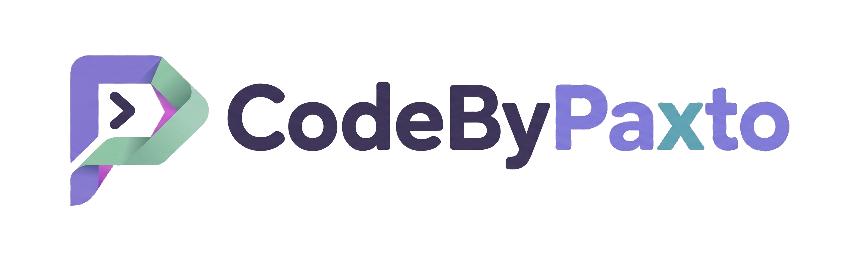
AI & ML PLAYGROUND · MODULE 04
NumPy
Numerical computing in Python — the array engine every Data Science and ML tool is built on.
by CodeByPaxto
01

Slide 2

WHERE THIS FITS
The AI & ML Playground Roadmap
Python
→
Math for DS
→
Git & GitHub
→
NumPy
→
Pandas
→
Matplotlib
→
Seaborn
→
Data Analytics
→
Supervised ML
You are here — right after Git & GitHub. NumPy is the foundation Pandas, Matplotlib, and Seaborn are all built on top of; almost every array operation you'll do for the rest of this course traces back to what you learn here.
02

Slide 3
BEFORE WE START
If Python Has Lists, Why NumPy?
PYTHON LIST
NUMPY ARRAY
Flexible — can hold mixed types in one list.
Looping over a list to do math is slow — Python re-checks each element's type, one at a time.
No built-in idea of "shape" — no easy way to treat data as a matrix or grid.
Stores one fixed data type — this lets NumPy use fast, low-level compiled code underneath.
Vectorized — apply an operation to an entire array at once, no explicit loop needed.
Built-in shape, dimensions, and broadcasting — the natural way to represent vectors, matrices, and tensors.
The honest framing: NumPy doesn't replace Python lists everywhere — but for any numerical work, it's dramatically faster and is the shared language every Data Science and ML library speaks.
CodeByPaxto · AI & ML Playground · NumPy
03

Slide 4
WHAT WE'RE COVERING
Today's Roadmap
01
02
03
04
Introduction to NumPy
Foundations & Terminology
Creating Arrays
Array Properties
05
06
07
08
Indexing & Slicing
Reshaping & Manipulation
Array Modification
Operations, Broadcasting & Vectorisation
09
10
11
12
Handling Missing Values
NumPy with Real-World Data
Bonus: Images as Arrays
Mini Projects
CodeByPaxto · AI & ML Playground · NumPy
04

Slide 5
PART 1 · INTRODUCTION
Introduction to NumPy
What it is, why it exists, and where it shows up across Data Science, AI, and ML.
05

Slide 6
PART 1 · INTRODUCTION
What Is NumPy?
NumPy (Numerical Python) is Python's core library for working with arrays — grids of numbers of any dimension.
Its central object is the ndarray — an n-dimensional array that stores numbers far more efficiently than a Python list.
Where you'll actually use it: cleaning and transforming data in Pandas, plotting in Matplotlib/Seaborn, and running the actual math behind every ML model — weights, gradients, and predictions are all NumPy arrays underneath.
If Python is the language of this course, NumPy is the language every other library in it is written in.
CodeByPaxto · AI & ML Playground · NumPy
06

Slide 7
PART 1 · INTRODUCTION
Installing & Importing
np is the near-universal alias for NumPy — you'll see it in almost every Data Science codebase, so use it too.
NumPy is a dependency of Pandas, Matplotlib, and most ML libraries — if you've installed those, NumPy is already there.
Everything in this module builds from one object: the ndarray.
# one-time install
pip install numpy
# every notebook / script
import numpy as np
arr = np.array([1, 2, 3])
print(arr)
# [1 2 3]
CodeByPaxto · AI & ML Playground · NumPy
07

Slide 8
◎
PART 1 · INTRODUCTION
Practice Set — Introduction to NumPy
Try these yourself first — no code shown, that's the point.
Install NumPy (if needed) and import it using the standard np alias.
1
Create a NumPy array from a plain Python list of 5 numbers and print it.
2
In your own words, explain why NumPy is faster than a Python list for math operations.
3
CodeByPaxto · AI & ML Playground · NumPy
08

Slide 9
PART 2 · FOUNDATIONS
Foundations & Terminology
12 core terms that unlock everything else in this module.
09

Slide 10
PART 2 · TERMINOLOGY
Terms 1–4 · The Core Object
1
ndarray
2
Axis
3
Shape
4
dtype
NumPy's core data structure — an n-dimensional array of a single data type.
A direction along which an operation happens — axis 0 is rows, axis 1 is columns.
A tuple describing an array's size along each dimension, e.g. (3, 4).
The data type shared by every element in an array, e.g. int64, float32.
CodeByPaxto · AI & ML Playground · NumPy
10

Slide 11
PART 2 · TERMINOLOGY
Terms 5–8 · Dimensions, Named
5
Vector
6
Matrix
7
Tensor
8
Scalar
A 1-dimensional array — a single row or column of numbers.
A 2-dimensional array — rows and columns, like a spreadsheet grid.
An array with 3 or more dimensions — the general term ML frameworks use.
A single number — technically a 0-dimensional array.
CodeByPaxto · AI & ML Playground · NumPy
11

Slide 12
PART 2 · TERMINOLOGY
Terms 9–12 · How NumPy Operates
9
Broadcasting
10
Vectorization
11
Indexing
12
Slicing
NumPy automatically stretching a smaller array to match a bigger one during an operation.
Applying an operation to an entire array at once, instead of looping element by element.
Accessing one specific element of an array by its position.
Accessing a range/subset of an array using start:stop:step.
CodeByPaxto · AI & ML Playground · NumPy
12

Slide 13
PART 2 · TERMINOLOGY
Vector, Matrix & Tensor — Visualized
Vector (1D)
Tensor (3D+)
A Vector is a 1D array — one row of numbers, like a single feature column.
A Matrix is a 2D array — rows and columns, like a spreadsheet or a grayscale image.
A Tensor is 3D or higher — stacked matrices, like a color image (height x width x channels) or a batch of them.
NumPy handles all three with the exact same ndarray object — only the shape changes.
4
8
15
16
23
5
6
1
2
7
8
Matrix (2D)
3
4
1
2
3
4
5
6
7
8
9
CodeByPaxto · AI & ML Playground · NumPy
13

Slide 14
◎
PART 2 · TERMINOLOGY
Practice Set — Foundations & Terminology
Try these yourself first — no code shown, that's the point.
In your own words, explain the difference between a vector, a matrix, and a tensor.
1
Name the axis number for rows and the axis number for columns in a 2D array.
2
Explain what broadcasting means, using a simple example (array + single number).
3
Explain why vectorization is usually faster than a Python for-loop.
4
CodeByPaxto · AI & ML Playground · NumPy
14

Slide 15
PART 3 · CREATING ARRAYS
Creating Arrays
Every array starts somewhere — from a list, a shortcut function, or a range of values.
15

Slide 16
PART 3 · CREATING ARRAYS
From a List — np.array()
np.array() converts a Python list (or list of lists) directly into an ndarray.
The nesting depth of the list determines the dimensionality — one level for a vector, two for a matrix, three for a tensor.
This is the most common way to create an array from data you already have.
vector = np.array([1, 2, 3])
print("Vector:", vector)
matrix = np.array([
[1, 2, 3],
[4, 5, 6]
])
print("Matrix:", matrix)
tensor = np.array([
[[1, 2], [3, 4]],
[[5, 6], [7, 8]]
])
print("Tensor:", tensor)
CodeByPaxto · AI & ML Playground · NumPy
16

Slide 17
PART 3 · CREATING ARRAYS
Shortcut Functions
Function / Attribute | Meaning
np.zeros((r, c)) | An array of the given shape, filled with 0s
np.ones((r, c)) | An array of the given shape, filled with 1s
np.full((r, c), value) | An array of the given shape, filled with any value
np.eye(n) | An n × n identity matrix (1s on the diagonal)
np.zeros((2, 3)) # 2x3 grid of 0s
np.ones((3, 3)) # 3x3 grid of 1s
np.full((2, 2), 7) # 2x2 grid of 7s
np.eye(3) # 3x3 identity matrix
CodeByPaxto · AI & ML Playground · NumPy
17

Slide 18
PART 3 · CREATING ARRAYS
Ranges — np.arange() & np.linspace()
np.arange(start, stop, step) works like Python's range(), but returns an array — stop is excluded.
np.linspace(start, stop, count) instead gives you an exact number of evenly spaced values, with stop included.
Use arange when you care about the step size; use linspace when you care about how many points you want.
np.arange(0, 10, 2)
# [0 2 4 6 8]
# start, stop (excluded), step
np.linspace(0, 1, 5)
# [0. 0.25 0.5 0.75 1. ]
# start, stop (included), count
CodeByPaxto · AI & ML Playground · NumPy
18

Slide 19
PART 3 · CREATING ARRAYS
Random Arrays — a Quick Reference
Function / Attribute | Meaning
np.random.rand(r, c) | Random floats between 0 and 1, in the given shape
np.random.randint(low, high, size) | Random integers between low (included) and high (excluded)
np.random.seed(n) | Fixes the random generator so results are reproducible
Useful for quickly generating sample data to practice with, or initializing values before training a model.
CodeByPaxto · AI & ML Playground · NumPy
19

Slide 20
◎
PART 3 · CREATING ARRAYS
Practice Set — Creating Arrays
Try these yourself first — no code shown, that's the point.
Create a 1D array from a list of 6 numbers, and a 2D array from a nested list.
1
Create a 3x4 array of zeros, and a 4x4 identity matrix.
2
Use np.arange() to create the even numbers from 0 to 20.
3
Use np.linspace() to create 10 evenly spaced values between 0 and 100.
4
CodeByPaxto · AI & ML Playground · NumPy
20

Slide 21
PART 4 · ARRAY PROPERTIES
Array Properties
Every array can tell you about itself — shape, type, and size, without writing any loops.
21

Slide 22
PART 4 · ARRAY PROPERTIES
Reading an Array's Properties
Function / Attribute | Meaning
arr.shape | A tuple giving the size along each dimension
arr.ndim | The number of dimensions (1 for vector, 2 for matrix, ...)
arr.dtype | The data type of every element, e.g. int64, float64
arr.size | The total number of elements in the array
arr.itemsize | The number of bytes each element takes up in memory
matrix = np.array([[1, 2, 3], [4, 5, 6]])
matrix.shape # (2, 3)
matrix.ndim # 2
matrix.dtype # dtype('int64')
matrix.size # 6
CodeByPaxto · AI & ML Playground · NumPy
22

Slide 23
◎
PART 4 · ARRAY PROPERTIES
Practice Set — Array Properties
Try these yourself first — no code shown, that's the point.
Create a 3x4 array and print its shape, ndim, dtype, and size.
1
Create an array of floats and check its dtype — is it what you expected?
2
Explain what would change about .shape if you added one more row to a matrix.
3
CodeByPaxto · AI & ML Playground · NumPy
23

Slide 24
PART 5 · INDEXING & SLICING
Indexing & Slicing
Reaching into an array to grab exactly the elements you need.
24

Slide 25
PART 5 · INDEXING & SLICING
Basic Indexing — One Element at a Time
arr = np.array([10, 20, 30, 40, 50])
10
20
30
40
50
0
1
2
3
4
arr[0] gets the first element — indexing starts at 0, not 1.
arr[2] → 30 — the highlighted cell above.
arr[-1] gets the last element — negative indices count backward from the end.
For a 2D array: matrix[row, col] — e.g. matrix[1, 2] gets row 1, column 2.
CodeByPaxto · AI & ML Playground · NumPy
25

Slide 26
PART 5 · INDEXING & SLICING
Slicing — A Range of Elements
arr = np.array([10, 20, 30, 40, 50])
10
20
30
40
50
0
1
2
3
4
Function / Attribute | Meaning
arr[1:4] | Elements at index 1, 2, 3 — stop is excluded, gives [20 30 40]
arr[:3] | Everything before index 3, gives [10 20 30]
arr[::2] | Every 2nd element, gives [10 30 50]
arr[::-1] | The whole array, reversed
CodeByPaxto · AI & ML Playground · NumPy
26

Slide 27
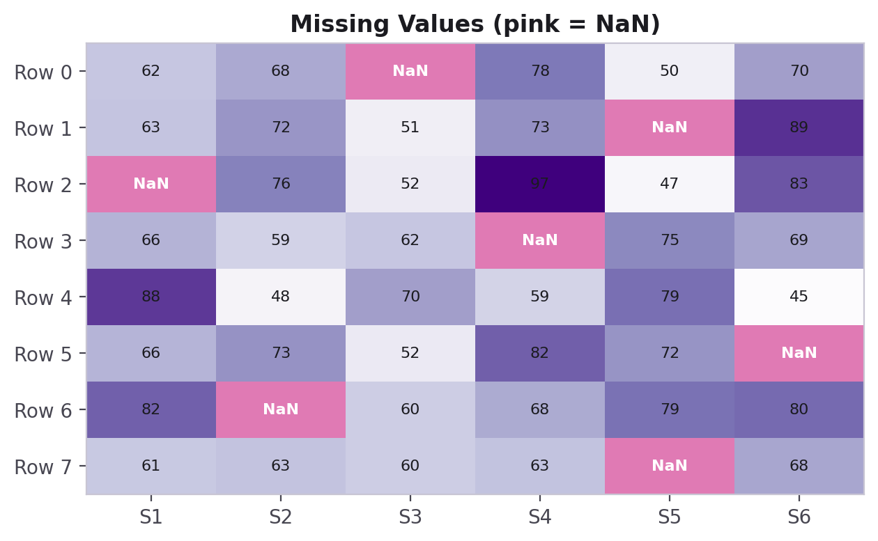
PART 5 · INDEXING & SLICING
Boolean Indexing — Filtering with a Condition
A boolean mask lets you select every element that matches a condition — no loop needed.
scores = np.array([45, 62, 78, 91, 55, 88])
mask = scores >= 60
print(mask)
# [False True True True False True]
passing = scores[mask]
print(passing)
# [62 78 91 88]
scores >= 60 creates an array of True/False values the same shape as scores — using it as an index keeps only the True positions.
CodeByPaxto · AI & ML Playground · NumPy
27

Slide 28
◎
PART 5 · INDEXING & SLICING
Practice Set — Indexing & Slicing
Try these yourself first — no code shown, that's the point.
Create a 1D array of 8 numbers and retrieve the 3rd and last elements.
1
Slice out the middle 4 elements of that array.
2
Create a 2D array and retrieve one full row and one full column.
3
Use boolean indexing to keep only the values greater than the array's mean.
4
CodeByPaxto · AI & ML Playground · NumPy
28

Slide 29
PART 6 · RESHAPING & MANIPULATION
Reshaping & Manipulation
Changing an array's shape without changing its data.
29

Slide 30
PART 6 · RESHAPING & MANIPULATION
reshape() — Same Data, New Shape
arr = np.arange(1, 7) # [1 2 3 4 5 6]
1
2
3
4
5
6
reshape() rearranges the same elements into a new shape — the total count must stay the same (6 = 2x3).
Pass -1 for one dimension to let NumPy calculate it automatically: arr.reshape(2, -1).
flatten() / ravel() do the reverse — collapse any array back down to 1D.
.T (transpose) flips rows and columns for a 2D array.
→ arr.reshape(2, 3)
1
2
3
4
5
6
CodeByPaxto · AI & ML Playground · NumPy
30

Slide 31
PART 6 · RESHAPING & MANIPULATION
Joining Arrays Together
Function / Attribute | Meaning
np.concatenate([a, b]) | Joins arrays end to end along an existing axis
np.vstack([a, b]) | Stacks arrays on top of each other (new rows)
np.hstack([a, b]) | Stacks arrays side by side (new columns)
np.split(arr, n) | Splits one array into n equal parts
a = np.array([1, 2, 3])
b = np.array([4, 5, 6])
np.concatenate([a, b]) # [1 2 3 4 5 6]
np.vstack([a, b]) # [[1 2 3] [4 5 6]]
CodeByPaxto · AI & ML Playground · NumPy
31

Slide 32
◎
PART 6 · RESHAPING & MANIPULATION
Practice Set — Reshaping & Manipulation
Try these yourself first — no code shown, that's the point.
Create a 1D array of 12 numbers and reshape it into a 3x4 matrix.
1
Reshape that matrix into 2x6 instead, then flatten it back to 1D.
2
Transpose a 2x3 matrix and check its new shape.
3
Stack two 1D arrays vertically, then split the result back into two.
4
CodeByPaxto · AI & ML Playground · NumPy
32

Slide 33
PART 7 · ARRAY MODIFICATION
Array Modification
Adding, removing, and safely copying elements.
33

Slide 34
PART 7 · ARRAY MODIFICATION
Adding & Removing Elements
Function / Attribute | Meaning
np.append(arr, value) | Returns a new array with value added at the end
np.insert(arr, index, value) | Returns a new array with value inserted at index
np.delete(arr, index) | Returns a new array with the element at index removed
arr = np.array([10, 20, 30])
np.append(arr, 40) # [10 20 30 40]
np.insert(arr, 1, 15) # [10 15 20 30]
np.delete(arr, 0) # [20 30]
CodeByPaxto · AI & ML Playground · NumPy
34

Slide 35
PART 7 · ARRAY MODIFICATION
Copy vs. View — An Important Gotcha
Slicing a NumPy array does NOT copy it — it returns a view, which still points at the same underlying data.
Changing a view changes the original array too — a very common source of confusing bugs.
Call .copy() explicitly whenever you need an independent, separate array.
arr = np.array([1, 2, 3, 4])
view = arr[1:3]
view[0] = 99
print(arr)
# [ 1 99 3 4] <- original changed!
safe_copy = arr[1:3].copy()
safe_copy[0] = 0
print(arr)
# [ 1 99 3 4] <- unaffected
CodeByPaxto · AI & ML Playground · NumPy
35

Slide 36
◎
PART 7 · ARRAY MODIFICATION
Practice Set — Array Modification
Try these yourself first — no code shown, that's the point.
Append 3 new values to the end of an existing array.
1
Insert a value in the middle of an array, then delete a different element.
2
Create a slice of an array, modify it, and check whether the original array changed.
3
Repeat the previous task using .copy() this time, and compare the result.
4
CodeByPaxto · AI & ML Playground · NumPy
36

Slide 37
PART 8 · OPERATIONS & BROADCASTING
Operations, Broadcasting & Vectorisation
Where NumPy's real power shows up — fast math across whole arrays, with no explicit loops.
37

Slide 38
PART 8 · OPERATIONS
Element-Wise Arithmetic
Standard math operators (+, -, *, /) work directly on arrays — no loop, no zip(), no list comprehension.
Each operation applies element by element: a[0]+b[0], a[1]+b[1], and so on.
The two arrays must have compatible shapes — which is exactly what broadcasting defines, next.
a = np.array([1, 2, 3])
b = np.array([10, 20, 30])
a + b # [11 22 33]
a - b # [-9 -18 -27]
a * b # [10 40 90]
b / a # [10. 10. 10.]
CodeByPaxto · AI & ML Playground · NumPy
38

Slide 39
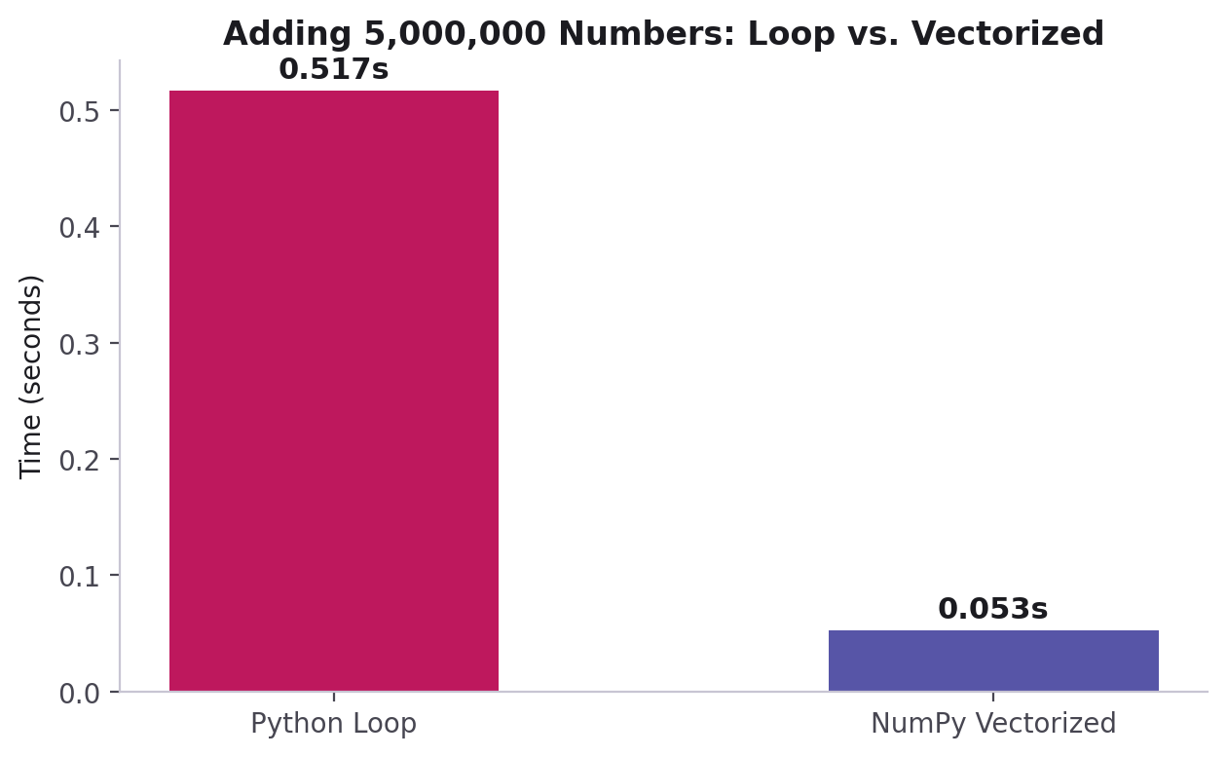
PART 8 · VECTORISATION
Why Vectorization Is Faster Than a Loop
# slow - explicit Python loop
result = []
for i in range(len(a)):
result.append(a[i] + b[i])
# fast - vectorized
result = a + b
The vectorized version runs the loop in fast, compiled C code under the hood — instead of Python's slower interpreted loop.
Measured on this machine — your numbers will vary, but the gap holds.
CodeByPaxto · AI & ML Playground · NumPy
39

Slide 40
PART 8 · BROADCASTING
Broadcasting — Different Shapes, Working Together
array + scalar
1
2
3
+
10
→
11
12
13
10 is stretched to [10, 10, 10] behind the scenes, then added element-wise — you never see this step, NumPy just handles it.
This is why arr * 2 or arr + 5 work directly on a whole array without writing a loop.
The same idea works between a matrix and a 1D array too, as long as the shapes are compatible.
Rule of thumb: shapes are compatible if, comparing from the right, each dimension either matches or one of them is 1.
CodeByPaxto · AI & ML Playground · NumPy
40

Slide 41
PART 8 · AGGREGATE FUNCTIONS
Summarizing an Array
Function / Attribute | Meaning
arr.sum() | Adds up every element
arr.mean() | The average value
arr.std() | The standard deviation — how spread out the values are
arr.min() / arr.max() | The smallest / largest value
arr.argmax() / arr.argmin() | The index of the largest / smallest value
axis=0 / axis=1 | Apply the function down columns / across rows, on a 2D array
CodeByPaxto · AI & ML Playground · NumPy
41

Slide 42
◎
PART 8 · OPERATIONS & BROADCASTING
Practice Set — Operations, Broadcasting & Vectorisation
Try these yourself first — no code shown, that's the point.
Create two same-sized arrays and compute their element-wise sum, difference, and product.
1
Add a single number to a whole array and explain what broadcasting did behind the scenes.
2
Compute the mean, std, min, and max of an array in one block of code.
3
For a 2D array, compute the sum once with axis=0 and once with axis=1, and explain the difference.
4
CodeByPaxto · AI & ML Playground · NumPy
42

Slide 43
PART 9 · MISSING VALUES
Handling Missing Values
Real data is rarely complete — NumPy gives you the tools to find and deal with the gaps.
43

Slide 44
PART 9 · MISSING VALUES
np.nan — Representing "No Value"
np.nan (Not a Number) is NumPy's placeholder for a missing numerical value — common in real, messy datasets.
data = np.array([72, 85, np.nan, 90, np.nan, 68])
np.isnan(data)
# [False False True False True False]
np.sum(np.isnan(data))
# 2 <- count of missing values
np.isnan() returns a boolean mask marking every NaN — combine it with boolean indexing (Part 5) to isolate or remove them.
CodeByPaxto · AI & ML Playground · NumPy
44

Slide 45
PART 9 · MISSING VALUES
Handling the Gaps
Function / Attribute | Meaning
np.nanmean(arr) | Average, ignoring NaN values
np.nanstd(arr) / np.nansum(arr) | Standard deviation / sum, ignoring NaN values
arr[~np.isnan(arr)] | Keeps only the non-missing values
np.where(np.isnan(arr), fill_value, arr) | Replaces every NaN with a chosen fill value
data = np.array([72, 85, np.nan, 90, np.nan, 68])
clean_mean = np.nanmean(data) # ignores NaNs
filled = np.where(np.isnan(data), clean_mean, data)
# every NaN replaced with the mean
CodeByPaxto · AI & ML Playground · NumPy
45

Slide 46
◎
PART 9 · MISSING VALUES
Practice Set — Handling Missing Values
Try these yourself first — no code shown, that's the point.
Create an array with a few np.nan values mixed in, and count how many there are.
1
Compute the mean of that array with and without ignoring NaN values, and compare.
2
Replace every NaN in the array with the column's mean using np.where().
3
Filter out the NaN values entirely and print only the valid numbers.
4
CodeByPaxto · AI & ML Playground · NumPy
46

Slide 47
PART 10 · REAL-WORLD DATA
NumPy with Real-World Data
Bringing everything together on a small, realistic dataset — six students, five subjects.
47

Slide 48
PART 10 · REAL-WORLD DATA
The Dataset — Student Scores
Rows are students, columns are subjects — a 2D array is a completely natural fit for this kind of tabular data.
This is exactly the shape of data you'll load into Pandas next module — NumPy is what's underneath it.
subjects = ["Math", "Physics", "Chemistry",
"Biology", "English"]
scores = np.array([
[78, 85, 92, 88, 76],
[65, 70, 60, 72, 80],
[90, 88, 95, 91, 85],
[55, 62, 58, 64, 70],
[82, 79, 84, 88, 90],
[70, 75, 68, 73, 77],
])
scores.shape
# (6, 5) <- 6 students, 5 subjects
CodeByPaxto · AI & ML Playground · NumPy
48

Slide 49
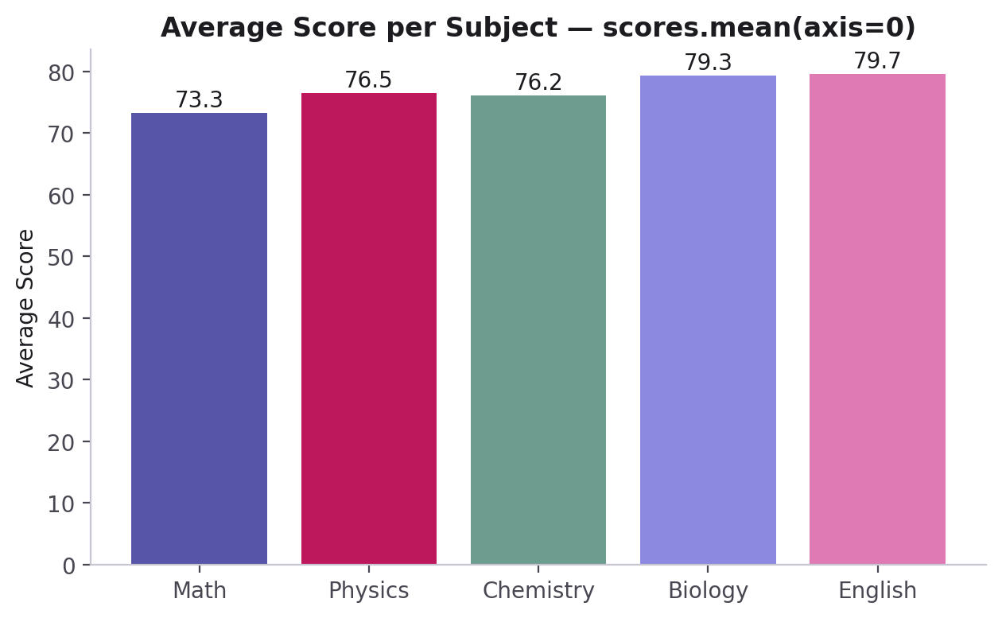
PART 10 · REAL-WORLD DATA
Average Score per Subject — axis=0
avg_per_subject = scores.mean(axis=0)
print(avg_per_subject)
# [73.3 76.5 76.2 79.3 79.7]
axis=0 collapses down the rows — one average per column (subject).
CodeByPaxto · AI & ML Playground · NumPy
49

Slide 50
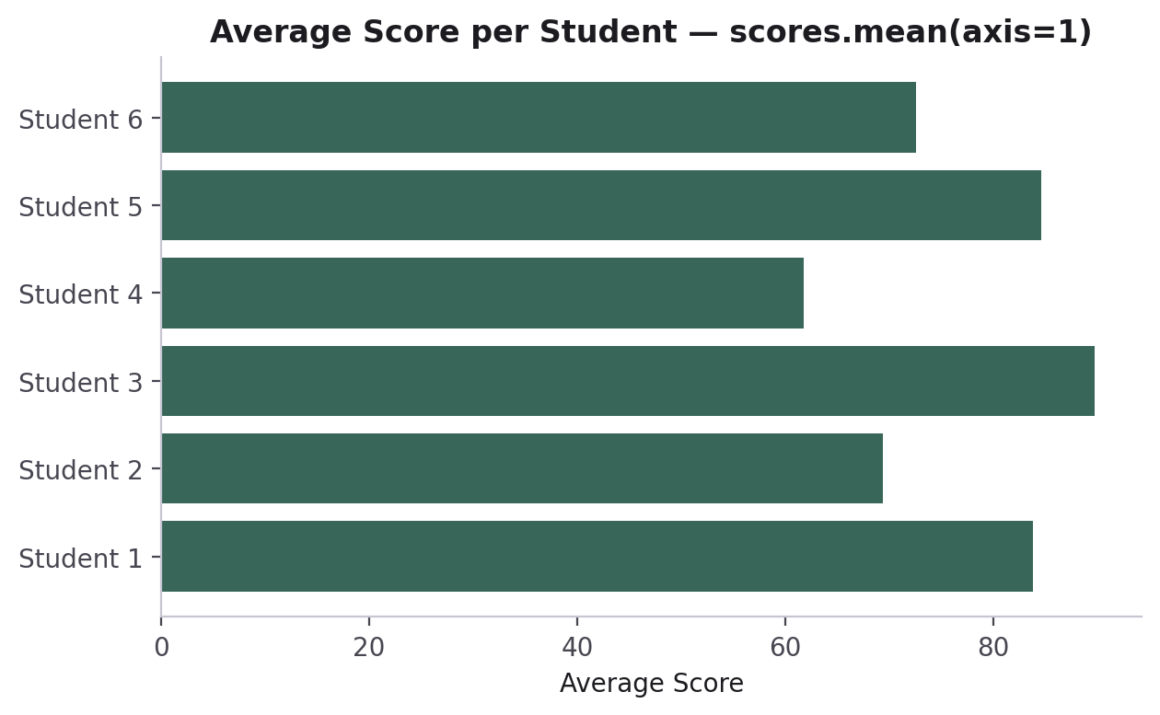
PART 10 · REAL-WORLD DATA
Average Score per Student — axis=1
avg_per_student = scores.mean(axis=1)
print(avg_per_student)
# [83.8 69.4 89.8 61.8 84.6 72.6]
top_student = np.argmax(avg_per_student)
# index 2 -> highest average
axis=1 collapses across the columns — one average per row (student).
CodeByPaxto · AI & ML Playground · NumPy
50

Slide 51
◎
PART 10 · REAL-WORLD DATA
Practice Set — NumPy with Real-World Data
Try these yourself first — no code shown, that's the point.
Build a 2D array representing 5 products' sales across 4 weeks.
1
Compute the average sales per week and the average sales per product.
2
Find which product had the single highest sales value, and in which week.
3
Use boolean indexing to find every product-week combination that sold above the overall average.
4
CodeByPaxto · AI & ML Playground · NumPy
51

Slide 52
PART 11 · BONUS
Images as NumPy Arrays
A genuinely fun demo: every image is secretly just a grid of numbers.
52

Slide 53
PART 11 · IMAGES AS ARRAYS
A Picture Is Just a Matrix
A grayscale image is a 2D array — one number per pixel, from 0 (black) to 255 (white).
A color image is a 3D array (a tensor!) — height x width x 3, one layer each for Red, Green, and Blue.
Once you see an image as an array, every NumPy tool you've learned today — indexing, slicing, arithmetic — becomes a way to edit it.
from PIL import Image
import numpy as np
img = Image.open("photo.png").convert("L")
img_array = np.array(img)
print(img_array.shape) # (200, 200)
print(img_array.dtype) # uint8
CodeByPaxto · AI & ML Playground · NumPy
53

Slide 54
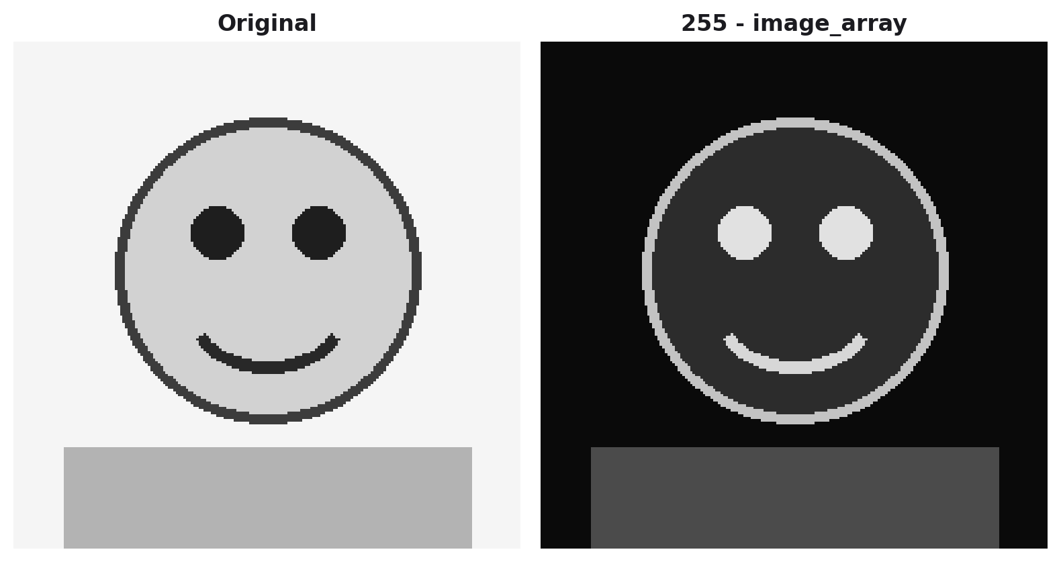
PART 11 · IMAGES AS ARRAYS
Dark Mode, in One Line
"Dark mode" for an image is just inverting every pixel value — a light background becomes dark, and vice versa.
img_array = np.array(image)
# every pixel is 0-255
dark_array = 255 - img_array
# bright pixels become dark,
# dark pixels become bright
dark_image = Image.fromarray(dark_array)
255 - img_array is a single broadcasted operation across every pixel — the exact same idea from Part 8, applied to a real image.
CodeByPaxto · AI & ML Playground · NumPy
54

Slide 55
◎
PART 11 · IMAGES AS ARRAYS
Practice Set — Bonus: Images as NumPy Arrays
Try these yourself first — no code shown, that's the point.
Load any image, convert it to grayscale, and print its shape and dtype.
1
Invert the image's pixel values to create a "dark mode" version.
2
Try slicing the array to keep only the top half of the image — what happens?
3
Try multiplying the array by 0.5 — what visual effect does that have, and why?
4
CodeByPaxto · AI & ML Playground · NumPy
55

Slide 56
PART 12 · MINI PROJECTS
Put It All Together
Three small projects combining everything from Foundations to Real-World Data — built end to end with NumPy.
56

Slide 57
PART 12 · MINI PROJECTS
Mini Project 1: Student Grade Book
Build a 2D array of scores for 6 students across 4 subjects.
Use indexing and slicing to pull out one student's full record and one subject's scores for everyone.
Compute each student's average (axis=1) and each subject's average (axis=0).
Use argmax() to find the top-performing student, and boolean indexing to list every student scoring above 80 overall.
1
Indexing +
Aggregate stats
CodeByPaxto · AI & ML Playground · NumPy
57

Slide 58
PART 12 · MINI PROJECTS
Mini Project 2: Sales Forecast Adjuster
Build a 2D array of weekly sales for 5 products over 6 weeks.
Apply a single broadcasted operation to increase every value by 10% (a projected price increase).
Use reshape() or transpose() to view the data product-first instead of week-first.
Compare the total runtime of a loop-based vs. vectorized version of the same calculation.
2
Broadcasting +
Vectorised operations
CodeByPaxto · AI & ML Playground · NumPy
58

Slide 59
PART 12 · MINI PROJECTS
Mini Project 3: Sensor Data Cleaner
Build a 1D array of 20 simulated temperature readings, with a few np.nan values mixed in.
Detect and count the missing readings using np.isnan().
Fill every missing reading with the array's mean using np.where().
Report the cleaned array's mean, min, and max, and how many readings were originally missing.
3
Missing values +
Real-world cleanup
CodeByPaxto · AI & ML Playground · NumPy
59

Slide 60
MODULE RECAP
Every array you sliced, reshaped, and broadcast today is the exact same object Pandas, Matplotlib, and every ML model you'll build later are quietly built on top of. You didn't just learn a library — you learned the language the rest of this course speaks.
Next up: Pandas — structured, labeled data, built directly on the NumPy arrays you just learned.
60

Slide 61
Thank You
NumPy · AI & ML Playground · CodeByPaxto
61

