Slide 1

AI & ML PLAYGROUND · MODULE 07
Seaborn
Statistical visualization, built on Matplotlib — the fast path from a DataFrame to real insight.
by CodeByPaxto
01

Slide 2

WHERE THIS FITS
The AI & ML Playground Roadmap
Python
→
Math for DS
→
Git & GitHub
→
NumPy
→
Pandas
→
Matplotlib
→
Seaborn
→
Data Analytics
→
Supervised ML
You are here — Matplotlib gave you full control over drawing charts by hand. Seaborn builds on that same engine and adds statistical intelligence and DataFrame-native syntax, so the EDA work in Data Analytics goes faster.
02

Slide 3
BEFORE WE START
If Matplotlib Exists, Why Seaborn?
MATPLOTLIB
SEABORN
The engine — can draw anything, but you specify almost everything by hand.
Statistics (regression lines, confidence intervals, density curves) must be computed yourself.
Works with plain arrays and lists.
Built directly on top of Matplotlib — every Seaborn chart is secretly a Matplotlib Figure underneath.
Computes statistics automatically — regression lines, confidence bands, KDE curves, one function call.
Reads a Pandas DataFrame directly — pass column names (x=, y=, hue=) instead of slicing arrays by hand.
The honest framing: Matplotlib is the foundation and the fine-tuning tool. Seaborn is the fast path for statistical, exploratory work — exactly what you'll do constantly in Data Analytics.
CodeByPaxto · AI & ML Playground · Seaborn
03

Slide 4
WHAT WE'RE COVERING
Today's Roadmap
01
02
03
04
05
Foundations & Terminology
Getting Started
Distribution Plots
Categorical Plots
Relational Plots
06
07
08
09
10
Regression Plots
Matrix Plots
Styling & Palettes
Seaborn for EDA & ML
Mini Projects
Running example: the tips dataset throughout — with a switch to titanic for the ML section.
CodeByPaxto · AI & ML Playground · Seaborn
04

Slide 5
PART 1 · FOUNDATIONS
Foundations & Terminology
10 core terms that unlock how Seaborn thinks about data — and why it feels so different from plain Matplotlib.
05

Slide 6
PART 1 · TERMINOLOGY
Terms 1–4 · Reading Data & Encodings
1
DataFrame-Native Plotting
2
hue
3
size / style
4
Figure-Level Function
Seaborn plots read straight from a Pandas DataFrame — you pass column names, not raw arrays.
A parameter that colors points/bars by a category, and adds the legend for you automatically.
Parameters that scale point size or change marker/line style by category — extra dimensions on one chart.
A function that creates its own Figure and can build multiple panels at once — e.g. displot(), lmplot().
CodeByPaxto · AI & ML Playground · Seaborn
06

Slide 7
PART 1 · TERMINOLOGY
Terms 5–7 · How Seaborn Builds Charts
5
Axes-Level Function
6
Facet
7
Estimator
A function that draws onto one Axes you give it — e.g. histplot(), boxplot() — plays nicely with plt.subplots().
A sub-plot created automatically by splitting data into a grid, based on a category (col=, row=).
The statistic used to summarize a group of values — mean is the default; np.sum is common too.
CodeByPaxto · AI & ML Playground · Seaborn
07

Slide 8
PART 1 · TERMINOLOGY
Terms 8–10 · Statistics, Built In
8
Confidence Interval
9
KDE (Kernel Density Estimate)
10
Palette
The shaded band around a line/bar showing the plausible range for the true value.
A smoothed curve estimating a variable's distribution — a smoother alternative to a histogram.
A named or custom set of colors used to distinguish categories or encode values.
CodeByPaxto · AI & ML Playground · Seaborn
08

Slide 9
PART 1 · TERMINOLOGY
Figure-Level vs. Axes-Level — The #1 Thing to Get Right
AXES-LEVEL
FIGURE-LEVEL
fig, ax = plt.subplots()
sns.histplot(df["tip"], ax=ax)
sns.boxplot(x="day", y="tip",
data=df, ax=ax)
sns.displot(
df["tip"], kind="hist"
)
# creates its own Figure
Draws onto one Axes you already have.
Fits directly into plt.subplots() grids.
Examples: histplot, boxplot, scatterplot, heatmap.
Creates and owns its own Figure — no ax= needed.
Can facet into a grid with col=/row=.
Examples: displot, catplot, relplot, lmplot.
Rule of thumb: if you need it inside a Matplotlib subplot grid, reach for the axes-level version.
CodeByPaxto · AI & ML Playground · Seaborn
09

Slide 10
◎
PART 1 · TERMINOLOGY
Practice Set — Foundations & Terminology
Try these yourself first — no code shown, that's the point.
In your own words, explain the difference between a figure-level and an axes-level function.
1
Name one parameter you'd add to a chart to encode a 3rd variable, and one for a 4th.
2
Explain what a confidence interval band is telling you when you see one around a line.
3
List two things a Palette can be used for on a chart.
4
CodeByPaxto · AI & ML Playground · Seaborn
10

Slide 11
PART 2 · GETTING STARTED
Getting Started with Seaborn
Installing, importing, loading a built-in dataset, and understanding how Seaborn sits on top of Matplotlib.
11

Slide 12
PART 2 · GETTING STARTED
Installing, Importing & Built-In Datasets
Seaborn ships a small library of clean sample datasets — tips, titanic, flights, iris, and more.
sns.load_dataset("name") pulls one straight into a Pandas DataFrame — no downloading, no missing-value cleanup.
This lets you focus entirely on visualization syntax while learning, instead of data wrangling.
We'll use tips as our running example, and switch to titanic for the ML section later.
# one-time install
pip install seaborn
import seaborn as sns
import matplotlib.pyplot as plt
# no downloading, no cleaning —
# just a ready DataFrame
tips = sns.load_dataset("tips")
tips.head()
CodeByPaxto · AI & ML Playground · Seaborn
12

Slide 13
PART 2 · GETTING STARTED
sns.set_theme() — One Line, Better Defaults
Call this once, near the top of your notebook — it affects every chart drawn afterward.
style= controls the background/grid look (darkgrid, whitegrid, dark, white, ticks).
palette= sets the default color scheme for categories across every chart.
This single line is most of why Seaborn charts look polished with almost no extra work.
sns.set_theme(
style="whitegrid",
palette="deep"
)
# every chart from here on
# uses this look automatically
sns.histplot(tips["total_bill"])
plt.show()
CodeByPaxto · AI & ML Playground · Seaborn
13

Slide 14
PART 2 · GETTING STARTED
Seaborn Layers on Top of Matplotlib
Every Seaborn chart is secretly a Matplotlib Figure and Axes underneath.
Pass ax= to draw a Seaborn chart onto an Axes you created with plt.subplots() — this is how the two libraries cooperate.
Once drawn, everything from your Matplotlib module still works: ax.set_title(), ax.set_xlabel(), plt.savefig().
Think of it as: Seaborn draws the statistics, Matplotlib does the fine detailing.
fig, ax = plt.subplots(figsize=(6, 4))
# Seaborn draws the chart...
sns.boxplot(x="day", y="tip",
data=tips, ax=ax)
# ...Matplotlib fine-tunes it
ax.set_title("Tips by Day")
ax.set_xlabel("Day of Week")
plt.show()
CodeByPaxto · AI & ML Playground · Seaborn
14

Slide 15
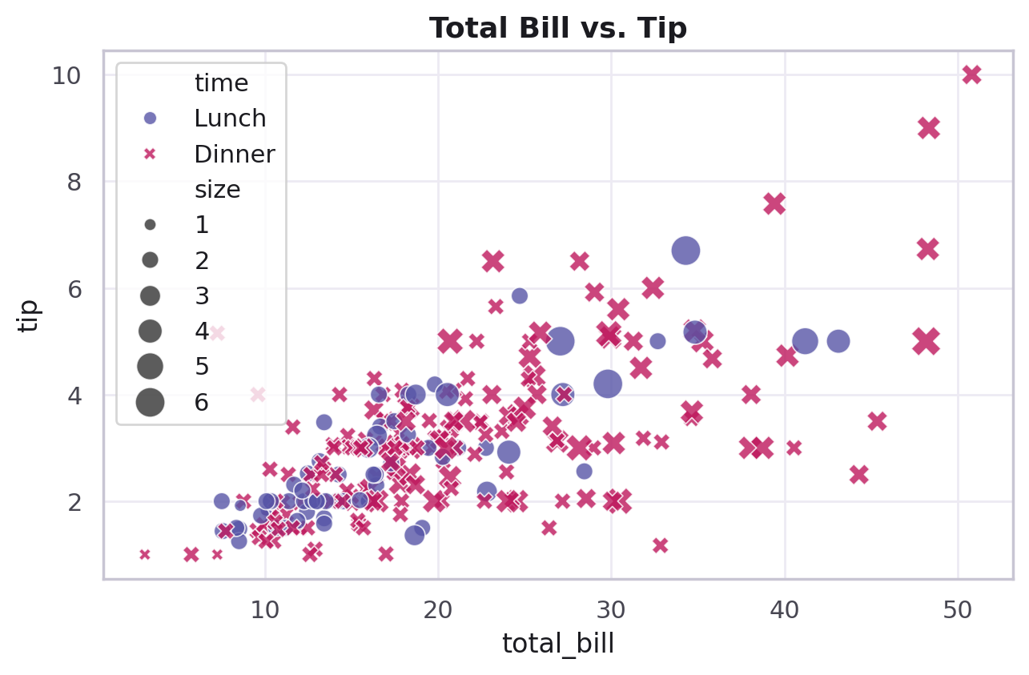
PART 2 · GETTING STARTED
Your First Seaborn Plot
import seaborn as sns
tips = sns.load_dataset("tips")
sns.scatterplot(
x="total_bill",
y="tip",
data=tips
)
Column names in, a finished chart out.
CodeByPaxto · AI & ML Playground · Seaborn
15

Slide 16
◎
PART 2 · GETTING STARTED
Practice Set — Getting Started
Try these yourself first — no code shown, that's the point.
Load the tips dataset and print its shape and column names.
1
Call sns.set_theme() with a style of your choice, then plot any histogram and see the difference.
2
Create a Figure with plt.subplots() and draw a Seaborn chart onto it using ax=.
3
Predict what sns.load_dataset("titanic") will contain before you check it — then check.
4
CodeByPaxto · AI & ML Playground · Seaborn
16

Slide 17
PART 3 · DISTRIBUTION PLOTS
Distribution Plots
Understanding how one quantitative variable is spread out — histograms, density curves, and multi-variable views, all built in.
17

Slide 18
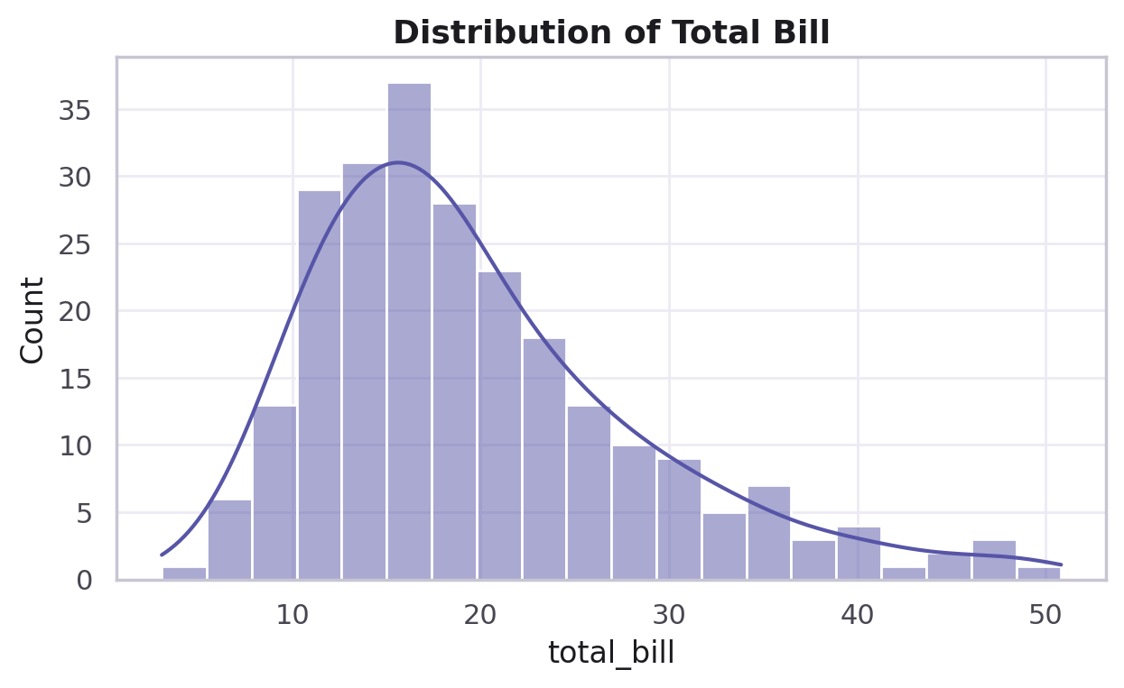
PART 3 · DISTRIBUTION PLOTS
What Is a Distribution Plot?
A distribution plot shows how the values of one numerical column are spread out — where most values cluster, and where the outliers sit.
This is usually the very first thing you check about any new dataset, before anything else.
Seaborn's distribution tools go beyond the plain histogram from Matplotlib — adding smoothed curves (KDE) and relationship views in one line.
This section covers: histplot / displot, kdeplot, rugplot, jointplot, and pairplot.
CodeByPaxto · AI & ML Playground · Seaborn
18

Slide 19
PART 3 · DISTRIBUTION PLOTS
Anatomy of sns.histplot()
Parameter | Meaning
data / x | The numerical column to plot
bins | Number of bars/intervals
kde | If True, overlays a smooth density curve
color | Fill color of the bars
sns.histplot(
data["total_bill"],
bins=20,
kde=True,
color="color_name"
)
sns.displot() is the figure-level twin of histplot() — same idea, but it creates its own Figure and can facet with col=.
CodeByPaxto · AI & ML Playground · Seaborn
19

Slide 20
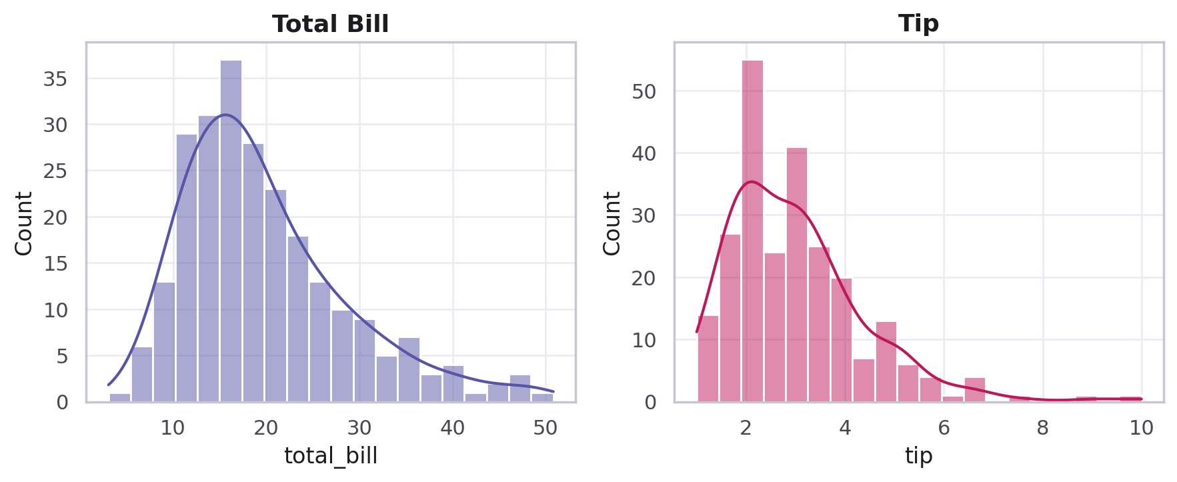
PART 3 · DISTRIBUTION PLOTS
Distribution of Total Bill
sns.histplot(
tips["total_bill"],
bins=20,
kde=True
)
plt.title("Distribution of Total Bill")
plt.show()
# side by side comparison:
plt.subplot(1, 2, 1)
sns.histplot(tips["total_bill"], kde=True)
plt.subplot(1, 2, 2)
sns.histplot(tips["tip"], kde=True)
Two histplot() calls, side by side with plt.subplot().
CodeByPaxto · AI & ML Playground · Seaborn
20

Slide 21
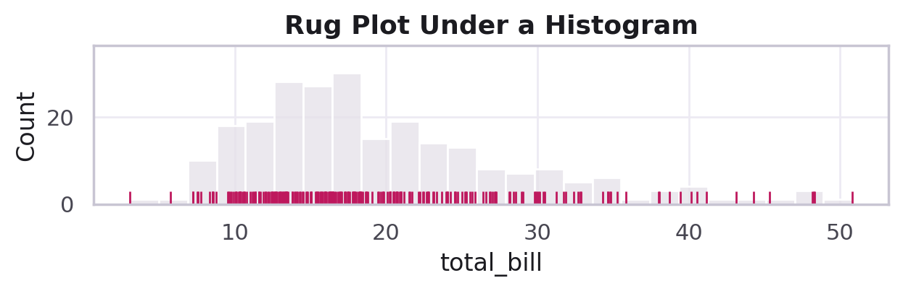
PART 3 · DISTRIBUTION PLOTS
kdeplot() & rugplot() — Two Lightweight Views
Parameter | Meaning
sns.kdeplot(data) | Just the smooth density curve, no bars
fill=True | Shades the area under the curve
sns.rugplot(data) | Draws a tiny tick mark for every single data point
kdeplot() is useful when bars would be visual noise — e.g. comparing two overlapping distributions.
rugplot() is almost always paired with a histogram or KDE — it shows exactly where the raw data points sit, bar or curve aside.
A rug plot under a histogram — every dot is one real bill.
CodeByPaxto · AI & ML Playground · Seaborn
21

Slide 22
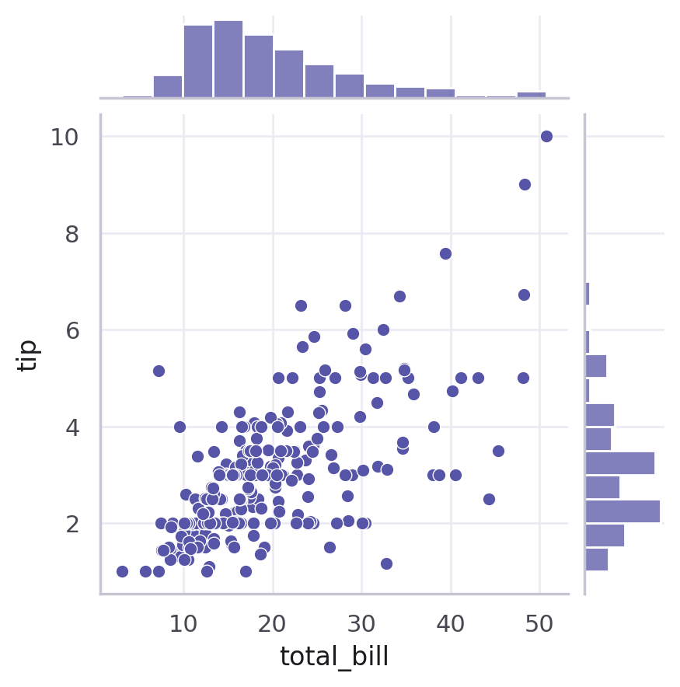
PART 3 · DISTRIBUTION PLOTS
jointplot() — Two Views in One
sns.jointplot(
x="total_bill", y="tip",
data=tips,
kind="scatter"
# or: "kde", "hist",
# "hex", "reg", "resid"
)
A jointplot pairs a central scatter/density chart with a mini histogram of each variable on the margins — relationship and distribution, in one figure.
kind= swaps the center chart between scatter, KDE, histogram, hexbin, or a regression fit.
kind="scatter" — total_bill vs. tip, with marginal histograms.
CodeByPaxto · AI & ML Playground · Seaborn
22

Slide 23
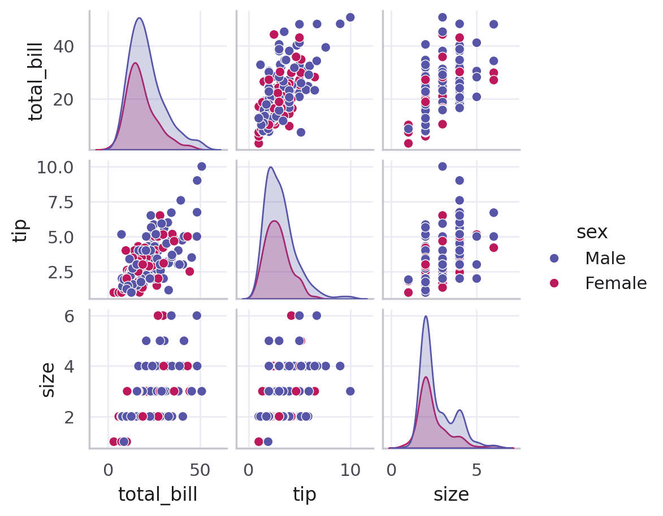
PART 3 · DISTRIBUTION PLOTS
pairplot() — Every Relationship, At Once
sns.pairplot(
tips,
hue="sex",
palette="rainbow"
)
pairplot() draws a scatter plot for every pair of numeric columns, and a distribution curve on the diagonal.
hue= colors every point by a category — instantly showing whether groups separate.
This is the single most-used function for scanning a whole dataset's relationships in one shot — a staple of early EDA.
CodeByPaxto · AI & ML Playground · Seaborn
23

Slide 24
◎
PART 3 · DISTRIBUTION PLOTS
Practice Set — Distribution Plots
Try these yourself first — no code shown, that's the point.
Plot a histplot() of the tip column with 15 bins and kde=True.
1
Compare a histplot and a kdeplot of the same column, side by side, and describe what changed visually.
2
Build a jointplot of total_bill vs. tip with kind="hex" and describe what the hex cells represent.
3
Run pairplot() on the tips dataset with hue="time" and identify one pair of columns where lunch and dinner separate visually.
4
CodeByPaxto · AI & ML Playground · Seaborn
24

Slide 25
PART 4 · CATEGORICAL PLOTS
Categorical Plots
Comparing a numerical variable across groups — boxplot, violinplot, barplot, countplot, and more.
25

Slide 26
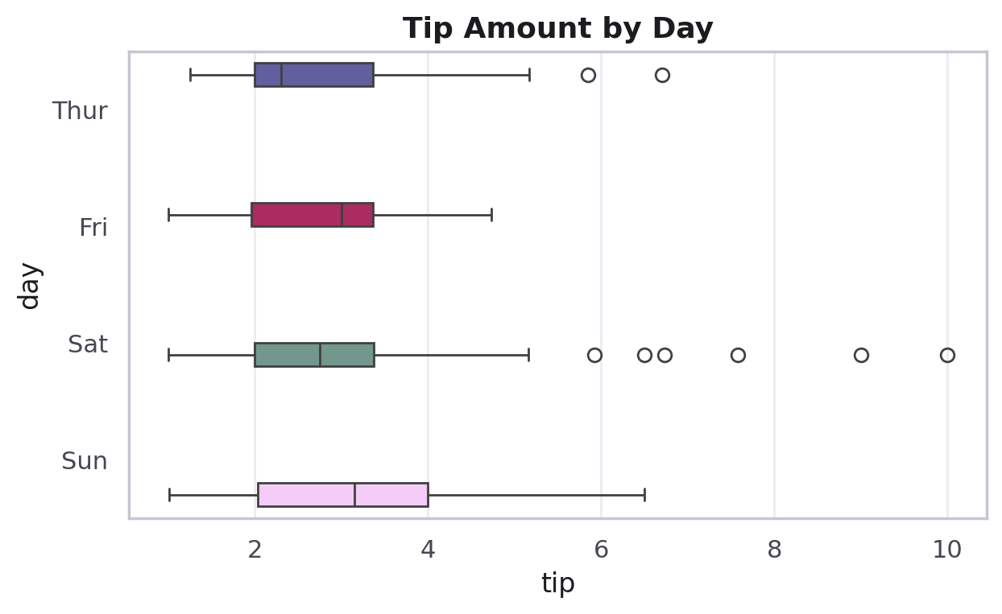
PART 4 · CATEGORICAL PLOTS
What Is a Categorical Plot?
A categorical plot compares a numerical variable across the groups of a categorical one — e.g. tip amount, broken down by day of the week.
This is how you answer "does this differ across groups?" — one of the most common EDA questions.
Seaborn gives you several categorical plot types, each trading off between summary and detail — from a single line (bar) to every raw point (swarm).
This section covers: boxplot, violinplot, barplot, countplot, stripplot, and swarmplot.
CodeByPaxto · AI & ML Playground · Seaborn
26

Slide 27
PART 4 · CATEGORICAL PLOTS
Anatomy of sns.boxplot()
Parameter | Meaning
x, y | One numeric column, one categorical column
data | The DataFrame to plot from
hue | Splits each box further by a second category
palette | Named or custom color set for the boxes
sns.boxplot(
x="tip",
y="day",
data=tips,
palette="Set2"
)
Reading it: the box spans the middle 50% of values, the line is the median, whiskers show the typical range, and dots beyond them are outliers — same as in Matplotlib's boxplot, just DataFrame-native.
CodeByPaxto · AI & ML Playground · Seaborn
27

Slide 28
PART 4 · CATEGORICAL PLOTS
Tip Amount by Day
sns.boxplot(
x="tip", y="day",
data=tips,
palette="Set2"
)
plt.title("Tip Amount by Day")
plt.show()
CodeByPaxto · AI & ML Playground · Seaborn
28

Slide 29
PART 4 · CATEGORICAL PLOTS
Anatomy of sns.violinplot()
Parameter | Meaning
x, y | Categorical column, numerical column
data | The DataFrame to plot from
palette | Color set across the violins
inner | What's drawn inside — quartiles, a mini box, or points
sns.violinplot(
x="day",
y="total_bill",
data=tips,
palette="RdBu"
)
A violin is a boxplot's shape wrapped by a KDE curve mirrored on both sides — it shows the full distribution shape, not just five summary numbers.
CodeByPaxto · AI & ML Playground · Seaborn
29

Slide 30
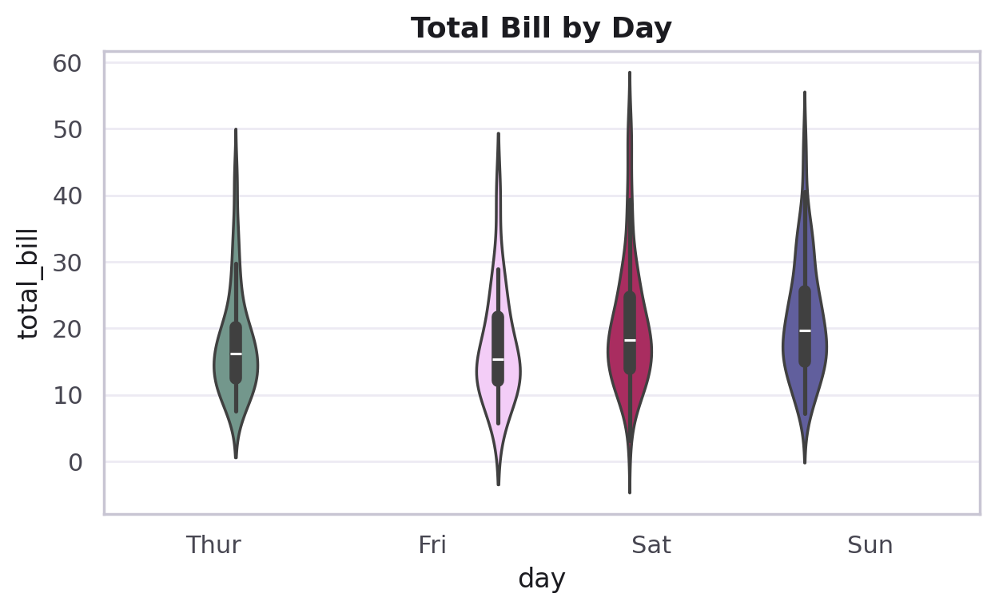
PART 4 · CATEGORICAL PLOTS
Total Bill by Day — Full Shape
sns.violinplot(
x="day", y="total_bill",
data=tips,
palette="RdBu"
)
plt.title("Total Bill by Day")
CodeByPaxto · AI & ML Playground · Seaborn
30

Slide 31
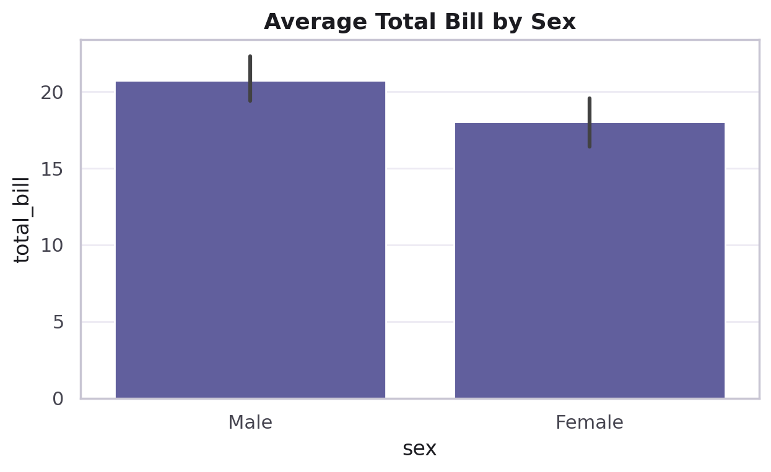
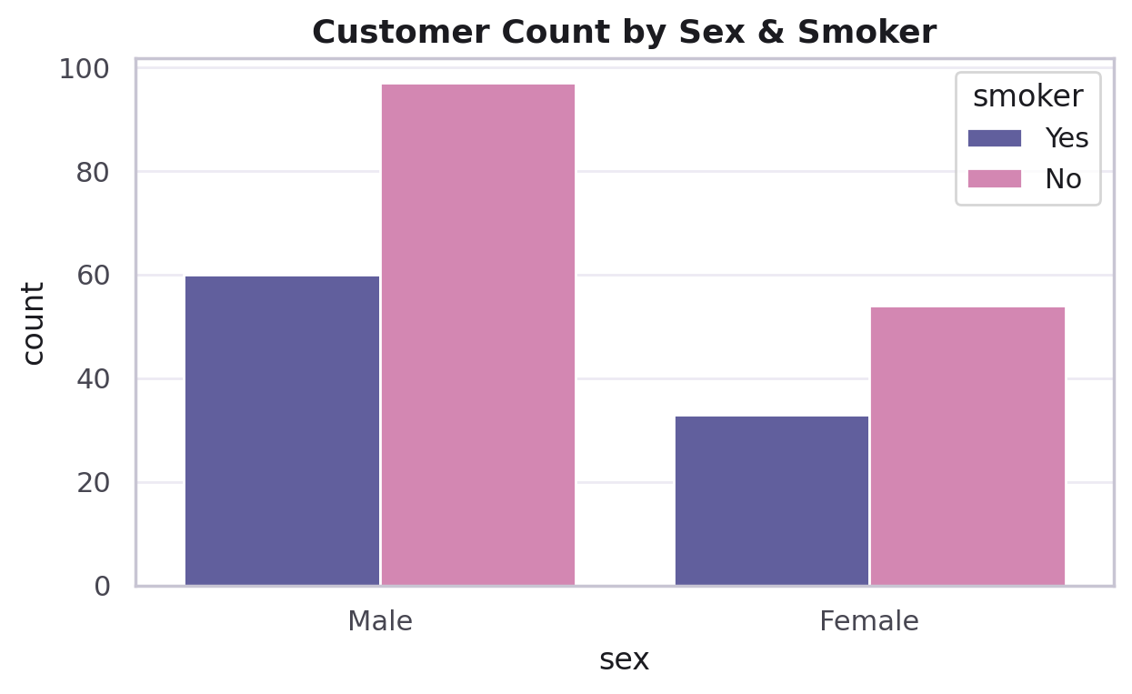
PART 4 · CATEGORICAL PLOTS
barplot() & countplot()
Parameter | Meaning
sns.barplot(x, y, data, estimator=) | Shows a summary statistic (mean by default) per category, with a CI whisker
sns.countplot(x, data, hue=) | Counts how many rows fall into each category — no y= needed
estimator=np.sum | Swap the default mean for any statistic, e.g. total instead of average
barplot — average total_bill by sex, with CI.
countplot — customers by sex & smoker status.
CodeByPaxto · AI & ML Playground · Seaborn
31

Slide 32
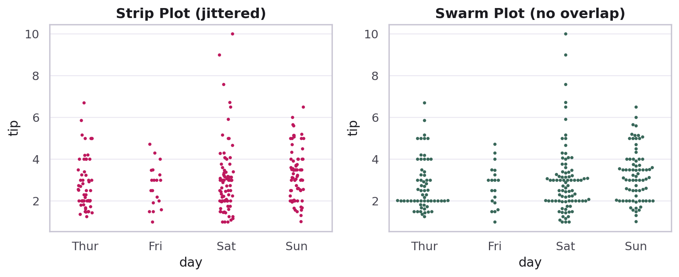
PART 4 · CATEGORICAL PLOTS
stripplot() & swarmplot() — Every Raw Point
Parameter | Meaning
sns.stripplot(x, y, data) | Plots every point, jittered sideways so they don't stack exactly
sns.swarmplot(x, y, data) | Plots every point, spaced out so none overlap at all
Same data, two ways of showing every individual tip.
CodeByPaxto · AI & ML Playground · Seaborn
32

Slide 33
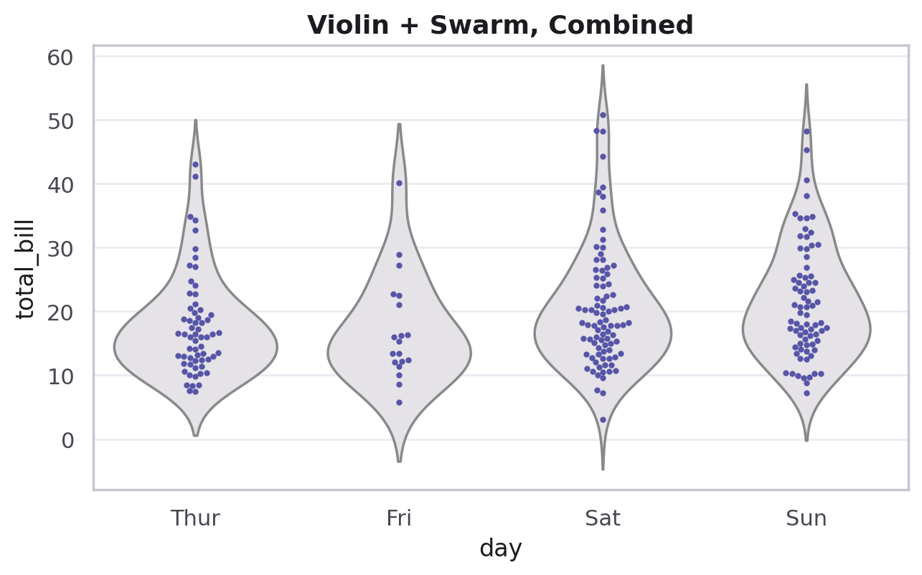
PART 4 · CATEGORICAL PLOTS
Combining Violin & Swarm
sns.violinplot(
x="day", y="total_bill",
data=tips, inner=None
)
sns.swarmplot(
x="day", y="total_bill",
data=tips, color=".2"
)
Two sns. calls, one after another, on the same Axes — Seaborn keeps drawing onto whatever's currently active, just like plt.
This gives you the overall shape (violin) and the real data points (swarm) in one chart — the best of both.
CodeByPaxto · AI & ML Playground · Seaborn
33

Slide 34
◎
PART 4 · CATEGORICAL PLOTS
Practice Set — Categorical Plots
Try these yourself first — no code shown, that's the point.
Build a boxplot comparing total_bill across day, and identify which day has the widest spread.
1
Build a violinplot of the same data and describe what you can see that the boxplot hid.
2
Build a countplot of smoker, split by hue="time" — which combination is most common?
3
Layer a swarmplot on top of a violinplot for the tip column, grouped by day.
4
CodeByPaxto · AI & ML Playground · Seaborn
34

Slide 35
PART 5 · RELATIONAL PLOTS
Relational Plots
Seeing how two numerical variables relate — with extra dimensions layered on through hue, size, and style.
35

Slide 36
PART 5 · RELATIONAL PLOTS
What Is a Relational Plot?
A relational plot shows how two numerical variables relate to each other — the same idea as a Matplotlib scatter plot, extended.
The upgrade: hue, size, and style let you encode 2–3 more variables on the exact same chart, without building separate panels.
sns.relplot() is the figure-level wrapper that can facet scatterplot/lineplot into a grid with col=/row=.
This section covers: scatterplot and lineplot.
CodeByPaxto · AI & ML Playground · Seaborn
36

Slide 37
PART 5 · RELATIONAL PLOTS
Anatomy of sns.scatterplot()
Parameter | Meaning
x, y | The two numerical columns being compared
hue | Colors points by a category
size | Scales point size by a numeric column
style | Changes marker shape by a category
sns.scatterplot(
x="total_bill", y="tip",
hue="time",
size="size",
style="time",
data=tips
)
CodeByPaxto · AI & ML Playground · Seaborn
37

Slide 38
PART 5 · RELATIONAL PLOTS
Total Bill vs. Tip — Four Dimensions, One Chart
sns.scatterplot(
x="total_bill", y="tip",
hue="time", size="size",
style="time",
data=tips,
alpha=0.8
)
plt.title("Total Bill vs. Tip")
x, y, color, and size — four variables at once.
CodeByPaxto · AI & ML Playground · Seaborn
38

Slide 39
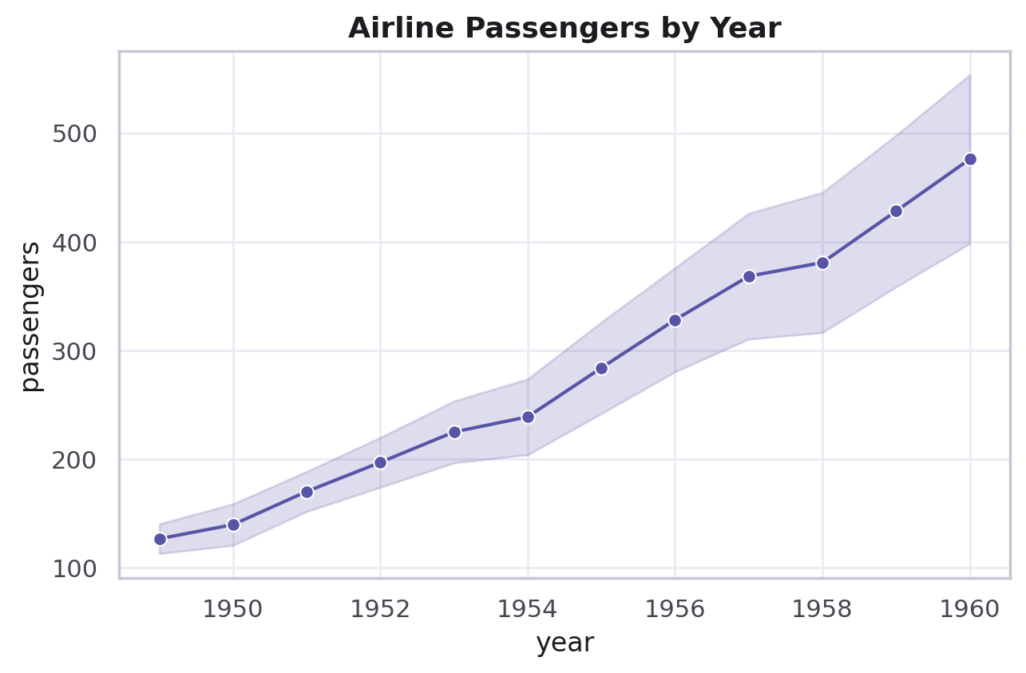
PART 5 · RELATIONAL PLOTS
sns.lineplot() — Trends, With a Confidence Band
sns.lineplot(
x="year",
y="passengers",
data=flights,
marker="o"
)
When multiple rows share the same X value, lineplot() automatically averages them and draws a confidence interval band around the line — a Matplotlib line chart can't do this on its own.
This makes lineplot the default choice for time trends in a DataFrame with repeated measurements.
Airline passengers per year, with a shaded CI band.
CodeByPaxto · AI & ML Playground · Seaborn
39

Slide 40
◎
PART 5 · RELATIONAL PLOTS
Practice Set — Relational Plots
Try these yourself first — no code shown, that's the point.
Build a scatterplot of tip vs. total_bill with hue="day".
1
Add size="size" to the same chart and describe what new information appears.
2
Build a lineplot from the flights dataset showing passengers over year, and explain what the shaded band means.
3
Try sns.relplot() with col="time" on the tips dataset — what does col= actually build?
4
CodeByPaxto · AI & ML Playground · Seaborn
40

Slide 41
PART 6 · REGRESSION PLOTS
Regression Plots
Fitting and visualizing a trend line automatically — with a confidence band around the fit.
41

Slide 42
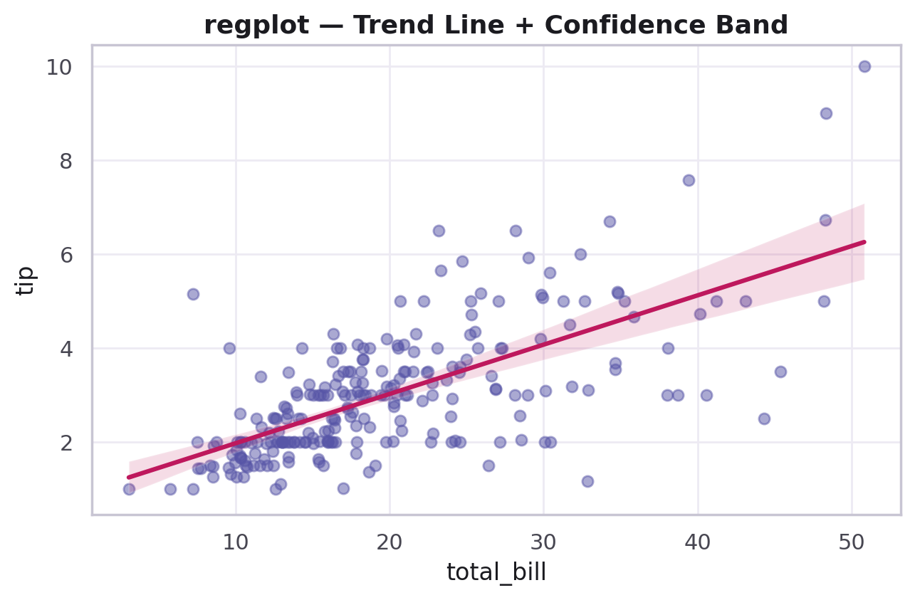
PART 6 · REGRESSION PLOTS
What Is a Regression Plot?
A regression plot draws a scatter of two numerical variables, plus a fitted trend line straight through them.
The shaded band around the line is the confidence interval — how sure Seaborn is about where the true trend sits.
This is one of the fastest ways to sanity-check "is there a relationship here at all?" before building any model.
This section covers: regplot (axes-level) and lmplot (figure-level, with faceting and hue support).
CodeByPaxto · AI & ML Playground · Seaborn
42

Slide 43
PART 6 · REGRESSION PLOTS
Anatomy of sns.regplot()
Parameter | Meaning
x, y | The two numerical columns
data | The DataFrame to plot from
scatter_kws | A dict of extra options passed to the scatter points
line_kws | A dict of extra options passed to the fit line
sns.regplot(
x="total_bill",
y="tip",
data=tips,
scatter_kws={"alpha": 0.5}
)
CodeByPaxto · AI & ML Playground · Seaborn
43

Slide 44
PART 6 · REGRESSION PLOTS
Reading a regplot() — Trend + Confidence Band
sns.regplot(
x="total_bill", y="tip",
data=tips,
scatter_kws={"alpha": 0.5},
line_kws={"color": "crimson"}
)
plt.title("Bill vs. Tip, with Trend")
The tighter the band, the more confident the fit.
CodeByPaxto · AI & ML Playground · Seaborn
44

Slide 45
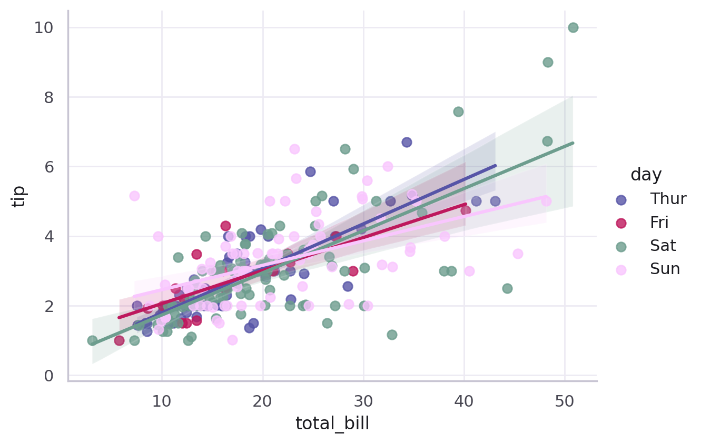
PART 6 · REGRESSION PLOTS
sns.lmplot() — One Fit Per Group
sns.lmplot(
x="total_bill", y="tip",
data=tips,
hue="day",
palette="deep",
markers="o",
scatter_kws={"s": 50}
)
hue="day" fits a separate trend line per day.
CodeByPaxto · AI & ML Playground · Seaborn
45

Slide 46
◎
PART 6 · REGRESSION PLOTS
Practice Set — Regression Plots
Try these yourself first — no code shown, that's the point.
Build a regplot of total_bill vs. tip, and describe whether the relationship looks strong or weak.
1
Rebuild it as an lmplot with hue="smoker" — do smokers and non-smokers follow the same trend?
2
Explain in one sentence what would make the confidence band narrower.
3
CodeByPaxto · AI & ML Playground · Seaborn
46

Slide 47
PART 7 · MATRIX PLOTS
Matrix Plots
Turning a grid of numbers — usually a correlation matrix — into an instantly readable picture.
47

Slide 48
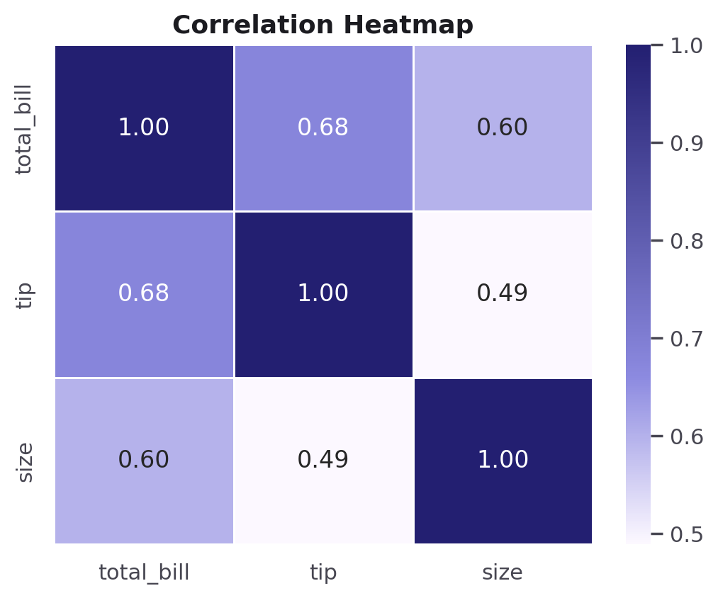
PART 7 · MATRIX PLOTS
What Is a Matrix Plot?
A matrix plot colors every cell of a 2D grid of numbers by its value — the classic use case is a correlation matrix.
Reading it: darker (or more saturated) cells mean a stronger relationship; the diagonal is always 1.0, since every column perfectly correlates with itself.
This turns a wall of numbers from df.corr() into something you can scan in two seconds.
This section covers: heatmap and a quick look at clustermap.
CodeByPaxto · AI & ML Playground · Seaborn
48

Slide 49
PART 7 · MATRIX PLOTS
Anatomy of sns.heatmap()
Parameter | Meaning
data | A 2D grid of numbers — usually a correlation matrix
annot | If True, prints the number inside each cell
cmap | The colormap used to encode value → color
linewidths | Adds thin gaps between cells
sns.heatmap(
data.corr(),
annot=True,
cmap="color_map",
linewidths=1
)
CodeByPaxto · AI & ML Playground · Seaborn
49

Slide 50
PART 7 · MATRIX PLOTS
A Correlation Heatmap
corr = tips[["total_bill",
"tip", "size"]].corr()
sns.heatmap(
corr,
annot=True,
cmap="Purples"
)
plt.title("Correlation Heatmap")
CodeByPaxto · AI & ML Playground · Seaborn
50

Slide 51
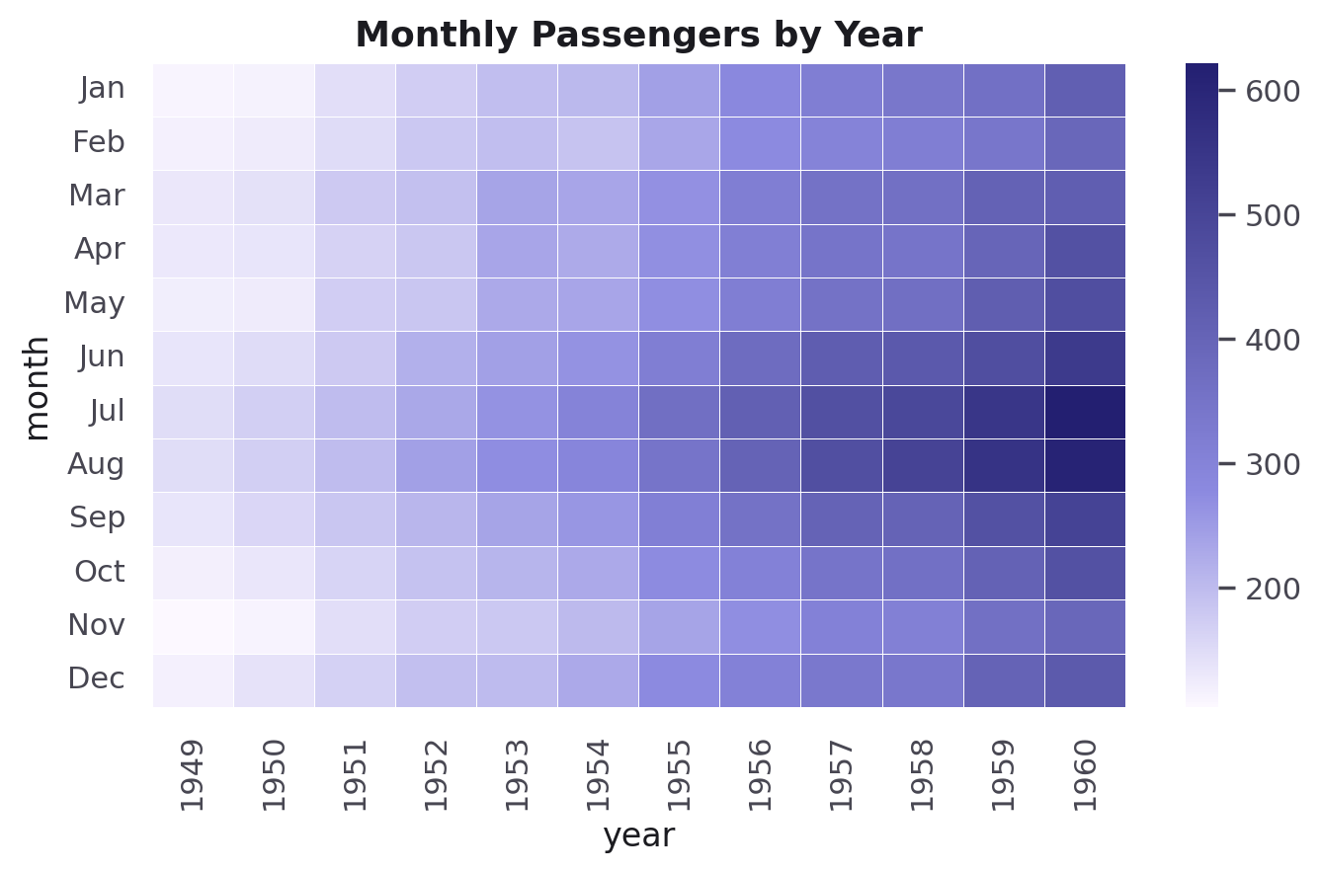
PART 7 · MATRIX PLOTS
Reshaping Data for a Heatmap
flights = sns.load_dataset("flights")
pvt = flights.pivot_table(
values="passengers",
index="month",
columns="year"
)
sns.heatmap(pvt, cmap="Purples")
pivot_table() reshapes long data into a grid heatmap can read.
CodeByPaxto · AI & ML Playground · Seaborn
51

Slide 52
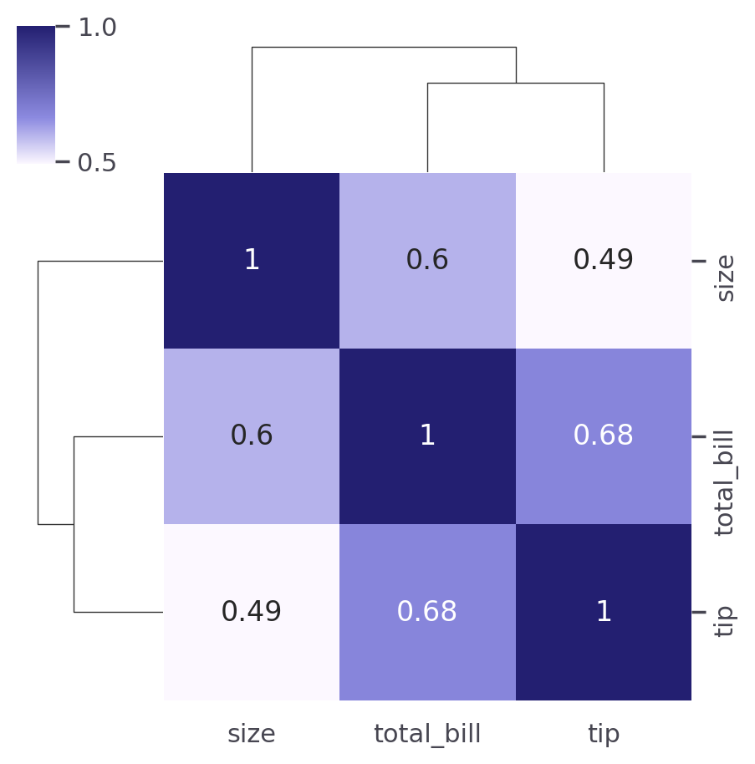
PART 7 · MATRIX PLOTS
A Quick Look: clustermap()
clustermap() draws the same heatmap, but reorders rows and columns to group similar ones together, with a small dendrogram (tree diagram) on the side.
You won't need this often as a beginner — but it's worth recognizing when you see it, since it's common in feature-correlation reports.
sns.clustermap(data.corr()) is literally a drop-in replacement for sns.heatmap(data.corr()).
CodeByPaxto · AI & ML Playground · Seaborn
52

Slide 53
◎
PART 7 · MATRIX PLOTS
Practice Set — Matrix Plots
Try these yourself first — no code shown, that's the point.
Build a correlation heatmap for any 3+ numeric columns of your choice, with annot=True.
1
Identify the strongest and weakest correlation pair in your heatmap.
2
Build a pivot_table from any dataset and turn it into a heatmap.
3
CodeByPaxto · AI & ML Playground · Seaborn
53

Slide 54
PART 8 · STYLING & PALETTES
Styling & Palettes
Making a chart presentation-ready in one or two extra lines.
54

Slide 55
PART 8 · STYLING & PALETTES
sns.set_style() — Background & Grid
Parameter | Meaning
"darkgrid" | Gray background, white grid lines (the default)
"whitegrid" | White background, gray grid lines — good for print/slides
"dark" / "white" | Same backgrounds, no grid lines at all
"ticks" | White background with small axis tick marks, no grid
Set it once, right after importing Seaborn: sns.set_style("whitegrid").
CodeByPaxto · AI & ML Playground · Seaborn
55

Slide 56
PART 8 · STYLING & PALETTES
sns.set_palette() — Choosing Colors
Parameter | Meaning
Sequential (e.g. "Blues", "Purples") | Light → dark, for one-directional numeric data
Diverging (e.g. "coolwarm", "RdBu") | Color → neutral → color, for data centered on zero
Qualitative (e.g. "Set2", "deep", "rainbow") | Distinct colors with no inherent order — for categories
sns.set_palette("deep")
# or per-chart, without changing the global default:
sns.boxplot(x="day", y="tip", data=tips, palette="Set2")
CodeByPaxto · AI & ML Playground · Seaborn
56

Slide 57
◎
PART 8 · STYLING & PALETTES
Practice Set — Styling & Palettes
Try these yourself first — no code shown, that's the point.
Redraw any earlier chart with sns.set_style("ticks") and compare it to the default.
1
Pick a sequential palette and a qualitative palette, and explain which you'd use for a correlation heatmap vs. a bar chart split by category.
2
Set a global palette with sns.set_palette(), then override it on one chart using palette= directly.
3
CodeByPaxto · AI & ML Playground · Seaborn
57

Slide 58
PART 9 · SEABORN FOR EDA & ML
Seaborn for EDA & Machine Learning
Switching to the titanic dataset — a real binary target, and the exact workflow you'll run before training any model.
58

Slide 59
PART 9 · SEABORN FOR EDA & ML
New Dataset: titanic
titanic has something tips doesn't: a real binary target column, survived — perfect for the class-balance and correlation workflows every ML project starts with.
Same sns. functions you already know — just a new, richer dataset.
titanic = sns.load_dataset("titanic")
titanic.shape
# (891, 15)
titanic[["survived", "pclass",
"age", "fare"]].head()
CodeByPaxto · AI & ML Playground · Seaborn
59

Slide 60
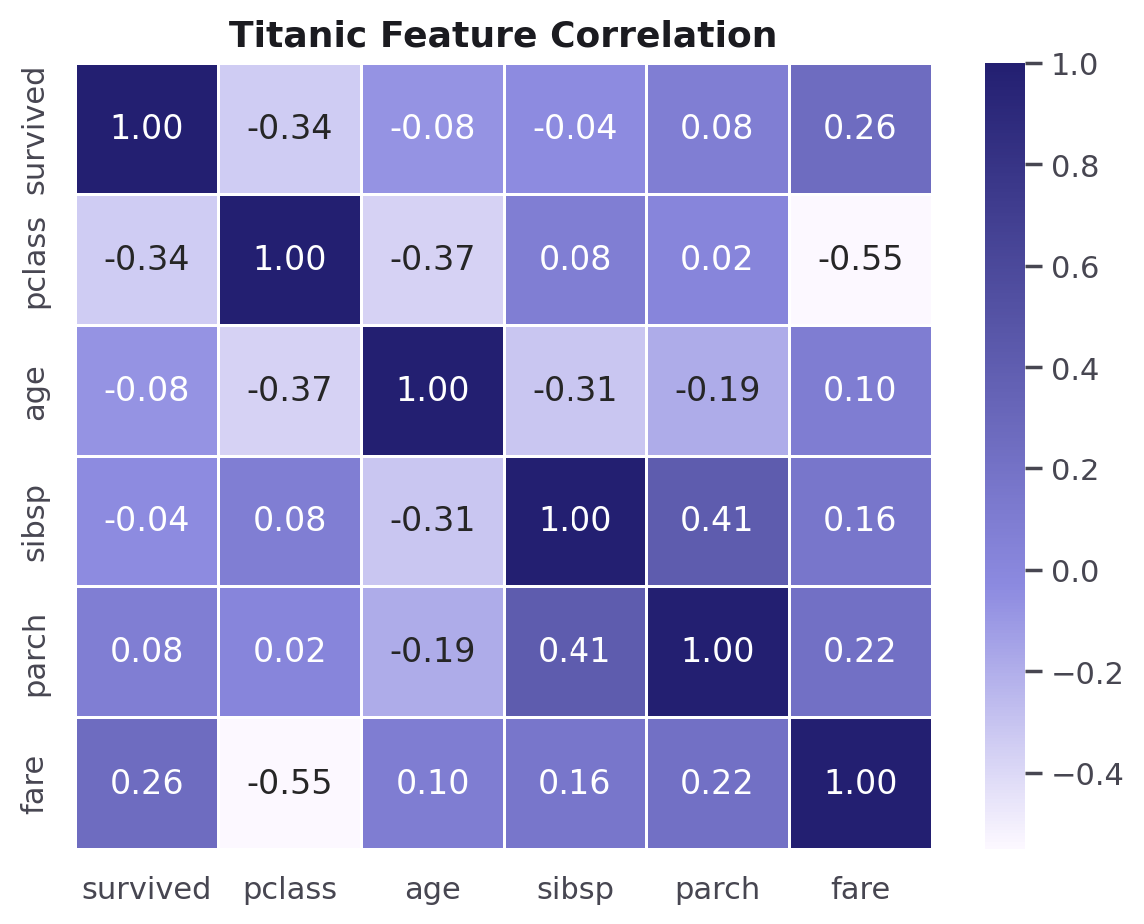
PART 9 · SEABORN FOR EDA & ML
Step 1 — Feature Screening with a Heatmap
Before building any model, check which features actually relate to your target — here, survived.
fare and pclass stand out immediately — worth investigating further; sibsp and parch barely move the needle alone.
num_cols = ["survived", "pclass",
"age", "sibsp", "parch", "fare"]
sns.heatmap(
titanic[num_cols].corr(),
annot=True, cmap="Purples"
)
CodeByPaxto · AI & ML Playground · Seaborn
60

Slide 61
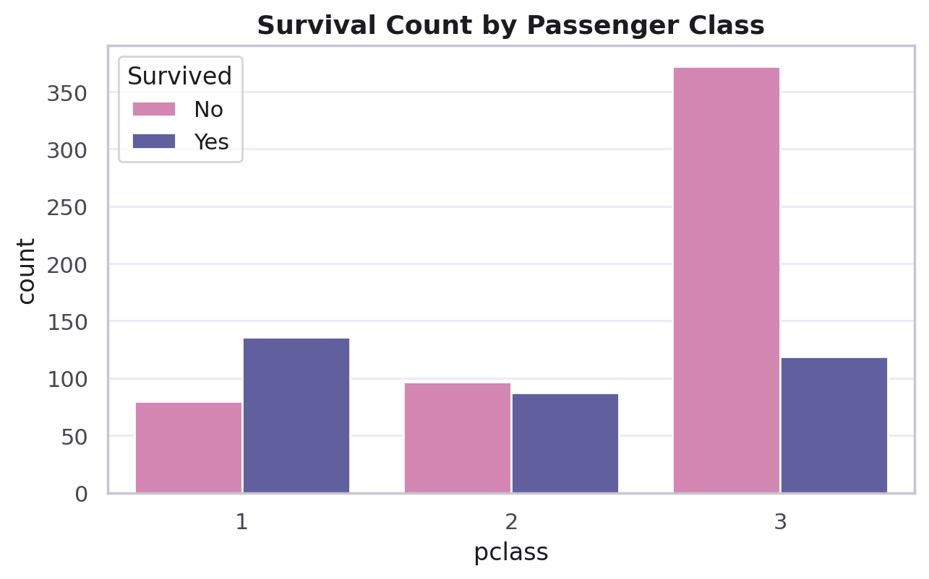
PART 9 · SEABORN FOR EDA & ML
Step 2 — Checking Class Balance
sns.countplot(
x="pclass",
hue="survived",
data=titanic,
palette=["#E07AB4", "#5755A7"]
)
A quick countplot answers: is my target balanced, and does the class break down differently by group?
1st class passengers survived at a noticeably higher rate — a strong early signal for modeling.
CodeByPaxto · AI & ML Playground · Seaborn
61

Slide 62
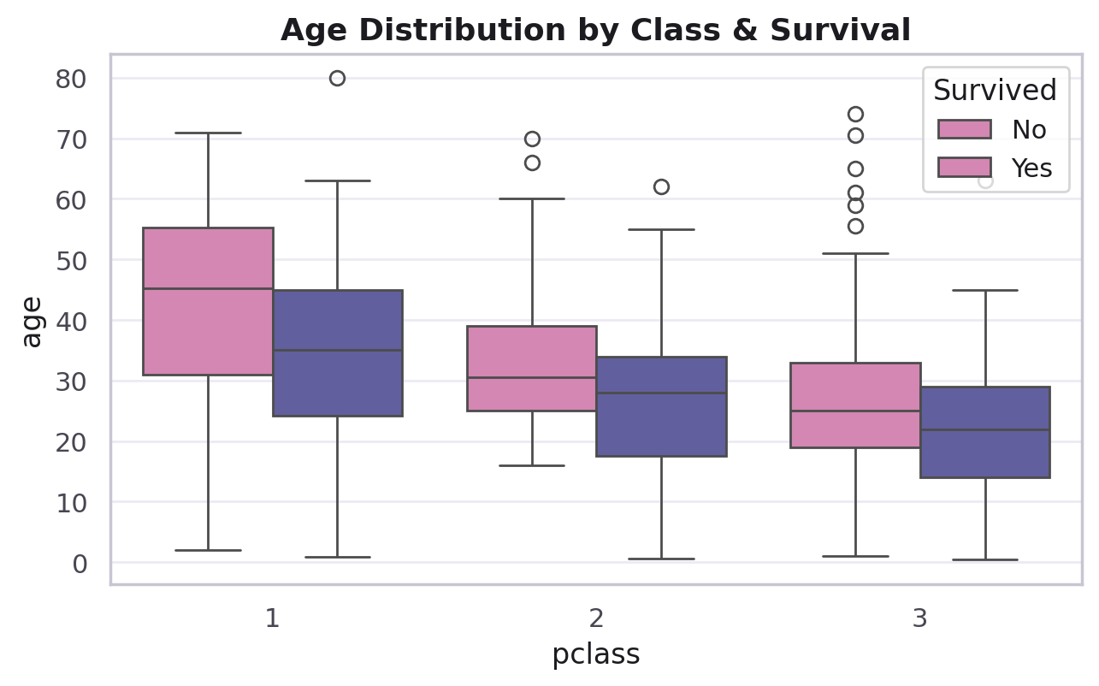
PART 9 · SEABORN FOR EDA & ML
Step 3 — Outlier & Group Checks
sns.boxplot(
x="pclass", y="age",
hue="survived",
data=titanic,
palette=["#E07AB4", "#5755A7"]
)
A boxplot per group, split by hue, is the fastest way to spot both outliers and whether a feature's spread differs meaningfully across your target.
CodeByPaxto · AI & ML Playground · Seaborn
62

Slide 63
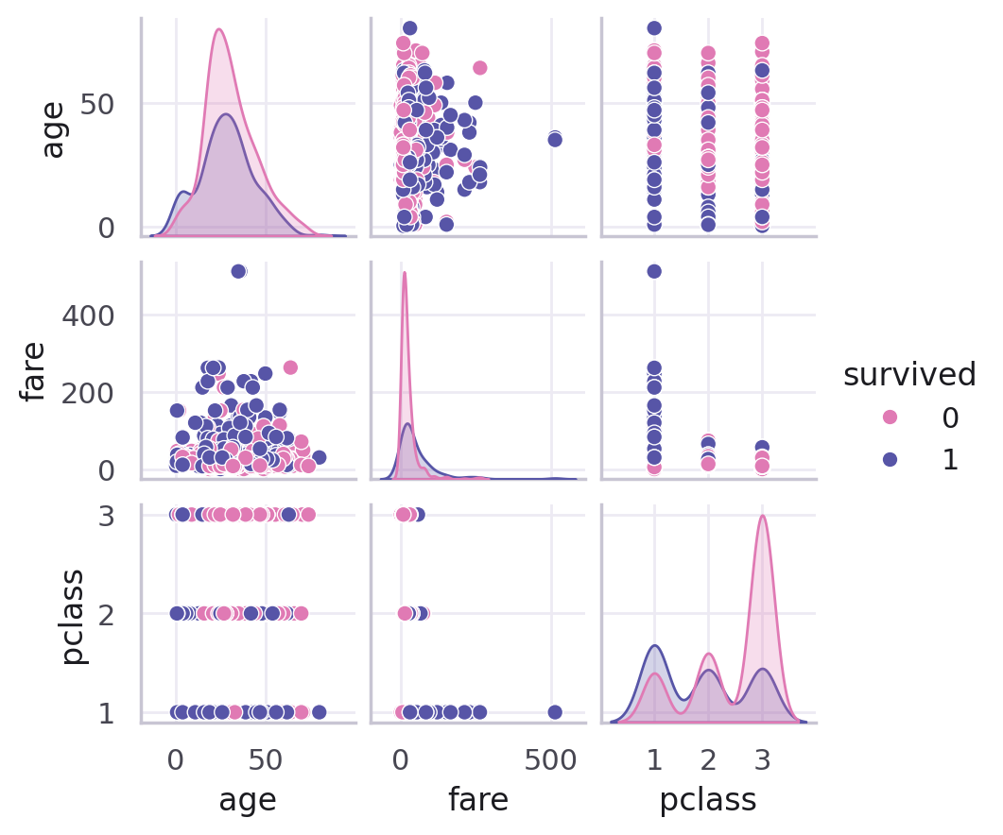
PART 9 · SEABORN FOR EDA & ML
Step 4 — Scanning Everything with pairplot()
sub = titanic[["survived", "age",
"fare", "pclass"]].dropna()
sns.pairplot(
sub, hue="survived",
palette=["#E07AB4", "#5755A7"]
)
The same pairplot() from Part 3, now with a real ML target as hue — a fast way to see which feature pairs visually separate survivors from non-survivors.
CodeByPaxto · AI & ML Playground · Seaborn
63

Slide 64
PART 9 · SEABORN FOR EDA & ML
The Workflow, Tied Together
1. Heatmap — which features even relate to the target?
2. Countplot — is the target balanced across groups?
3. Boxplot — where are the outliers, and do groups differ?
4. Pairplot — do any feature pairs visually separate the classes?
This four-step pass is almost always the first thing done to a new dataset before any model is trained — and it's now entirely built from tools you already know.
CodeByPaxto · AI & ML Playground · Seaborn
64

Slide 65
◎
PART 9 · SEABORN FOR EDA & ML
Practice Set — Seaborn for EDA & ML
Try these yourself first — no code shown, that's the point.
Build a correlation heatmap for titanic using different numeric columns than the example.
1
Build a countplot checking class balance for the sex column against survived.
2
Build a boxplot of fare by pclass, split by survived, and note anything unusual.
3
Run a pairplot on 3 columns of your choice from titanic, colored by survived.
4
CodeByPaxto · AI & ML Playground · Seaborn
65

Slide 66
PART 10 · MINI PROJECTS
Put It All Together
Three small projects combining everything from Foundations to EDA & ML — built end to end on real Seaborn datasets.
66

Slide 67
PART 10 · MINI PROJECTS
Mini Project 1: Restaurant Tipping Report
Build a 1×2 subplot: a histplot of total_bill, and a boxplot of tip grouped by day.
Use sns. functions with ax= so both panels share one Figure.
Add a title and axis labels to each panel using Matplotlib's ax. methods.
Write one sentence per panel summarizing what it shows about tipping behavior.
1
Distribution +
Categorical, combined
CodeByPaxto · AI & ML Playground · Seaborn
67

Slide 68
PART 10 · MINI PROJECTS
Mini Project 2: Titanic EDA Dashboard
Build a 2×2 grid: correlation heatmap, class-balance countplot, age boxplot by class/survival, and a small pairplot-style scatter.
Use hue="survived" consistently across every panel that supports it.
Call plt.tight_layout() so nothing overlaps.
Write a 2–3 sentence summary of what the dashboard suggests about who survived.
2
Heatmap + Countplot +
Boxplot + Pairplot
CodeByPaxto · AI & ML Playground · Seaborn
68

Slide 69
PART 10 · MINI PROJECTS
Mini Project 3: Bill vs. Tip, Fully Explained
Build a scatterplot of total_bill vs. tip with hue="time" and size="size".
Add a regplot (or lmplot with hue="day") showing the trend and confidence band.
Add a boxplot comparing tip percentage (tip / total_bill) across day.
Combine all three into one Figure using plt.subplots(1, 3, figsize=(15, 5)).
3
Scatter + Regression +
Categorical, layered
CodeByPaxto · AI & ML Playground · Seaborn
69

Slide 70
MODULE RECAP
Seaborn didn't replace Matplotlib — it gave you a faster, statistically smarter way to ask questions of a DataFrame. That heatmap-countplot-boxplot-pairplot habit is exactly what you'll run on every dataset from here forward.
Next up: Data Analytics — real datasets, real questions, and the full EDA workflow.
70

Slide 71

Thank You
Seaborn · AI & ML Playground · CodeByPaxto
71

