Slide 1
Probability
SESSION 20 · AI & ML PLAYGROUND
Rules, Conditional Probability, Bayes’ Theorem & the Central Limit Theorem — with Python
Notes:
Session 20. Probability is the bridge between descriptive statistics (Sessions 18–19) and inferential statistics (Sessions 21–22).

Slide 2
What We’re Covering Today
What probability is — sample space, events and the basic rules
1
Combining probabilities — “or”, “and” and independence
2
Conditional probability — how new information changes the odds
3
Bayes’ Theorem — updating belief, and the medical-test paradox
4
Distributions — Uniform, Binomial, Normal, plus PDF, CDF and Inverse CDF
5
The Central Limit Theorem — why inferential tests are allowed to work
6
Tasks and a mini project: Bayes’ Theorem in a real decision
7
Notes:
Every concept today follows the same rhythm: explanation, then a picture, then a few lines of Python.

Slide 3
Python Setup for This Session
Three tools cover everything today: numpy, scipy and itertools (built in).
numpy simulates random events; scipy.stats gives exact probabilities.
Every snippet is small — copy, run, then change the numbers.
# One-time install (in your terminal):
# pip install numpy scipy
import numpy as np
from scipy import stats
import itertools
rng = np.random.default_rng(42) # fixed seed
print(rng.integers(1, 7)) # a die roll: 1 to 6

Slide 4
Foundations
PART 1
The vocabulary and the basic rules everything else builds on

Slide 5
What Is Probability, Really?
A probability is a number from 0 to 1: 0 means impossible, 1 means certain.
It replaces vague words like “probably” with something you can calculate.
p-values, confidence levels and significance (Sessions 21–22) are all probability statements.
You already reason this way informally — today adds precise rules.
P
A number for uncertainty
Notes:
Ask the class for a time they said 'probably' — then show that probability makes that precise.

Slide 6
Sample Space & Events
The sample space is the set of every possible outcome: 6 die faces, 2 coin sides, 40 students.
An event is any subset you care about: “an even number”, “a student who knows ML”, “at least one head”.
With equally likely outcomes, a probability is just counting: favorable ÷ total.
Every other rule today builds on this idea.
S
Every possible outcome

Slide 7
Events as Sets: ∪, ∩ and Complement
An event is a set of outcomes, so events can be combined with set operations.
A ∪ B (union): A or B happens — at least one of them.
A ∩ B (intersection): A and B both happen.
Aᶜ (complement): A does not happen.
Every rule that follows is these symbols written inside P( ).
A ∪ B = A or B
A ∩ B = A and B
Aᶜ = not A
Read: union · intersection · complement
Class example: 40 students, A = knows FastAPI (28), B = knows ML (20). A ∪ B = all 40 students. A ∩ B = the 8 who know both.

Slide 8
Sample Space Picture: Two Dice
Two dice: all 36 outcomes
6 of 36 outcomes sum to 7
1
2
3
4
5
6
1
2
3
4
5
6
7
Each cell is one outcome; the number inside is the sum.
The teal diagonal is the event “sum = 7”.
P(sum = 7) = 6/36 = 1/6 ≈ 0.167
No other sum can be made in as many ways.
2
3
4
5
6
7
8
3
4
5
6
7
8
9
4
5
6
7
8
9
10
5
6
7
8
9
10
11
6
7
8
9
10
11
12
rows = die 1 · columns = die 2
Notes:
Walk along the teal diagonal: 1+6, 2+5, 3+4, 4+3, 5+2, 6+1.

Slide 9
Sample Space in Python
itertools.product lists every outcome of a repeated experiment.
An event is just a filter on that list.
Probability = len(event) / len(space).
import itertools
dice = list(itertools.product(range(1, 7), repeat=2))
print(len(dice)) # 36
sum7 = [d for d in dice if sum(d) == 7]
print(len(sum7)) # 6
print(round(len(sum7) / len(dice), 4)) # 0.1667

Slide 10
Probability Is Counting
For equally likely outcomes: P(event) = favorable ÷ total.
Always between 0 and 1 — an answer like 1.4 means a mistake.
Complement rule: P(not A) = 1 − P(A).
# P(event) = favorable / total
die = [1, 2, 3, 4, 5, 6]
even = [x for x in die if x % 2 == 0]
p_even = len(even) / len(die)
print(p_even) # 0.5
# complement rule: P(not A) = 1 - P(A)
print(1 - p_even) # 0.5

Slide 11
Probability as Long-Run Frequency
More flips, steadier answer
After 10 flips: 70% heads. After 10,000 flips: 49.3%.
Probability is the value the proportion settles toward as trials grow.
This is the Law of Large Numbers.
Small samples are noisy — remember this in Sessions 21–22.
Notes:
Same idea as standard error: more data, less wobble.

Slide 12
Simulating a Coin in Python
numpy draws random flips: 1 = heads, 0 = tails.
The mean of the flips is the proportion of heads.
Bigger n → closer to the true 0.5.
rng = np.random.default_rng(7)
flips = rng.integers(0, 2, size=10_000) # 1 = heads
for n in [10, 100, 1000, 10_000]:
print(n, flips[:n].mean())
# 10 0.7
# 100 0.56
# 1000 0.516
# 10000 0.4926

Slide 13
Practice Set — Foundations
◎
PART 1
Try these yourself first — pencil, paper or a quick Python cell.
List the full sample space for flipping two coins.
1
Find P(a random student knows FastAPI) if 28 of 40 do, then P(not).
2
Why would a probability of 1.4 signal a mistake in a calculation?
3
Python: use itertools to find P(sum = 8) for two dice.
4

Slide 14
Combining Probabilities
PART 2
Real questions involve more than one event — here is how “or” and “and” work

Slide 15
Addition Rule: What Does It Answer?
The Addition Rule finds the probability that at least one of two events occurs.
In plain words: the chance of A or B happening.
In probability language this is the union: P(A ∪ B).
“At least one” covers three cases: only A, only B, or both together.
Keyword to listen for in a question: “or”.
P(A ∪ B)
Probability that A or B (or both) occurs
First question to ask: can A and B happen together? The answer decides which version of the rule to use.

Slide 16
The General Addition Rule
General rule — valid for any two events A and B.
P(A ∪ B): probability of A or B occurring.
P(A ∩ B): probability that both A and B occur — the overlap.
Adding P(A) + P(B) counts the overlap twice, once inside each event.
So we subtract P(A ∩ B) to avoid double-counting the overlap.
P(A ∪ B) = P(A) + P(B)
− P(A ∩ B)
Works whether or not the events overlap
A
A ∩ B
B

Slide 17
Worked Example: FastAPI or ML
Pick one student from 40. Find P(FastAPI or ML).
A = knows FastAPI: P(A) = 28/40. B = knows ML: P(B) = 20/40.
Overlap = students who know both: P(A ∩ B) = 8/40.
FastAPI and ML can happen together, so the events are not mutually exclusive.
Check by counting: 20 FastAPI only + 12 ML only + 8 both = 40.
28/40 + 20/40 − 8/40
= 40/40 = 1
P(A ∪ B) for FastAPI or ML
Without the subtraction we would get 48/40 — above 1, because the 8 “both” students are counted twice.

Slide 18
Mutually Exclusive Events
Mutually exclusive events cannot happen at the same time.
A and B are mutually exclusive if P(A ∩ B) = 0 — the overlap is empty.
Examples: Heads and Tails on one toss; a 2 and a 5 on one die; “FastAPI only” and “ML only” for one student.
Not mutually exclusive: FastAPI and ML — a student who knows both is in each.
Careful: mutually exclusive does not mean independent.
P(A ∩ B) = 0
Zero overlap — the circles do not touch
A
B

Slide 19
Special Case: Mutually Exclusive Addition
If A and B are mutually exclusive, then P(A ∩ B) = 0.
The general rule loses its last term — there is no overlap to subtract.
This is the simple “just add” version of the Addition Rule.
Example: FastAPI only or ML only → 20/40 + 12/40 = 32/40 = 4/5.
Example: a 2 or a 5 on one die → 1/6 + 1/6 = 1/3.
P(A ∪ B) = P(A) + P(B)
Use only when P(A ∩ B) = 0
A
B

Slide 20
The Addition Rule — “OR”
Mutually exclusive
Overlapping
The events can never happen together.
Just add: P(A or B) = P(A) + P(B).
Example: a 2 or a 5 on one die → 1/6 + 1/6 = 1/3.
The events can happen together.
Subtract the overlap: P(A or B) = P(A) + P(B) − P(A and B).
Example: FastAPI or ML → 28/40 + 20/40 − 8/40 = 1.

Slide 21
The Overlap Is Counted Twice
P(A or B) = 0.6
S (sample space)
A
B
P(A) = 0.4, P(B) = 0.3, P(A and B) = 0.1.
Adding 0.4 + 0.3 counts the overlap twice.
Subtract it once: 0.4 + 0.3 − 0.1 = 0.6
Each number in the picture is the probability of that region.
A ∩ B
0.3
0.1
0.2
P(A) = 0.3 + 0.1 = 0.4 P(B) = 0.2 + 0.1 = 0.3
Notes:
Point at the overlap: both circles include it, so a plain sum counts it twice.

Slide 22
Python & Machine Learning: The Overlap
Class of 40 Students
Class of 40 students
Neither: 10
Python
Machine Learning
12 know only Python.
8 know both Python and Machine Learning.
10 know only Machine Learning.
10 know neither.
Question: What is the probability that a randomly selected student knows Python OR Machine Learning?
Both
12
8
10
The overlap holds the 8 students who know both subjects.

Slide 23
Step by Step: Python OR Machine Learning
Step 1: Find the total who know Python.
P(A) = (12 + 8) / 40 = 20/40
1
P(A ∪ B) = 75%
Step 2: Find the total who know Machine Learning.
P(B) = (10 + 8) / 40 = 18/40
The answer is 75%, or 30 out of 40 students.
Remember: Add both groups, subtract the students counted in both, and divide by the total number of students.
2
Step 3: Add both probabilities.
20/40 + 18/40 = 38/40
Oops! The 8 students who know both subjects have been counted twice.
3
Step 4: Subtract the overlap once.
P(A ∪ B) = (20 + 18 − 8) / 40 = 30/40 = 75%
4

Slide 24
The Addition Rule in Python
No overlap → plain addition.
Overlap → subtract the shared part once.
Whenever you can, check against counting a real class list.
# No overlap: a 2 OR a 5 on one die
p = 1/6 + 1/6
print(round(p, 3)) # 0.333
# Overlap: FastAPI OR ML
p_fast, p_ml, p_both = 28/40, 20/40, 8/40
p_or = p_fast + p_ml - p_both
print(round(p_or, 3)) # 1.0 (= 40/40)

Slide 25
Multiplication Rule: What Does It Answer?
The Multiplication Rule finds the probability that two events happen together.
In plain words: the chance of A and B both occurring.
In probability language this is the intersection: P(A ∩ B).
Keywords: “and”, “both”, “then”, “in a row”.
There are two versions: one for independent events, one for dependent events.
P(A ∩ B)
Probability that A and B both occur
Every extra “and” multiplies by a number below 1, so joint events are rarer than single events.

Slide 26
Independent Events
Independent events: one event does not affect the occurrence of the other.
A and B are independent if P(A ∩ B) = P(A) · P(B).
Equivalent test: P(B | A) = P(B) — knowing A happened does not change B.
The probability of both is simply the product of the individual probabilities.
Use this version when one event does not affect the other.
P(A ∩ B) = P(A) · P(B)
Independent events
Typical independent cases: separate coin flips, different dice, draws with replacement.

Slide 27
Independent Events: Tossing a Coin Twice
Let A = the first toss is Heads. Let B = the second toss is Tails.
The coin has no memory: the first toss cannot change the second.
So A and B are independent: P(A) = 1/2 and P(B) = 1/2.
Check with the sample space {HH, HT, TH, TT}: only HT matches — 1 of 4.
Another case: a 6 on a die and Heads on a coin → 1/6 · 1/2 = 1/12.
P(A ∩ B) = 1/2 · 1/2
= 1/4
Heads then Tails
The product rule agrees with direct counting: 1 favorable outcome out of 4.

Slide 28
Dependent Events
Dependent events: one event affects the probability of the other.
A and B are dependent if P(A ∩ B) ≠ P(A) · P(B).
Equivalent test: P(B | A) ≠ P(B) — knowing A changes how likely B is.
Typical source: picking students without replacement — the class changes.
In real life, rain and heavy traffic are linked.
P(B | A) ≠ P(B)
Dependent events
Dependence needs conditional probability: P(B | A) is the probability of B given that A has happened.

Slide 29
Dependent Events: Two Picks Without Replacement
Class of 40 (8 know both). A = first pick knows both. B = second pick knows both, first student not put back.
P(A) = 8/40.
One “both” student is gone: 7 remain among 39, so P(B | A) = 7/39.
Multiply: first “both” student and then second one.
Wrongly treating them as independent gives (8/40)² = 0.04 — too high.
P(A ∩ B) = P(A) · P(B | A)
= 8/40 · 7/39 = 7/195 ≈ 0.0359
Two “both” students in a row
Same multiplication idea — only the second factor changes after the first draw.

Slide 30
The Multiplication Rule — “AND”
It gives the probability that A and B both happen.
For independent events, multiply: P(A and B) = P(A) × P(B).
Two heads in a row: 0.5 × 0.5 = 0.25.
Every extra requirement shrinks the probability.
×
Both must happen

Slide 31
Probabilities Shrink Fast
8 heads in a row: 0.4%
Each extra flip multiplies the chance by 0.5.
8 in a row is 1 in 256.
Asking for more things to happen together makes the whole less likely.
Rare chains are rarer than they feel.

Slide 32
The Multiplication Rule in Python
Independent events: multiply the individual probabilities.
A simulation is a good sanity check on the maths.
100,000 trials land very close to 0.25.
# Two heads in a row (independent)
print(0.5 * 0.5) # 0.25
# A 6 on a die, then a student who knows both
print(round((1/6) * (8/40), 4)) # 0.0333
# Check the first one by simulation
rng = np.random.default_rng(1)
a = rng.integers(0, 2, 100_000)
b = rng.integers(0, 2, 100_000)
print(((a + b) == 2).mean()) # 0.24955

Slide 33
Independent vs. Dependent Events
Independent
Dependent
One event has no effect on the other.
Examples: separate coin flips, two different dice.
Multiply directly: P(A) × P(B).
One event changes the other’s probability.
Example: picking students without replacement.
Needs conditional probability — coming up in Part 3.
Notes:
Deciding whether events are independent is often the hardest judgement call in a real problem.

Slide 34
Without Replacement: Two “Both” Students
After one “both” student is picked, only 7 are left among 39 students.
So the second draw depends on the first.
Treating it as independent gives a wrong answer.
# Two students who know both, WITHOUT replacement
p_first = 8 / 40
p_second = 7 / 39 # one “both” student is already gone
print(round(p_first * p_second, 4)) # 0.0359
# Wrong: pretending the draws are independent
print(round((8/40) ** 2, 4)) # 0.04

Slide 35
Independent vs. Mutually Exclusive
Independent
Mutually exclusive
One event does not change the other’s probability.
P(A ∩ B) = P(A) · P(B)
Both can happen together.
Example: Heads on coin 1 and Heads on coin 2.
The events cannot happen together.
P(A ∩ B) = 0
If A happens, B is impossible — they strongly affect each other.
Example: one die showing a 2 and a 5.
If P(A) > 0 and P(B) > 0, mutually exclusive events are always dependent.

Slide 36
Which Rule Do I Use?
“OR” → Addition Rule
“AND” → Multiplication Rule
Look for: or, at least one, either.
Union: P(A ∪ B)
Overlap possible: P(A) + P(B) − P(A ∩ B)
Mutually exclusive: P(A) + P(B)
Look for: and, both, then, in a row.
Intersection: P(A ∩ B)
Independent: P(A) · P(B)
Dependent: P(A) · P(B | A)
Ask two questions every time: OR or AND? Then overlap or independence?

Slide 37
Practice Set — Combining Probabilities
◎
PART 2
Try these yourself first — pencil, paper or a quick Python cell.
In a class of 40 (20 FastAPI only, 12 ML only, 8 both), find P(FastAPI only OR ML only).
1
Find P(rolling a 3 on one die AND flipping heads on one coin).
2
Are “it rains today” and “traffic is heavy today” independent or dependent? Why?
3
P(A) = 0.4, P(B) = 0.3, P(A and B) = 0.1. Find P(A or B) in Python.
4

Slide 38
Conditional Probability & Bayes
PART 3
What happens to a probability once you learn something new — the most useful idea in this session

Slide 39
What Is Conditional Probability?
P(A | B) is the probability of A, given that B already happened.
The bar means “given” — it is not division.
New information changes probabilities: rain is likelier given dark clouds.
Bayes’ Theorem is built entirely on this idea.
|
Given this, what about that?

Slide 40
Conditional Probability: The Formula
P(A | B) is the probability of A given that B has already happened.
Knowing B shrinks the sample space to only the outcomes where B is true.
Inside that smaller world, count where A also happens: that is A ∩ B.
So divide: both happen ÷ B happens.
Example: P(Both | FastAPI) = (8/40) ÷ (28/40) = 8/28 = 2/7.
P(A | B) = P(A ∩ B) / P(B)
Requires P(B) > 0
Rearranged, this is the Multiplication Rule for dependent events: P(A ∩ B) = P(B) · P(A | B).

Slide 41
Given FastAPI, the Class Shrinks to 28
A class of 40 students: 4 rows × 10 seats
P(Both | FastAPI)
R1
D
D
D
D
D
B
B
M
M
M
R2
D
D
D
D
D
B
B
M
M
M
Given: the student knows FastAPI.
The sample space shrinks from 40 students to 28.
8 of those 28 know both.
P = 8/28 = 2/7 ≈ 0.286
With no information, P(Both) is only 8/40 = 0.20.
R3
D
D
D
D
D
B
B
M
M
M
R4
D
D
D
D
D
B
B
M
M
M
FastAPI only — 20
Both — 8
ML only — 12
Given “FastAPI”, only the purple and teal students remain.
Notes:
Conditioning means: throw away every outcome where B is false, then count again.

Slide 42
Conditional Probability in Python
Build the class list, then filter to the “given” group.
Count how many in that group also satisfy the event.
Formula: P(A | B) = P(A and B) ÷ P(B).
# 20 FastAPI only (D), 12 ML only (M), 8 both (B)
students = ["D"] * 20 + ["M"] * 12 + ["B"] * 8
# Given: the student knows FastAPI
data = [s for s in students if s in ("D", "B")]
both = [s for s in data if s == "B"]
print(len(data), len(both)) # 28 8
print(round(len(both) / len(data), 4)) # 0.2857

Slide 43
P(A | B) Is Not P(B | A)
P(Both | FastAPI)
P(FastAPI | Both)
Given FastAPI, how likely is Both?
8 of the 28 FastAPI students know both.
P = 8/28 ≈ 0.29
Given Both, how likely is FastAPI?
All 8 “both” students know FastAPI.
P = 8/8 = 1.0
Notes:
Setup for Bayes: a test gives P(positive | disease), but a patient needs P(disease | positive).

Slide 44
Bayes’ Theorem — Updating Beliefs
You often know P(evidence | hypothesis) but want P(hypothesis | evidence).
A test gives P(positive | disease); a patient wants P(disease | positive).
Bayes’ Theorem flips the condition and updates your belief.
It powers spam filters, diagnosis tools and Naive Bayes in ML.
↔
Flip the condition around

Slide 45
The Four Parts of Bayes’ Theorem
1
2
3
4
Prior
P(A)
Likelihood
P(B | A)
Evidence
P(B)
Posterior
P(A | B)
What you believed before seeing any evidence.
How probable the evidence is if the hypothesis is true.
The overall chance of seeing this evidence — it normalizes the result.
Your updated belief after the evidence.
P(A | B) = P(B | A) × P(A) ÷ P(B)
posterior = likelihood × prior ÷ evidence
Notes:
A = hypothesis (has the disease). B = evidence (tested positive).

Slide 46
Where Bayes’ Theorem Comes From
Write the Multiplication Rule two ways for the same event A ∩ B.
P(A ∩ B) = P(A | B) · P(B)
P(A ∩ B) = P(B | A) · P(A)
Both equal P(A ∩ B), so set them equal and divide by P(B).
The result flips the condition: from P(B | A) to P(A | B).
P(A | B) = P(B | A) · P(A) / P(B)
Bayes’ Theorem
Posterior = likelihood × prior ÷ evidence.

Slide 47
Bayes Step by Step: The Medical Test
Let D = has the disease, + = tests positive.
P(D) = 0.01 (prior). P(+ | D) = 0.95. P(+ | Dᶜ) = 0.05.
Evidence: P(+) = 0.95·0.01 + 0.05·0.99 = 0.0095 + 0.0495 = 0.059.
Posterior: P(D | +) = 0.0095 ÷ 0.059 ≈ 0.161.
A positive test still leaves only about a 16% chance of disease.
P(D | +) = (0.95 × 0.01) / 0.059
≈ 0.161
Posterior probability
P(+) adds every way to test positive: true positives and false positives.

Slide 48
Bayes Medical Test: Out of 10,000 People
Disease prevalence 1% · test is 95% accurate
590 positives, only 95 are sick
Test + 95
Has disease
100 (1%)
95 true positives + 495 false positives = 590 positive tests.
P(disease | positive) = 95 / 590 ≈ 16%
The big healthy group makes far more false alarms than the small sick group makes true hits.
Test − 5
10,000 people
Test + 495
No disease
9,900 (99%)
Test − 9,405
teal = true positives rose = false positives
Notes:
Disease prevalence 1%, test sensitivity 95%, specificity 95%. Read left to right: split by disease, then by test result.

Slide 49
Why Prevalence Changes Everything
Same test, different priors
The test is 95% accurate in every bar.
At 1% prevalence a positive is right only 16% of the time (the rose bar).
The prior matters as much as the test.
At 50% prevalence the same positive is 95% reliable.

Slide 50
Bayes’ Theorem in Python
One small function turns the formula into code.
Inputs: prior, sensitivity and specificity.
Output: P(disease | positive) = 0.161.
def bayes(prior, sens, spec):
# P(positive) = true + false positives
p_pos = sens * prior + (1 - spec) * (1 - prior)
return sens * prior / p_pos
# 1% prevalence, 95% sensitivity, 95% specificity
post = bayes(0.01, 0.95, 0.95)
print(round(post, 3)) # 0.161

Slide 51
A Second Positive Test
Today’s posterior becomes tomorrow’s prior.
One positive: 16%. Two positives: 78.5%.
This is why doctors order a confirmatory test.
# uses bayes() from the previous slide
# the posterior after test 1 is the prior for test 2
p1 = bayes(0.01, 0.95, 0.95) # after 1st positive
p2 = bayes(p1, 0.95, 0.95) # after 2nd positive
print(round(p1, 3)) # 0.161
print(round(p2, 3)) # 0.785

Slide 52
Practice Set — Conditional Probability & Bayes
◎
PART 3
Try these yourself first — pencil, paper or a quick Python cell.
Class of 40: 20 FastAPI only, 12 ML only, 8 both. Count P(FastAPI | ML) in Python.
1
Explain the difference between P(A | B) and P(B | A) using your own example.
2
A filter flags 98% of real spam, and only 1% of all email is spam. Why can a “spam” flag still be wrong?
3
Python: run bayes(0.05, 0.90, 0.90). Is the answer higher or lower than you expected?
4

Slide 53
Probability Distributions & the CLT
PART 4
Shapes that describe which outcomes are likely — and the theorem that makes inference work

Slide 54
What Is a Probability Distribution?
A distribution lists every possible outcome and how likely each one is.
Its shape — flat, lopsided, bell-shaped — reveals the process behind the data.
Today: Uniform, Binomial and Normal.
It extends Session 19’s histograms to true, known probabilities.
~
The shape of possible outcomes

Slide 55
Three Shapes, Three Stories
Uniform
Binomial
Normal
Every outcome equally likely — a fair die.
Successes in a fixed number of trials — heads in 10 flips.
The bell curve — heights, errors, test scores.
Notes:
Which shape fits depends entirely on what you are measuring.

Slide 56
Uniform in Python
Uniform: every outcome has the same probability.
stats.randint models a fair die — faces 1 to 6.
6,000 simulated rolls land near 1,000 per face.
die = stats.randint(1, 7) # faces 1 to 6
print(round(die.pmf(3), 4)) # 0.1667 P(X = 3)
print(round(die.cdf(4), 4)) # 0.6667 P(X <= 4)
rng = np.random.default_rng(3)
rolls = rng.integers(1, 7, size=6000)
print(np.bincount(rolls)[1:])
# [1032 1017 1003 960 1005 983]

Slide 57
The Binomial Distribution
Counts successes in n independent trials, each with probability p.
Example: heads in 10 fair flips (n = 10, p = 0.5).
Mean = n × p, so 5 heads on average.
Used for conversions, defects and yes/no survey counts.
n
Successes in fixed trials

Slide 58
Binomial: Heads in 10 Fair Flips
P(exactly 5) = 0.246
Teal bar: exactly 5 heads — the single most likely outcome.
Rose bars: 8 or more heads, P ≈ 0.055.
Extreme results sit in the thin tails.
Mean = 5, standard deviation ≈ 1.58.

Slide 59
Binomial in Python
.pmf() gives P(X = k) exactly.
.cdf() gives P(X ≤ k) — a running total.
Use 1 − cdf for “more than” questions.
heads = stats.binom(n=10, p=0.5)
print(round(heads.pmf(5), 3)) # 0.246 P(exactly 5)
print(round(heads.cdf(3), 3)) # 0.172 P(at most 3)
print(round(1 - heads.cdf(7), 3)) # 0.055 P(8 or more)
print(heads.mean()) # 5.0
print(round(heads.std(), 2)) # 1.58

Slide 60
The Normal Distribution
The classic symmetric bell curve: most values sit near the mean.
Height, blood pressure, measurement error and test scores follow it closely.
Two numbers define it: the mean (centre) and the standard deviation (width).
This is the curve behind Session 19’s empirical rule.
N
Nature’s favorite shape

Slide 61
The Normal Curve and the 68–95–99.7 Rule
How much sits where
≈ 68% of values fall within ±1σ of the mean.
≈ 95% fall within ±2σ.
≈ 99.7% fall within ±3σ.
Beyond ±3σ (rose, barely visible): about 0.3% in total.
Notes:
Session 19's empirical rule, now stated as probabilities.

Slide 62
The Probability Density Function (PDF)
The PDF is the bell curve itself: its height shows how likely values are.
Tall part = common values. Thin tails = rare values.
Height alone is not a probability — the area under the curve is.
Total area under the curve = 1 (100%).
The PDF of a Normal curve
f(x) = 1 / (σ · √(2π))
× e^( −½ · ((x − μ) / σ)² )
No need to memorise it — just know the parts:
x = the value you look up
μ = the mean (centre of the bell)
σ = the standard deviation (how wide)
e ≈ 2.718 (Euler’s number)
SciPy does the maths: norm.pdf(x, mean, sd)
Source: Essential Math for Data Science — Thomas Nield (O’Reilly), Ch. 3
Notes:
Plain-language intro to the PDF. Reference: Essential Math for Data Science (Thomas Nield, O’Reilly), Chapter 3, “The Probability Density Function (PDF)”. Stress: height is NOT probability; area is.

Slide 63
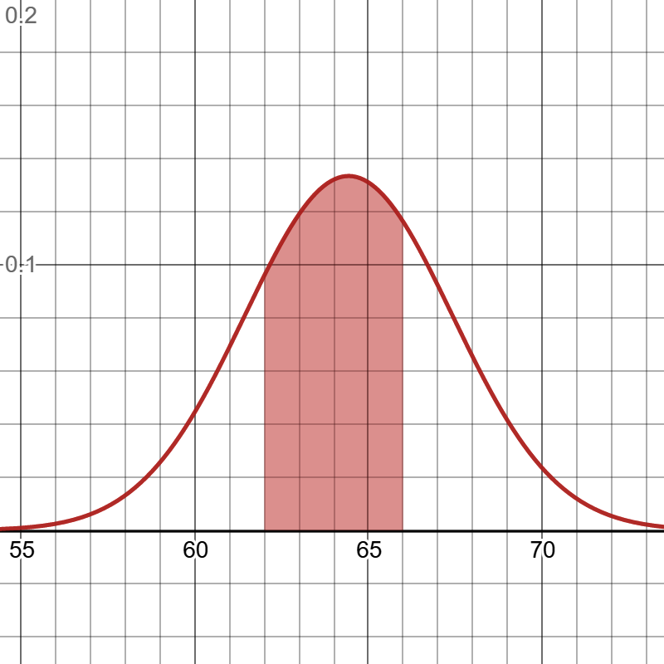
Probability Is the Area Under the PDF
Ask about a range, then find the area
Golden retriever weights: mean 64.43 lb, SD 2.99 lb.
The shaded slice between 62 and 66 lb is the probability of a dog landing in that range.
The Normal curve is continuous, so one exact value (like 64.000 lb) has almost zero probability — we always ask about a range.
Finding that area is the job of the CDF.
Figure 3-7 · shaded area = P(62 ≤ weight ≤ 66 lb)
Source: Essential Math for Data Science — Thomas Nield (O’Reilly)
Notes:
Figure 3-7 from Essential Math for Data Science (Nield, O’Reilly). Example: golden retriever weights, mean 64.43, SD 2.99. Explain: we can’t ask for P(exactly 64), only ranges.

Slide 64
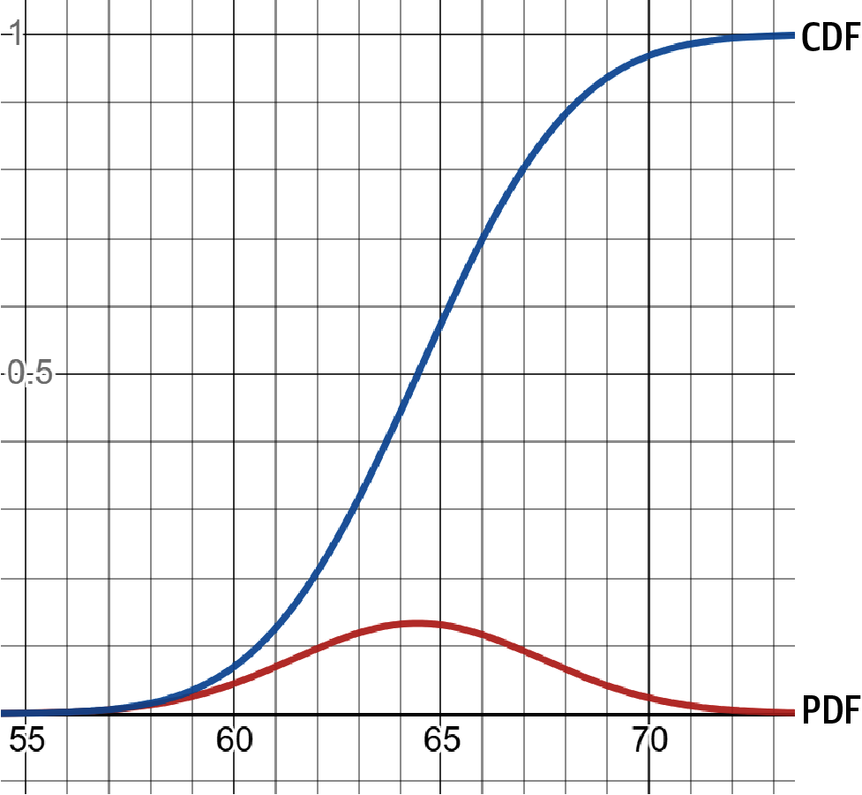
The CDF: Area Up To a Point
CDF(x) = the area to the left of x
Red bell = the PDF. Blue S-curve = the CDF (CDF = Cumulative Distribution Function).
At any x on the bottom axis, the blue curve’s height is the probability of getting a value up to x.
It climbs from 0 (nothing collected yet) to 1 (everything collected).
The S is steepest where the bell is tallest.
Figure 3-8 · a PDF alongside its CDF
Source: Essential Math for Data Science — Thomas Nield (O’Reilly)
Notes:
Figure 3-8 from Essential Math for Data Science (Nield, O’Reilly). Analogy: the CDF is a running total of the PDF’s area.

Slide 65
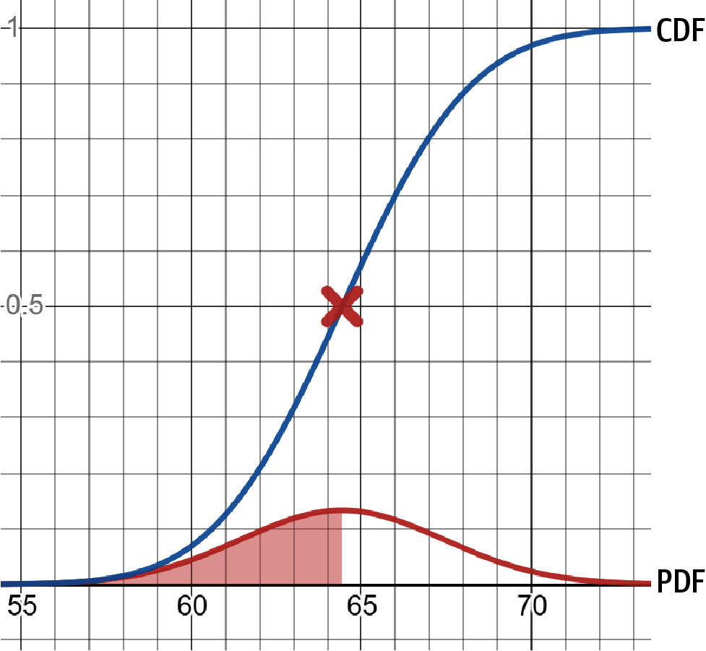
The CDF at the Mean Is 0.5
Half the area sits left of the mean
Shaded: all the area from far left up to the mean, 64.43 lb.
The Normal curve is symmetric, so exactly half of the area lies on each side of the mean.
That is why the CDF reads 0.5, or 50%, at the mean — the red X.
To read a CDF: pick x on the bottom, go up to the blue curve, read the probability on the side.
Figure 3-9 · PDF and CDF, area up to the mean
Source: Essential Math for Data Science — Thomas Nield (O’Reilly)
Notes:
Figure 3-9 from Essential Math for Data Science (Nield, O’Reilly). Symmetry argument: 50% below the mean, 50% above.

Slide 66
PDF and CDF in Python
norm.pdf(x, mean, sd) gives the curve’s height at x — a likelihood, not a probability.
norm.cdf(x, mean, sd) gives the area up to x — a real probability.
Half the area is below the mean, so the CDF at the mean is 0.5.
from scipy.stats import norm
mean, sd = 64.43, 2.99
# curve height at the peak (a likelihood)
print(round(norm.pdf(64.43, mean, sd), 4))
# 0.1334
# area up to the mean
print(norm.cdf(64.43, mean, sd))
# 0.5
# area up to 66 lb = P(weight <= 66)
print(round(norm.cdf(66, mean, sd), 4))
# 0.7002
Notes:
Examples adapted from Essential Math for Data Science (Nield, O’Reilly), Chapter 3, Examples 3-9 to 3-11. norm.pdf is the curve height; norm.cdf is the area up to x.

Slide 67
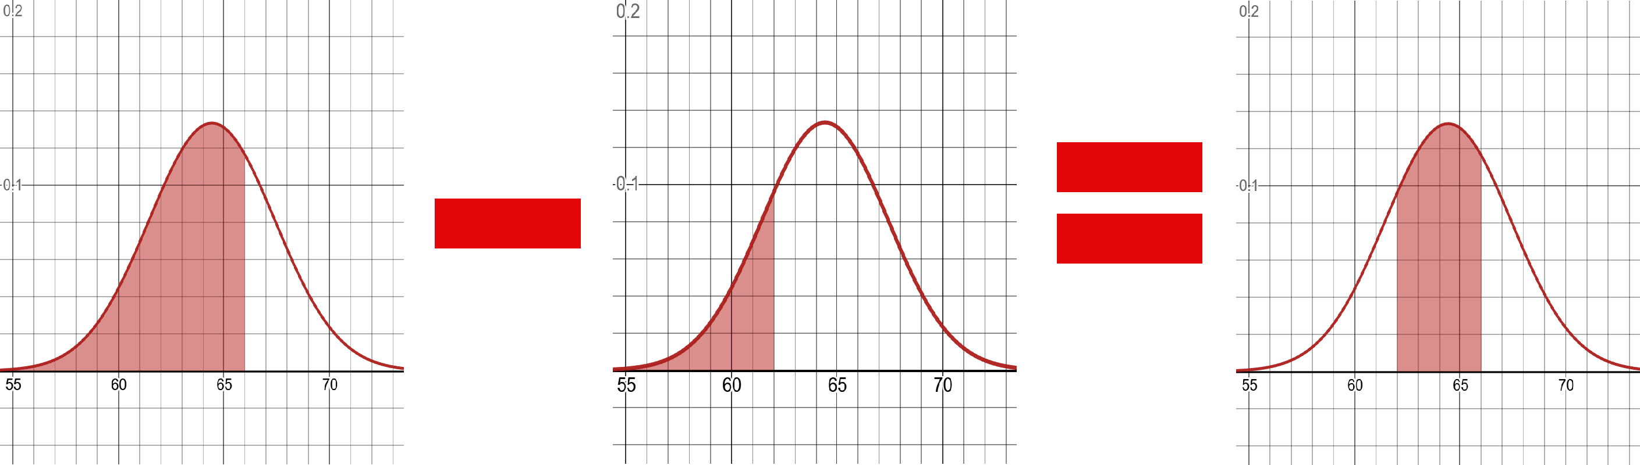
Middle Range: CDF(66) − CDF(62)
Big area − small area
0.7002 − 0.2082 = 0.4920
About 49.2% of golden retrievers weigh between 62 and 66 lb.
Figure 3-10 · finding a middle range of probability
Source: Essential Math for Data Science — Thomas Nield (O’Reilly)
x = norm.cdf(66, mean, sd) - norm.cdf(62, mean, sd)
print(x) # 0.4920 -> P(62 <= weight <= 66)
Notes:
Figure 3-10 and Example 3-11 from Essential Math for Data Science (Nield, O’Reilly), Chapter 3. Big area minus small area leaves the middle slice.

Slide 68
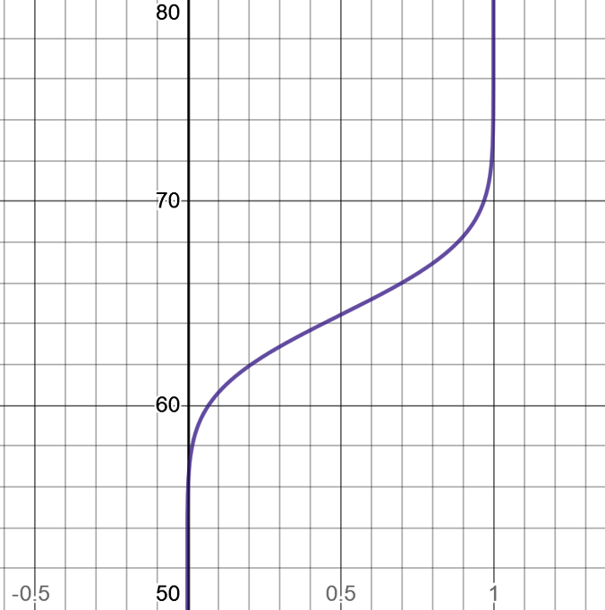
The Inverse CDF (PPF)
Flip the CDF: probability in, value out
CDF: give a weight, get a probability (the area up to it).
Inverse CDF (also called the PPF or quantile function): give a probability, get the weight.
It is the same curve with its axes swapped.
Example: 95% of golden retrievers weigh 69.35 lb or less.
Figure 3-11 · the inverse CDF, also called the PPF or quantile function
Source: Essential Math for Data Science — Thomas Nield (O’Reilly)
Notes:
Figure 3-11 from Essential Math for Data Science (Nield, O’Reilly). In SciPy the inverse CDF is norm.ppf (percent point function).

Slide 69
The Inverse CDF in Python
norm.ppf(p, mean, sd) is the inverse CDF: probability in, value out.
Here: 95% of golden retrievers weigh 69.348 lb or less.
Feed it random numbers between 0 and 1 to simulate realistic weights.
from scipy.stats import norm
import random
mean, sd = 64.43, 2.99
# weight that 95% of dogs fall under
print(round(norm.ppf(0.95, mean, sd), 3))
# 69.348
# 1,000 random realistic weights
weights = []
for i in range(1000):
p = random.uniform(0.0, 1.0)
weights.append(norm.ppf(p, mean, sd))
Notes:
Examples adapted from Essential Math for Data Science (Nield, O’Reilly), Chapter 3, Examples 3-12 and 3-13. ppf = inverse CDF. Feeding random numbers between 0 and 1 into ppf simulates data that follows the Normal distribution.

Slide 70
The Empirical Rule in Python
stats.norm.cdf(z) gives P(Z ≤ z).
Subtract two cdf values to get a range.
These are the empirical-rule numbers, now exact.
z = stats.norm(loc=0, scale=1)
# P(within 1, 2, 3 standard deviations)
print(round(z.cdf(1) - z.cdf(-1), 3)) # 0.683
print(round(z.cdf(2) - z.cdf(-2), 3)) # 0.954
print(round(z.cdf(3) - z.cdf(-3), 3)) # 0.997

Slide 71
Normal Tail Probabilities
Real data needs only a mean and a standard deviation.
Example: IQ ~ Normal(mean 100, SD 15).
ppf is the reverse of cdf: probability in, value out.
This is the mechanism behind the z-test in Session 21.
iq = stats.norm(loc=100, scale=15)
print(round(1 - iq.cdf(130), 4)) # 0.0228 P(IQ > 130)
print(round(iq.cdf(85), 4)) # 0.1587 P(IQ < 85)
# which IQ marks the top 2.5%?
print(round(iq.ppf(0.975), 1)) # 129.4

Slide 72
The Central Limit Theorem
Take many samples from any population and compute each sample’s mean.
Those means form a normal distribution — even if the population is skewed.
It needs a large enough sample: n ≥ 30 is the usual rule of thumb.
This is why inferential tests can assume normality on messy data.
x̄
Normal, no matter the source
Notes:
This single theorem is why Sessions 21 and 22 work.

Slide 73
The CLT in Pictures
The population
Sample means, n = 5
Sample means, n = 30
Heavily skewed — real data rarely looks normal.
Already smoothing out, even from skewed data.
Nearly normal, whatever the population shape.
Notes:
Real simulation: exponential population (mean 10), 3,000 samples at each size. Histograms show the share of means in each bin.

Slide 74
Simulating the CLT in Python
A skewed population: exponential, mean ≈ 10.
Draw 2,000 samples at each size and keep every mean.
σ/√n predicts how widely those means spread.
rng = np.random.default_rng(42)
pop = rng.exponential(scale=10, size=100_000)
print(round(pop.mean(), 1), round(pop.std(), 1))
# 10.0 10.1 (heavily skewed)
for n in [5, 30]:
means = [rng.choice(pop, n).mean()
for _ in range(2000)]
print(n, round(np.std(means), 2))
# 5 4.45 (theory: 10/sqrt(5) = 4.47)
# 30 1.81 (theory: 10/sqrt(30) = 1.83)

Slide 75
Why the CLT Matters for What Comes Next
1
2
3
Any population
Large enough n
Sample means ≈ Normal
Skewed, uniform or lumpy — the original shape does not matter.
n ≥ 30 is a rule of thumb, not a hard law. Very skewed data may need more.
So the z-tests and t-tests in Sessions 21–22 may assume normality.
SE = σ / √n
the more data you collect, the tighter the sample means cluster

Slide 76
Practice Set — Distributions & the CLT
◎
PART 4
Try these yourself first — pencil, paper or a quick Python cell.
Give a real-world example each of a Uniform, a Binomial and a Normal variable.
1
Use stats.norm to find the probability a value falls within 1 SD of the mean.
2
Why does the CLT matter when your original data is heavily skewed?
3
Why is n = 30 a rule of thumb rather than a hard requirement?
4

Slide 77
Your Turn: Three Task Sets
TASKS
Practise in Python — small steps, real numbers

Slide 78
Counting & Combining
1
TASK 1
Use itertools and numpy.
Build the two-dice sample space. Find P(sum = 7) and P(sum ≥ 10).
1
In a class of 40 (8 know both), find P(two “both” students in a row, no replacement), then simulate 100,000 picks.
2
In that class (20 FastAPI only, 12 ML only), find P(FastAPI only or ML only) by hand, then count a class list.
3
Simulate 10,000 pairs of coin flips and compare P(two heads) to 0.25.
4

Slide 79
Conditional Probability & Bayes
2
TASK 2
Write the formula as a function, then test it.
Class of 40 (20 FastAPI only, 12 ML only, 8 both): compute P(ML | FastAPI) by counting.
1
Write bayes(prior, sens, spec) and test it with 5% prevalence and 90% accuracy.
2
Loop over prevalence 0.1% to 50% and print each posterior. What pattern do you see?
3
Update twice for two positive tests. Report both posteriors.
4

Slide 80
Distributions & the CLT
3
TASK 3
Simulate it, then compare with the theory.
Simulate 30 die rolls and average them. Repeat 10 times, then 1,000 times. Describe the shape.
1
Use stats.binom to find P(8 or more heads in 10 flips).
2
Use stats.norm to find the probability of a value more than 2 SD above the mean.
3
Repeat the CLT demo with a uniform population. Do the sample means still look normal?
4

Slide 81
Mini Project: Bayes’ Theorem in a Real Decision
Pick a real scenario: spam filter, fraud alert, defect scanner or background check.
Estimate three numbers: the prior, the true-positive rate and the false-positive rate.
Build a tree for 1,000+ people and compute the posterior in Python.
Write 5 sentences: is the result more or less trustworthy than gut instinct, and why?
+
A complete Bayes decision, start to finish

Slide 82
Mini Project: Starter Template
Fill in the blanks, then extend it.
Write your assumptions as comments first.
Simulate 1,000+ people to confirm the maths.
# Fill in the blanks, then extend it
prior = ____ # P(problem) before any alert
sens = ____ # P(alert | real problem)
fpr = ____ # P(alert | no problem)
p_alert = sens * prior + fpr * (1 - prior)
posterior = sens * prior / p_alert
print(round(posterior, 3))
# next: simulate 1,000+ people and compare

Slide 83
What You Can Do Now
SESSION 20 COMPLETE
Calculate probabilities by counting and by simulation
Combine events with the Addition and Multiplication Rules
Compute conditional probabilities and apply Bayes’ Theorem
Recognise Uniform, Binomial and Normal distributions
Explain the Central Limit Theorem — and demonstrate it
Next up — Session 21: Inferential Statistics I · confidence intervals, hypothesis tests and p-values

