Slide 1
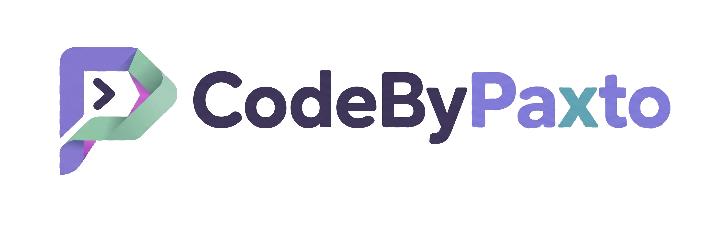
AI & ML PLAYGROUND · MODULE 04
NumPy
Numerical computing in Python — the array engine every Data Science and ML tool is built on.
CodeByPaxto: The AI & ML Playground · Hafiz Waseem Ahmed (Paxto)
01

Slide 2
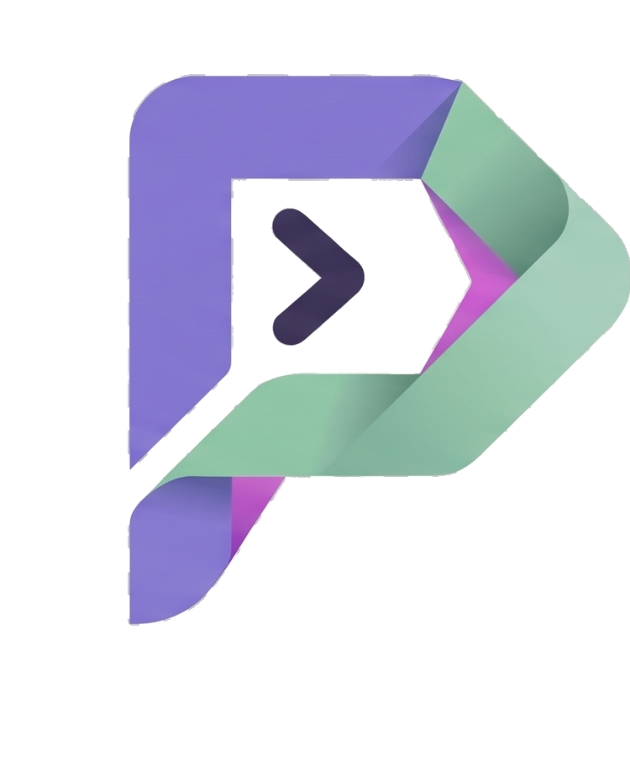
WHERE THIS FITS
The AI & ML Playground Roadmap
Python
→
Math for DS
→
Git & GitHub
→
NumPy
→
Pandas
→
Matplotlib
→
Seaborn
→
Data Analytics
→
Supervised ML
You are here — right after Git & GitHub. NumPy is the foundation Pandas, Matplotlib, and Seaborn are all built on top of; almost every array operation you'll do for the rest of this course traces back to what you learn here.
02

Slide 3
BEFORE WE START
If Python Has Lists, Why NumPy?
PYTHON LIST
NUMPY ARRAY
Flexible — can hold mixed types in one list.
Looping over a list to do math is slow — Python re-checks each element's type, one at a time.
No built-in idea of "shape" — no easy way to treat data as a matrix or grid.
Stores one fixed data type — this lets NumPy use fast, low-level compiled code underneath.
Vectorized — apply an operation to an entire array at once, no explicit loop needed.
Built-in shape, dimensions, and broadcasting — the natural way to represent vectors, matrices, and tensors.
The honest framing: NumPy doesn't replace Python lists everywhere — but for any numerical work, it's dramatically faster and is the shared language every Data Science and ML library speaks.
CodeByPaxto · AI & ML Playground · Hafiz Waseem Ahmed (Paxto)
03

Slide 4
WHAT WE'RE COVERING
Today's Roadmap
01
02
03
04
Introduction to NumPy
Foundations, Shapes & Axes
Creating Arrays & Random Data
Array Properties & Data Types
05
06
07
08
Indexing, Slicing & where()
Reshaping, Sorting & Joining
Array Modification
Operations, Broadcasting & Vectorisation
09
10
11
12
Handling Missing Values
NumPy with Real-World Data
Bonus: Images as Arrays
Mini Projects
CodeByPaxto · AI & ML Playground · Hafiz Waseem Ahmed (Paxto)
04

Slide 5
PART 1 · INTRODUCTION
Introduction to NumPy
What it is, why it exists, and where it shows up across Data Science, AI, and ML.
05

Slide 6
PART 1 · INTRODUCTION
What Is NumPy?
NumPy (Numerical Python) is Python's core library for working with arrays — grids of numbers of any dimension.
Its central object is the ndarray — an n-dimensional array that stores numbers far more efficiently than a Python list.
Where you'll actually use it: cleaning and transforming data in Pandas, plotting in Matplotlib/Seaborn, and running the actual math behind every ML model — weights, gradients, and predictions are all NumPy arrays underneath.
If Python is the language of this course, NumPy is the language every other library in it is written in.
CodeByPaxto · AI & ML Playground · Hafiz Waseem Ahmed (Paxto)
06

Slide 7
PART 1 · INTRODUCTION
Installing & Importing
np is the near-universal alias for NumPy — you'll see it in almost every Data Science codebase, so use it too.
NumPy is a dependency of Pandas, Matplotlib, and most ML libraries — if you've installed those, NumPy is already there.
Everything in this module builds from one object: the ndarray.
# one-time install
pip install numpy
# every notebook / script
import numpy as np
arr = np.array([1, 2, 3])
print(arr)
# [1 2 3]
CodeByPaxto · AI & ML Playground · Hafiz Waseem Ahmed (Paxto)
07

Slide 8
PART 1 · INTRODUCTION
Your First ndarray — Version & Type
The array object is called ndarray. np.array() accepts a list, a tuple, or any array-like object.
Check np.__version__ first when your code behaves differently from a tutorial.
A string is not split into characters: np.array("Hey there") is a 0-dimensional array with shape (). Wrap list(...) around it to get one element per character.
import numpy as np
np.__version__ # e.g. 2.2.5
arr = np.array([1, 2, 3, 4, 5])
type(arr) # numpy.ndarray
np.array((1, 2, 3, 4)) # from a tuple
np.array("Hey there") # 0-D, dtype <U9
np.array(list("Hey")) # 1-D, dtype <U1
CodeByPaxto · AI & ML Playground · Hafiz Waseem Ahmed (Paxto)
08

Slide 9
◎
PART 1 · INTRODUCTION
Practice Set — Introduction to NumPy
Try these yourself first — no code shown, that's the point.
Install NumPy (if needed), import it as np, and print np.__version__.
1
Create a NumPy array from a plain Python list of 5 numbers and print it.
2
In your own words, explain why NumPy is faster than a Python list for math operations.
3
CodeByPaxto · AI & ML Playground · Hafiz Waseem Ahmed (Paxto)
09

Slide 10
PART 2 · FOUNDATIONS
Foundations & Terminology
12 core terms, plus how to read shapes and axes.
10

Slide 11
PART 2 · TERMINOLOGY
Terms 1–4 · The Core Object
1
ndarray
2
Axis
3
Shape
4
dtype
NumPy's core data structure — an n-dimensional array of a single data type.
A direction along which an operation happens — axis 0 is rows, axis 1 is columns.
A tuple describing an array's size along each dimension, e.g. (3, 4).
The data type shared by every element in an array, e.g. int64, float32.
CodeByPaxto · AI & ML Playground · Hafiz Waseem Ahmed (Paxto)
11

Slide 12
PART 2 · TERMINOLOGY
Terms 5–8 · Dimensions, Named
5
Vector
6
Matrix
7
Tensor
8
Scalar
A 1-dimensional array — a single row or column of numbers.
A 2-dimensional array — rows and columns, like a spreadsheet grid.
An array with 3 or more dimensions — the general term ML frameworks use.
A single number — technically a 0-dimensional array.
CodeByPaxto · AI & ML Playground · Hafiz Waseem Ahmed (Paxto)
12

Slide 13
PART 2 · TERMINOLOGY
Terms 9–12 · How NumPy Operates
9
Broadcasting
10
Vectorization
11
Indexing
12
Slicing
NumPy automatically stretching a smaller array to match a bigger one during an operation.
Applying an operation to an entire array at once, instead of looping element by element.
Accessing one specific element of an array by its position.
Accessing a range/subset of an array using start:stop:step.
CodeByPaxto · AI & ML Playground · Hafiz Waseem Ahmed (Paxto)
13

Slide 14
PART 2 · TERMINOLOGY
Vector, Matrix & Tensor — Visualized
Vector (1D)
Tensor (3D+)
A Vector is a 1D array — one row of numbers, like a single feature column.
A Matrix is a 2D array — rows and columns, like a spreadsheet or a grayscale image.
A Tensor is 3D or higher — stacked matrices, like a color image (height x width x channels) or a batch of them.
NumPy handles all three with the exact same ndarray object — only the shape changes.
4
8
15
16
23
5
6
1
2
7
8
Matrix (2D)
3
4
1
2
3
4
5
6
7
8
9
CodeByPaxto · AI & ML Playground · Hafiz Waseem Ahmed (Paxto)
14

Slide 15
PART 2 · SHAPES & AXES
Reading a Shape — Nested Dolls
A shape is a tuple: each number says how many things exist in that direction. Read left to right — the leftmost number is the outermost container, like Russian dolls.
(4,) has a comma because it is a one-item tuple: 4 values along one axis. () is a bare number with no axes at all.
(2, 3) means 2 rows (axis 0) and 3 columns (axis 1) — a table, like a spreadsheet or a grayscale image.
# shape = (3, 4)
# 3 -> things along axis 0 (outermost)
# 4 -> things along axis 1
np.array(7).shape # ()
np.array([10, 20, 30]).shape # (3,)
np.array([[1, 2, 3],
[4, 5, 6]]).shape # (2, 3)
CodeByPaxto · AI & ML Playground · Hafiz Waseem Ahmed (Paxto)
15

Slide 16
PART 2 · SHAPES & AXES
Shape Has No Fixed Meaning
Shape | What each number means
(64, 64, 3) | One RGB image: 64 tall, 64 wide, 3 channels [R, G, B]
(10, 28, 28) | 10 grayscale images, each 28 tall × 28 wide — no channels
(8, 64, 64, 3) | Batch of 8 RGB images: (batch, height, width, channels)
(32, 10, 64, 64, 3) | 32 videos × 10 frames × 64×64 RGB: (batch, time, H, W, C)
img = np.zeros((64, 64, 3)) # one RGB image
imgs = np.zeros((10, 28, 28)) # 10 gray images
# the shape gives sizes; YOU decide what each axis means
CodeByPaxto · AI & ML Playground · Hafiz Waseem Ahmed (Paxto)
16

Slide 17
PART 2 · SHAPES & AXES
Axes, Features & ML Shapes
Summing along an axis removes that axis: (2, 3) with axis=0 becomes (3,), and with axis=1 becomes (2,).
ML rule: rows = samples, columns = features. Two people with age, salary and experience give X.shape = (2, 3); their labels y have shape (2,).
Cheat sheet: gray image (H, W) · RGB image (H, W, 3) · batch (N, H, W, 3) · sequence (batch, timesteps, features).
x = np.array([[1, 2, 3],
[4, 5, 6]])
x.sum(axis=0) # [5 7 9] shape (3,)
x.sum(axis=1) # [ 6 15] shape (2,)
X = np.array([[22, 30000, 1],
[35, 70000, 10]])
X.shape # (2, 3): samples, features
CodeByPaxto · AI & ML Playground · Hafiz Waseem Ahmed (Paxto)
17

Slide 18
◎
PART 2 · SHAPES & AXES
Practice Set — Shapes & Axes
Try these yourself first — no code shown, that's the point.
For the shape (8, 64, 64, 3), say what each number could mean, then build an array of zeros with that shape.
1
Create a (2, 3) array and predict the shape of sum(axis=0) and sum(axis=1) before running them.
2
Create a feature matrix X for 4 samples and 3 features, plus a matching target array y — print both shapes.
3
Explain why (10, 28, 28) could be images or time steps — what tells you which one it is?
4
CodeByPaxto · AI & ML Playground · Hafiz Waseem Ahmed (Paxto)
18

Slide 19
◎
PART 2 · TERMINOLOGY
Practice Set — Foundations & Terminology
Try these yourself first — no code shown, that's the point.
In your own words, explain the difference between a vector, a matrix, and a tensor.
1
Name the axis number for rows and the axis number for columns in a 2D array.
2
Explain what broadcasting means, using a simple example (array + single number).
3
Explain why vectorization is usually faster than a Python for-loop.
4
CodeByPaxto · AI & ML Playground · Hafiz Waseem Ahmed (Paxto)
19

Slide 20
PART 3 · CREATING ARRAYS
Creating Arrays
Every array starts somewhere — from a list, a shortcut function, or a range of values.
20

Slide 21
PART 3 · CREATING ARRAYS
From a List — np.array()
np.array() converts a Python list (or list of lists) directly into an ndarray.
The nesting depth of the list determines the dimensionality — one level for a vector, two for a matrix, three for a tensor.
This is the most common way to create an array from data you already have.
vector = np.array([1, 2, 3])
print("Vector:", vector)
matrix = np.array([
[1, 2, 3],
[4, 5, 6]
])
print("Matrix:", matrix)
tensor = np.array([
[[1, 2], [3, 4]],
[[5, 6], [7, 8]]
])
print("Tensor:", tensor)
CodeByPaxto · AI & ML Playground · Hafiz Waseem Ahmed (Paxto)
21

Slide 22
PART 3 · CREATING ARRAYS
Shortcut Functions
Function / Attribute | Meaning
np.zeros((r, c)) | An array of the given shape, filled with 0s
np.ones((r, c)) | An array of the given shape, filled with 1s
np.full((r, c), value) | An array of the given shape, filled with any value
np.eye(n) | An n × n identity matrix (1s on the diagonal)
np.zeros((2, 3)) # 2x3 grid of 0s
np.ones((3, 3)) # 3x3 grid of 1s
np.full((2, 2), 7) # 2x2 grid of 7s
np.eye(3) # 3x3 identity matrix
CodeByPaxto · AI & ML Playground · Hafiz Waseem Ahmed (Paxto)
22

Slide 23
PART 3 · CREATING ARRAYS
Ranges — np.arange() & np.linspace()
np.arange(start, stop, step) works like Python's range(), but returns an array — stop is excluded.
np.linspace(start, stop, count) instead gives you an exact number of evenly spaced values, with stop included.
Use arange when you care about the step size; use linspace when you care about how many points you want.
np.arange(0, 10, 2)
# [0 2 4 6 8]
# start, stop (excluded), step
np.linspace(0, 1, 5)
# [0. 0.25 0.5 0.75 1. ]
# start, stop (included), count
CodeByPaxto · AI & ML Playground · Hafiz Waseem Ahmed (Paxto)
23

Slide 24
PART 3 · CREATING ARRAYS
Random Arrays — a Quick Reference
Function / Attribute | Meaning
np.random.rand(r, c) | Random floats between 0 and 1, in the given shape
np.random.randint(low, high, size) | Random integers between low (included) and high (excluded)
np.random.seed(n) | Fixes the random generator so results are reproducible
Useful for quickly generating sample data to practice with, or initializing values before training a model.
CodeByPaxto · AI & ML Playground · Hafiz Waseem Ahmed (Paxto)
24

Slide 25
PART 3 · CREATING ARRAYS
More Ways to Create — ones_like & ndmin
ones_like() copies the shape (and dtype) of an existing array but fills it with 1s — handy for a matching mask or template. zeros_like() is its twin.
ndmin= forces a minimum number of dimensions: ndmin=7 turns [1, 2, 3, 4] into shape (1, 1, 1, 1, 1, 1, 4).
np.random.random((2, 3)) takes the shape as one tuple, unlike rand(2, 3), which takes separate numbers.
existing = np.array([[1, 2, 3],
[4, 5, 6]])
np.ones_like(existing) # same shape, all 1s
np.zeros_like(existing) # same shape, all 0s
np.array([1, 2, 3, 4], ndmin=3).shape
# (1, 1, 4)
np.random.random((2, 3)) # floats in [0, 1)
CodeByPaxto · AI & ML Playground · Hafiz Waseem Ahmed (Paxto)
25

Slide 26
PART 3 · CREATING ARRAYS
Random Numbers — randint, rand & choice
The random module generates numbers: randint() gives integers (stop excluded), rand() gives floats between 0 and 1.
Add size= (randint) or extra arguments (rand) to get whole arrays — size=(3, 5) means 3 rows of 5 values.
choice() draws from your own values, and size= fills an array with repeats of them. Results change every run; seed() makes them repeatable.
from numpy import random as rn
rn.randint(100) # one int, 0-99
rn.rand() # one float, 0-1
rn.randint(100, size=(3, 5)) # 3x5 ints
rn.rand(3, 5) # 3x5 floats
rn.choice([2, 34, 56, 123]) # pick one
rn.choice([3, 5, 7], size=(3, 5))
CodeByPaxto · AI & ML Playground · Hafiz Waseem Ahmed (Paxto)
26

Slide 27
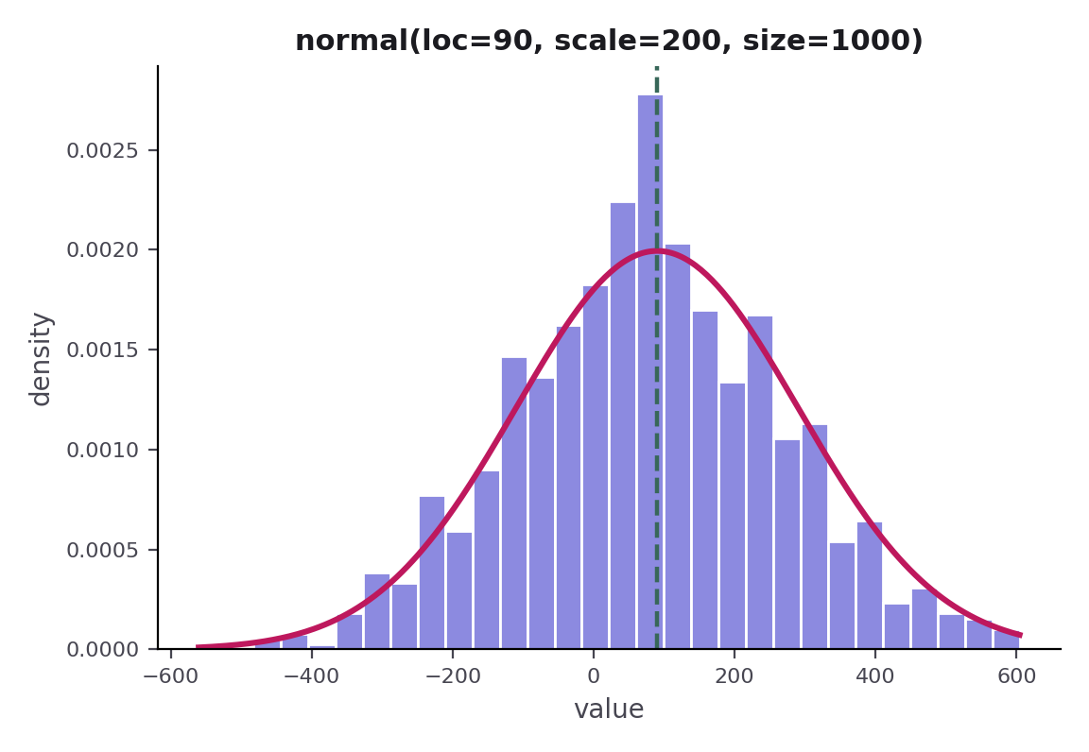
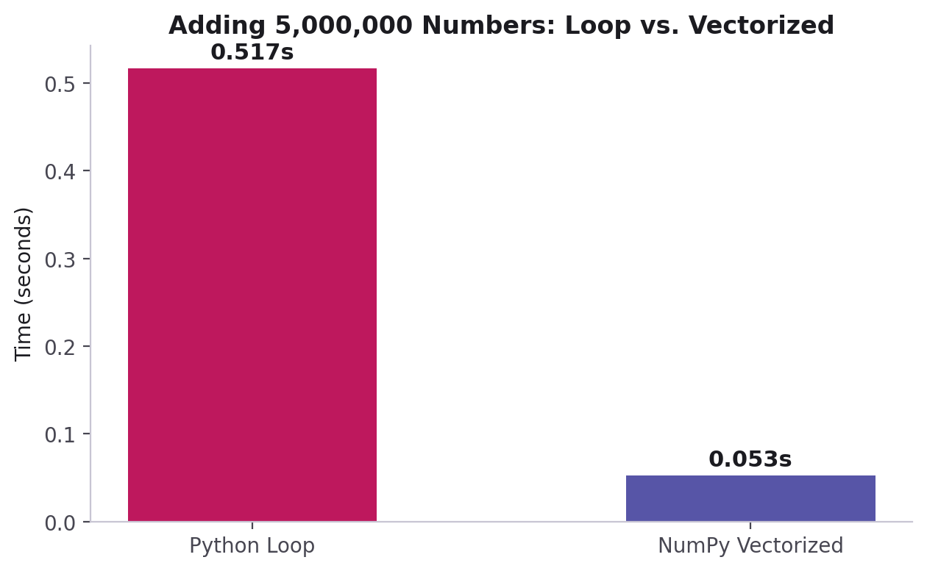
PART 3 · RANDOM DISTRIBUTIONS
The Normal Distribution — normal()
from numpy import random as rn
x = rn.normal(size=(2, 3)) # mean 0, std 1
x = rn.normal(loc=90, scale=200, size=1000)
x.mean() # about 90
x.std() # about 200
A data distribution lists the possible values and how often each occurs. normal() draws a bell curve: loc is the center, scale the spread.
1,000 values from normal(loc=90, scale=200) — a bell curve centered near 90.
CodeByPaxto · AI & ML Playground · Hafiz Waseem Ahmed (Paxto)
27

Slide 28
◎
PART 3 · CREATING ARRAYS
Practice Set — Creating Arrays
Try these yourself first — no code shown, that's the point.
Create a 1D array from a list of 6 numbers, and a 2D array from a nested list.
1
Create a 3x4 array of zeros, a 4x4 identity matrix, and a ones_like() copy of an existing array.
2
Use np.arange() for the even numbers from 0 to 20, and np.linspace() for 10 evenly spaced values between 0 and 100.
3
Use randint(), rand() and choice() with size=(3, 5), and draw 1,000 values with normal(loc=..., scale=...).
4
CodeByPaxto · AI & ML Playground · Hafiz Waseem Ahmed (Paxto)
28

Slide 29
PART 4 · ARRAY PROPERTIES
Array Properties
Shape, data type, and memory — without writing any loops.
29

Slide 30
PART 4 · ARRAY PROPERTIES
Reading an Array's Properties
Function / Attribute | Meaning
arr.shape | A tuple giving the size along each dimension
arr.ndim | The number of dimensions (1 for vector, 2 for matrix, ...)
arr.dtype | The data type of every element, e.g. int64, float64
arr.size | The total number of elements in the array
arr.itemsize | The number of bytes each element takes up in memory
matrix = np.array([[1, 2, 3], [4, 5, 6]])
matrix.shape # (2, 3)
matrix.ndim # 2
matrix.dtype # dtype('int64')
matrix.size # 6
CodeByPaxto · AI & ML Playground · Hafiz Waseem Ahmed (Paxto)
30

Slide 31
PART 4 · ARRAY PROPERTIES
Arrays by Dimension — 0D to 4D
Array | Shape · ndim · size
np.array(42) | () · 0 · 1 — a single value (0D)
np.array([10, 20, 30, 40]) | (4,) · 1 · 4 — a vector (1D)
np.zeros((5, 4)) | (5, 4) · 2 · 20 — a matrix (2D)
np.zeros((8, 64, 64, 3)) | (8, 64, 64, 3) · 4 · 98304 — a batch of RGB images
a = np.zeros((8, 64, 64, 3)) # float64 by default
a.size, a.itemsize, a.nbytes # 98304, 8, 786432
np.zeros((4, 30, 224, 224, 3)).nbytes # 144,506,880 bytes (~138 MB)
# nbytes = size x itemsize, so dtype choice changes RAM use
CodeByPaxto · AI & ML Playground · Hafiz Waseem Ahmed (Paxto)
31

Slide 32
PART 4 · DATA TYPES
Data Types — Numbers
Code | Type and what it is for
'i' -> int32 | Integer: whole numbers, can be negative (ages, counts, coordinates)
'u1' -> uint8 | Unsigned integer: 0–255, no negatives — exactly what image pixels are
'f' -> float32 | Float: decimals — normalized pixels (0.0–1.0), weights, loss values
'c8' -> complex64 | Complex: real + imaginary part (3+2j) — e.g. Fourier transforms
np.array([1, 2, 3], dtype='i').dtype # int32
np.array([1, 2, 3], dtype='u1').dtype # uint8
np.array([1.4, 2.5], dtype='f').dtype # float32
np.array([1+2j], dtype='c8').dtype # complex64
CodeByPaxto · AI & ML Playground · Hafiz Waseem Ahmed (Paxto)
32

Slide 33
PART 4 · DATA TYPES
Data Types — Booleans, Time & Text
Careful: the code "b" is a signed 8-bit integer (int8), not a boolean — in the notebook, dtype="b" turned True/False into 1 and 0. Use bool (or "?") for true booleans.
m (lowercase) is a duration; M (capital) is an actual moment in time. object ("O") means NumPy gave up on a clean type — you lose its speed, usually a sign of messy data.
Text: "U" is Unicode (Arabic, Urdu and Japanese all work) and is the type you want; "S" stores raw bytes and is rarely used; "V" is raw memory, mostly seen in record arrays.
np.array([True, False]).dtype # bool
np.array([1, 1, 0], dtype='b').dtype # int8 !
np.array([10, 20], dtype='m8[s]') # durations
np.array(['2026-04-04'], dtype='M') # dates
np.array([1, 'hi'], dtype='O') # object
np.array(["Cat", "Dog"]).dtype # <U3
CodeByPaxto · AI & ML Playground · Hafiz Waseem Ahmed (Paxto)
33

Slide 34
PART 4 · DATA TYPES
The 3 dtypes You'll Use — uint8, float32, bool
Three dtypes carry most computer-vision work: uint8 for pixels as loaded from a file, float32 for normalized values that models expect, and bool for masks and thresholds.
astype() returns a converted copy — dividing by 255.0 maps 0–255 onto 0.0–1.0.
A comparison like img > 128 returns a boolean array: every pixel either passes the test or it doesn’t.
img.dtype # uint8 (0-255)
img_f = img.astype("float32") / 255.0
img_f.dtype # float32
# (0.0-1.0)
mask = img > 128
mask.dtype # bool
CodeByPaxto · AI & ML Playground · Hafiz Waseem Ahmed (Paxto)
34

Slide 35
◎
PART 4 · DATA TYPES
Practice Set — Array Properties & Data Types
Try these yourself first — no code shown, that's the point.
Create a 3x4 array and print its shape, ndim, size, dtype, and nbytes.
1
Create the same values as int8, uint8, and float32, and compare their itemsize and nbytes.
2
Convert an array of 0–255 values to float32 between 0.0 and 1.0 using astype() and division by 255.
3
Explain why image pixels use uint8, and what changes in .shape if you add one more row to a matrix.
4
CodeByPaxto · AI & ML Playground · Hafiz Waseem Ahmed (Paxto)
35

Slide 36
PART 5 · INDEXING & SLICING
Indexing & Slicing
Reaching into an array to grab exactly the elements you need.
36

Slide 37
PART 5 · INDEXING & SLICING
Basic Indexing — One Element at a Time
arr = np.array([10, 20, 30, 40, 50])
10
20
30
40
50
0
1
2
3
4
arr[0] gets the first element — indexing starts at 0, not 1.
arr[2] → 30 — the highlighted cell above.
arr[-1] gets the last element — negative indices count backward from the end.
For a 2D array: matrix[row, col] — e.g. matrix[1, 2] gets row 1, column 2.
CodeByPaxto · AI & ML Playground · Hafiz Waseem Ahmed (Paxto)
37

Slide 38
PART 5 · INDEXING & SLICING
Slicing — A Range of Elements
arr = np.array([10, 20, 30, 40, 50])
10
20
30
40
50
0
1
2
3
4
Function / Attribute | Meaning
arr[1:4] | Elements at index 1, 2, 3 — stop is excluded, gives [20 30 40]
arr[:3] | Everything before index 3, gives [10 20 30]
arr[::2] | Every 2nd element, gives [10 30 50]
arr[::-1] | The whole array, reversed
CodeByPaxto · AI & ML Playground · Hafiz Waseem Ahmed (Paxto)
38

Slide 39
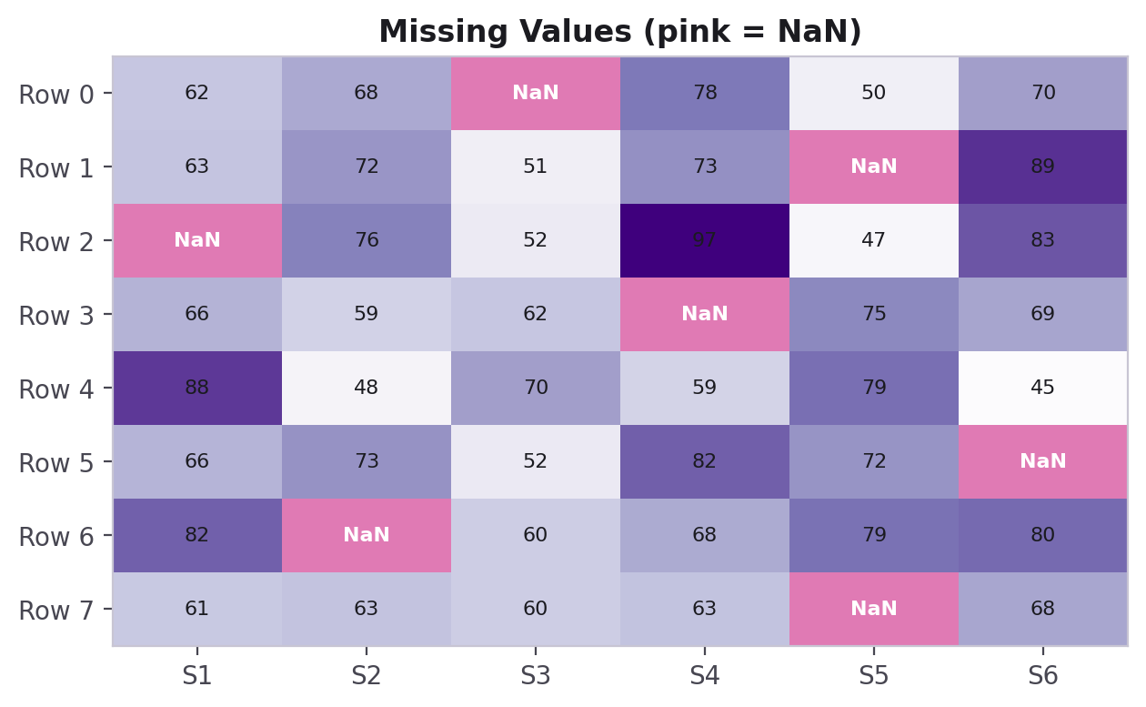
PART 5 · INDEXING & SLICING
Boolean Indexing — Filtering with a Condition
A boolean mask lets you select every element that matches a condition — no loop needed.
scores = np.array([45, 62, 78, 91, 55, 88])
mask = scores >= 60
print(mask)
# [False True True True False True]
passing = scores[mask]
print(passing)
# [62 78 91 88]
scores >= 60 creates an array of True/False values the same shape as scores — using it as an index keeps only the True positions.
CodeByPaxto · AI & ML Playground · Hafiz Waseem Ahmed (Paxto)
39

Slide 40
PART 5 · INDEXING & SLICING
Indexing 2D & 3D Arrays
Use one index per axis, separated by commas: a 2D array takes [row, col], a 3D array takes [block, row, col].
Read arr3[0, 1, 2] as “first block, second row, third value” = 6. Counting always starts at 0.
Negative indices count from the end on every axis, so [-1, -1, -1] is always the very last element.
arr2 = np.array([[1, 2, 3, 4, 5],
[6, 7, 8, 9, 10]])
arr2[0, 1] # 2 (row 0, col 1)
arr2[1, -1] # 10 (last of row 1)
arr3 = np.array([[[1, 2, 3], [4, 5, 6]],
[[7, 8, 9], [10, 11, 12]]])
arr3[0, 1, 2] # 6
arr3[-1, -1, -1] # 12
CodeByPaxto · AI & ML Playground · Hafiz Waseem Ahmed (Paxto)
40

Slide 41
PART 5 · INDEXING & SLICING
Slicing Multi-Dimensional Arrays
Slice of img (3264, 4928, 3) | Resulting shape
img[0:500] | (500, 4928, 3) — first 500 rows; columns and channels untouched
img[:, 0:300] | (3264, 300, 3) — all rows, first 300 columns
img[:, :, 0] | (3264, 4928) — one channel only, so that axis disappears
img[::2, ::2] | (1632, 2464, 3) — every 2nd row and every 2nd column
img[100:200, 200:400].shape # (100, 200, 3)
img[::-1].shape # (3264, 4928, 3) rows reversed
img[::-2].shape # (1632, 4928, 3)
img[1:5:2, 1:50:3, 0:2].shape # (2, 17, 2)
CodeByPaxto · AI & ML Playground · Hafiz Waseem Ahmed (Paxto)
41

Slide 42
PART 5 · INDEXING & SLICING
Fancy Indexing & np.where()
Fancy indexing: pass a list of positions to pick elements in any order — numbers[[0, 2, 4]] returns 1, 3, 5.
np.where(condition) returns the positions where it is True, as a tuple with one array per axis (a 2D array gives row indexes and column indexes).
np.where(condition, if_true, if_false) builds a new array: multiply, clip to a limit, or even label values "Pass" / "Fail".
numbers = np.arange(1, 11)
numbers[[0, 2, 4]] # [1 3 5]
np.where(numbers > 5)
# (array([5, 6, 7, 8, 9]),)
np.where(numbers > 5, numbers * 4, numbers)
# [ 1 2 3 4 5 24 28 32 36 40]
marks = np.array([45, 72, 33, 81])
np.where(marks >= 50, "Pass", "Fail")
# ["Fail" "Pass" "Fail" "Pass"]
CodeByPaxto · AI & ML Playground · Hafiz Waseem Ahmed (Paxto)
42

Slide 43
◎
PART 5 · INDEXING & SLICING
Practice Set — Indexing & Slicing
Try these yourself first — no code shown, that's the point.
Create a 1D array of 8 numbers and retrieve the 3rd and last elements.
1
Slice out the middle 4 elements of that array.
2
Create a 2D array, retrieve one full row and one full column, and index a 3D array with arr[0, 1, 2].
3
Use a boolean mask to keep values above the mean, then np.where() to replace values above a limit.
4
CodeByPaxto · AI & ML Playground · Hafiz Waseem Ahmed (Paxto)
43

Slide 44
PART 6 · RESHAPING & MANIPULATION
Reshaping & Manipulation
Changing an array's shape without changing its data.
44

Slide 45
PART 6 · RESHAPING & MANIPULATION
reshape() — Same Data, New Shape
arr = np.arange(1, 7) # [1 2 3 4 5 6]
1
2
3
4
5
6
reshape() rearranges the same elements into a new shape — the total count must stay the same (6 = 2x3).
Pass -1 for one dimension to let NumPy calculate it automatically: arr.reshape(2, -1).
flatten() / ravel() do the reverse — collapse any array back down to 1D.
.T (transpose) flips rows and columns for a 2D array.
→ arr.reshape(2, 3)
1
2
3
4
5
6
CodeByPaxto · AI & ML Playground · Hafiz Waseem Ahmed (Paxto)
45

Slide 46
PART 6 · RESHAPING & MANIPULATION
Joining Arrays Together
Function / Attribute | Meaning
np.concatenate([a, b]) | Joins arrays end to end along an existing axis
np.vstack([a, b]) | Stacks arrays on top of each other (new rows)
np.hstack([a, b]) | Stacks arrays side by side (new columns)
np.split(arr, n) | Splits one array into n equal parts
a = np.array([1, 2, 3])
b = np.array([4, 5, 6])
np.concatenate([a, b]) # [1 2 3 4 5 6]
np.vstack([a, b]) # [[1 2 3] [4 5 6]]
CodeByPaxto · AI & ML Playground · Hafiz Waseem Ahmed (Paxto)
46

Slide 47
PART 6 · RESHAPING & MANIPULATION
Sorting — np.sort() & axis
np.sort() returns a sorted copy — the original array is unchanged.
On 2D arrays, axis decides what gets sorted: axis=0 sorts each column, axis=1 sorts each row, and axis=None flattens everything first.
The same rule scales to 3D, 4D and 5D: pick the axis you want ordered — for shape (2, 2, 4), axis=2 sorts the values inside each row.
a = np.array([3, 6, 1, 8, 1, 9])
np.sort(a) # [1 1 3 6 8 9]
m = np.array([[3, 1], [4, 6], [0, 10]])
np.sort(m, axis=0) # sorts each column
# [[ 0 1] [ 3 6] [ 4 10]]
np.sort(m, axis=1) # sorts each row
# [[ 1 3] [ 4 6] [ 0 10]]
np.sort(m, axis=None) # flat: [0 1 3 4 6 10]
CodeByPaxto · AI & ML Playground · Hafiz Waseem Ahmed (Paxto)
47

Slide 48
◎
PART 6 · RESHAPING & MANIPULATION
Practice Set — Reshaping & Manipulation
Try these yourself first — no code shown, that's the point.
Create a 1D array of 12 numbers and reshape it into a 3x4 matrix.
1
Reshape that matrix into 2x6 instead, then flatten it back to 1D.
2
Transpose a 2x3 matrix and check its new shape, then sort a 2D array with axis=0 and with axis=1.
3
Stack two 1D arrays vertically, then split the result back into two.
4
CodeByPaxto · AI & ML Playground · Hafiz Waseem Ahmed (Paxto)
48

Slide 49
PART 7 · ARRAY MODIFICATION
Array Modification
Adding, removing, and safely copying elements.
49

Slide 50
PART 7 · ARRAY MODIFICATION
Adding & Removing Elements
Function / Attribute | Meaning
np.append(arr, value) | Returns a new array with value added at the end
np.insert(arr, index, value) | Returns a new array with value inserted at index
np.delete(arr, index) | Returns a new array with the element at index removed
arr = np.array([10, 20, 30])
np.append(arr, 40) # [10 20 30 40]
np.insert(arr, 1, 15) # [10 15 20 30]
np.delete(arr, 0) # [20 30]
CodeByPaxto · AI & ML Playground · Hafiz Waseem Ahmed (Paxto)
50

Slide 51
PART 7 · ARRAY MODIFICATION
Copy vs. View — An Important Gotcha
Slicing a NumPy array does NOT copy it — it returns a view, which still points at the same underlying data.
Changing a view changes the original array too — a very common source of confusing bugs.
Call .copy() explicitly whenever you need an independent, separate array.
arr = np.array([1, 2, 3, 4])
view = arr[1:3]
view[0] = 99
print(arr)
# [ 1 99 3 4] <- original changed!
safe_copy = arr[1:3].copy()
safe_copy[0] = 0
print(arr)
# [ 1 99 3 4] <- unaffected
CodeByPaxto · AI & ML Playground · Hafiz Waseem Ahmed (Paxto)
51

Slide 52
◎
PART 7 · ARRAY MODIFICATION
Practice Set — Array Modification
Try these yourself first — no code shown, that's the point.
Append 3 new values to the end of an existing array.
1
Insert a value in the middle of an array, then delete a different element.
2
Create a slice of an array, modify it, and check whether the original array changed.
3
Repeat the previous task using .copy() this time, and compare the result.
4
CodeByPaxto · AI & ML Playground · Hafiz Waseem Ahmed (Paxto)
52

Slide 53
PART 8 · OPERATIONS & BROADCASTING
Operations, Broadcasting & Vectorisation
Where NumPy's real power shows up — fast math across whole arrays, with no explicit loops.
53

Slide 54
PART 8 · OPERATIONS
Element-Wise Arithmetic
Standard math operators (+, -, *, /) work directly on arrays — no loop, no zip(), no list comprehension.
Each operation applies element by element: a[0]+b[0], a[1]+b[1], and so on.
The two arrays must have compatible shapes — which is exactly what broadcasting defines, next.
a = np.array([1, 2, 3])
b = np.array([10, 20, 30])
a + b # [11 22 33]
a - b # [-9 -18 -27]
a * b # [10 40 90]
b / a # [10. 10. 10.]
CodeByPaxto · AI & ML Playground · Hafiz Waseem Ahmed (Paxto)
54

Slide 55
PART 8 · OPERATIONS
Lists vs. Arrays — + and * Differ
The same operator means different things: on a list, * repeats and + concatenates; on an array, * and + do real math, element by element.
That is vectorization: no loop and no map(lambda ...), and NumPy runs the loop in compiled code (0.005 s vs 0.009 s for 100,000 values in one notebook run — use timeit for fair comparisons).
Mixing the two is a classic bug: a list * 2 never doubles the numbers.
my_list = [1, 2, 3, 4, 5]
my_arr = np.array(my_list)
my_list * 2 # [1,2,3,4,5,1,2,3,4,5]
my_arr * 2 # [ 2 4 6 8 10]
[1, 2] + [3, 4] # [1, 2, 3, 4]
a, b = np.array([1, 2]), np.array([3, 4])
a + b # [4 6]
CodeByPaxto · AI & ML Playground · Hafiz Waseem Ahmed (Paxto)
55

Slide 56
PART 8 · VECTORISATION
Why Vectorization Is Faster Than a Loop
# slow - explicit Python loop
result = []
for i in range(len(a)):
result.append(a[i] + b[i])
# fast - vectorized
result = a + b
The vectorized version runs the loop in fast, compiled C code under the hood — instead of Python's slower interpreted loop.
Measured on this machine — your numbers will vary, but the gap holds.
CodeByPaxto · AI & ML Playground · Hafiz Waseem Ahmed (Paxto)
56

Slide 57
PART 8 · BROADCASTING
Broadcasting — Different Shapes, Working Together
array + scalar
1
2
3
+
10
→
11
12
13
10 is stretched to [10, 10, 10] behind the scenes, then added element-wise — you never see this step, NumPy just handles it.
This is why arr * 2 or arr + 5 work directly on a whole array without writing a loop.
The same idea works between a matrix and a 1D array too, as long as the shapes are compatible.
Rule of thumb: shapes are compatible if, comparing from the right, each dimension either matches or one of them is 1.
CodeByPaxto · AI & ML Playground · Hafiz Waseem Ahmed (Paxto)
57

Slide 58
PART 8 · AGGREGATE FUNCTIONS
Summarizing an Array
Function / Attribute | Meaning
arr.sum() | Adds up every element
arr.mean() | The average value
arr.std() | The standard deviation — how spread out the values are
arr.min() / arr.max() | The smallest / largest value
arr.argmax() / arr.argmin() | The index of the largest / smallest value
axis=0 / axis=1 | Apply the function down columns / across rows, on a 2D array
CodeByPaxto · AI & ML Playground · Hafiz Waseem Ahmed (Paxto)
58

Slide 59
◎
PART 8 · OPERATIONS & BROADCASTING
Practice Set — Operations, Broadcasting & Vectorisation
Try these yourself first — no code shown, that's the point.
Create two same-sized arrays and compute their element-wise sum, difference, and product.
1
Add a single number to a whole array and explain what broadcasting did behind the scenes.
2
Compute the mean, std, min, and max of an array in one block of code.
3
For a 2D array, compute the sum once with axis=0 and once with axis=1, and explain the difference.
4
CodeByPaxto · AI & ML Playground · Hafiz Waseem Ahmed (Paxto)
59

Slide 60
PART 8 · STATISTICS
Statistics — Mean, Median & Mode
Mean and median come straight from NumPy: np.mean() and np.median(). NumPy has no mode function, so scipy.stats.mode() steps in.
This dataset has two values tied for most frequent (0.25 and 2.25) — mode() reports the smallest, 0.25. A tie is a reminder that mode can be ambiguous.
For [5, 7, 8, 9, 10, 100], stats.gmean() (geometric) is 11.67 and stats.hmean() (harmonic) is 8.71 — other kinds of average.
from scipy import stats
a = np.array([2.25, 0.25, 0.25, 2.25])
np.mean(a) # 1.25
np.median(a) # 1.25
stats.mode(a).mode # 0.25
# scipy also has stats.gmean(), hmean()
CodeByPaxto · AI & ML Playground · Hafiz Waseem Ahmed (Paxto)
60

Slide 61
PART 8 · STATISTICS
Statistics — Variance & STD (ddof)
NumPy defaults to the population formula (ddof=0). For a sample, pass ddof=1 — many other tools default to the sample formula, which is why numbers can differ.
The 100 drags the mean up to 23.17 while five of the six values sit between 5 and 10 — outliers inflate variance and std dramatically.
Std is the square root of variance, in the same units as the data — easier to interpret.
data = np.array([5, 7, 8, 9, 10, 100])
np.mean(data) # 23.1667
np.var(data) # 1183.14 (ddof=0)
np.var(data, ddof=1) # 1419.77 (sample)
np.std(data) # 34.40 (ddof=0)
np.std(data, ddof=1) # 37.68 (sample)
CodeByPaxto · AI & ML Playground · Hafiz Waseem Ahmed (Paxto)
61

Slide 62
PART 8 · STATISTICS
Statistics — Quartiles, IQR & Outliers
Quartiles split sorted data into four parts: Q1 (25%), Q2 (the median) and Q3 (75%). method="midpoint" averages the two neighbours; the default "linear" gives 7.25 and 9.75 instead.
IQR = Q3 − Q1 measures the middle 50% of the data, so extreme values barely affect it.
The 1.5 × IQR rule: anything below Q1 − 1.5·IQR or above Q3 + 1.5·IQR is an outlier. Here the bounds are 4.5 and 12.5, so only 100 is flagged.
q1, q2, q3 = np.percentile(
data, [25, 50, 75], method="midpoint")
# 7.5, 8.5, 9.5
iqr = q3 - q1 # 2.0
lower = q1 - 1.5 * iqr # 4.5
upper = q3 + 1.5 * iqr # 12.5
data[(data < lower) | (data > upper)]
# [100]
CodeByPaxto · AI & ML Playground · Hafiz Waseem Ahmed (Paxto)
62

Slide 63
PART 8 · STATISTICS
Handling Outliers — Remove vs. Cap
Removing outliers keeps real data but shrinks the sample: the mean falls from 23.17 to 7.8 and the sample std from 37.68 to 1.92.
Capping (winsorization) replaces extreme values with the nearest bound using np.clip() — the 100 becomes 12.5 and no values are lost. Convert to float first so 12.5 fits.
The median barely moves (8.5 original, 8.0 removed, 8.5 capped) — one reason it is the robust choice when outliers are present.
# Method 1: remove outliers
kept = data[(data >= lower) & (data <= upper)]
# [ 5 7 8 9 10] mean 7.8, std 1.92
# Method 2: cap with np.clip
capped = np.clip(data.astype(float),
lower, upper)
# [5. 7. 8. 9. 10. 12.5] mean 8.58
CodeByPaxto · AI & ML Playground · Hafiz Waseem Ahmed (Paxto)
63

Slide 64
◎
PART 8 · STATISTICS
Practice Set — Statistics with NumPy
Try these yourself first — no code shown, that's the point.
Compute the mean, median and mode of a small array, then create a tie for the mode and see which value scipy.stats.mode() reports.
1
Compute np.var() and np.std() with ddof=0 and ddof=1 on the same data, and explain which one you would use for a sample.
2
Find Q1, Q3 and the IQR of an array, then list every outlier using the 1.5 × IQR rule.
3
Clean the same array two ways — remove outliers with a boolean mask, then cap them with np.clip() — and compare the means.
4
CodeByPaxto · AI & ML Playground · Hafiz Waseem Ahmed (Paxto)
64

Slide 65
PART 9 · MISSING VALUES
Handling Missing Values
Real data is rarely complete — NumPy gives you the tools to find and deal with the gaps.
65

Slide 66
PART 9 · MISSING VALUES
np.nan — Representing "No Value"
np.nan (Not a Number) is NumPy's placeholder for a missing numerical value — common in real, messy datasets.
data = np.array([72, 85, np.nan, 90, np.nan, 68])
np.isnan(data)
# [False False True False True False]
np.sum(np.isnan(data))
# 2 <- count of missing values
np.isnan() returns a boolean mask marking every NaN — combine it with boolean indexing (Part 5) to isolate or remove them.
CodeByPaxto · AI & ML Playground · Hafiz Waseem Ahmed (Paxto)
66

Slide 67
PART 9 · MISSING VALUES
Handling the Gaps
Function / Attribute | Meaning
np.nanmean(arr) | Average, ignoring NaN values
np.nanstd(arr) / np.nansum(arr) | Standard deviation / sum, ignoring NaN values
arr[~np.isnan(arr)] | Keeps only the non-missing values
np.where(np.isnan(arr), fill_value, arr) | Replaces every NaN with a chosen fill value
data = np.array([72, 85, np.nan, 90, np.nan, 68])
clean_mean = np.nanmean(data) # ignores NaNs
filled = np.where(np.isnan(data), clean_mean, data)
# every NaN replaced with the mean
CodeByPaxto · AI & ML Playground · Hafiz Waseem Ahmed (Paxto)
67

Slide 68
◎
PART 9 · MISSING VALUES
Practice Set — Handling Missing Values
Try these yourself first — no code shown, that's the point.
Create an array with a few np.nan values mixed in, and count how many there are.
1
Compute the mean of that array with and without ignoring NaN values, and compare.
2
Replace every NaN in the array with the column's mean using np.where().
3
Filter out the NaN values entirely and print only the valid numbers.
4
CodeByPaxto · AI & ML Playground · Hafiz Waseem Ahmed (Paxto)
68

Slide 69
PART 10 · REAL-WORLD DATA
NumPy with Real-World Data
Bringing everything together on a small, realistic dataset — six students, five subjects.
69

Slide 70
PART 10 · REAL-WORLD DATA
The Dataset — Student Scores
Rows are students, columns are subjects — a 2D array is a completely natural fit for this kind of tabular data.
This is exactly the shape of data you'll load into Pandas next module — NumPy is what's underneath it.
subjects = ["Math", "Physics", "Chemistry",
"Biology", "English"]
scores = np.array([
[78, 85, 92, 88, 76],
[65, 70, 60, 72, 80],
[90, 88, 95, 91, 85],
[55, 62, 58, 64, 70],
[82, 79, 84, 88, 90],
[70, 75, 68, 73, 77],
])
scores.shape
# (6, 5) <- 6 students, 5 subjects
CodeByPaxto · AI & ML Playground · Hafiz Waseem Ahmed (Paxto)
70

Slide 71
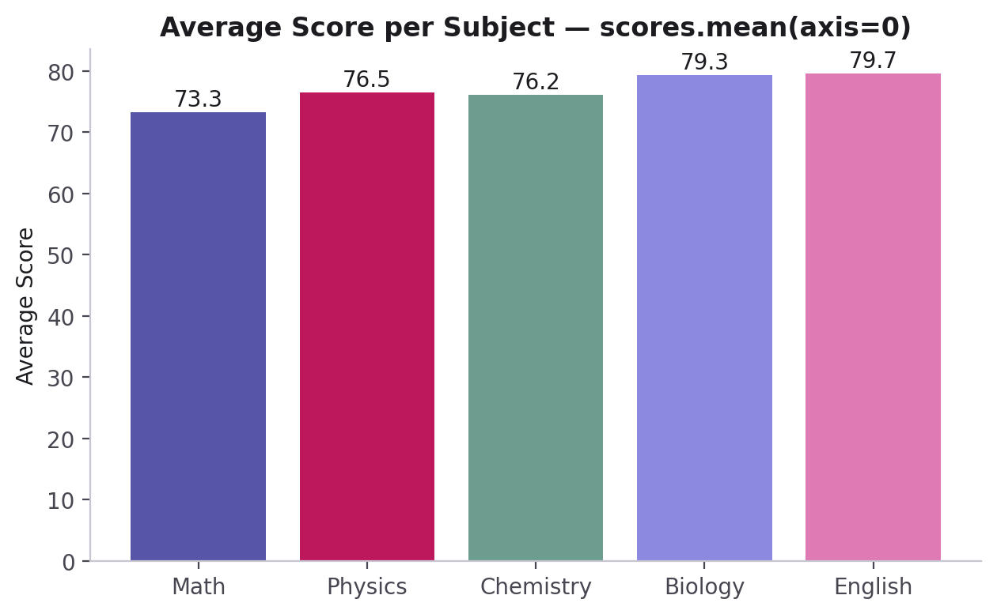
PART 10 · REAL-WORLD DATA
Average Score per Subject — axis=0
avg_per_subject = scores.mean(axis=0)
print(avg_per_subject)
# [73.3 76.5 76.2 79.3 79.7]
axis=0 collapses down the rows — one average per column (subject).
CodeByPaxto · AI & ML Playground · Hafiz Waseem Ahmed (Paxto)
71

Slide 72
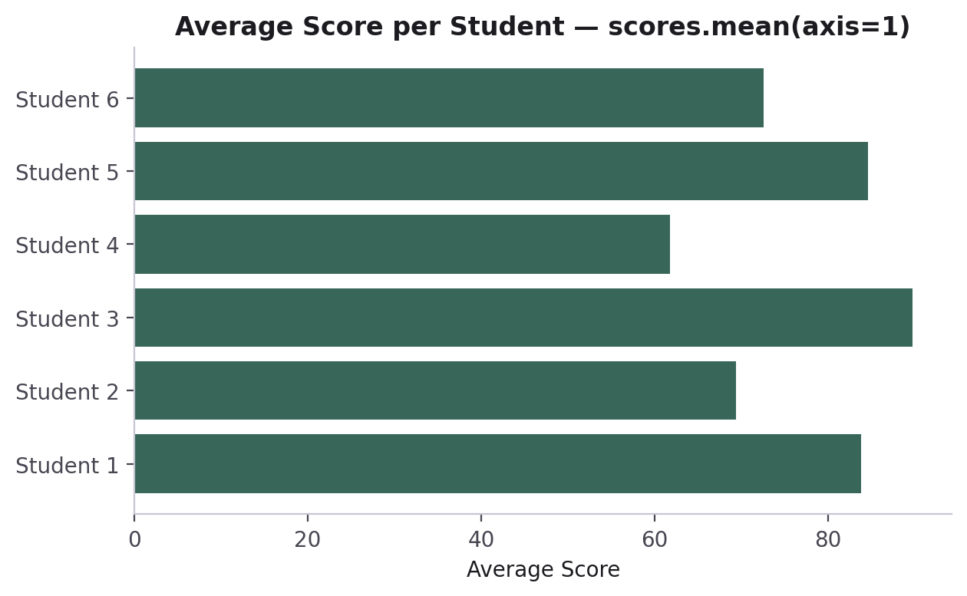
PART 10 · REAL-WORLD DATA
Average Score per Student — axis=1
avg_per_student = scores.mean(axis=1)
print(avg_per_student)
# [83.8 69.4 89.8 61.8 84.6 72.6]
top_student = np.argmax(avg_per_student)
# index 2 -> highest average
axis=1 collapses across the columns — one average per row (student).
CodeByPaxto · AI & ML Playground · Hafiz Waseem Ahmed (Paxto)
72

Slide 73
◎
PART 10 · REAL-WORLD DATA
Practice Set — NumPy with Real-World Data
Try these yourself first — no code shown, that's the point.
Build a 2D array representing 5 products' sales across 4 weeks.
1
Compute the average sales per week and the average sales per product.
2
Find which product had the single highest sales value, and in which week.
3
Use boolean indexing to find every product-week combination that sold above the overall average.
4
CodeByPaxto · AI & ML Playground · Hafiz Waseem Ahmed (Paxto)
73

Slide 74
PART 11 · BONUS
Images as NumPy Arrays
A genuinely fun demo: every image is secretly just a grid of numbers.
74

Slide 75
PART 11 · IMAGES AS ARRAYS
A Picture Is Just a Matrix
A grayscale image is a 2D array — one number per pixel, from 0 (black) to 255 (white).
A color image is a 3D array (a tensor!) — height x width x 3, one layer each for Red, Green, and Blue.
Once you see an image as an array, every NumPy tool you've learned today — indexing, slicing, arithmetic — becomes a way to edit it.
from PIL import Image
import numpy as np
img = Image.open("photo.png").convert("L")
img_array = np.array(img)
print(img_array.shape) # (200, 200)
print(img_array.dtype) # uint8
CodeByPaxto · AI & ML Playground · Hafiz Waseem Ahmed (Paxto)
75

Slide 76
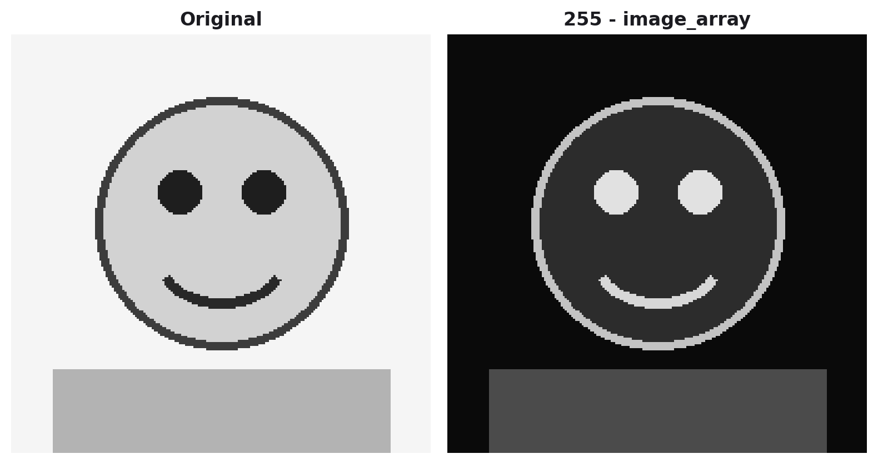
PART 11 · IMAGES AS ARRAYS
Dark Mode, in One Line
"Dark mode" for an image is just inverting every pixel value — a light background becomes dark, and vice versa.
img_array = np.array(image)
# every pixel is 0-255
dark_array = 255 - img_array
# bright pixels become dark,
# dark pixels become bright
dark_image = Image.fromarray(dark_array)
255 - img_array is a single broadcasted operation across every pixel — the exact same idea from Part 8, applied to a real image.
CodeByPaxto · AI & ML Playground · Hafiz Waseem Ahmed (Paxto)
76

Slide 77
PART 11 · IMAGES AS ARRAYS
OpenCV — Loading an Image (BGR)
cv2.imread() returns an ordinary NumPy array, so everything from this module works on it. The flag 1 loads color; (3264, 4928, 3) means 3264 rows, 4928 columns, 3 channels.
Watch the channel order: OpenCV stores Blue, Green, Red. The top-left pixel [24 30 29] is B=24, G=30, R=29, and img[-1, -1, -1] (96) is the Red value of the bottom-right pixel.
imshow() opens a window and waitKey(0) waits for a key press. Libraries that expect RGB need the channels reversed with img[:, :, ::-1].
import cv2
img = cv2.imread("./images/japan_street.jpg", 1)
type(img) # numpy.ndarray
img.shape # (3264, 4928, 3)
img[0, 0] # [24 30 29] (B, G, R)
cv2.imshow("Japan Street", img)
cv2.waitKey(0)
CodeByPaxto · AI & ML Playground · Hafiz Waseem Ahmed (Paxto)
77

Slide 78
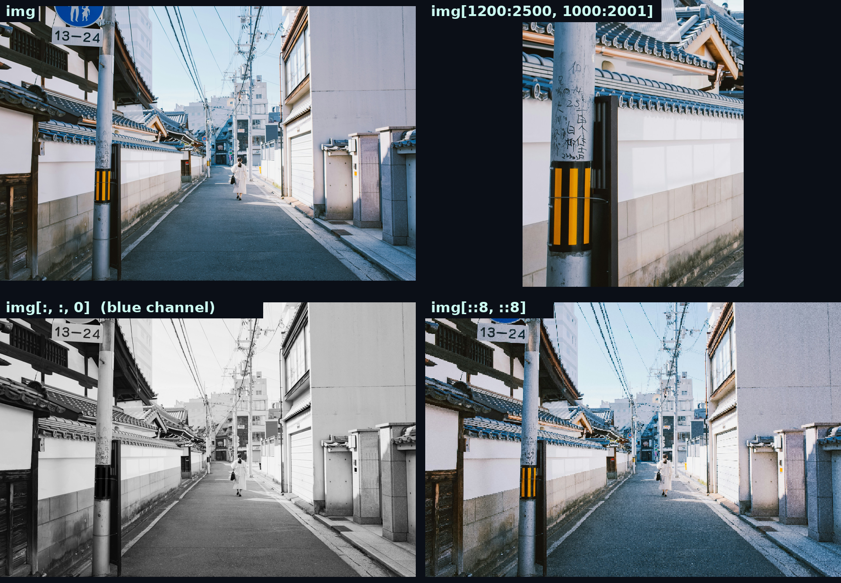
PART 11 · IMAGES AS ARRAYS
Slicing Pixels — Crop, Channel & Downsample
crop = img[1200:2500, 1000:2001]
# rows first, then columns
blue = img[:, :, 0] # (3264, 4928)
small = img[::8, ::8] # (408, 616, 3)
img.dtype # uint8
Rows come first, then columns, then channels — the exact slicing rules from Part 5, applied to a real photo.
Real output from japan_street.jpg: original, crop, blue channel, every 8th pixel.
CodeByPaxto · AI & ML Playground · Hafiz Waseem Ahmed (Paxto)
78

Slide 79
◎
PART 11 · IMAGES AS ARRAYS
Practice Set — Bonus: Images as NumPy Arrays
Try these yourself first — no code shown, that's the point.
Load any image, convert it to grayscale, and print its shape and dtype.
1
Invert the image's pixel values to create a "dark mode" version.
2
Slice the array to keep only the top half of the image, and extract one color channel with img[:, :, 0].
3
Try multiplying the array by 0.5 — what visual effect does that have, and why?
4
CodeByPaxto · AI & ML Playground · Hafiz Waseem Ahmed (Paxto)
79

Slide 80
PART 12 · MINI PROJECTS
Put It All Together
Three small projects combining everything from Foundations to Real-World Data — built end to end with NumPy.
80

Slide 81
PART 12 · MINI PROJECTS
Mini Project 1: Student Grade Book
Build a 2D array of scores for 6 students across 4 subjects.
Use indexing and slicing to pull out one student's full record and one subject's scores for everyone.
Compute each student's average (axis=1) and each subject's average (axis=0).
Use argmax() to find the top-performing student, and boolean indexing to list every student scoring above 80 overall.
1
Indexing +
Aggregate stats
CodeByPaxto · AI & ML Playground · Hafiz Waseem Ahmed (Paxto)
81

Slide 82
PART 12 · MINI PROJECTS
Mini Project 2: Sales Forecast Adjuster
Build a 2D array of weekly sales for 5 products over 6 weeks.
Apply a single broadcasted operation to increase every value by 10% (a projected price increase).
Use reshape() or transpose() to view the data product-first instead of week-first.
Compare the total runtime of a loop-based vs. vectorized version of the same calculation.
2
Broadcasting +
Vectorised operations
CodeByPaxto · AI & ML Playground · Hafiz Waseem Ahmed (Paxto)
82

Slide 83
PART 12 · MINI PROJECTS
Mini Project 3: Sensor Data Cleaner
Build a 1D array of 20 simulated temperature readings, with a few np.nan values mixed in.
Detect and count the missing readings using np.isnan().
Fill every missing reading with the array's mean using np.where().
Report the cleaned array’s mean, min, and max, flag outliers with the 1.5 × IQR rule, and cap them with np.clip().
3
Missing values +
Real-world cleanup
CodeByPaxto · AI & ML Playground · Hafiz Waseem Ahmed (Paxto)
83

Slide 84
MODULE RECAP
Every array you sliced, reshaped, and broadcast today is the exact same object Pandas, Matplotlib, and every ML model you'll build later are quietly built on top of. You didn't just learn a library — you learned the language the rest of this course speaks.
Next up: Pandas — structured, labeled data, built directly on the NumPy arrays you just learned.
84

Slide 85
Thank You
NumPy · AI & ML Playground · CodeByPaxto
85

