Slide 1

AI & ML PLAYGROUND · MODULE 05
Pandas
Structured, labeled data in Python — cleaning, exploring, and reshaping real datasets.
CodeByPaxto: The AI & ML Playground · Hafiz Waseem Ahmed (Paxto)
01

Slide 2

WHERE THIS FITS
The AI & ML Playground Roadmap
Python
→
Math for DS
→
Git & GitHub
→
NumPy
→
Pandas
→
Matplotlib
→
Seaborn
→
Data Analytics
→
Supervised ML
You are here — right after NumPy. Pandas wraps NumPy arrays in labeled rows and columns, turning raw numbers into the kind of structured tables real datasets actually come in — exactly what Matplotlib, Seaborn, and every EDA workflow expect.
02

Slide 3
BEFORE WE START
If NumPy Exists, Why Pandas?
NUMPY ARRAY
PANDAS DATAFRAME
Fast at pure numerical math — but every column must be the same data type.
No column names — you track "column 3" by position, not by meaning.
No built-in idea of missing data, grouping, or merging labeled tables.
Every column can hold its own type — numbers, text, dates — like a real spreadsheet.
Rows and columns have labels — you select "age" or "name", not "column 3".
Built-in tools for missing data, grouping, merging, and reshaping — the actual daily work of a Data Analyst.
The honest framing: a DataFrame is built on top of NumPy arrays under the hood — Pandas adds the labels, structure, and tooling that real, messy, tabular data actually needs.
CodeByPaxto · AI & ML Playground · Hafiz Waseem Ahmed (Paxto)
03

Slide 4
WHAT WE'RE COVERING
Today's Roadmap
01
02
03
04
05
Introduction to Pandas
Foundations, Terms & Series
Creating & Loading Data
Selecting & Filtering
Modifying, Dropping & apply()
06
07
08
09
10
Handling Missing Data
Sorting & Ranking
GroupBy & Aggregation
Merging, Joining & Concatenating
Pivot Tables & Reshaping
11
12
13
14
String & DateTime Operations
Pandas + Visualization
Pandas for Real-World Data
Mini Projects
Running examples: simple student/grade tables for syntax — plus the tips, flights, and titanic datasets for real-world sections.
CodeByPaxto · AI & ML Playground · Hafiz Waseem Ahmed (Paxto)
04

Slide 5
PART 1 · INTRODUCTION
Introduction to Pandas
What it is, why it exists, and how it fits with NumPy.
05

Slide 6
PART 1 · INTRODUCTION
What Is Pandas?
Pandas is Python's core library for working with structured, tabular data — rows and columns, like a spreadsheet or a database table.
Its two main objects are the Series (a single labeled column) and the DataFrame (a full labeled table).
Where you'll actually use it: loading a CSV, cleaning messy data, filtering rows, grouping and summarizing, and preparing a dataset before it's plotted (Matplotlib/Seaborn) or modeled (Machine Learning).
If NumPy is the engine, Pandas is the dashboard — the layer you'll actually spend most of your time in during real Data Analytics work.
CodeByPaxto · AI & ML Playground · Hafiz Waseem Ahmed (Paxto)
06

Slide 7
PART 1 · INTRODUCTION
Installing & Importing
pd is the near-universal alias for Pandas — used across virtually every Data Science codebase.
Pandas depends on NumPy internally — installing Pandas installs NumPy too, if it isn't already there.
Everything in this module builds from two objects: the Series and the DataFrame.
# one-time install
pip install pandas
# every notebook / script
import pandas as pd
df = pd.DataFrame({
"name": ["Amina", "Ben"],
"score": [88, 74]
})
print(df)
CodeByPaxto · AI & ML Playground · Hafiz Waseem Ahmed (Paxto)
07

Slide 8
◎
PART 1 · INTRODUCTION
Practice Set — Introduction to Pandas
Try these yourself first — no code shown, that's the point.
Install Pandas and openpyxl (if needed), then import Pandas using the standard pd alias.
1
Create a small DataFrame from a dictionary of your own choosing and print it.
2
In your own words, explain the difference between a Series and a DataFrame.
3
CodeByPaxto · AI & ML Playground · Hafiz Waseem Ahmed (Paxto)
08

Slide 9
PART 2 · FOUNDATIONS
Foundations & Terminology
12 core terms, plus the Series — the building blocks of every table.
09

Slide 10
PART 2 · TERMINOLOGY
Terms 1–4 · The Core Objects
1
DataFrame
2
Series
3
Index
4
Column
A 2D labeled table — rows and columns, Pandas' central object.
A single labeled column of data — one column of a DataFrame, or a standalone 1D structure.
The labels identifying each row — shown on the left of every DataFrame.
One labeled field of data running down a DataFrame, e.g. "age".
CodeByPaxto · AI & ML Playground · Hafiz Waseem Ahmed (Paxto)
10

Slide 11
PART 2 · TERMINOLOGY
Terms 5–8 · Reading a DataFrame
5
Label
6
dtype
7
NaN
8
Axis
The name used to refer to a row (via the index) or a column.
The data type of a column's values, e.g. int64, float64, object (text).
Pandas' marker for a missing value — "Not a Number", inherited from NumPy.
The direction of an operation — axis=0 is down rows, axis=1 is across columns.
CodeByPaxto · AI & ML Playground · Hafiz Waseem Ahmed (Paxto)
11

Slide 12
PART 2 · TERMINOLOGY
Terms 9–12 · How Pandas Operates
9
Boolean Mask
10
GroupBy
11
Merge
12
Method Chaining
A True/False Series used to filter rows that meet a condition.
Splitting data into groups by a column's values, to summarize each group separately.
Combining two DataFrames based on a shared key column, like a database join.
Calling several DataFrame methods back to back in one line, e.g. df.dropna().sort_values("age").
CodeByPaxto · AI & ML Playground · Hafiz Waseem Ahmed (Paxto)
12

Slide 13
PART 2 · TERMINOLOGY
Anatomy of a DataFrame
Column labels →
name
age
score
The Index (left) labels every row — by default it's 0, 1, 2, ... but can be set to anything, like names or dates.
Each Column has its own label and its own dtype — "name" holds text, "age" and "score" hold numbers.
One highlighted column ("age") is itself a Series — a DataFrame is really a collection of aligned Series sharing one Index.
df.loc[] and df.iloc[] (Part 4) are how you reach into this grid by label or by position.
0
Amina
22
88
1
Ben
25
74
2
Chen
21
91
3
Diego
24
67
← Index (row labels)
CodeByPaxto · AI & ML Playground · Hafiz Waseem Ahmed (Paxto)
13

Slide 14
◎
PART 2 · TERMINOLOGY
Practice Set — Foundations & Terminology
Try these yourself first — no code shown, that's the point.
In your own words, explain the difference between a DataFrame's Index and its columns.
1
Name which axis number refers to rows, and which refers to columns.
2
Explain what a boolean mask is, using a simple example.
3
Explain what GroupBy does, in one or two sentences, without writing any code.
4
CodeByPaxto · AI & ML Playground · Hafiz Waseem Ahmed (Paxto)
14

Slide 15
PART 2 · SERIES
Series vs. a Python List
Feature | Python list → Pandas Series
Index | Only 0, 1, 2… → numbers OR custom labels
Math (sum, mean…) | Manual loops → built in: .sum() .mean() .max()
Missing values | No concept → NaN, with isna() / fillna()
Part of a DataFrame? | No → Yes: every column is a Series
s = pd.Series([10, 20, 30], index=["a", "b", "c"])
s["b"], s.mean() # 20, 20.0
CodeByPaxto · AI & ML Playground · Hafiz Waseem Ahmed (Paxto)
15

Slide 16
PART 2 · SERIES
Creating a Series
A Series is one labeled column: a list of values where every value has an index label — by default 0, 1, 2…
Build it from a Python list, a NumPy array, or a dictionary. A dictionary’s keys become the index and its values become the data.
Pass index= by name to set custom labels. Passing labels as the second argument also works, but index= is clearer.
labels = ["a", "b", "c"]
nums = [10, 20, 30]
pd.Series(nums) # 0, 1, 2
pd.Series(nums, index=labels) # a, b, c
pd.Series(np.array(nums)) # from NumPy
pd.Series({"Waseem": 10,
"Kamran": 20}) # from dict
CodeByPaxto · AI & ML Playground · Hafiz Waseem Ahmed (Paxto)
16

Slide 17
PART 2 · SERIES
Custom Labels — the Locker Analogy
Analogy: a locker system. Instead of lockers 0, 1, 2 you name them x, y, z — then ask for “what’s in locker x?”
Once labeled, you read values by label — s["x"] — instead of by position.
dtype tells you what is stored: int64 means 64-bit whole numbers.
a = [100, 2, 3]
s = pd.Series(a, index=["x", "y", "z"])
print(s["x"]) # 100
print(s["y"]) # 2
print(s["z"]) # 3
print(s.dtype) # int64
CodeByPaxto · AI & ML Playground · Hafiz Waseem Ahmed (Paxto)
17

Slide 18
PART 2 · SERIES
Series from a Dict — and DataFrames
A dict maps straight onto a Series — keys become the index, values the data — so .sum(), .mean() and .idxmax() work immediately.
Pass index= with a dict to pick only the keys you want. A key that isn’t in the dict still appears, filled with NaN (and the numbers become floats).
A DataFrame is Series side by side: a dict of lists becomes columns, and type() confirms each column is a Series.
cal = {"day1": 420, "day2": 380, "day3": 390}
s = pd.Series(cal)
s.sum(), s.mean(), s.idxmax()
# 1190, 396.7, "day1"
pd.Series(cal, index=["day1", "day4"])
# day1 420.0 day4 NaN
df = pd.DataFrame({
"calories": [420, 380, 390],
"duration": [50, 40, 45]})
type(df["calories"]) # Series
CodeByPaxto · AI & ML Playground · Hafiz Waseem Ahmed (Paxto)
18

Slide 19
◎
PART 2 · SERIES
Practice Set — Pandas Series
Try these yourself first — no code shown, that's the point.
Create a Series from a list, then again with custom index labels, and read one value by its label.
1
Build a Series from a dictionary, select only two of its keys with index=, then request a missing key and explain the NaN.
2
Compute the sum, mean, and idxmax() of a Series and say what each one told you.
3
Build a DataFrame from a dict of lists and confirm with type() that one column is a Series.
4
CodeByPaxto · AI & ML Playground · Hafiz Waseem Ahmed (Paxto)
19

Slide 20
PART 3 · CREATING & LOADING DATA
Creating & Loading Data
Every analysis starts with getting data into a DataFrame.
20

Slide 21
PART 3 · CREATING & LOADING DATA
From a Dictionary or List
A dict of lists becomes columns — each key is a column name, each list is that column's values.
A list of dicts becomes rows — each dict is one row, with its keys as column names.
Both are common ways to build a small DataFrame directly in code, without a file.
# from a dictionary of lists
df = pd.DataFrame({
"name": ["Amina", "Ben", "Chen"],
"age": [22, 25, 21],
"score": [88, 74, 91]
})
# from a list of dictionaries
records = [
{"name": "Amina", "score": 88},
{"name": "Ben", "score": 74}
]
df2 = pd.DataFrame(records)
CodeByPaxto · AI & ML Playground · Hafiz Waseem Ahmed (Paxto)
21

Slide 22
PART 3 · CREATING & LOADING DATA
Reading Real Files
Function / Attribute | Meaning
pd.read_csv("file.csv") | Loads a CSV file into a DataFrame
pd.read_excel("file.xlsx") | Loads an Excel spreadsheet into a DataFrame
pd.read_json("file.json") | Loads a JSON file into a DataFrame
df.to_csv("out.csv", index=False) | Saves a DataFrame back out to a CSV file
df = pd.read_csv("students.csv")
# common useful arguments:
pd.read_csv("data.csv", index_col=0) # use column 0 as the index
pd.read_csv("data.csv", usecols=["name", "score"]) # load only some columns
CodeByPaxto · AI & ML Playground · Hafiz Waseem Ahmed (Paxto)
22

Slide 23
PART 3 · CREATING & LOADING DATA
First Look — head(), tail(), shape
head() and tail() are the very first thing to run on any new dataset — a quick sanity check on what you're working with.
shape tells you the size instantly, without scrolling through the whole table.
df.head() # first 5 rows (default)
df.head(3) # first 3 rows
df.tail() # last 5 rows
df.shape # (rows, columns), e.g. (150, 4)
df.columns # list of column names
CodeByPaxto · AI & ML Playground · Hafiz Waseem Ahmed (Paxto)
23

Slide 24
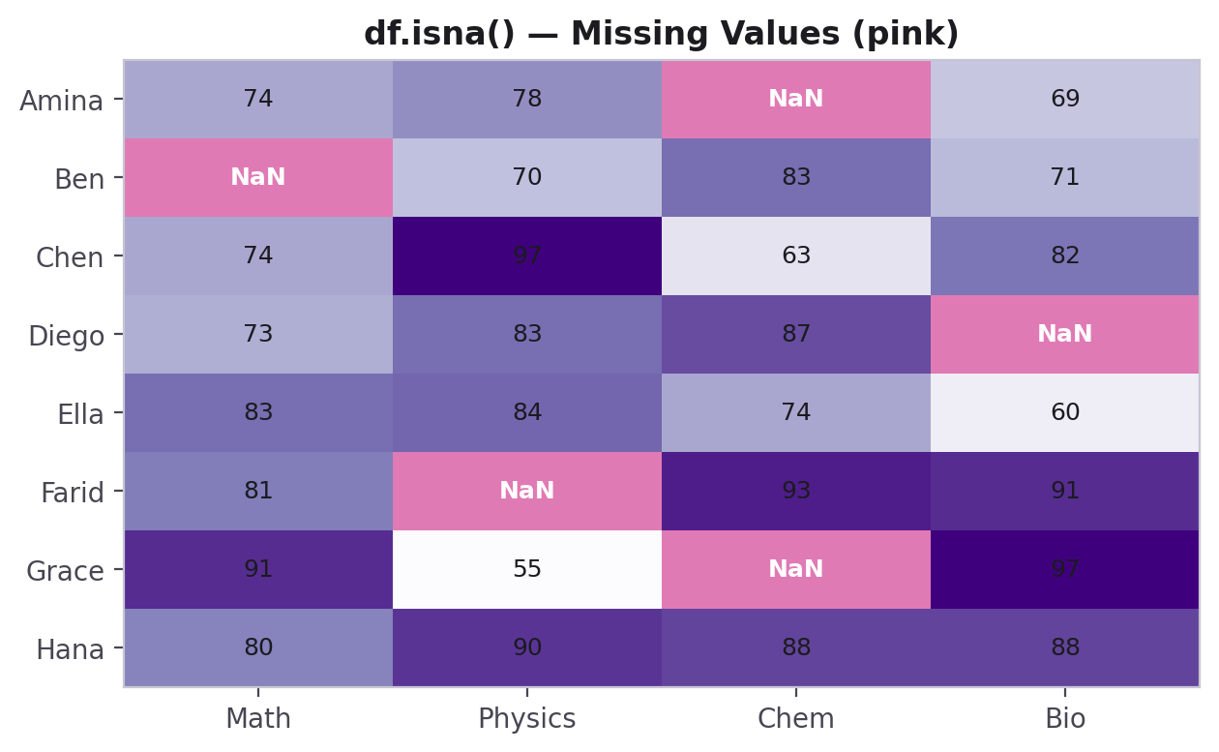
PART 3 · CREATING & LOADING DATA
Understanding a Dataset — info() & describe()
Before doing anything else, info() and describe() give you a fast, complete summary of a DataFrame.
df.info()
# column names, dtypes,
# non-null counts, memory usage
df.describe()
# count, mean, std, min,
# 25/50/75%, max
# for every numeric column
info() tells you what's there and what's missing; describe() tells you the shape of each numeric column — both take one line and save many mistakes.
CodeByPaxto · AI & ML Playground · Hafiz Waseem Ahmed (Paxto)
24

Slide 25
PART 3 · CREATING & LOADING DATA
Explore a Column — unique() & value_counts()
unique() lists each distinct value once — the fastest way to learn what categories a column holds.
value_counts() counts how often each value appears, most frequent first — here, tehsils per province.
df.PROVINCE is shorthand for df["PROVINCE"], but only works when the column name has no spaces, so brackets are the safe habit.
df = pd.read_csv("./Datasets/population.csv")
df["PROVINCE"].unique()
# ["PUNJAB" "SINDH" "BALOCHISTAN"
# "KPK" "KPK/FATA"]
df["PROVINCE"].value_counts()
# PUNJAB 143 · SINDH 137 · BALOCHISTAN 131
# KPK 71 · KPK/FATA 46
df.PROVINCE # same as df["PROVINCE"]
CodeByPaxto · AI & ML Playground · Hafiz Waseem Ahmed (Paxto)
25

Slide 26
PART 3 · CREATING & LOADING DATA
Setting the Index — set_index()
Three ways to label rows: index= when you build the DataFrame, assigning df.index later, or set_index("col") to promote an existing column.
set_index() is the one you’ll use most — a Name or ID column makes .loc["Waseem"] read like plain English.
inplace=True changes the real DataFrame; leave it out and you get a modified copy while the original stays unchanged.
cols = ["Name", "Age", "City", "Salary"]
# 1. labels at creation
pd.DataFrame(rows, columns=cols,
index=["A", "B", "C", "D"])
# 2. replace the index afterwards
df.index = ["row1", "row2", "row3", "row4"]
# 3. promote a column to the index
df.set_index("Name", inplace=True)
df.loc["Waseem"]
CodeByPaxto · AI & ML Playground · Hafiz Waseem Ahmed (Paxto)
26

Slide 27
PART 3 · CREATING & LOADING DATA
Saving & Loading — Excel and JSON
to_excel() writes a .xlsx file; index=False drops the 0, 1, 2… row numbers and sheet_name= names the tab.
Excel files need the openpyxl package (pip install openpyxl). Read the file straight back and compare .shape to check nothing was lost.
read_json() depends on the JSON layout: orient="index" treats each outer key as a row, while the default treats outer keys as columns.
df.to_excel("out.xlsx", index=False,
sheet_name="Population")
pd.read_excel("out.xlsx").shape
# (528, 21)
# JSON: outer keys are row labels
pd.read_json("recipes.json", orient="index")
# default: outer keys are column names
pd.DataFrame({"Duration": {"0": 60, "1": 60}})
CodeByPaxto · AI & ML Playground · Hafiz Waseem Ahmed (Paxto)
27

Slide 28
PART 3 · CREATING & LOADING DATA
Tip — Display More Rows
Pandas abbreviates big tables with “…” in the middle. pd.options.display.max_rows controls how many rows Jupyter shows.
It changes only the display — your data is untouched, like zooming in on a map.
Be careful: showing 10,000+ rows slows your notebook. Prefer head(20) / tail(20), and reset the setting afterwards.
pd.options.display.max_rows
# 60 (the default)
pd.options.display.max_rows = 530
df # all 528 rows are now shown
pd.options.display.max_rows = 60
# reset when you are done
CodeByPaxto · AI & ML Playground · Hafiz Waseem Ahmed (Paxto)
28

Slide 29
◎
PART 3 · CREATING & LOADING DATA
Practice Set — Creating & Loading Data
Try these yourself first — no code shown, that's the point.
Create a DataFrame from a dictionary (3+ columns, 4+ rows), then give it custom row labels using index= and using set_index().
1
Load a CSV with pd.read_csv(), print its shape, then run .head(), .info(), and .describe() and explain what each told you.
2
Use unique() and value_counts() on a categorical column, and raise then reset pd.options.display.max_rows.
3
Save a DataFrame with to_excel(index=False), read it back with read_excel(), and confirm the shape matches.
4
CodeByPaxto · AI & ML Playground · Hafiz Waseem Ahmed (Paxto)
29

Slide 30
PART 4 · SELECTING & FILTERING
Selecting & Filtering Data
Reaching into a DataFrame to grab exactly the rows and columns you need.
30

Slide 31
PART 4 · SELECTING & FILTERING
Selecting Columns
name
age
score
0
Amina
22
88
1
Ben
25
74
2
Chen
21
91
df["name"] # one column -> a Series
df[["name","age"]] # multiple columns -> a DataFrame
Single brackets with one column name return a Series; double brackets with a list return a DataFrame — even for one column.
CodeByPaxto · AI & ML Playground · Hafiz Waseem Ahmed (Paxto)
31

Slide 32
PART 4 · SELECTING & FILTERING
.loc[] — Selecting by Label
Function / Attribute | Meaning
df.loc[0] | The row labeled 0
df.loc[0, "name"] | The value at row 0, column "name"
df.loc[0:2, "name":"score"] | A slice of rows and columns, by label — both ends included
df.loc[df["score"] > 80] | Every row where the condition is True
.loc[] always works with labels — the index values and column names you see on the DataFrame itself.
CodeByPaxto · AI & ML Playground · Hafiz Waseem Ahmed (Paxto)
32

Slide 33
PART 4 · SELECTING & FILTERING
.iloc[] — Selecting by Position
Function / Attribute | Meaning
df.iloc[0] | The first row, regardless of its label
df.iloc[0, 1] | The value at row position 0, column position 1
df.iloc[0:2, 0:2] | A slice by position — stop is excluded, just like Python lists
df.iloc[-1] | The last row
.iloc[] always works with integer positions — the same way indexing works on a Python list or a NumPy array.
CodeByPaxto · AI & ML Playground · Hafiz Waseem Ahmed (Paxto)
33

Slide 34
PART 4 · SELECTING & FILTERING
Boolean Filtering — Rows That Match a Condition
The most common way to filter a DataFrame: build a True/False condition, then use it as an index.
passing = df[df["score"] >= 60]
# combine conditions with & and |
honors = df[
(df["score"] >= 90) &
(df["age"] < 23)
]
df["score"] >= 60 creates a boolean Series the same length as df — wrapping df[...] around it keeps only the True rows. Use & / | (not and/or) and wrap each condition in parentheses.
CodeByPaxto · AI & ML Playground · Hafiz Waseem Ahmed (Paxto)
34

Slide 35
PART 4 · SELECTING & FILTERING
loc & iloc — Beyond the Basics
Pass a list to .iloc[] to pick rows by position; iloc[:, 0] is every row of the first column, and iloc[0:3:2] takes every second row.
.loc[condition, "col"] filters rows and picks a column in one step. Assigning with iloc[0, 2] = value overwrites that cell for good — one outlier can badly skew describe().
Concatenating frames that share labels leaves duplicate labels, so .loc["A"] returns every match. Use ignore_index=True to renumber.
df.iloc[[0, 3]] # rows 0 and 3
df.iloc[:, 0] # first column
df.iloc[0:3:2] # every 2nd row
df.loc[df["City"] == "Quetta", "Name"]
# Waseem, Kamran
df.iloc[0, 2] = 20500000 # set one cell
CodeByPaxto · AI & ML Playground · Hafiz Waseem Ahmed (Paxto)
35

Slide 36
◎
PART 4 · SELECTING & FILTERING
Practice Set — Selecting & Filtering Data
Try these yourself first — no code shown, that's the point.
Select a single column from a DataFrame as a Series, and two columns as a DataFrame.
1
Use .loc[] to select a range of rows and a range of columns by label.
2
Use .iloc[] to select the same data by position — try a list, a step slice, and iloc[:, 0].
3
Filter a DataFrame to rows matching two combined conditions, using & and parentheses.
4
CodeByPaxto · AI & ML Playground · Hafiz Waseem Ahmed (Paxto)
36

Slide 37
PART 5 · MODIFYING DATA
Adding, Modifying & Dropping
Reshaping the columns and rows of a DataFrame you already have.
37

Slide 38
PART 5 · MODIFYING DATA
Adding & Modifying Columns
Assigning to a new column name creates it — the calculation is vectorized, just like NumPy.
Assigning to an existing column name overwrites it.
rename() relabels columns without changing any data; inplace=True applies the change directly instead of returning a copy.
df["pass"] = df["score"] >= 60
# new column, computed from an existing one
df["score"] = df["score"] + 5
# modifies an existing column in place
df.rename(
columns={"score": "final_score"},
inplace=True
)
CodeByPaxto · AI & ML Playground · Hafiz Waseem Ahmed (Paxto)
38

Slide 39
PART 5 · MODIFYING DATA
Dropping Rows & Columns
Function / Attribute | Meaning
df.drop(columns=["age"]) | Returns a new DataFrame without the "age" column
df.drop(index=[0, 1]) | Returns a new DataFrame without rows 0 and 1
df.drop("age", axis=1) | Same as above — axis=1 means "a column"
inplace=True | Apply the drop directly, instead of returning a new DataFrame
df.drop(columns=["age"], inplace=True)
df.drop(index=[0], inplace=True)
CodeByPaxto · AI & ML Playground · Hafiz Waseem Ahmed (Paxto)
39

Slide 40
PART 5 · MODIFYING DATA
Applying Functions — apply() & lambda
apply() runs a function on every value in a column — pass your own def function or a one-line lambda (an anonymous function).
Use def for logic you’ll reuse; use lambda x: x ** 2 for a quick one-off.
Watch out: df["B"] = df["B"].apply(square) overwrites the column. Re-run that cell and it squares again — 10 becomes 100, then 10,000.
def square(x):
return x ** 2
df["B"] = df["B"].apply(square)
# 10, 20, 30 ... -> 100, 400, 900 ...
df["D"] = df["B"].apply(lambda x: x ** 2)
# lambda: same idea, no def needed
CodeByPaxto · AI & ML Playground · Hafiz Waseem Ahmed (Paxto)
40

Slide 41
◎
PART 5 · MODIFYING DATA
Practice Set — Adding, Modifying & Dropping
Try these yourself first — no code shown, that's the point.
Add a new column to a DataFrame that's computed from an existing column.
1
Rename one column to a more descriptive name.
2
Drop one column and one row from a DataFrame, using drop().
3
Use apply() with a def function and with a lambda to add a computed column, and explain what inplace=True does.
4
CodeByPaxto · AI & ML Playground · Hafiz Waseem Ahmed (Paxto)
41

Slide 42
PART 6 · MISSING DATA
Handling Missing Data
Real datasets are rarely complete — Pandas gives you the tools to find and fix the gaps.
42

Slide 43
PART 6 · MISSING DATA
Finding Missing Values — isna() & notna()
isna() marks every missing value across a whole DataFrame at once, column by column.
df.isna()
# True/False grid, same shape as df
df.isna().sum()
# count of missing values,
# per column
df.isna().sum().sum()
# total missing values
isna().sum() is one of the very first things to run on a new dataset — it tells you exactly where cleanup is needed before anything else.
CodeByPaxto · AI & ML Playground · Hafiz Waseem Ahmed (Paxto)
43

Slide 44
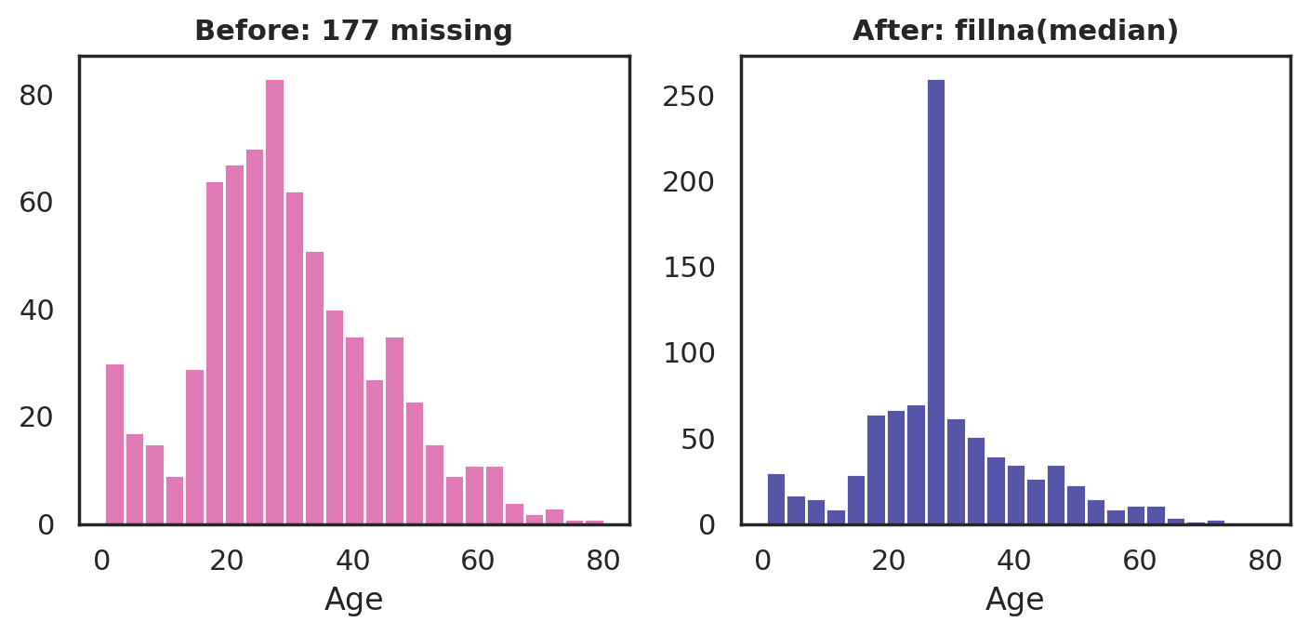
PART 6 · MISSING DATA
Dealing with the Gaps
Function / Attribute | Meaning
df.dropna() | Removes every row that has at least one missing value
df.dropna(subset=["age"]) | Removes rows only if "age" specifically is missing
df.fillna(0) | Replaces every missing value with 0
df.fillna(df["age"].median()) | Replaces missing values with a computed statistic, like the median
titanic["age"] before and after filling missing values with the median.
CodeByPaxto · AI & ML Playground · Hafiz Waseem Ahmed (Paxto)
44

Slide 45
PART 6 · MISSING DATA
Thresholds — any() & dropna(thresh=)
isna().any() answers yes/no per column; isna().sum() counts the gaps.
dropna() deletes any row with even one NaN — in the 5×5 example, that deletes everything.
thresh=n is the minimum number of non-missing values a row needs to survive. Each row has 4 real values out of 5, so thresh=4 keeps all five and thresh=5 keeps none.
df.isna().any()
# A–E: all True (each has a gap)
df.dropna()
# Empty — every row has a NaN
df.dropna(thresh=4)
# rows with 4+ real values: all 5 kept
df.dropna(thresh=5)
# rows with 5 real values: none
CodeByPaxto · AI & ML Playground · Hafiz Waseem Ahmed (Paxto)
45

Slide 46
PART 6 · MISSING DATA
fillna() with a Per-Column Dictionary
fillna(df.mean()) fills each column’s gaps with that column’s own average — one call, five different fill values.
fillna(value=dict) lets you choose: each key is a column name, and its value is the fill for that column only.
These methods return a new DataFrame unless you pass inplace=True — assign the result back or it’s lost.
df.fillna(df.mean())
# each NaN -> its own column’s mean
values = {"A": 0, "B": 1, "C": 2,
"D": 3, "E": 4}
df.fillna(value=values)
# row 2, col A -> 0.0
# row 1, col B -> 1.0
CodeByPaxto · AI & ML Playground · Hafiz Waseem Ahmed (Paxto)
46

Slide 47
◎
PART 6 · MISSING DATA
Practice Set — Handling Missing Data
Try these yourself first — no code shown, that's the point.
Create a small DataFrame with a few missing values, and count them per column.
1
Drop rows with dropna(), then try dropna(thresh=...) and compare how many rows survive.
2
Fill missing values with the column mean or median, then with a fillna() dictionary giving each column its own fill.
3
Explain when you'd choose dropna() over fillna(), and vice versa.
4
CodeByPaxto · AI & ML Playground · Hafiz Waseem Ahmed (Paxto)
47

Slide 48
PART 7 · SORTING & RANKING
Sorting & Ranking
Ordering a DataFrame to see what stands out first.
48

Slide 49
PART 7 · SORTING & RANKING
Sorting Values & the Index
Function / Attribute | Meaning
df.sort_values("score") | Sorts rows by a column's values, ascending by default
df.sort_values("score", ascending=False) | Sorts descending — highest first
df.sort_values(["class", "score"]) | Sorts by multiple columns, in order
df.sort_index() | Sorts rows back into index order
df["score"].rank() | Gives each value its rank, 1 = smallest
df.sort_values("score", ascending=False).head(3)
# the 3 highest scores, in order
CodeByPaxto · AI & ML Playground · Hafiz Waseem Ahmed (Paxto)
49

Slide 50
◎
PART 7 · SORTING & RANKING
Practice Set — Sorting & Ranking
Try these yourself first — no code shown, that's the point.
Sort a DataFrame by one column, ascending and then descending.
1
Sort a DataFrame by two columns at once.
2
Find the top 3 rows by a numeric column using sort_values() and head() together.
3
Rank a column's values and add the ranks as a new column.
4
CodeByPaxto · AI & ML Playground · Hafiz Waseem Ahmed (Paxto)
50

Slide 51
PART 8 · GROUPBY & AGGREGATION
GroupBy & Aggregation
The single most-used Pandas skill for EDA — split your data into groups, then summarize each one.
51

Slide 52
PART 8 · GROUPBY
The Idea: Split → Apply → Combine
→
→
1. Split
2. Apply
3. Combine
Group rows by a column's value — e.g. every row becomes part of its "day" group.
Run a function on each group separately — e.g. compute the mean tip within each day.
Collect each group's result back into a single, summarized table.
This exact pattern — split, apply, combine — is what groupby() automates in one line of code.
CodeByPaxto · AI & ML Playground · Hafiz Waseem Ahmed (Paxto)
52

Slide 53
PART 8 · GROUPBY
Anatomy of groupby()
Function / Attribute | Meaning
groupby("col") | The column whose values define the groups
["target"] | The column to summarize within each group
.mean() / .sum() / .count() | The aggregate statistic to compute
.agg({...}) | Apply different statistics to different columns at once
df.groupby("column_name")["target_column"].agg_function()
# examples:
df.groupby("day")["tip"].mean()
df.groupby("day")["tip"].sum()
df.groupby("day")["tip"].count()
df.groupby("day").agg({"tip": "mean", "size": "sum"})
CodeByPaxto · AI & ML Playground · Hafiz Waseem Ahmed (Paxto)
53

Slide 54
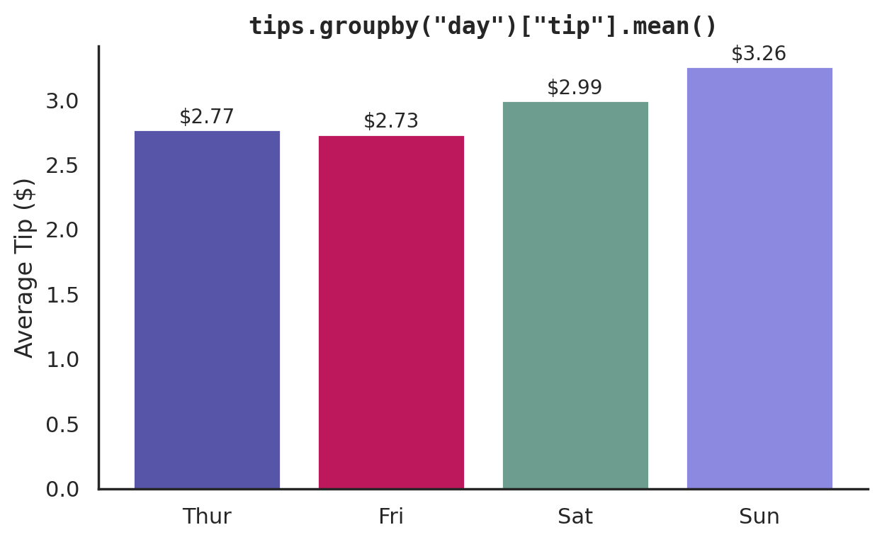
PART 8 · GROUPBY
Average Tip by Day — a Real Example
tips = sns.load_dataset("tips")
avg_tip = tips.groupby("day")["tip"].mean()
print(avg_tip)
# Thur 2.77
# Fri 2.73
# Sat 2.99
# Sun 3.26
One line answers a real question: which day tips the highest, on average? Sunday.
CodeByPaxto · AI & ML Playground · Hafiz Waseem Ahmed (Paxto)
54

Slide 55
PART 8 · GROUPBY
Looking Inside a GroupBy Object
groupby() returns a GroupBy object — a plan, not a table — so printing it shows only an object address.
Loop over it and you get (name, sub-table) pairs: A, B and C each get their own DataFrame — the Split step made visible.
Pass a list of columns to group by several keys; the result has a two-level index (Store, then Category).
cat = df.groupby("Category")
cat # a GroupBy object, not a table
for name, group in cat:
print(name)
print(group) # A, B, C sub-tables
df.groupby(["Store", "Category"])["Sales"].sum()
# S1: A 220, B 500
# S2: A 150, B 180, C 450
CodeByPaxto · AI & ML Playground · Hafiz Waseem Ahmed (Paxto)
55

Slide 56
PART 8 · GROUPBY
Aggregating with agg() — a List of Functions
Aggregation means combining many values into one result — mean, median, min, max, count, std.
agg() takes a list of function names and returns all of them in one call, instead of five separate lines.
The same agg() works after a groupby, giving each group its own full summary.
df["Sales"].mean()
# 187.5
df["Sales"].agg(
["mean", "median", "min", "max", "std"])
# mean 187.5
# median 190.0
# min 100.0
# max 300.0
# std 66.06
CodeByPaxto · AI & ML Playground · Hafiz Waseem Ahmed (Paxto)
56

Slide 57
◎
PART 8 · GROUPBY & AGGREGATION
Practice Set — GroupBy & Aggregation
Try these yourself first — no code shown, that's the point.
Group a DataFrame by one categorical column and compute the mean of a numeric column.
1
Group by the same column and compute several statistics at once with .agg(), e.g. ["mean", "median", "min", "max", "std"].
2
Group by two columns at once (e.g. day and time) and compare the results.
3
In your own words, describe the split-apply-combine idea using your own grouped result as the example.
4
CodeByPaxto · AI & ML Playground · Hafiz Waseem Ahmed (Paxto)
57

Slide 58
PART 9 · MERGING & JOINING
Merging, Joining & Concatenating
Combining two DataFrames into one — by stacking them, or by matching a shared key.
58

Slide 59
PART 9 · MERGING & JOINING
Two Small Tables
students
grades
name
class
name
score
0
Amina
10A
0
Amina
88
1
Ben
10B
1
Ben
74
2
Chen
10A
2
Diego
67
"students" and "grades" share a common column: "name" — this is the key that joins them together.
Notice Chen has no matching grade, and Diego has no matching class — a realistic mismatch we'll handle next.
concat() would just stack these on top of each other; merge() matches rows by the shared key instead.
CodeByPaxto · AI & ML Playground · Hafiz Waseem Ahmed (Paxto)
59

Slide 60
PART 9 · MERGING & JOINING
concat() — Stacking DataFrames
Function / Attribute | Meaning
pd.concat([df1, df2]) | Stacks rows on top of each other (same columns)
pd.concat([df1, df2], axis=1) | Places DataFrames side by side (same index)
ignore_index=True | Renumbers the index instead of keeping the originals
Use concat() when you have multiple chunks of the same kind of data — e.g. sales data from 12 separate monthly files.
CodeByPaxto · AI & ML Playground · Hafiz Waseem Ahmed (Paxto)
60

Slide 61
PART 9 · MERGING & JOINING
merge() — Matching by a Shared Key
pd.merge(
students, grades,
on="name",
how="inner"
# or "left", "right", "outer"
)
inner
left
right
outer
inner — only rows where the key matches in both DataFrames.
left / right — every row from one side, matched where possible (NaN where there's no match).
outer — every row from both sides, matched where possible.
CodeByPaxto · AI & ML Playground · Hafiz Waseem Ahmed (Paxto)
61

Slide 62
PART 9 · MERGING & JOINING
Merge in Action — Employees & Salaries
employees has IDs 1–5 and salaries has IDs 1, 2, 3, 6, 7 — only 1, 2 and 3 appear in both.
With no on= Pandas joins on the column the tables share, and with no how= it uses inner, so only the three matching employees survive.
how="outer" keeps all seven IDs and fills gaps with NaN. Because NaN is a float, salary shows as 60000.0 — a classic surprise.
pd.merge(employees, salaries)
# inner join on employee_id: IDs 1, 2, 3
pd.merge(employees, salaries,
on="employee_id", how="outer")
# IDs 4, 5: salary, bonus -> NaN
# IDs 6, 7: name, department -> NaN
CodeByPaxto · AI & ML Playground · Hafiz Waseem Ahmed (Paxto)
62

Slide 63
◎
PART 9 · MERGING & JOINING
Practice Set — Merging, Joining & Concatenating
Try these yourself first — no code shown, that's the point.
Create two small DataFrames that share one key column, with a couple of non-matching rows.
1
Merge them with how="inner" and note which rows survive.
2
Merge the same two DataFrames with how="left" and how="outer", and compare the results.
3
Concatenate two DataFrames with the same columns using pd.concat().
4
CodeByPaxto · AI & ML Playground · Hafiz Waseem Ahmed (Paxto)
63

Slide 64
PART 10 · PIVOT TABLES & RESHAPING
Pivot Tables & Reshaping
Turning long, repetitive data into a wide summary grid, and back again.
64

Slide 65
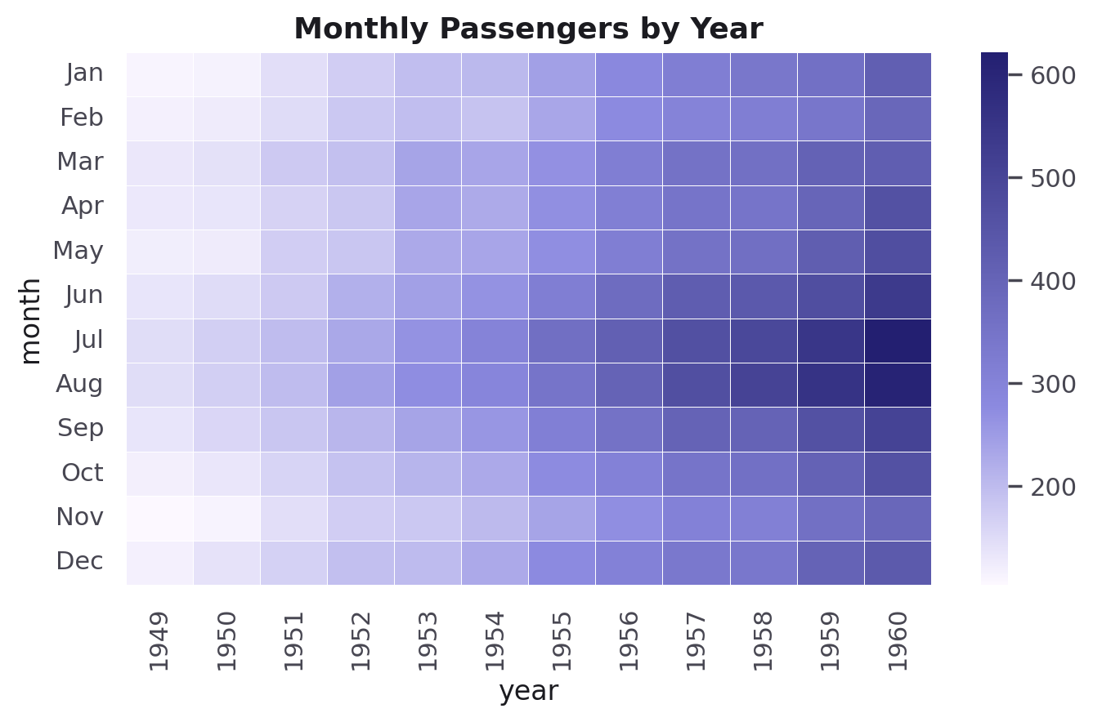
PART 10 · PIVOT TABLES
pivot_table() — Long Data, Summarized Wide
flights = sns.load_dataset("flights")
pvt = flights.pivot_table(
values="passengers",
index="month",
columns="year"
)
pivot_table() reshapes long-format rows (one row per month + year) into a wide grid — months down, years across.
By default it aggregates with mean() if there are multiple matching rows per cell — pass aggfunc= to change that.
The pivoted grid, visualized as a heatmap (Seaborn, Part 7 of that module).
CodeByPaxto · AI & ML Playground · Hafiz Waseem Ahmed (Paxto)
65

Slide 66
PART 10 · PIVOT TABLES
pivot_table() — Multiple Values
aggfunc takes a name like "median", "sum" or "mean" — don’t just rely on the default mean.
Pass a list to values= to summarize several columns at once: one block per measure (Sales, Units) side by side.
NaN cells mean no rows exist for that Region–Product pair. Here each region sold exactly one product, so most cells are empty.
pd.pivot_table(df, values="Sales",
index="Region", columns="Product",
aggfunc="median")
pd.pivot_table(df,
values=["Sales", "Units"],
index="Region", columns="Product",
aggfunc="median")
CodeByPaxto · AI & ML Playground · Hafiz Waseem Ahmed (Paxto)
66

Slide 67
PART 10 · RESHAPING
melt() — Wide Data, Back to Long
Function / Attribute | Meaning
df.melt(id_vars=["name"]) | Turns wide columns into two columns: variable and value
value_vars=[...] | Choose which columns to "unpivot"; others are left as identifiers
wide = pd.DataFrame({
"name": ["Amina", "Ben"],
"Math": [88, 74], "Physics": [85, 70]
})
long = wide.melt(id_vars="name",
var_name="subject", value_name="score")
# name subject score
# 0 Amina Math 88
# 1 Ben Math 74
# 2 Amina Physics 85
# 3 Ben Physics 70
CodeByPaxto · AI & ML Playground · Hafiz Waseem Ahmed (Paxto)
67

Slide 68
PART 10 · PIVOT TABLES
pd.crosstab() — Counting Combinations
crosstab() counts how often each combination of two categories occurs — a frequency table, no numeric column needed.
pivot_table() summarizes a number (like Sales); crosstab() counts rows. Use crosstab to see how two categories overlap.
The zeros tell the same story as the NaN cells in the pivot: every region sold only one product.
pd.crosstab(df["Region"], df["Product"])
# Product A B C D
# East 5 0 0 0
# North 0 0 5 0
# South 0 0 0 5
# West 0 5 0 0
CodeByPaxto · AI & ML Playground · Hafiz Waseem Ahmed (Paxto)
68

Slide 69
◎
PART 10 · PIVOT TABLES & RESHAPING
Practice Set — Pivot Tables & Reshaping
Try these yourself first — no code shown, that's the point.
Build a pivot table from a small dataset, summarizing one numeric column across two categories.
1
Change aggfunc from the default mean to sum or median, and pass two columns to values=.
2
Take a wide DataFrame (one column per subject) and melt() it into long format.
3
Build a crosstab() of two categorical columns, and explain when you’d use pivot_table() vs. crosstab() vs. melt().
4
CodeByPaxto · AI & ML Playground · Hafiz Waseem Ahmed (Paxto)
69

Slide 70
PART 11 · STRING & DATETIME OPERATIONS
String & DateTime Operations
Cleaning text and working with dates — two accessors that unlock a huge amount of real-world cleanup.
70

Slide 71
PART 11 · STRING OPERATIONS
The .str Accessor
The .str accessor applies a string method to every value in a Series at once — vectorized, just like NumPy math.
Extremely common for cleaning messy, inconsistently-cased or padded text columns before analysis.
Chainable: names.str.strip().str.lower() runs both in sequence.
names = pd.Series([" Amina ", "BEN", "chen"])
names.str.strip() # remove extra whitespace
names.str.lower() # "amina", "ben", "chen"
names.str.title() # "Amina", "Ben", "Chen"
names.str.contains("a", case=False)
# True, False, True
names.str.replace("e", "3")
CodeByPaxto · AI & ML Playground · Hafiz Waseem Ahmed (Paxto)
71

Slide 72
PART 11 · DATETIME OPERATIONS
The .dt Accessor
pd.to_datetime() converts a text/date column into a real datetime type — required before .dt will work.
Once converted, .dt gives you year, month, day, weekday name, and more, all vectorized.
This is essential for any time-series data — sales by month, sensor readings by day, and so on.
df["date"] = pd.to_datetime(
["2026-01-15", "2026-02-03"]
)
df["date"].dt.year # 2026, 2026
df["date"].dt.month # 1, 2
df["date"].dt.day_name()
# "Thursday", "Tuesday"
CodeByPaxto · AI & ML Playground · Hafiz Waseem Ahmed (Paxto)
72

Slide 73
◎
PART 11 · STRING & DATETIME OPERATIONS
Practice Set — String & DateTime Operations
Try these yourself first — no code shown, that's the point.
Create a Series of messy text (extra spaces, mixed case) and clean it with .str methods.
1
Filter a DataFrame to rows where a text column contains a specific substring.
2
Convert a column of date strings to real dates with pd.to_datetime().
3
Extract the month and weekday name from that date column using .dt.
4
CodeByPaxto · AI & ML Playground · Hafiz Waseem Ahmed (Paxto)
73

Slide 74
PART 12 · PANDAS + VISUALIZATION
Pandas + Visualization
A DataFrame can plot itself — a fast bridge into Matplotlib and Seaborn.
74

Slide 75
PART 12 · PANDAS + VISUALIZATION
df.plot() — Charts in One Line
avg_tip = tips.groupby("day")["tip"].mean()
avg_tip.plot(kind="bar", color="#5755A7")
plt.title("Average Tip by Day")
plt.ylabel("Tip ($)")
plt.show()
.plot() is built on Matplotlib under the hood — kind="bar"/"line"/"hist"/"scatter" covers most quick checks.
Great for a fast look while exploring; switch to Matplotlib or Seaborn directly once you want full control over styling.
Same chart, drawn straight from the GroupBy result.
CodeByPaxto · AI & ML Playground · Hafiz Waseem Ahmed (Paxto)
75

Slide 76
◎
PART 12 · PANDAS + VISUALIZATION
Practice Set — Pandas + Visualization
Try these yourself first — no code shown, that's the point.
Group any DataFrame and plot the result directly with .plot(kind="bar").
1
Try kind="line" and kind="hist" on two different columns and compare.
2
Customize a .plot() output using regular Matplotlib calls (plt.title(), plt.ylabel()) afterward.
3
CodeByPaxto · AI & ML Playground · Hafiz Waseem Ahmed (Paxto)
76

Slide 77
PART 13 · REAL-WORLD DATA
Pandas for Real-World Data
Putting the whole toolkit together on the titanic dataset — the same EDA workflow you'll run on every new dataset.
77

Slide 78
PART 13 · REAL-WORLD DATA
Step 1 — Load & Inspect
Always start the same way: shape, info(), and isna().sum() — know what you have and what's missing before touching anything.
age has real gaps worth handling; deck is missing so often it may not be usable at all.
titanic = sns.load_dataset("titanic")
titanic.shape
# (891, 15)
titanic.info()
titanic.isna().sum()
# age 177
# deck 688
# embarked 2
CodeByPaxto · AI & ML Playground · Hafiz Waseem Ahmed (Paxto)
78

Slide 79
PART 13 · REAL-WORLD DATA
Step 2 — Clean the Missing Values
titanic["age"] = titanic["age"].fillna(
titanic["age"].median()
)
titanic.drop(columns=["deck"], inplace=True)
titanic.dropna(subset=["embarked"], inplace=True)
age's distribution barely shifts after filling with the median.
CodeByPaxto · AI & ML Playground · Hafiz Waseem Ahmed (Paxto)
79

Slide 80
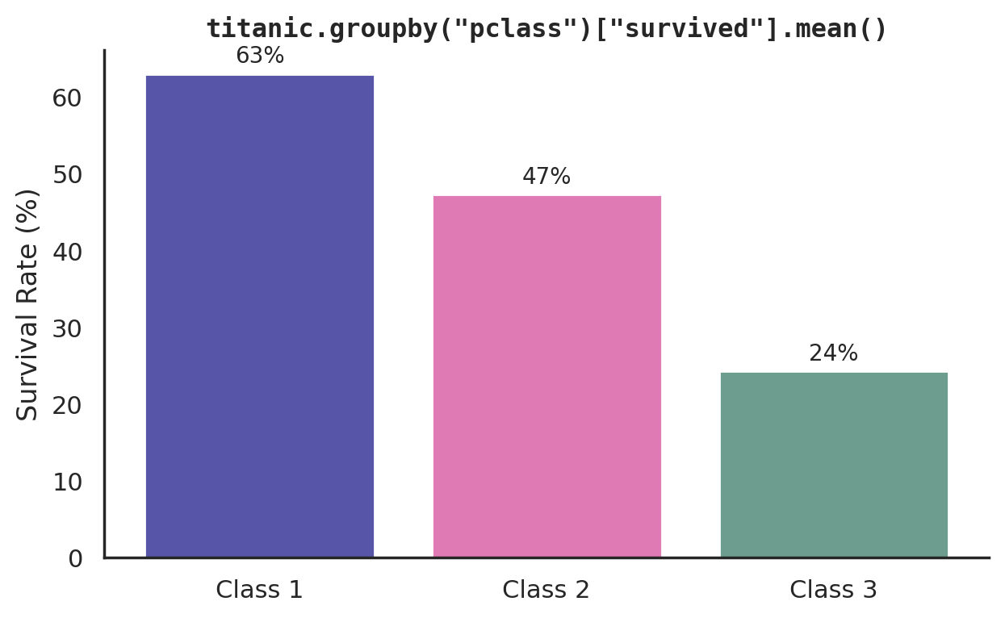
PART 13 · REAL-WORLD DATA
Step 3 — Ask a Real Question with GroupBy
survival_rate = titanic.groupby("pclass")["survived"].mean()
print(survival_rate)
# 1 0.63
# 2 0.47
# 3 0.24
This single groupby().mean() answers a real historical question: 1st class passengers survived at more than double the rate of 3rd class.
CodeByPaxto · AI & ML Playground · Hafiz Waseem Ahmed (Paxto)
80

Slide 81
◎
PART 13 · REAL-WORLD DATA
Practice Set — Pandas for Real-World Data
Try these yourself first — no code shown, that's the point.
Load the titanic dataset and run shape, info(), and isna().sum().
1
Clean the age column's missing values with a sensible fill strategy.
2
Group by sex and compute the survival rate — how does it compare to the class breakdown?
3
Write 2-3 sentences summarizing what you learned about who was more likely to survive.
4
CodeByPaxto · AI & ML Playground · Hafiz Waseem Ahmed (Paxto)
81

Slide 82
PART 14 · MINI PROJECTS
Put It All Together
Three small projects combining everything from Foundations to Real-World Data — built end to end with Pandas.
82

Slide 83
PART 14 · MINI PROJECTS
Mini Project 1: Class Grade Report
Build a DataFrame of students with name, class, and scores across 3 subjects.
Filter to students passing every subject, using combined boolean conditions.
Group by class and compute the average score per class.
Use apply() with a lambda to add a letter-grade column, then sort by overall average and report the top 3.
1
Filtering +
GroupBy + sorting
CodeByPaxto · AI & ML Playground · Hafiz Waseem Ahmed (Paxto)
83

Slide 84
PART 14 · MINI PROJECTS
Mini Project 2: Sales Data Merge & Clean
Build two small DataFrames: one with product info, one with monthly sales figures, sharing a product ID key.
Merge them with how="left" and identify any products with no matching sales.
Fill missing sales with a fillna() dictionary (a different fill per column), and use dropna(thresh=...) to drop rows with too few real values.
Group the merged result by product category and report total sales per category.
2
Merge +
Missing data cleanup
CodeByPaxto · AI & ML Playground · Hafiz Waseem Ahmed (Paxto)
84

Slide 85
PART 14 · MINI PROJECTS
Mini Project 3: Titanic EDA Report
Load the titanic dataset and run the standard inspect to clean workflow (Part 13).
Compute survival rate grouped by sex, and separately by pclass.
Plot one of your grouped results directly with .plot(kind="bar").
Write a short summary (3-4 sentences) of the strongest pattern you found in who survived.
3
Real-world EDA +
GroupBy + visualization
CodeByPaxto · AI & ML Playground · Hafiz Waseem Ahmed (Paxto)
85

Slide 86
MODULE RECAP
Every DataFrame you filtered, grouped, and merged today is the exact same structure you'll load, clean, and hand off to Matplotlib, Seaborn, and every model in this course. Selecting, GroupBy, and merge aren't just Pandas skills — they're the daily grammar of Data Analytics.
Next up: Matplotlib — turning the clean DataFrames you just built into pictures you can actually reason about.
86

Slide 87
Thank You
Pandas · AI & ML Playground · CodeByPaxto
87

