Slide 1

AI & ML PLAYGROUND · MODULE 06
Matplotlib
Turning numbers into pictures — the visualization foundation for Data Analytics and Machine Learning.
CodeByPaxto: The AI & ML Playground · Hafiz Waseem Ahmed (Paxto)
01

Slide 2

WHERE THIS FITS
The AI & ML Playground Roadmap
Python
→
Math for DS
→
Git & GitHub
→
NumPy
→
Pandas
→
Matplotlib
→
Seaborn
→
Data Analytics
→
Supervised ML
You are here — Matplotlib turns the clean arrays and DataFrames you built in NumPy and Pandas into visuals you can actually reason about, and it's the visualization language you'll keep using all the way through Machine Learning.
02

Slide 3
WHAT WE'RE COVERING
Today's Roadmap
01
02
03
Foundations & Terminology
Getting Started
Pyplot & Line Plots
04
05
06
Bar, Pie, Histogram, Scatter
Subplots
The Object-Oriented API
07
08
09
Controlling the View
Color, Images & Customization
Text, Annotations & Stats Plots
10
11
12
Saving Figures
NumPy & Pandas Integration
Matplotlib for AI/ML
CodeByPaxto · AI & ML Playground · Hafiz Waseem Ahmed (Paxto)
03

Slide 4
PART 1 · FOUNDATIONS
Foundations & Terminology
19 core terms — the shared vocabulary you'll use for every chart you ever build in Matplotlib.
04

Slide 5
PART 1 · TERMINOLOGY
Terms 1–4 · Building Blocks of a Chart
1
Data Point
2
X-axis / Y-axis
3
Figure
4
Axes
A single (x, y) value plotted on a chart — one observation from your dataset.
The horizontal (X) and vertical (Y) reference lines a chart is measured against.
The entire canvas or window that holds everything — like the picture frame.
One individual plot area inside a Figure — the thing you actually draw on.
CodeByPaxto · AI & ML Playground · Hafiz Waseem Ahmed (Paxto)
05

Slide 6
PART 1 · TERMINOLOGY
Terms 5–8 · Describing a Plot's Look
5
Plot
6
Marker
7
Line Style
8
Color
A visual representation of data — a line, bar, scatter, etc. drawn on Axes.
The symbol used for each data point — circle, triangle, x, and more.
How a line looks — solid, dashed, dotted, dash-dot.
The visual color assigned to a line, bar, marker, or fill.
CodeByPaxto · AI & ML Playground · Hafiz Waseem Ahmed (Paxto)
06

Slide 7
PART 1 · TERMINOLOGY
Terms 9–12 · Labeling What You See
9
Legend
10
Label
11
Title
12
Grid
A key that maps colors/markers to what they represent.
Text describing a data series, axis, or point.
The heading text that names the whole chart.
Light background lines that help read values across a chart.
CodeByPaxto · AI & ML Playground · Hafiz Waseem Ahmed (Paxto)
07

Slide 8
PART 1 · TERMINOLOGY
Terms 13–16 · The Language of Code
13
Function
14
Method
15
Parameters
16
Keyword Arguments
A reusable block of code that performs a task, e.g. plt.plot().
A function that belongs to an object, e.g. ax.plot().
The inputs a function/method accepts, e.g. x, y in plt.plot(x, y).
Named parameters passed as name=value, e.g. color="red".
CodeByPaxto · AI & ML Playground · Hafiz Waseem Ahmed (Paxto)
08

Slide 9
PART 1 · TERMINOLOGY
Terms 17–19 · Structure, Quality & Rendering
17
Object-Oriented API
18
DPI
19
Backend
Building a chart via explicit fig and ax objects: ax.plot(), ax.set_title().
Dots Per Inch — controls the resolution/sharpness of a saved or displayed figure.
The system Matplotlib uses to render or display a figure (screen, file, notebook).
CodeByPaxto · AI & ML Playground · Hafiz Waseem Ahmed (Paxto)
09

Slide 10
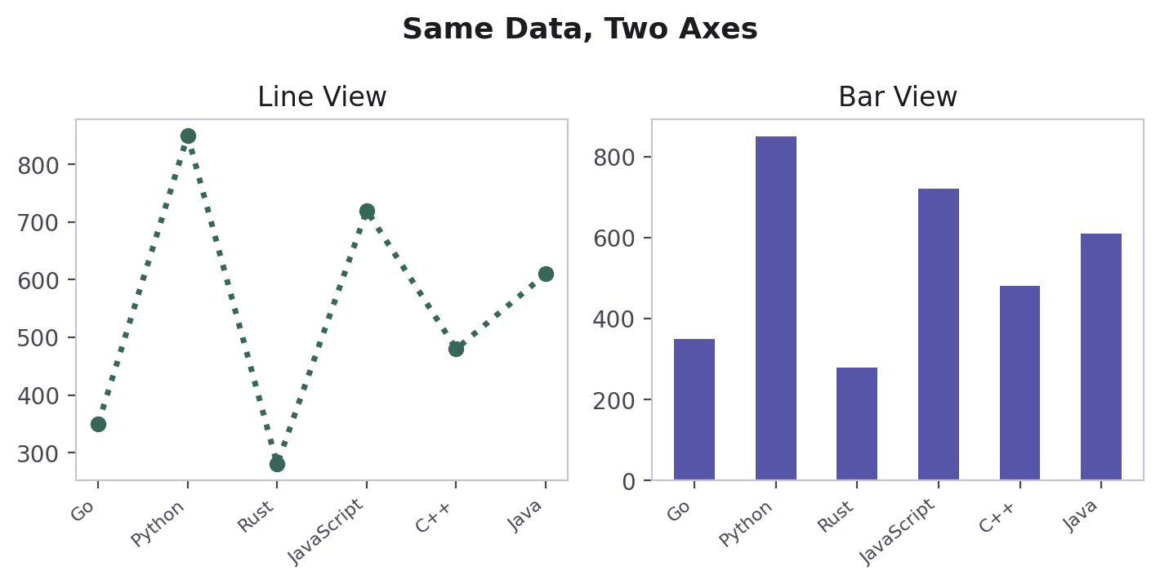
PART 1 · TERMINOLOGY
Figure vs. Axes — Visualized
Figure
A Figure is the whole canvas — the entire window or image file.
An Axes is one plot area living inside that Figure — it holds the actual X-axis, Y-axis, title, legend, and data.
One Figure can contain many Axes (this is exactly what Subplots are, covered in Part 8).
Every plt.plot(), plt.title(), etc. call quietly targets "the current Axes" of "the current Figure."
Axes
Y-axis
X-axis
CodeByPaxto · AI & ML Playground · Hafiz Waseem Ahmed (Paxto)
10

Slide 11
◎
PART 1 · TERMINOLOGY
Practice Set — Foundations & Terminology
Try these yourself first — no code shown, that's the point.
In your own words, explain the difference between a Figure and an Axes.
1
Sketch a simple chart on paper and label its title, legend, X-axis, and Y-axis.
2
Explain the difference between a function and a method, using plt.plot() and ax.plot() as your examples.
3
List two keyword arguments you'd expect plt.plot() to accept, and what each one controls.
4
CodeByPaxto · AI & ML Playground · Hafiz Waseem Ahmed (Paxto)
11

Slide 12
PART 2 · GETTING STARTED
Getting Started with Matplotlib
Installing, importing, and understanding the basic workflow before you plot anything.
12

Slide 13
PART 2 · GETTING STARTED
Installing & Importing Matplotlib
Install once per environment: pip install matplotlib
The pyplot module is the part we use most — it's imported with a standard alias, plt.
plt.show() renders the current Figure — in scripts it opens a window; in Jupyter it displays inline.
Nothing appears on screen until show() is called (in most environments) — building the plot and displaying it are two separate steps.
# one-time install (terminal)
pip install matplotlib
# every notebook / script
import matplotlib.pyplot as plt
plt.plot([1, 2, 3], [4, 9, 16])
plt.show() # render it!
CodeByPaxto · AI & ML Playground · Hafiz Waseem Ahmed (Paxto)
13

Slide 14
PART 2 · GETTING STARTED
The Basic Matplotlib Workflow
→
→
→
1
2
3
4
Prepare data
Create a Figure
Plot & customize
Show or save
Lists, NumPy arrays, or Pandas columns for X and Y.
plt.figure() or plt.subplots() sets up the canvas.
plt.plot()/bar()/... then labels, title, legend, grid.
plt.show() to view, plt.savefig() to export.
Two ways to build Figures: plt.figure() creates a blank canvas you plot onto with pyplot commands. plt.subplots() creates a Figure and one or more Axes at once, and hands them back to you — this is the door into the Object-Oriented API (Part 9).
CodeByPaxto · AI & ML Playground · Hafiz Waseem Ahmed (Paxto)
14

Slide 15
PART 2 · GETTING STARTED
Two APIs, One Library
PYPLOT / PROCEDURAL
OBJECT-ORIENTED (OO)
Quick and direct. You call plt.___() functions and Matplotlib tracks "the current figure" for you.
Explicit and scalable. You hold onto fig and ax objects and call methods on them directly.
plt.plot(x, y)
plt.title("Sales")
plt.xlabel("Month")
plt.show()
fig, ax = plt.subplots()
ax.plot(x, y)
ax.set_title("Sales")
ax.set_xlabel("Month")
plt.show()
CodeByPaxto · AI & ML Playground · Hafiz Waseem Ahmed (Paxto)
15

Slide 16
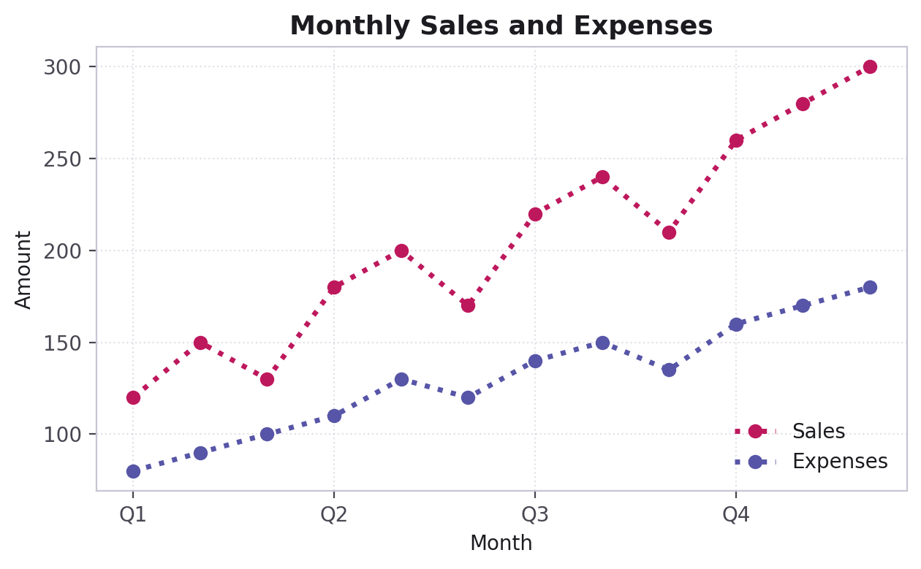
PART 2 · GETTING STARTED
Your First Plot
import matplotlib.pyplot as plt
x = [1, 2, 3, 4, 5]
y = [16, 40, 26, 50, 45]
plt.plot(x, y)
plt.show()
Three lists become three visual ideas: position along X, height along Y, and the connecting line between them. Every chart you'll build starts from this same idea.
CodeByPaxto · AI & ML Playground · Hafiz Waseem Ahmed (Paxto)
16

Slide 17
◎
PART 2 · GETTING STARTED
Practice Set — Getting Started
Try these yourself first — no code shown, that's the point.
Import matplotlib.pyplot and plot any 5 numbers of your choice against their squares.
1
Create a Figure with plt.figure() and a separate one with plt.subplots() — compare what each gives you back.
2
Predict what happens if you remove plt.show() from a script, then test it and see if you were right.
3
Rewrite one pyplot-style plot using the Object-Oriented style, without looking back at the slides.
4
CodeByPaxto · AI & ML Playground · Hafiz Waseem Ahmed (Paxto)
17

Slide 18
PART 3 · PYPLOT
Pyplot & Line Plots
A deep, hands-on look at plt.plot() and everything that controls how a line chart looks and reads.
18

Slide 19
PART 3 · PYPLOT
Anatomy of plt.plot()
Parameter | Meaning
x, y | The data being plotted — position and value
color | Line color — named color or hex code
linestyle | Solid, dashed, dotted, dash-dot
linewidth | Thickness of the line
marker | Symbol drawn at each data point
label | Name shown for this line in the legend
plt.plot(
x, y,
color="color_name",
linestyle="line_style",
linewidth=value,
marker="marker_style",
label="label_name"
)
CodeByPaxto · AI & ML Playground · Hafiz Waseem Ahmed (Paxto)
19

Slide 20
PART 3 · PYPLOT
Multiple Lines on One Chart
days = ["Monday", "Tuesday", "Wednesday",
"Thursday", "Friday"]
sales = [120, 150, 100, 180, 160]
expenses = [80, 100, 90, 120, 110]
plt.plot(days, sales, label="Sales")
plt.plot(days, expenses, label="Expenses")
plt.title("Weekly Sales vs Expenses")
plt.xlabel("Weekdays")
plt.ylabel("Amount")
plt.legend()
plt.show()
Two series, one Axes, one legend.
Calling plt.plot() twice draws two lines on the same Axes.
Each label= becomes an entry once you call plt.legend().
CodeByPaxto · AI & ML Playground · Hafiz Waseem Ahmed (Paxto)
20

Slide 21
PART 3 · PYPLOT
Color & Line Style Options
Parameter | Meaning
"red", "blue", "green"... | Named colors — the simplest way to set color
"#5755A7" | Hex codes — for precise, brand-exact colors
"-" | Solid line (the default)
"--" | Dashed line
":" | Dotted line
"-." | Dash-dot line
color= accepts a named color ("red") or a hex string ("#BE185D") — both work identically.
linestyle= changes how the connecting line looks without touching the data at all.
These two parameters alone are often enough to tell two lines apart at a glance — even before a legend.
CodeByPaxto · AI & ML Playground · Hafiz Waseem Ahmed (Paxto)
21

Slide 22
PART 3 · PYPLOT
Markers & Line Width
Parameter | Meaning
"o" | Circle marker
"x" | X marker
"^" | Triangle marker
"s" | Square marker
markersize | Controls how big each marker is drawn
linewidth | Controls how thick the connecting line is
plt.plot(
x, y,
color="red",
linestyle=":",
linewidth=2,
marker="o",
label="Sales"
)
CodeByPaxto · AI & ML Playground · Hafiz Waseem Ahmed (Paxto)
22

Slide 23
PART 3 · PYPLOT
Marker Styling — Face, Edge & Size
Parameter | Meaning
markersize (ms) | Size of the marker symbol, in points
markerfacecolor | Fill color inside the marker
markeredgecolor | Color of the marker’s outline
markeredgewidth | Thickness of that outline
marker | Symbol: o s * + x D ^ v < > p h . 1–4
lw / ls | Shorthand for linewidth / linestyle
plt.plot(
x, y,
color="purple", lw=1, ls="-",
marker="s",
markersize=8,
markerfacecolor="yellow",
markeredgecolor="green",
markeredgewidth=3,
)
CodeByPaxto · AI & ML Playground · Hafiz Waseem Ahmed (Paxto)
23

Slide 24
PART 3 · PYPLOT
Dashes, Draw Styles & the Marker Catalog
Four built-in line styles: "-" solid, "--" dashed, "-." dash-dot, ":" dotted. ls and lw are shorthand for linestyle and linewidth.
For a custom pattern, grab the Line2D object (note the comma in line, = ax.plot(...)) and call set_dashes([on, off, on, off, ...]) — values are in points.
"steps" is not a valid linestyle in current Matplotlib; use drawstyle="steps-post" (or "steps-pre", "steps-mid") for a staircase.
line, = ax.plot(x, y, color="black", lw=1.5)
line.set_dashes([5, 50, 15, 50])
# draw 5pt, skip 50, draw 15, skip 50...
ax.plot(x, y, drawstyle="steps-post")
# staircase line
ax.plot(x, y, ls="-.", marker="D")
# markers: + o * s , . 1 2 3 4 D ^ v < > x p h
CodeByPaxto · AI & ML Playground · Hafiz Waseem Ahmed (Paxto)
24

Slide 25
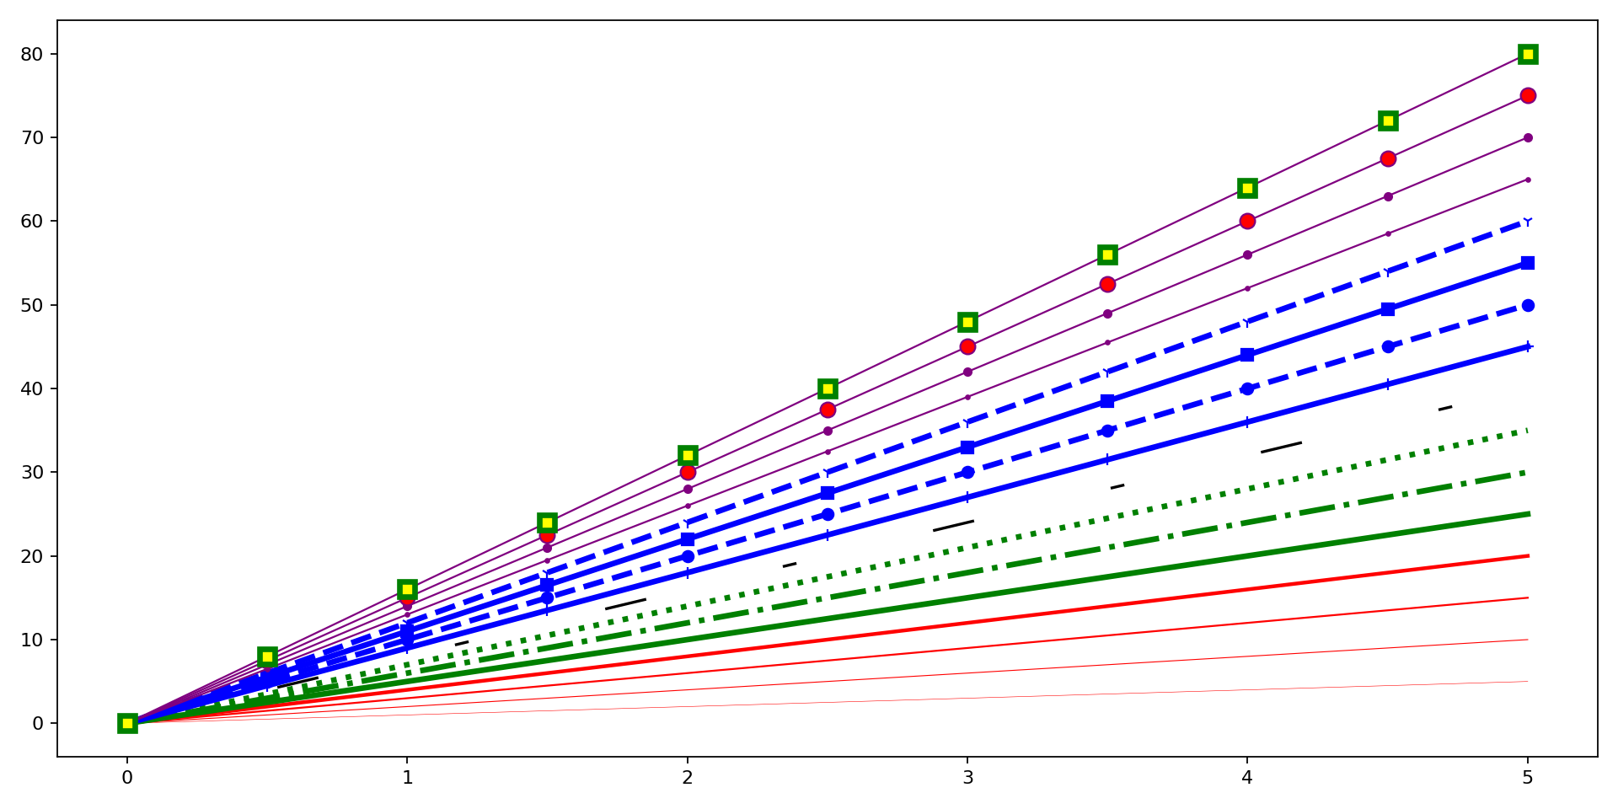
PART 3 · PYPLOT
Everything at Once — 16 Styled Lines
fig, ax = plt.subplots(figsize=(12, 6))
ax.plot(xaxis, xaxis*1, color="red", lw=0.25)
ax.plot(xaxis, xaxis*5, color="green",
lw=3, ls="-.")
ax.plot(xaxis, xaxis*10, color="blue",
lw=3, ls="--", marker="o")
ax.plot(xaxis, xaxis*16, color="purple",
lw=1, marker="s", markersize=8,
markerfacecolor="yellow",
markeredgewidth=3,
markeredgecolor="green")
Real output of the notebook’s 16-line demo: widths, line styles, markers and marker colors on a single Axes.
CodeByPaxto · AI & ML Playground · Hafiz Waseem Ahmed (Paxto)
25

Slide 26
PART 3 · PYPLOT
Putting It All Together
plt.plot(months, sales, color="red",
linestyle=":", linewidth=2,
marker="o", label="Sales")
plt.plot(months, expenses, color="blue",
linestyle=":", linewidth=2,
marker="o", label="Expenses")
plt.title("Monthly Sales and Expenses")
plt.xlabel("Quarters")
plt.ylabel("Amount")
plt.legend(loc="lower right")
color + linestyle + marker + label, combined.
CodeByPaxto · AI & ML Playground · Hafiz Waseem Ahmed (Paxto)
26

Slide 27
PART 3 · PYPLOT
Titles, Labels & Legend Placement
Parameter | Meaning
plt.title("...") | Sets the chart's overall title
plt.xlabel("...") | Names what the X-axis represents
plt.ylabel("...") | Names what the Y-axis represents
plt.legend() | Draws the legend using each label=
plt.legend(loc="upper left") | Places the legend in a specific corner
plt.legend(loc="best") | Lets Matplotlib pick the least crowded spot
CodeByPaxto · AI & ML Playground · Hafiz Waseem Ahmed (Paxto)
27

Slide 28
PART 3 · PYPLOT
Styling Text — fontsize, fontweight, pad
Text functions — title(), xlabel(), ylabel() — accept style arguments: fontsize, fontweight ("bold"), and color (a name or hex code).
pad= adds space (in points) between the title and the plot, so a bold title doesn’t crowd the top edge.
tight_layout() adjusts spacing so labels and titles don’t overlap or get cut off — call it just before show() or savefig().
plt.title(
"Product Sale Comparison",
fontweight="bold",
fontsize=14,
pad=15,
color="#3A3C3A",
)
plt.xlabel("Product", color="#333333")
plt.ylabel("Sales", color="#333333")
plt.tight_layout()
CodeByPaxto · AI & ML Playground · Hafiz Waseem Ahmed (Paxto)
28

Slide 29
PART 3 · PYPLOT
Controlling Ticks: xticks() & yticks()
By default, ticks are placed automatically at even, readable intervals.
Pass a list of positions plus a list of custom labels to relabel any tick — great for grouping 12 months into 4 quarters.
The position list and label list must be the same length, matched one-to-one.
Useful for renaming raw values into ranges or categories readers understand instantly.
plt.xticks(
[0, 3, 6, 9],
["Q1", "Q2", "Q3", "Q4"]
)
plt.yticks(
[50, 150, 250, 350],
["50-150", "150-250",
"250-350", "350+"]
)
CodeByPaxto · AI & ML Playground · Hafiz Waseem Ahmed (Paxto)
29

Slide 30
PART 3 · PYPLOT
The Grid — plt.grid()
Parameter | Meaning
plt.grid() | Turns the grid on (default style)
plt.grid(False) | Turns the grid off
axis="x" / "y" / "both" | Show only vertical, only horizontal, or both
linestyle=":" | Style of the grid lines
linewidth=0.5 | Thickness of the grid lines
alpha=0.5 | Transparency of the grid lines
CodeByPaxto · AI & ML Playground · Hafiz Waseem Ahmed (Paxto)
30

Slide 31
PART 3 · PYPLOT
Setting the Range: plt.ylim()
plt.ylim(0, 350)
# also available:
plt.xlim(min_val, max_val)
plt.ylim(min, max) fixes the visible Y-axis range instead of letting Matplotlib auto-scale it.
Useful for keeping axis ranges consistent when comparing several charts side by side.
plt.xlim() does the same thing for the X-axis.
ylim(0, 350) keeps the chart's scale predictable.
CodeByPaxto · AI & ML Playground · Hafiz Waseem Ahmed (Paxto)
31

Slide 32
◎
PART 3 · PYPLOT
Practice Set — Pyplot & Line Plots
Try these yourself first — no code shown, that's the point.
Plot monthly expenses vs. income as two lines, then restyle one with a dashed line, square markers, a yellow marker face, and a thick green marker edge.
1
Add a legend, title, and axis labels to the chart above.
2
Relabel your X-axis ticks to show quarters instead of individual months.
3
Fix the Y-axis range with plt.ylim() so two related charts stay visually comparable.
4
CodeByPaxto · AI & ML Playground · Hafiz Waseem Ahmed (Paxto)
32

Slide 33
PART 4 · BAR CHARTS
Bar Charts
Comparing categories side by side with plt.bar() and plt.barh().
33

Slide 34
PART 4 · BAR CHARTS
Anatomy of plt.bar()
Parameter | Meaning
x | Category names or positions
height | Values represented by each bar
color | Bar fill color
width | How wide each bar is drawn
label | Name used in the legend
plt.bar(
x, # category positions
height, # bar values
color="color_name",
width=value,
label="label_name"
)
CodeByPaxto · AI & ML Playground · Hafiz Waseem Ahmed (Paxto)
34

Slide 35
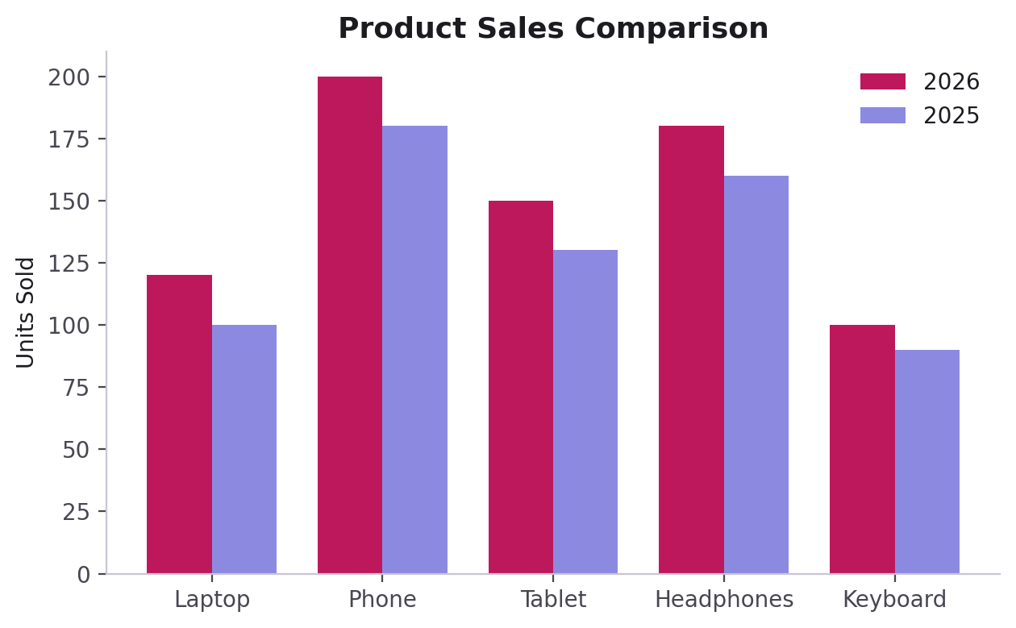
PART 4 · BAR CHARTS
Grouped Bars — Comparing Two Series
x = np.arange(len(products))
width = 0.4
plt.bar(x - width/2, sales_2026,
width=width, color="orange",
label="Sales 2026")
plt.bar(x + width/2, sales_2025,
width=width, color="blue",
label="Sales 2025")
plt.xticks(x, products)
plt.legend()
np.arange() gives evenly spaced positions; shifting each series by ± width/2 sits the two bars side by side instead of stacking on top of each other.
CodeByPaxto · AI & ML Playground · Hafiz Waseem Ahmed (Paxto)
35

Slide 36
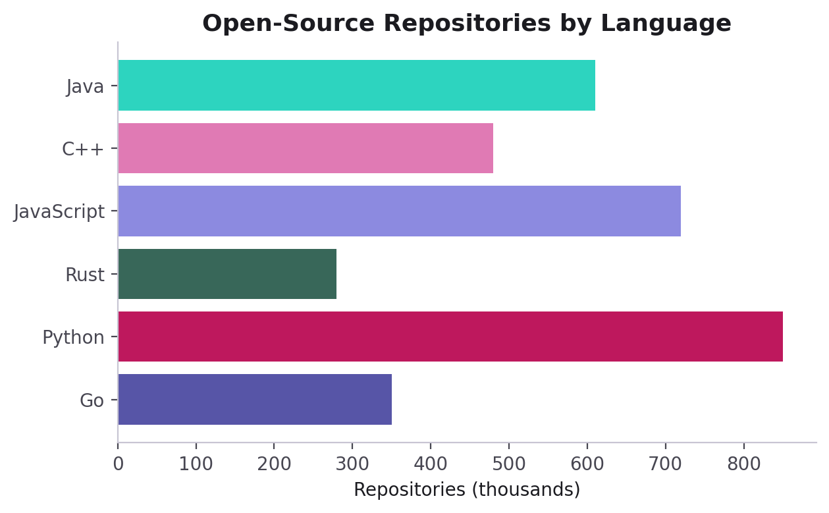
PART 4 · BAR CHARTS
Horizontal Bars — plt.barh()
plt.barh(
languages,
repositories,
color="teal"
)
plt.xlabel("Repositories")
plt.barh() flips the orientation — categories run down the Y-axis instead of across the X-axis.
Ideal when category names are long, or when you have many categories to list.
CodeByPaxto · AI & ML Playground · Hafiz Waseem Ahmed (Paxto)
36

Slide 37
PART 4 · BAR CHARTS
Quick Reference
Parameter | Meaning
plt.bar(x, height) | Vertical bars
plt.barh(y, width) | Horizontal bars
width= | Controls bar thickness (vertical bars)
x ± width/2 | The trick for placing grouped bars side by side
color=[list] | Assign a different color per bar or series
CodeByPaxto · AI & ML Playground · Hafiz Waseem Ahmed (Paxto)
37

Slide 38
◎
PART 4 · BAR CHARTS
Practice Set — Bar Charts
Try these yourself first — no code shown, that's the point.
Plot the number of hours you studied each day this week as a bar chart.
1
Turn it into a grouped bar chart comparing this week vs. last week.
2
Convert your chart to horizontal bars using plt.barh().
3
Give each bar a distinct color and a label so a legend makes sense.
4
CodeByPaxto · AI & ML Playground · Hafiz Waseem Ahmed (Paxto)
38

Slide 39
PART 5 · PIE CHARTS
Pie Charts
Showing how a whole splits into parts with plt.pie().
39

Slide 40
PART 5 · PIE CHARTS
Anatomy of plt.pie()
Parameter | Meaning
values | Numerical values behind each slice
labels | Names shown for each slice
colors | Colors for each slice
autopct | Displays each slice's percentage
startangle | Rotates where the first slice begins
explode | Pulls a slice outward to highlight it
plt.pie(
values,
labels=labels_list,
colors=color_list,
autopct="%1.1f%%",
startangle=90,
explode=(0.05,0,0,0)
)
CodeByPaxto · AI & ML Playground · Hafiz Waseem Ahmed (Paxto)
40

Slide 41
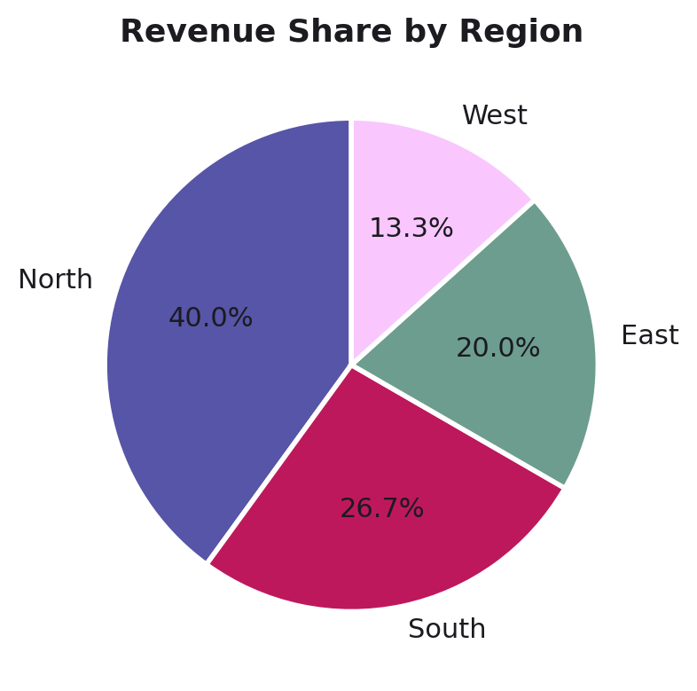
PART 5 · PIE CHARTS
Revenue Share by Region
regions = ["North", "South",
"East", "West"]
revenue = [3000, 2000, 1500, 1000]
plt.pie(
revenue,
labels=regions,
autopct="%1.1f%%",
colors=["teal", "skyblue",
"lightgreen", "coral"]
)
plt.show()
CodeByPaxto · AI & ML Playground · Hafiz Waseem Ahmed (Paxto)
41

Slide 42
PART 5 · PIE CHARTS
When to Use — and Avoid — Pie Charts
✓ Good fit
✕ Avoid it
A few categories (2–5)
Parts clearly add up to one whole
You want a quick "share of total" impression, not precise comparison
Many categories (8+) — slices become unreadable
Values are close together — humans compare angles poorly
You need to track change over time — use a line chart instead
CodeByPaxto · AI & ML Playground · Hafiz Waseem Ahmed (Paxto)
42

Slide 43
◎
PART 5 · PIE CHARTS
Practice Set — Pie Charts
Try these yourself first — no code shown, that's the point.
Build a pie chart showing how you'd split a 24-hour day into categories (sleep, work, study, etc.).
1
Add autopct to show percentages, and explode your largest slice.
2
Re-plot the same data as a bar chart, and decide which one communicates it better — and why.
3
CodeByPaxto · AI & ML Playground · Hafiz Waseem Ahmed (Paxto)
43

Slide 44
PART 6 · HISTOGRAMS
Histograms
Understanding how a numerical variable is distributed with plt.hist().
44

Slide 45
PART 6 · HISTOGRAMS
Anatomy of plt.hist()
Parameter | Meaning
data | Numerical data to distribute into bins
bins | Number of intervals/groups
color | Fill color of the bars
edgecolor | Border color of each bar
plt.hist(
data,
bins=number_of_bins,
color="color_name",
edgecolor="black"
)
CodeByPaxto · AI & ML Playground · Hafiz Waseem Ahmed (Paxto)
45

Slide 46
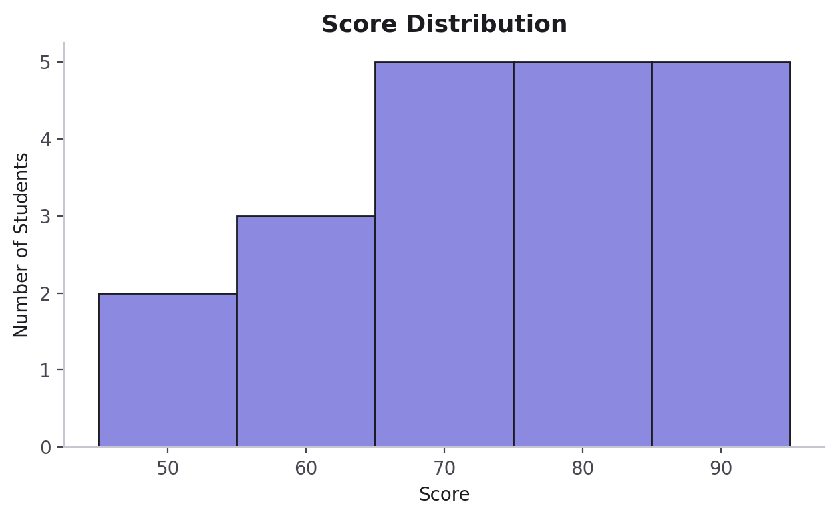
PART 6 · HISTOGRAMS
Score Distribution
scores = [45, 52, 58, 61, 63, 67, 69,
70, 72, 74, 75, 77, 79, 81,
83, 85, 87, 89, 92, 95]
plt.hist(scores, bins=5,
color="orange", edgecolor="black")
plt.xlabel("Scores")
plt.ylabel("Number of Students")
plt.title("Score Distribution")
plt.show()
CodeByPaxto · AI & ML Playground · Hafiz Waseem Ahmed (Paxto)
46

Slide 47
PART 6 · HISTOGRAMS
Understanding Bins, and Histogram vs. Bar Chart
A bin is a range of values — bins=5 splits the data into 5 equal-width ranges and counts how many values fall in each.
Fewer bins = smoother, more general shape. More bins = finer detail, but noisier.
Histogram
Bar Chart
Numerical data grouped into ranges. Bars touch — the X-axis is continuous.
Distinct categories, each with its own value. Bars are separated — the X-axis is categorical.
CodeByPaxto · AI & ML Playground · Hafiz Waseem Ahmed (Paxto)
47

Slide 48
◎
PART 6 · HISTOGRAMS
Practice Set — Histograms
Try these yourself first — no code shown, that's the point.
Invent 20 numbers (e.g. quiz scores) and plot a histogram with 5 bins.
1
Re-plot the same data with 10 bins and compare what changes.
2
Add edgecolor so individual bars are easier to tell apart.
3
Explain, in one sentence, why this data couldn't be shown as a regular bar chart.
4
CodeByPaxto · AI & ML Playground · Hafiz Waseem Ahmed (Paxto)
48

Slide 49
PART 7 · SCATTER PLOTS
Scatter Plots
Seeing the relationship between two numerical variables with plt.scatter().
49

Slide 50
PART 7 · SCATTER PLOTS
Anatomy of plt.scatter()
Parameter | Meaning
x, y | Data for the X-axis and Y-axis
color | Color of the points
marker | Shape/style of the points
s | Size of each point
alpha | Transparency (0 = invisible, 1 = solid)
label | Name used in the legend
plt.scatter(
x, y,
color="color_name",
marker="style",
s=size,
alpha=transparency,
label="label_name"
)
CodeByPaxto · AI & ML Playground · Hafiz Waseem Ahmed (Paxto)
50

Slide 51
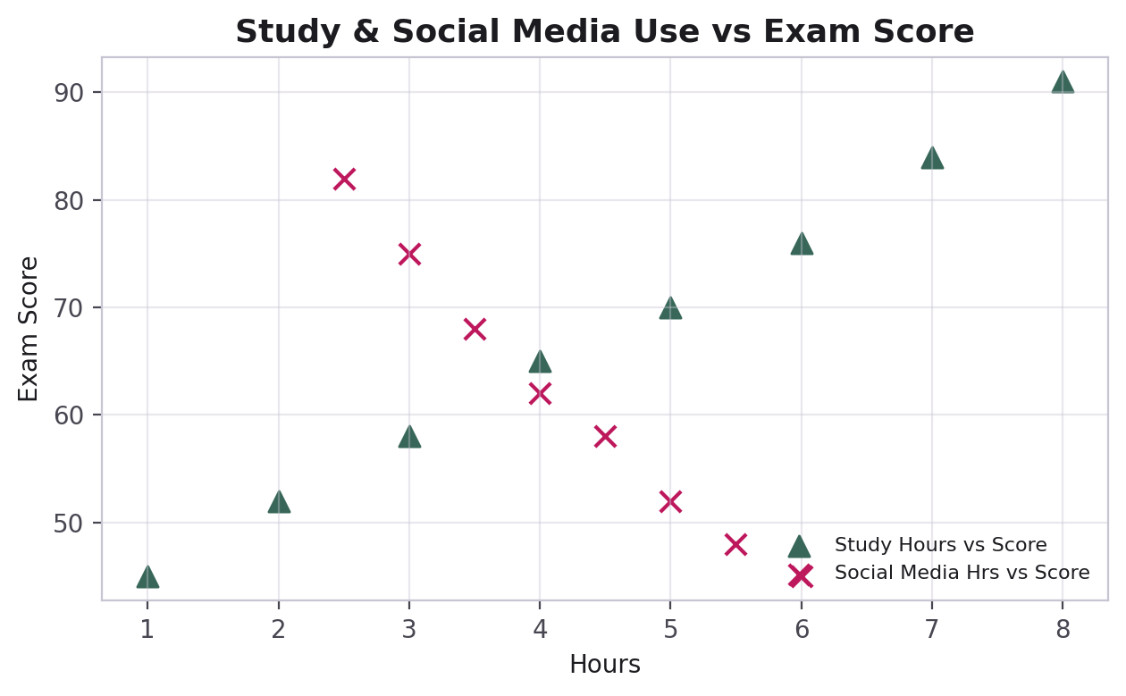
PART 7 · SCATTER PLOTS
Study Hours vs. Exam Scores
plt.scatter(hours_studied, exam_scores,
color="green", marker="^",
label="Hours Studied vs Exam Scores")
plt.scatter(social_media_hours,
social_media_scores,
color="red", marker="x",
label="Social Media vs Exam Scores")
plt.xlabel("Hours")
plt.ylabel("Exam Scores")
plt.legend(loc="best")
CodeByPaxto · AI & ML Playground · Hafiz Waseem Ahmed (Paxto)
51

Slide 52
PART 7 · SCATTER PLOTS
Reading Relationships Visually
Positive correlation
Negative correlation
No clear correlation
As X increases, Y tends to increase too — points trend up and to the right.
As X increases, Y tends to decrease — points trend down and to the right.
Points scatter with no visible pattern — X doesn't predict Y.
This is exactly the kind of visual reasoning you'll use constantly in EDA (Exploratory Data Analysis) and when checking relationships between features before training a model.
CodeByPaxto · AI & ML Playground · Hafiz Waseem Ahmed (Paxto)
52

Slide 53
◎
PART 7 · SCATTER PLOTS
Practice Set — Scatter Plots
Try these yourself first — no code shown, that's the point.
Plot hours of sleep vs. focus level (invent 10 data points) as a scatter plot.
1
Adjust alpha and s until overlapping points become easy to read.
2
Add a second dataset to the same chart using a different marker and color.
3
Decide whether your data shows positive, negative, or no correlation — and say why.
4
CodeByPaxto · AI & ML Playground · Hafiz Waseem Ahmed (Paxto)
53

Slide 54
PART 8 · SUBPLOTS
Subplots
One Figure, several Axes — building multi-panel charts side by side.
54

Slide 55
PART 8 · SUBPLOTS
One Figure, Many Axes
A subplot is simply an additional Axes placed inside the same Figure.
You choose a grid of rows × columns, and each Axes gets its own position in that grid.
Every Axes still has its own title, labels, legend, and grid — they just share one Figure/canvas.
This is where the Figure vs. Axes distinction from Part 1 becomes genuinely useful.
One Figure holding two Axes, side by side.
CodeByPaxto · AI & ML Playground · Hafiz Waseem Ahmed (Paxto)
55

Slide 56
PART 8 · SUBPLOTS
plt.subplot() — The Classic Way
plt.subplot(nrows, ncols, index)
# index is 1-based, not 0-based
plt.subplot(1, 2, 1)
plt.plot(x, repositories, marker="o")
plt.title("Programming Languages")
plt.subplot(1, 2, 2)
plt.bar(x, repositories)
plt.title("Repositories by Language")
plt.show()
Each plt.subplot(...) call selects a new active Axes — commands after it apply to that panel only.
CodeByPaxto · AI & ML Playground · Hafiz Waseem Ahmed (Paxto)
56

Slide 57
PART 8 · SUBPLOTS
plt.subplots() — The Modern Way
fig, ax = plt.subplots(
1, 2,
figsize=(10, 5)
)
ax[0].plot(x, repositories, marker="o")
ax[0].set_title("Line Graph")
ax[1].bar(x, repositories)
ax[1].set_title("Bar Chart")
plt.tight_layout()
plt.show()
fig, ax = plt.subplots(...) hands back the Figure and an array of Axes in one line — the foundation of the Object-Oriented API (Part 9).
CodeByPaxto · AI & ML Playground · Hafiz Waseem Ahmed (Paxto)
57

Slide 58
PART 8 · SUBPLOTS
Quick Reference: Sizing & Layout
Parameter | Meaning
figsize=(w, h) | Sets the Figure's width and height, in inches
plt.tight_layout() | Automatically fixes spacing so titles/labels don't overlap
sharex=True | All Axes in a grid share one X-axis scale
sharey=True | All Axes in a grid share one Y-axis scale
fig, ax = plt.subplots(rows, cols) | Creates a Figure and a grid of Axes together
CodeByPaxto · AI & ML Playground · Hafiz Waseem Ahmed (Paxto)
58

Slide 59
◎
PART 8 · SUBPLOTS
Practice Set — Subplots
Try these yourself first — no code shown, that's the point.
Create a 1×2 subplot grid with plt.subplots() showing a line chart and a bar chart of the same data.
1
Add one shared title for the whole Figure using fig.suptitle().
2
Call plt.tight_layout() and observe exactly what it changes.
3
Rebuild the same layout using the older plt.subplot() approach instead.
4
CodeByPaxto · AI & ML Playground · Hafiz Waseem Ahmed (Paxto)
59

Slide 60
PART 9 · OBJECT-ORIENTED API
The Object-Oriented API
The same charts, built by talking to fig and ax directly — the pattern behind every real Matplotlib project.
60

Slide 61
PART 9 · OO API
Pyplot vs. Object-Oriented — Side by Side
PYPLOT
OBJECT-ORIENTED
plt.plot(x, y)
plt.title("Sales")
plt.legend()
ax.plot(x, y)
ax.set_title("Sales")
ax.legend()
Implicit — Matplotlib tracks the "current" figure and axes behind the scenes.
Explicit — you name exactly which Axes you're drawing on, every time.
CodeByPaxto · AI & ML Playground · Hafiz Waseem Ahmed (Paxto)
61

Slide 62
PART 9 · OO API
Meet fig and ax
fig, ax = plt.subplots() creates both objects in one line.
fig is the whole canvas — used for figure-level things like size and saving.
ax is the individual plotting surface — used for everything you draw and label.
With multiple subplots, ax becomes a list/array — ax[0], ax[1], and so on.
Holding onto ax explicitly is what makes it possible to build reusable plotting functions later.
fig, ax = plt.subplots(figsize=(6, 4))
ax.plot(x, y, color="#5755A7")
ax.set_title("Revenue Over Time")
ax.set_xlabel("Month")
ax.set_ylabel("Revenue")
ax.legend()
ax.grid(alpha=0.3)
fig.savefig("revenue.png")
CodeByPaxto · AI & ML Playground · Hafiz Waseem Ahmed (Paxto)
62

Slide 63
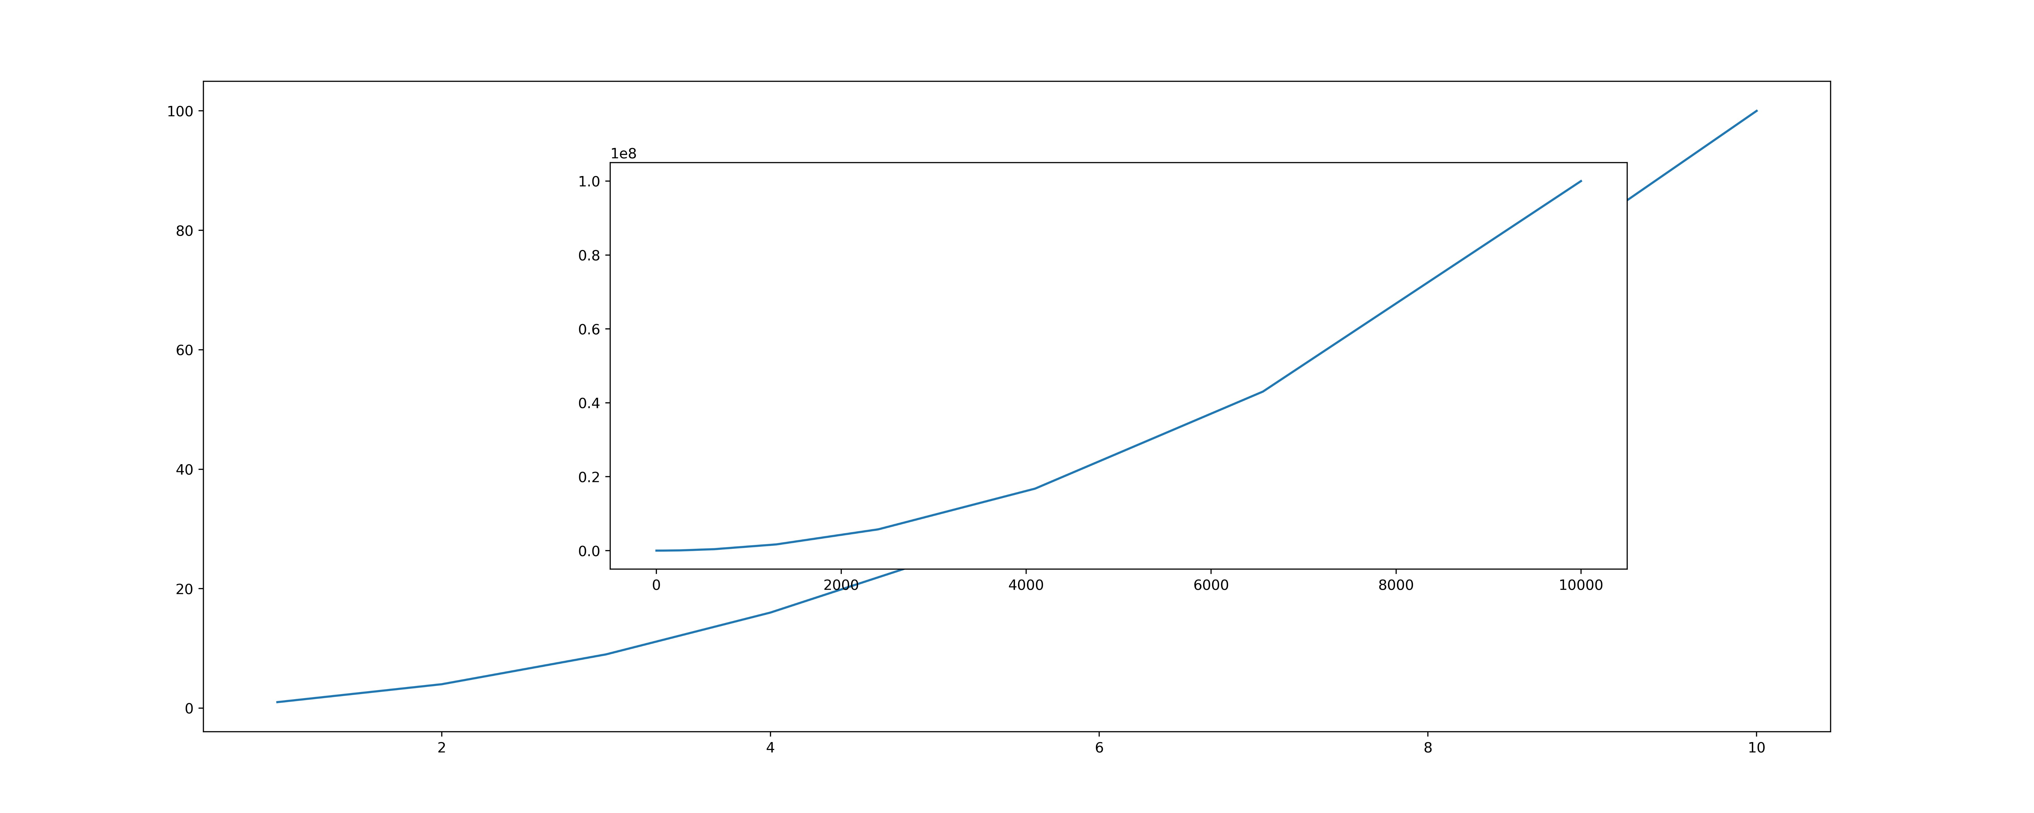
PART 9 · OO API
Axes by Hand — fig.add_axes() & Insets
fig = plt.figure(figsize=(20, 8))
main = fig.add_axes([0.1, 0.1, 0.8, 0.8])
main.plot(x, y)
inset = fig.add_axes([0.3, 0.3, 0.5, 0.5])
inset.plot(a, b)
# [left, bottom, width, height]
# each one a fraction (0-1) of the Figure
add_axes([left, bottom, width, height]) places an Axes anywhere using fractions of the Figure — overlap two for an inset.
Careful: figsize=(20, 8) at dpi=1000 is a 20,000 × 8,000 px canvas. Keep dpi low while experimenting.
CodeByPaxto · AI & ML Playground · Hafiz Waseem Ahmed (Paxto)
63

Slide 64
PART 9 · OO API
Object-Oriented Method Reference
Parameter | Meaning
ax.plot(x, y) | Draw a line plot on this Axes
ax.bar(x, height) | Draw a bar chart on this Axes
ax.scatter(x, y) | Draw a scatter plot on this Axes
ax.set_title("...") | Set this Axes' title
ax.set_xlabel("...") / set_ylabel("...") | Set this Axes' axis labels
ax.legend() | Draw the legend for this Axes
ax.grid() | Toggle the grid for this Axes
CodeByPaxto · AI & ML Playground · Hafiz Waseem Ahmed (Paxto)
64

Slide 65
PART 9 · OO API
Why the OO API Matters for Real Projects
Multi-panel dashboards need it — you must address ax[0], ax[1] individually; pyplot's "current axes" idea breaks down fast.
It's easier to wrap in a reusable function — e.g. def plot_metric(ax, data): ... that any script can call.
It's the style used throughout Pandas' .plot(ax=...), Seaborn, and most production ML reporting code.
Bottom line: pyplot is great for quick, single charts. The OO API is what you'll actually reach for in Data Analytics and ML projects.
CodeByPaxto · AI & ML Playground · Hafiz Waseem Ahmed (Paxto)
65

Slide 66
◎
PART 9 · OO API
Practice Set — The Object-Oriented API
Try these yourself first — no code shown, that's the point.
Rewrite any earlier pyplot chart using fig, ax = plt.subplots() and ax. methods only.
1
Write a small function def plot_line(ax, x, y, title): that plots onto whichever Axes it's given.
2
Use fig.add_axes() to build a main Axes plus a smaller inset Axes on top, and say what the four numbers mean.
3
CodeByPaxto · AI & ML Playground · Hafiz Waseem Ahmed (Paxto)
66

Slide 67
PART 10 · CONTROLLING THE VIEW
Controlling the View
Fine-tuning axis ranges, ticks, figure size, and resolution.
67

Slide 68
PART 10 · CONTROLLING THE VIEW
Limits & Tick Reference
Parameter | Meaning
plt.xlim(min, max) / plt.ylim(min, max) | Fix the visible axis range (pyplot)
ax.set_xlim(min, max) / ax.set_ylim(min, max) | Fix the visible axis range (OO API)
plt.xticks(positions, labels) | Set custom tick positions and labels
plt.xticks(rotation=45) | Rotate tick labels — useful for long category names
ha="right" | Aligns rotated labels neatly against their tick
CodeByPaxto · AI & ML Playground · Hafiz Waseem Ahmed (Paxto)
68

Slide 69
PART 10 · CONTROLLING THE VIEW
figsize & DPI
figsize=(width, height) sets the Figure's size in inches — e.g. (10, 5) for a wide chart.
DPI (Dots Per Inch) controls sharpness — higher DPI means a crisper image, especially once saved or printed.
On-screen, a moderate DPI (100) is plenty. For reports or print, 200–300 DPI looks noticeably sharper.
Bigger figsize + higher DPI = a larger file: (20, 8) at dpi=1000 is a 20,000 × 8,000 px canvas, so match it to where the chart will be viewed.
CodeByPaxto · AI & ML Playground · Hafiz Waseem Ahmed (Paxto)
69

Slide 70
◎
PART 10 · CONTROLLING THE VIEW
Practice Set — Controlling the View
Try these yourself first — no code shown, that's the point.
Take any chart from earlier and fix its X and Y limits with set_xlim()/set_ylim().
1
Rotate your X tick labels by 45 degrees so long labels stop overlapping.
2
Resize your Figure with figsize=(10, 4) and compare it side by side with the default size.
3
CodeByPaxto · AI & ML Playground · Hafiz Waseem Ahmed (Paxto)
70

Slide 71
PART 11 · COLOR & CUSTOMIZATION
Color & Visual Customization
Named colors, hex, RGBA, and colormaps — how Matplotlib thinks about color.
71

Slide 72
PART 11 · COLOR & CUSTOMIZATION
Four Ways to Specify Color
Parameter | Meaning
"teal" | Named color — simplest, ~150 names built in
"#5755A7" | Hex code — precise, brand-exact colors
(0.34, 0.34, 0.65) | RGB tuple — red, green, blue, each 0 to 1
(0.34, 0.34, 0.65, 0.5) | RGBA — RGB plus alpha (transparency)
alpha=0.5 | A separate parameter for transparency on any plot
CodeByPaxto · AI & ML Playground · Hafiz Waseem Ahmed (Paxto)
72

Slide 73
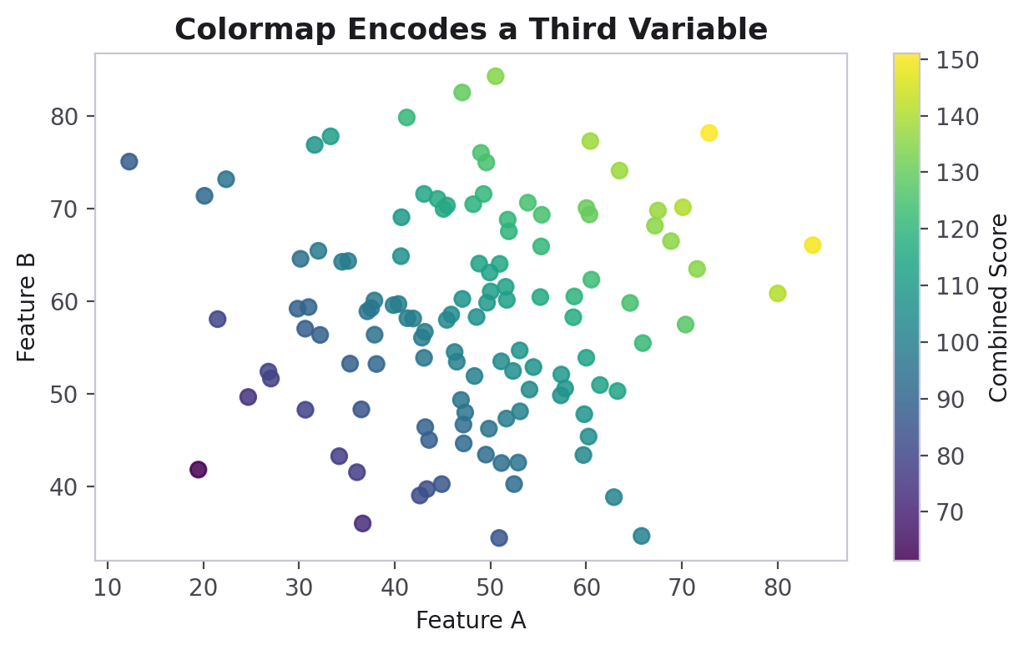
PART 11 · COLOR & CUSTOMIZATION
Colormaps — Encoding a Third Variable
sc = plt.scatter(
feature_a, feature_b,
c=combined_score,
cmap="viridis",
alpha=0.85
)
plt.colorbar(sc, label="Score")
cmap= colors points/bars by a numeric value instead of a fixed color — a colormap.
Sequential colormaps (viridis, Blues) go light→dark for one-directional data, like counts.
Diverging colormaps (coolwarm, RdBu) go color→neutral→color — great for data centered on zero, like error or change.
plt.colorbar() adds the legend strip explaining what each color means.
CodeByPaxto · AI & ML Playground · Hafiz Waseem Ahmed (Paxto)
73

Slide 74

PART 11 · COLOR & CUSTOMIZATION
Showing Images — imread & imshow
import matplotlib.image as mpimg
img = mpimg.imread("./flower.jpg")
img.shape # (4465, 8000, 3)
img.dtype # uint8 (0-255)
plt.imshow(img)
plt.axis("off")
plt.show()
imread() returns a plain NumPy array in RGB order (OpenCV uses BGR). JPEGs load as uint8 0–255; PNGs as float 0–1.
imshow() draws the pixels; axis("off") hides the ticks so the photo stands alone.
CodeByPaxto · AI & ML Playground · Hafiz Waseem Ahmed (Paxto)
74

Slide 75
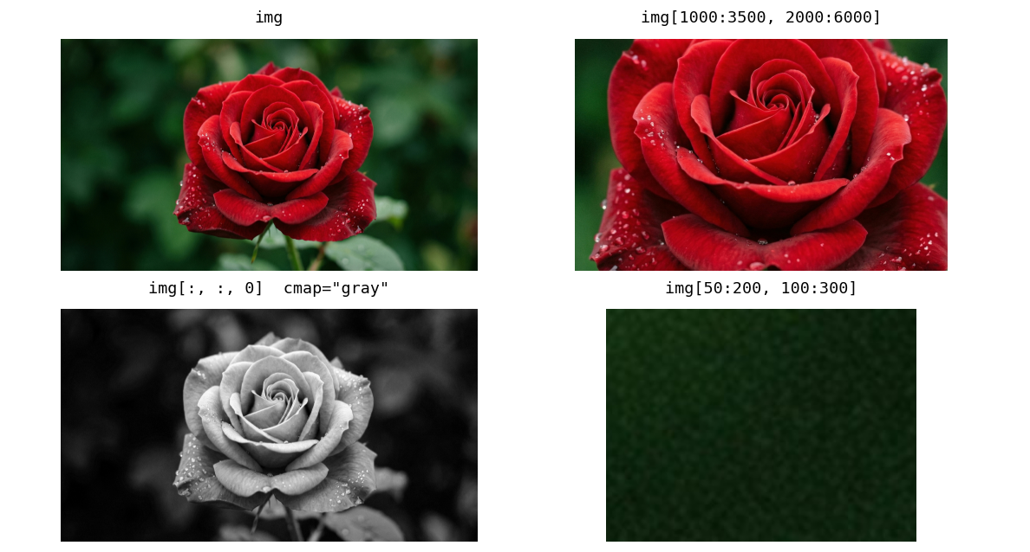
PART 11 · COLOR & CUSTOMIZATION
Cropping & Channels with Slicing
crop = img[1000:3500, 2000:6000]
plt.imshow(crop)
red = img[:, :, 0]
plt.imshow(red, cmap="gray")
# notebook crop: img[50:200, 100:300]
# = a 150 x 200 corner (bottom-right panel)
Slicing is NumPy slicing: img[rows, columns]. The notebook’s img[50:200, 100:300] is only a 150 × 200 corner — pick bounds from img.shape.
One channel is 2D, so add cmap="gray" or Matplotlib falls back to viridis.
CodeByPaxto · AI & ML Playground · Hafiz Waseem Ahmed (Paxto)
75

Slide 76
◎
PART 11 · COLOR & CUSTOMIZATION
Practice Set — Color & Visual Customization
Try these yourself first — no code shown, that's the point.
Recreate one earlier chart using a hex color instead of a named color.
1
Build a scatter plot where color represents a third variable, using cmap=.
2
Load an image with mpimg.imread(), show it with imshow() and axis("off"), crop it with slicing, and display one channel with cmap="gray".
3
CodeByPaxto · AI & ML Playground · Hafiz Waseem Ahmed (Paxto)
76

Slide 77
PART 12 · TEXT & ANNOTATIONS
Text & Annotations
Calling out the moments in your data that matter most.
77

Slide 78
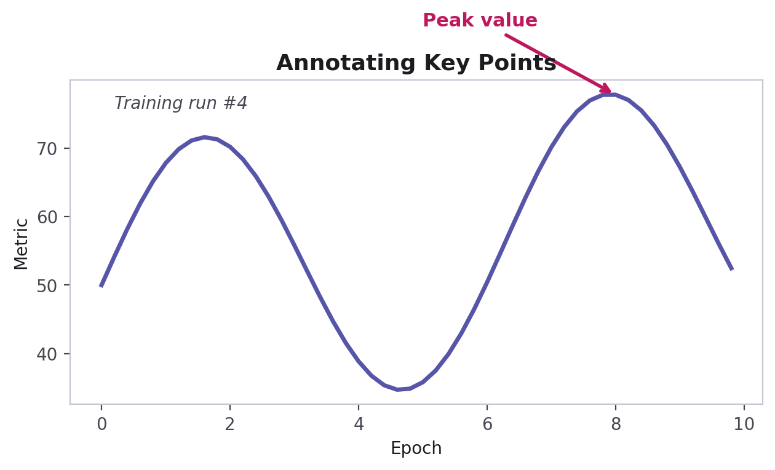
PART 12 · TEXT & ANNOTATIONS
plt.text() & plt.annotate()
plt.text(
x, y, "Training run #4",
fontsize=10, style="italic"
)
plt.annotate(
"Peak value",
xy=(peak_x, peak_y),
xytext=(peak_x-3, peak_y+10),
arrowprops=dict(arrowstyle="->")
)
plt.text() places plain text at a coordinate.
plt.annotate() adds text with a pointing arrow — great for calling out a peak, a threshold, or an outlier.
CodeByPaxto · AI & ML Playground · Hafiz Waseem Ahmed (Paxto)
78

Slide 79
PART 12 · TEXT & ANNOTATIONS
Shapes on a Chart — matplotlib.patches
matplotlib.patches holds ready-made shapes — Circle, Rectangle, Arrow, Polygon, and more.
A patch works like any other Artist: create it, then hand it to an Axes with ax.add_patch(patch).
Most useful for highlighting a region, building a custom legend swatch, or drawing simple diagrams — like the Figure vs. Axes diagram back in Part 1.
You won't reach for these in everyday charts, but recognizing the pattern helps when reading other people's Matplotlib code.
from matplotlib.patches import Circle
fig, ax = plt.subplots()
ax.plot(x, y)
highlight = Circle(
(5, 20), radius=1.5,
color="orange", alpha=0.3
)
ax.add_patch(highlight)
plt.show()
CodeByPaxto · AI & ML Playground · Hafiz Waseem Ahmed (Paxto)
79

Slide 80
PART 12 · TEXT & ANNOTATIONS
A Peek at Animation — matplotlib.animation
matplotlib.animation redraws a Figure frame by frame — useful for showing a process over time, like training progress or a simulation.
FuncAnimation is the core tool: you write one update() function, and Matplotlib calls it once per frame.
This is a genuinely advanced topic — full animation programming is outside this module's scope. For now, just know it exists and what it's for.
Curious? matplotlib.org has interactive animation examples worth exploring on your own time.
from matplotlib.animation import FuncAnimation
fig, ax = plt.subplots()
line, = ax.plot(x, y[:1])
def update(frame):
line.set_ydata(y[:frame])
return line,
anim = FuncAnimation(
fig, update, frames=len(y)
)
plt.show()
CodeByPaxto · AI & ML Playground · Hafiz Waseem Ahmed (Paxto)
80

Slide 81
◎
PART 12 · TEXT & ANNOTATIONS
Practice Set — Text, Annotations & Shapes
Try these yourself first — no code shown, that's the point.
Use plt.annotate() to point an arrow at the highest value in a line chart.
1
Add plt.text() somewhere on the chart to label a specific observation in plain words.
2
Draw a Circle or Rectangle patch to highlight one region of an existing chart.
3
CodeByPaxto · AI & ML Playground · Hafiz Waseem Ahmed (Paxto)
81

Slide 82
PART 13 · STATISTICAL VISUALIZATION
Statistical Visualization
Box plots — reading spread, center, and outliers at a glance.
82

Slide 83
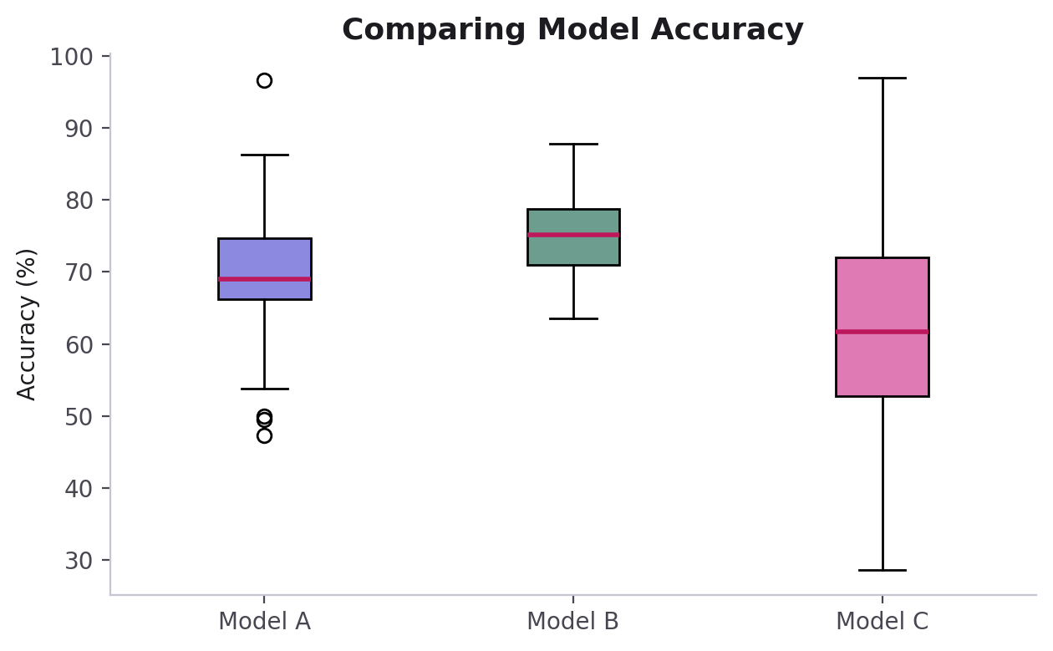
PART 13 · STATISTICAL VISUALIZATION
plt.boxplot() — Median, Quartiles & Outliers
plt.boxplot(
[model_a, model_b, model_c],
labels=["Model A","Model B","Model C"]
)
plt.ylabel("Accuracy (%)")
The box spans the middle 50% of the data (25th to 75th percentile).
The line inside the box is the median.
Whiskers extend to the typical range; dots beyond them are outliers.
CodeByPaxto · AI & ML Playground · Hafiz Waseem Ahmed (Paxto)
83

Slide 84
PART 13 · STATISTICAL VISUALIZATION
Box Plot vs. Histogram
Histogram
Box Plot
Shows the full shape of a distribution — how values spread across ranges. Best for understanding one variable in depth.
Compresses a distribution into 5 key numbers. Best for comparing spread and outliers across several groups at once.
In EDA, it's common to start with a histogram to understand one feature, then switch to box plots to compare that feature across categories or classes.
CodeByPaxto · AI & ML Playground · Hafiz Waseem Ahmed (Paxto)
84

Slide 85
◎
PART 13 · STATISTICAL VISUALIZATION
Practice Set — Statistical Visualization
Try these yourself first — no code shown, that's the point.
Build a box plot comparing three groups of numbers you invent.
1
Identify, just by looking at it, which group has the most outliers.
2
Plot the same data as a histogram, one group at a time, and compare the two views.
3
CodeByPaxto · AI & ML Playground · Hafiz Waseem Ahmed (Paxto)
85

Slide 86
PART 14 · SAVING FIGURES
Saving Figures
Turning a plot into a file you can share, embed, or print — with plt.savefig().
86

Slide 87
PART 14 · SAVING FIGURES
Anatomy of plt.savefig()
Parameter | Meaning
"filename.png" / .jpg / .pdf / .svg | Output format — set by the file extension
dpi | Resolution — higher = sharper, larger file
bbox_inches="tight" | Trims extra whitespace around the figure
plt.savefig(
"filename.png",
dpi=300,
bbox_inches="tight"
)
PNG — best default for slides, docs, and the web (supports transparency).
JPG — smaller file size, no transparency; fine for photos, not ideal for charts with text.
PDF / SVG — vector formats that stay crisp at any zoom level; great for print and papers.
Always call savefig() before plt.show() — some backends clear the figure after showing it.
CodeByPaxto · AI & ML Playground · Hafiz Waseem Ahmed (Paxto)
87

Slide 88
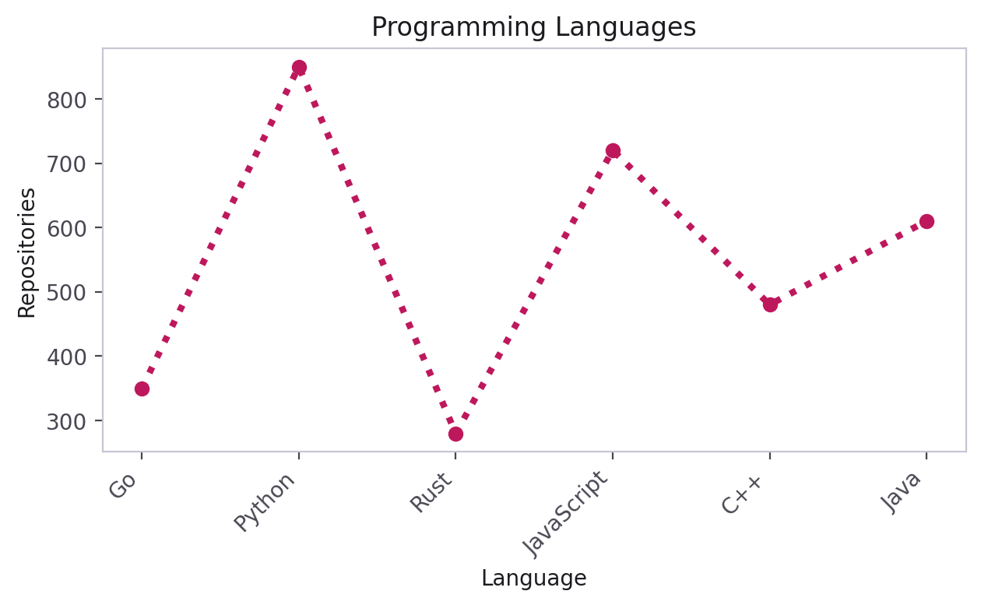
PART 14 · SAVING FIGURES
Saving a High-Quality Chart
plt.plot(x1, repositories, color="red",
linewidth=3, linestyle=":", marker="o")
plt.title("Programming Languages")
plt.xticks(x1, languages,
rotation=45, ha="right")
plt.tight_layout()
plt.savefig(
"./outputs/languages_chart.png",
dpi=300,
bbox_inches="tight"
)
CodeByPaxto · AI & ML Playground · Hafiz Waseem Ahmed (Paxto)
88

Slide 89
◎
PART 14 · SAVING FIGURES
Practice Set — Saving Figures
Try these yourself first — no code shown, that's the point.
Save any chart from this module as a PNG at 300 DPI.
1
Save the same chart again with bbox_inches="tight" and compare the two files.
2
Save one chart as a PDF and note what's different about opening it.
3
CodeByPaxto · AI & ML Playground · Hafiz Waseem Ahmed (Paxto)
89

Slide 90
PART 15 · NUMPY & PANDAS INTEGRATION
Matplotlib with NumPy & Pandas
Why this module comes after NumPy and Pandas — plotting the data you already know how to build.
90

Slide 91
PART 15 · NUMPY & PANDAS
From NumPy Arrays to Plots
plt.plot(), scatter(), bar() all accept NumPy arrays exactly like plain lists.
np.arange() and np.linspace() are the two most common ways to generate smooth X values for a curve.
You already used np.arange() for bar positioning in Part 4 — same array, new purpose.
import numpy as np
x = np.linspace(0, 10, 100)
y = np.sin(x)
plt.plot(x, y, color="#5755A7")
plt.title("A NumPy-Generated Curve")
plt.show()
CodeByPaxto · AI & ML Playground · Hafiz Waseem Ahmed (Paxto)
91

Slide 92
PART 15 · NUMPY & PANDAS
Plotting Pandas Series & DataFrames
A Pandas Series or DataFrame column can be passed straight into plt.plot() — no conversion needed.
Pandas also ships its own .plot() method, built on top of Matplotlib, for one-line quick charts.
This is exactly the bridge from cleaned data (Pandas) to visual insight (Matplotlib) — the core of EDA.
import pandas as pd
df = pd.read_csv("sales.csv")
# Plot one column directly
plt.plot(df["month"], df["revenue"])
# Pandas' own shortcut
df["revenue"].plot(kind="line")
df.plot(x="month", y="revenue", kind="bar")
CodeByPaxto · AI & ML Playground · Hafiz Waseem Ahmed (Paxto)
92

Slide 93
◎
PART 15 · NUMPY & PANDAS
Practice Set — Matplotlib with NumPy & Pandas
Try these yourself first — no code shown, that's the point.
Generate 50 points with np.linspace() and plot a smooth curve using them.
1
Load any small CSV (or make one up) into Pandas and plot one column directly with plt.plot().
2
Use Pandas' own df.plot() shortcut on the same data and compare the result.
3
CodeByPaxto · AI & ML Playground · Hafiz Waseem Ahmed (Paxto)
93

Slide 94
PART 16 · MATPLOTLIB FOR AI, ML & DATA SCIENCE
Matplotlib for AI, ML & Data Science
Why you're really learning this — the visualization jobs that show up in every ML project.
94

Slide 95
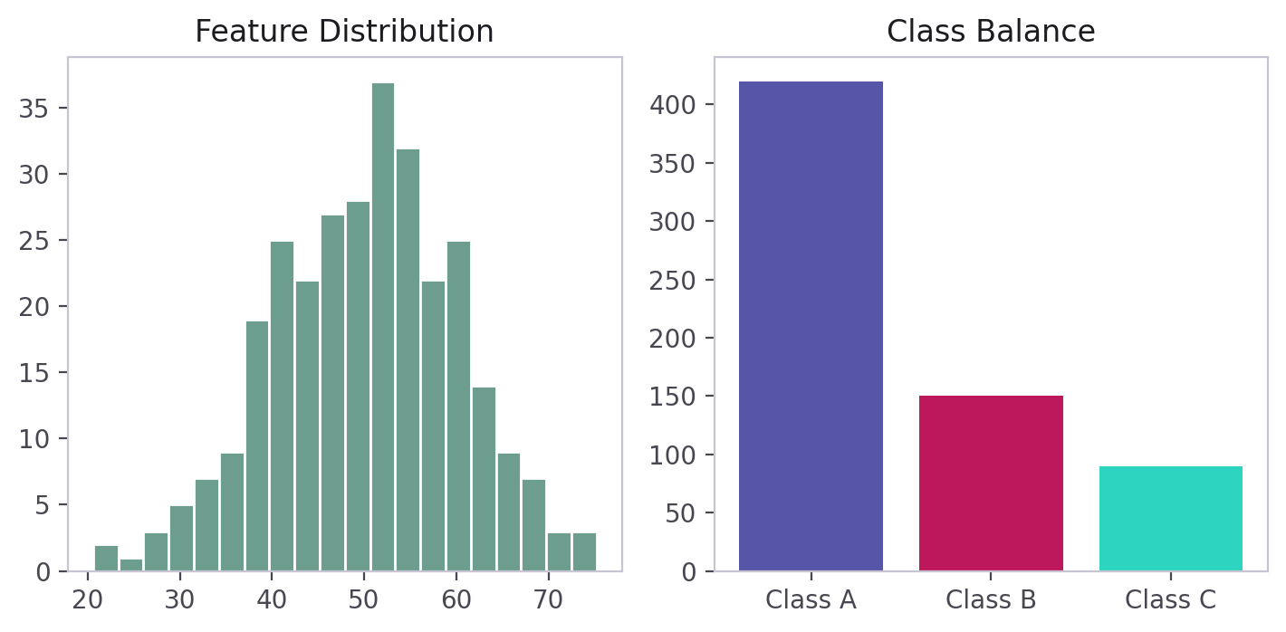
PART 16 · MATPLOTLIB FOR AI/ML
Understanding Your Data First
Feature distributions — a histogram reveals skew, scale, and unexpected values before you train anything.
Class distributions — a bar chart shows whether your dataset is balanced or dominated by one class.
This is always step one in a real ML workflow, before any modeling begins.
Feature distribution (left) and class balance (right).
CodeByPaxto · AI & ML Playground · Hafiz Waseem Ahmed (Paxto)
95

Slide 96
PART 16 · MATPLOTLIB FOR AI/ML
Spotting Relationships & Outliers
Scatter plots reveal how two features relate — a key step before choosing a model.
Points far from the main cluster are candidate outliers, worth inspecting before training.
A colormap can encode a third variable (like the target) directly into the same chart.
Feature relationships, colored by a third variable.
CodeByPaxto · AI & ML Playground · Hafiz Waseem Ahmed (Paxto)
96

Slide 97
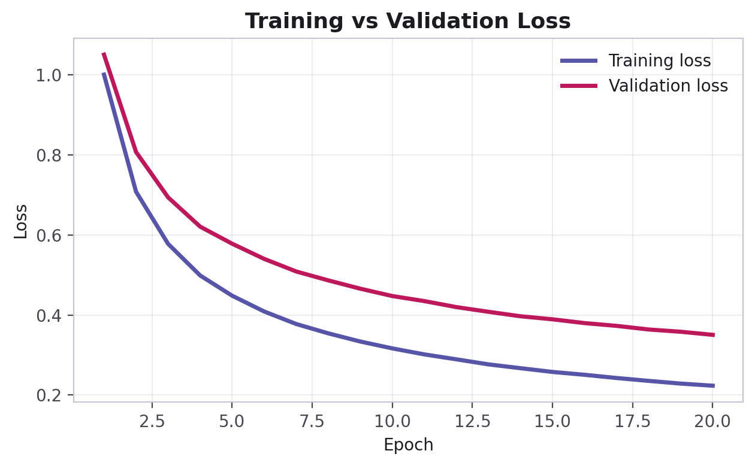
PART 16 · MATPLOTLIB FOR AI/ML
Evaluating a Model — Training Curves
A training/validation curve plots a metric (loss, accuracy) per epoch for both sets.
If validation loss rises while training loss keeps falling, that's a classic overfitting signal — and it's only visible because you plotted it.
This single line chart is one of the most-viewed charts in any ML project.
Training vs. validation loss, over time.
CodeByPaxto · AI & ML Playground · Hafiz Waseem Ahmed (Paxto)
97

Slide 98
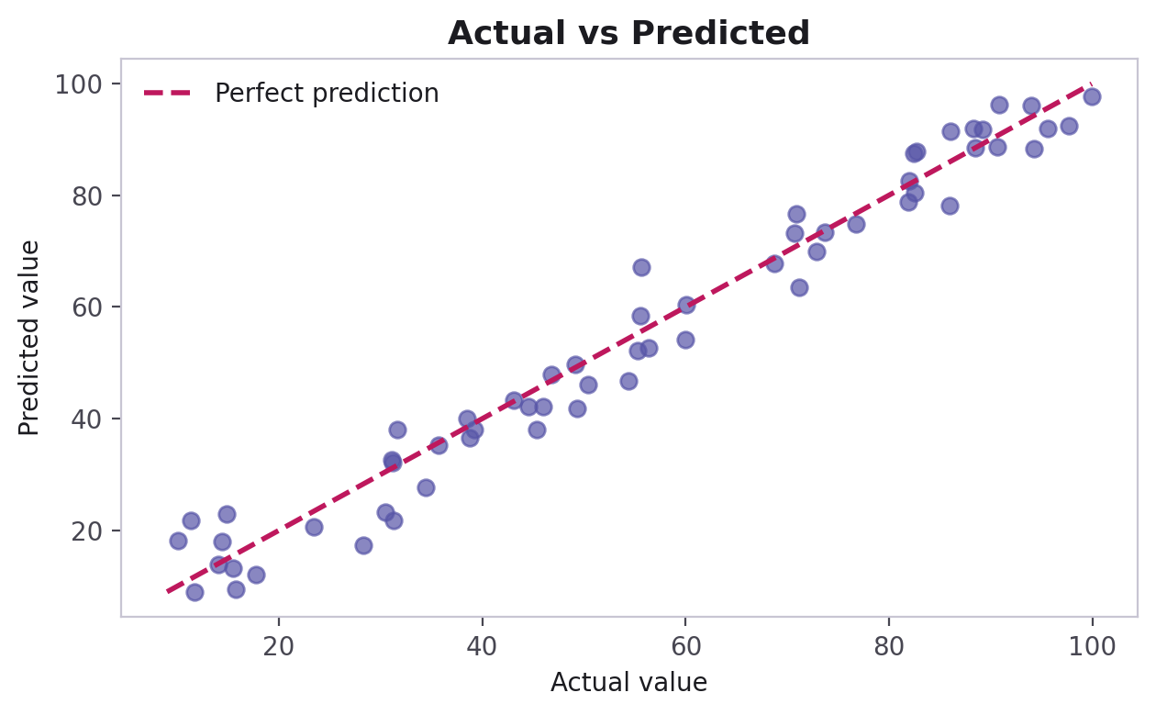
PART 16 · MATPLOTLIB FOR AI/ML
Evaluating a Model — Predictions & Comparison
Actual vs. predicted — the closer to the diagonal, the better.
Comparing accuracy across several models.
CodeByPaxto · AI & ML Playground · Hafiz Waseem Ahmed (Paxto)
98

Slide 99
PART 16 · MATPLOTLIB FOR AI/ML
The Confusion Matrix — Basic Concept
Predicted →
For classification models, a confusion matrix is a grid showing predicted class vs. actual class.
The diagonal cells are correct predictions — everything off the diagonal is a mistake worth understanding.
In Matplotlib, this is typically drawn as a color-coded grid: plt.imshow(matrix, cmap="Blues") with the counts written into each cell using plt.text().
You'll build these for real once you reach Supervised Machine Learning — for now, just recognize the shape and purpose.
42
3
2
38
CodeByPaxto · AI & ML Playground · Hafiz Waseem Ahmed (Paxto)
99

Slide 100
PART 17 · MINI PROJECTS
Put It All Together
Three small projects combining everything from Foundations to AI/ML visualization — built end to end, using the Object-Oriented API.
100

Slide 101
PART 17 · MINI PROJECTS
Mini Project 1: Sales & Expenses Report
Build a 1×2 subplot: a line chart of monthly sales vs. expenses, and a bar chart of totals by quarter.
Use the Object-Oriented API — fig, ax — throughout, not plt. shortcuts.
Add a title, axis labels, and a legend to each panel.
Save the final figure as a 300 DPI PNG with plt.savefig().
1
Line + Bar,
combined
CodeByPaxto · AI & ML Playground · Hafiz Waseem Ahmed (Paxto)
101

Slide 102
PART 17 · MINI PROJECTS
Mini Project 2: Student Performance Dashboard
Build a 2×2 grid: average score per subject (line), grade-band counts (bar), study hours vs. score colored by pass/fail (scatter), and score distribution (histogram).
Call plt.tight_layout() so nothing overlaps between panels.
Use plt.annotate() to call out the highest-scoring student on the scatter panel.
Save with plt.savefig("dashboard.png", dpi=200, bbox_inches="tight").
2
Line + Bar +
Scatter + Histogram
CodeByPaxto · AI & ML Playground · Hafiz Waseem Ahmed (Paxto)
102

Slide 103
PART 17 · MINI PROJECTS
Mini Project 3: Model Evaluation Snapshot
Plot training vs. validation loss curves across 20 epochs for a model (real or invented).
Plot actual vs. predicted values with a diagonal reference line.
Compare accuracy across 3 models using a box plot.
Combine all three panels into one Figure using plt.subplots().
3
Training curves +
Actual vs. Predicted
CodeByPaxto · AI & ML Playground · Hafiz Waseem Ahmed (Paxto)
103

Slide 104
MODULE RECAP
Matplotlib turns raw numbers into a picture you can actually reason about — and that same picture is what you'll lean on for every EDA, every model check, and every report from here forward.
Next up: Seaborn — statistical charts, built on everything you just learned.
104

Slide 105
Thank You
Matplotlib · AI & ML Playground · CodeByPaxto
105

