Slide 1

Code, Data & Decisions
From First Principles to Real-World AI & Data Science
Day 1 & 2 · Orientation and The Big Picture
BS(CS), 6th Semester — University of Bahrain
1
Notes:
Welcome slide. Keep it warm and simple.

Slide 2








Day 1 — Where We Begin
What is programming?
How does a computer "think"?
Compiled vs. interpreted languages
Why we use Python
Why this course exists
Our 16-week roadmap
Tools to install before next class
Code, Data & Decisions
2
Notes:
Quick preview only — each item gets its own slide.

Slide 3
Programming = Giving Clear Instructions
People understand hints and context. Computers do not.
A program is just a list of simple steps. This list is called an algorithm.
Try this: tell someone how to make a sandwich, step by step. You will find gaps you never noticed.
Programming means noticing your own gaps before the computer does.
"Say exactly
what you mean"
Code, Data & Decisions
3
Notes:
Do the sandwich exercise live here.

Slide 4
Inside a Computer: Just Switches
A computer is made of billions of tiny switches called transistors.
Each switch is either on or off. We call this 1 and 0.
A program is like a path — each step moves you to the next point on that path.
Nothing "understands" your code. That is why we must be exact.
2 states only:
on / off
Code, Data & Decisions
4
Notes:
Keep the state idea simple — do not call it a literal finite state machine.

Slide 5
Two Ways to Run Code
Compiled (C/C++, Java)
Interpreted (Python)
Write Code
Write Code
↓
↓
Compiler Translates It
Interpreter Reads Each Line
↓
↓
Computer Runs It Fast
Runs Right Away
Simple rule: Compiled = runs fast. Interpreted (Python) = lets you test ideas fast.
Code, Data & Decisions
5

Slide 6
Why Python? (And Its Limits)
Why Python Is Great
Where It Falls Short
Reads almost like English
All the best data tools live here (NumPy, Pandas, scikit-learn)
A 200-line C++ program can be 20 lines in Python
Fewer strict rules — easier to turn an idea into working code
Runs slower than compiled languages
Not built for parallel processing (a detail called the GIL)
Not a great fit for mobile apps or embedded devices
Its speed in data work often comes from C code running underneath
Code, Data & Decisions
6

Slide 7
WHY THIS COURSE
"You are not here to become computer scientists or software engineers.
You are here so your research never waits on someone else."
And if you enjoy it — this is a real path into data science.
7
Notes:
Say this close to word-for-word.

Slide 8





The 16-Week Journey
1 · Orientation
2 · Python Core
3 · Stats & Math
Week 1 — what a computer is, why Python, first code
Weeks 2–4 — functions, lists, dicts, files, errors
Weeks 5–7 — just the math the next phase needs
4 · NumPy, Pandas, Viz
5 · EDA
6 · ML + Capstone
Weeks 8–10 — the real tools of data work
Weeks 11–12 — reading a real dataset before modeling it
Weeks 13–16 — first models, and a project of your own
Code, Data & Decisions
8
Notes:
Close with: every phase exists because the next one needs it.

Slide 9
BEFORE NEXT CLASS
Tools You Will Need
Five simple tools — install them before our next session.
9

Slide 10

Miniconda
Miniconda installs Python on your computer
It also creates separate, clean workspaces called "environments" for each project
This stops different projects from breaking each other's tools
Think of it as a toolbox manager for all your Python projects
Manages Python
and its tools
Code, Data & Decisions
10

Slide 11
Visual Studio Code (VS Code)
VS Code is a free, popular code editor
It highlights your code in color, so mistakes are easy to spot
It has helpful extensions — small add-ons for Python, Jupyter notebooks, and more
This is the app you will open every single class
Where you
write your code
Code, Data & Decisions
11

Slide 12

Git — Version Control
Git saves snapshots of your code as you work — like checkpoints in a game
If you break something, you can go back to an earlier snapshot
It also lets many people work on the same project without overwriting each other
Git runs on your own computer
"Save points"
for your code
Code, Data & Decisions
12

Slide 13

GitHub
GitHub stores your Git snapshots online, safely
It lets you share your code, back it up, and show it to others (like future employers)
You connect Git (on your computer) to GitHub (online) so the two stay in sync
Almost every professional programmer and researcher uses GitHub
Your code's
online home
Code, Data & Decisions
13

Slide 14

Linux / Ubuntu (Optional)
Linux is another operating system, like Windows or macOS
Ubuntu is a beginner-friendly version of Linux
Many data science and AI tools were originally built for Linux
You do NOT need it for this course — Windows or macOS work perfectly fine
Optional —
not required
Code, Data & Decisions
14

Slide 15


Day 1 Task
Set Up Your Coding Environment
Install Miniconda on your computer
Install VS Code on your computer
Install Git on your computer
Create your own GitHub account
Connect Git (your computer) to your GitHub account
Due before our next class · Ask in the group chat if you get stuck
Code, Data & Decisions
15

Slide 16
Day 1 gave you the foundations.
Day 2 shows you where they lead.
16

Slide 17



Day 2 — Where This Takes You
What does "Intelligence" mean?
What does "Artificial" mean?
What is Artificial Intelligence?
A short history of AI
The main areas of AI
Real research examples
What is Data Science?
Code, Data & Decisions
17

Slide 18
UNDERSTANDING INTELLIGENCE
What Does "Intelligence" Actually Mean?
18

Slide 19
INTELLIGENCE · WORD ORIGIN
Where Does the Word Come From?
There is no single agreed definition of "intelligence" — even experts disagree.
It is a noun, and it comes from the Latin word "Intelliger", which means "to understand."
Code, Data & Decisions
19

Slide 20

INTELLIGENCE · THE TWO PARTS
To Understand, Then To Learn
Intelligence has two connected ideas:
1) To understand something. 2) To learn from it.
We always understand first — and only then can we truly learn.
Code, Data & Decisions
20

Slide 21

INTELLIGENCE · DEFINITION 1 OF 9
Capacity to Acquire Capacity
Intelligence is not just what you know — it is how ready you are to gain new abilities.
Code, Data & Decisions
21

Slide 22
INTELLIGENCE · DEFINITION 2 OF 9
Ability to Reason
Intelligence is the skill of thinking things through logically, step by step.
Code, Data & Decisions
22

Slide 23

INTELLIGENCE · DEFINITION 3 OF 9
Ability to Judge
Intelligence means being able to weigh choices and decide what is right or best.
Code, Data & Decisions
23

Slide 24

INTELLIGENCE · DEFINITION 4 OF 9
Ability to Relate Concepts and Situations
Intelligence means connecting what you already know to a brand-new situation.
Code, Data & Decisions
24

Slide 25

INTELLIGENCE · DEFINITION 5 OF 9
★ ONE OF THE BEST
Ability to Handle Situations Flexibly
This is often called one of the best definitions of intelligence: the ability to adapt — to bend, not break — when a situation changes. This is also called resilience.
Code, Data & Decisions
25

Slide 26

INTELLIGENCE · DEFINITION 6 OF 9
Goal-Oriented Behavior
Intelligence is behavior aimed at a clear goal — adapting your actions until you reach it.
— Robert Sternberg & Salter, Definition of Intelligence
Code, Data & Decisions
26

Slide 27

INTELLIGENCE · DEFINITION 7 OF 9
Ability to Take Profit from Experience
Intelligent behavior means learning from your past — using old experience to do better next time.
Code, Data & Decisions
27

Slide 28

INTELLIGENCE · DEFINITION 8 OF 9
Proper Use of Limited Resources
Intelligence means using what little time, energy, or resources you have in the smartest possible way to reach your goal.
— Ray Kurzweil (American computer scientist and author), Definition of Intelligence
Code, Data & Decisions
28

Slide 29

INTELLIGENCE · DEFINITION 9 OF 9
Getting Better Over Time
One simple, powerful idea: if something keeps improving with practice and experience, that is intelligence.
— Roger Schank (American computer scientist), Definition of Intelligence
Code, Data & Decisions
29

Slide 30
ARTIFICIAL · WORD ORIGIN
What Does "Artificial" Mean?
"Artificial" is an adjective. It comes from the Latin word "Artificium."
Some researchers trace it further back to "Artefact" — meaning something man-made, not natural.
Code, Data & Decisions
30

Slide 31
ARTIFICIAL · IN SIMPLE WORDS
Artificial = Man-Made
A natural lake is made by nature. An artificial lake is built by people.
In the same way, "Artificial Intelligence" means intelligence that is built by people — not born naturally.
Code, Data & Decisions
31

Slide 32
Artificial + Intelligence
"Man-made" ability to understand, reason, and learn.
Now let's look at how experts formally define this field.
32

Slide 33
FORMAL DEFINITIONS
How Do Experts Define Artificial Intelligence?
33

Slide 34
AI DEFINITIONS · 1 OF 8
The General Definition
AI is the ability of a system to understand, learn, gain knowledge, and use that knowledge in the right way.
Code, Data & Decisions
34

Slide 35

AI DEFINITIONS · 2 OF 8
Buchanan's Definition
AI is the part of computer science that solves problems which humans, right now, can still do better than computers.
Code, Data & Decisions
35

Slide 36

AI DEFINITIONS · 3 OF 8
Buchanan's Symbolic AI Definition
AI can solve problems by turning information into symbols, then using simple rules of thumb (called heuristics) on those symbols.
Heuristics: are mental shortcuts or "rules of thumb" that allow the brain to solve problems and make quick judgments with minimal effort
Code, Data & Decisions
36

Slide 37
AI DEFINITIONS · 4 OF 8
Making Computers Smart
In simple words, AI is the area of computer science used to make computers "smart."
Code, Data & Decisions
37

Slide 38

AI DEFINITIONS · 5 OF 8
Automation of Intelligent Behavior
AI is the branch of computer science that automates behavior we would normally call "intelligent."
Code, Data & Decisions
38

Slide 39

AI DEFINITIONS · 6 OF 8
Intelligent Agents
AI designs "agents" — programs that can sense their surroundings and take action to reach a goal.
Code, Data & Decisions
39

Slide 40
AI DEFINITIONS · 7 OF 8
Learning From Experience
AI solves hard problems by learning from experience, and getting better at it over time.
Code, Data & Decisions
40

Slide 41

AI DEFINITIONS · 8 OF 8
Mimicking Human Behavior
AI is a branch of computer science where machines are taught to mimic human intelligence and behavior.
Code, Data & Decisions
41

Slide 42
A SHORT STORY
A Short History of Artificial Intelligence
42

Slide 43
Al-Jazari (12th Century)
One of the earliest inventors of programmable, mechanical machines
Built automatic devices, water clocks, and human-shaped robots (automata)
Wrote a famous book: "The Book of Knowledge of Ingenious Mechanical Devices"
His work laid the groundwork for robotics and automation, centuries early
1200s
Early Machines
Code, Data & Decisions
43

Slide 44

Alan Turing (1930s–1950s)
A British mathematician who first asked: "Can machines think?"
Introduced the Turing Machine — the theory behind all modern computers
In 1950, wrote the paper "Computing Machinery and Intelligence"
Created the famous Turing Test to check if a machine can act intelligently
A Turing machine is a simple mathematical model of a computer. Invented by Alan Turing, it explains how any computer problem is solved.
1936
The Turing Machine
Code, Data & Decisions
44

Slide 45
The Dartmouth Conference (1956)
A summer research meeting that officially created AI as its own field of study
Organized by John McCarthy, Marvin Minsky, Claude Shannon, and Nathaniel Rochester
John McCarthy coined the actual term "Artificial Intelligence" here
This event marks the true "birthday" of AI as a science
1956
AI Is Born
Code, Data & Decisions
45

Slide 46

The First AI Winter (1970s)
Interest and funding in AI research dropped sharply
Computers were still too weak — not enough power or memory
Many earlier promises about AI turned out to be too optimistic
Researchers focused more on theory than on working, practical systems
1970s
Progress Slows
Code, Data & Decisions
46

Slide 47
AI Revival (1980s–1990s)
Expert Systems became popular and genuinely useful
Computers became faster and more powerful
A lot more digital data became available to learn from
Machine Learning made real, practical progress during this time
1980s–90s
AI Returns
Code, Data & Decisions
47

Slide 48
THE BUILDING BLOCKS
The Main Areas of Artificial Intelligence
48

Slide 49
Expert Systems
Expert Systems are programs built to copy the decision-making of a real human expert, using stored knowledge and rules.
Rules from
human experts
Used for: medical diagnosis, financial advice, technical troubleshooting, decision support
Code, Data & Decisions
49

Slide 50
Machine Learning
Machine Learning lets a computer find patterns in data by itself — instead of a human writing every single rule by hand.
Learning
from data
Used for: predictions, recommendation systems, fraud detection, speech recognition
Code, Data & Decisions
50

Slide 51
Machine Learning
Machine Learning lets a computer find patterns in data by itself — instead of a human writing every single rule by hand.
Learning
from data
Used for: predictions, recommendation systems, fraud detection, speech recognition
Code, Data & Decisions
50

Slide 52

Machine Learning — 4 Types
Supervised Learning
Unsupervised Learning
Learns from labeled examples — each has a known correct answer
Finds hidden patterns in data with no labels at all
Semi-Supervised Learning
Reinforcement Learning
Learns from a mix of labeled and unlabeled data
Learns by trial and error, earning rewards for good choices
Code, Data & Decisions
51

Slide 53

Artificial Neural Networks (ANN)
An Artificial Neural Network is a computing system made of connected "neurons" (nodes), loosely inspired by the human brain.
Each connection has a weight. During training, the network adjusts these weights so its outputs get closer and closer to the correct answer.
Inspired by
the brain
Used for: image recognition, speech translation, self-driving cars, chatbots
Code, Data & Decisions
50

Slide 54

Evolutionary Algorithms
These methods borrow ideas from natural evolution — testing many possible solutions, and keeping the best ones over many rounds.
Inspired by
evolution
Used for: optimization problems, scheduling, engineering design
Code, Data & Decisions
52

Slide 55
Computer Vision
Computer Vision lets a computer understand and interpret images and videos, much like a human eye and brain would.
Machines
that "see"
Used for: facial recognition, medical imaging, self-driving cars, security cameras
Code, Data & Decisions
53

Slide 56

Robotics
Robotics combines AI with physical machines, so robots can sense their surroundings, plan, and act on their own.
AI with a
physical body
Used for: manufacturing, healthcare, military, space exploration
Code, Data & Decisions
54

Slide 57

Natural Language Processing (NLP)
NLP lets a computer understand, process, and even generate human language — written or spoken.
Machines
that "talk"
Used for: chatbots, translation, speech recognition, sentiment analysis, virtual assistants
Code, Data & Decisions
55

Slide 58

Swarm Intelligence
Swarm Intelligence copies how groups of simple animals — ants, bees, birds, fish — solve problems together, with no single leader.
Inspired by
ants & bees
Used for: optimization, delivery routing, scheduling, distributed problem-solving
Code, Data & Decisions
56

Slide 59
AI Ethics
AI Ethics makes sure AI systems are built fairly and safely for everyone — this area is growing quickly as AI spreads.
Building AI
responsibly
Used for: fairness, bias, privacy, transparency, accountability, safety, security
Code, Data & Decisions
57

Slide 60
AI Fields at a Glance
Expert Systems
Machine Learning
Evolutionary Algorithms
Computer Vision
Robotics
NLP
Swarm Intelligence
AI Ethics
Code, Data & Decisions
58
Notes:
Fast recap before moving to career paths.

Slide 61

Career Paths in AI
NLP Engineer
Computer Vision Engineer
Expert System Developer
Builds chatbots, translators, and language tools
Builds systems that understand images & video
Builds rule-based decision tools
Machine Learning Engineer
Optimization Researcher
Robotics Engineer
Builds and trains learning models
Works on swarm & evolutionary methods
Builds physical, autonomous machines
Code, Data & Decisions
59

Slide 62
REAL RESEARCH
Where This Shows Up in the Real World
60

Slide 63
How This Course Helps Your Research
Every field now creates more data than people can check by hand
The tools in this course — Python, statistics, EDA, ML — are used in almost every research field today
You do not need to become an AI expert. You just need enough skill to ask your data a question, and get a real answer
Same tools,
every field
Code, Data & Decisions
61

Slide 64

Case Study: Agriculture
Predicting crop yield using soil, weather, and satellite data
Computer Vision spotting plant disease from leaf photos
Sensors (soil moisture, temperature) automating watering
Precision
farming
Code, Data & Decisions
62

Slide 65
Case Study: Robotics
Combining camera, LiDAR, and motion data into one picture of the world
Path-planning — deciding the best route using probability and math
Reinforcement Learning — robots improving through trial and error
Perception
+ action
Code, Data & Decisions
63

Slide 66

Case Study: Self-Driving Cars
Computer Vision spotting lanes, signs, and people in real time
Huge labeled datasets — the same EDA & cleaning skills from this course apply directly
Decision-making models trained on real driving data
Millions of
miles of data
Code, Data & Decisions
64

Slide 67
Case Study: Any Research Project
Automating data cleaning that used to take days by hand
Statistical tests to check — or challenge — a hypothesis
Charts and visuals that make a thesis or paper much stronger
Faster,
stronger work
Code, Data & Decisions
65

Slide 68
What Is Data Science?
Data Science means pulling useful insight and decisions out of data
It combines statistics, programming, and knowledge of a specific field
AI asks "can a machine act smart?" — Data Science asks "what does this data actually tell us?"
The two fields overlap constantly — most AI is built and tested using data science methods
Data →
insight →
decision
Code, Data & Decisions
66

Slide 69
Career Paths in Data Science
Data Analyst
Data Engineer
Data Scientist
Turns raw data into reports and dashboards
Builds the pipelines that move and store data
Builds models, makes predictions, runs experiments
ML Engineer
BI Analyst
Research Scientist
Puts models into real, working products
Tracks business metrics to support decisions
Pushes the field forward in labs or academia
Code, Data & Decisions
67

Slide 70
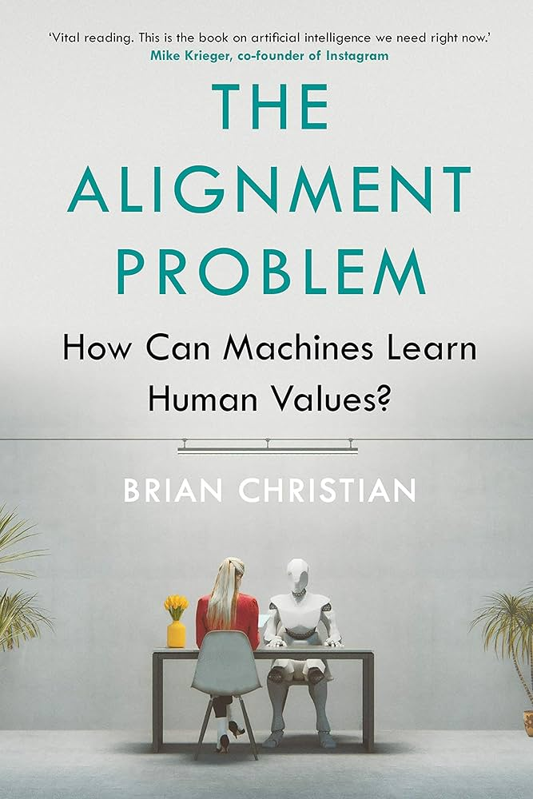
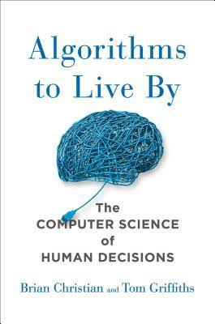
Two interesting Books to understand AI and Algorithms Deeply
A lecture by the Author on the Alignment Problem:
https://youtu.be/z6atNBhItBs?si=eFS5ZURNpYF094rC
Code, Data & Decisions
67

Slide 71
WHERE YOU FIT IN
Whatever field pulls you — agriculture, robotics,
healthcare, or policy — the path starts
with the same first step: today.
See you next session.
68
Notes:
End warm. Confirm the Day 1 task deadline before dismissing.

