Slide 1
Bittoo Tikki Wala — Expanded Market Analysis & Correlation Report
Power Bi

Slide 2
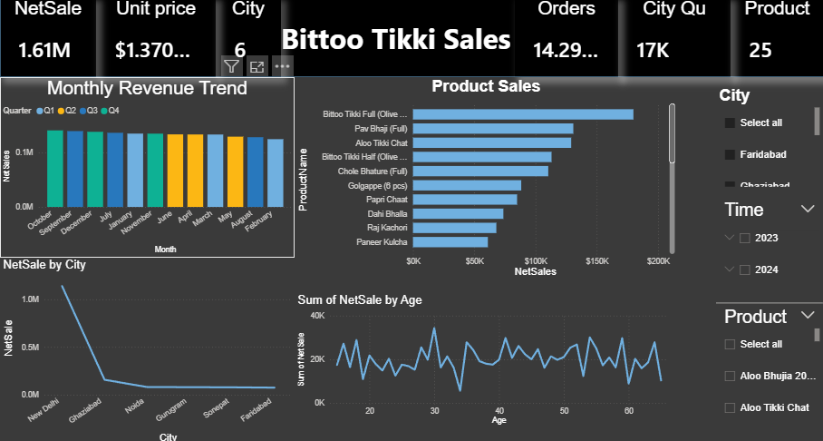

Slide 3
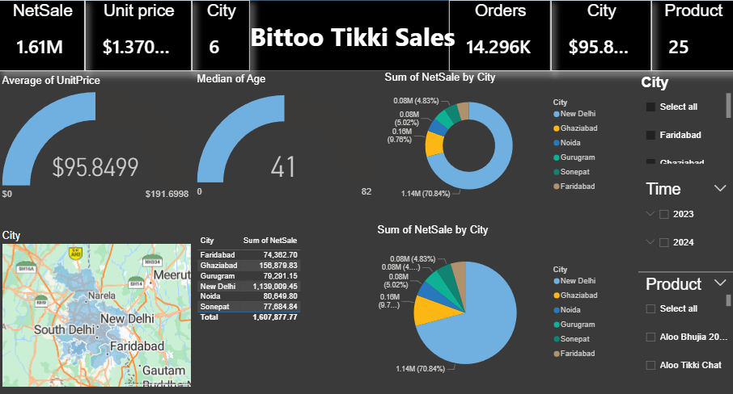

Slide 4
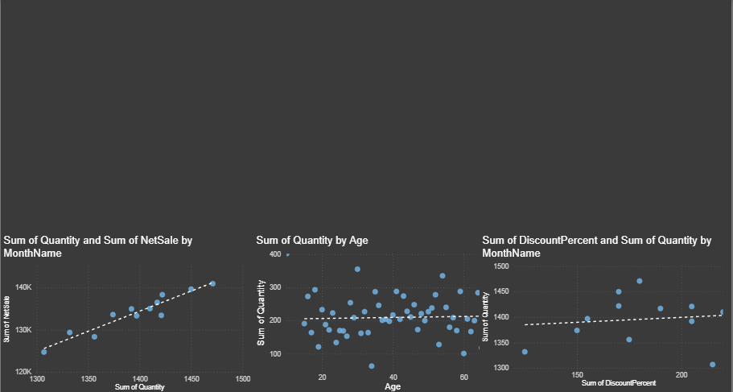

Slide 5
