Slide 1
Spark
Waseem Ahmad Chishti
University of management and technology
Lahore, Pakistan
Resource: IBM online course

Slide 2
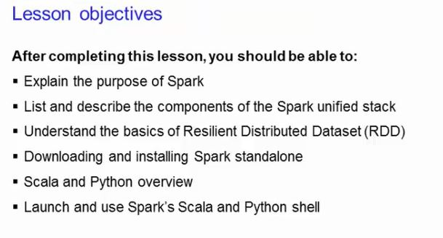
Lesson 1

Slide 3
Apache Spark is a lightning-fast unified analytics engine for big data and machine learning. It was originally developed at UC Berkeley in 2009
Apache Spark™ is a unified analytics engine for large-scale data processing
Spark provides an interface for programming entire clusters with implicit data parallelism and fault tolerance.

Slide 4
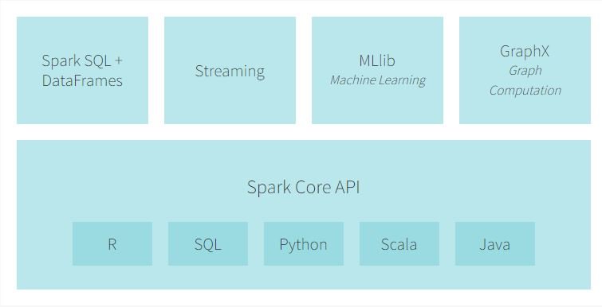
Spark Ecosystem

Slide 5
Spark Ecosystem
SparkSQL+DataFrame
Many data scientists, analysts, and general business intelligence users rely on interactive SQL queries for exploring data. Spark SQL is a Spark module for structured data processing. It provides a programming abstraction called DataFrames and can also act as distributed SQL query engine. It enables unmodified Hadoop Hive queries to run up to 100x faster on existing deployments and data. It also provides powerful integration with the rest of the Spark ecosystem (e.g., integrating SQL query processing with machine learning).

Slide 6
Spark Ecosystem
Streaming Analytics: Spark Streaming
Many applications need the ability to process and analyze not only batch data, but also streams of new data in real-time. Running on top of Spark, Spark Streaming enables powerful interactive and analytical applications across both streaming and historical data, while inheriting Spark’s ease of use and fault tolerance characteristics. It readily integrates with a wide variety of popular data sources, including HDFS, Flume, Kafka, and Twitter.

Slide 7
Spark Ecosystem
Machine Learning: MLlib
Machine learning has quickly emerged as a critical piece in mining Big Data for actionable insights. Built on top of Spark, MLlib is a scalable machine learning library that delivers both high-quality algorithms (e.g., multiple iterations to increase accuracy) and blazing speed (up to 100x faster than MapReduce). The library is usable in Java, Scala, and Python as part of Spark applications, so that you can include it in complete workflows.

Slide 8
Spark Ecosystem
Graph Computation: GraphX
GraphX is a graph computation engine built on top of Spark that enables users to interactively build, transform and reason about graph structured data at scale. It comes complete with a library of common algorithms.

Slide 9
Spark Ecosystem
General Execution: Spark Core
Spark Core is the underlying general execution engine for the Spark platform that all other functionality is built on top of. It provides in-memory computing capabilities to deliver speed, a generalized execution model to support a wide variety of applications, and Java, Scala, and Python APIs for ease of development.
Notes:
In-memory computing is the storage of information in the main random access memory (RAM) of dedicated servers rather than in complicated relational databases operating on comparatively slow disk drives

Slide 10
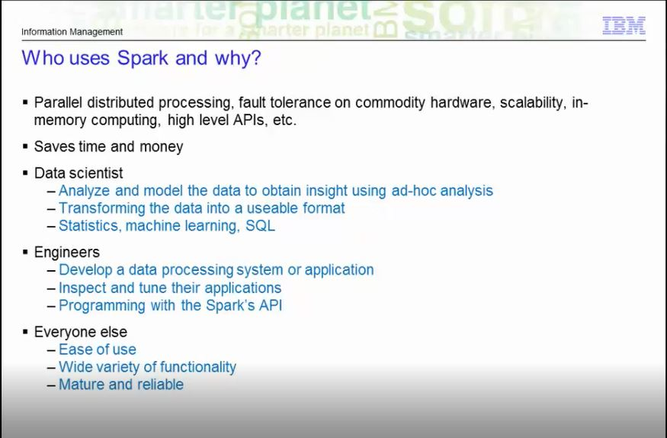

Slide 11
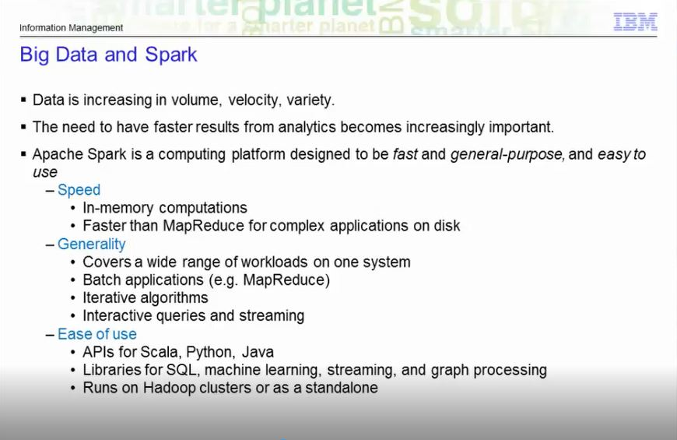

Slide 12
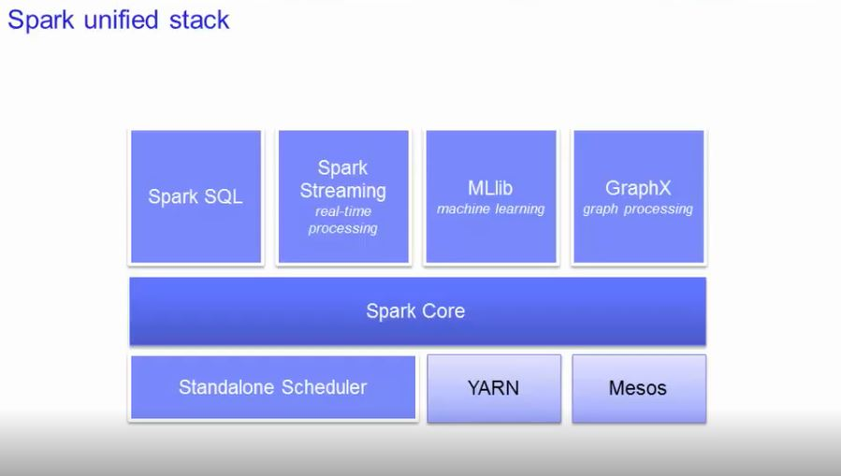

Slide 13
Spark core
Spark Core is the foundation of the overall project. It provides distributed task dispatching, scheduling, and basic I/O functionalities, exposed through an application programming interface (for Java, Python, Scala, and R) centered on the RDD abstraction .he Spark core is a ageneral-purpose system providing scheduling, distributing, and monitoring of the applications across a cluster.
Then you have the components on top of the core that are designed to interoperate closely, letting the users combine them, just like they would any libraries in a software project.
The benefit of such a stack is that all the higher layer components will inherit
the improvements made at the lower layers. Example: Optimization to the Spark Core will speed up the SQL, the streaming, the machine learning and the graph processing librariesas well. The Spark core is designed to scale up from one to thousands of nodes. It canrun over a variety of cluster managers including Hadoop YARN and Apache Mesos. Or simply, it can even run as a standalone with its own built-in scheduler.

Slide 14
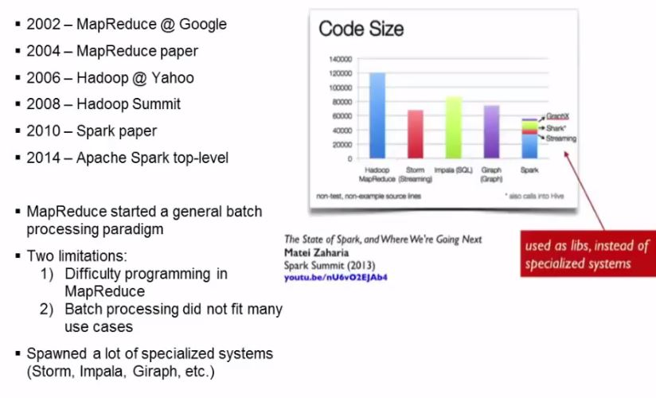

Slide 15
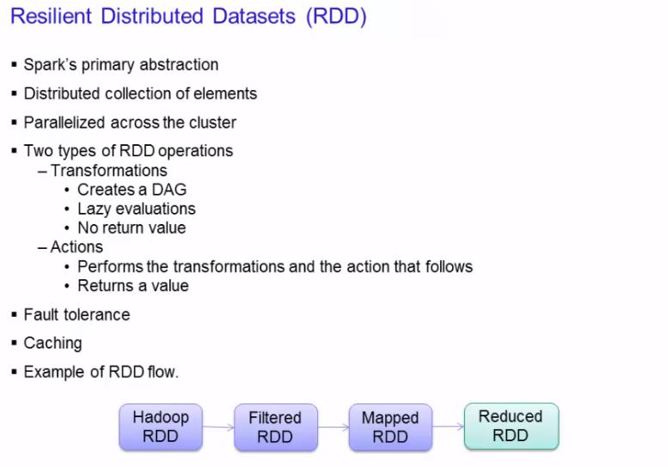

Slide 16
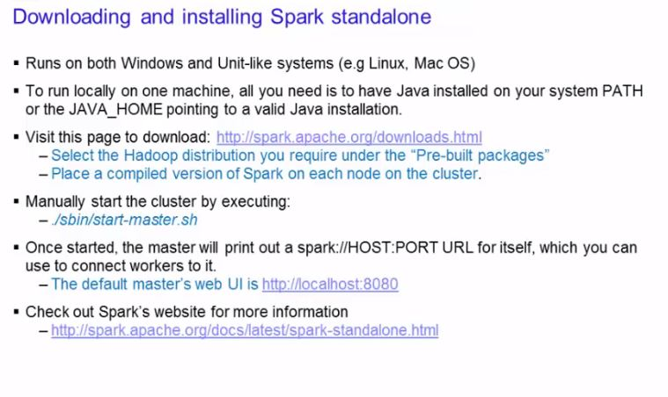

Slide 17
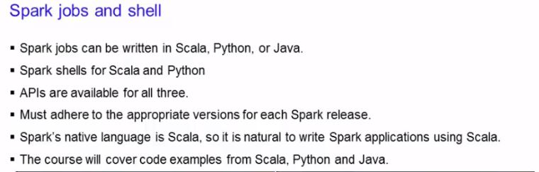

Slide 18
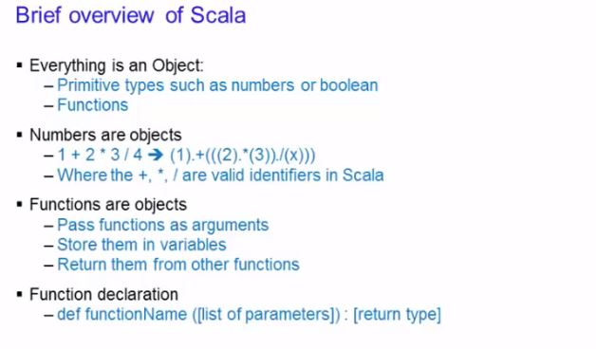

Slide 19
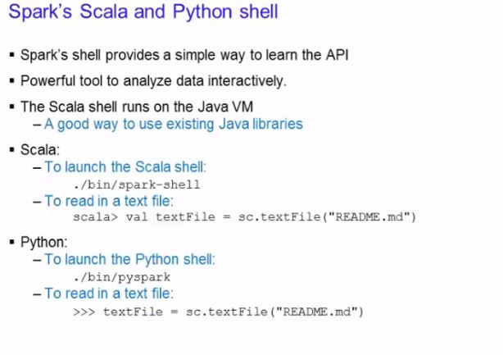

Slide 20
Reading file in Scala
1.Run spark-shell
spark-shell
2. Val readfile=sc.textFile(“path/file”)
3. RDDs have actions, which return values, and transformations, which return pointers to new RDDs. Let’s start with a few actions:
readfile.count()
readfile.first()
4. Now let’s use a transformation. We will use the filter transformation to return a new RDD with a subset of the items in the file.
val linesWithSpark = readfile.filter(line => line.contains("Spark"))
5. We can chain together transformations and actions:
readfile.filter(line => line.contains("Spark")).count() // How many lines contain "Spark"?

Slide 21
RDD actions and transformations can be used for more complex computations. Let’s say we want to find the line with the most words:
readfile.map(line => line.split(" ").size).reduce((a, b) => if (a > b) a else b) // line with most words

