Slide 1
Lessons Learned
Standards are there for a reason
    Comma-separated lists
    Dynamic scoping is easy
    if/else implemented as a tree, not a list
Tests are good
    Build test suite early, many tests
    Found us a bug on precedence for method calls

Slide 2
Lessons Learned
Catching errors early is hard
    Move errors from scanner and parser down to the interpreter
    Less efficient for the user, may run half of the code before an error
Ocaml's inference is great
    When it guesses what you want it to guess
    We one thaught we could do type inference ourselves...!
Pair programming works well
    One by itslef, hard to take decision
    More than 2 around a computer is useless

Slide 3
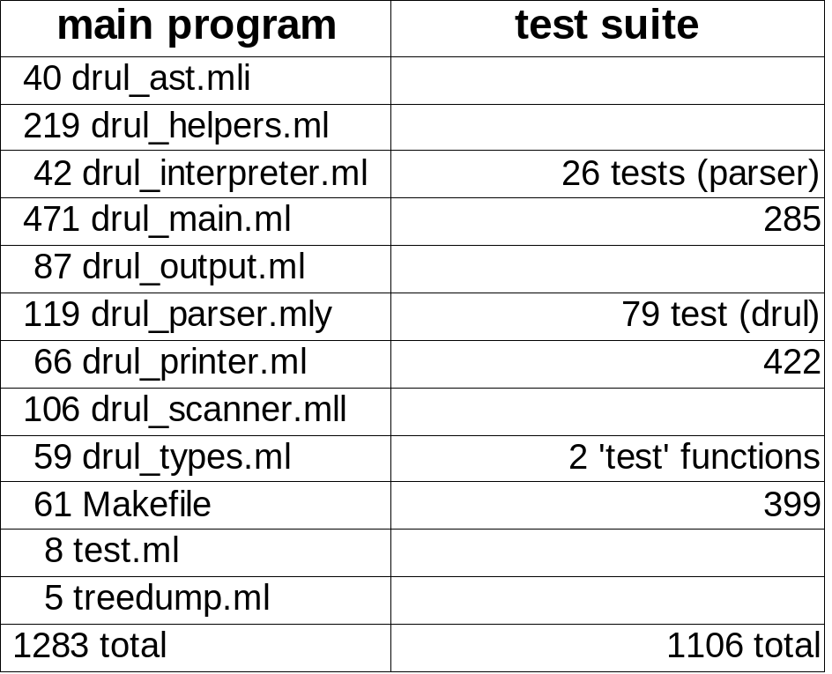
Lines of code

