Slide 1
Secure Continue Plugin (PoC)
Java AI Engineer Assignment – Secure Plugin Build
Name: Waseem Irfan Shaik
Objective: Ensure Continue plugin cannot access or be configured to access any external network resources.

Slide 2
Why This Needed Securing
Continue is designed for:
Cloud models
External registries
SaaS control plane
In enterprise / offline environments this creates:
Data exfiltration risk
Supply‑chain risk
Compliance violations
Key point:
“The default Continue architecture assumes Data exfiltration access. This PoC inverts that assumption.”

Slide 3
Security Requirements — Contract
R1 — Plugin must never access any external networks
R2 — Developers must not be able to reconfigure it externally
R3 — Source code must not contain any external URLs
Engineering translation:
Req‑1 → Runtime network enforcement
Req‑2 → Configuration attack‑surface removal
Req‑3 → Source‑level cleanup

Slide 4
Threat Model
What we defend against:
Accidental cloud usage
Malicious configuration changes
Hidden URLs and SDK defaults
UI actions opening external sites
Threat actors:
Developer misconfiguration
Compromised plugin build
Upstream defaults and dependencies

Slide 5
Secure Architecture — Enforcement Layers
IntelliJ Plugin UI
Continue Core Engine
BLOCKED ZONE OpenAI • Anthropic • Continue Cloud • GitHub • Telemetry • MCP 🚫 External Network Access
Enforcement Zone • Runtime Network Gate (R1) • Config Gate (R2) • Source Purge (R3)
Local Models Only (Ollama / On‑prem LLMs)

Slide 6
What Actually Changed
Runtime layer:
Global fetch/http/https hardening
DNS validation and CIDR allowlist
IntelliJ request interception
Configuration layer:
OpenAI / Anthropic blocked
External apiBase / proxyUrl rejected
Remote MCP disabled
Source layer:
External URLs removed
External UI buttons neutralized
Control‑plane endpoints forced local

Slide 7
Test Strategy
Positive tests:
• Local Ollama usage works
Negative tests:
• OpenAI / Anthropic blocked
• External endpoints rejected
UI tests:
• External buttons fail
Audit tests:
• Codebase scanned for URLs and providers

Slide 8
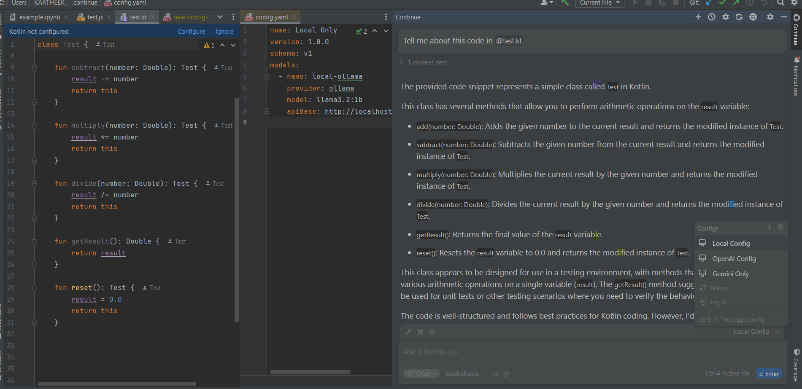
Evidence (Add Screenshots / Logs)
Chat Scenario

Slide 9
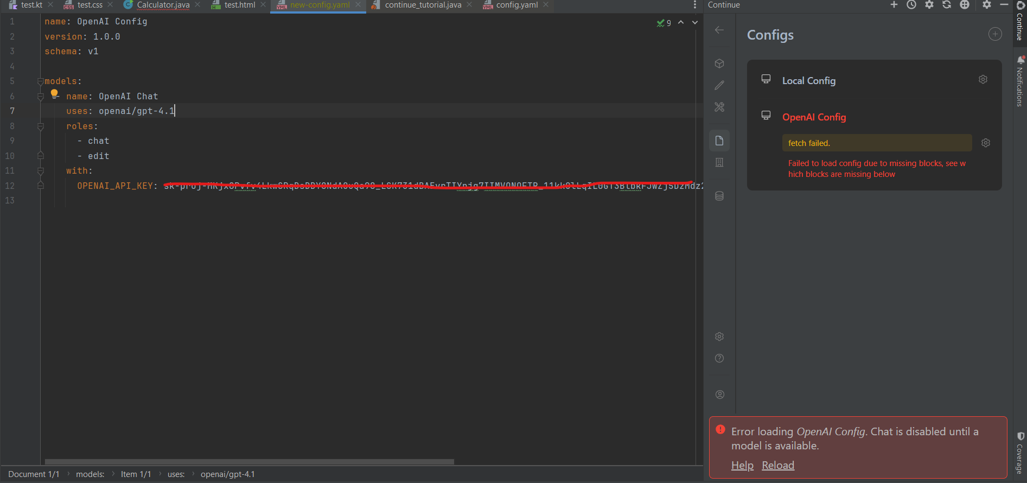
Evidence (Add Screenshots / Logs)
Config Failed Scenario

Slide 10
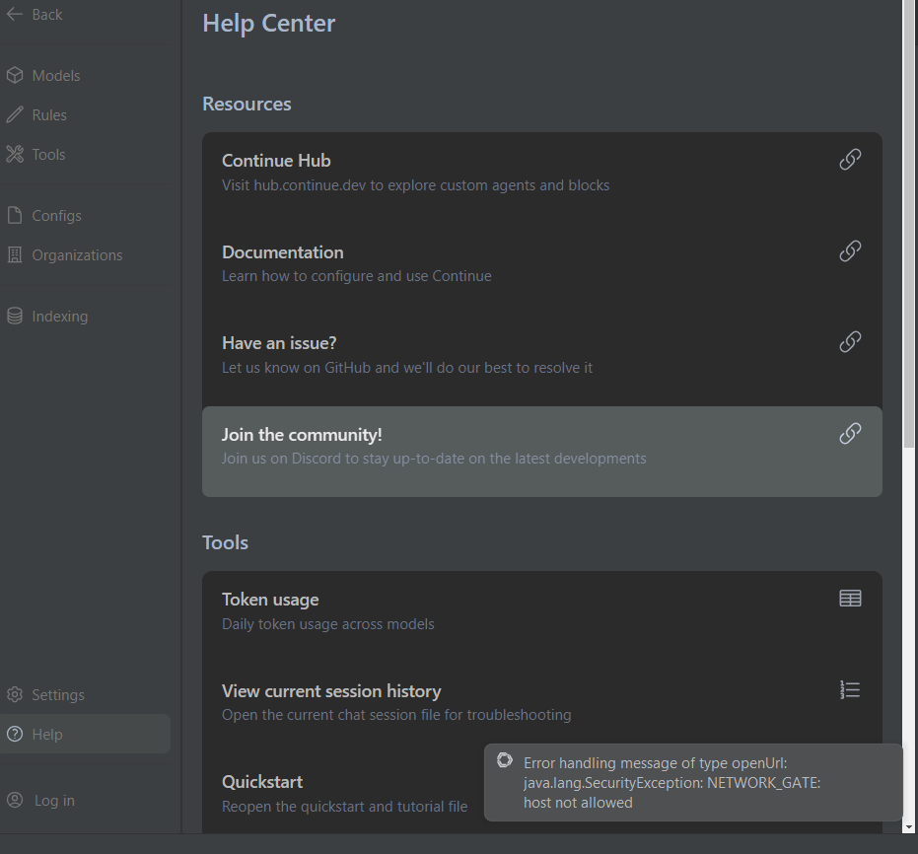
Evidence (Add Screenshots / Logs)
Disabling network level calls

Slide 11
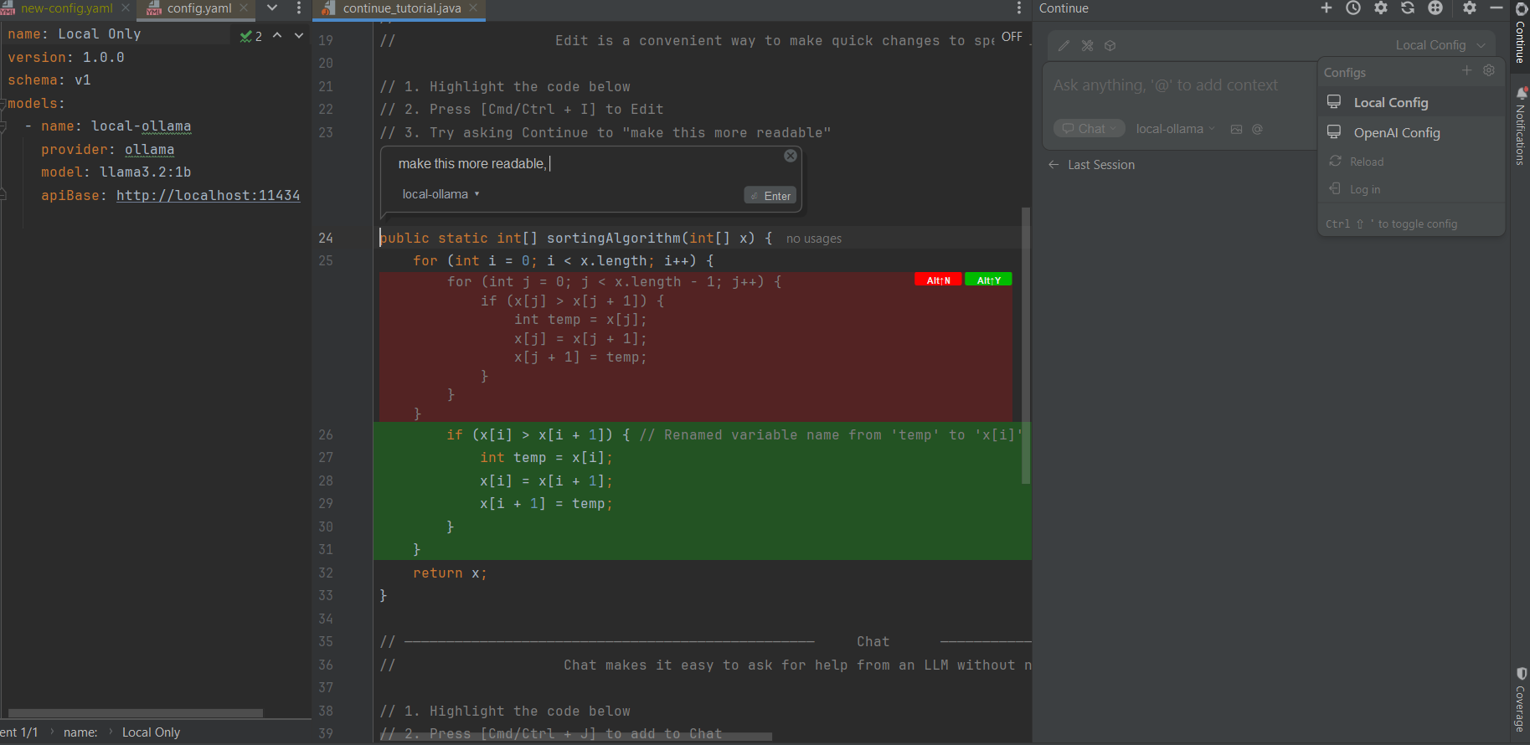
Evidence (Add Screenshots / Logs)
Inline edit Scenario

Slide 12
Results Summary
✔ No external network access possible
✔ No external reconfiguration possible
✔ No external URLs in source
Outcome:
Plugin functions as a local AI assistant
Cloud capability fully removed
Safe for air‑gapped enterprise environments

Slide 13
Next Steps (If Productized)
CI rule to fail builds on https:// presence
Automated unit tests for network gates
Local‑only configuration schema
Signed internal model registry
Admin‑managed allowlist
“PoC proves feasibility. These steps harden it into a production‑grade secure plugin.”

