Slide 1

INTERNSHIP 2025 – VIGINUM
3rd February - 1st August

Slide 2
SUMMARY
About Viginum
Internal training (1 month)
Metrics stack (3 months)
Logs stack (2 months)
Conclusion

Slide 3
ABOUT VIGINUM
Decree of July 2021, Decree of December 2021
Prime minister service
Integrated within the `Secretariat General de la Defense et de la Securite Nationale` in french (SGDSN)
Mission : detect, analyze and counter foreign digital interference (FDI)
Approach : actor/entity-based + narrative analysis

Slide 4
ABOUT VIGINUM
4 criteria foreign digital interference :
  False or misleading content
  Intent to harm the fundamental interests of the Nation
  Direct or indirect involvement
  Spreading or intent to amplify the content

Slide 5
ABOUT VIGINUM
Official public report :
  UN-notorious BIG : a digital information manipulation campaign targeting the French overseas territories (DROM-COM) and Corsica
  Manipulation of algorithms and the instrumentalization of influencers : Lessons from the Romanian presidential election & risks for France
  African Initiative : describing pro-Russian informational tactics in Africa

Slide 6




INTERNAL TRAINING
OSI Model
SSH
NTP (Network Time Protocol)
High Availability and redundancy (Haproxy, Keepalived)
Vault KV & Vault PKI
Ansible
OpenTofu (forked terraform)

Slide 7



METRICS STACK (PROD)
Node_Exporter
Prometheus (x3)
Alertmanager (x3)
Grafana (x2)
Thanos Stack for High Availability
S3
All communication secured with mTLS

Slide 8
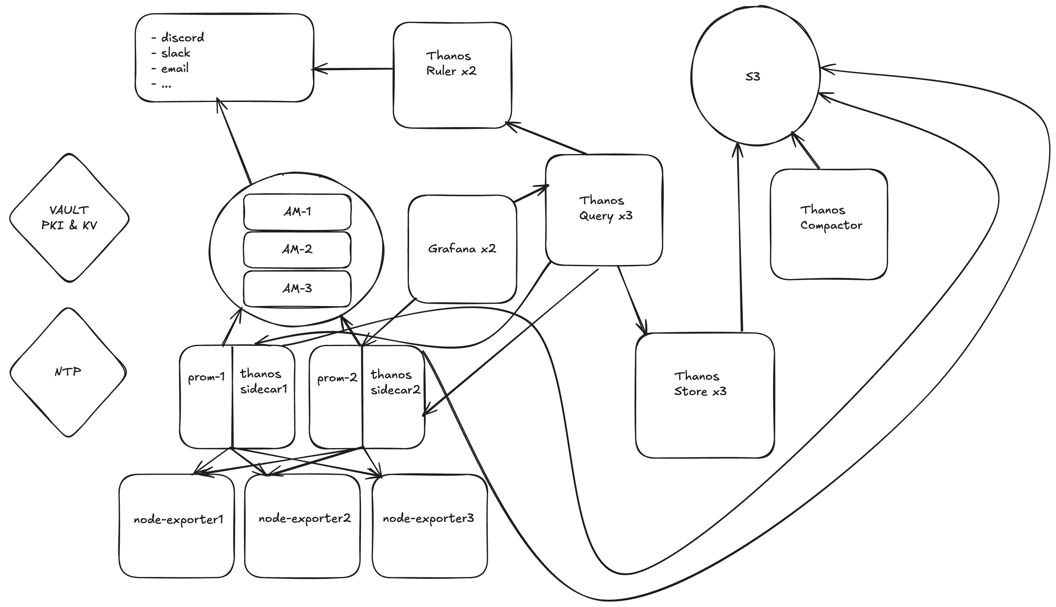
METRICS STACK (PROD)

Slide 9






LOGS STACK (DEV)
Log Shipper :
  Promtail
  Fluentbit
  Logstash
  Rsyslog
Databases :
  Loki
  Elasticsearch
Dashboard :
  Grafana
  Kibana

Slide 10



LOGS STACK (DEV)
All my tests :
  Kubernetes Logs
  Docker logs
  Web Server logs (nginx)
  Syslog

Slide 11
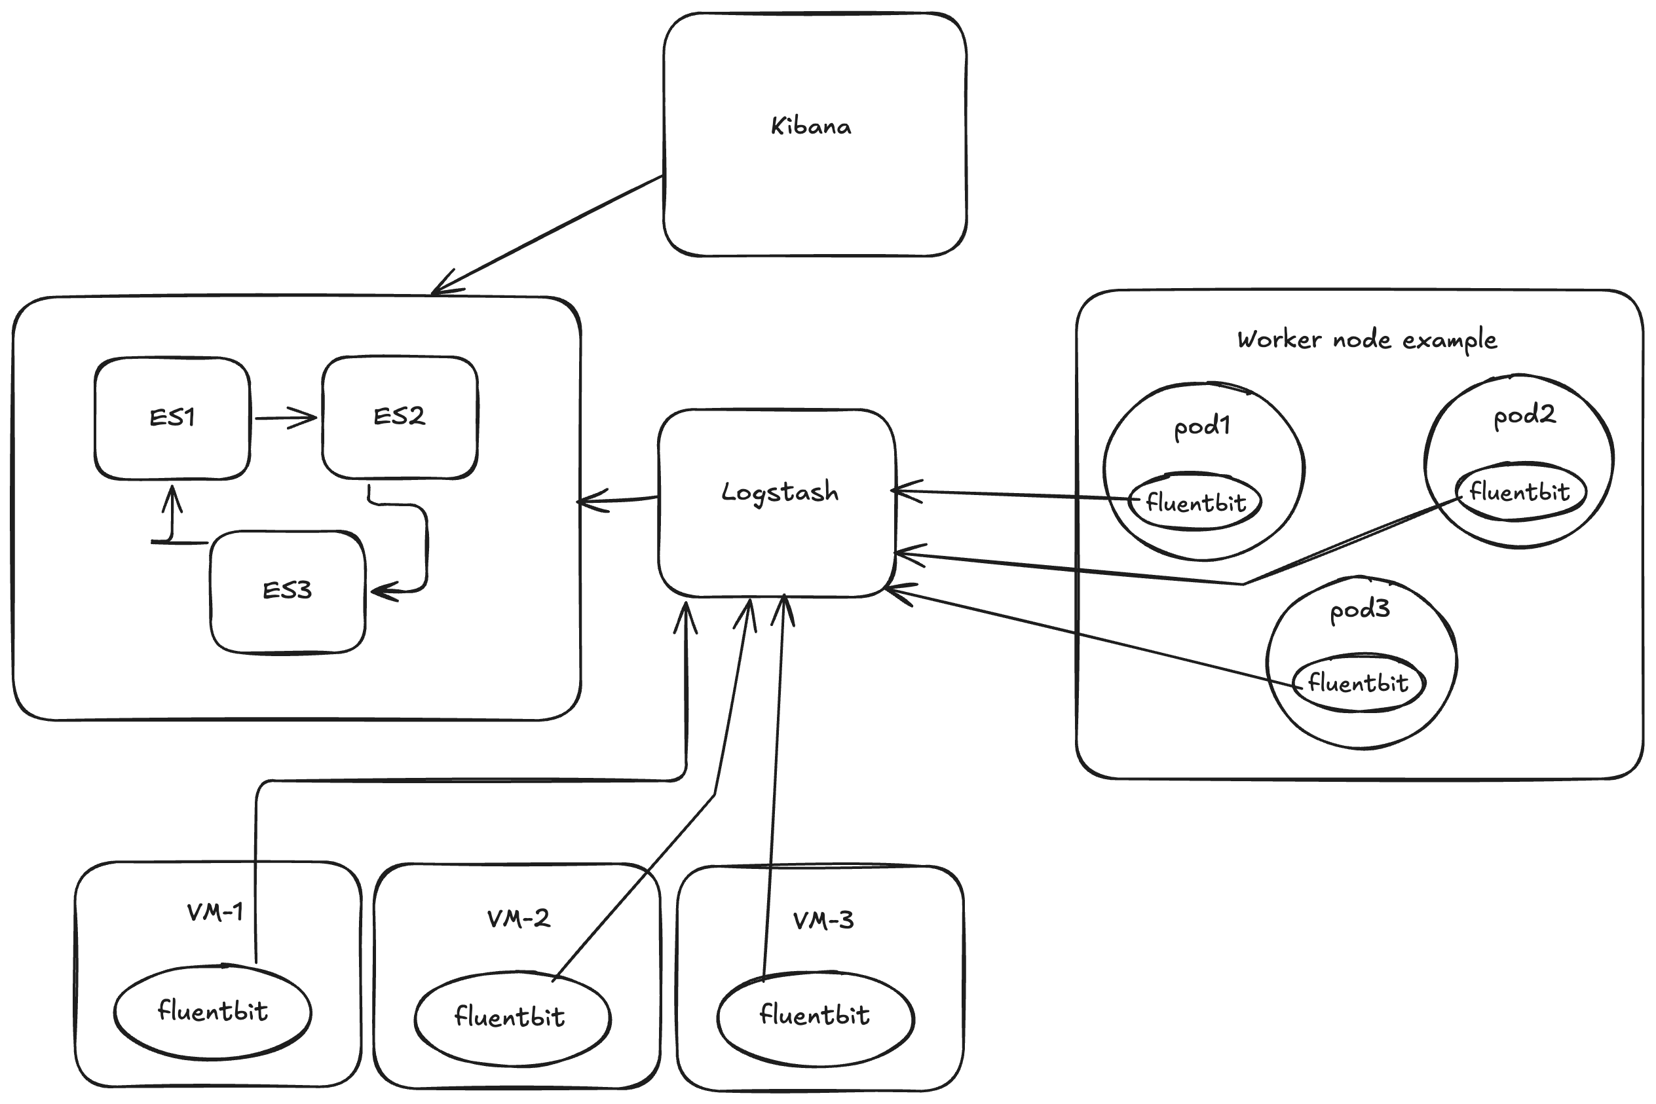
LOGS STACK (DEV)

Slide 12
CONCLUSION

