Slide 1
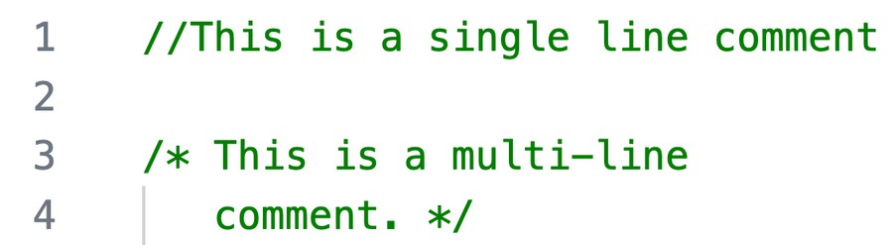
Comments in JS
Part of the code that is not executed

Slide 2
Operators in JS
Used to perform some operation on data
Arithmetic Operators
+, -, *, /
Modulus ExponentŤatŤon Increment Decrement

Slide 3
Operators in JS
Assignment operators
= += -= *=
%=
**=

Slide 4
Operators Ťn JS
Comparison operators
==
===
!==
Equal to
Equal to & type
!=
Not equal to
Not equal to & type
>, >=, <, <=

Slide 5
Operators Ťn JS
Logical operators
LogŤcal AND
&&
||
!
LogŤcal OR
LogŤcal NOT

Slide 6
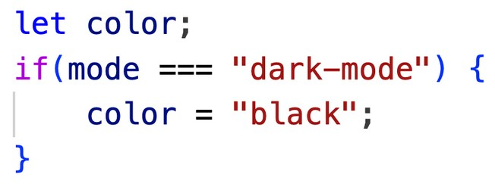
Conditional Statement
To implement conditions in code
IF Statement

Slide 7
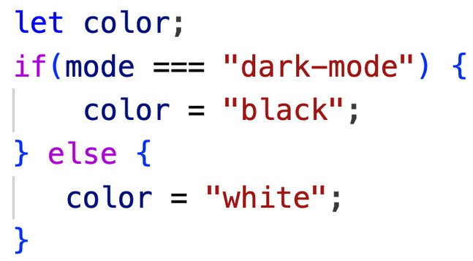
Conditional Statement
Else-if Statement

Slide 8
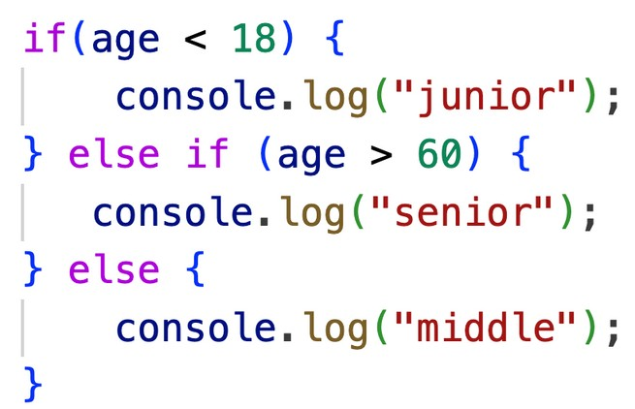
Conditional Statement
else-if Statement

Slide 9
Let‘s PractŤce
Qs1. Get user to Ťnput a number usŤng prompt(“Enter a number:”). Check Ťf the number Ťs a multŤple of 5 or not.

Slide 10





Let‘s PractŤce
Qs2. WrŤte a code whŤch can gŤve grades to students accordŤng to theŤr scores: 80-100, A
70-89, B
60-69, C
50-59, D
0-49, F

