Slide 1

Financial Indicator
Compute coefficients of correlation between metrics
Name of the presenter : Washim Ahmed
Date: January 2017

Slide 2
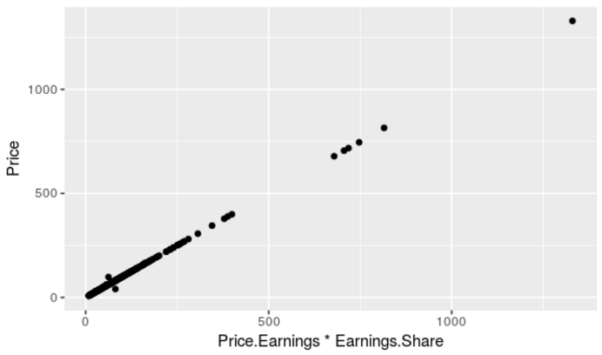
Stock Price vs Price Earnings and Earning Share
Conclusion
Here I found Coefficient of correlation 0.9997068 which represent very strong positive correlation.
Price Earning and Earning share both together highly correlated with stock price.
If anyone Price Earning or Earning share increase or decrease it will influence stock price.

Slide 3
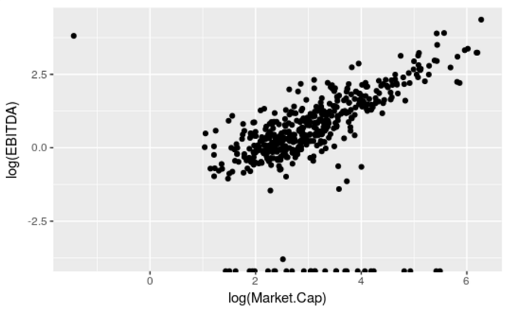
Market Capital vs EBITDA
Conclusion
Here I found Coefficient of correlation 0.7538602 which represent very strong positive correlation.
EBITDA indicates a measure of a company's total value, often used as a more comprehensive alternative to equity market capitalization.

Slide 4
Thank you

