Slide 1
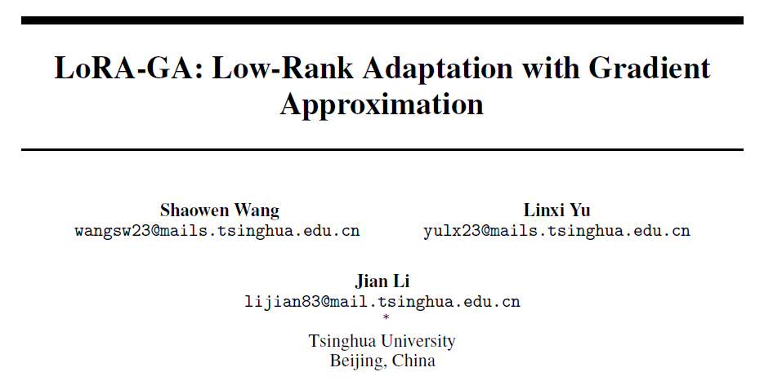

Slide 2
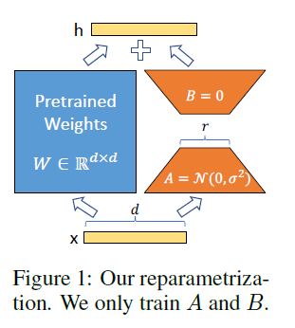
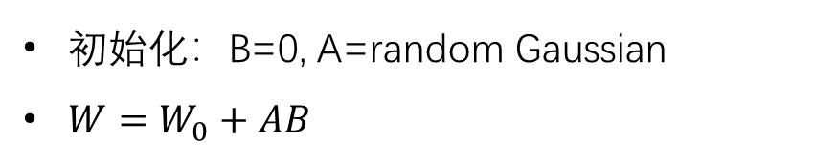
LoRA
初始化：B=0, A=random Gaussian
$W=W_{0}+AB$

Slide 3
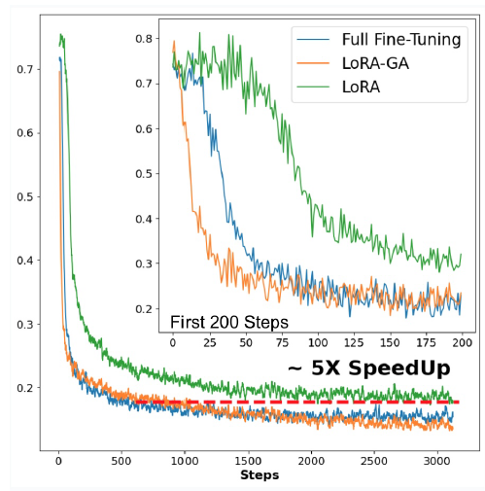
LoRA收敛慢
相同学习率下，需要约5倍的Step，loss才能收敛到和全量微调类似的水平

Slide 4
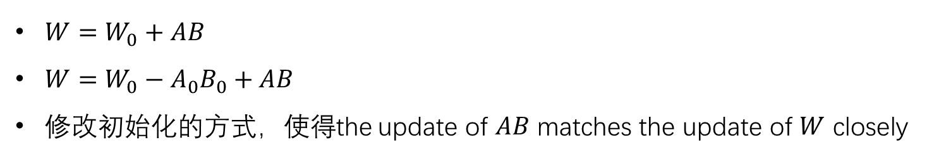
LoRA-GA
$W=W_{0}+AB$
$W=W_{0}−A_{0}B_{0}+AB$
修改初始化的方式，使得the update of $AB$ matches the update of $W$ closely

Slide 5
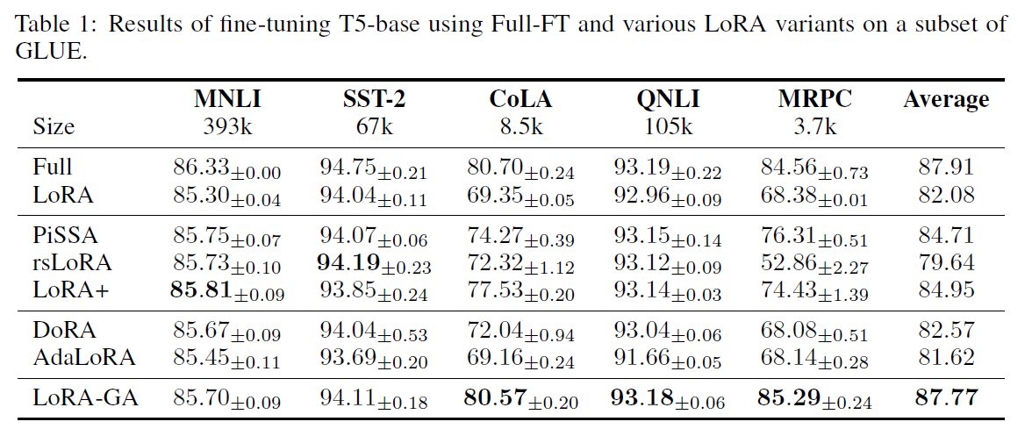
Experiment on T5-base

Slide 6
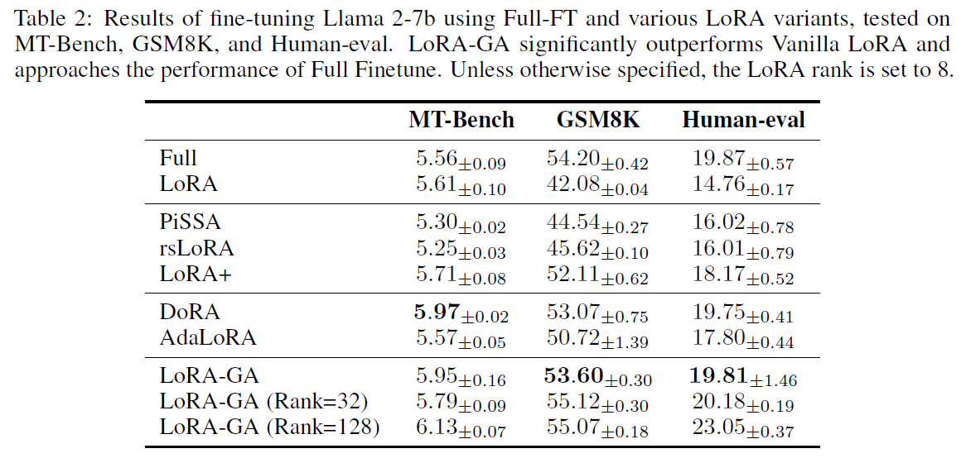
Experiment on Llama2-7B

Slide 7
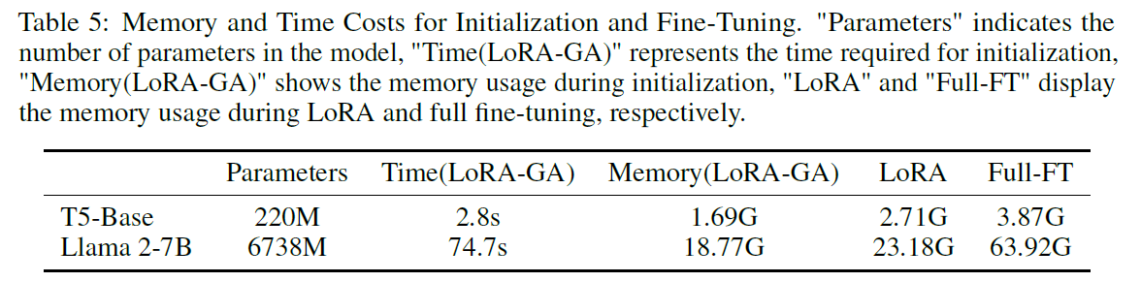
Memory and Time Costs

