Slide 1
St. Louis Central Corridor West Building Permits
Monthly Report: May 2020

Slide 2
Introduction
Data retreived from https://www.stlouis-mo.gov/data/
Building permits with a cost of $0 were dropped
Building permits that were cancelled were dropped
Infinite change indicates 0 permits in the current or previous time period/comparison month so there was a overall increase or decrease

Slide 3
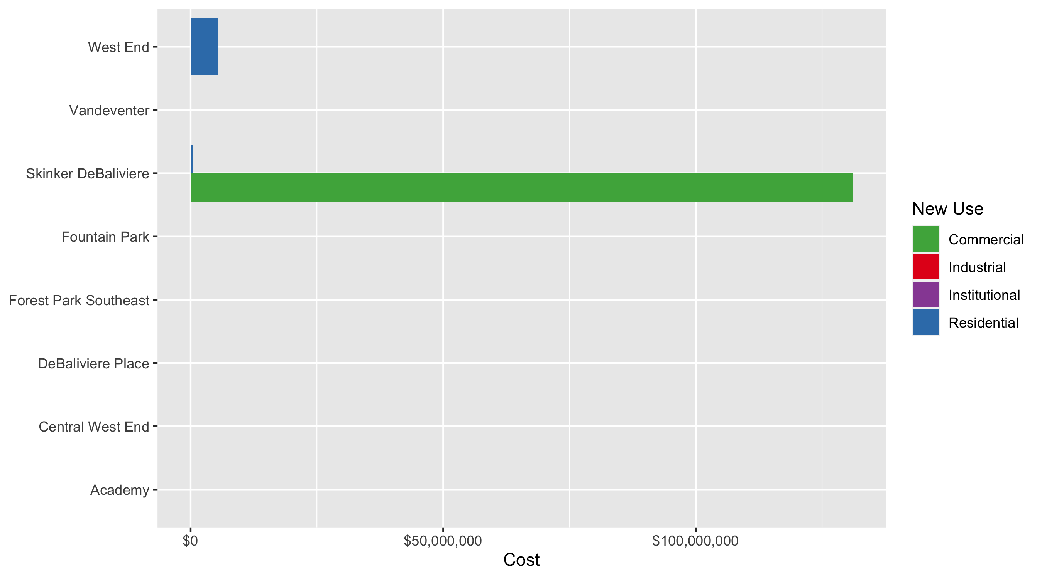
Neighborhood Summary: Average Building Permit Cost

Slide 4
Neighborhood Summary
Neighborhood | Average Cost | # of Permits
Academy | $3,200 | 1
Central West End | $50,593 | 37
DeBaliviere Place | $62,333 | 6
Forest Park Southeast | $9,590 | 8
Fountain Park | $10,500 | 1
Skinker DeBaliviere | $33,050,561 | 12
Vandeventer | $1,350 | 2
West End | $5,423,125 | 2

Slide 5
Forest Park Southeast: Summary Notes
8 building permits in May 2020
-27.27% change compared to May 2019 (11 total building permits)
$9,590: Average building permit cost in May 2020
-17.08% change compared to May 2019 ($11,565)
48 total building permits in 2020
-38.46% change compared to this time in 2019 (78 total building permits)
$127,077: Average building permit cost in 2020
-9.58% change compared to this time in 2019 ($140,536)

Slide 6
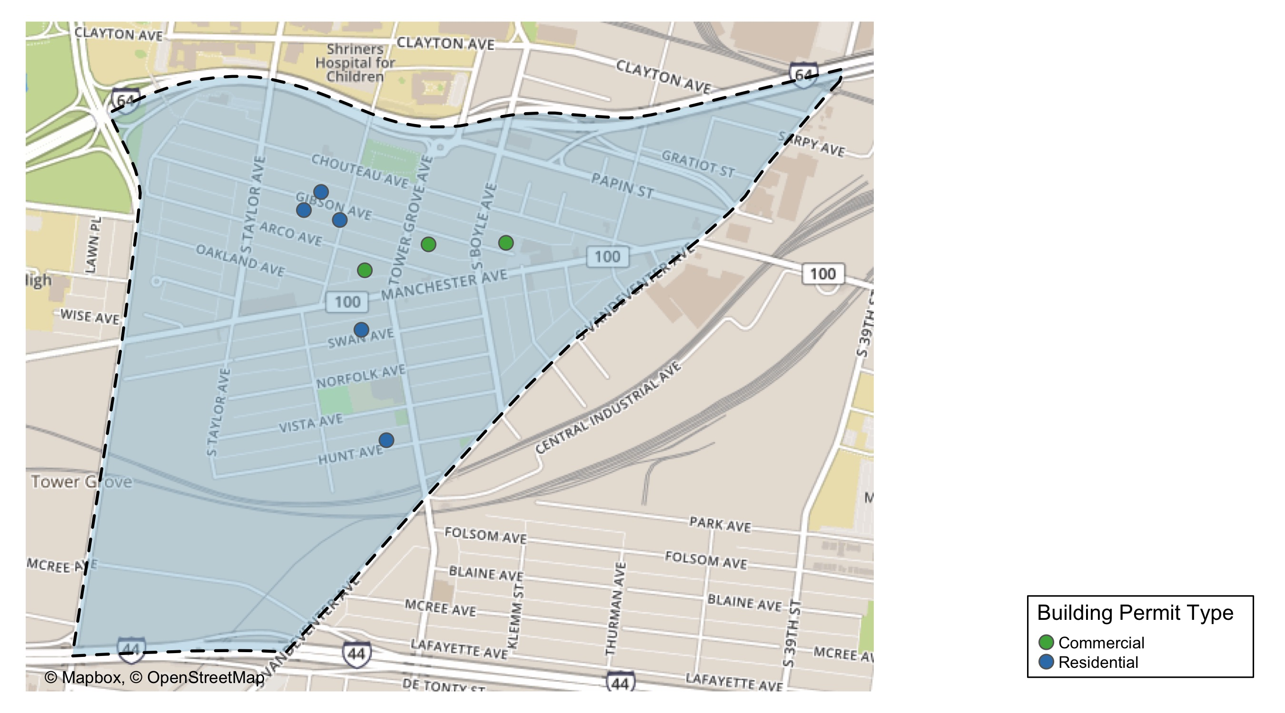
Forest Park Southeast

Slide 7
Forest Park Southeast
New Use | Average Cost | # of Permits
Commercial | $14,667 | 3
Residential | $6,543 | 5

Slide 8
Forest Park Southeast Individual Permit Breakdown
Owner | New Use | Cost | address
POPEK, JACOB M | Residential | $4,000 | 4440 GIBSON AV
LONI PROPERTIES CO | Commercial | $15,000 | 4121 MANCHESTER AV
CITY DOGS REALTY LLC | Residential | $1,000 | 4322 VISTA AV
SPENCER REAL ESTATE 763 NORTH LLC | Residential | $3,266 | 4306 MANCHESTER AV
CROSSFACE LLC | Commercial | $26,000 | 4243 MANCHESTER AV
MCNALLY, SHANNON R | Residential | $24,000 | 4455 OAKLAND AV
TROUTS LANDING LLC | Commercial | $3,000 | 4234 GIBSON AV
PRIME PORCH LLC | Residential | $450 | 4412 CHOUTEAU AV

Slide 9
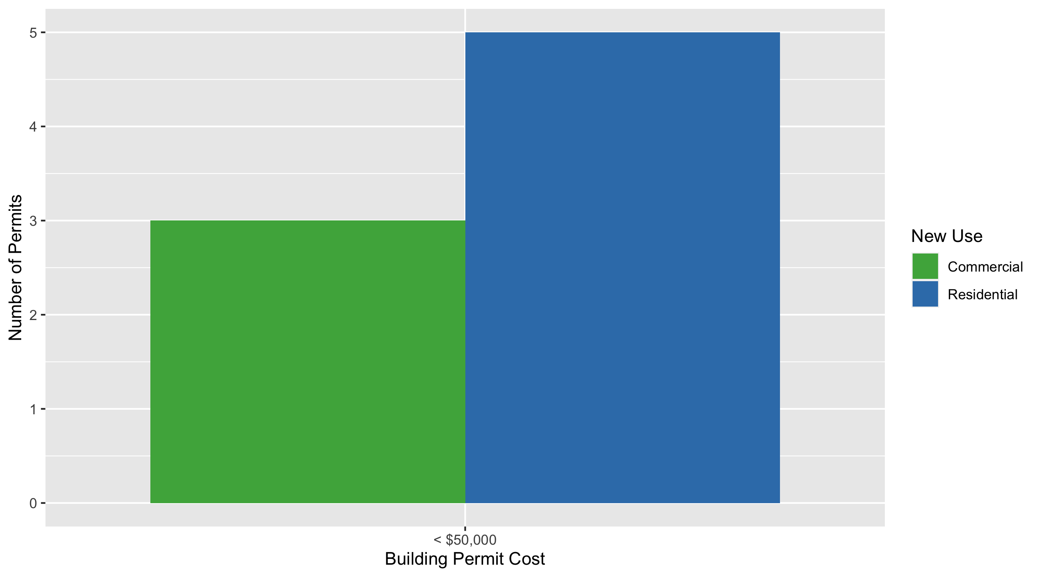
Forest Park Southeast Permit Cost Breakdown

Slide 10
Central West End: Summary Notes
37 building permits in May 2020
-7.50% change compared to May 2019 (40 total building permits)
$50,593: Average building permit cost in May 2020
-48.60% change compared to May 2019 ($98,436)
177 total building permits in 2020
-6.84% change compared to this time in 2019 (190 total building permits)
$491,269: Average building permit cost in 2020
110.17% change compared to this time in 2019 ($233,752)

Slide 11
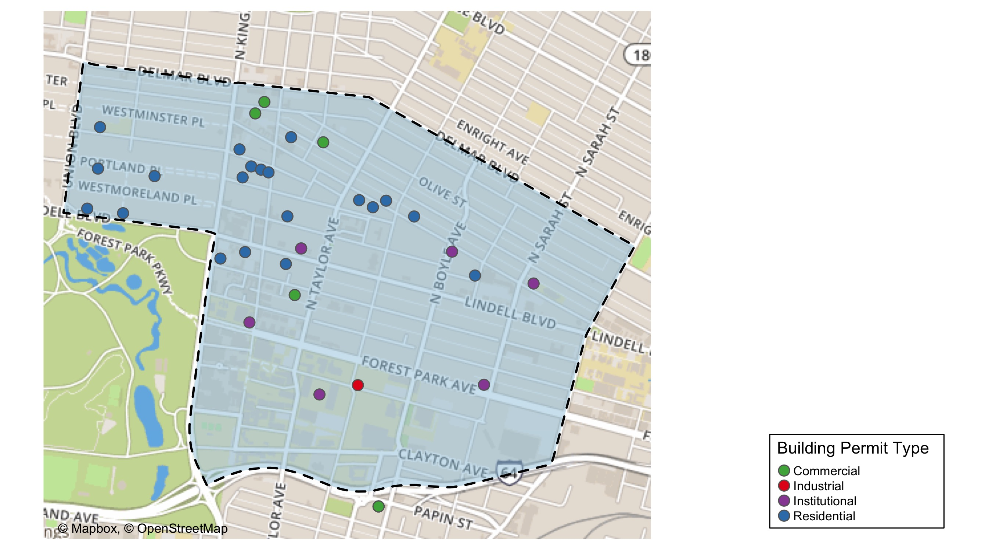
Central West End

Slide 12
Central West End
New Use | Average Cost | # of Permits
Commercial | $43,584 | 7
Industrial | $20,000 | 1
Institutional | $102,089 | 7
Residential | $37,829 | 22

Slide 13
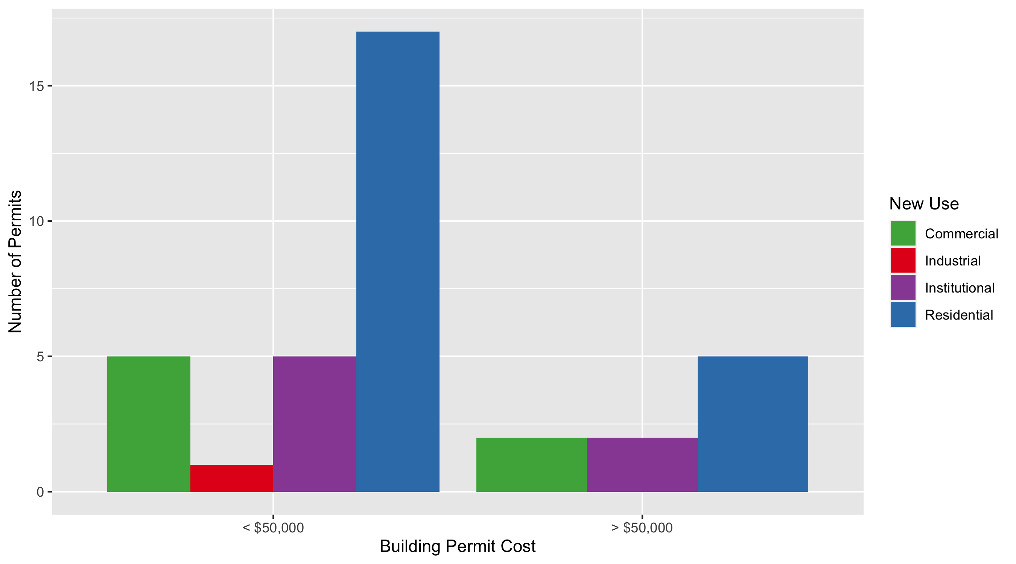
Cental West End Permit Cost Breakdown

Slide 14
DeBaliviere Place: Summary Notes
6 building permits in May 2020
50.00% change compared to May 2019 (4 total building permits)
$62,333: Average building permit cost in May 2020
361.10% change compared to May 2019 ($13,518)
20 total building permits in 2020
-23.08% change compared to this time in 2019 (26 total building permits)
$1,077,203: Average building permit cost in 2020
1524.87% change compared to this time in 2019 ($66,295)

Slide 15
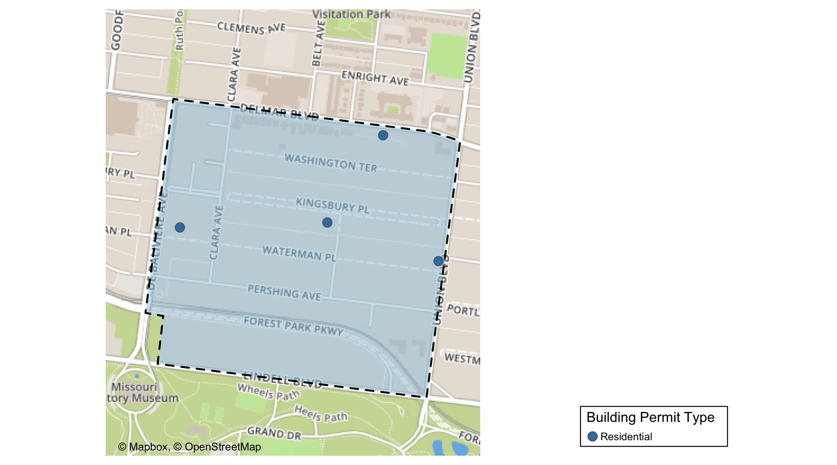
DeBaliviere Place

Slide 16
DeBaliviere Place
New Use | Average Cost | # of Permits
Residential | $62,333 | 6

Slide 17
DeBaliviere Place Individual Permit Breakdown
Owner | New Use | Cost | Address
WATERMAN-KINGSBURY CONDOMINIUM | Residential | $4,300 | 5696 KINGSBURY AV
HURLEY, MARIA YADIRA & JOHN L PRATER | Residential | $19,669 | 34 KINGSBURY PL
BULLOCK, JAMES R & DAN S | Residential | $182,351 | 13 KINGSBURY PL
BURKE, TIMOTHY ROBERT & | Residential | $30,000 | 1 WASHINGTON TER
BERNSTEIN, CAROLYN | Residential | $62,679 | 39 KINGSBURY PL
RUWITCH, THOMAS E & MELISSA E | Residential | $75,000 | 6 KINGSBURY PL

Slide 18
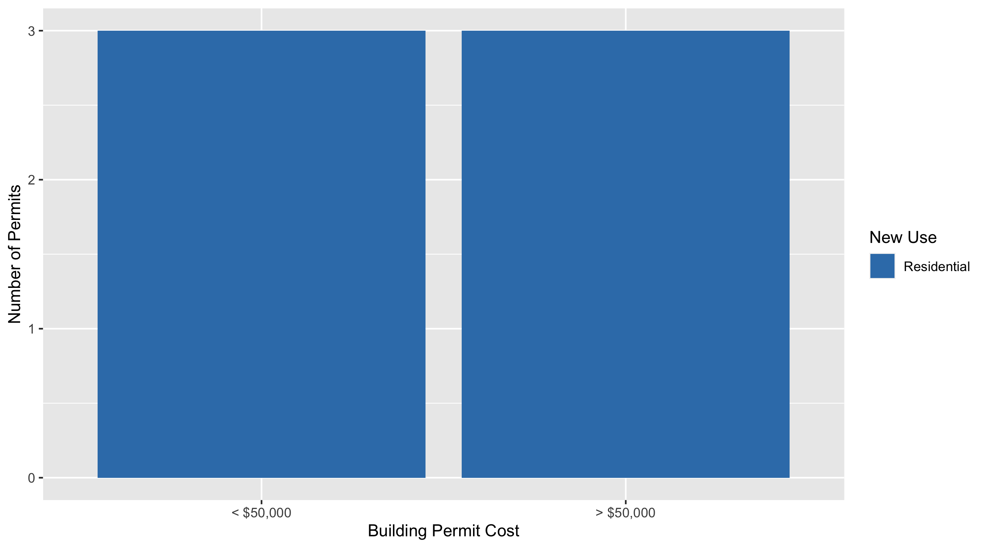
DeBaliviere Place Permit Cost Breakdown

Slide 19
Skinker DeBaliviere: Summary Notes
12 building permits in May 2020
50.00% change compared to May 2019 (8 total building permits)
$33,050,561: Average building permit cost in May 2020
270515.11% change compared to May 2019 ($12,213)
55 total building permits in 2020
111.54% change compared to this time in 2019 (26 total building permits)
$7,226,885: Average building permit cost in 2020
44658.21% change compared to this time in 2019 ($16,146)

Slide 20
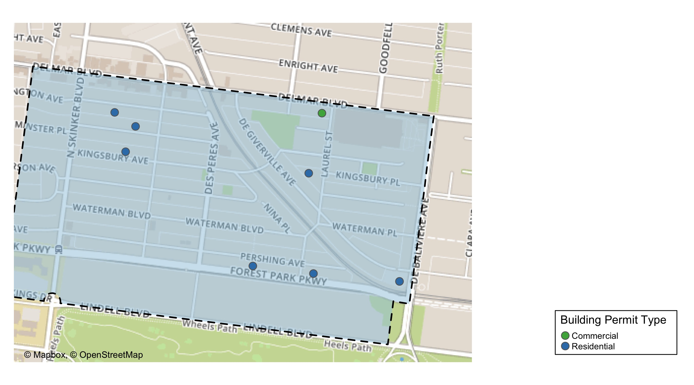
Skinker DeBaliviere

Slide 21
Skinker DeBaliviere
New Use | Average Cost | # of Permits
Commercial | $131,082,701 | 3
Residential | $373,181 | 9

Slide 22
Skinker DeBaliviere Individual Permit Breakdown
Owner | New Use | Cost | Address
BIG BRICK BUILDINGS ML LLC | Residential | $20,700 | 6030 PERSHING AV
BI-STATE DEVELOPMENT AGENCY | Commercial | $370,462,221 | 5720 DEGIVERVILLE AV
DEBALIVIERE COMMUNITY CTR LP | Commercial | $22,355,881 | 301 DEBALIVIERE AV
PAGEDALE CONGREGATION OF | Commercial | $430,000 | 5930 DELMAR BLVD
RON RAMMAHA | Residential | $1,900 | 5948 PERSHING AV
BI-STATE DEVELOPMENT AGENCY | Residential | $1,831,648 | 5720 DEGIVERVILLE AV
DEBALIVIERE COMMUNITY CTR LP | Residential | $1,330,804 | 301-331 DEBALIVIERE AV
RAINEY, TERESA & SHAUN L | Residential | $8,450 | 5830 WESTMINSTER PL
BONAN, F WILLIAM | Residential | $40,000 | 6159 LINDELL BLVD
AYERS, CAMERON & REBECCA | Residential | $3,833 | 6152 WASHINGTON AV
SCHOENFELD, KING & DEANNA | Residential | $2,600 | 6124 WESTMINSTER PL
HESS, ROBERT J & BEATRIZ ANGELICA | Residential | $118,698 | 6175 KINGSBURY AV

Slide 23
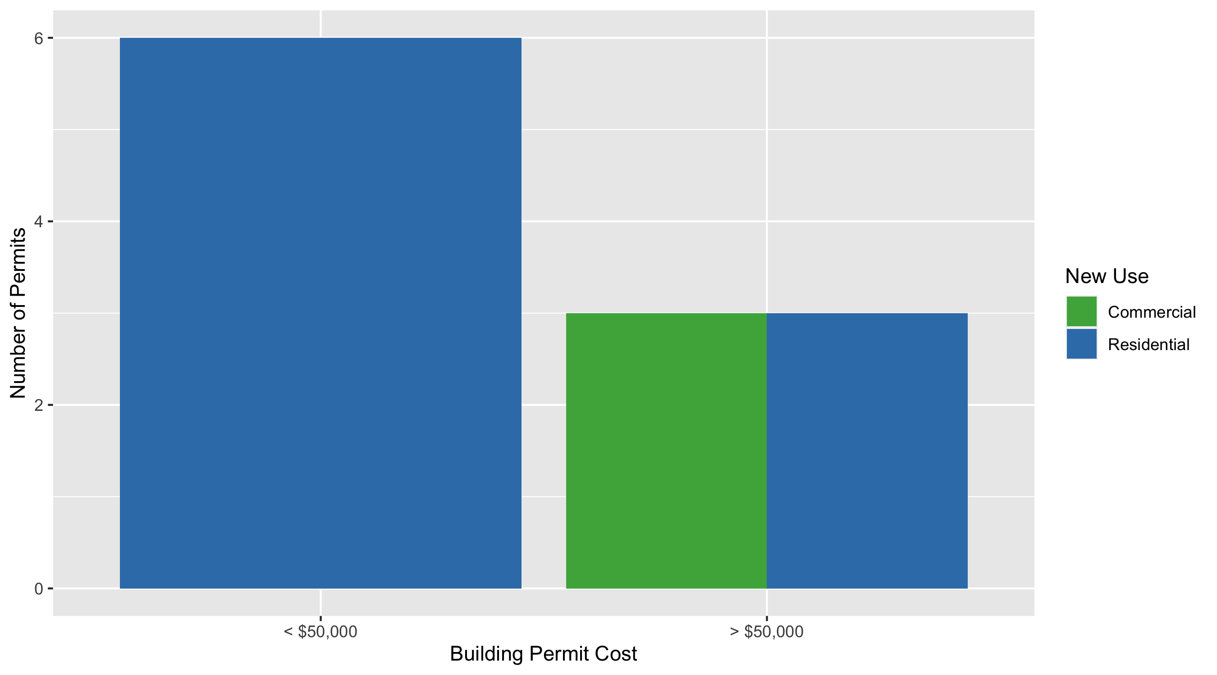
Skinker DeBaliviere Permit Cost Breakdown

Slide 24
West End: Summary Notes
2 building permits in May 2020
0.00% change compared to May 2019 (2 total building permits)
$5,423,125: Average building permit cost in May 2020
16088.43% change compared to May 2019 ($33,500)
30 total building permits in 2020
114.29% change compared to this time in 2019 (14 total building permits)
$746,922: Average building permit cost in 2020
377.22% change compared to this time in 2019 ($156,514)

Slide 25
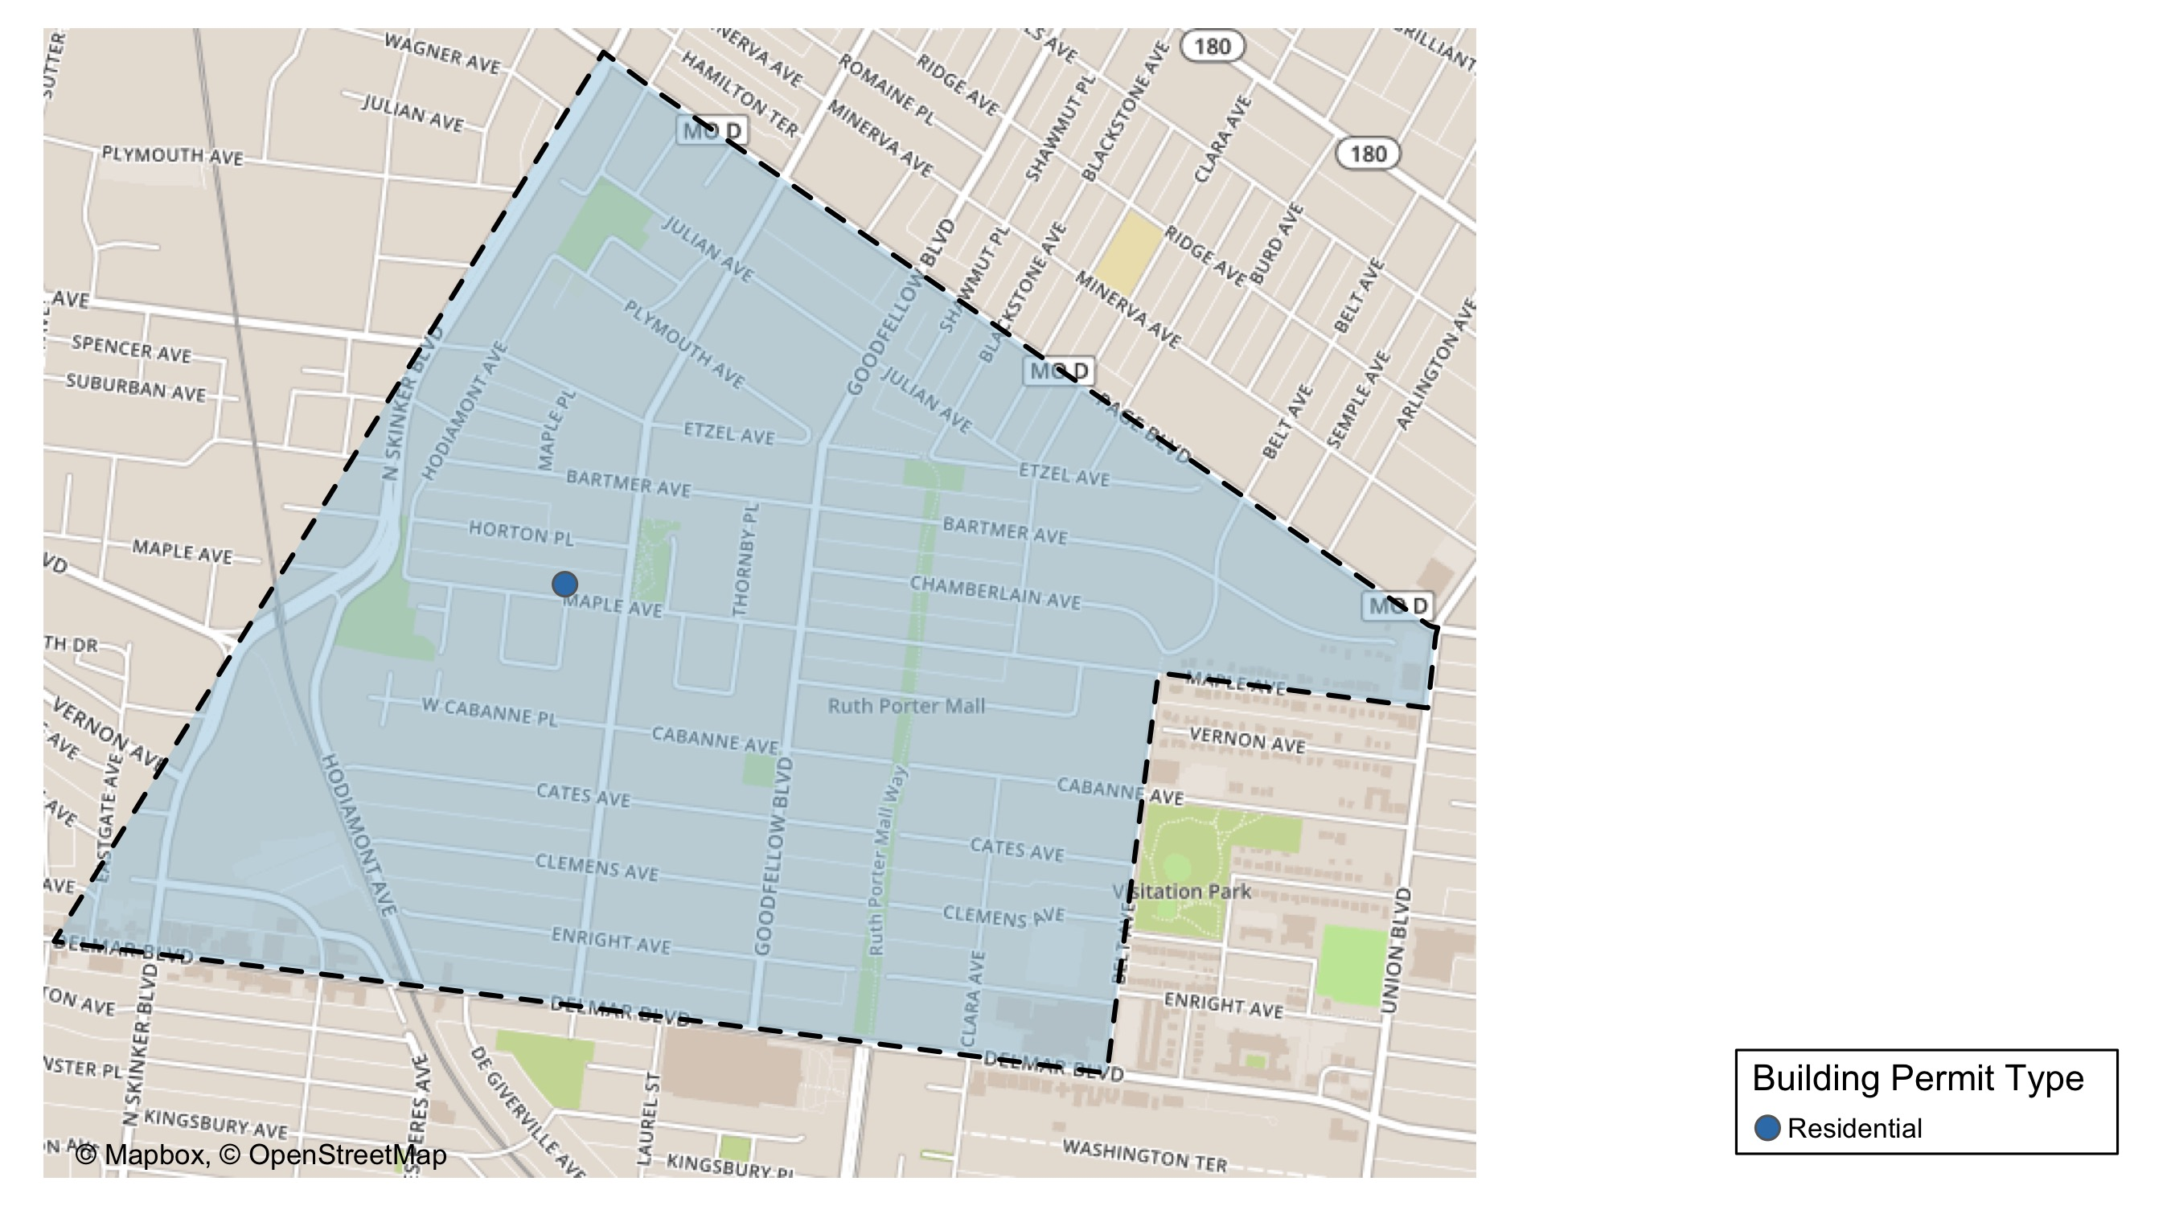
West End

Slide 26
West End
New Use | Average Cost | # of Permits
Residential | $5,423,125 | 2

Slide 27
West End Individual Permit Breakdown
Owner | New Use | Cost | Address
DELMAR DIVINE MASTER LANDLORD COMMER | Residential | $10,840,000 | 5535 DELMAR BLVD
MABS LLC | Residential | $6,250 | 5931 MAPLE AV

Slide 28
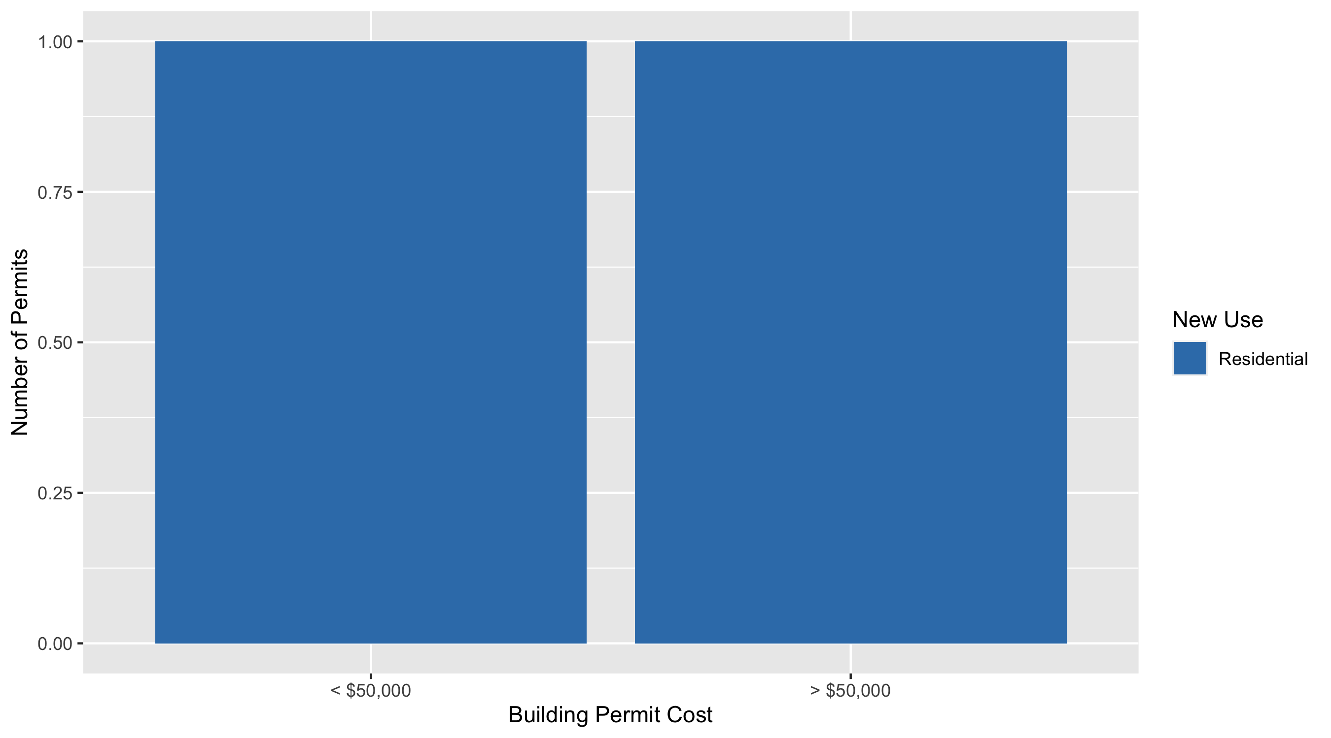
West End Permit Cost Breakdown

Slide 29
Visitation Park: Summary Notes
0 building permits in May 2020
0.00% change compared to May 2019 (0 total building permits)
$0: Average building permit cost in May 2020
0.00% change compared to May 2019 ($0)
1 total building permits in 2020
Infinite change compared to this time in 2019 (0 total building permits)
$14,000: Average building permit cost in 2020
Infinite change compared to this time in 2019 ($0)

Slide 30
Academy: Summary Notes
1 building permits in May 2020
Infinite change compared to May 2019 (0 total building permits)
$3,200: Average building permit cost in May 2020
Infinite change compared to May 2019 ($0)
14 total building permits in 2020
-12.50% change compared to this time in 2019 (16 total building permits)
$76,225: Average building permit cost in 2020
19.90% change compared to this time in 2019 ($63,575)

Slide 31
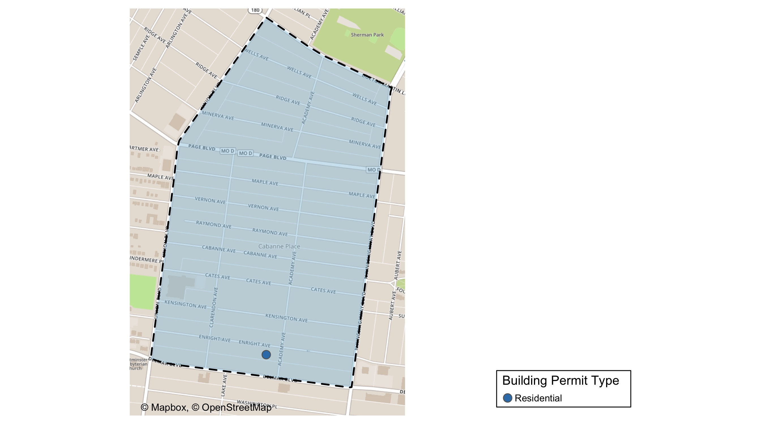
Academy

Slide 32
Academy
New Use | Average Cost | # of Permits
Residential | $3,200 | 1

Slide 33
Academy Individual Permit Breakdown
Owner | New Use | Cost | Address
MDE PROPERTIES LLC | Residential | $3,200 | 5166 ENRIGHT AV

Slide 34
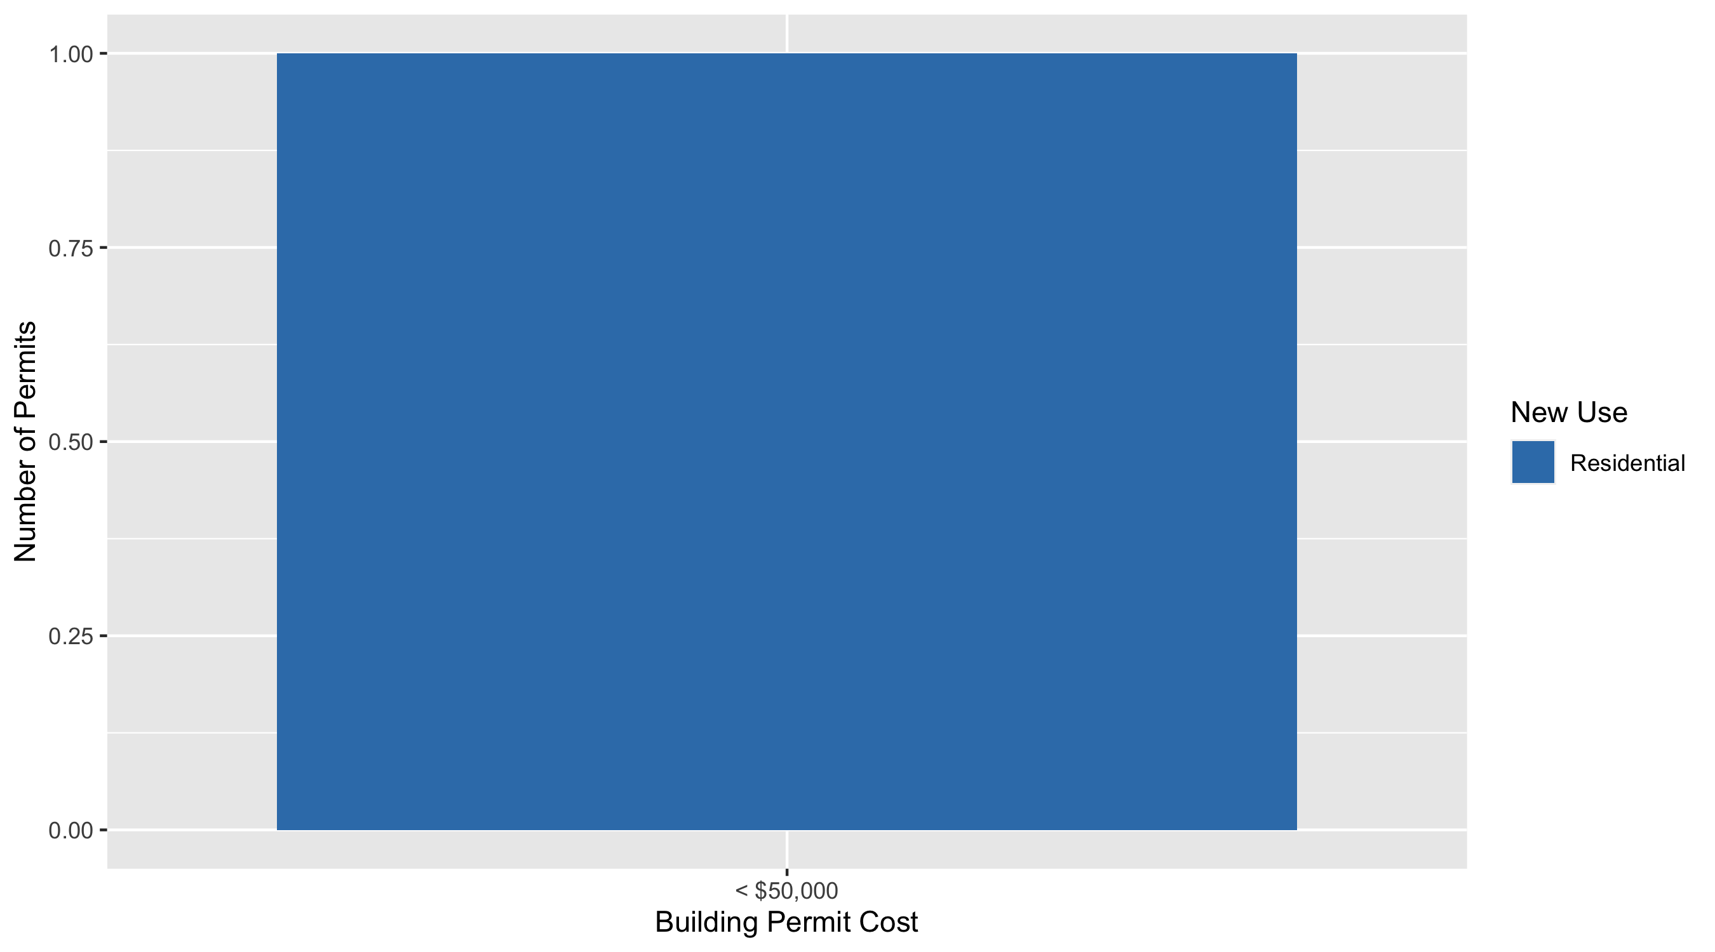
Academy Permit Cost Breakdown

Slide 35
Fountain Park: Summary Notes
1 building permits in May 2020
Infinite change compared to May 2019 (0 total building permits)
$10,500: Average building permit cost in May 2020
Infinite change compared to May 2019 ($0)
5 total building permits in 2020
150.00% change compared to this time in 2019 (2 total building permits)
$62,700: Average building permit cost in 2020
8260.00% change compared to this time in 2019 ($750)

Slide 36
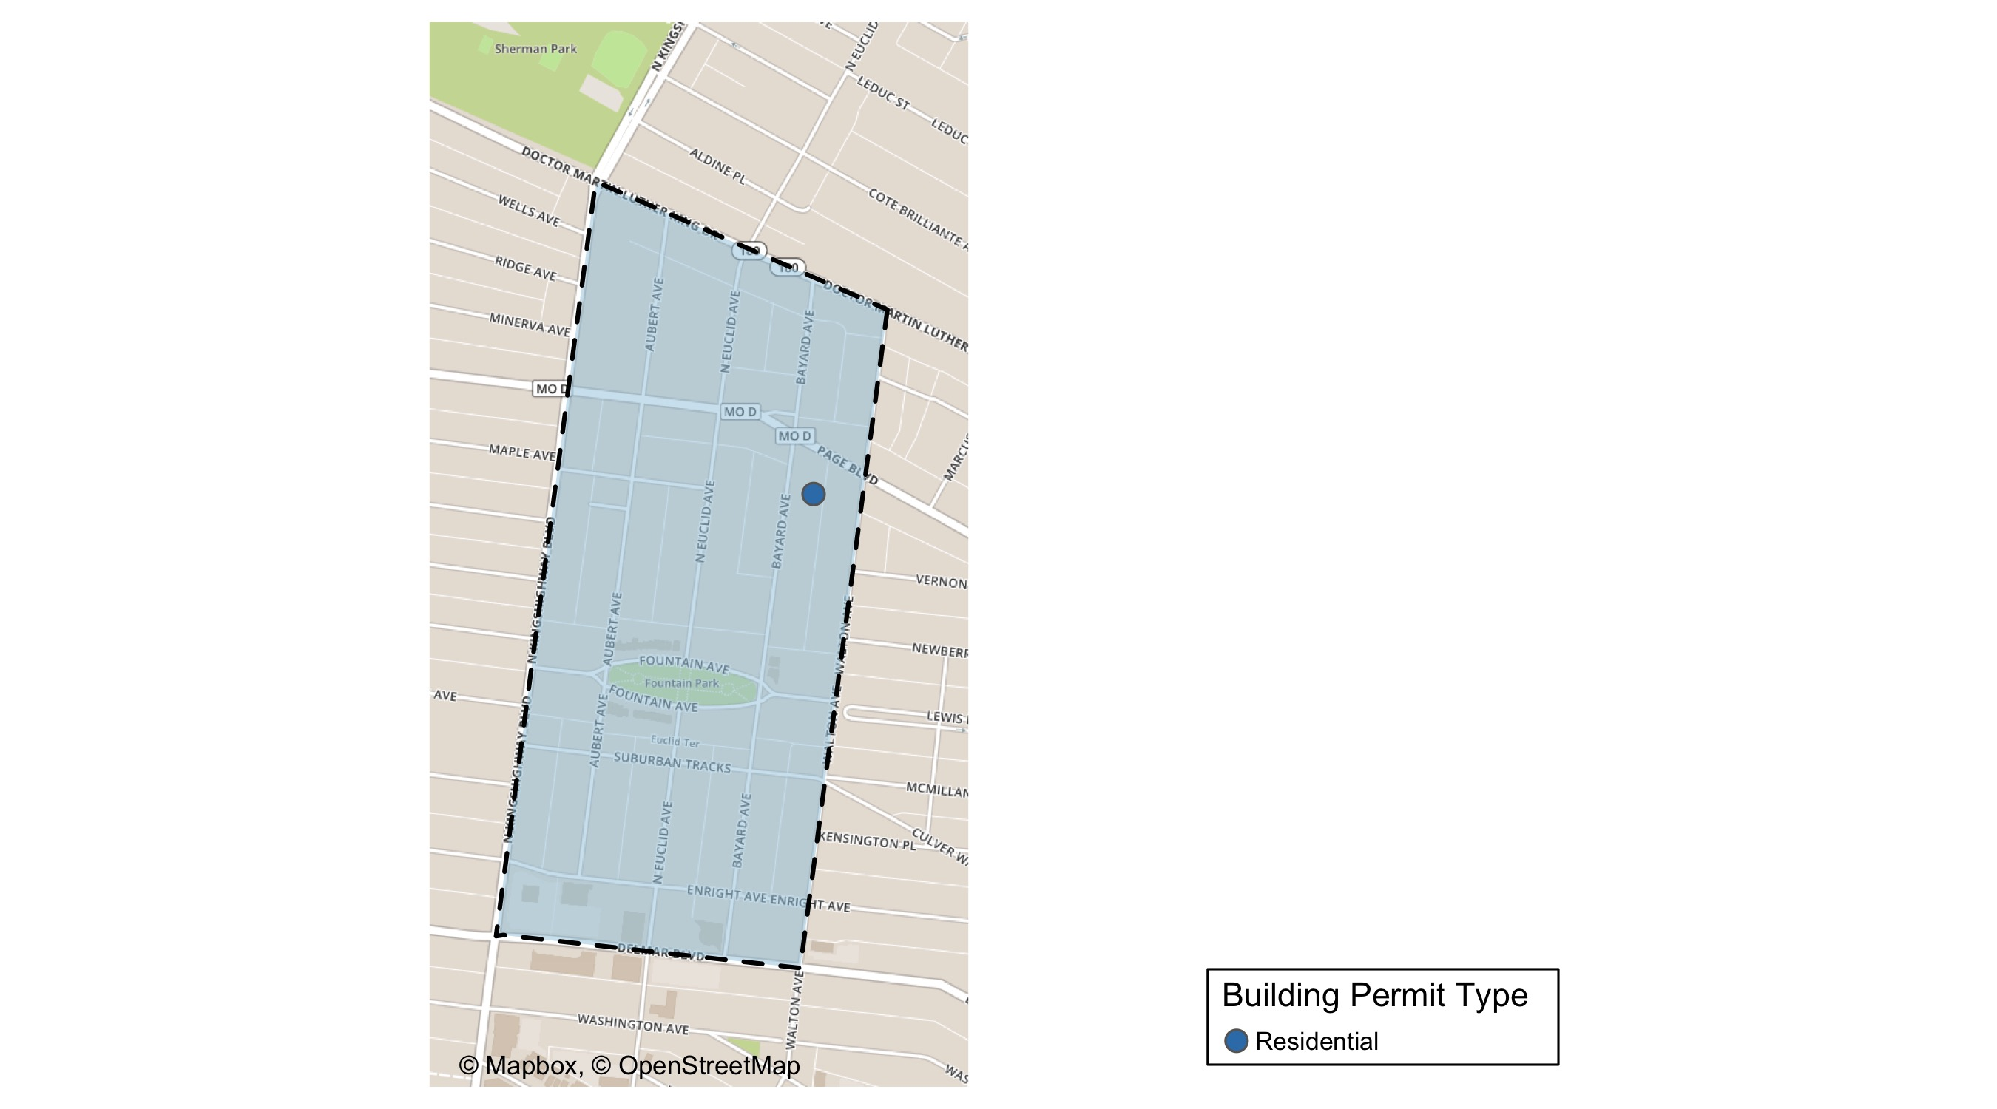
Fountain Park

Slide 37
Fountain Park
New Use | Average Cost | # of Permits
Residential | $10,500 | 1

Slide 38
Fountain Park Individual Permit Breakdown
Owner | New Use | Cost | Address
BOOKER, RICHARD JR & | Residential | $10,500 | 1234 BAYARD AV

Slide 39
Fountain Park Permit Cost Breakdown

Slide 40
Lewis Place: Summary Notes
0 building permits in May 2020
-100.00% change compared to May 2019 (1 total building permits)
$0: Average building permit cost in May 2020
-100.00% change compared to May 2019 ($15,000)
4 total building permits in 2020
-33.33% change compared to this time in 2019 (6 total building permits)
$800: Average building permit cost in 2020
-88.32% change compared to this time in 2019 ($6,850)

Slide 41
Vandeventer: Summary Notes
2 building permits in May 2020
-66.67% change compared to May 2019 (6 total building permits)
$1,350: Average building permit cost in May 2020
-92.77% change compared to May 2019 ($18,667)
6 total building permits in 2020
-64.71% change compared to this time in 2019 (17 total building permits)
$40,013: Average building permit cost in 2020
-77.56% change compared to this time in 2019 ($178,321)

Slide 42
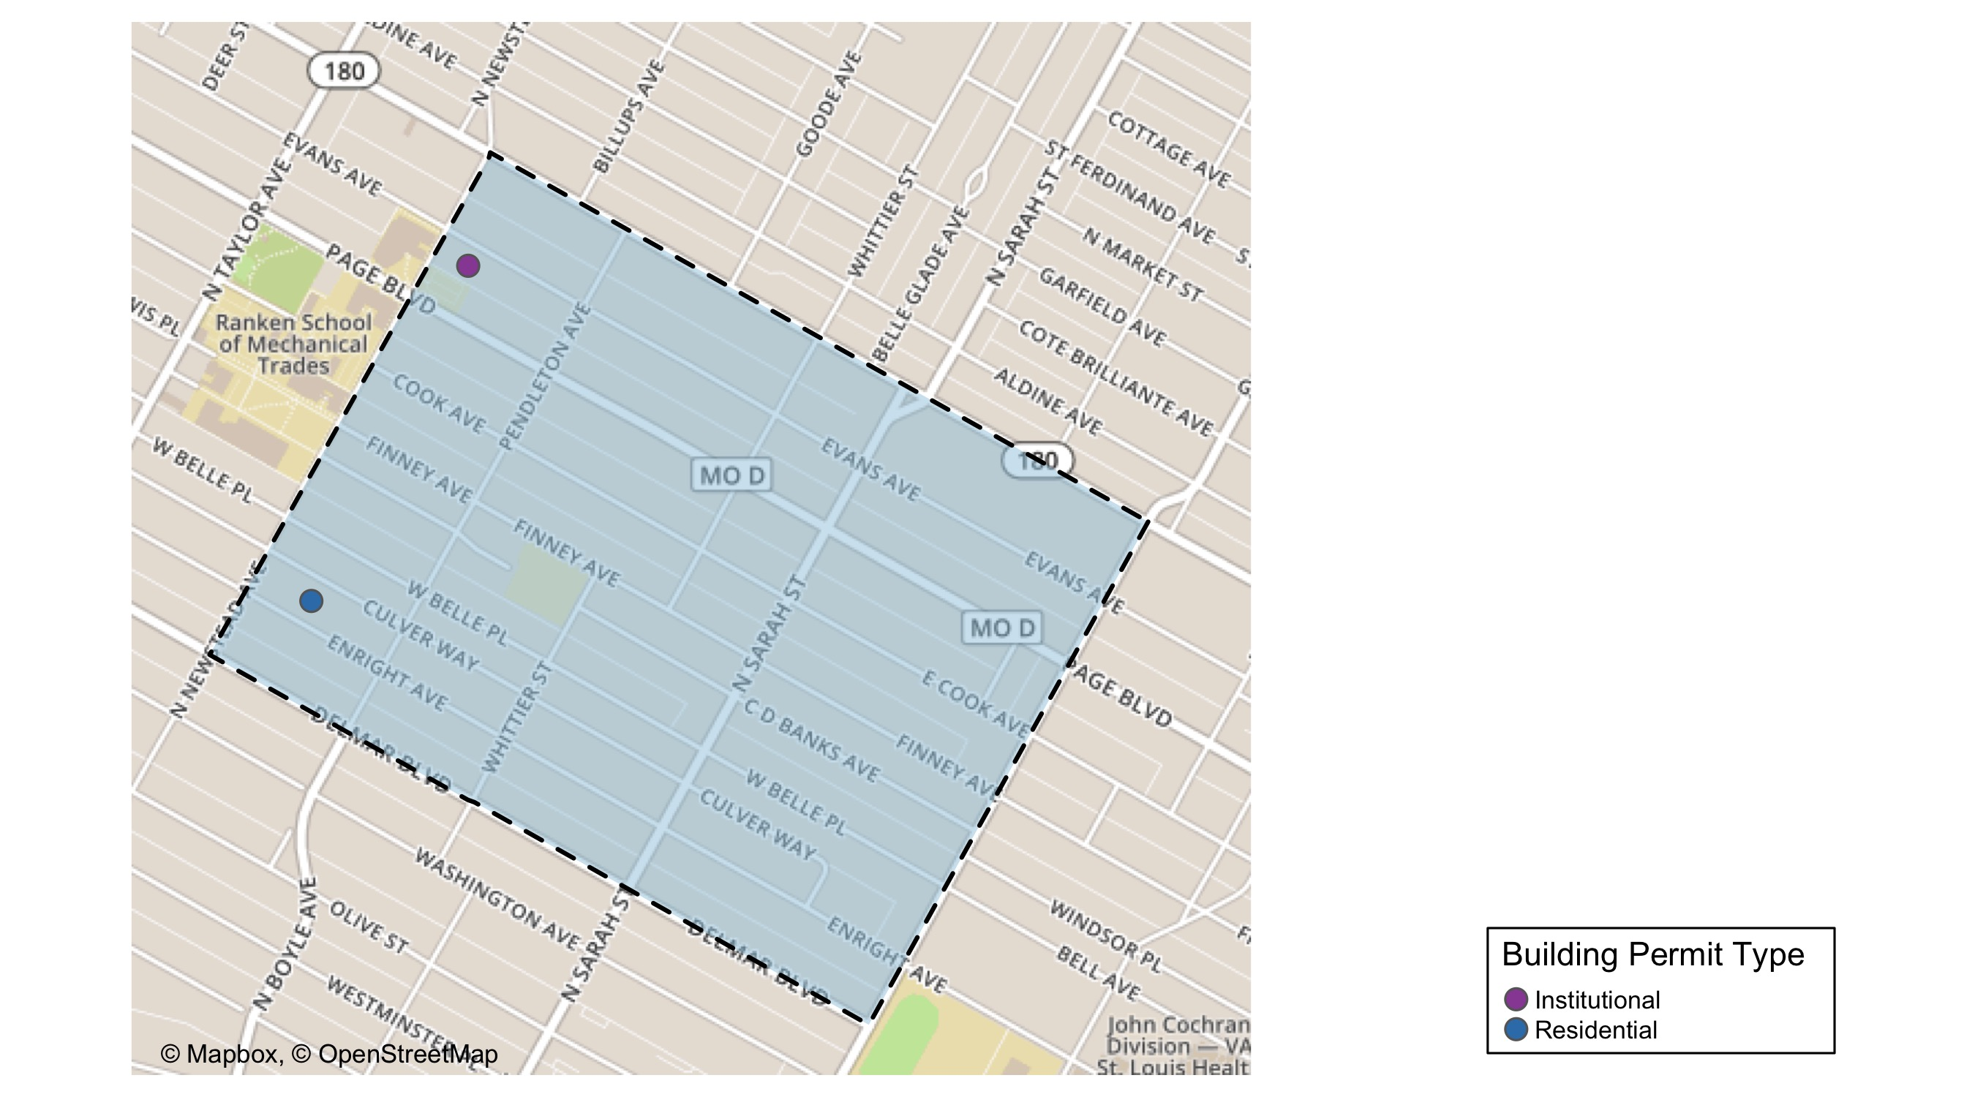
Vandeventer

Slide 43
Vandeventer
New Use | Average Cost | # of Permits
Institutional | $500 | 1
Residential | $2,200 | 1

Slide 44
Vandeventer Individual Permit Breakdown
Owner | New Use | Cost | Address
FLOWERS, DEAUN A | Residential | $2,200 | 915 PENDLETON AV
PATTERSON, SHARON E & NICHOLE | Institutional | $500 | 1318 N NEWSTEAD AV

Slide 45
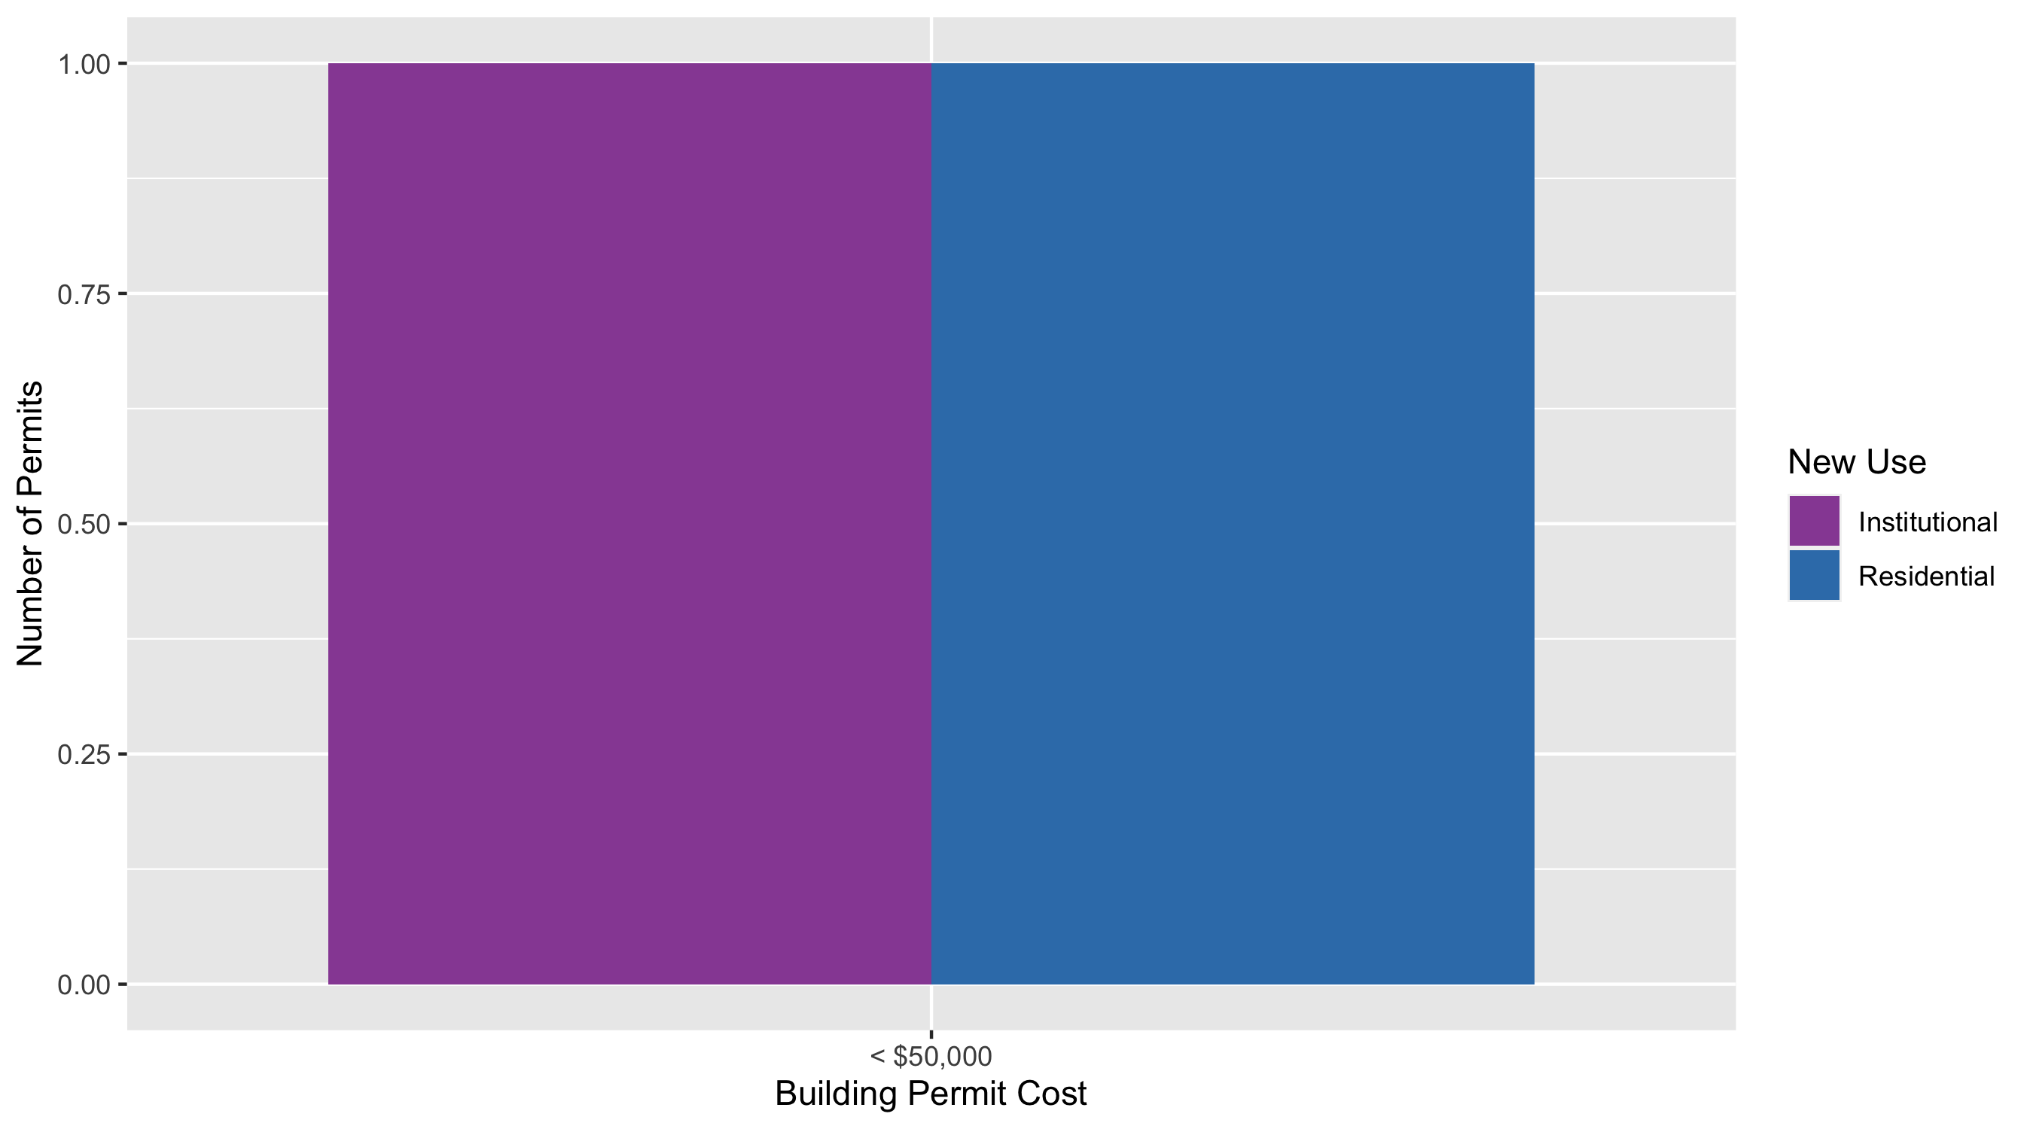
Vandeventer Permit Cost Breakdown

