Slide 1
St. Louis Central Corridor West Building Permits
January
2020

Slide 2
Introduction
Data retreived from https://www.stlouis-mo.gov/data/
Building permits with a cost of $0 were dropped
Building permits that were cancelled were dropped

Slide 3
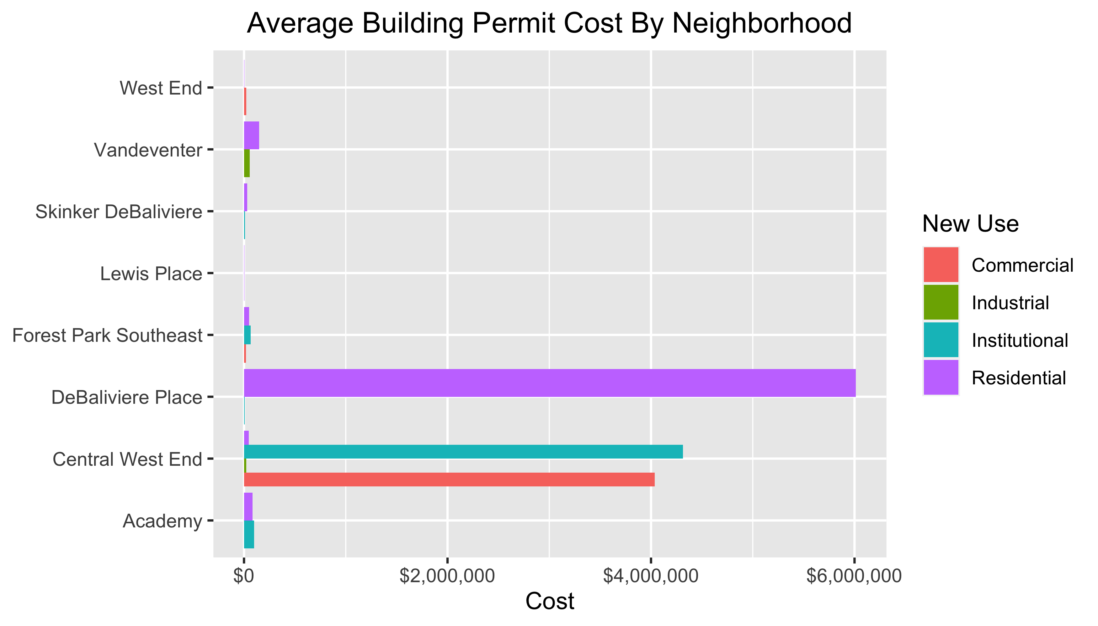
Neighborhood Summary

Slide 4
Neighborhood Summary
Neighborhood | Average Cost | # of Permits
Academy | $85,825 | 6
Central West End | $2,091,923 | 37
DeBaliviere Place | $4,512,000 | 4
Forest Park Southeast | $44,015 | 9
Lewis Place | $2,500 | 1
Skinker DeBaliviere | $27,571 | 7
Vandeventer | $102,500 | 2
West End | $8,000 | 10

Slide 5
Forest Park Southeast: Summary Notes
9 building permits in Forest Park Southeast in January 2020
-35.71% change compared to January 2019 (14 total building permits)
$44,015 : Average building permit cost in Forest Park Southeast in January 2020
-70.77% change compared to January 2019 ($150,583)

Slide 6
Forest Park Southeast: Summary Notes
9 total building permits in Forest Park Southeast in 2020
-35.71% change compared to this time in 2019 (14 total building permits)
$44,015 : Average building permit cost in Forest Park Southeast in 2020
-70.77% change compared to this time in 2019 ($150,583)

Slide 7
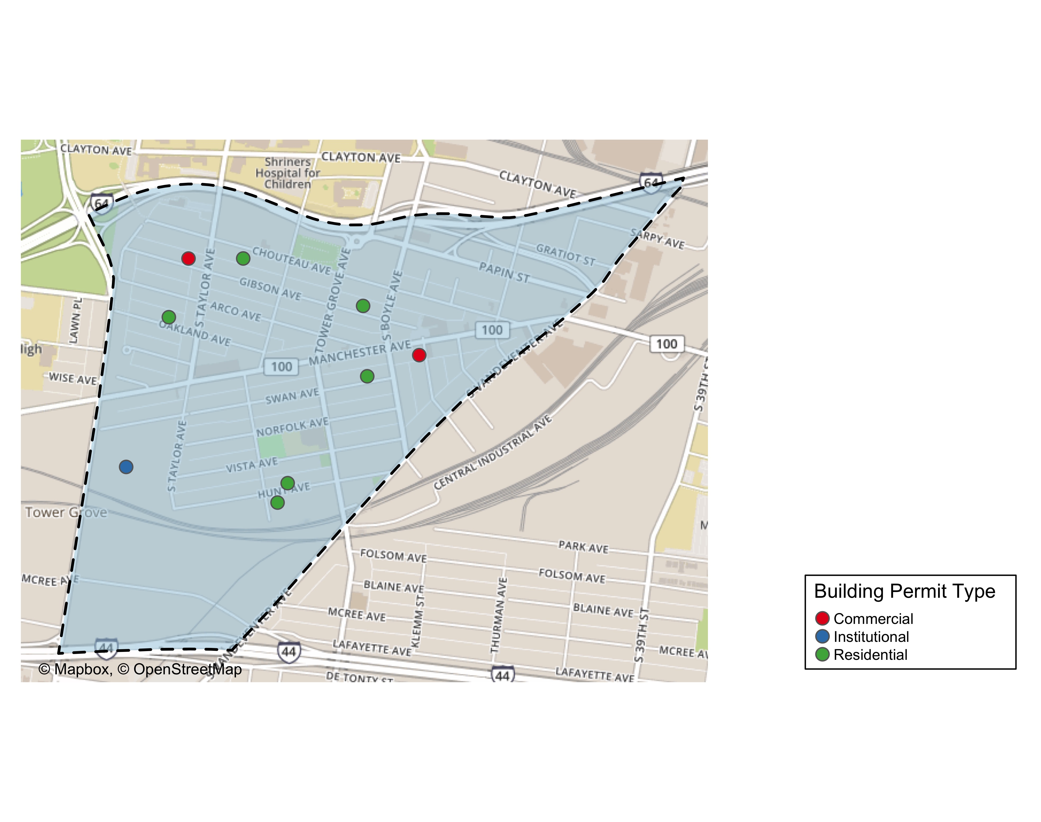
Forest Park Southeast

Slide 8
Forest Park Southeast

Slide 9
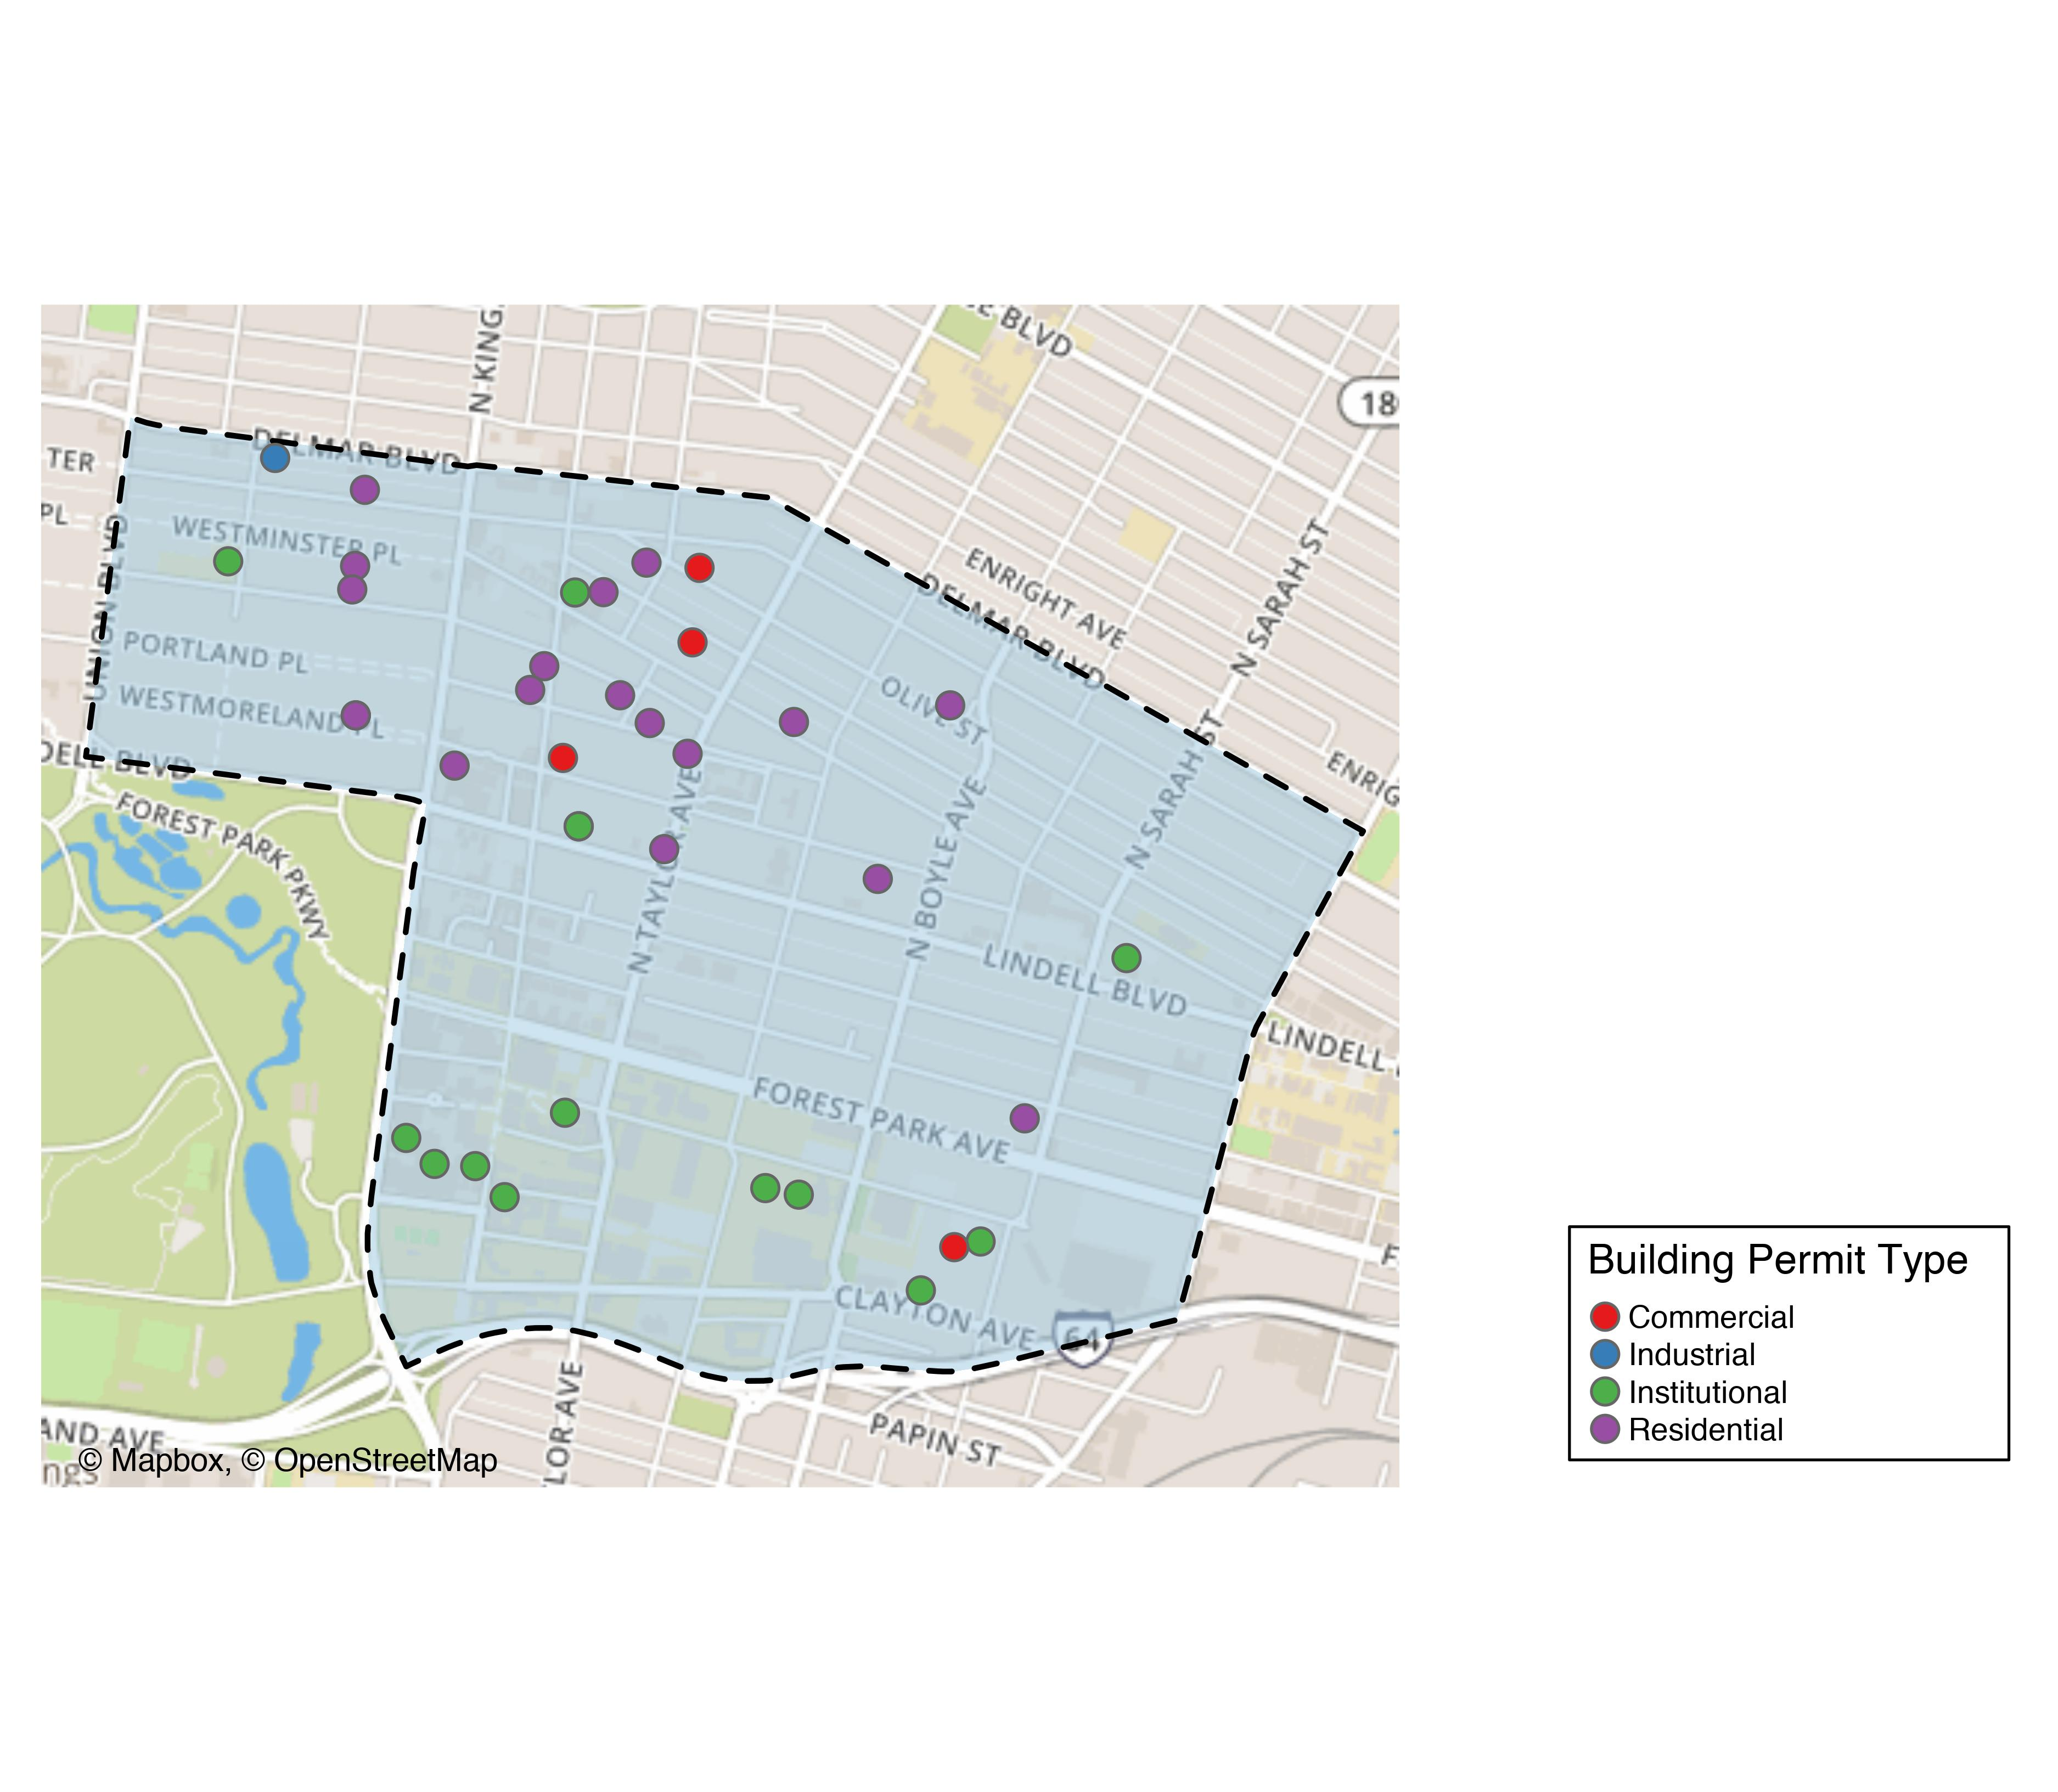
Central West End

Slide 12
Central West End

Slide 13
Forest Park Southeast

Slide 14
Forest Park Southeast

