Slide 1
St. Louis Central Corridor West Building Permits
January
2020

Slide 2
Introduction
Data retreived from https://www.stlouis-mo.gov/data/
Building permits with a cost of $0 were dropped
Building permits that were cancelled were dropped

Slide 3
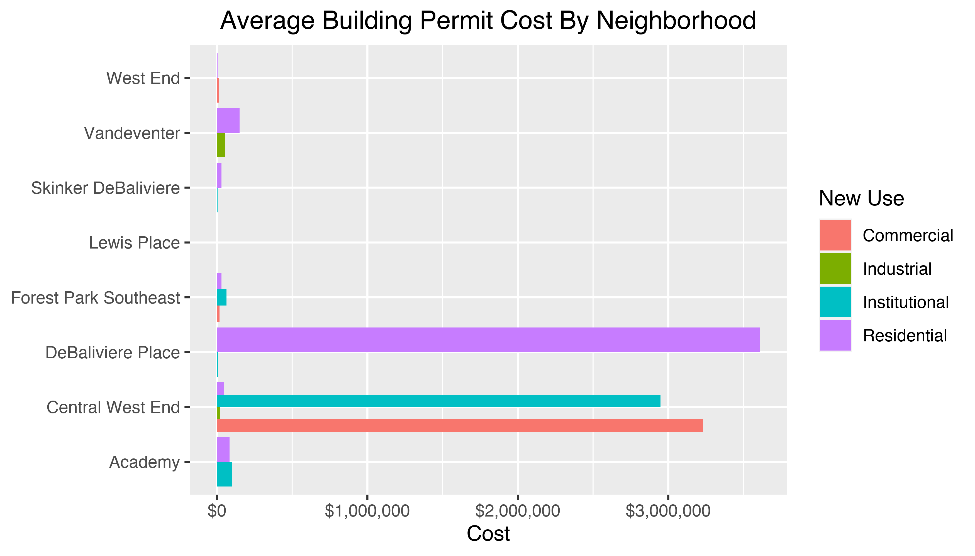
Neighborhood Summary

Slide 4
Neighborhood Summary
Neighborhood | Average Cost | # of Permits
Academy | $85,825 | 6
Central West End | $1,783,365 | 36
DeBaliviere Place | $4,512,000 | 4
Forest Park Southeast | $44,015 | 9
Lewis Place | $2,500 | 1
Skinker DeBaliviere | $27,571 | 7
Vandeventer | $102,500 | 2
West End | $8,000 | 10

Slide 5
Forest Park Southeast: Summary Notes
9 building permits in Forest Park Southeast in January 2020
Inf change compared to January 2019 (0 total building permits)
$44,015 : Average building permit cost in Forest Park Southeast in January 2020
NaN change compared to January 2019 (NaN)

Slide 6
Forest Park Southeast: Summary Notes
9 total building permits in Forest Park Southeast in 2020
Inf change compared to this time in 2019 (0 total building permits)
$44,015 : Average building permit cost in Forest Park Southeast in 2020
NaN change compared to this time in 2019 (NaN)

Slide 7
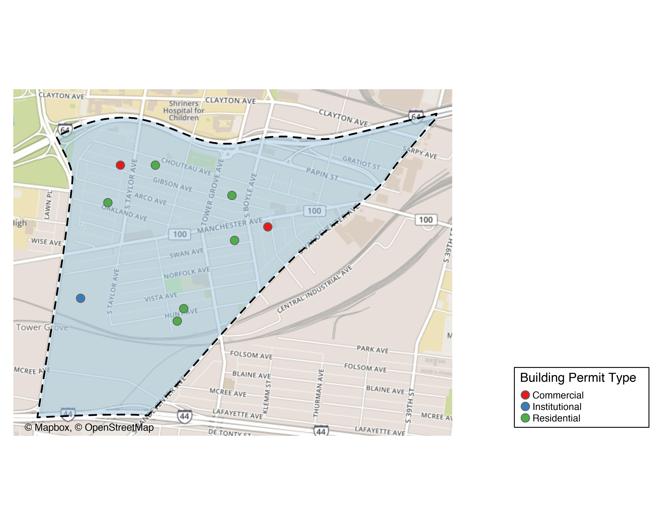
Forest Park Southeast

Slide 8
Forest Park Southeast
New Use | Average Cost | # of Permits
Commercial | $17,500 | 2
Institutional | $64,145 | 1
Residential | $49,498 | 6

Slide 9
Forest Park Southeast Individual Permit Breakdown
Owner | New Use | Cost | address
MITCHELL, TIMOTHY J | Residential | $3,000 | 4535 OAKLAND AV
ROBBINS, ARNOLD J & TERRIE L | Residential | $250,000 | 4353 HUNT AV
ALBIN, MICHAEL & LISA | Residential | $3,990 | 4227 SWAN AV
TISOTO, JEFFREY & LYNNE | Commercial | $15,000 | 4523 GIBSON AV
WASHINGTON UNIVERSITY | Institutional | $64,145 | 1234 S KINGSHIGHWAY BLVD
VITT, VICTOR J JR | Residential | $9,000 | 4366 HUNT AV
4176 MANCHESTER LLC | Commercial | $20,000 | 4176 MANCHESTER AV
KAMPE, NICHOLAS R | Residential | $30,000 | 4448 CHOUTEAU AV
JOHNSON, ISAIAH & CALLIE | Residential | $1,000 | 4327 GIBSON AV

Slide 10
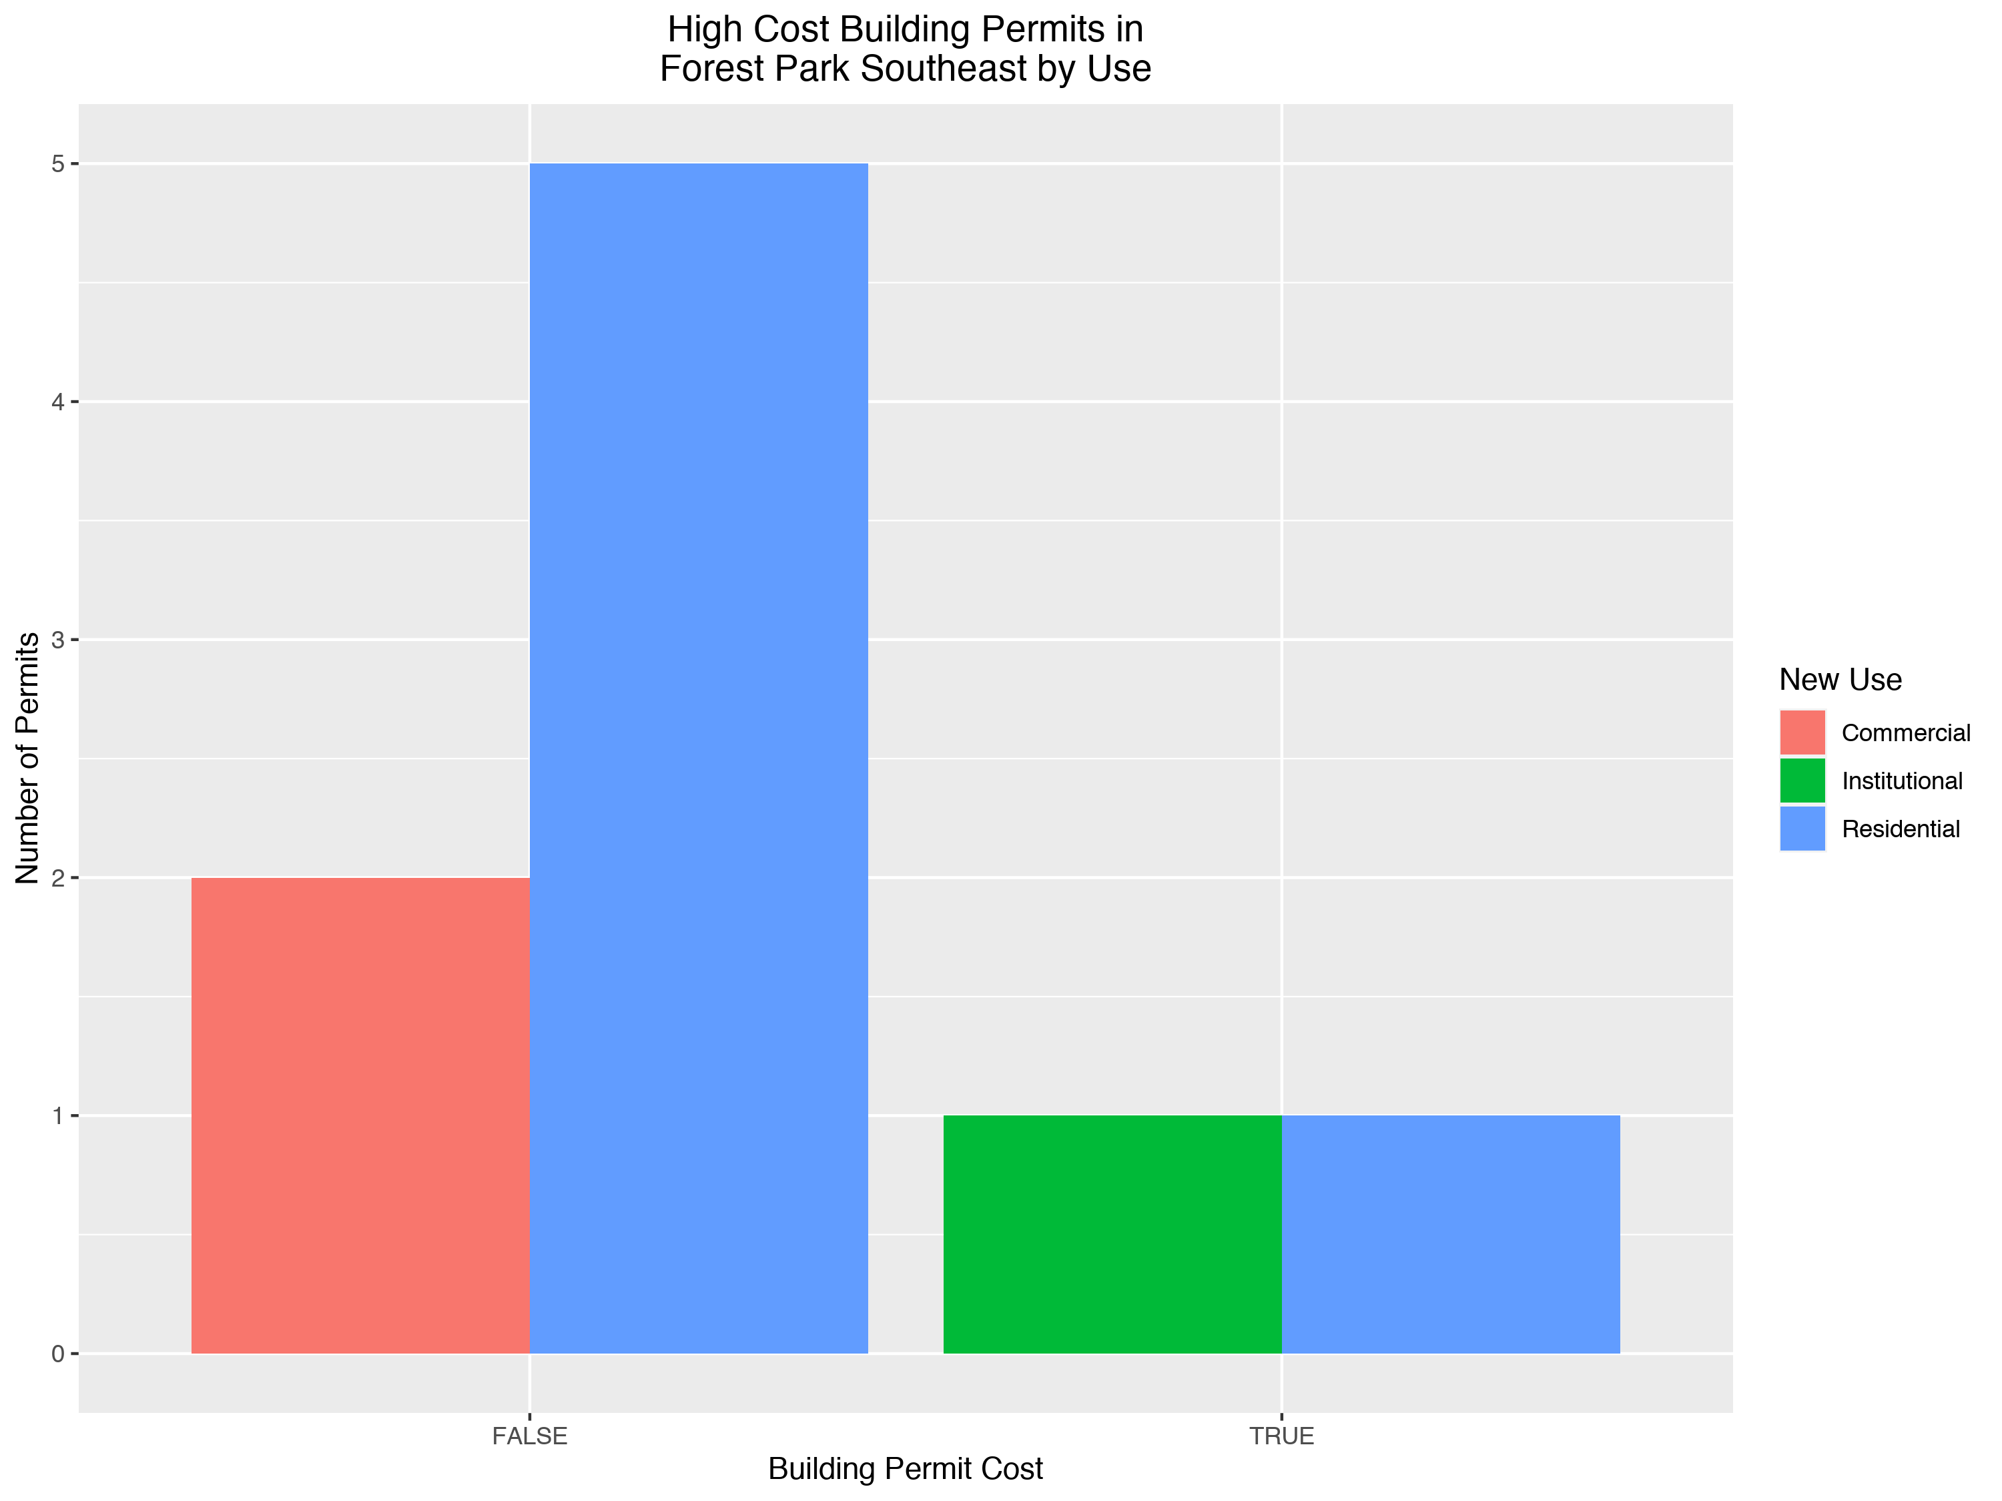

Slide 11
Central West End: Summary Notes
36 building permits in Central West End in January 2020
Inf change compared to January 2019 (0 total building permits)
$1,783,365 : Average building permit cost in Central West End in January 2020
NaN change compared to January 2019 (NaN)

Slide 12
Central West End: Summary Notes
36 total building permits in Central West End in 2020
Inf change compared to this time in 2019 (0 total building permits)
$1,783,365 : Average building permit cost in Central West End in 2020
NaN change compared to this time in 2019 (NaN)

Slide 13
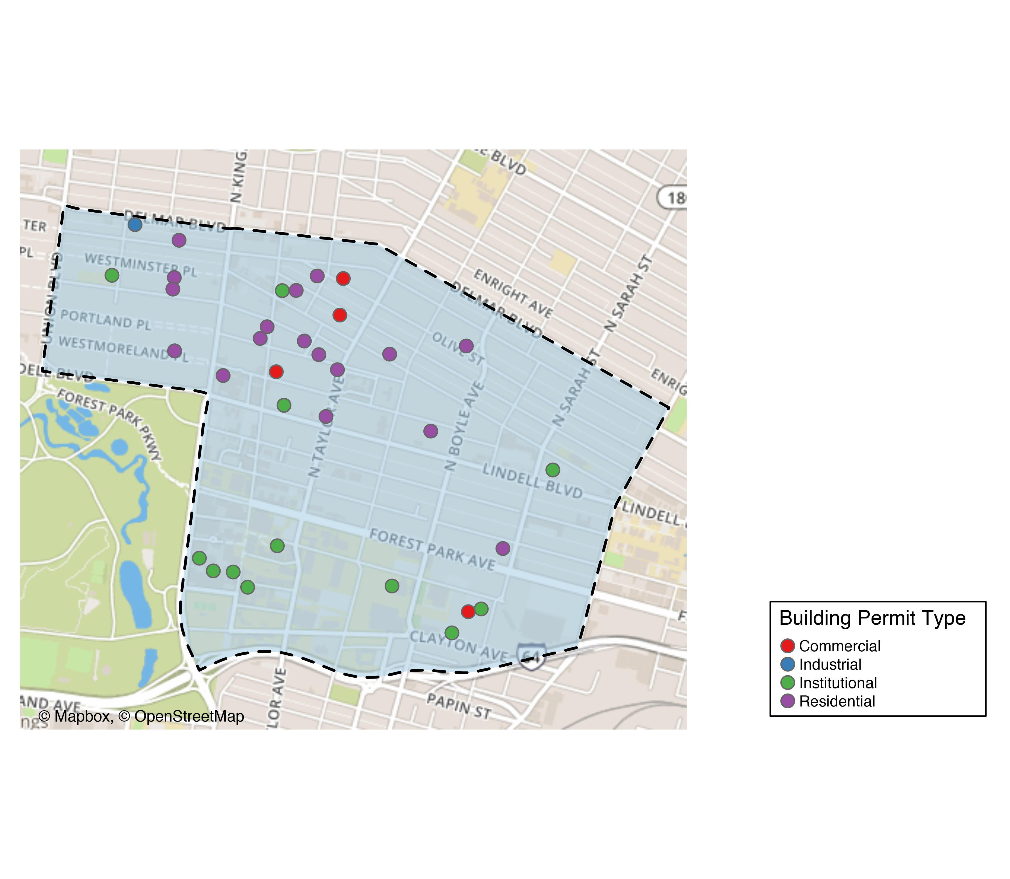
Central West End

Slide 14
Central West End
New Use | Average Cost | # of Permits
Commercial | $4,037,500 | 4
Industrial | $21,676 | 1
Institutional | $3,629,497 | 13
Residential | $47,000 | 18

Slide 15
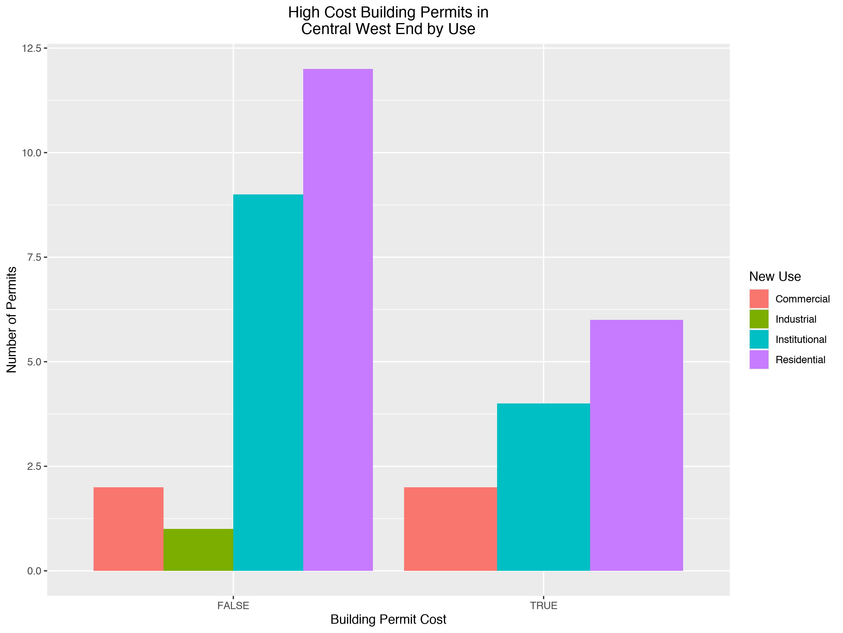

Slide 16
DeBaliviere Place: Summary Notes
4 building permits in DeBaliviere Place in January 2020
Inf change compared to January 2019 (0 total building permits)
$4,512,000 : Average building permit cost in DeBaliviere Place in January 2020
NaN change compared to January 2019 (NaN)

Slide 17
DeBaliviere Place: Summary Notes
4 total building permits in DeBaliviere Place in 2020
Inf change compared to this time in 2019 (0 total building permits)
$4,512,000 : Average building permit cost in DeBaliviere Place in 2020
NaN change compared to this time in 2019 (NaN)

Slide 18
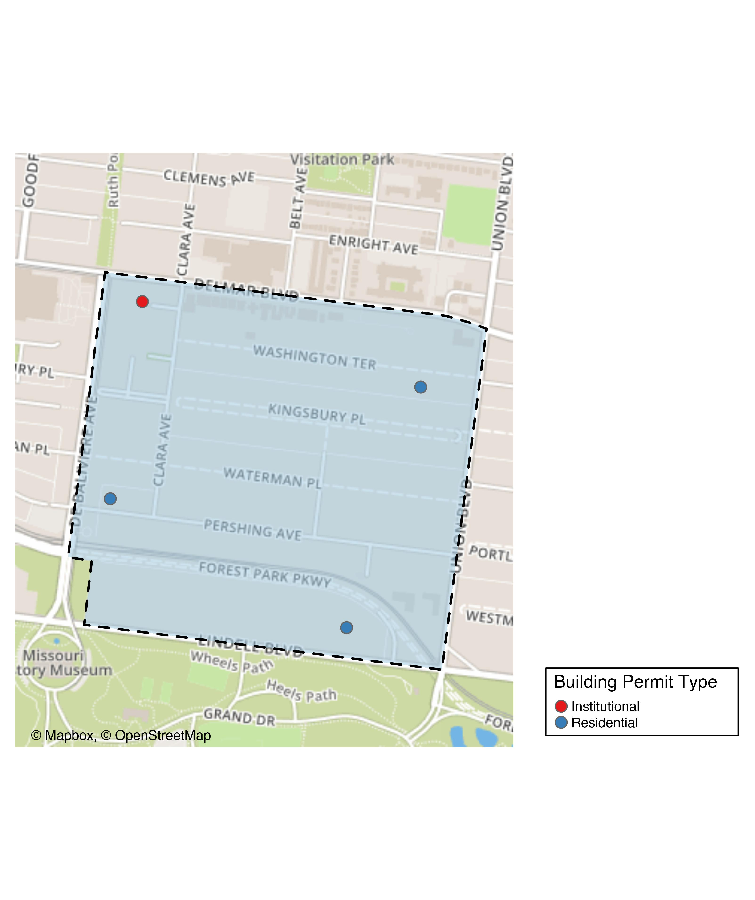
DeBaliviere Place

Slide 19
DeBaliviere Place
New Use | Average Cost | # of Permits
Institutional | $8,000 | 1
Residential | $6,013,333 | 3

Slide 20
DeBaliviere Place Individual Permit Breakdown
Owner | New Use | Cost | Address
DEL MONTE APARTMENTS LLC | Institutional | $8,000 | 5622 DELMAR BLVD
CALHOUN, BARRY & SHIRA SPETNER | Residential | $5,000 | 10 WASHINGTON TER
REDIGER, DOUGLAS HTRS | Residential | $35,000 | 5373 LINDELL BLVD
KILAMANJARO V LLC | Residential | $18,000,000 | 5637 PERSHING AV

Slide 21
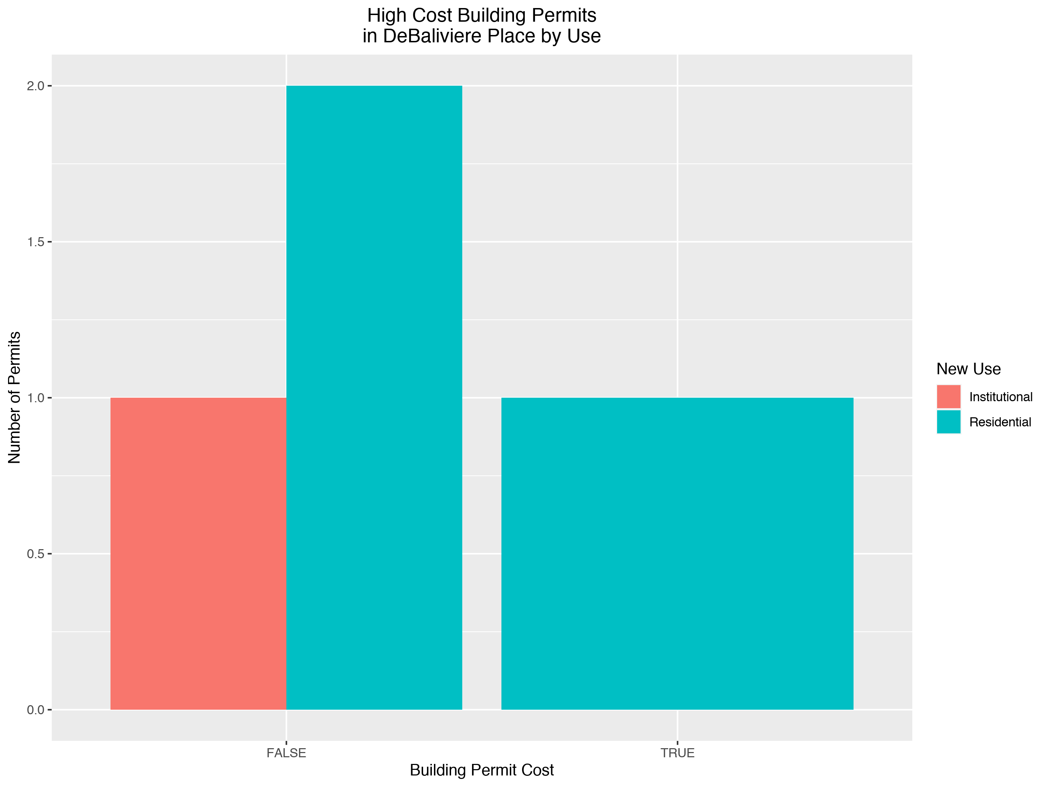

Slide 22
Skinker DeBaliviere: Summary Notes
7 building permits in Skinker DeBaliviere in January 2020
Inf change compared to January 2019 (0 total building permits)
$27,571 : Average building permit cost in Skinker DeBaliviere in January 2020
NaN change compared to January 2019 (NaN)

Slide 23
Skinker DeBaliviere: Summary Notes
7 total building permits in Skinker DeBaliviere in 2020
Inf change compared to this time in 2019 (0 total building permits)
$27,571 : Average building permit cost in Skinker DeBaliviere in 2020
NaN change compared to this time in 2019 (NaN)

Slide 24
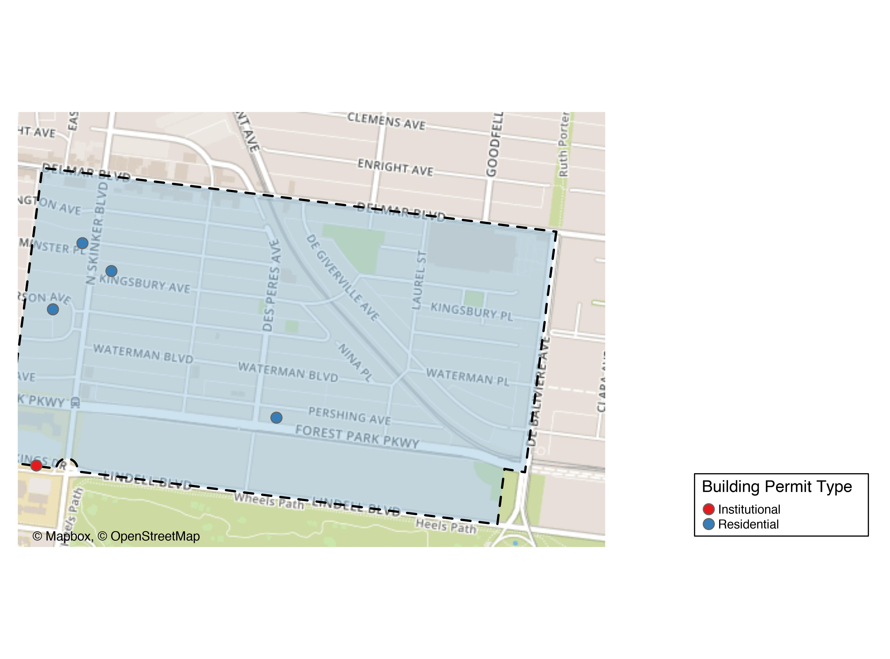
Skinker DeBaliviere

Slide 25
Skinker DeBaliviere
New Use | Average Cost | # of Permits
Institutional | $10,000 | 1
Residential | $30,500 | 6

Slide 26
Skinker DeBaliviere Individual Permit Breakdown
Owner | New Use | Cost | Address
WASHINGTON UNIVERSITY ART BUILDING | Institutional | $10,000 | 6220 FOREST PARK PARKWAY
DEE, MICHAEL PATRICK & | Residential | $76,500 | 6232 MCPHERSON AV
HOFFMAN, CHERI L | Residential | $27,000 | 6211 WESTMINSTER PL
WELCH, MARGARET & MARY LOU | Residential | $17,500 | 6189 KINGSBURY AV
ONE WORLD - USA, LLC | Residential | $33,000 | 5948 PERSHING AV
ONE WORLD - USA, LLC | Residential | $14,000 | 5948 PERSHING AV
DEE, MICHAEL PATRICK & | Residential | $15,000 | 6232 MCPHERSON AV

Slide 27
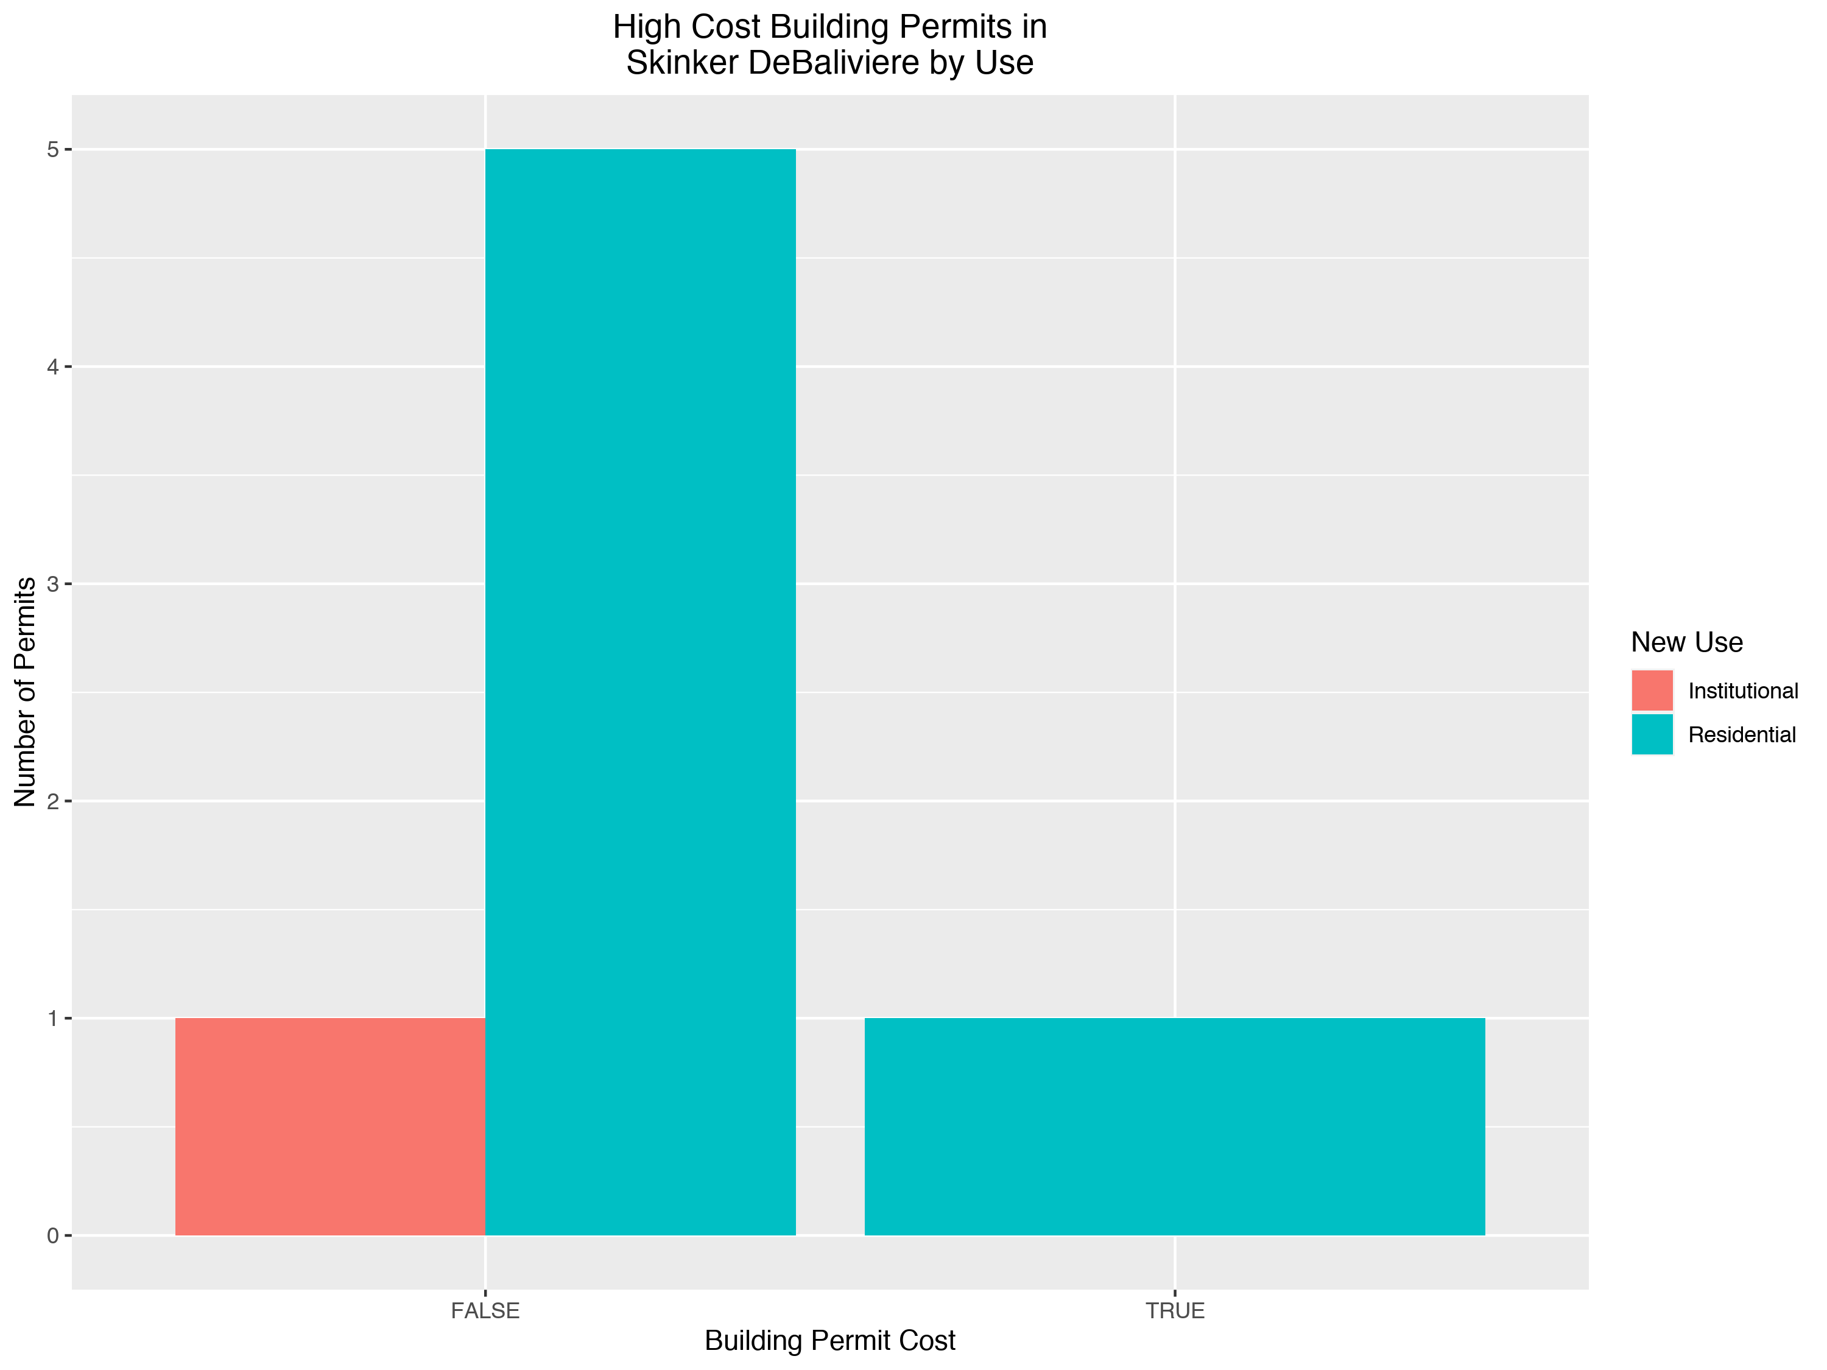

Slide 28
West End: Summary Notes
10 building permits in West End in January 2020
Inf change compared to January 2019 (0 total building permits)
$8,000 : Average building permit cost in West End in January 2020
NaN change compared to January 2019 (NaN)

Slide 29
West End: Summary Notes
10 total building permits in West End in 2020
Inf change compared to this time in 2019 (0 total building permits)
$8,000 : Average building permit cost in West End in 2020
NaN change compared to this time in 2019 (NaN)

Slide 30
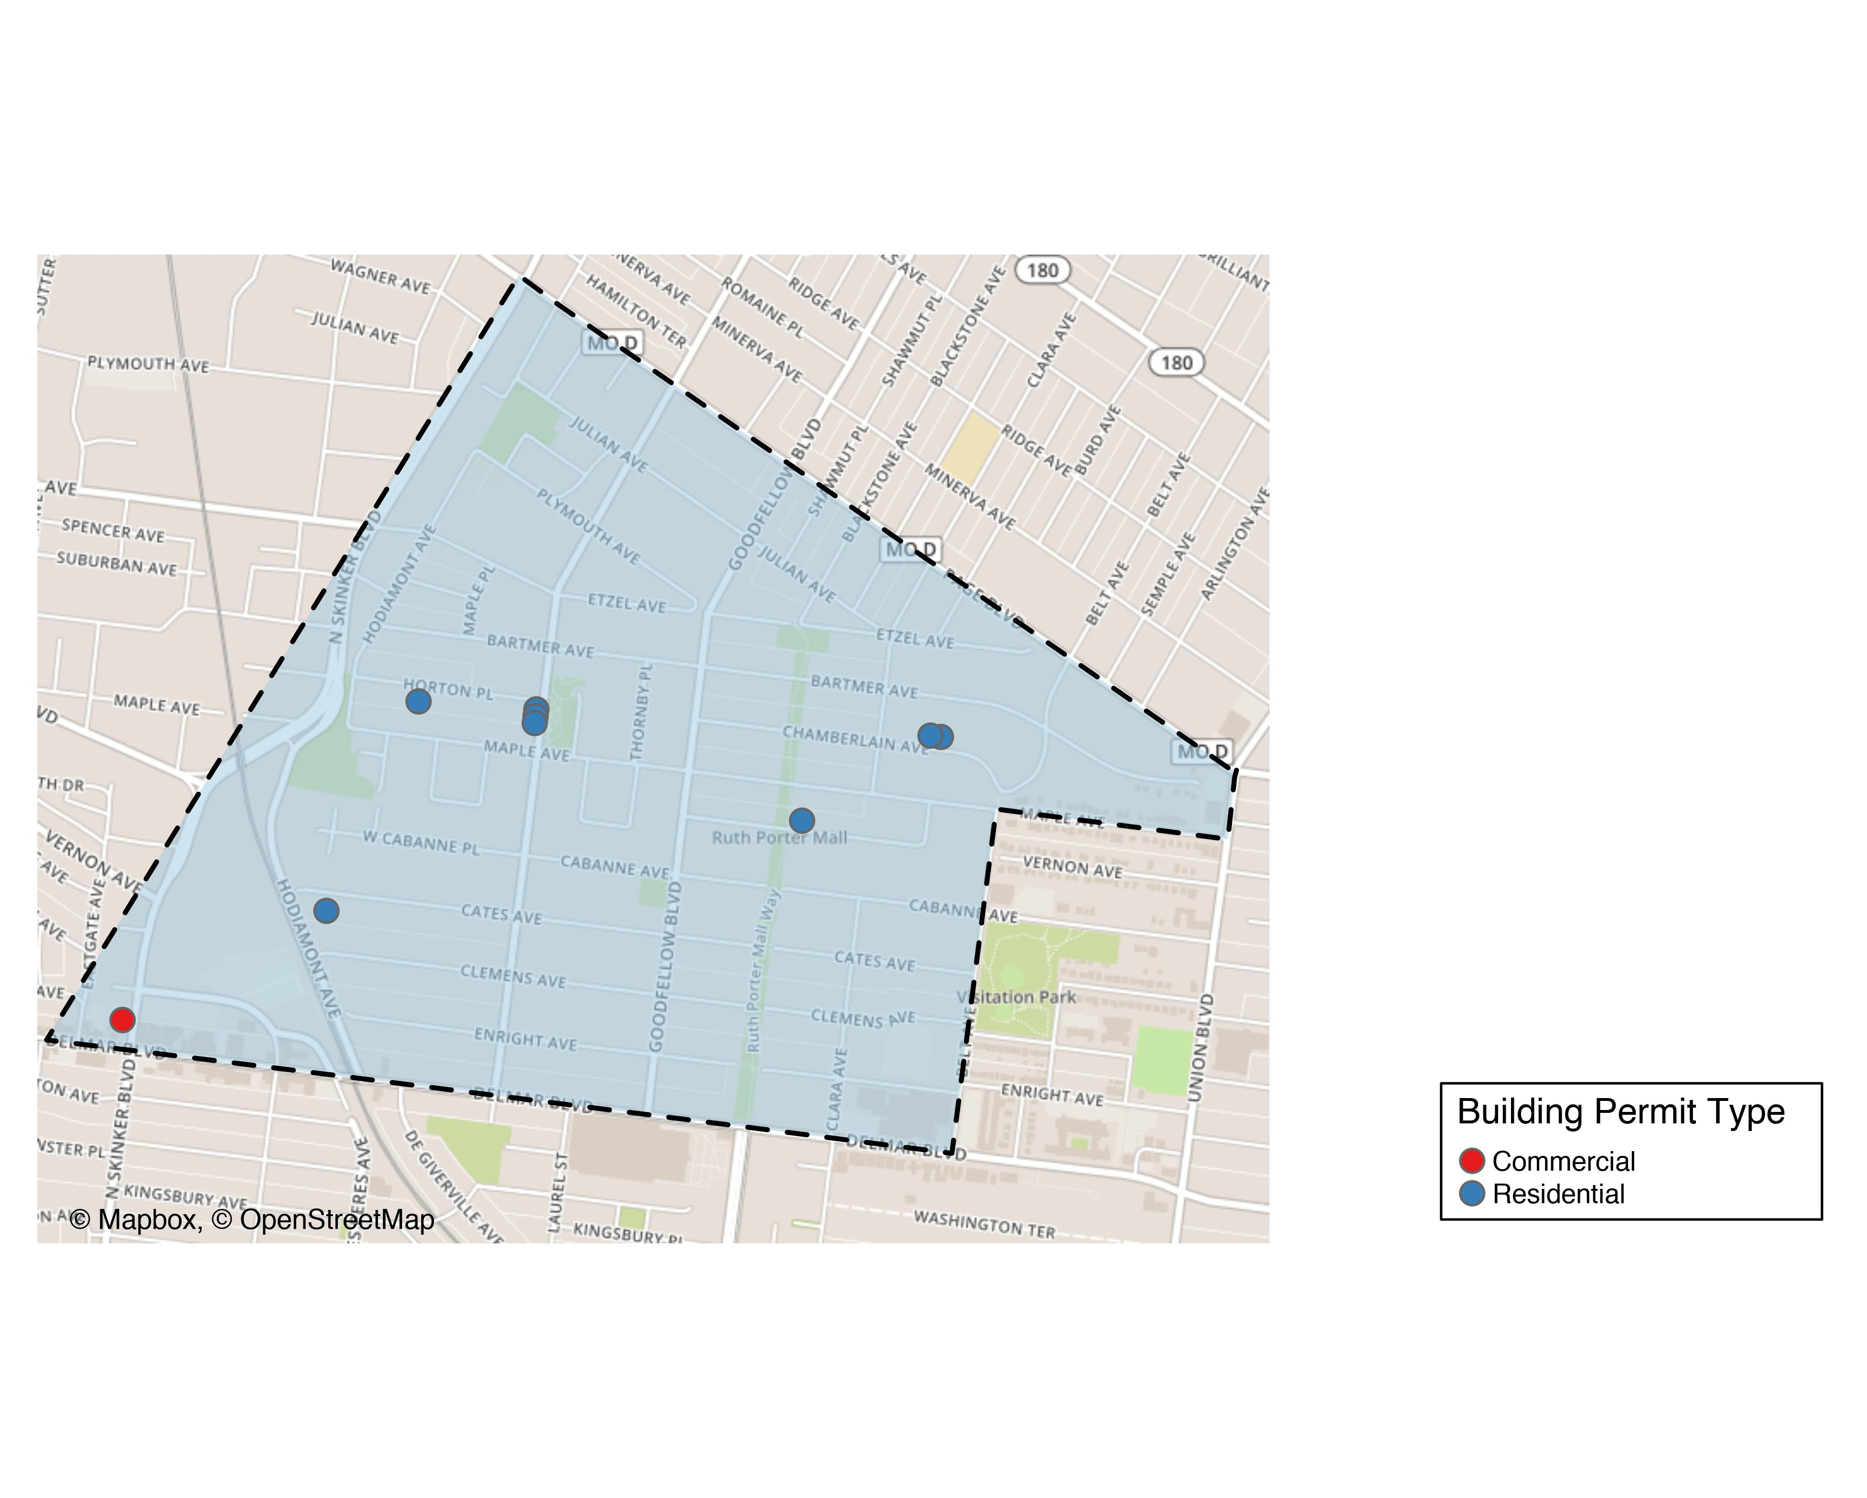
West End

Slide 31
West End
New Use | Average Cost | # of Permits
Commercial | $21,000 | 2
Residential | $4,750 | 8

Slide 32
West End Individual Permit Breakdown
Owner | New Use | Cost | Address
KEY MASTERS LLC | Residential | $2,000 | 5647 VERNON AV
THREE DOORS PROPERTIES LLC | Residential | $30,000 | 6018 HORTON PL
WESTEND CATES LLC | Residential | $1,000 | 6062 CATES AV
WESTEND CHAMBERLAIN LLC | Residential | $1,000 | 5561-5565 CHAMBERLAIN AV
WESTEND CHAMBERLAIN LLC | Residential | $1,000 | 5569-5571 CHAMBERLAIN AV
WESTEND HAMILTON LLC | Residential | $1,000 | 5902-5906 HORTON PL
WESTEND HAMILTON LLC | Residential | $1,000 | 1019-1021 HAMILTON AV
WESTEND HAMILTON LLC | Residential | $1,000 | 1023-1025 HAMILTON AV
PACE-DELMAR ASSOCIATES LLC | Commercial | $32,000 | 6211 DELMAR BLVD
PACE-DELMAR ASSOCIATES LLC | Commercial | $10,000 | 621 N SKINKER BLVD

Slide 33
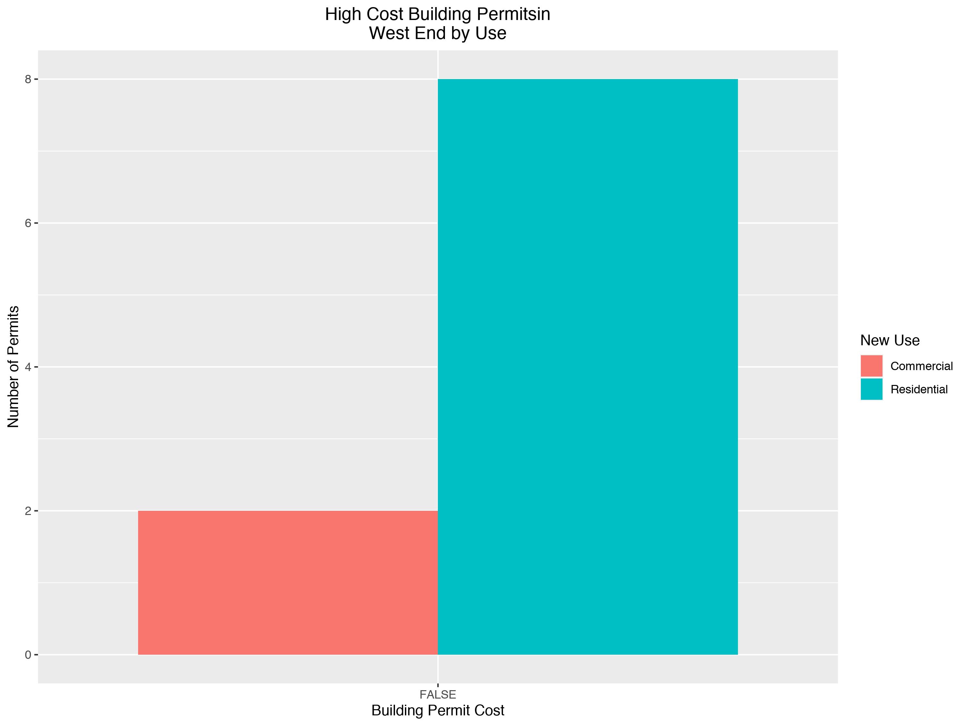

Slide 34
Visitation Park: Summary Notes
0 building permits in Visitation Park in January 2020
NaN change compared to January 2019 (0 total building permits)
NaN : Average building permit cost in Visitation Park in January 2020
NaN change compared to January 2019 (NaN)

Slide 35
Visitation Park: Summary Notes
0 total building permits in Visitation Park in 2020
NaN change compared to this time in 2019 (0 total building permits)
NaN : Average building permit cost in Visitation Park in 2020
NaN change compared to this time in 2019 (NaN)

Slide 36
Academy: Summary Notes
6 building permits in Academy in January 2020
Inf change compared to January 2019 (0 total building permits)
$85,825 : Average building permit cost in Academy in January 2020
NaN change compared to January 2019 (NaN)

Slide 37
Academy: Summary Notes
6 total building permits in Academy in 2020
Inf change compared to this time in 2019 (0 total building permits)
$85,825 : Average building permit cost in Academy in 2020
NaN change compared to this time in 2019 (NaN)

Slide 38
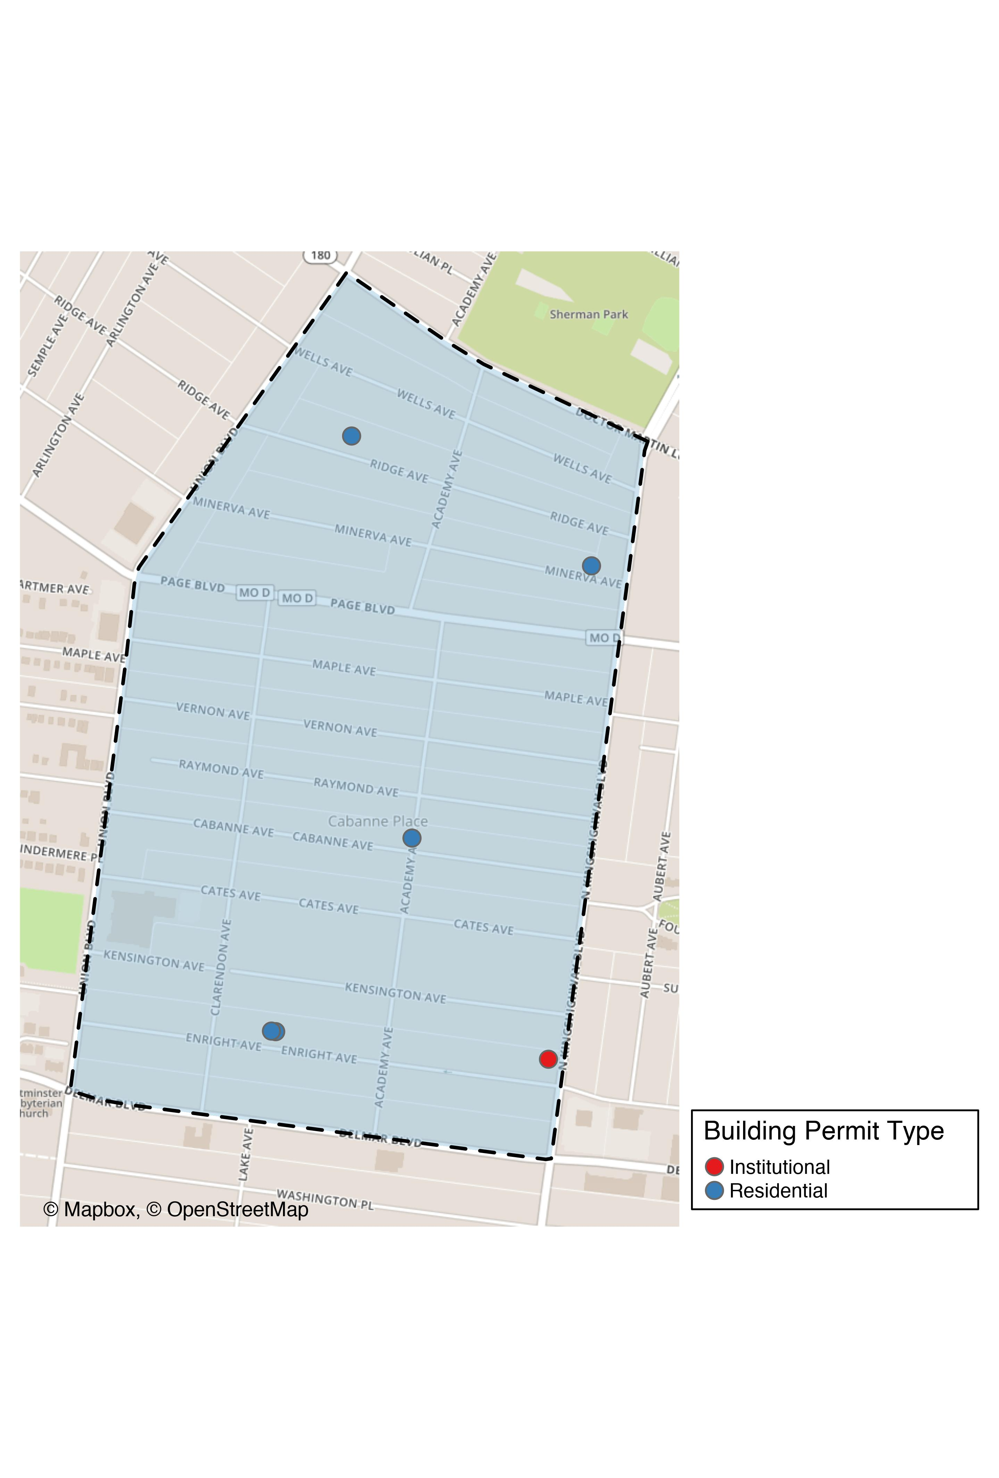
Academy

Slide 39
Academy
New Use | Average Cost | # of Permits
Institutional | $100,000 | 1
Residential | $82,990 | 5

Slide 40
Academy Individual Permit Breakdown
Owner | New Use | Cost | Address
MCCLENDON, GARY & GENA | Residential | $1,500 | 5021 MINERVA AV
GREEN LINE LLC | Residential | $200,000 | 5169 ENRIGHT AV
GREEN LINE LLC | Residential | $200,000 | 5167 ENRIGHT AV
MURPHY, CHRISTINA | Residential | $8,450 | 5101 CABANNE AV
ELDER, O TERRY | Institutional | $100,000 | 813 N KINGSHIGHWAY BLVD
JONES, ELLA M | Residential | $5,000 | 5207 RIDGE AV

Slide 41
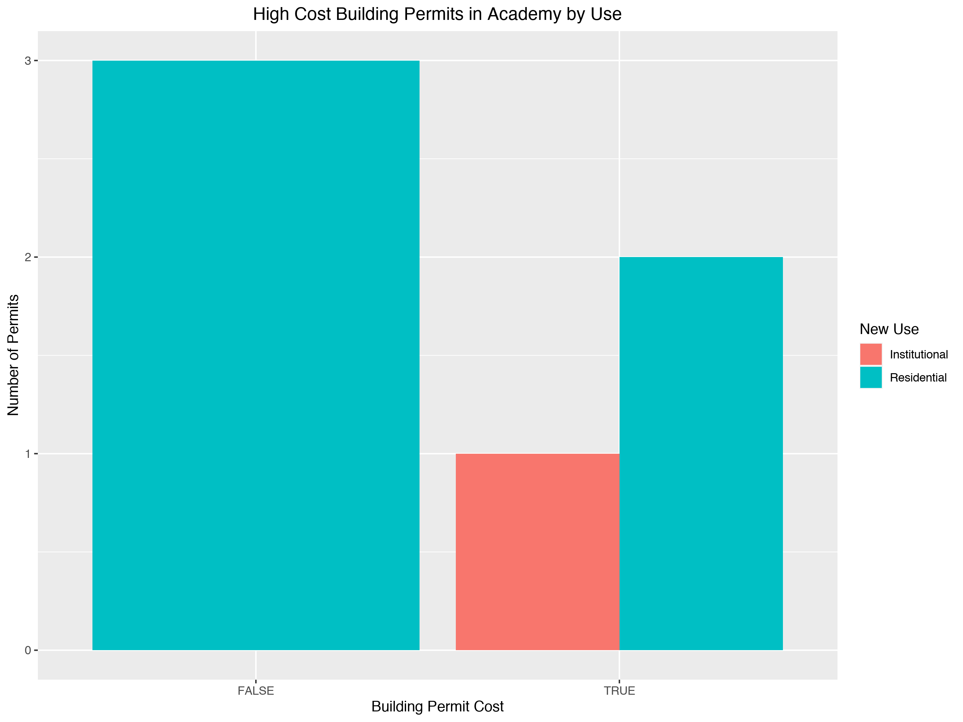

Slide 42
Fountain Park: Summary Notes
0 building permits in Fountain Park in January 2020
NaN change compared to January 2019 (0 total building permits)
NaN : Average building permit cost in Fountain Park in January 2020
NaN change compared to January 2019 (NaN)

Slide 43
Fountain Park: Summary Notes
0 total building permits in Fountain Park 2020
NaN change compared to this time in 2019 (0 total building permits)
NaN : Average building permit cost in Fountain Park in 2020
NaN change compared to this time in 2019 (NaN)

Slide 44
Lewis Place: Summary Notes
1 building permits in Lewis Place in January 2020
Inf change compared to January 2019 (0 total building permits)
$2,500 : Average building permit cost in Lewis Place in January 2020
NaN change compared to January 2019 (NaN)

Slide 45
Lewis Place: Summary Notes
1 total building permits in Lewis Place in 2020
Inf change compared to this time in 2019 (0 total building permits)
$2,500 : Average building permit cost in Lewis Place in 2020
NaN change compared to this time in 2019 (NaN)

Slide 46
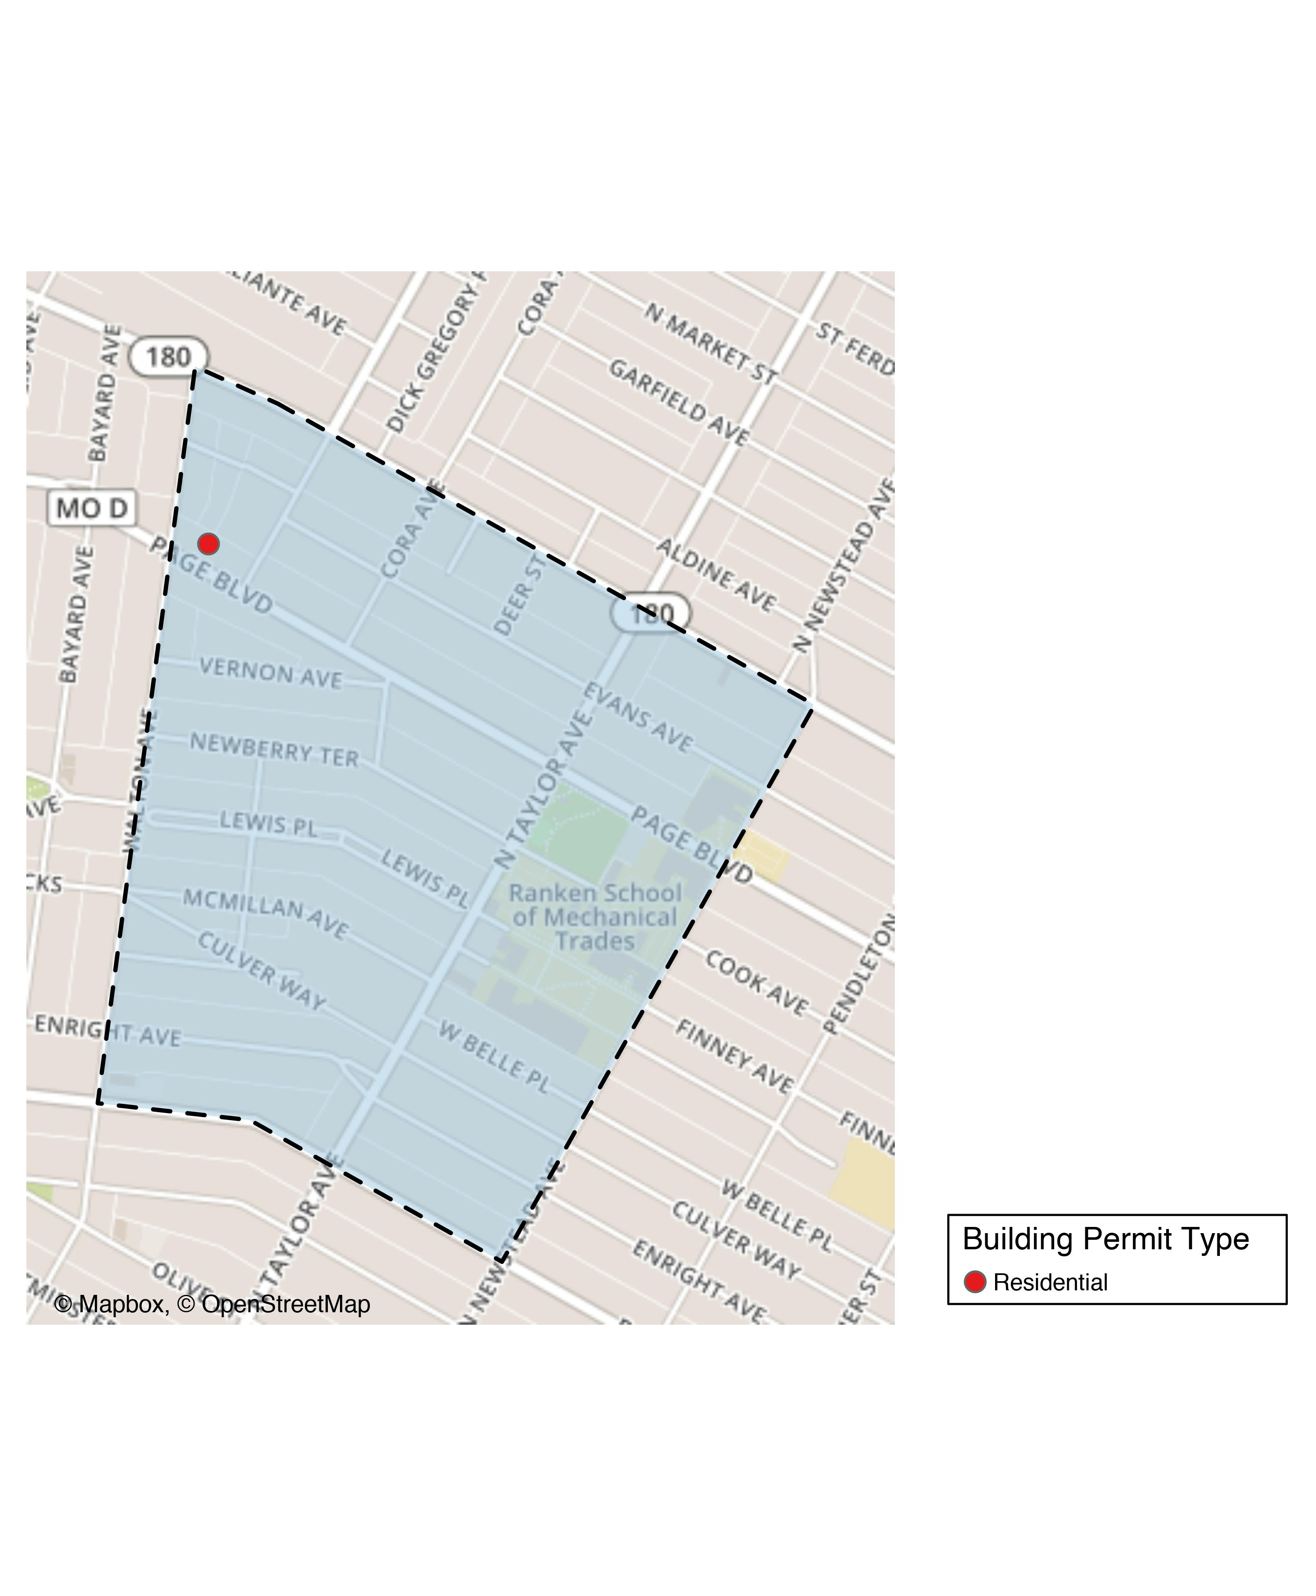
Lewis Place

Slide 47
Lewis Place
New Use | Average Cost | # of Permits
Residential | $2,500 | 1

Slide 48
Lewis Place Individual Permit Breakdown
Owner | New Use | Cost | Address
GRAVES, JOHN E | Residential | $2,500 | 4727 PAGE BLVD

Slide 49
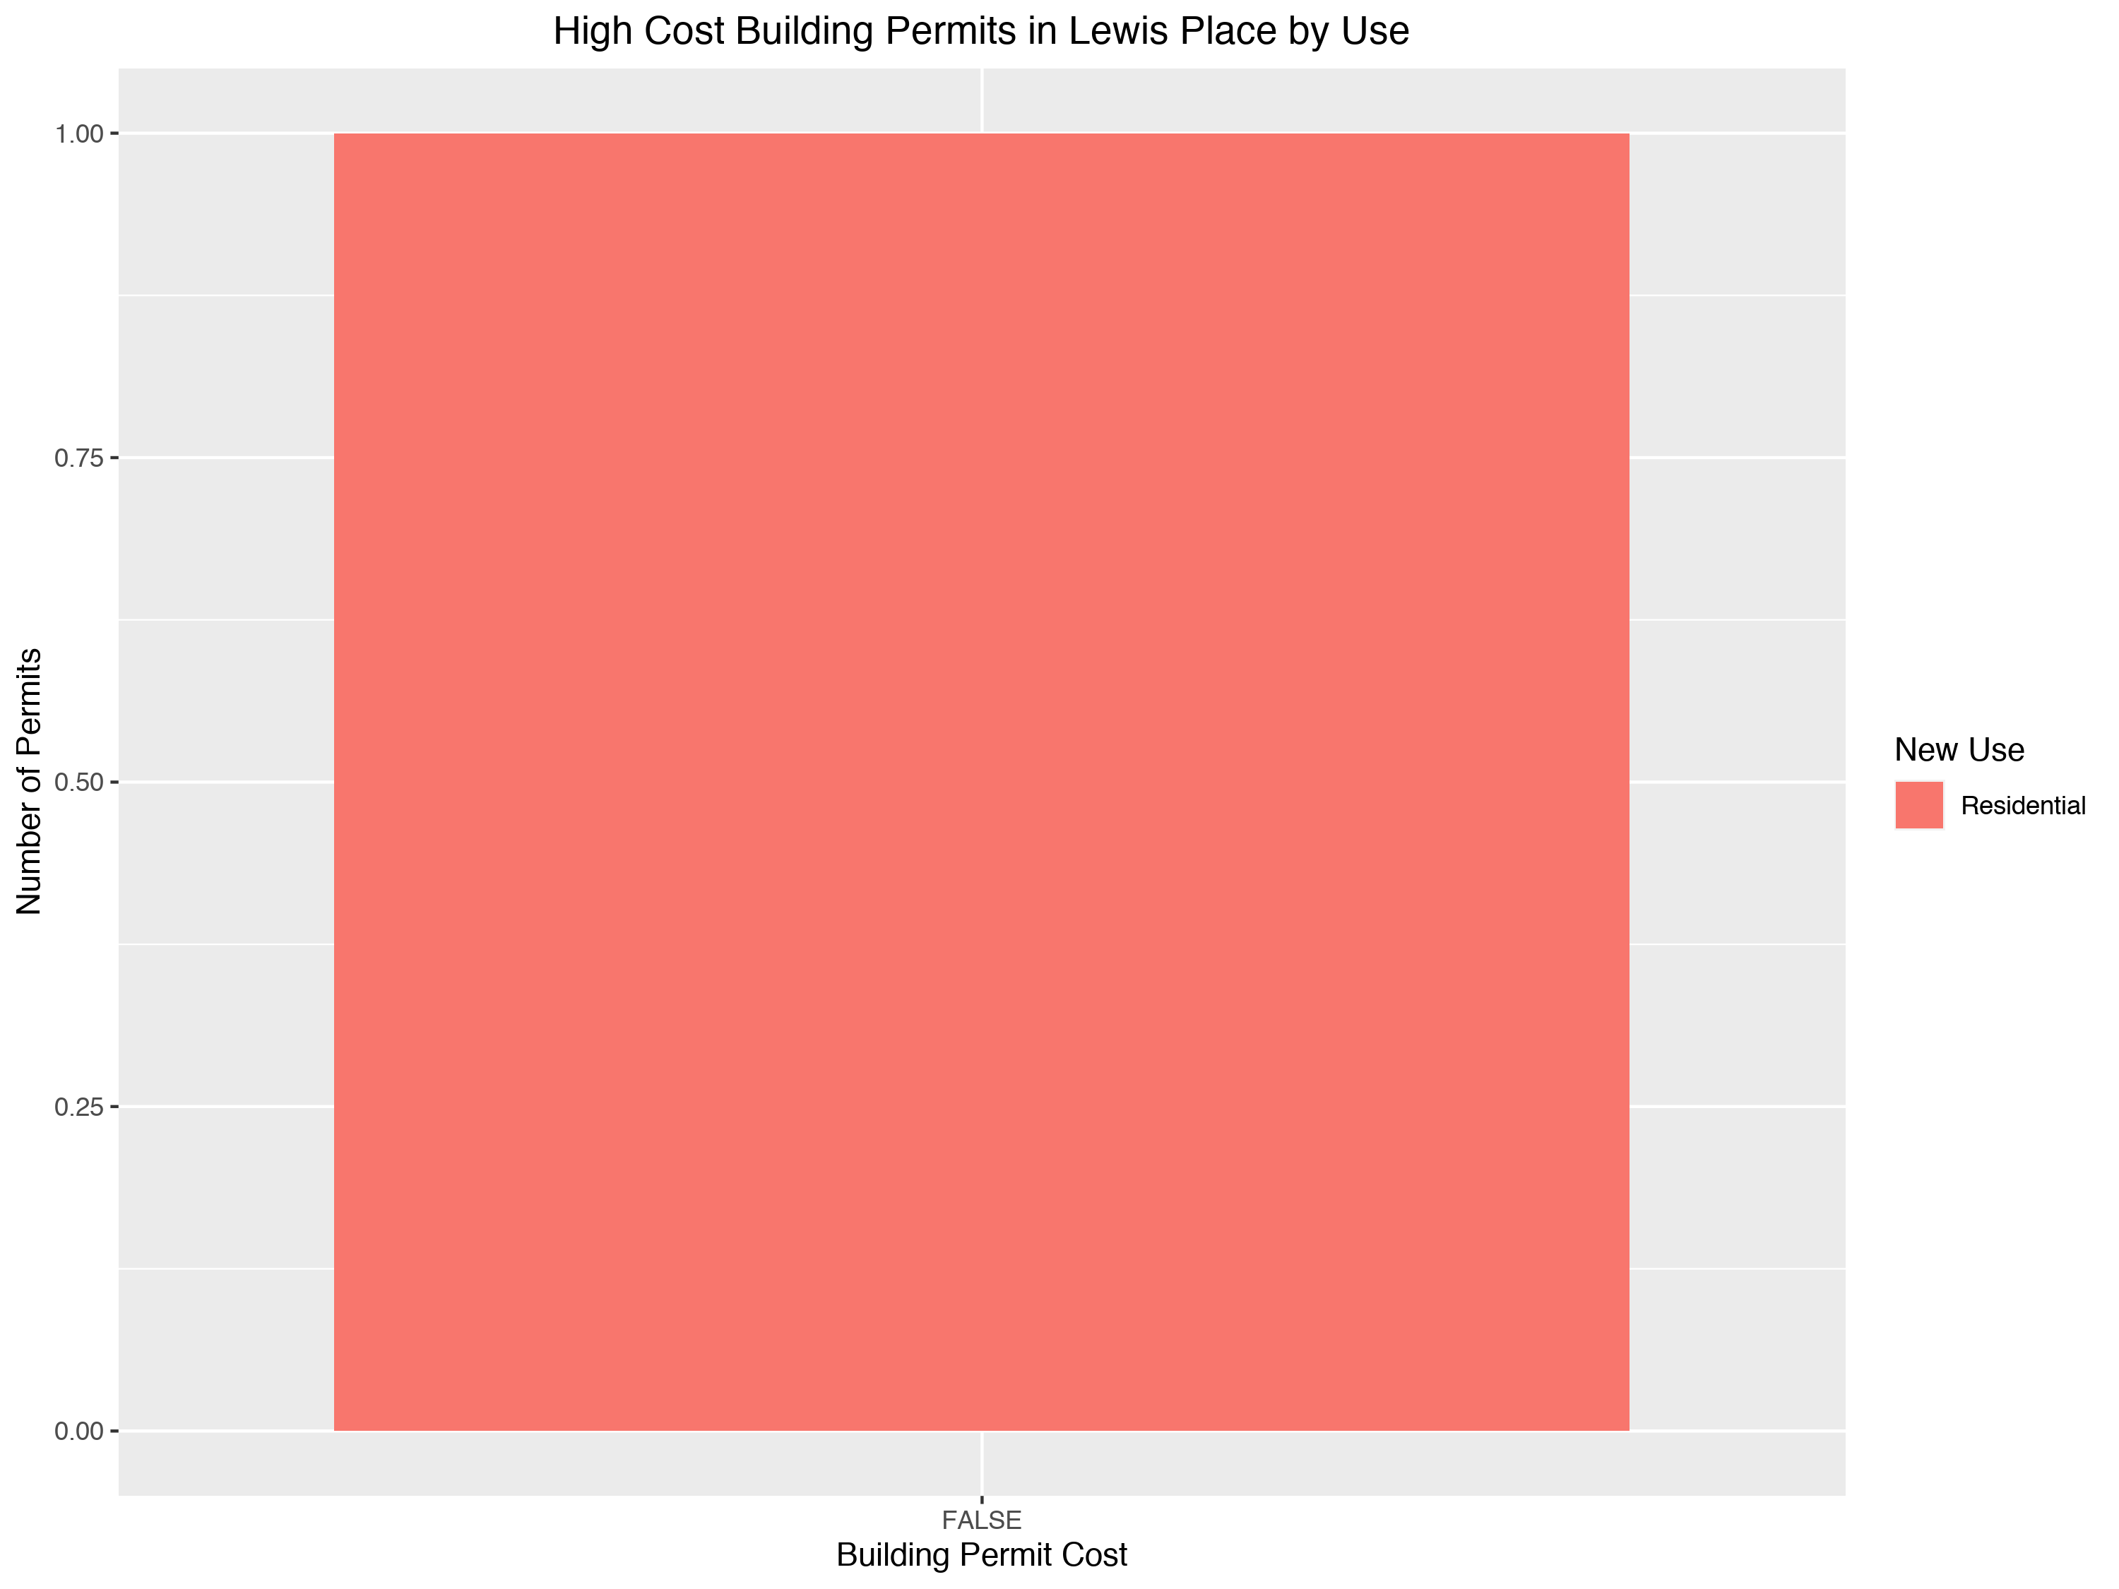

Slide 50
Vandeventer: Summary Notes
2 building permits in Vandeventer in January 2020
Inf change compared to January 2019 (0 total building permits)
$102,500 : Average building permit cost in Vandeventer in January 2020
NaN change compared to January 2019 (NaN)

Slide 51
Vandeventer: Summary Notes
2 total building permits in Vandeventer in 2020
Inf change compared to this time in 2019 (0 total building permits)
$102,500 : Average building permit cost in Vandeventer in 2020
NaN change compared to this time in 2019 (NaN)

Slide 52
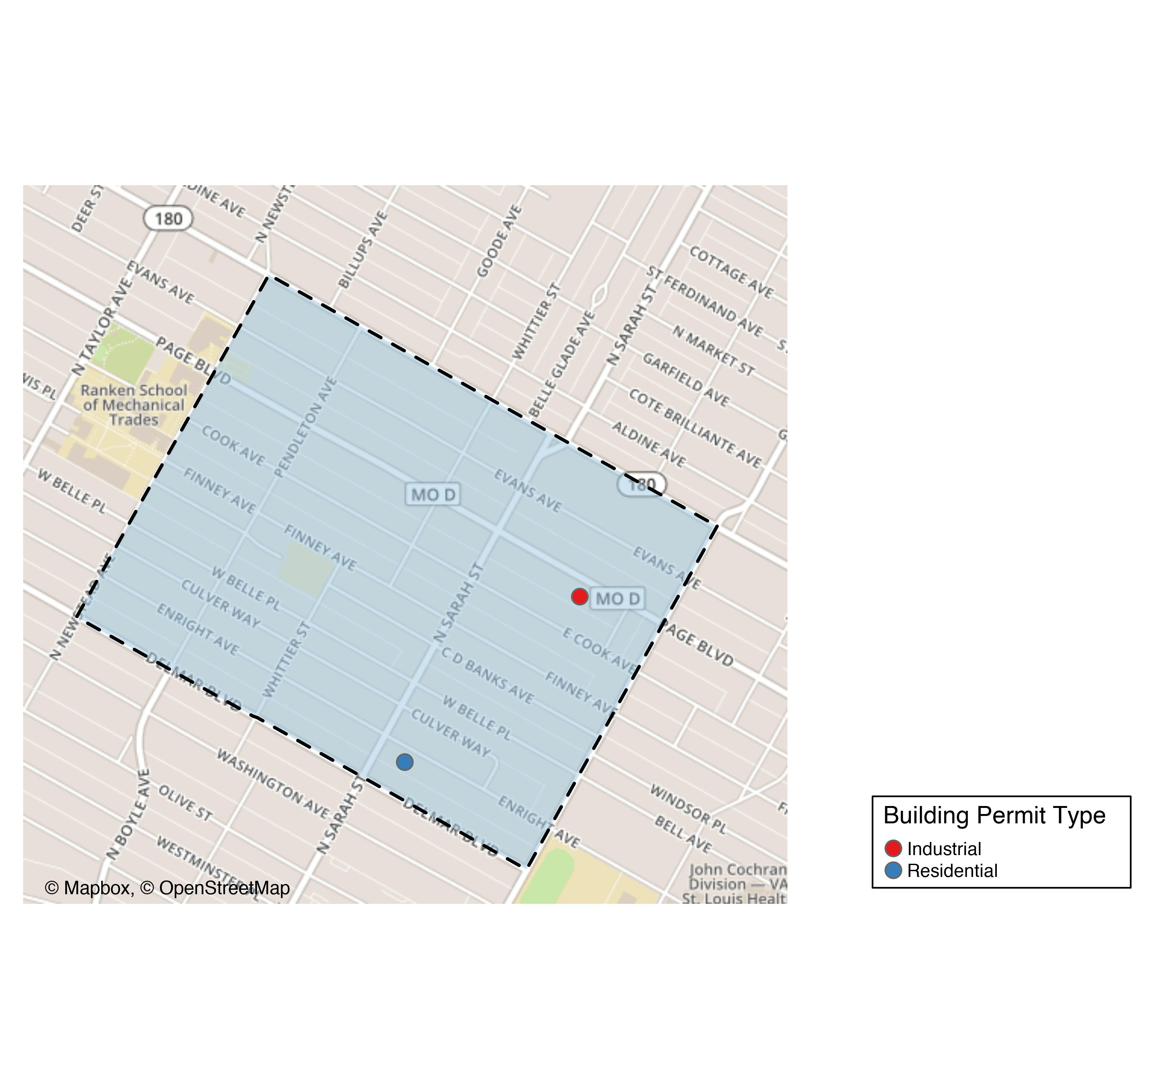
Vandeventer

Slide 53
Vandeventer
New Use | Average Cost | # of Permits
Industrial | $55,000 | 1
Residential | $150,000 | 1

Slide 54
Vandeventer Individual Permit Breakdown
Owner | New Use | Cost | Address
LOTT, JAMALIA | Residential | $150,000 | 4050 ENRIGHT AV
BROWN, TONY C SR & SHARON D BROWN | Industrial | $55,000 | 3960-66 PAGE BLVD

Slide 55
