Slide 1
St. Louis Central Corridor West Building Permits
Monthly Report: January 2020

Slide 2
Introduction
Data retreived from https://www.stlouis-mo.gov/data/
Building permits with a cost of $0 were dropped
Building permits that were cancelled were dropped

Slide 3
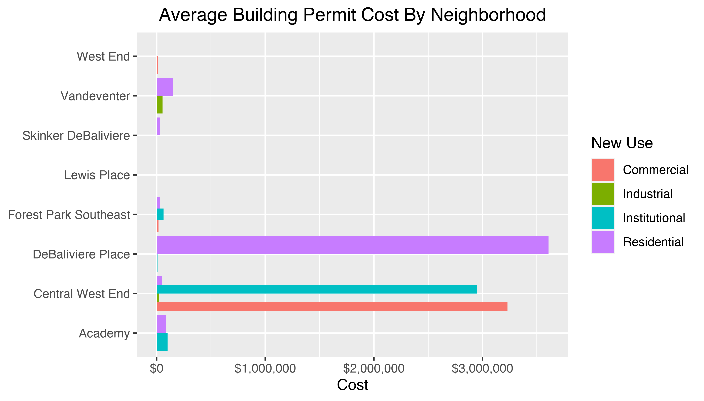
Neighborhood Summary

Slide 4
Neighborhood Summary
Neighborhood | Average Cost | # of Permits
Academy | $85,825 | 6
Central West End | $1,783,365 | 36
DeBaliviere Place | $4,512,000 | 4
Forest Park Southeast | $44,015 | 9
Lewis Place | $2,500 | 1
Skinker DeBaliviere | $27,571 | 7
Vandeventer | $102,500 | 2
West End | $8,000 | 10

Slide 5
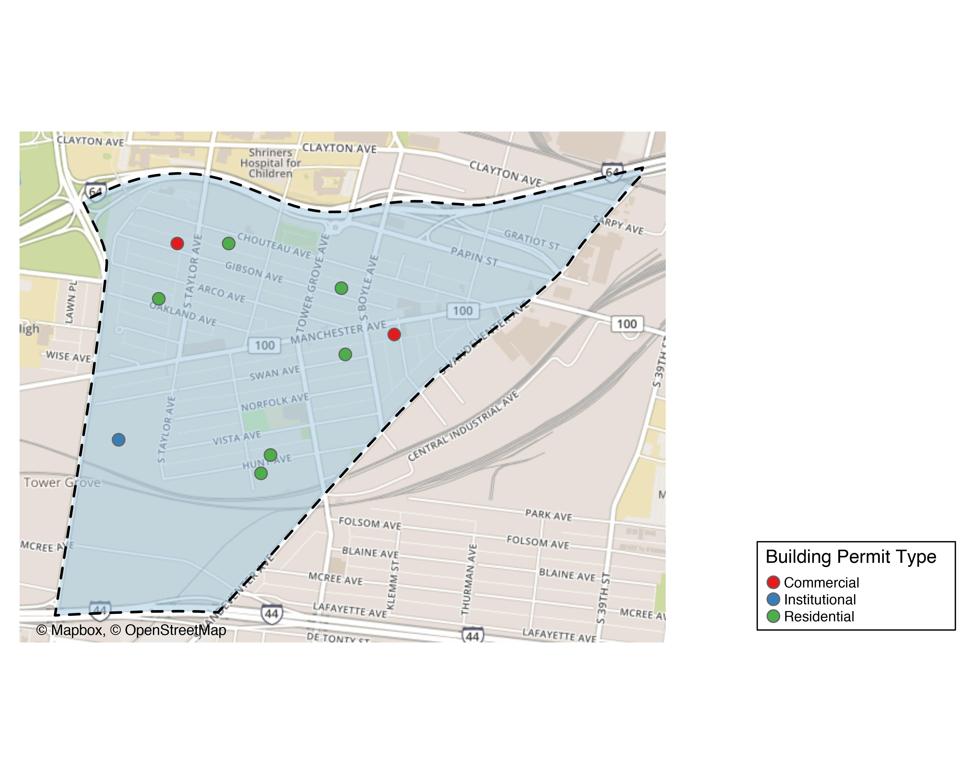
Forest Park Southeast

Slide 6
Forest Park Southeast
New Use | Average Cost | # of Permits
Commercial | $17,500 | 2
Institutional | $64,145 | 1
Residential | $49,498 | 6

Slide 7
Forest Park Southeast Individual Permit Breakdown
Owner | New Use | Cost | address
MITCHELL, TIMOTHY J | Residential | $3,000 | 4535 OAKLAND AV
ROBBINS, ARNOLD J & TERRIE L | Residential | $250,000 | 4353 HUNT AV
ALBIN, MICHAEL & LISA | Residential | $3,990 | 4227 SWAN AV
TISOTO, JEFFREY & LYNNE | Commercial | $15,000 | 4523 GIBSON AV
WASHINGTON UNIVERSITY | Institutional | $64,145 | 1234 S KINGSHIGHWAY BLVD
VITT, VICTOR J JR | Residential | $9,000 | 4366 HUNT AV
4176 MANCHESTER LLC | Commercial | $20,000 | 4176 MANCHESTER AV
KAMPE, NICHOLAS R | Residential | $30,000 | 4448 CHOUTEAU AV
JOHNSON, ISAIAH & CALLIE | Residential | $1,000 | 4327 GIBSON AV

Slide 8
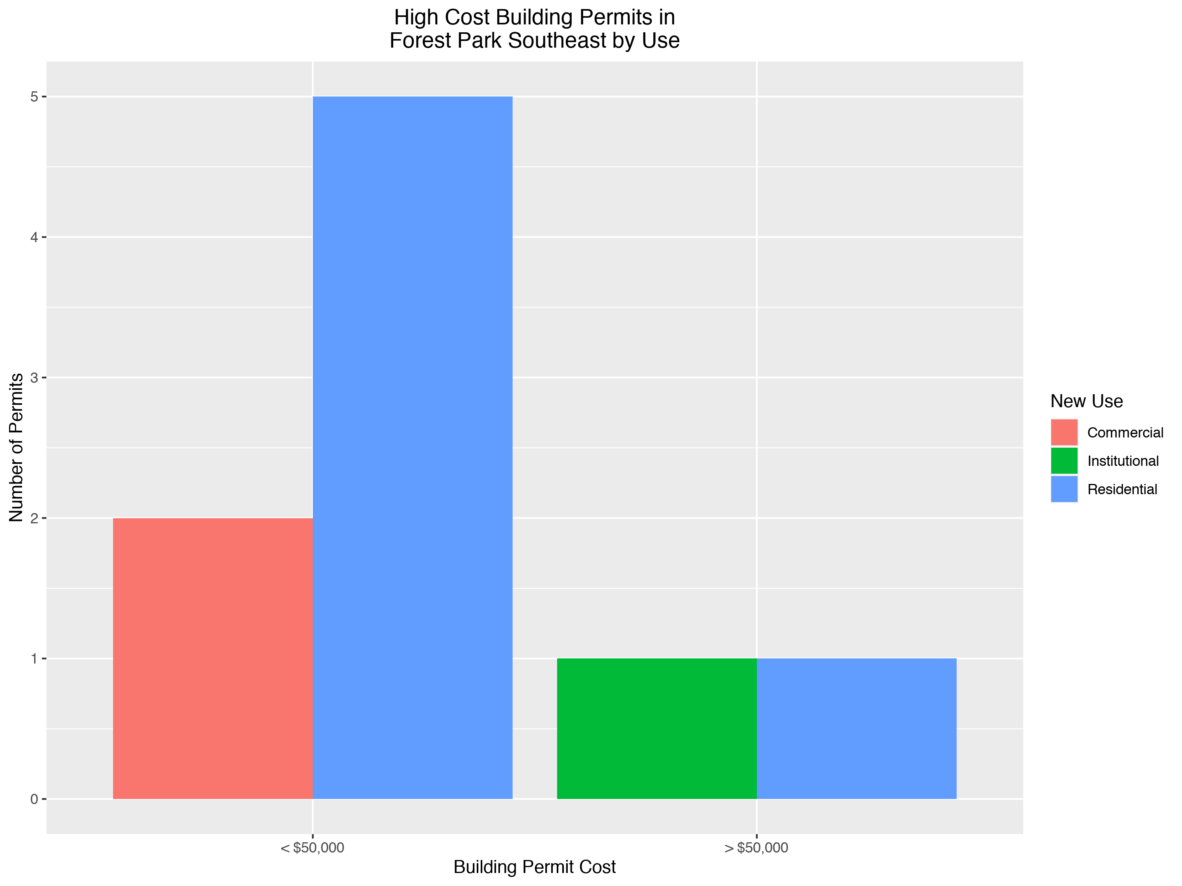

Slide 9
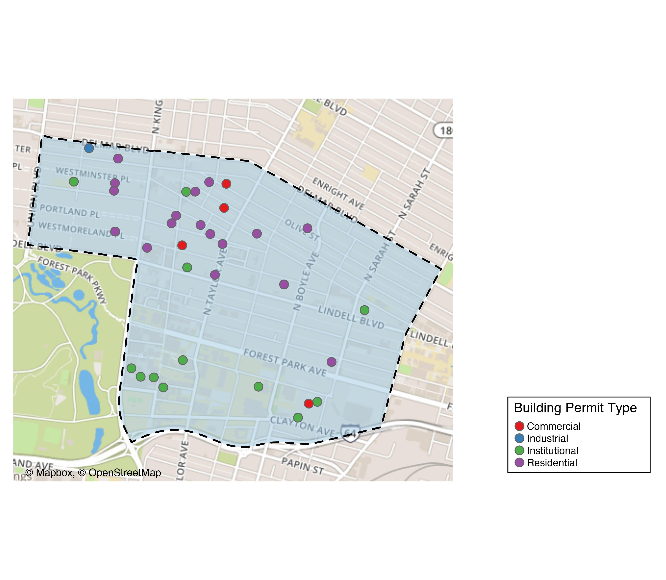
Central West End

Slide 10
Central West End
New Use | Average Cost | # of Permits
Commercial | $4,037,500 | 4
Industrial | $21,676 | 1
Institutional | $3,629,497 | 13
Residential | $47,000 | 18

Slide 11
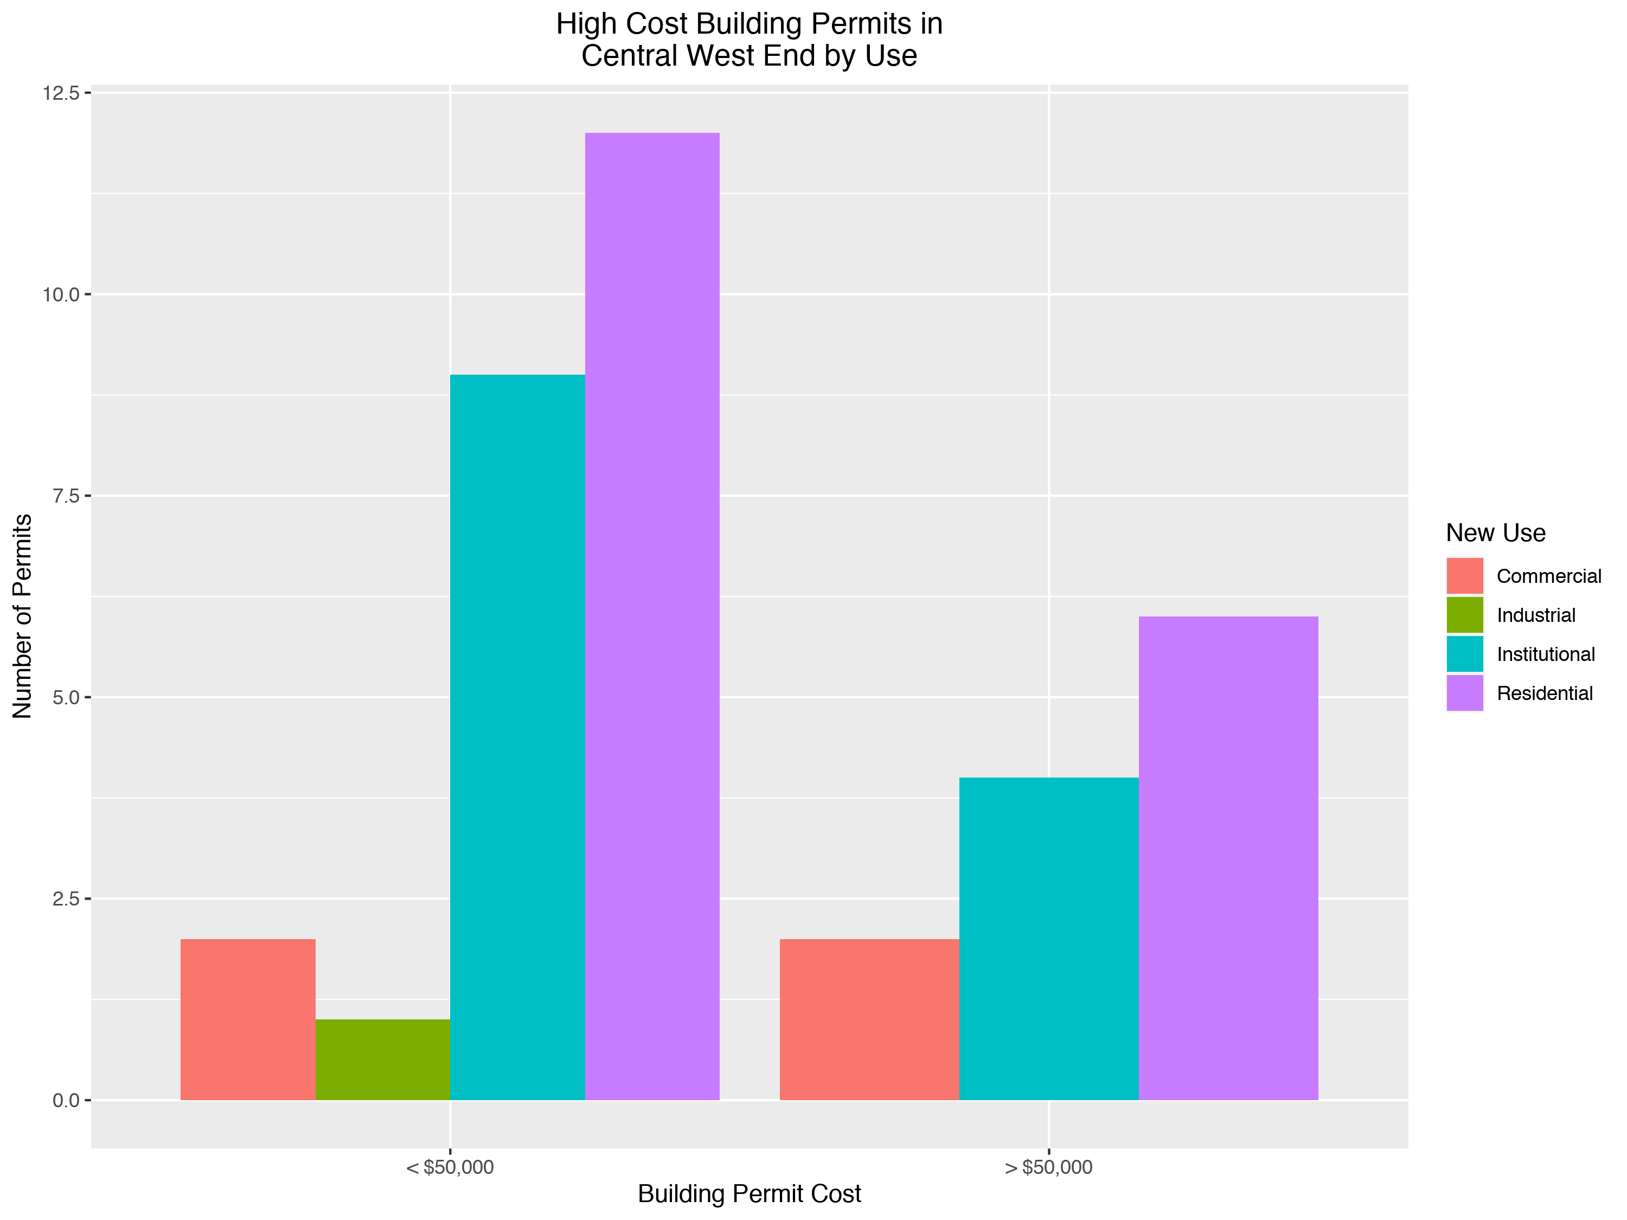

Slide 12
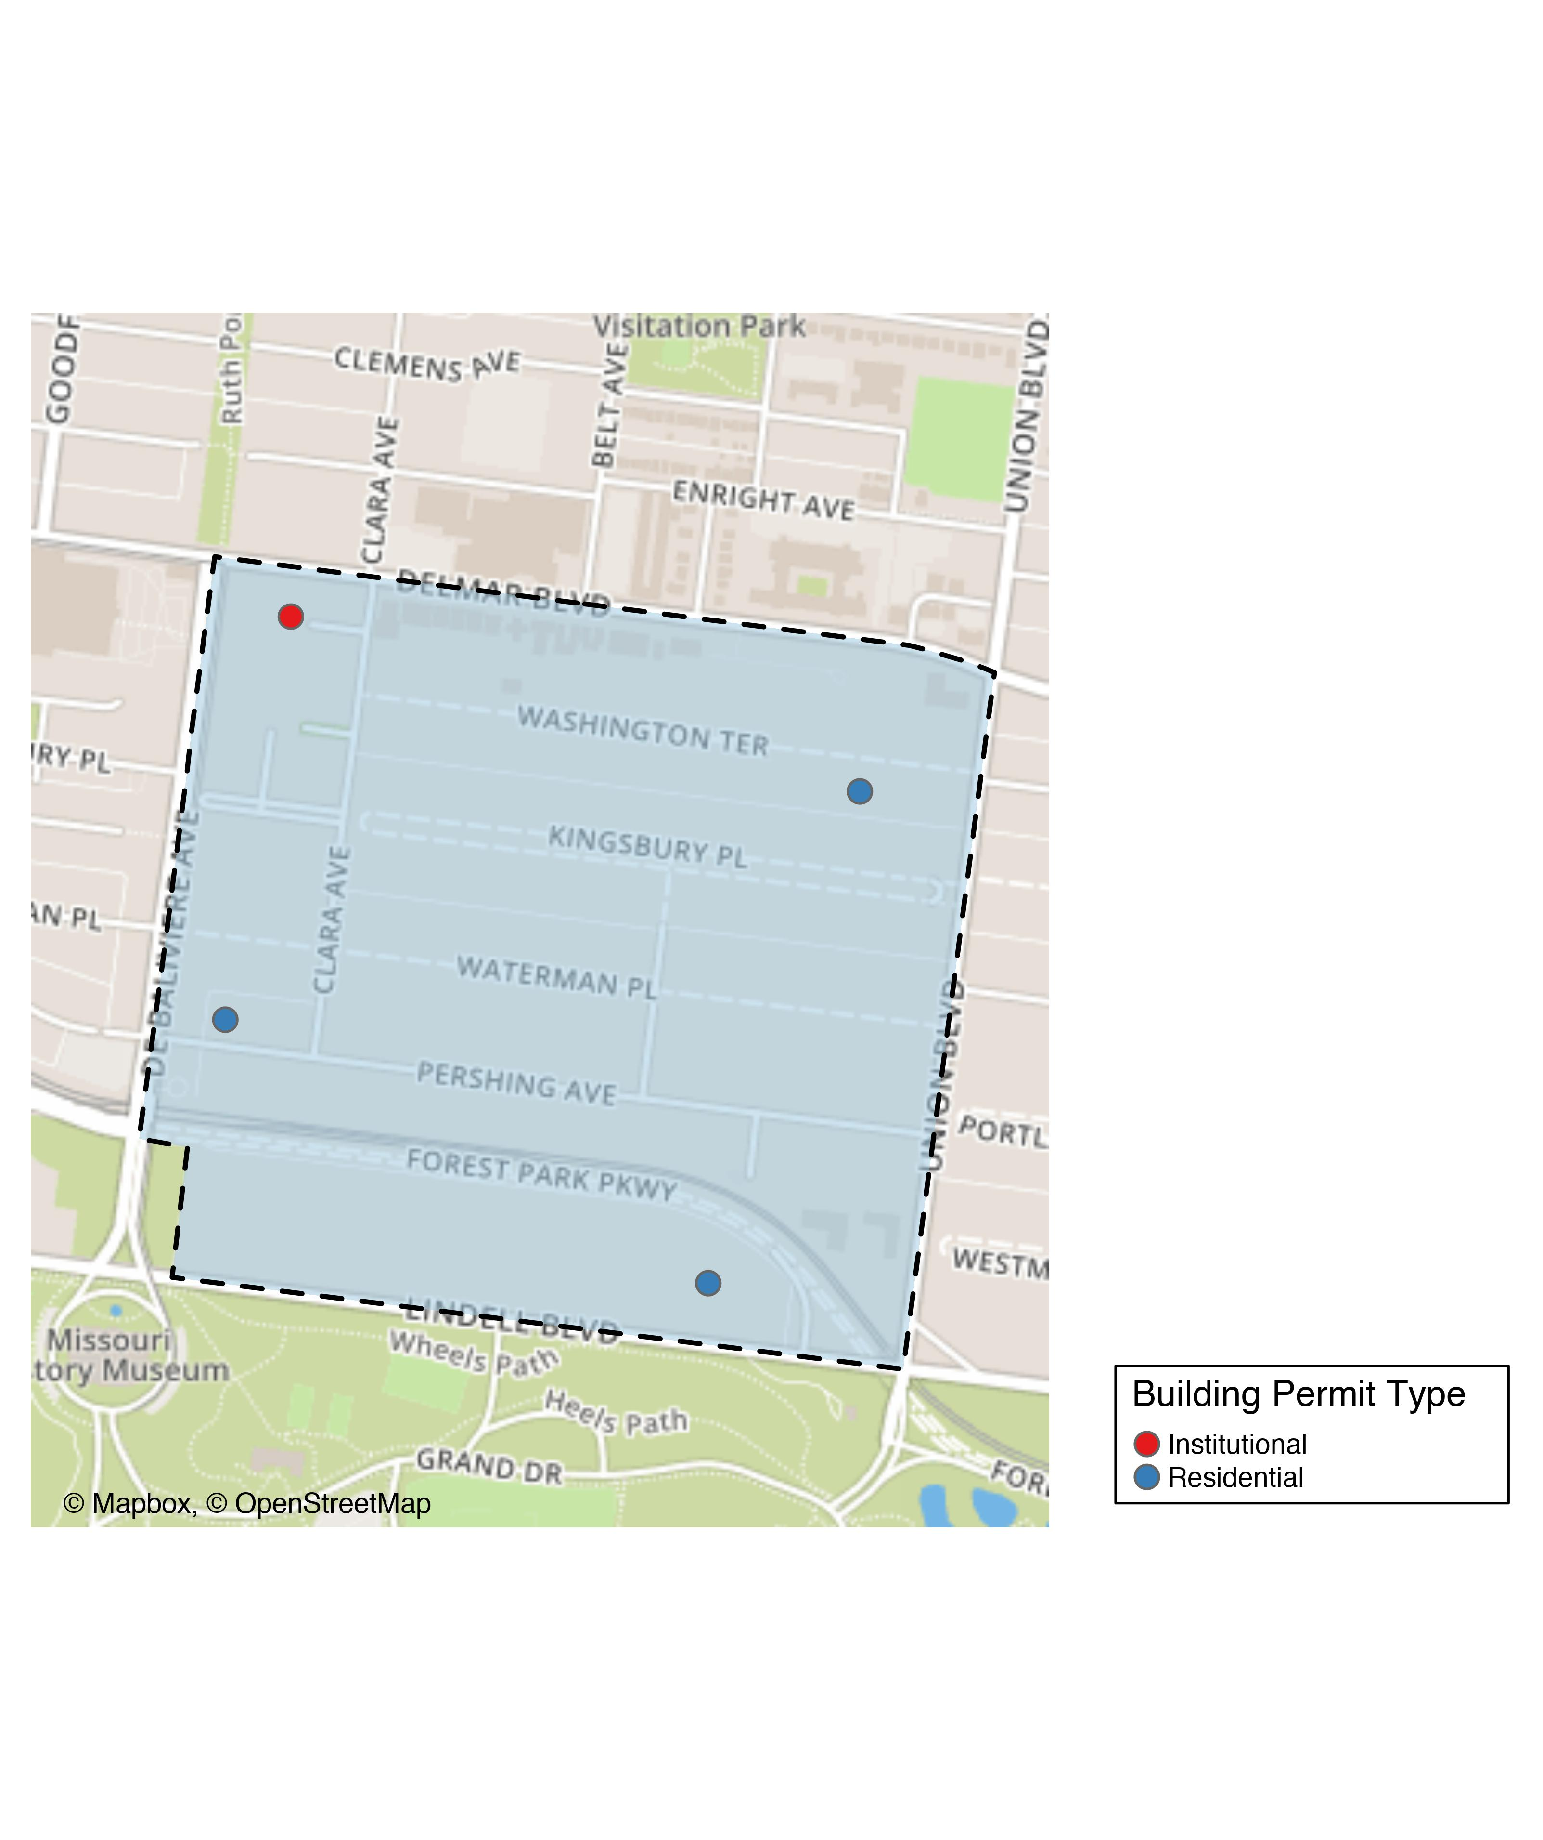
DeBaliviere Place

Slide 13
DeBaliviere Place
New Use | Average Cost | # of Permits
Institutional | $8,000 | 1
Residential | $6,013,333 | 3

Slide 14
DeBaliviere Place Individual Permit Breakdown
Owner | New Use | Cost | Address
DEL MONTE APARTMENTS LLC | Institutional | $8,000 | 5622 DELMAR BLVD
CALHOUN, BARRY & SHIRA SPETNER | Residential | $5,000 | 10 WASHINGTON TER
REDIGER, DOUGLAS HTRS | Residential | $35,000 | 5373 LINDELL BLVD
KILAMANJARO V LLC | Residential | $18,000,000 | 5637 PERSHING AV

Slide 15
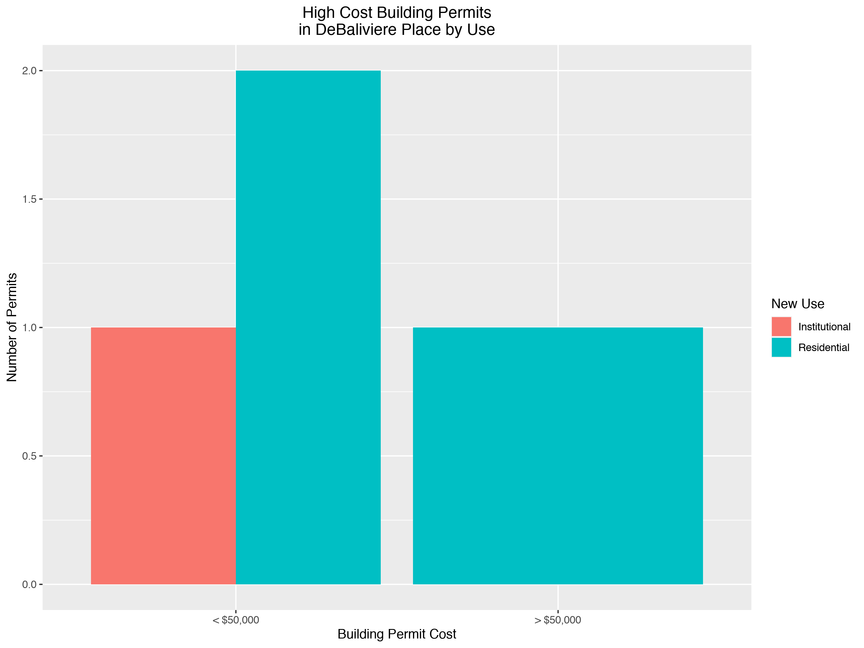

Slide 16
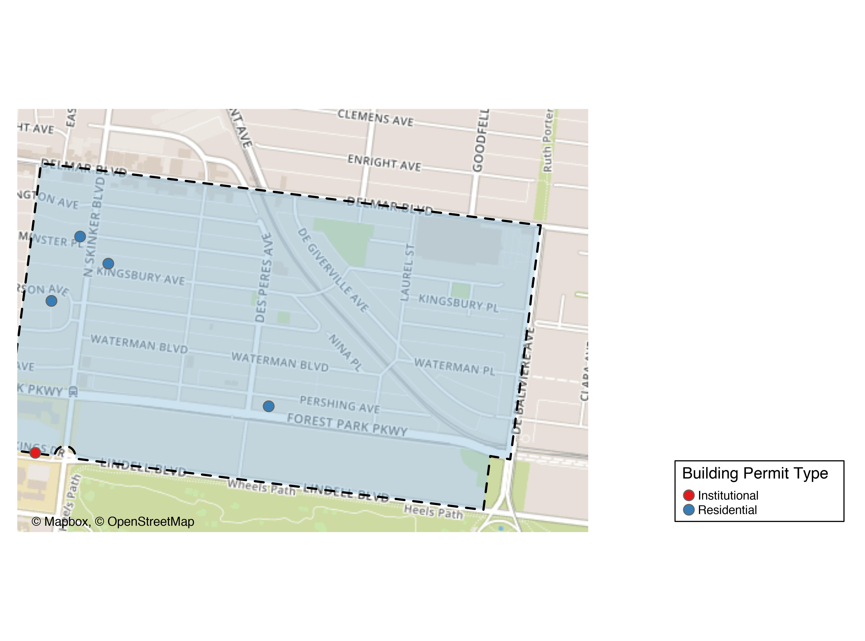
Skinker DeBaliviere

Slide 17
Skinker DeBaliviere
New Use | Average Cost | # of Permits
Institutional | $10,000 | 1
Residential | $30,500 | 6

Slide 18
Skinker DeBaliviere Individual Permit Breakdown
Owner | New Use | Cost | Address
WASHINGTON UNIVERSITY ART BUILDING | Institutional | $10,000 | 6220 FOREST PARK PARKWAY
DEE, MICHAEL PATRICK & | Residential | $76,500 | 6232 MCPHERSON AV
HOFFMAN, CHERI L | Residential | $27,000 | 6211 WESTMINSTER PL
WELCH, MARGARET & MARY LOU | Residential | $17,500 | 6189 KINGSBURY AV
ONE WORLD - USA, LLC | Residential | $33,000 | 5948 PERSHING AV
ONE WORLD - USA, LLC | Residential | $14,000 | 5948 PERSHING AV
DEE, MICHAEL PATRICK & | Residential | $15,000 | 6232 MCPHERSON AV

Slide 19
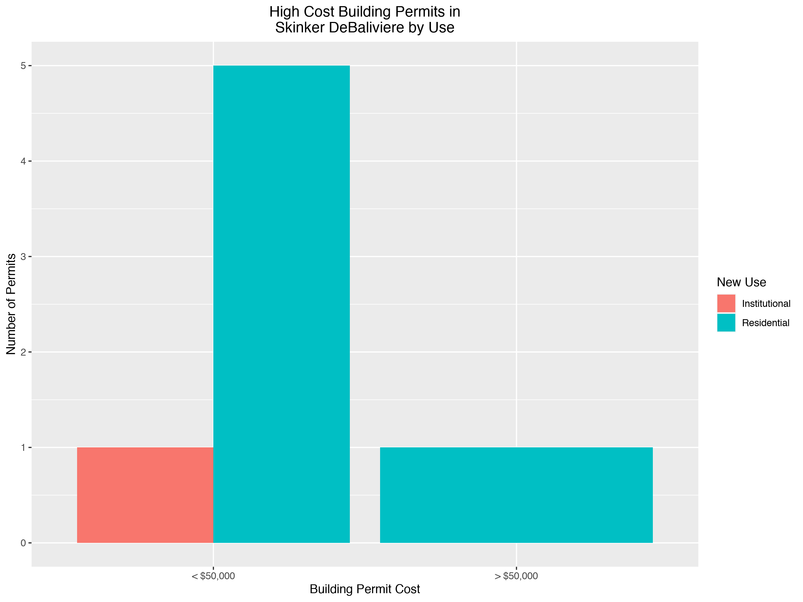

Slide 20
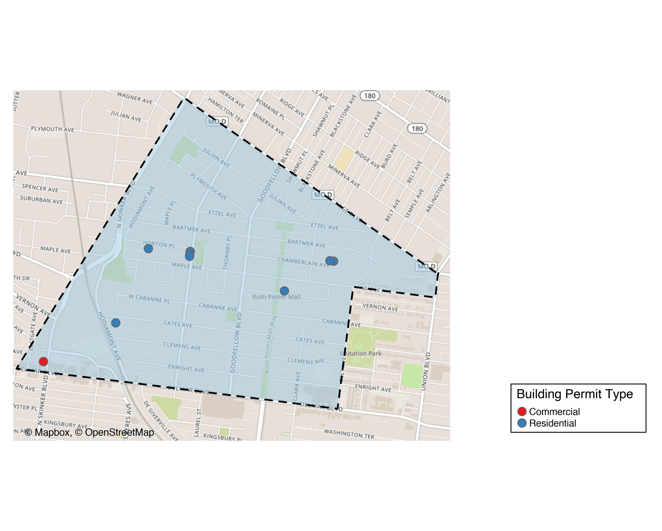
West End

Slide 21
West End
New Use | Average Cost | # of Permits
Commercial | $21,000 | 2
Residential | $4,750 | 8

Slide 22
West End Individual Permit Breakdown
Owner | New Use | Cost | Address
KEY MASTERS LLC | Residential | $2,000 | 5647 VERNON AV
THREE DOORS PROPERTIES LLC | Residential | $30,000 | 6018 HORTON PL
WESTEND CATES LLC | Residential | $1,000 | 6062 CATES AV
WESTEND CHAMBERLAIN LLC | Residential | $1,000 | 5561-5565 CHAMBERLAIN AV
WESTEND CHAMBERLAIN LLC | Residential | $1,000 | 5569-5571 CHAMBERLAIN AV
WESTEND HAMILTON LLC | Residential | $1,000 | 5902-5906 HORTON PL
WESTEND HAMILTON LLC | Residential | $1,000 | 1019-1021 HAMILTON AV
WESTEND HAMILTON LLC | Residential | $1,000 | 1023-1025 HAMILTON AV
PACE-DELMAR ASSOCIATES LLC | Commercial | $32,000 | 6211 DELMAR BLVD
PACE-DELMAR ASSOCIATES LLC | Commercial | $10,000 | 621 N SKINKER BLVD

Slide 23
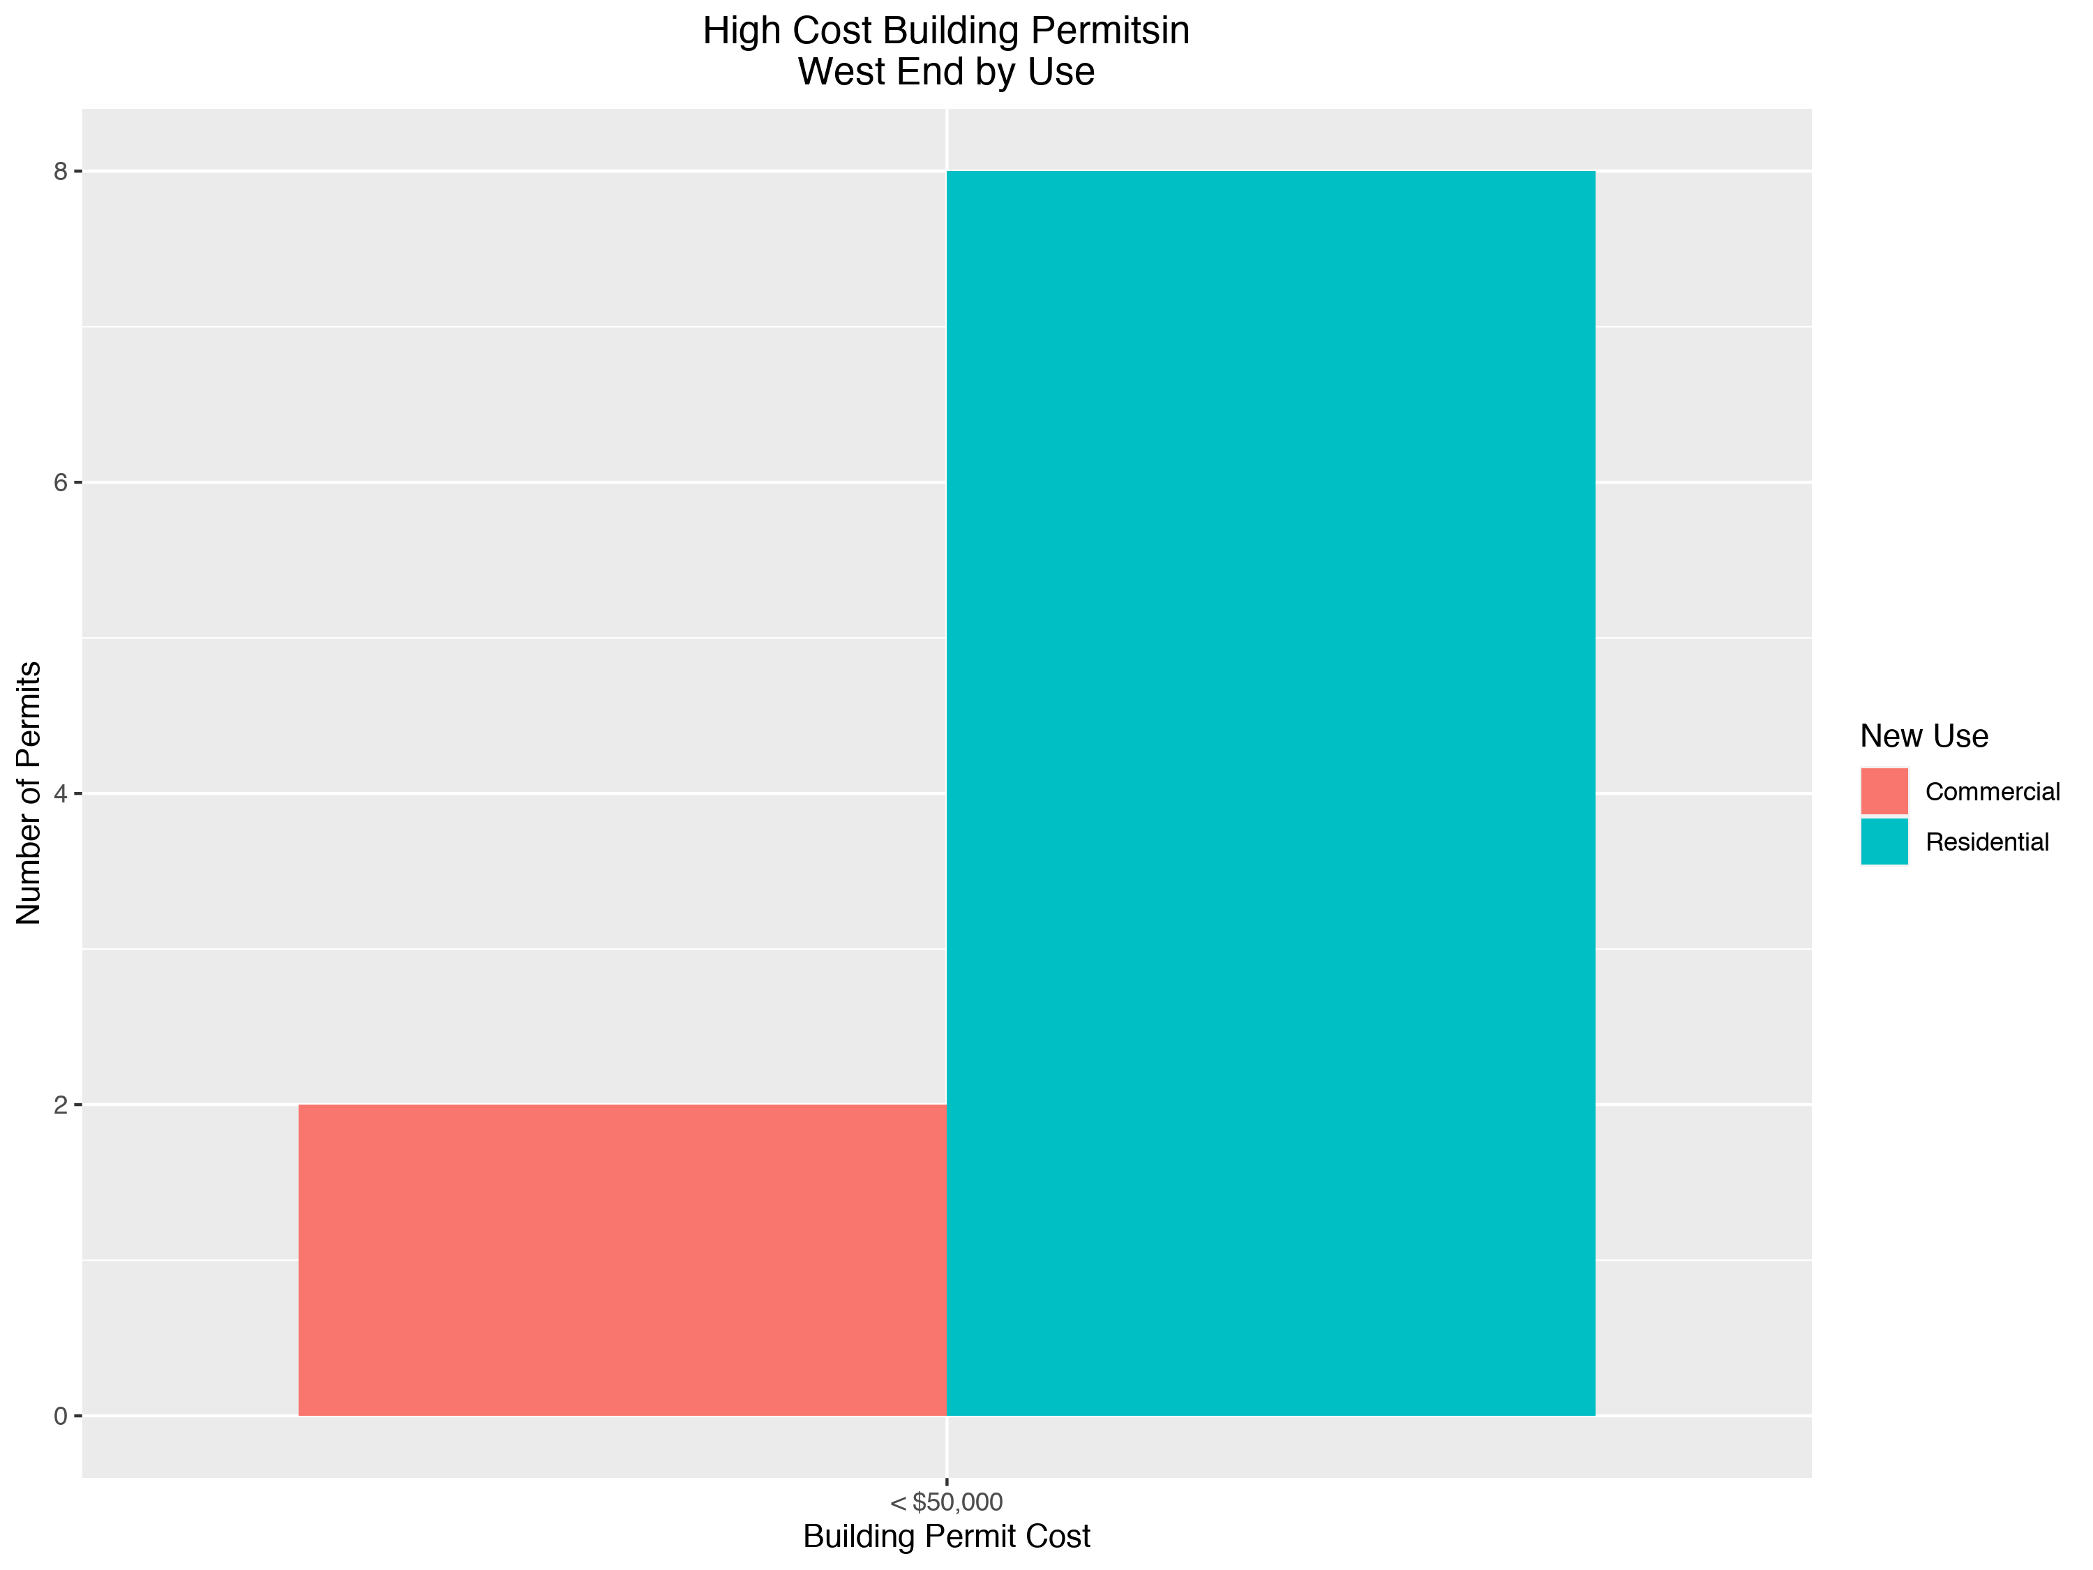

Slide 24
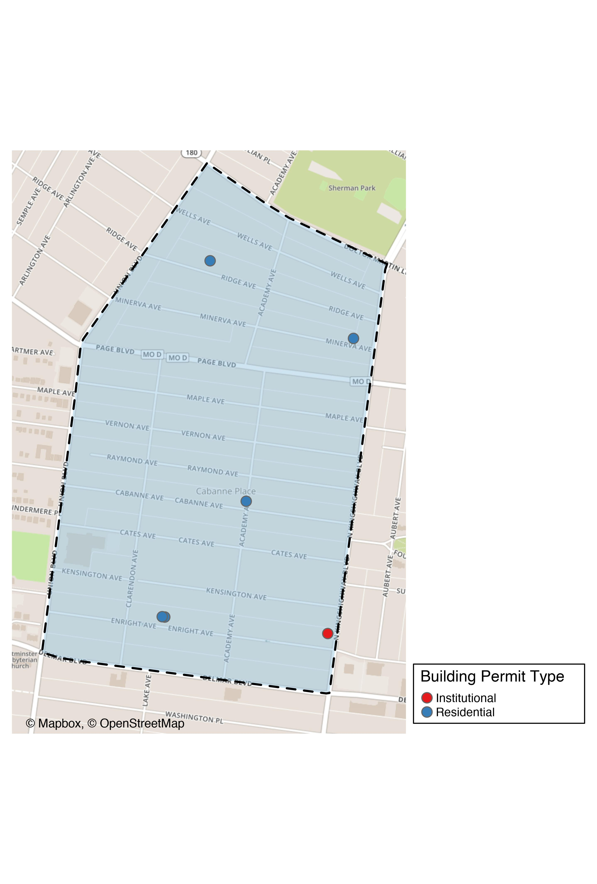
Academy

Slide 25
Academy
New Use | Average Cost | # of Permits
Institutional | $100,000 | 1
Residential | $82,990 | 5

Slide 26
Academy Individual Permit Breakdown
Owner | New Use | Cost | Address
MCCLENDON, GARY & GENA | Residential | $1,500 | 5021 MINERVA AV
GREEN LINE LLC | Residential | $200,000 | 5169 ENRIGHT AV
GREEN LINE LLC | Residential | $200,000 | 5167 ENRIGHT AV
MURPHY, CHRISTINA | Residential | $8,450 | 5101 CABANNE AV
ELDER, O TERRY | Institutional | $100,000 | 813 N KINGSHIGHWAY BLVD
JONES, ELLA M | Residential | $5,000 | 5207 RIDGE AV

Slide 27
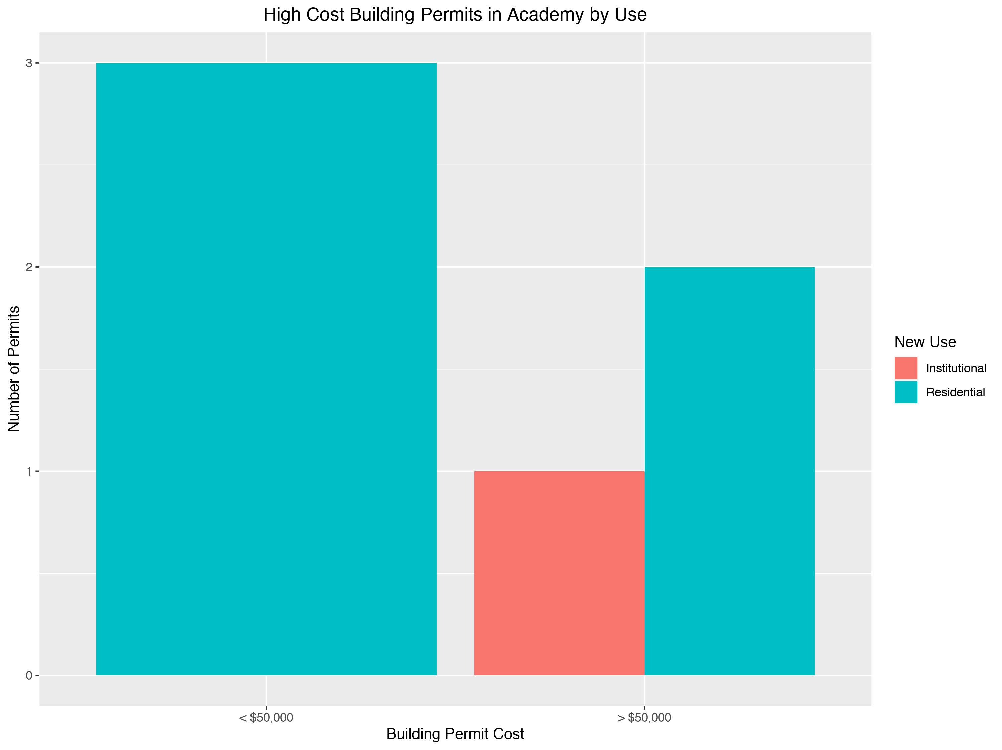

Slide 28
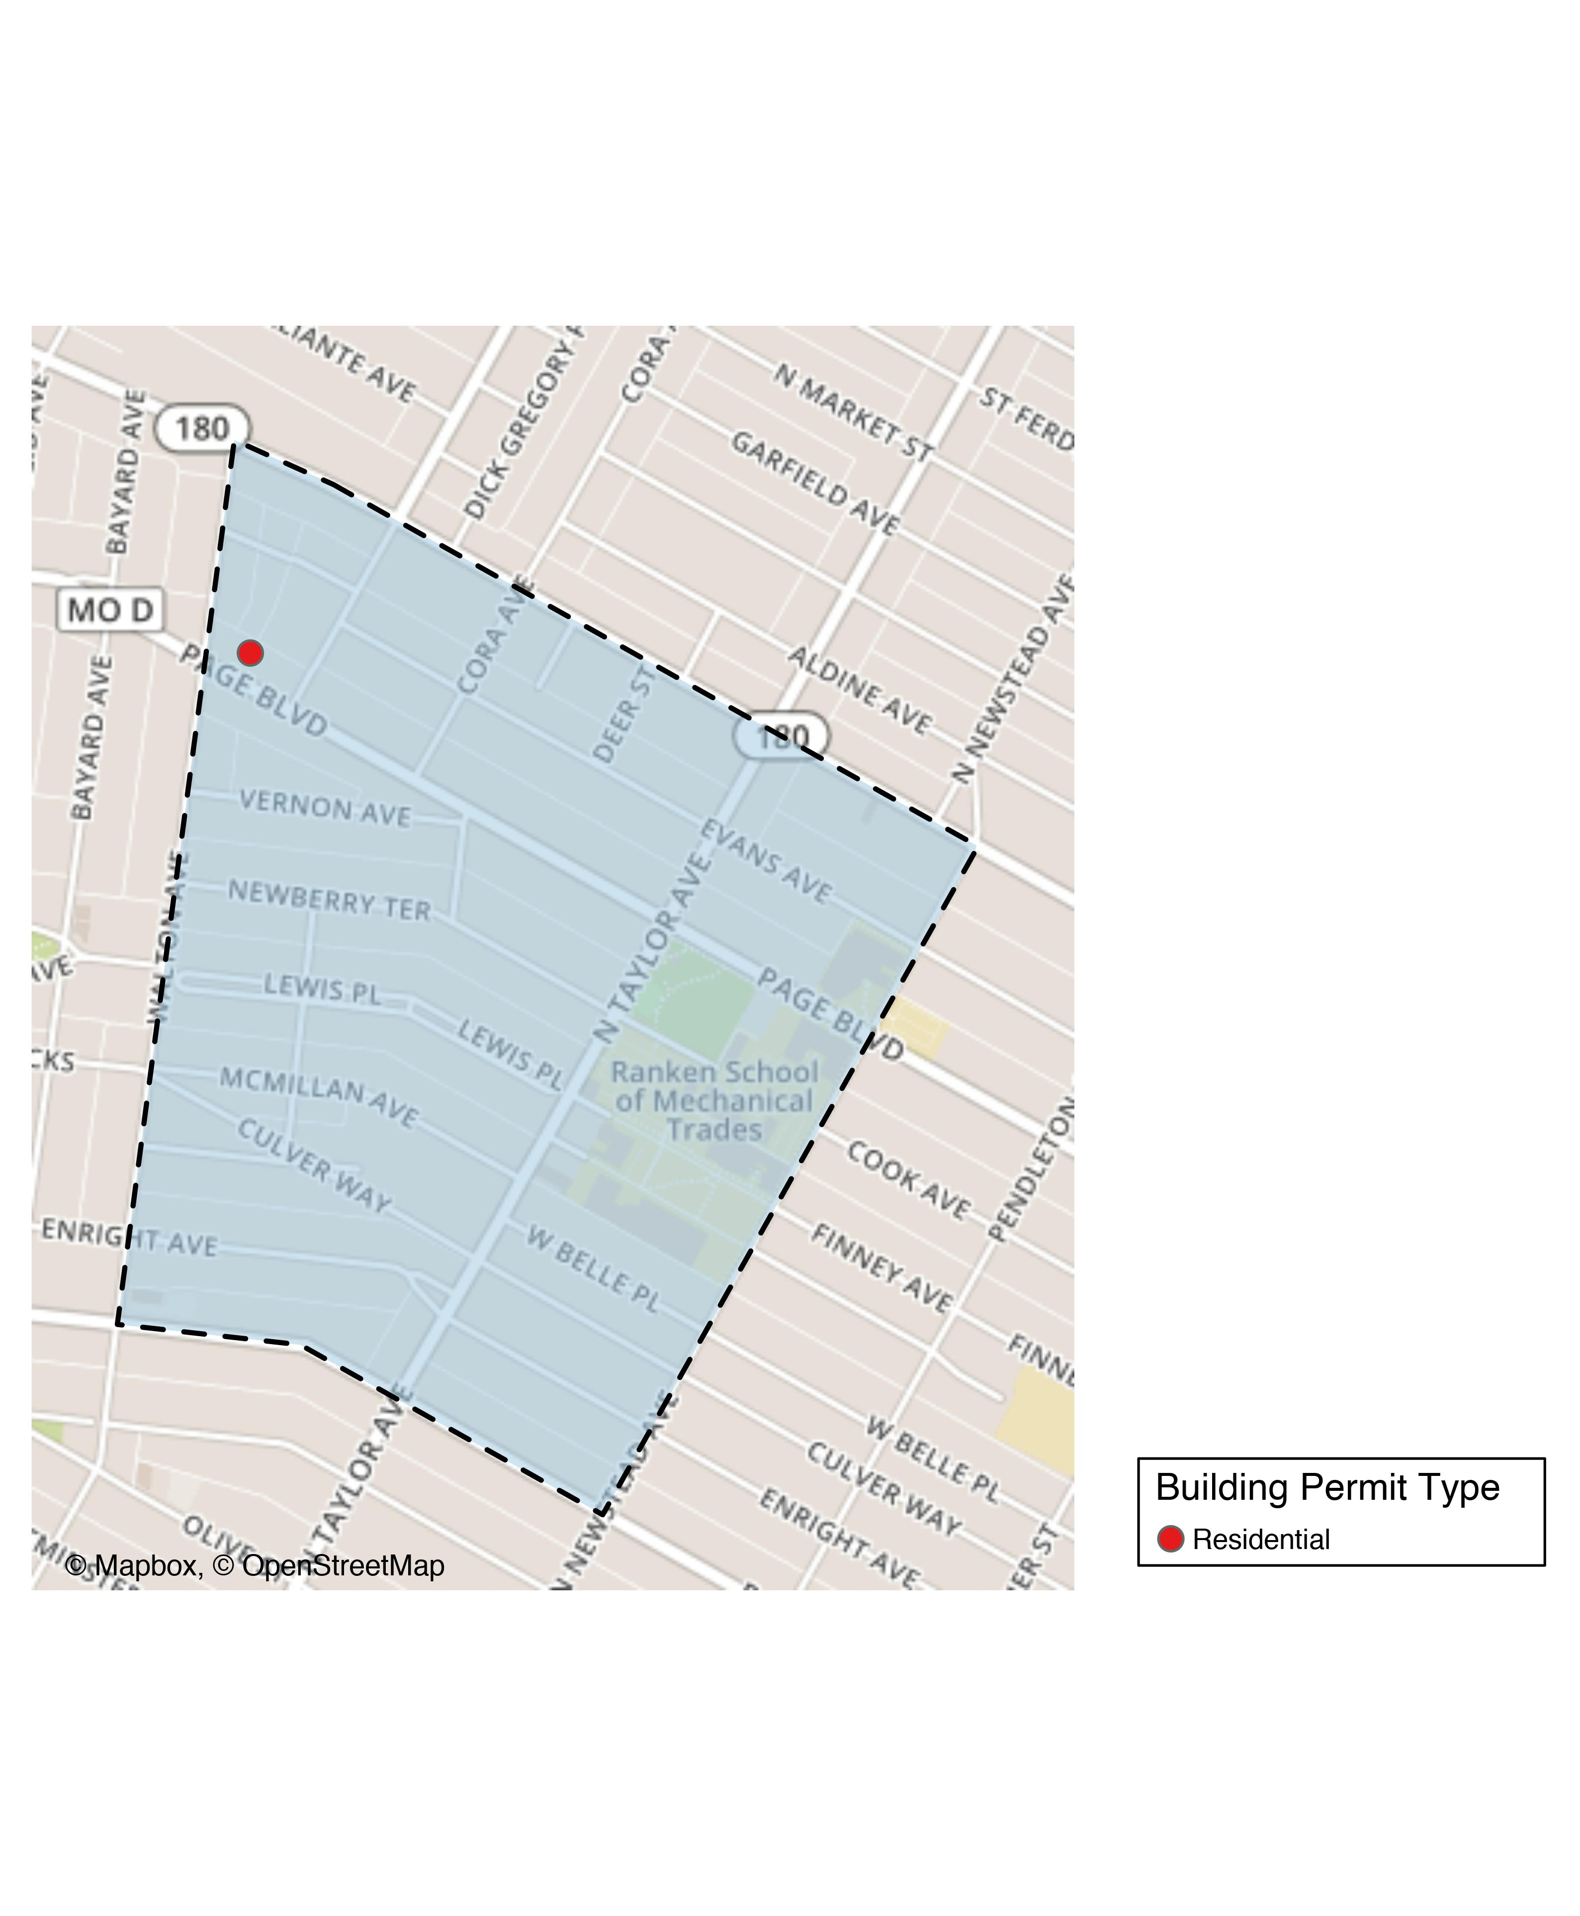
Lewis Place

Slide 29
Lewis Place
New Use | Average Cost | # of Permits
Residential | $2,500 | 1

Slide 30
Lewis Place Individual Permit Breakdown
Owner | New Use | Cost | Address
GRAVES, JOHN E | Residential | $2,500 | 4727 PAGE BLVD

Slide 31
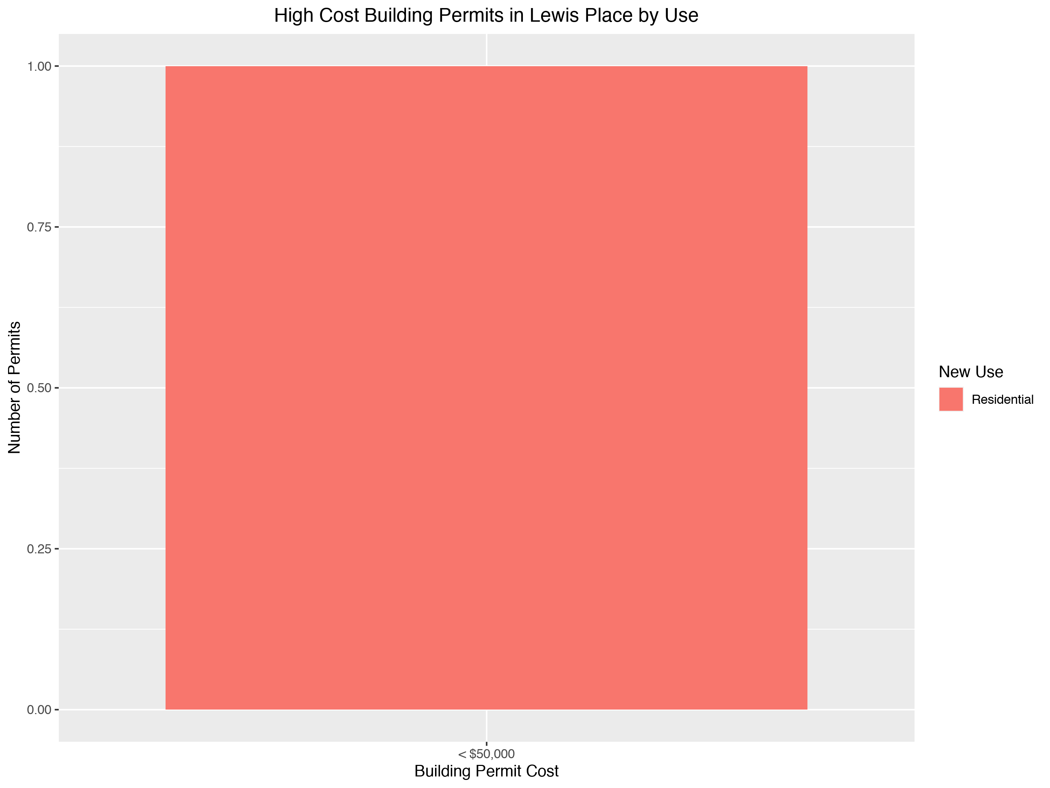

Slide 32
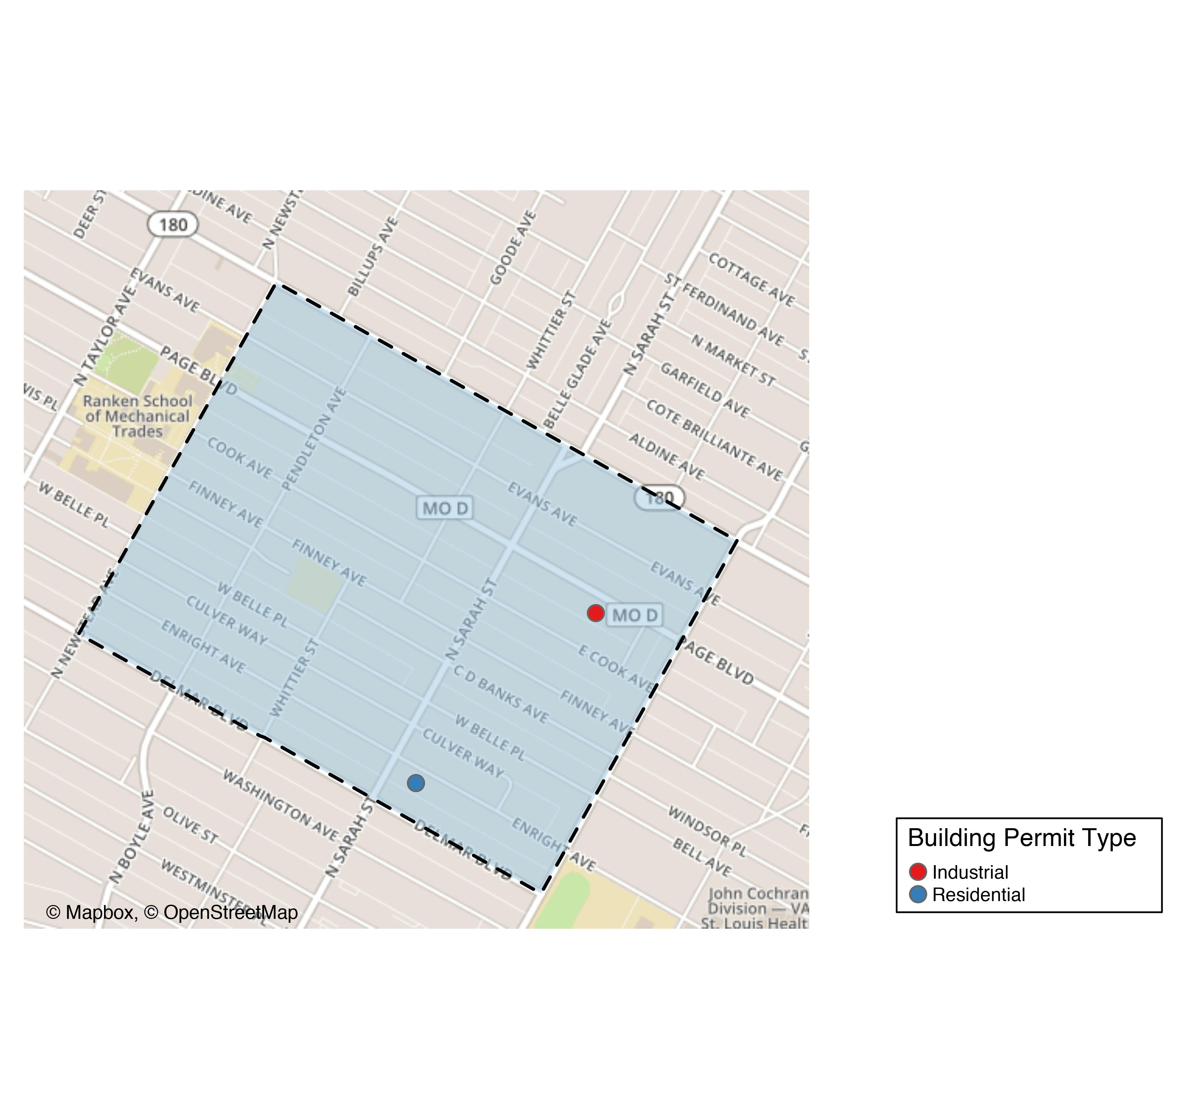
Vandeventer

Slide 33
Vandeventer
New Use | Average Cost | # of Permits
Industrial | $55,000 | 1
Residential | $150,000 | 1

Slide 34
Vandeventer Individual Permit Breakdown
Owner | New Use | Cost | Address
LOTT, JAMALIA | Residential | $150,000 | 4050 ENRIGHT AV
BROWN, TONY C SR & SHARON D BROWN | Industrial | $55,000 | 3960-66 PAGE BLVD

Slide 35
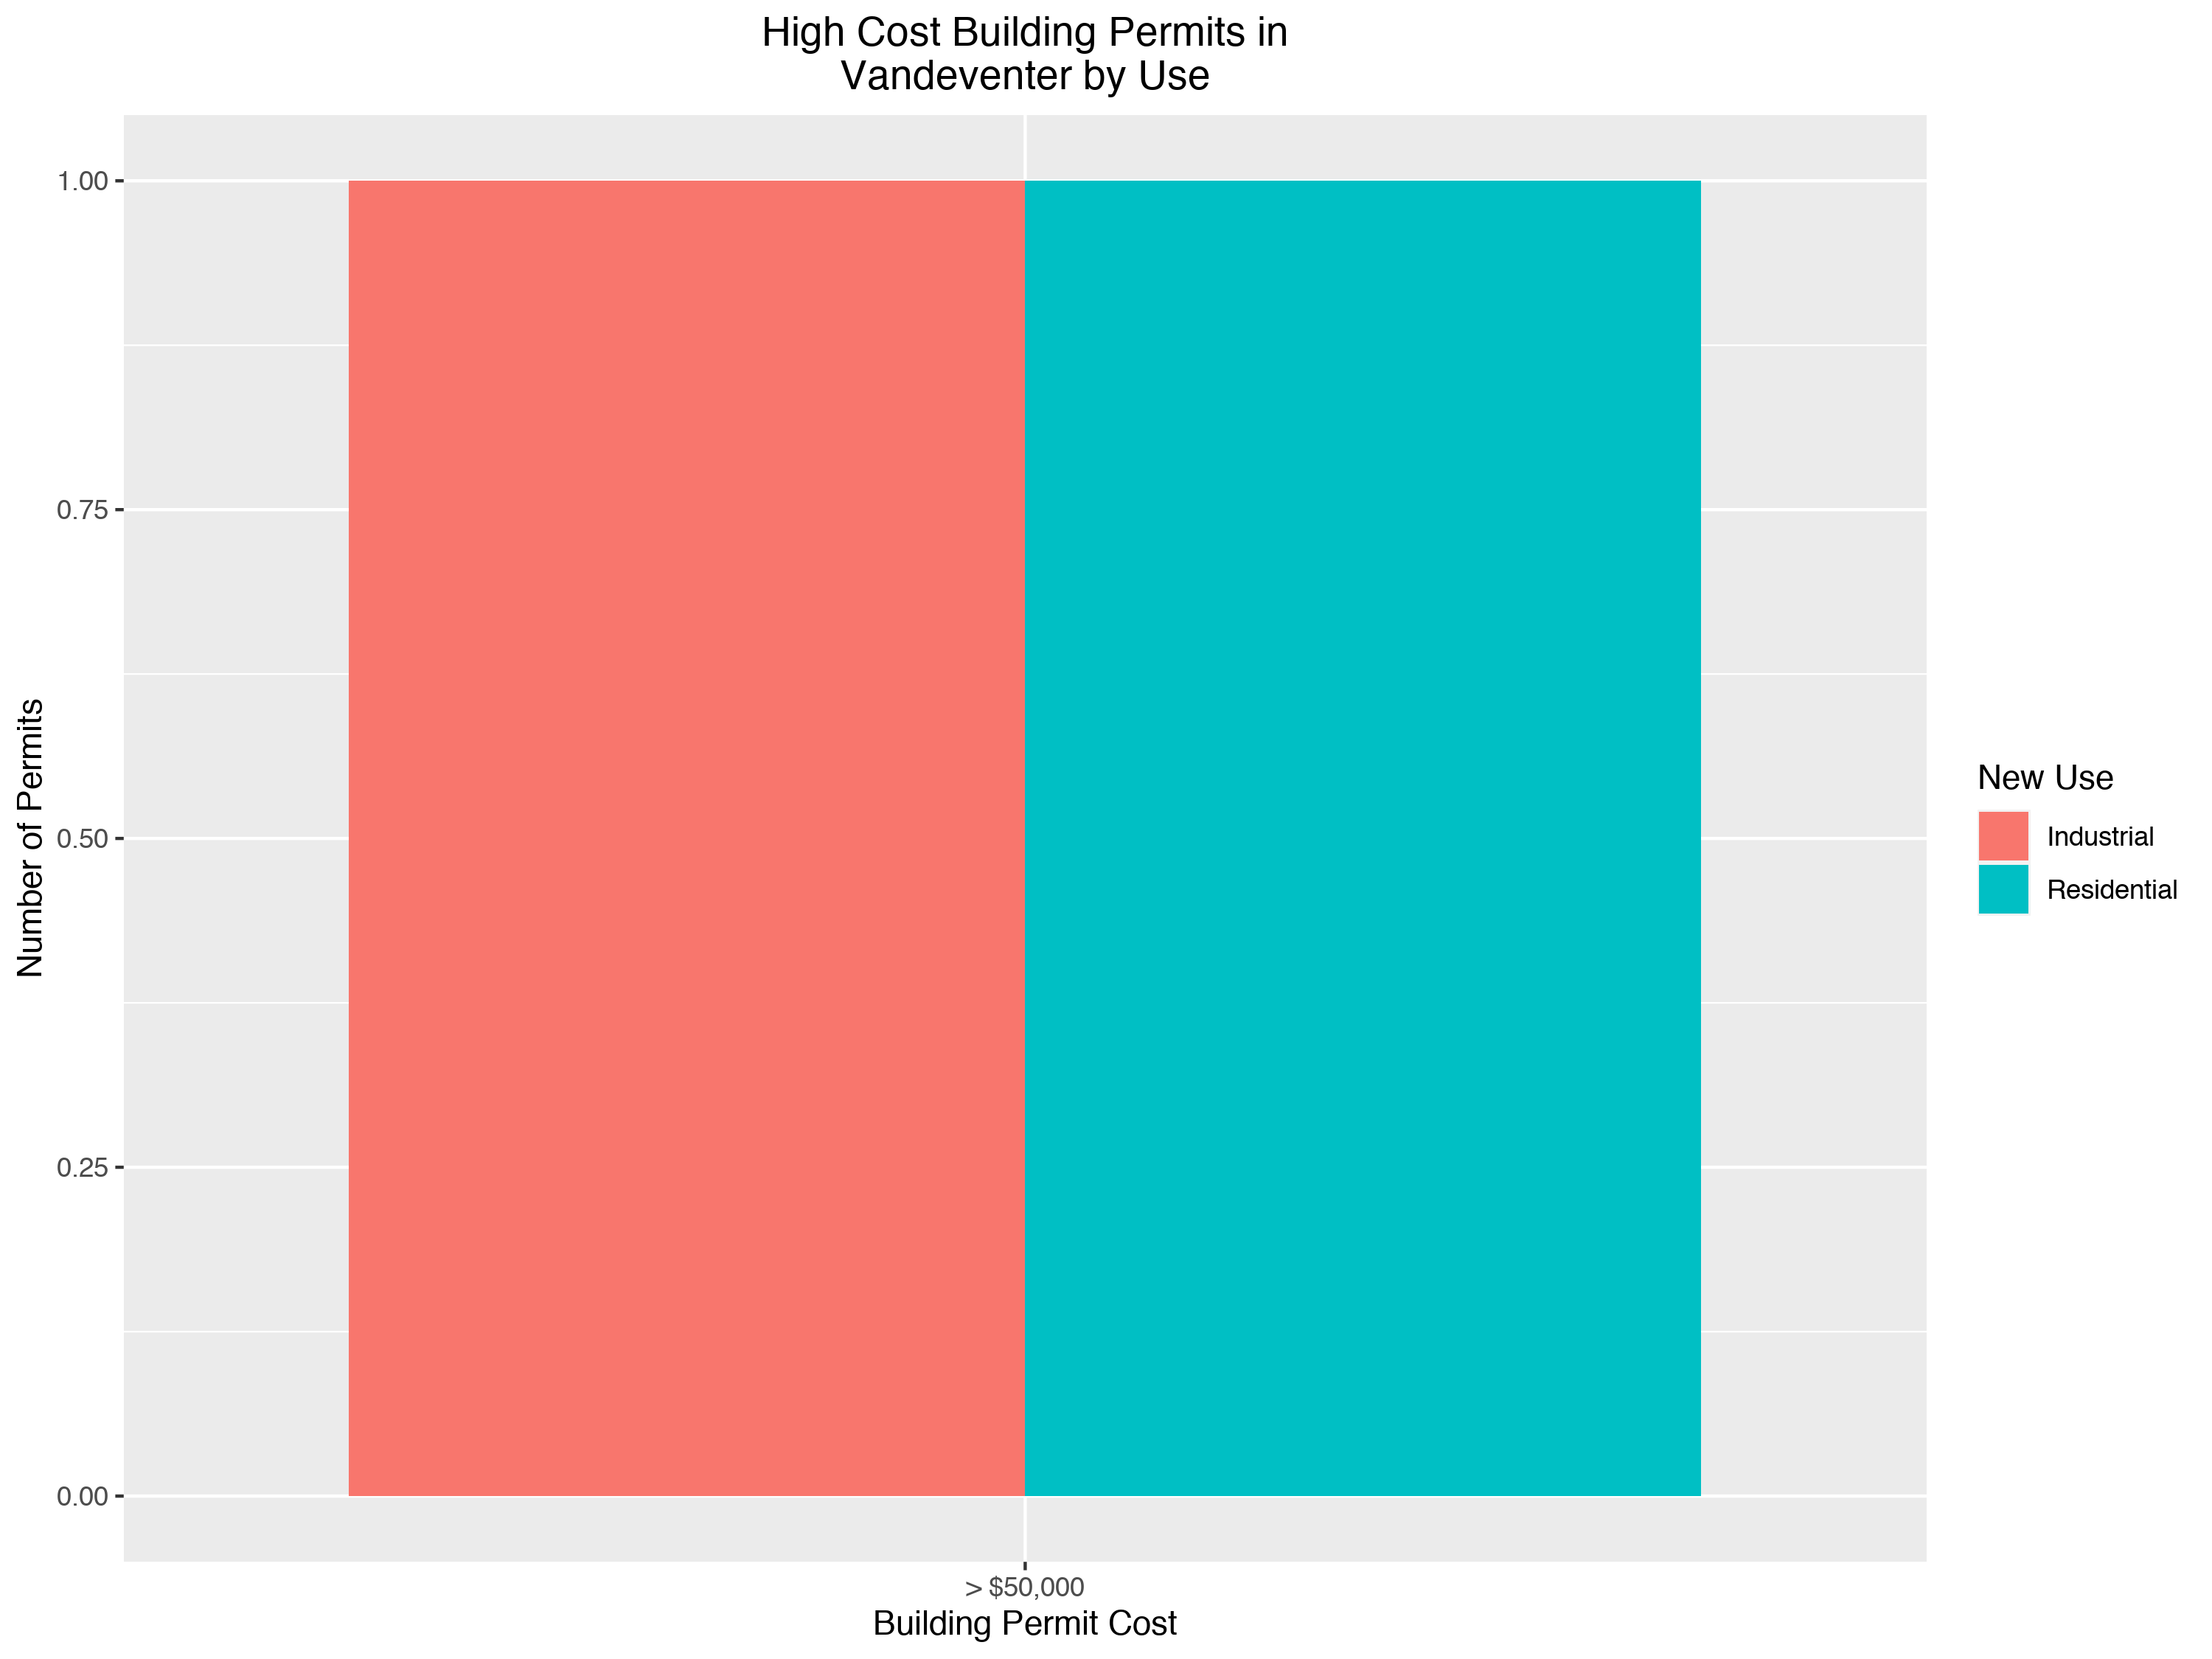

Slide 36
St. Louis Central Corridor West Building Permits
January
2020

