Slide 1
St. Louis Central Corridor West Building Permits
Monthly Report: 2020

Slide 2
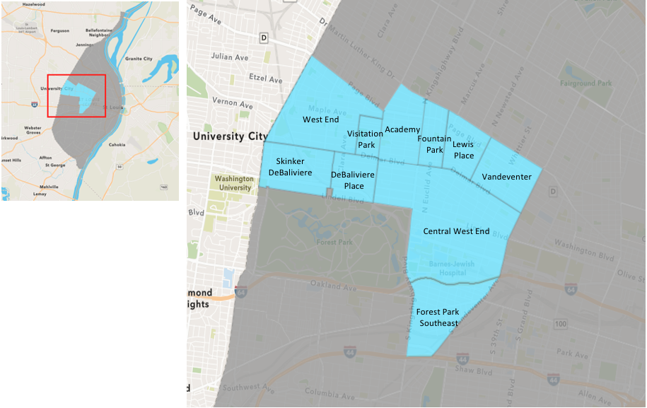
St. Louis Neighborhood Spatial Reference

Slide 3
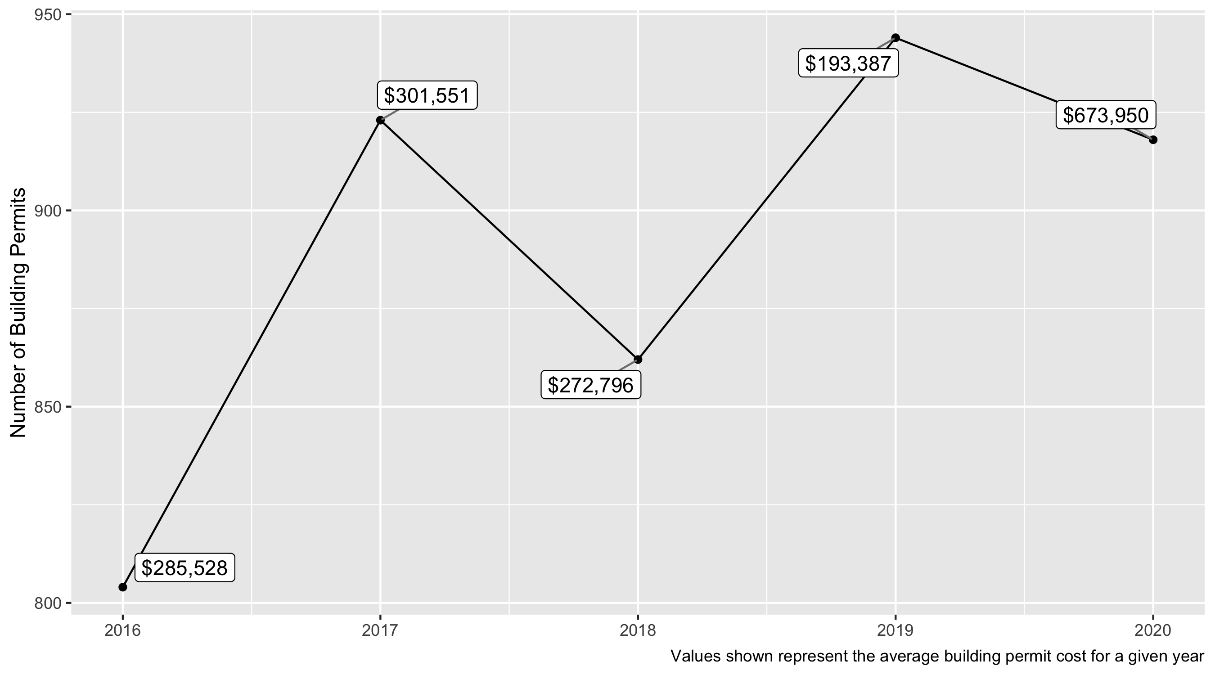
5 Year Analysis

Slide 4
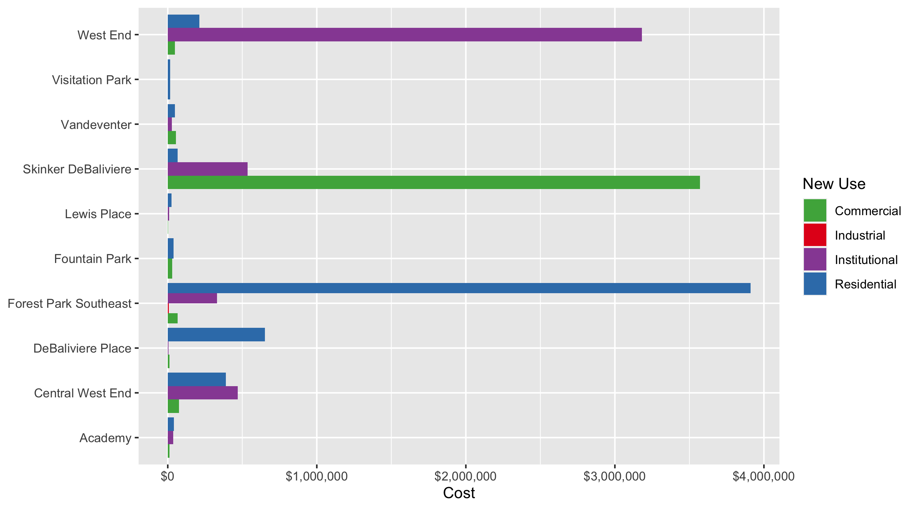
Neighborhood Summary: Average Building Permit Cost

Slide 5
Neighborhood Summary
2020 | 2020 | 2020 | 2020
Neighborhood | Average Cost | # of Permits | Total Value of Permits
Academy | 38,836.6 | 47 | 1,825,319.0
Central West End | 366,177.5 | 431 | 157,822,483.9
DeBaliviere Place | 576,828.5 | 60 | 34,609,709.5
Forest Park Southeast | 2,691,674.5 | 123 | 331,075,965.0
Fountain Park | 38,083.3 | 6 | 228,500.0
Lewis Place | 21,206.5 | 19 | 402,923.0
Skinker DeBaliviere | 544,001.0 | 124 | 67,456,127.0
Vandeventer | 43,846.8 | 16 | 701,549.0
Visitation Park | 14,966.1 | 8 | 119,729.0
West End | 290,999.8 | 84 | 24,443,986.0
2019 | 2019 | 2019 | 2019
Neighborhood | Average Cost | # of Permits | Total Value of Permits
Academy | 54,518.3 | 36 | 1,962,660.0
Central West End | 257,679.8 | 494 | 127,293,823.5
DeBaliviere Place | 50,949.6 | 56 | 2,853,180.0
Forest Park Southeast | 218,408.0 | 172 | 37,566,171.0
Fountain Park | 35,651.4 | 11 | 392,165.0
Lewis Place | 12,511.1 | 9 | 112,600.0
Skinker DeBaliviere | 21,078.1 | 75 | 1,580,854.0
Vandeventer | 111,850.1 | 33 | 3,691,052.0
Visitation Park | 8,000.0 | 1 | 8,000.0
West End | 124,498.2 | 57 | 7,096,399.0

Slide 6
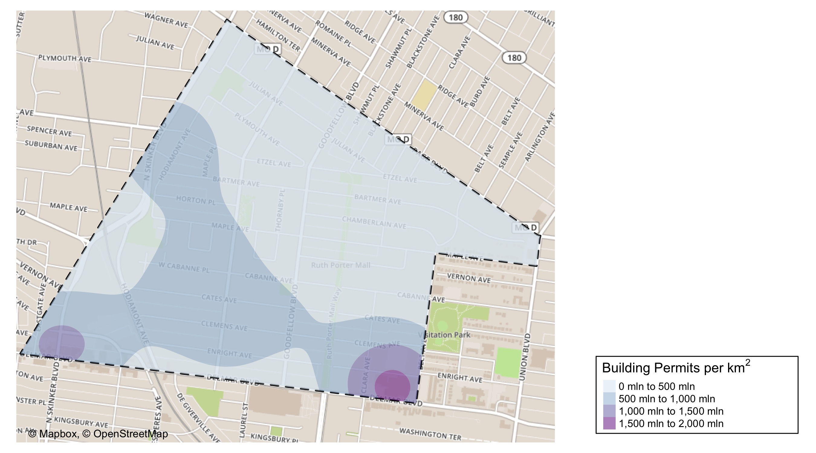
West End: Building Permit Density

Slide 7
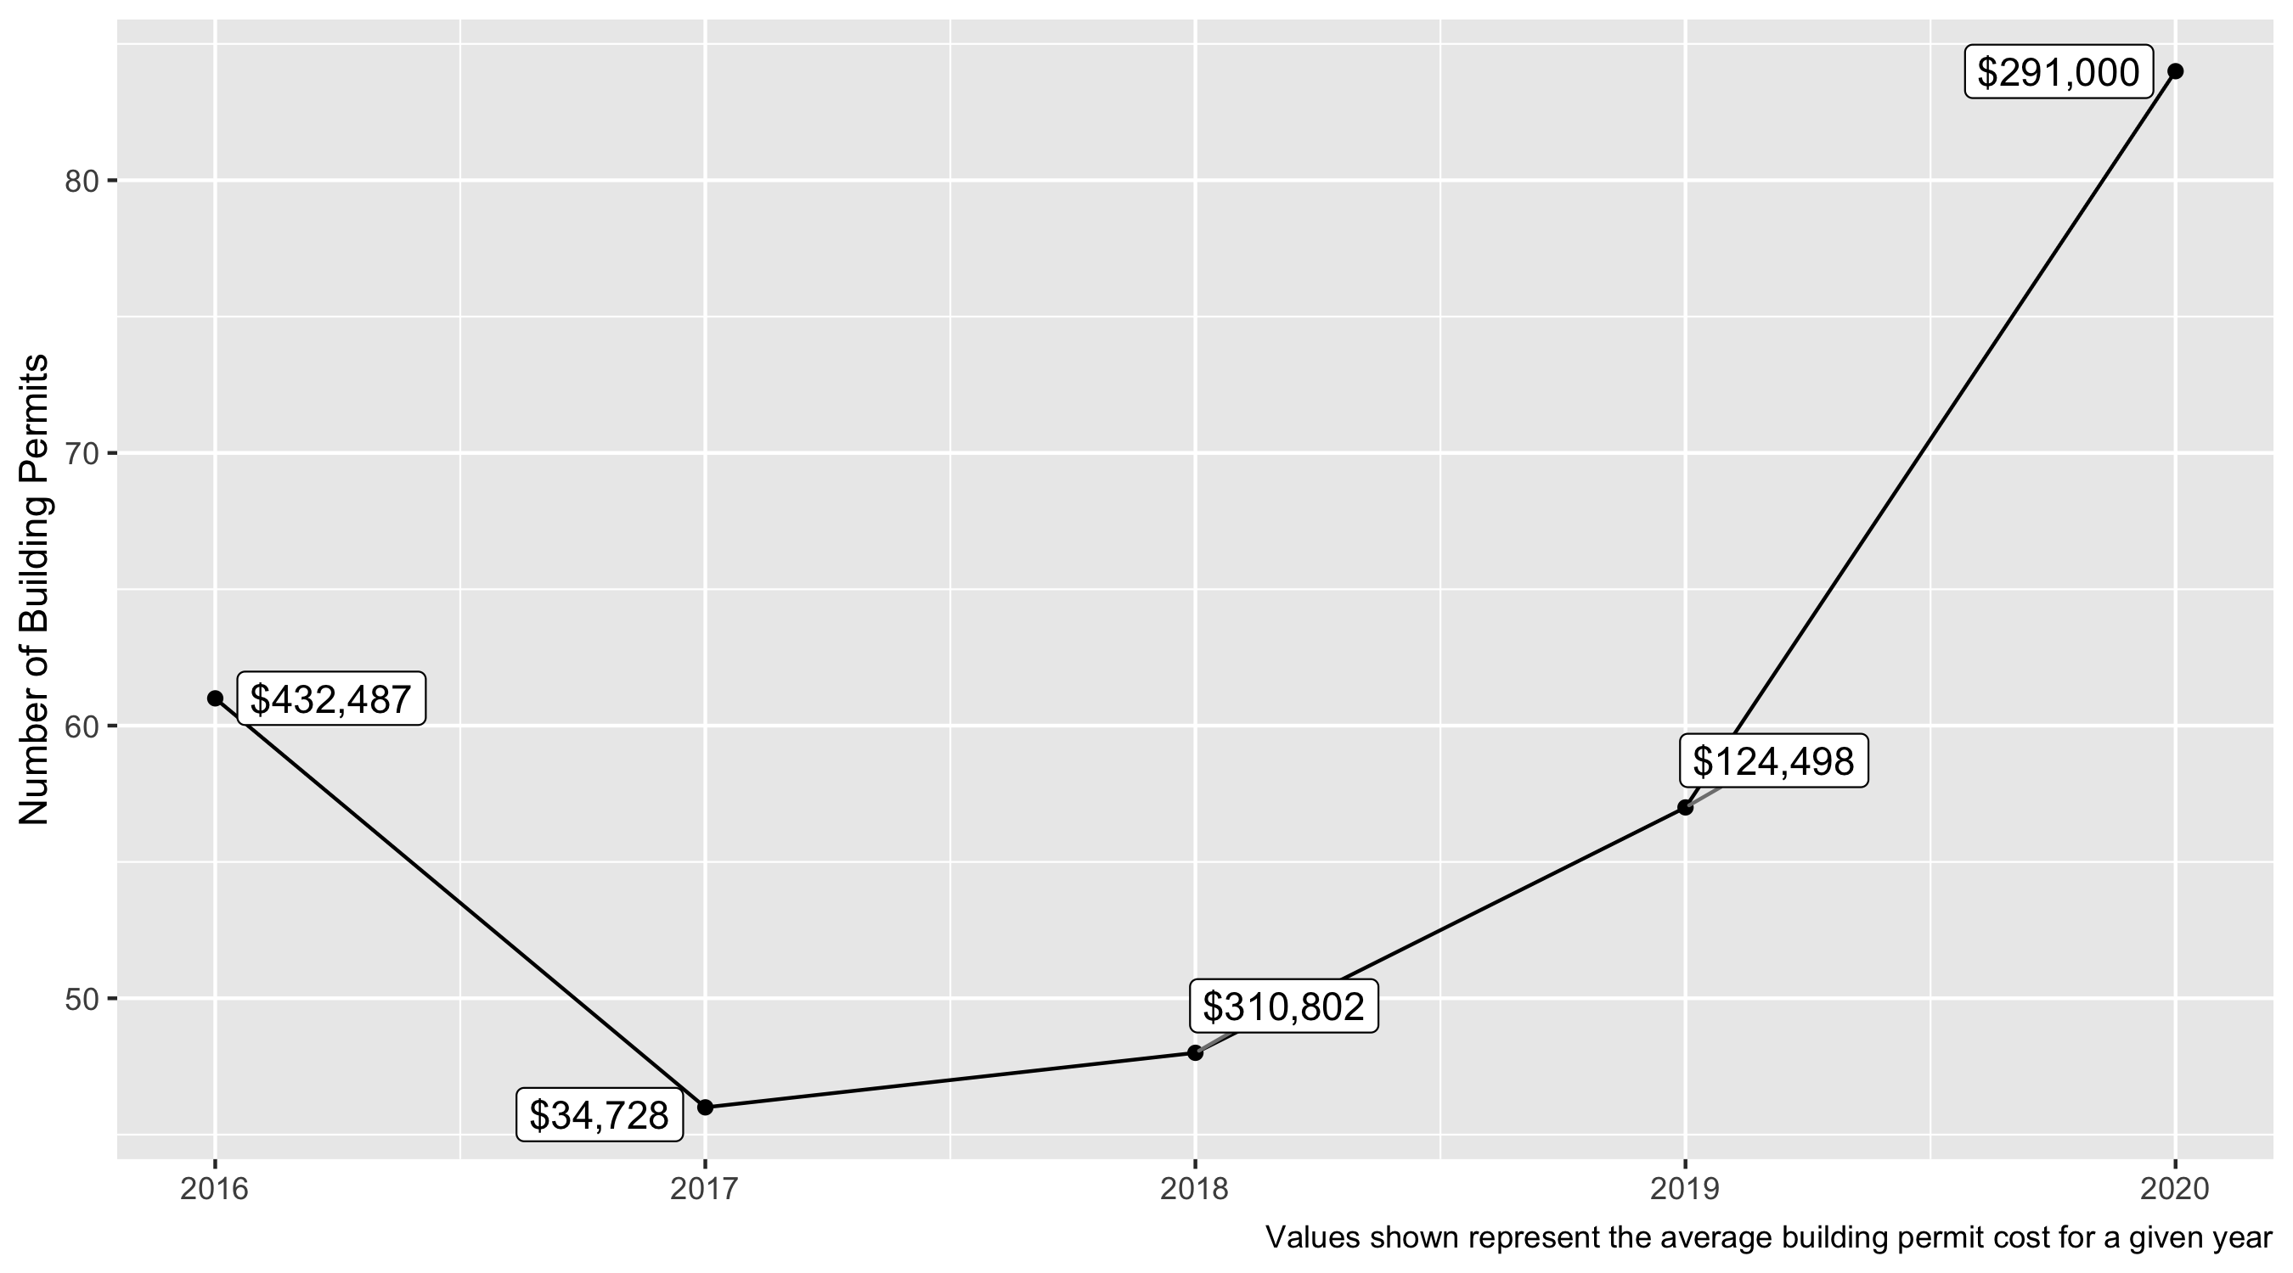
West End 5 Year Analysis
In the West End there were over 80 building permits issued in 2020
In 2020 the average building permit cost was $291,000 compared to an average building permit cost of $124,498 in 2019.

Slide 8
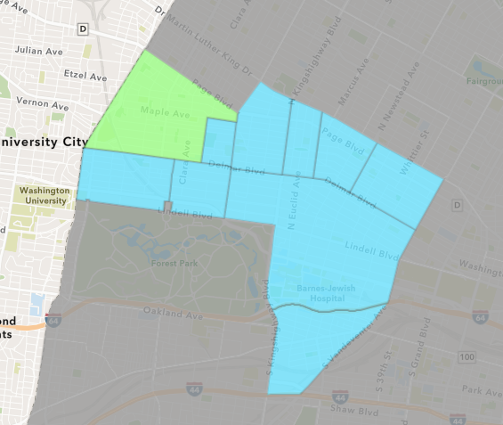
West End
2020 Neighborhood Cost Breakdown
Mean: $291,000
Median: $6,750
Range: $400 - $10,840,000

Slide 9
West End: Summary Notes
123 building permits in 2020
-28.49% change compared to 2019 (172 total building permits)
$2,691,675: Average building permit cost in 2020
1132.41% change compared to 2019 ($218,408)

Slide 10
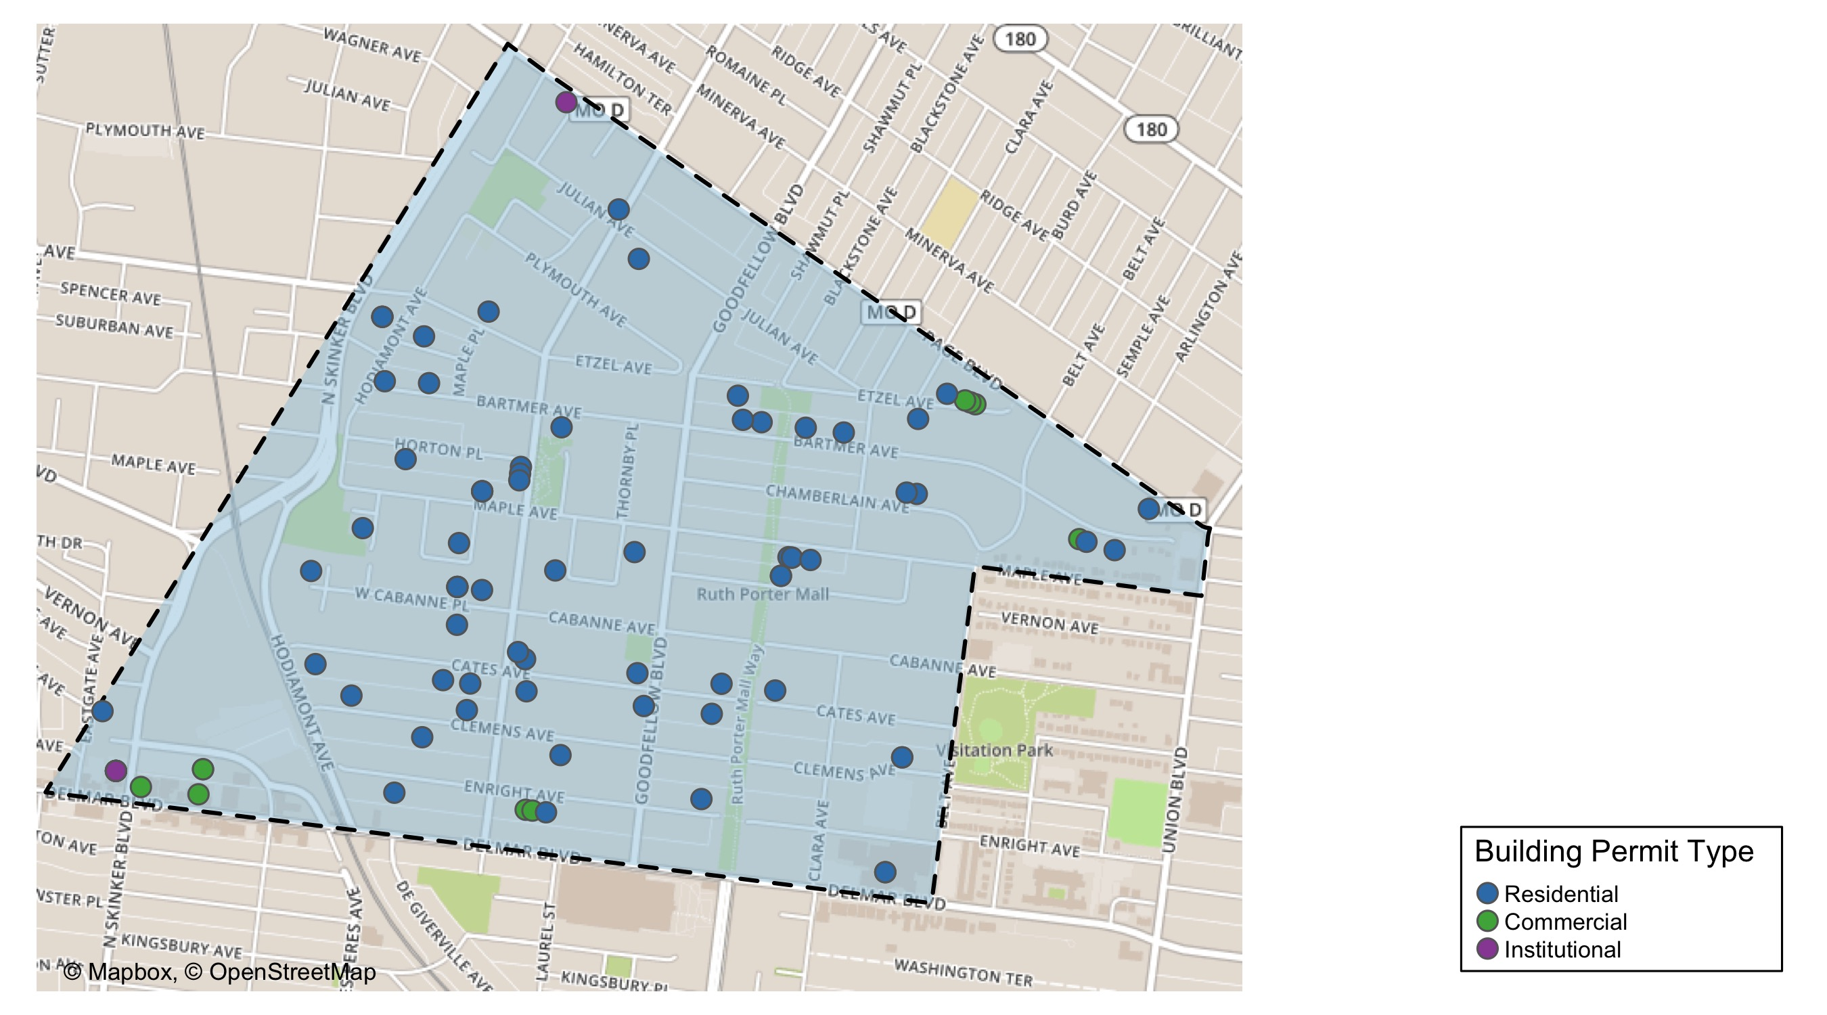
West End

Slide 11
West End
2020 | 2020 | 2020 | 2020
Permit Use | Average Cost | # of Permits | Total Value of Permits
Commercial | 48,391.4 | 14.0 | 677,480.0
Industrial | 0.0 | 0.0 | 0.0
Institutional | 3,182,011.7 | 3.0 | 9,546,035.0
Residential | 212,245.8 | 67.0 | 14,220,471.0
2019 | 2019 | 2019 | 2019
Permit Use | Average Cost | # of Permits | Total Value of Permits
Commercial | 191,700.0 | 9 | 1,725,300.0
Industrial | 30,000.0 | 1 | 30,000.0
Institutional | 350,820.2 | 8 | 2,806,562.0
Residential | 64,988.1 | 39 | 2,534,537.0

Slide 12
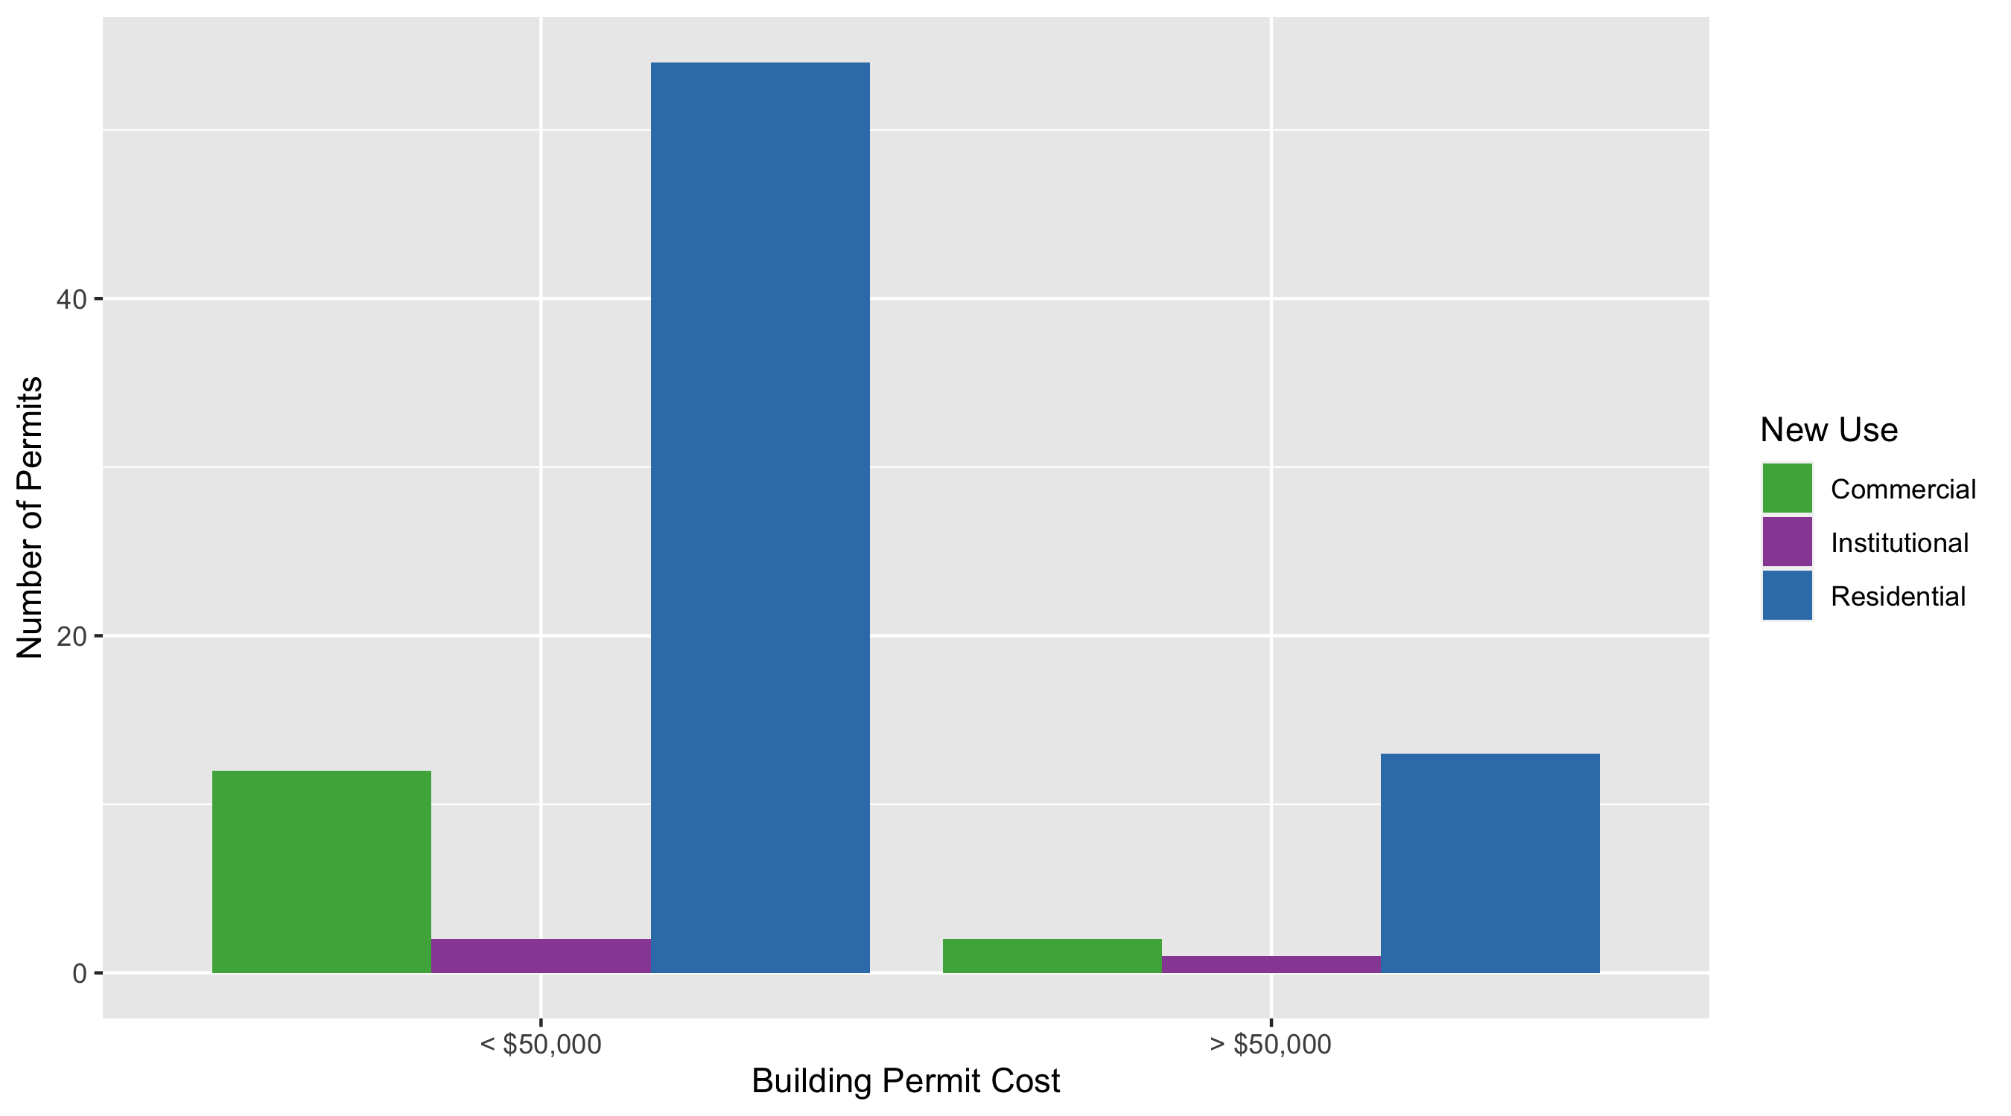
West End Permit Cost Breakdown

Slide 13
Visitation Park: Building Permit Density

Slide 14
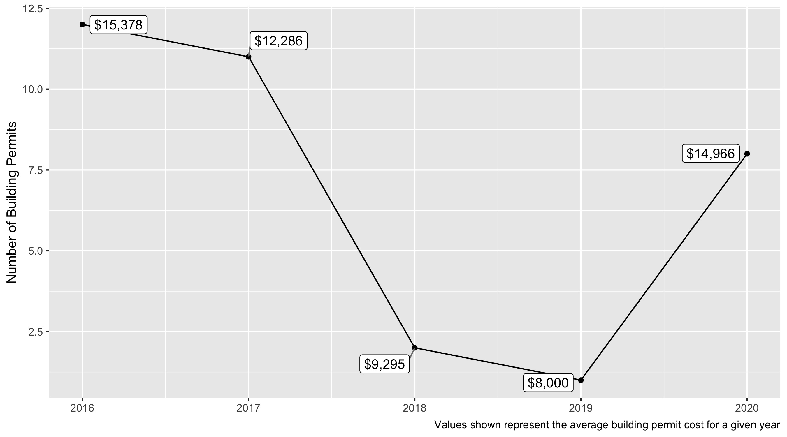
Visitation Park 5 Year Analysis
In Visitation Park 8 building permits issued in 2020 compared to just 1 issued in 2019.
In 2020 the average building permit cost in Visitation Park was $14,966.

Slide 15
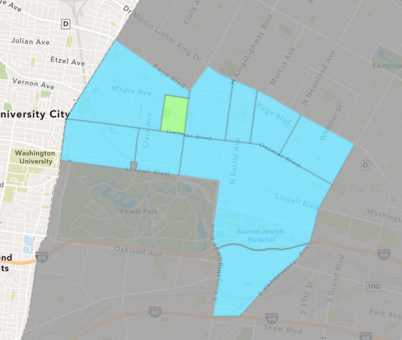
Visitation Park
2020 Neighborhood Cost Breakdown
Mean: $14,966
Median: $7,512
Range: $2,500 - $65,544

Slide 16
Visitation Park: Summary Notes
8 building permits in 2020
700.00% change compared to 2019 (1 total building permits)
$14,966: Average building permit cost in 2020
87.08% change compared to 2019 ($8,000)

Slide 17
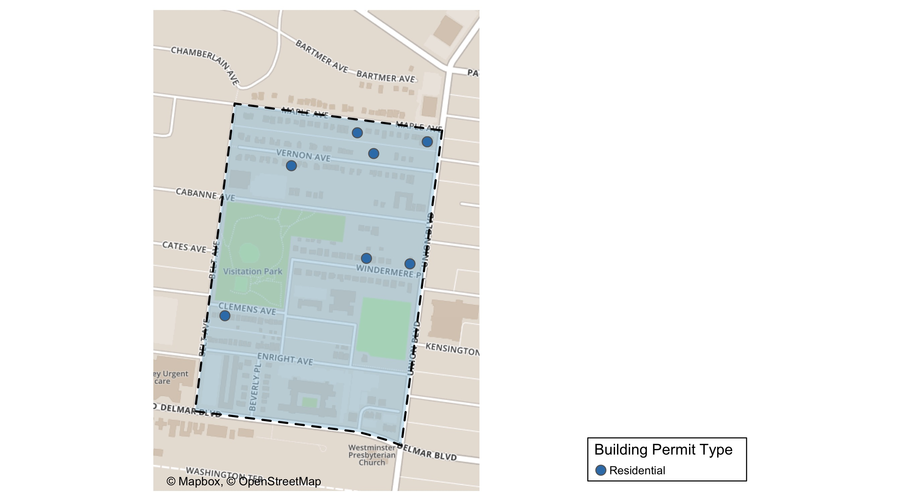
Visitation Park

Slide 18
Visitation Park
2020 | 2020 | 2020 | 2020
Permit Use | Average Cost | # of Permits | Total Value of Permits
Commercial | 0.0 | 0.0 | 0.0
Industrial | 0.0 | 0.0 | 0.0
Institutional | 0.0 | 0.0 | 0.0
Residential | 14,966.1 | 8.0 | 119,729.0
2019 | 2019 | 2019 | 2019
Permit Use | Average Cost | # of Permits | Total Value of Permits
Commercial | 0.0 | 0.0 | 0.0
Industrial | 0.0 | 0.0 | 0.0
Institutional | 0.0 | 0.0 | 0.0
Residential | 8,000.0 | 1.0 | 8,000.0

Slide 19
Visitation Park Individual Permit Breakdown
Owner | New Use | Cost | Address
JOHNSON, KIM M | Residential | 14,000.0 | 5347 VERNON AV
BOHANNON, ANTHONY | Residential | 7,250.0 | 5436 VERNON AV
MONTGOMERY, JUDY TRS | Residential | 6,261.0 | 13 WINDERMERE PL
WWREALESTATEINVEST LLC | Residential | 10,000.0 | 5304-08 MAPLE AV
DU MAINE, JESSICA J | Residential | 65,544.0 | 5470 CLEMENS PL
WWREALESTATEINVEST LLC | Residential | 6,400.0 | 5300-5304 MAPLE AV
BUTLER, BREONA | Residential | 7,774.0 | 5364 MAPLE AV
EVERETT, EDGAR III & | Residential | 2,500.0 | 1 WINDERMERE PL

Slide 20
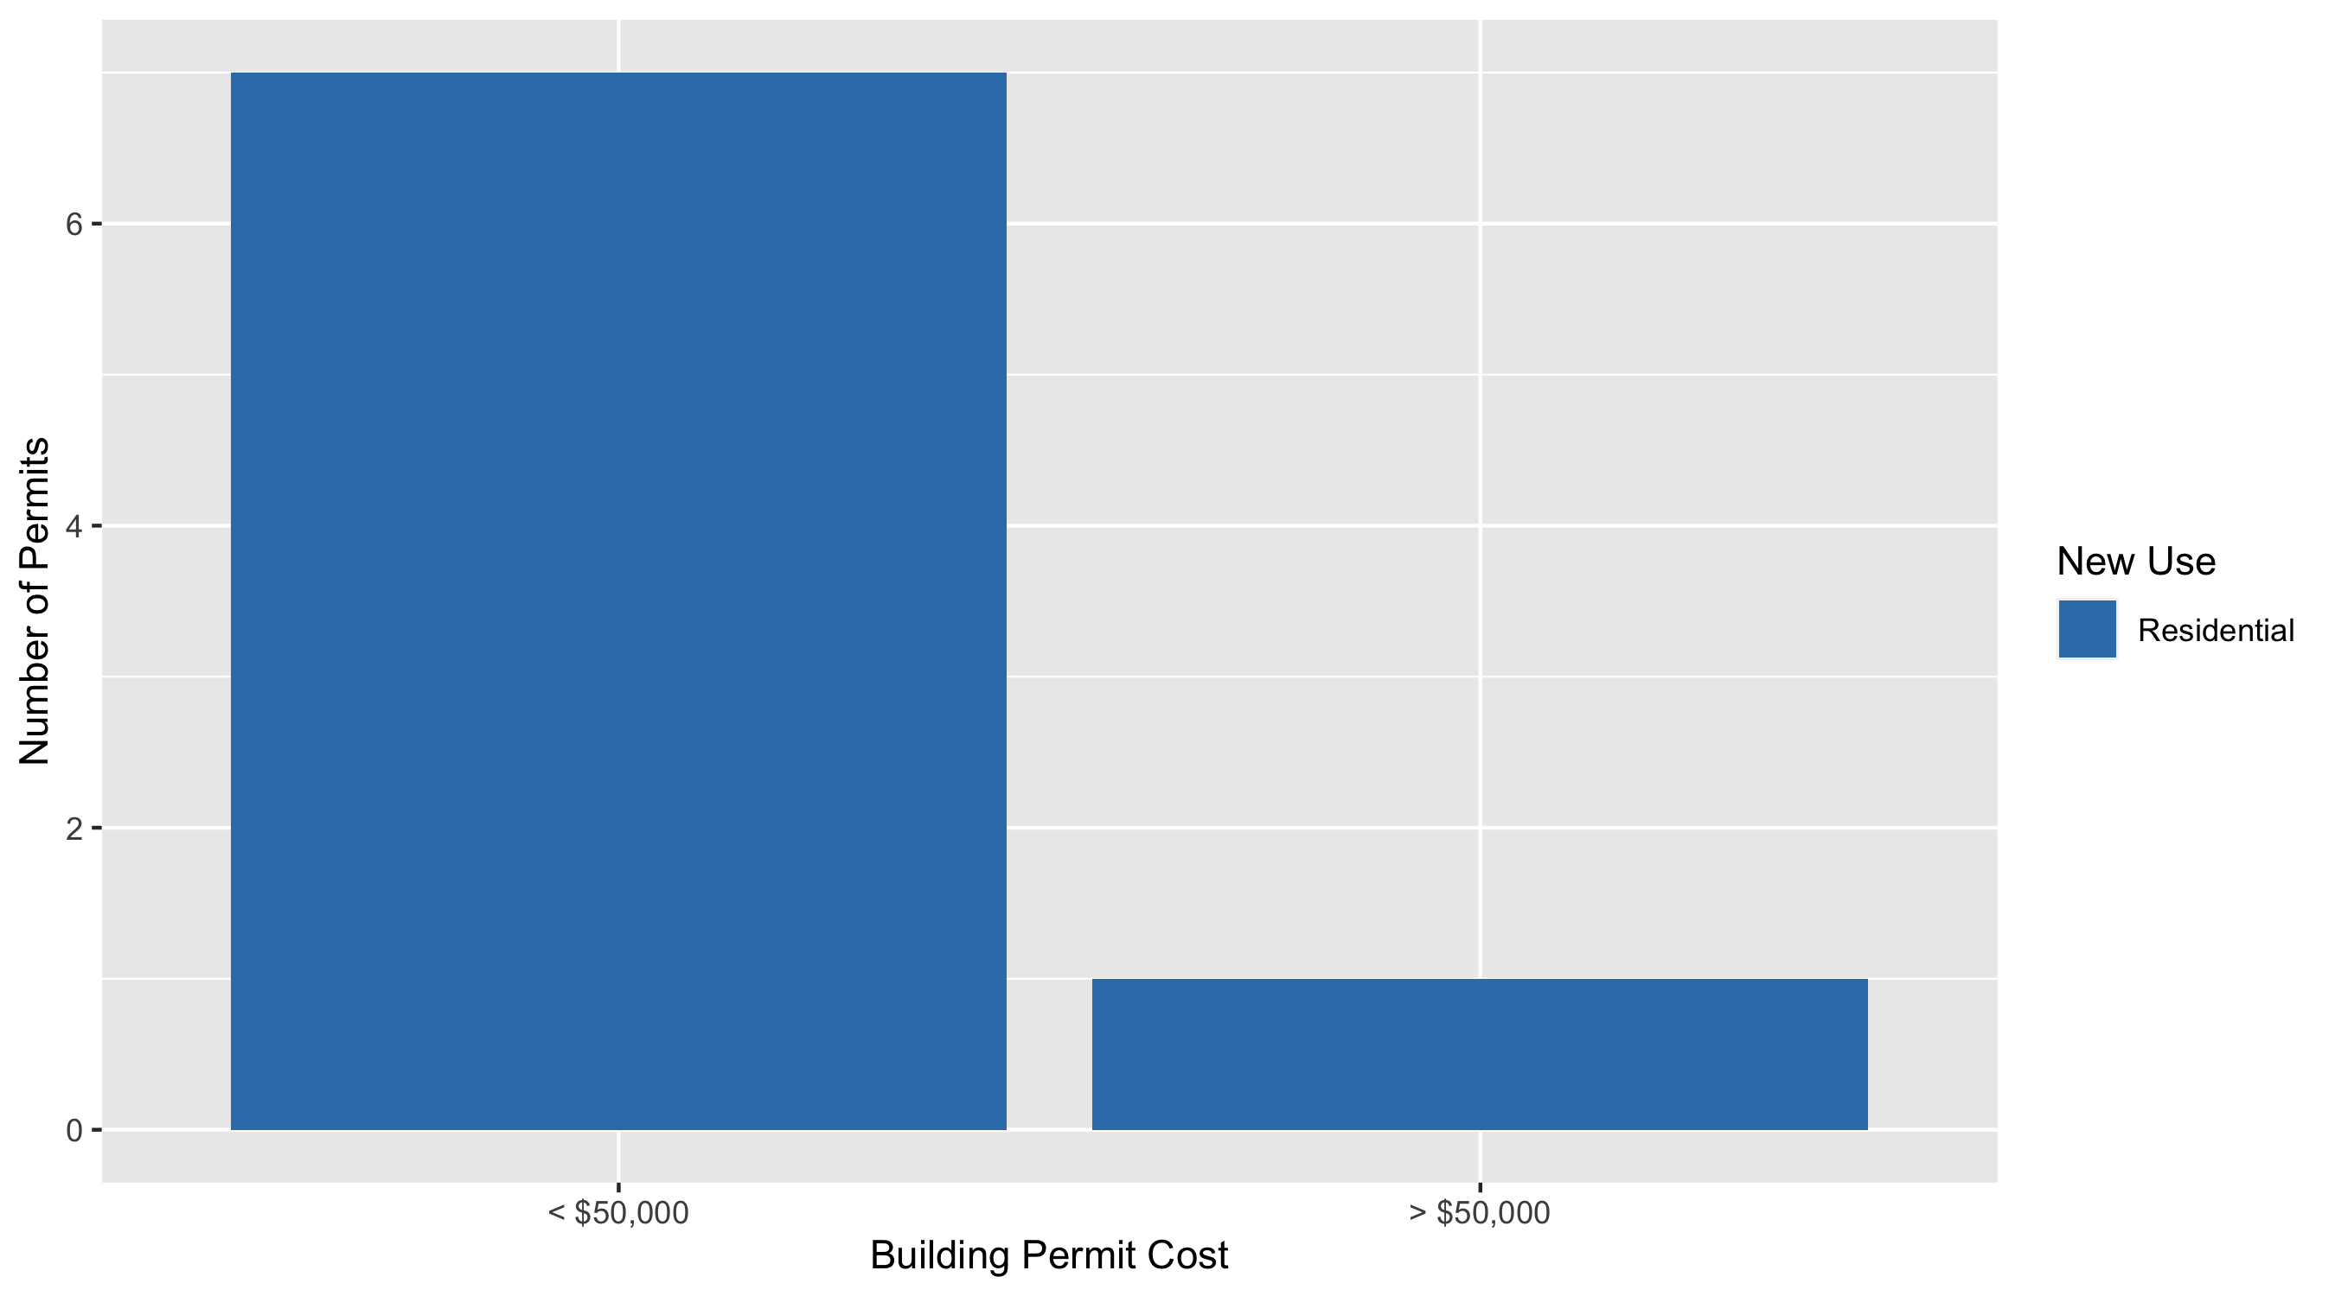
Visitation Park Permit Cost Breakdown

Slide 21
Additional Notes
Data retreived from https://www.stlouis-mo.gov/data/
Building permits with a cost of $0 were dropped
Building permits that were cancelled were dropped
Infinite change indicates 0 permits in the current or previous time period/comparison month so there was a overall increase or decrease

