Slide 2
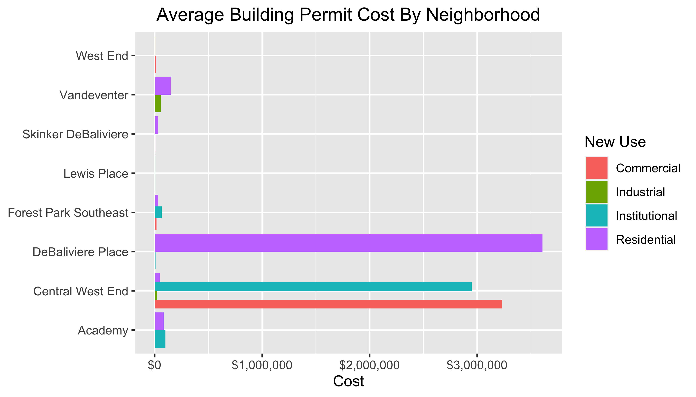

Slide 3
Neighborhood Summary

