Slide 2
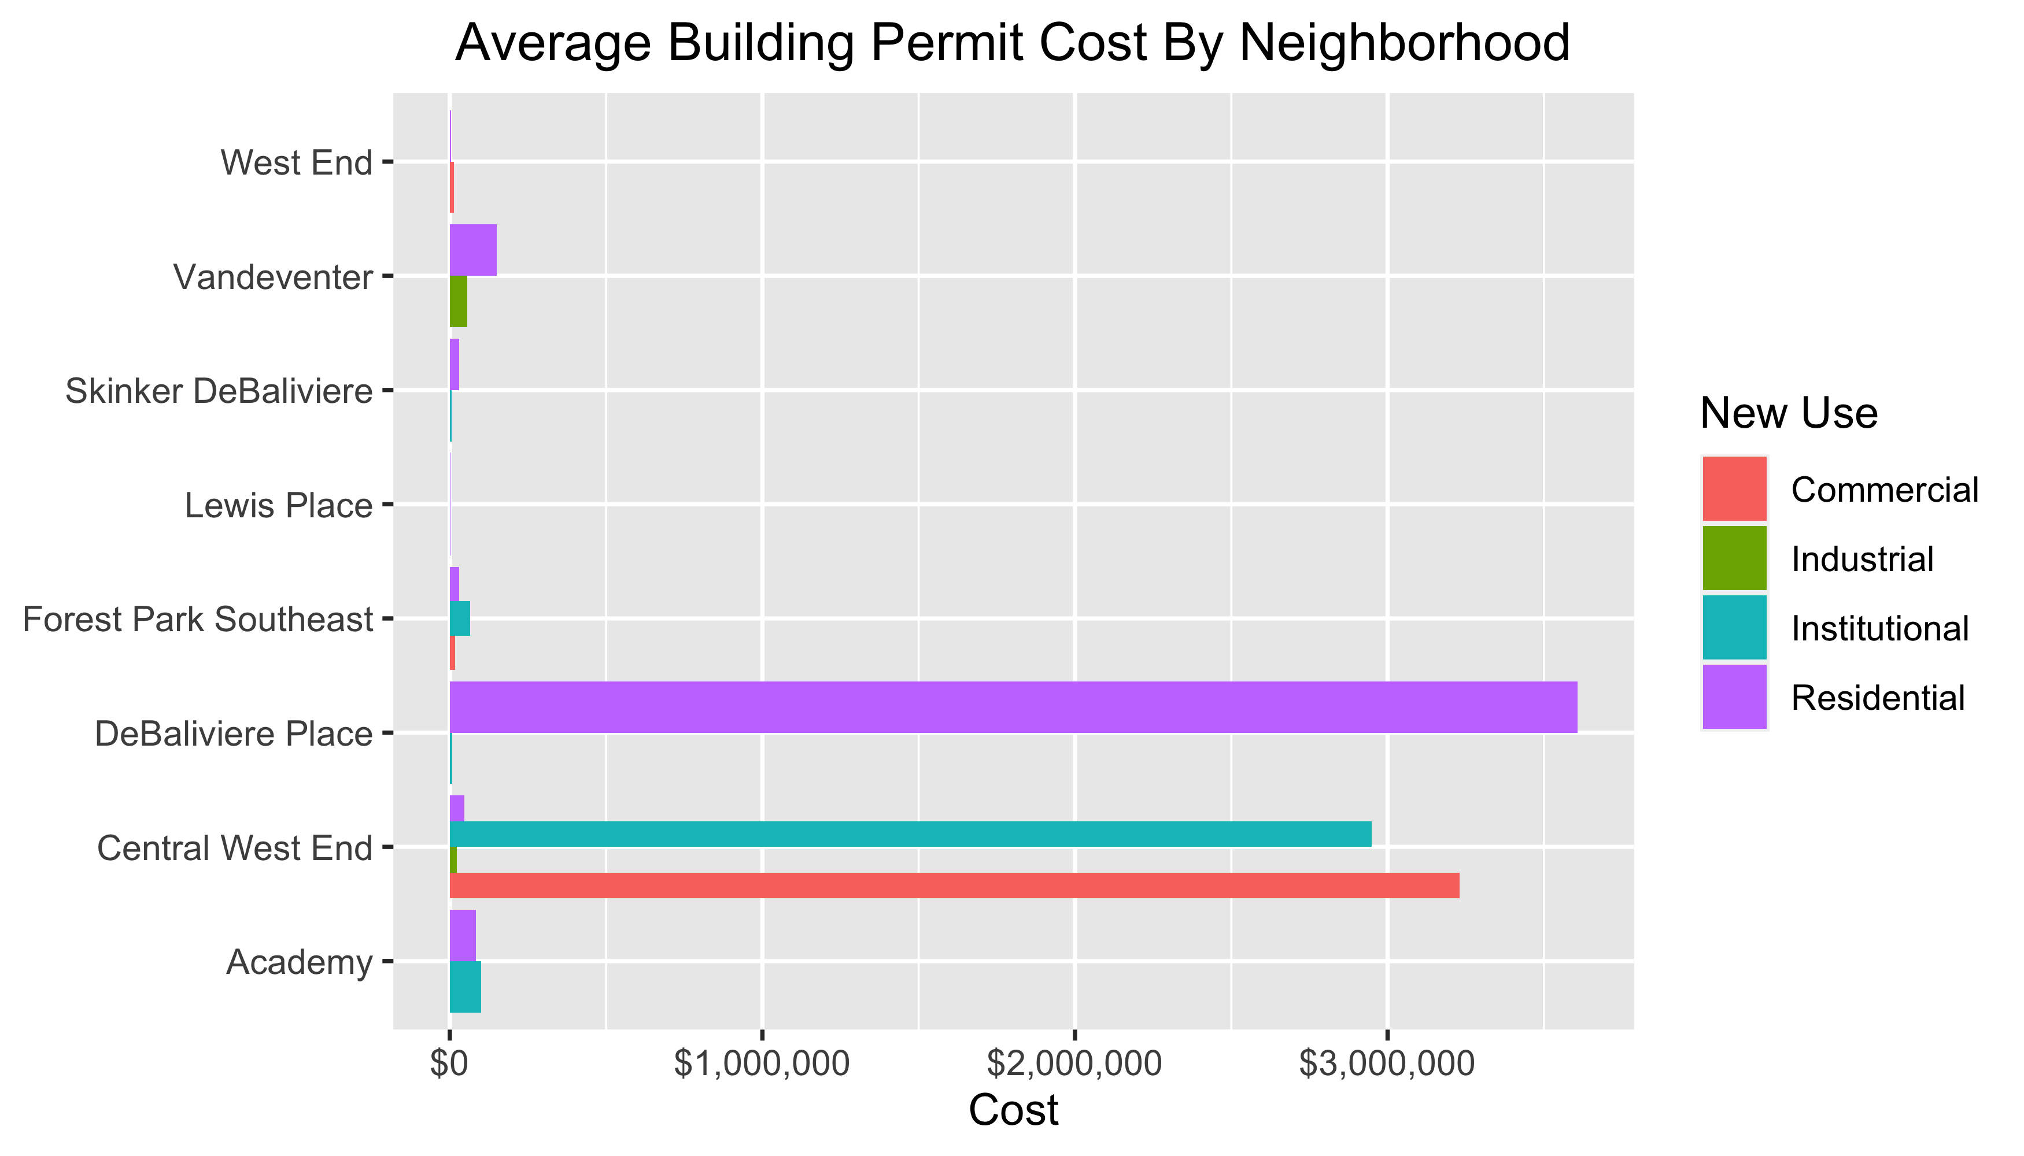

Slide 3
Neighborhood Summary
Neighborhood Summary

