Slide 1
St. Louis Central Corridor West Building Permits
February
2020

Slide 2
Introduction
Data retreived from https://www.stlouis-mo.gov/data/
Building permits with a cost of $0 were dropped
Building permits that were cancelled were dropped
Infinite change indicates 0 permits in the current or previous time period/comparison month so there was a overall increase or decrease

Slide 3
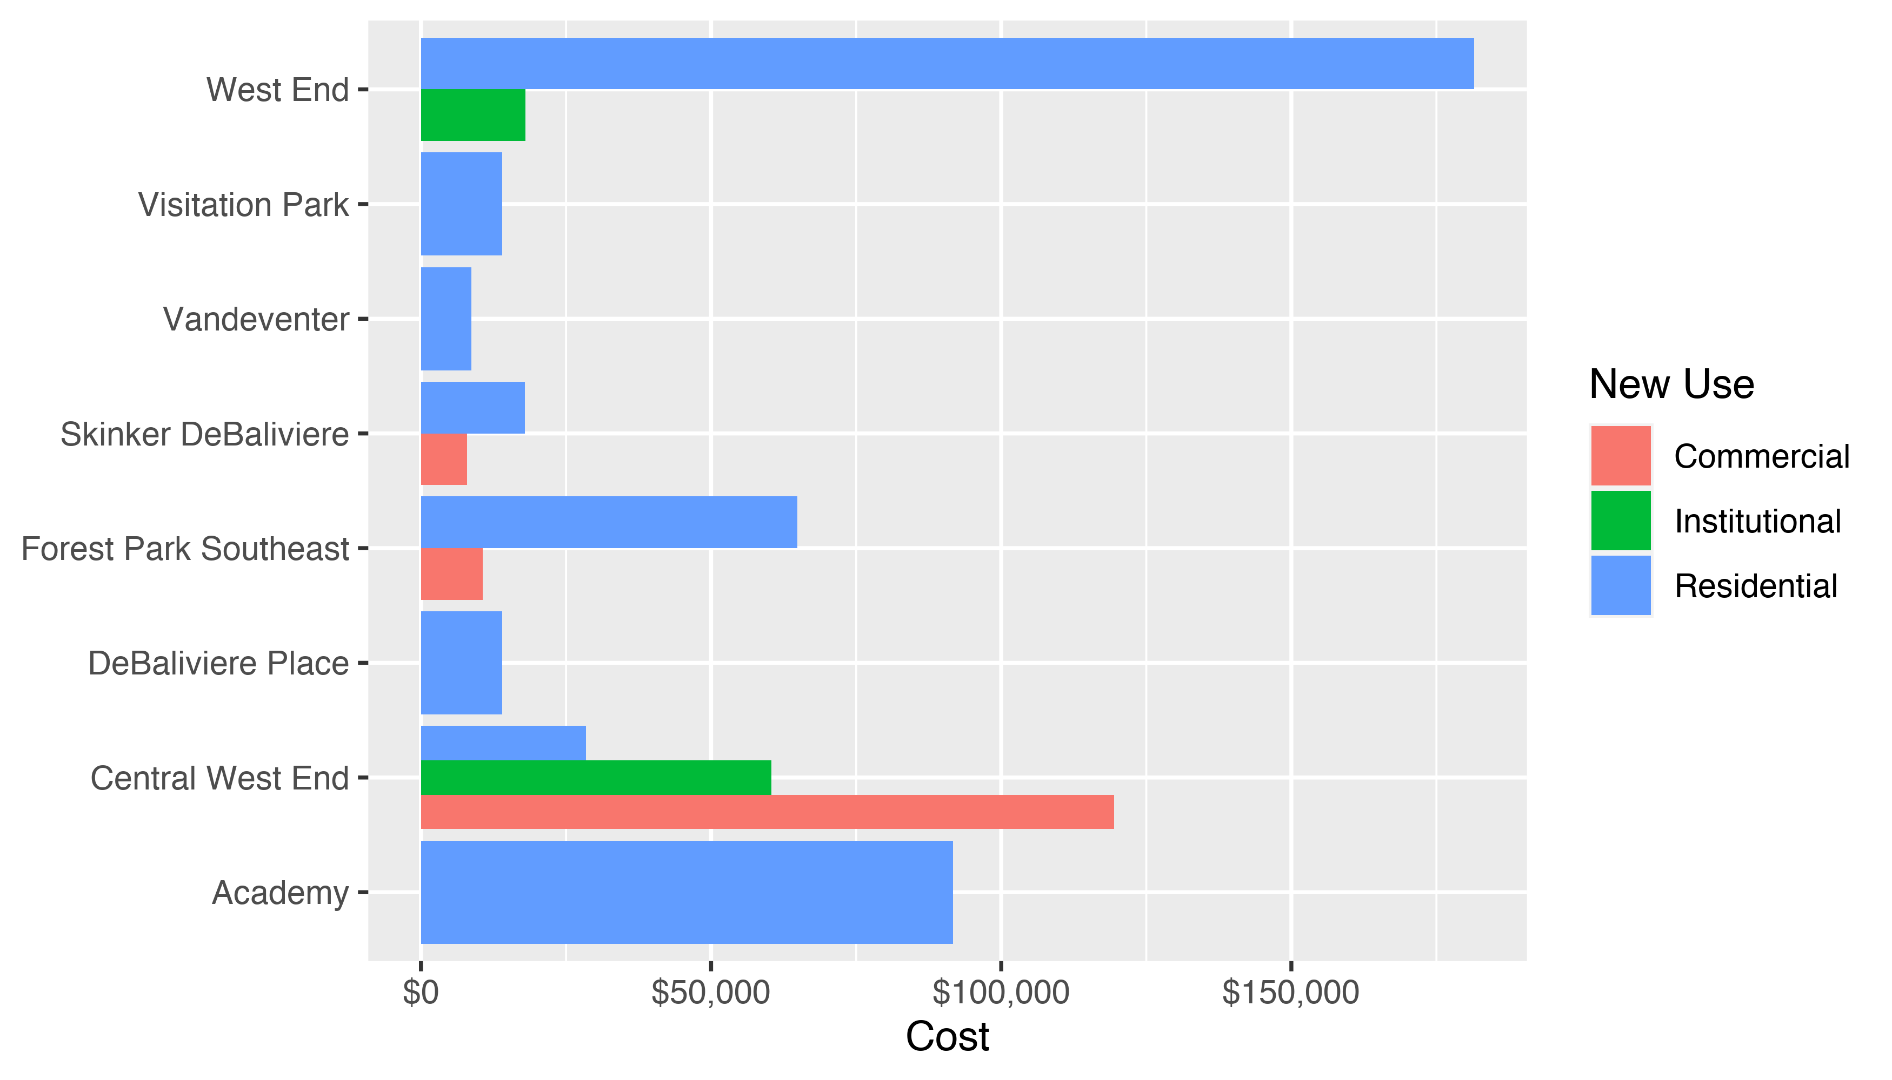
Neighborhood Summary: Average Building Permit Cost

Slide 4
Neighborhood Summary
Neighborhood | Average Cost | # of Permits
Academy | $91,667 | 3
Central West End | $53,581 | 31
DeBaliviere Place | $14,000 | 1
Forest Park Southeast | $46,822 | 9
Skinker DeBaliviere | $16,303 | 19
Vandeventer | $8,731 | 1
Visitation Park | $14,000 | 1
West End | $161,081 | 8

Slide 5
Forest Park Southeast: Summary Notes
9 building permits in Forest Park Southeast in February 2020
-57.14% change compared to February 2019 (21 total building permits)
$46,822 : Average building permit cost in Forest Park Southeast in February 2020
-83.21% change compared to February 2019 ($278,796)

Slide 6
Forest Park Southeast: Summary Notes
18 total building permits in Forest Park Southeast in 2020
-48.57% change compared to this time in 2019 (35 total building permits)
$45,419 : Average building permit cost in Forest Park Southeast in 2020
-80.04% change compared to this time in 2019 ($227,511)

Slide 7
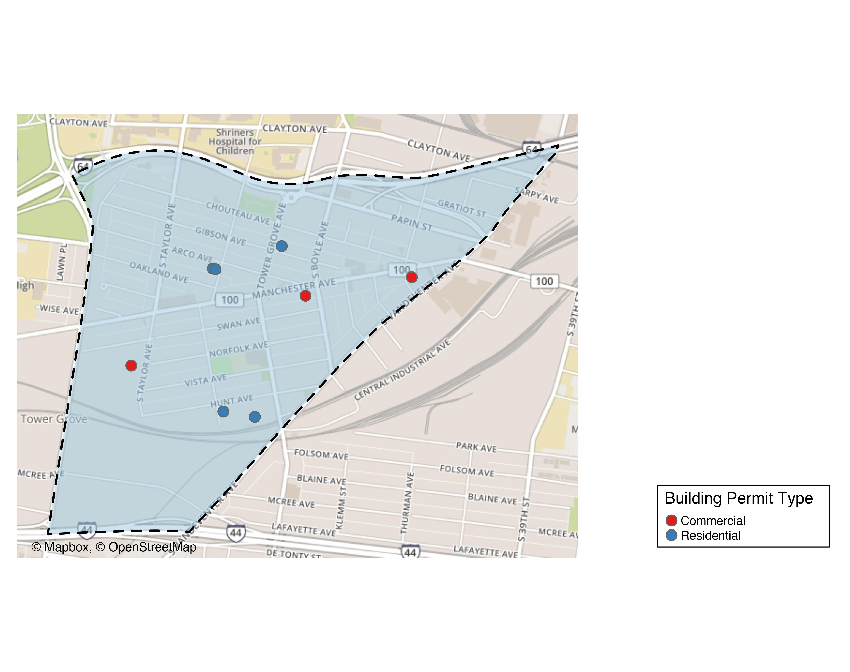
Forest Park Southeast

Slide 8
Forest Park Southeast
New Use | Average Cost | # of Permits
Commercial | $10,667 | 3
Residential | $64,900 | 6

Slide 9
Forest Park Southeast Individual Permit Breakdown
Owner | New Use | Cost | address
MATTSON, LOREEN K | Residential | $12,000 | 4408 ARCO AV
GREEN STREET SWAN INVESTORS LLC | Commercial | $5,500 | 4500 SWAN AV
VONESCHEN, CAROLE ANNE | Residential | $5,650 | 4410 ARCO AV
ROTHSCHILD PROPERTIES WEST END LLC | Commercial | $1,500 | 4054 CHOUTEAU AV
MCDANIEL, JUDITH | Residential | $105,000 | 4359-61 HUNT AV
CHEUNG, ALAN | Commercial | $25,000 | 4216 MANCHESTER AV
WOODWARD LOFTS LLC | Residential | $1,752 | 4300 HUNT AV
GARCIA, ANA LILIA ORTIZ | Residential | $15,000 | 4370 HUNT AV
UIC HOMES LLCPMENT LLC | Residential | $250,000 | 4347 GIBSON AV

Slide 10
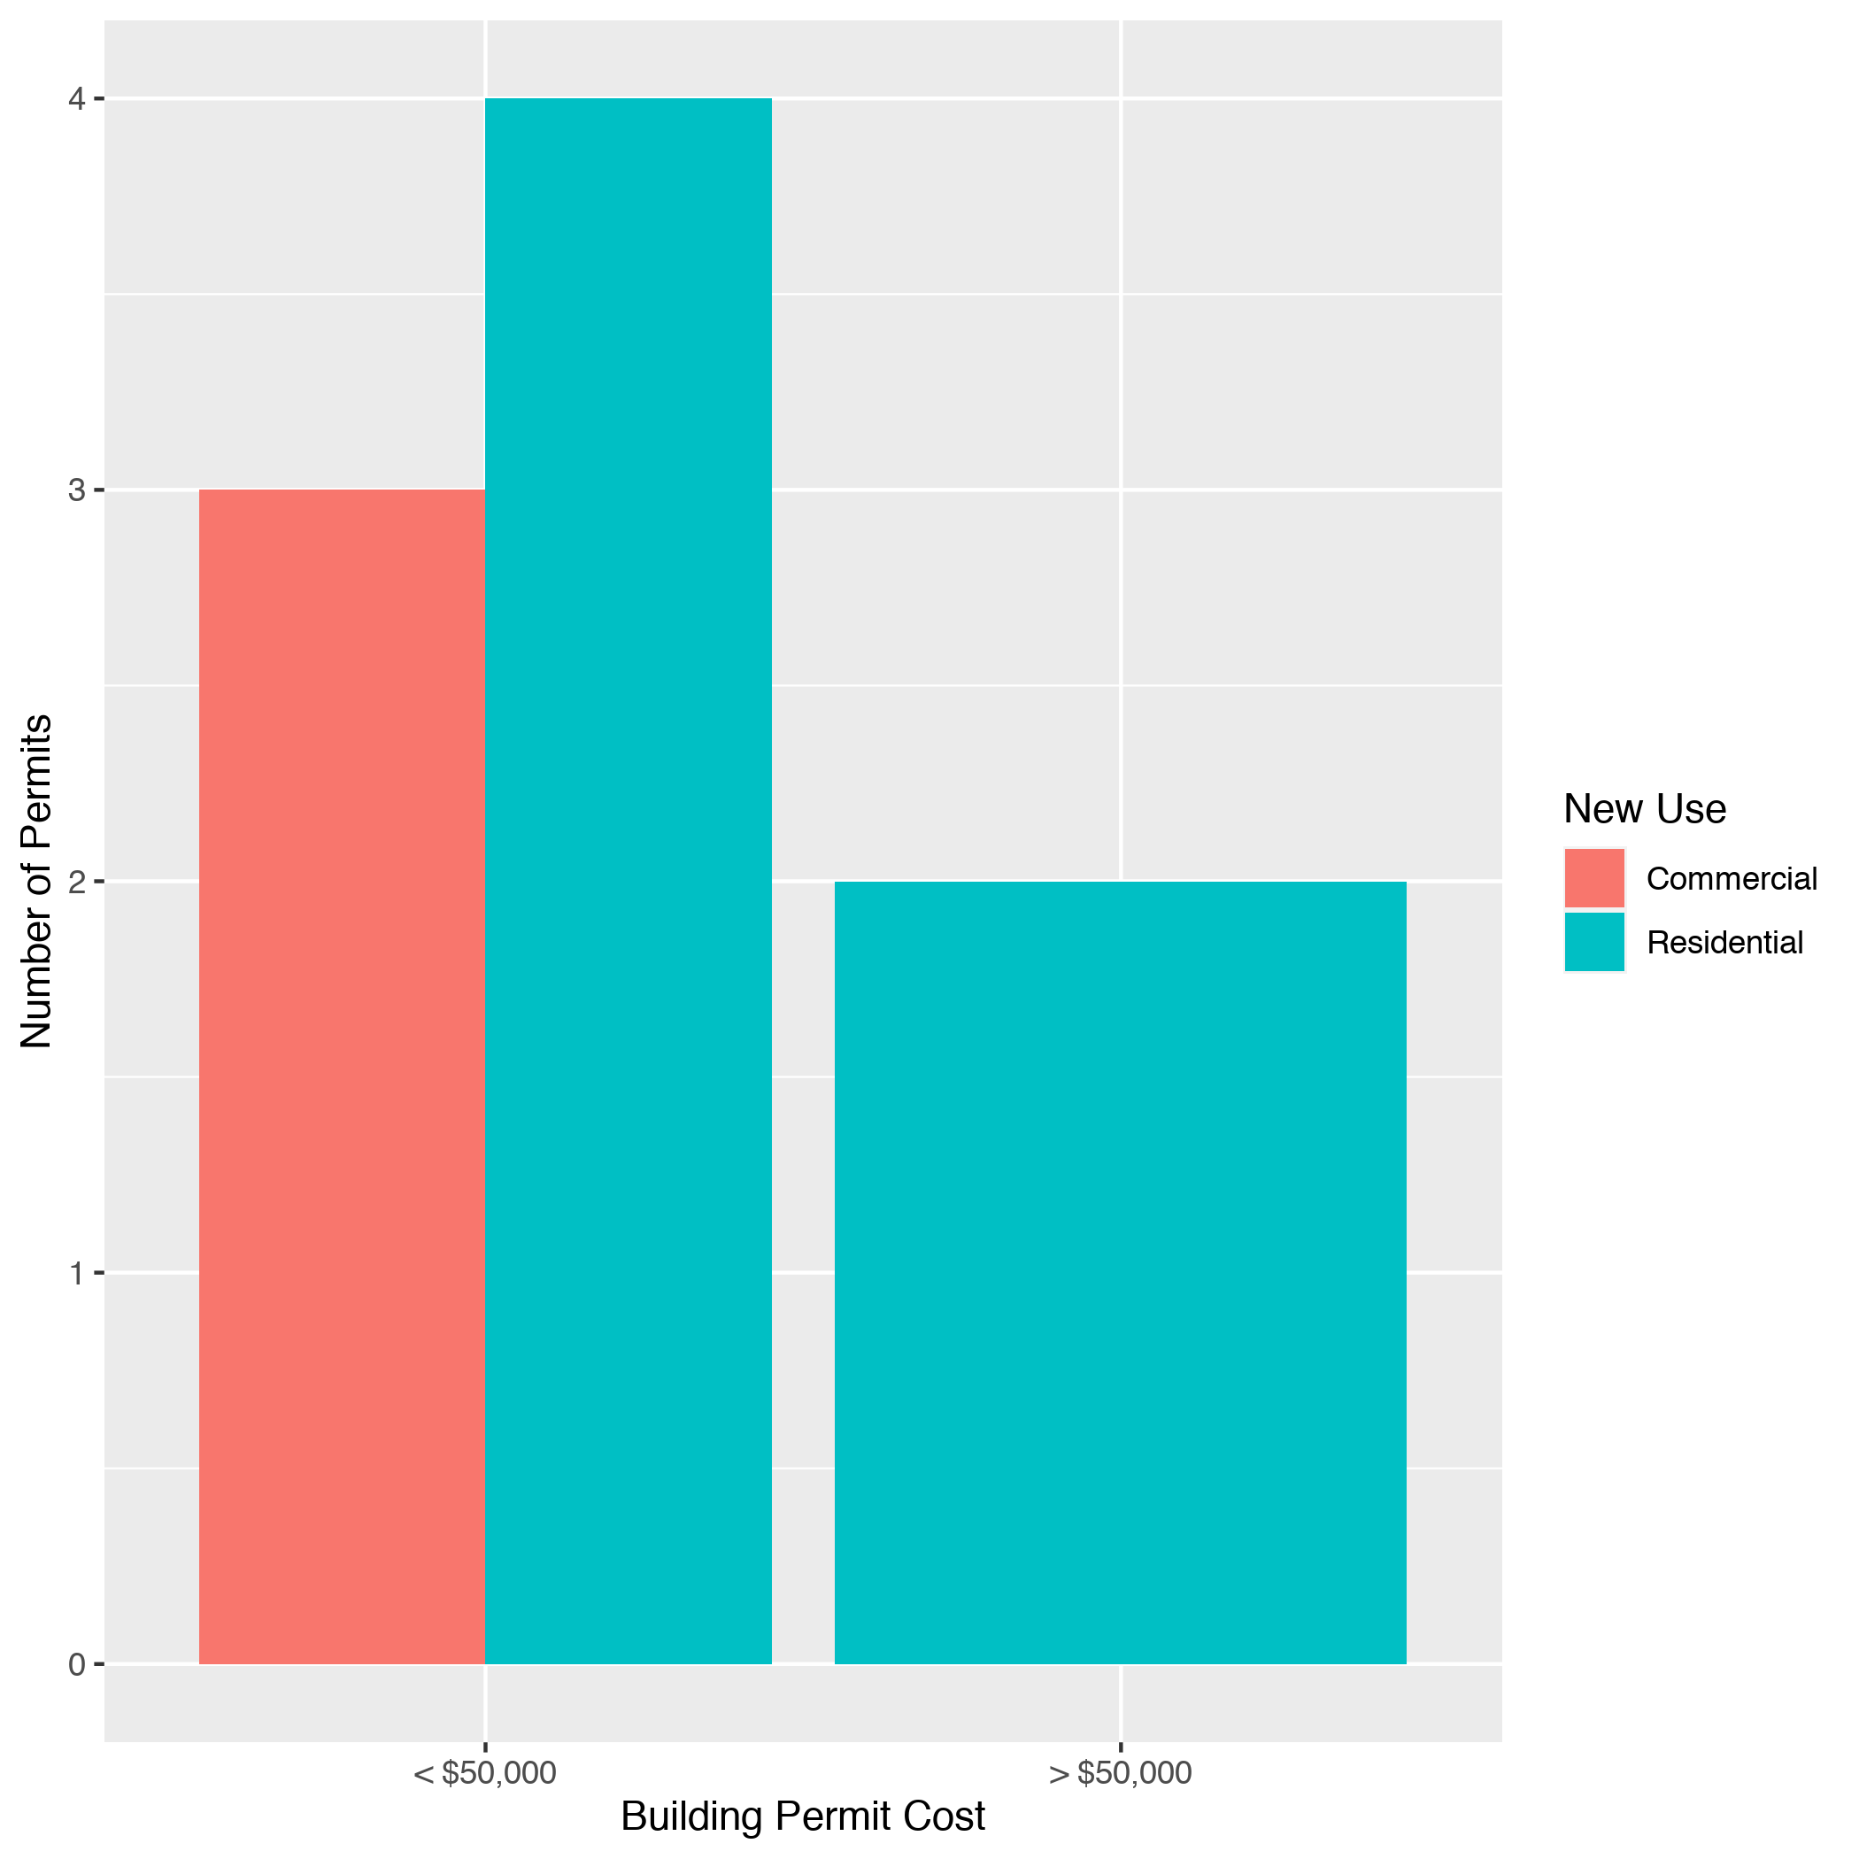
Forest Park Southeast High Cost Permits

Slide 11
Central West End: Summary Notes
31 building permits in Central West End in February 2020
-13.89% change compared to February 2019 (36 total building permits)
$53,581 : Average building permit cost in Central West End in February 2020
-79.53% change compared to February 2019 ($261,797)

Slide 12
Central West End: Summary Notes
68 total building permits in Central West End in 2020
-20.00% change compared to this time in 2019 (85 total building permits)
$1,162,679 : Average building permit cost in Central West End in 2020
607.89% change compared to this time in 2019 ($164,245)

Slide 13
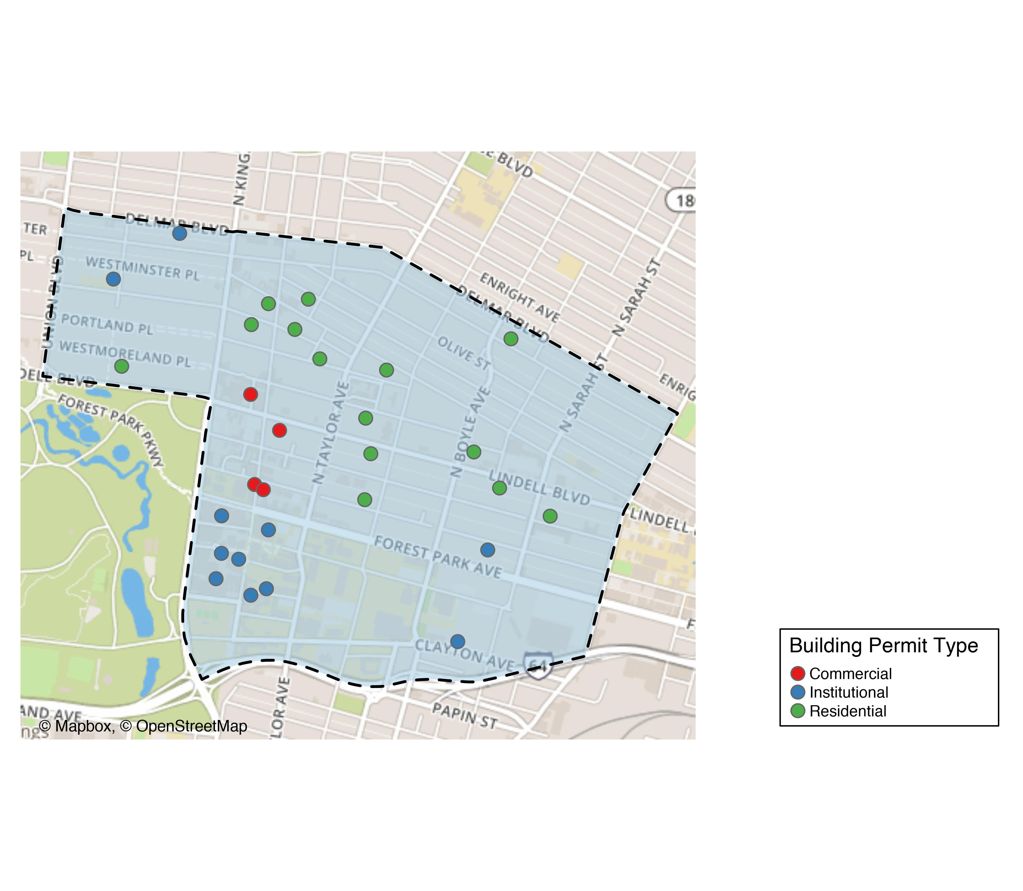
Central West End

Slide 14
Central West End
New Use | Average Cost | # of Permits
Commercial | $119,438 | 4
Institutional | $60,387 | 13
Residential | $28,445 | 14

Slide 15
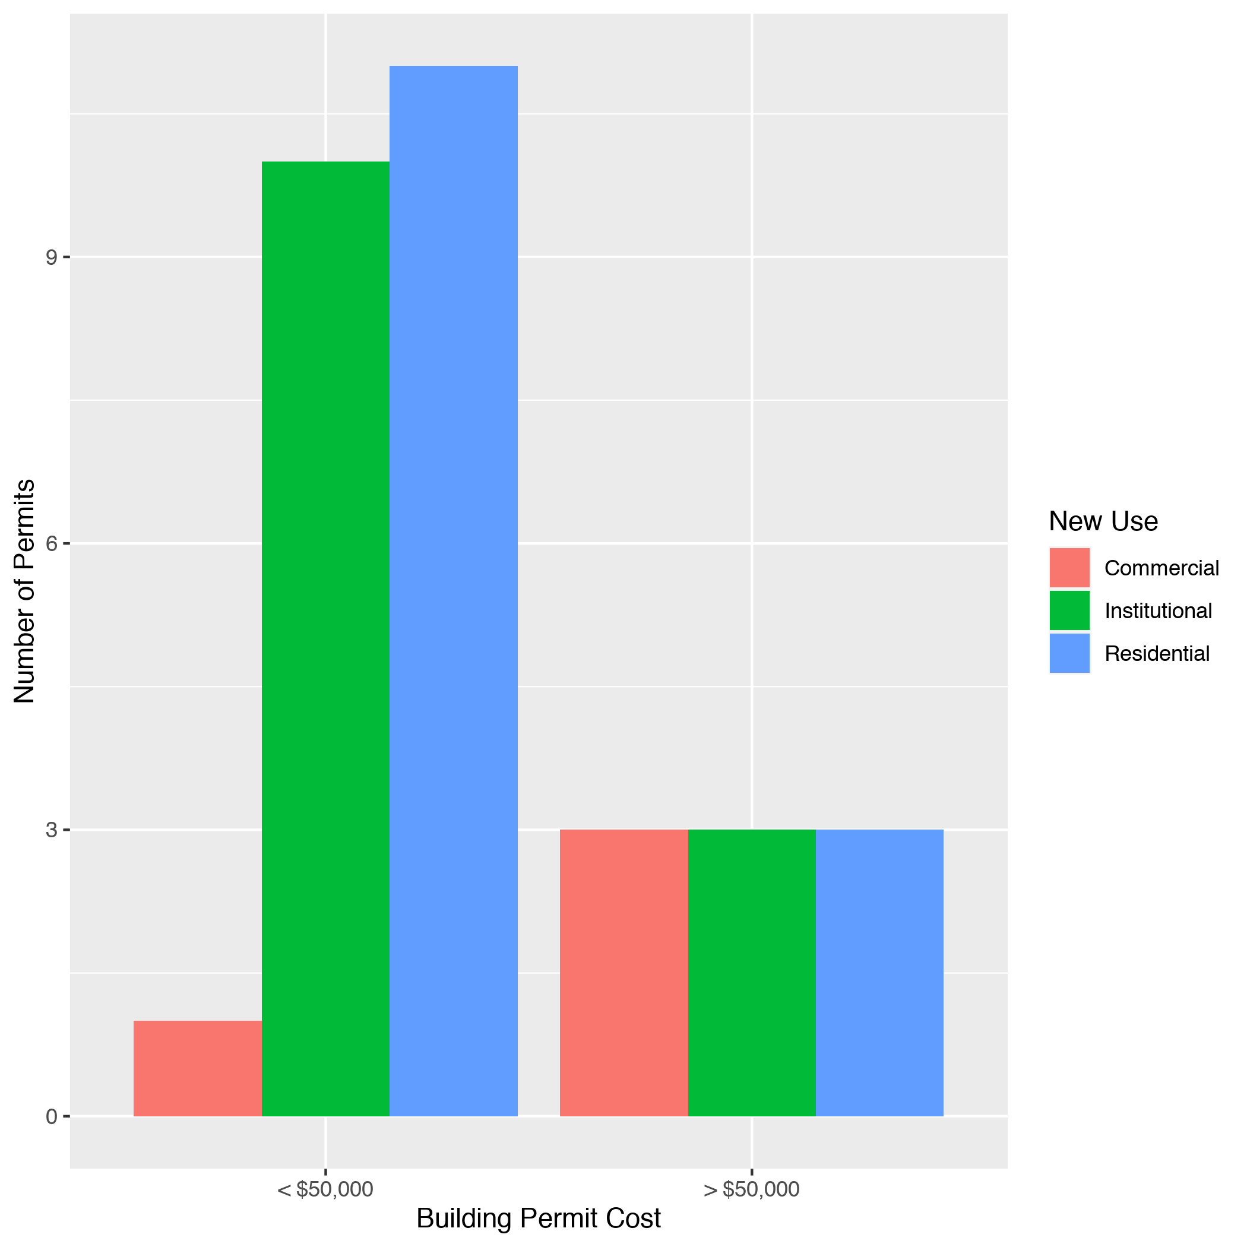
Cental West End High Cost Permits

Slide 16
DeBaliviere Place: Summary Notes
1 building permits in DeBaliviere Place in February 2020
-80.00% change compared to February 2019 (5 total building permits)
$14,000 : Average building permit cost in DeBaliviere Place in February 2020
-45.80% change compared to February 2019 ($25,832)

Slide 17
DeBaliviere Place: Summary Notes
5 total building permits in DeBaliviere Place in 2020
-58.33% change compared to this time in 2019 (12 total building permits)
$3,612,400 : Average building permit cost in DeBaliviere Place in 2020
13133.85% change compared to this time in 2019 ($27,297)

Slide 18
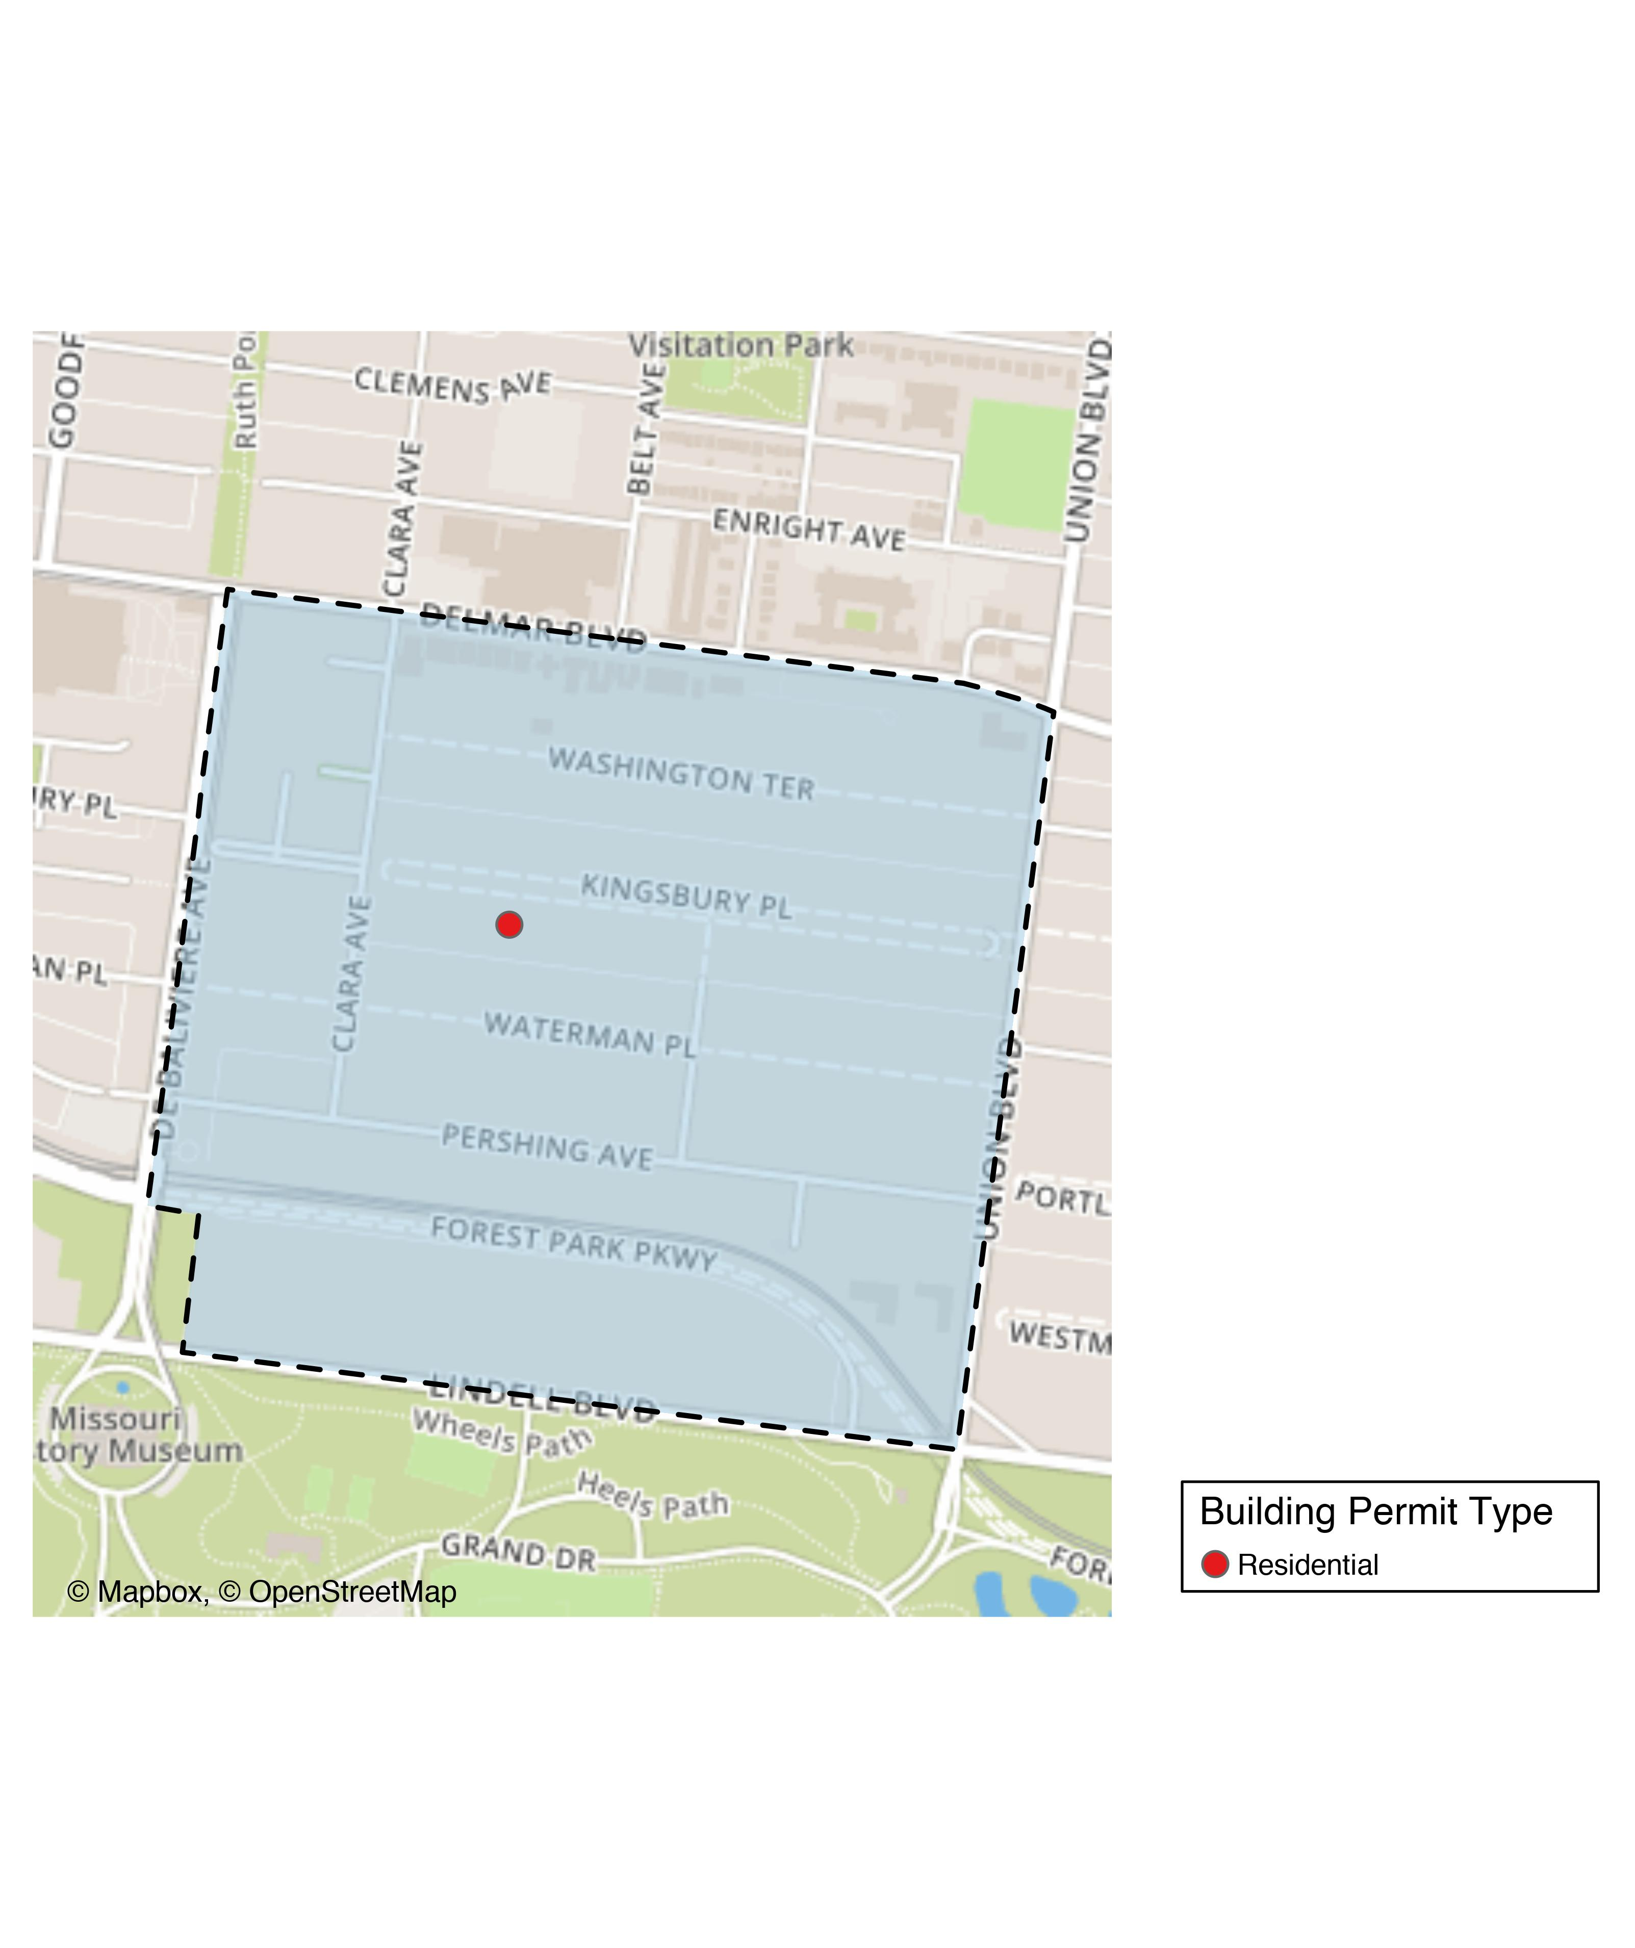
DeBaliviere Place

Slide 19
DeBaliviere Place
New Use | Average Cost | # of Permits
Residential | $14,000 | 1

Slide 20
DeBaliviere Place Individual Permit Breakdown
Owner | New Use | Cost | Address
RIEKES, LINDA J TRS | Residential | $14,000 | 48 KINGSBURY PL

Slide 21
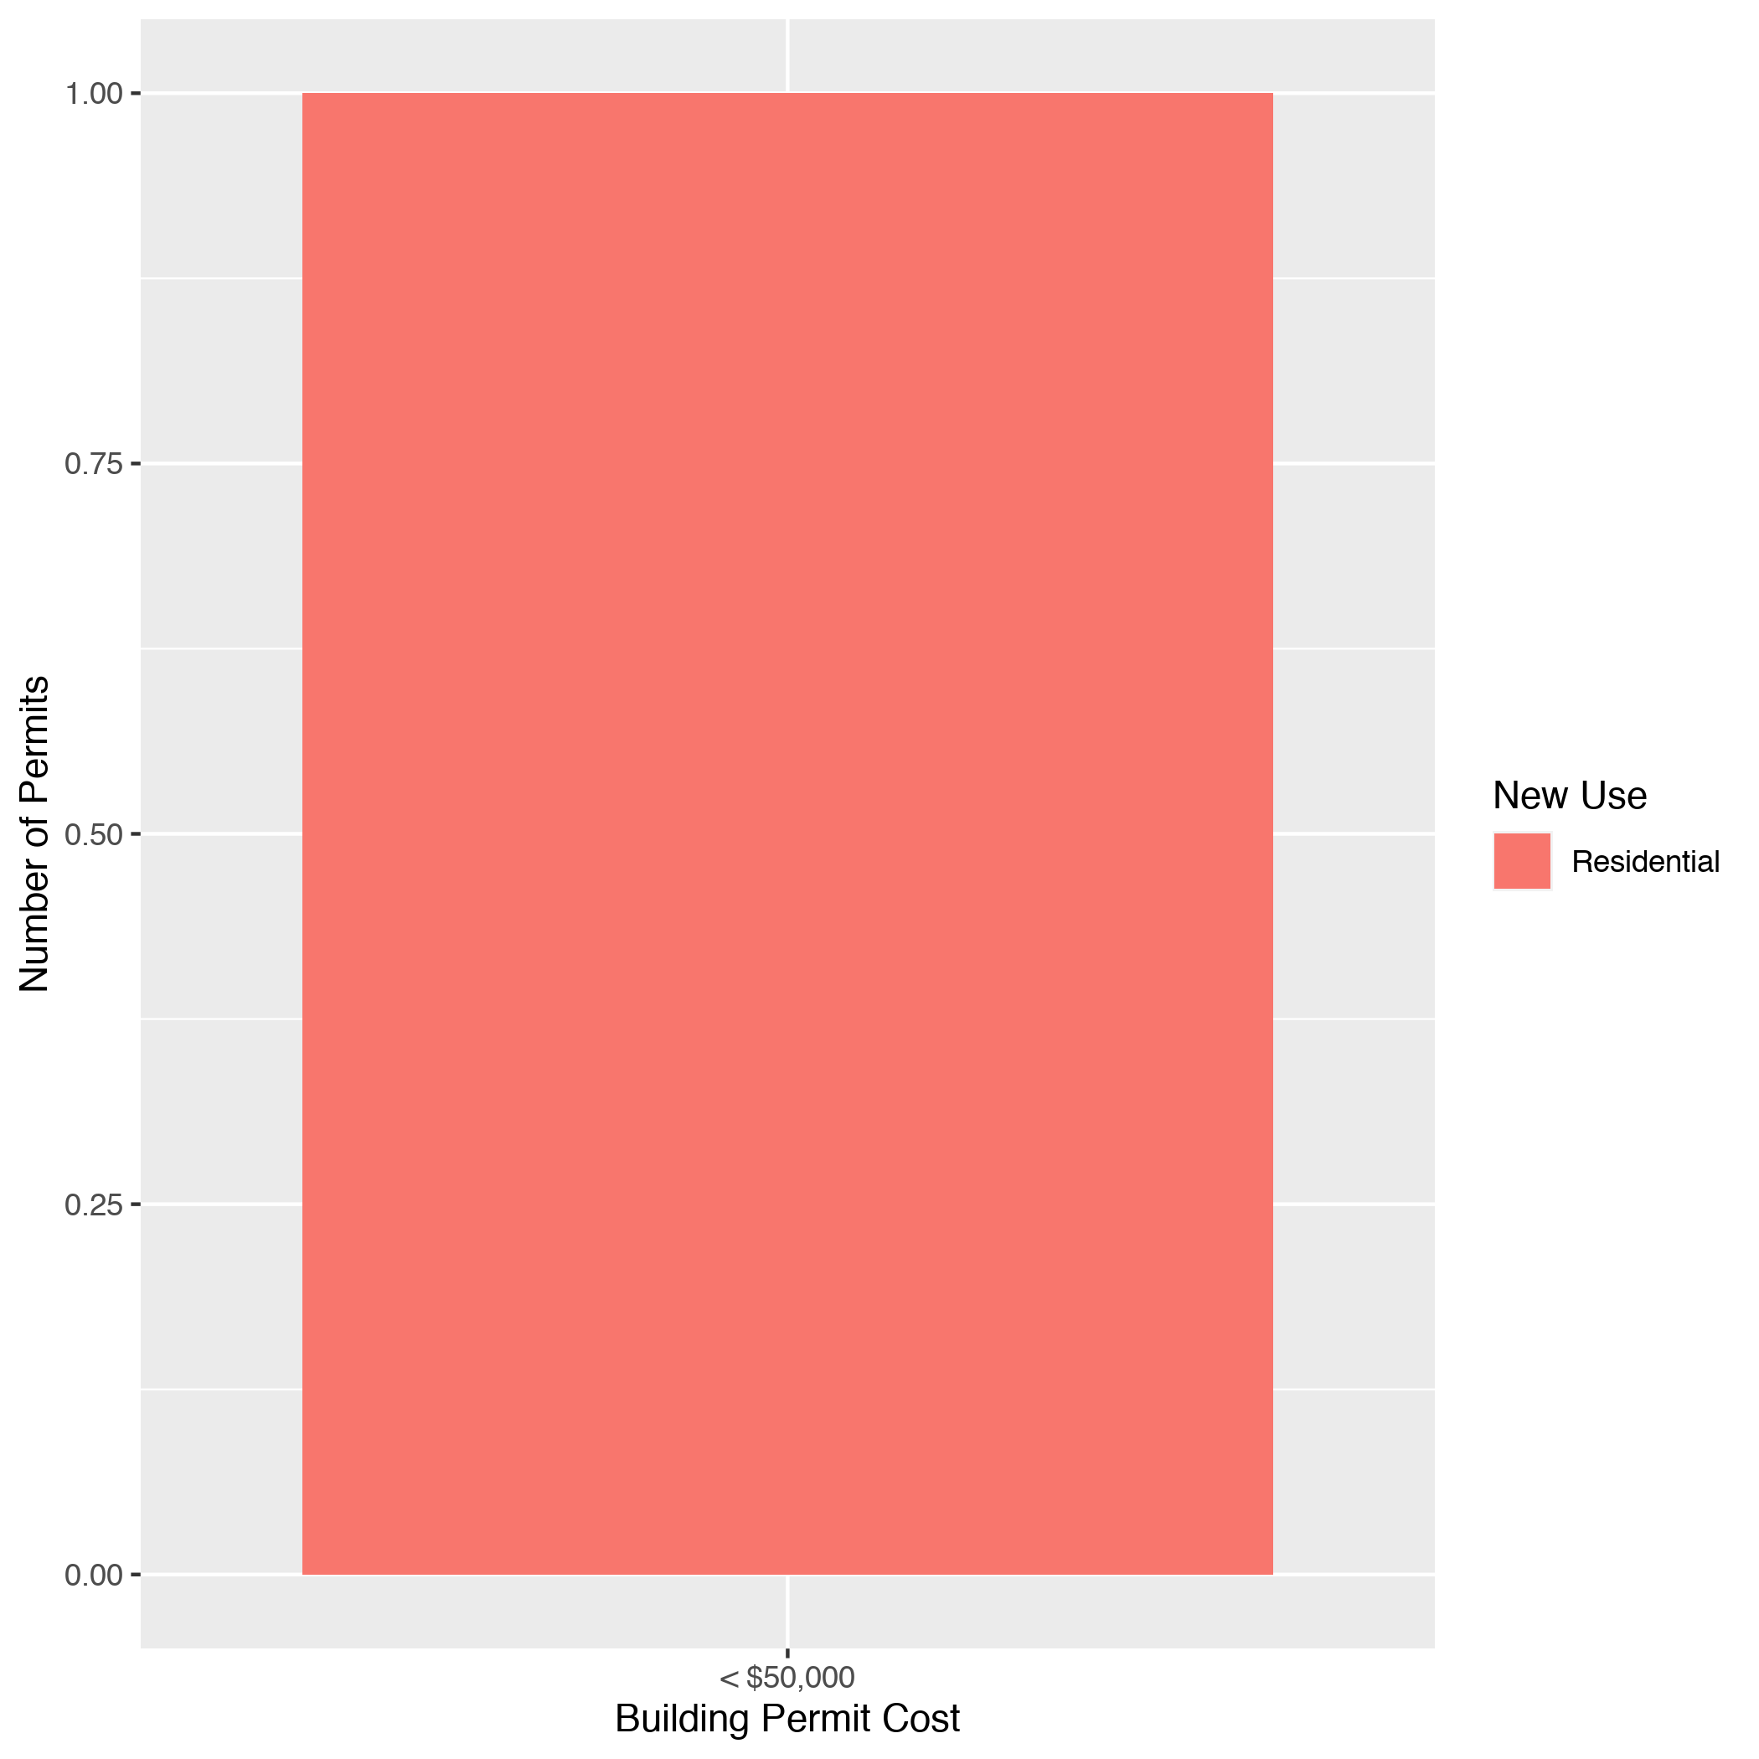
DeBaliviere Place High Cost Permits

Slide 22
Skinker DeBaliviere: Summary Notes
19 building permits in Skinker DeBaliviere in February 2020
111.11% change compared to February 2019 (9 total building permits)
$16,303 : Average building permit cost in Skinker DeBaliviere in February 2020
39.47% change compared to February 2019 ($11,689)

Slide 23
Skinker DeBaliviere: Summary Notes
26 total building permits in Skinker DeBaliviere in 2020
73.33% change compared to this time in 2019 (15 total building permits)
$19,337 : Average building permit cost in Skinker DeBaliviere in 2020
-6.50% change compared to this time in 2019 ($20,682)

Slide 24
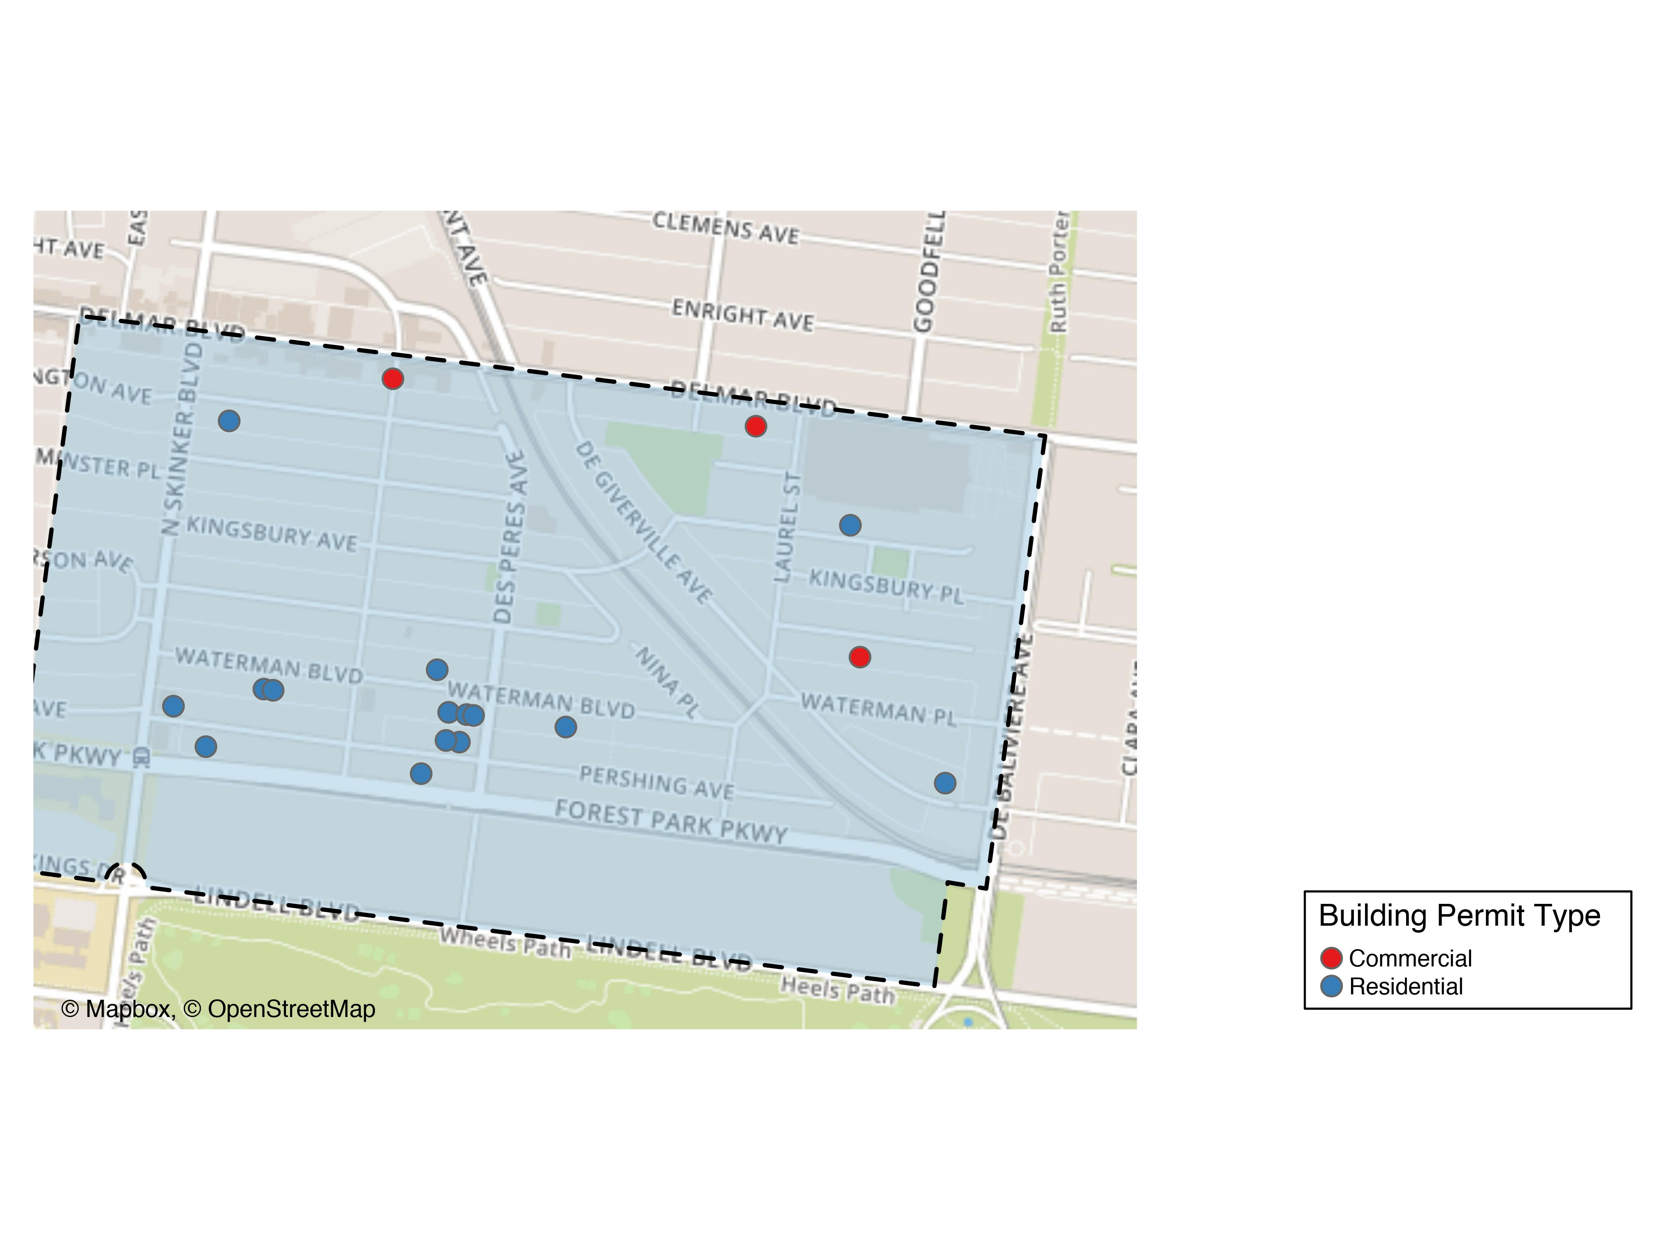
Skinker DeBaliviere

Slide 25
Skinker DeBaliviere
New Use | Average Cost | # of Permits
Commercial | $7,959 | 3
Residential | $17,867 | 16

Slide 26
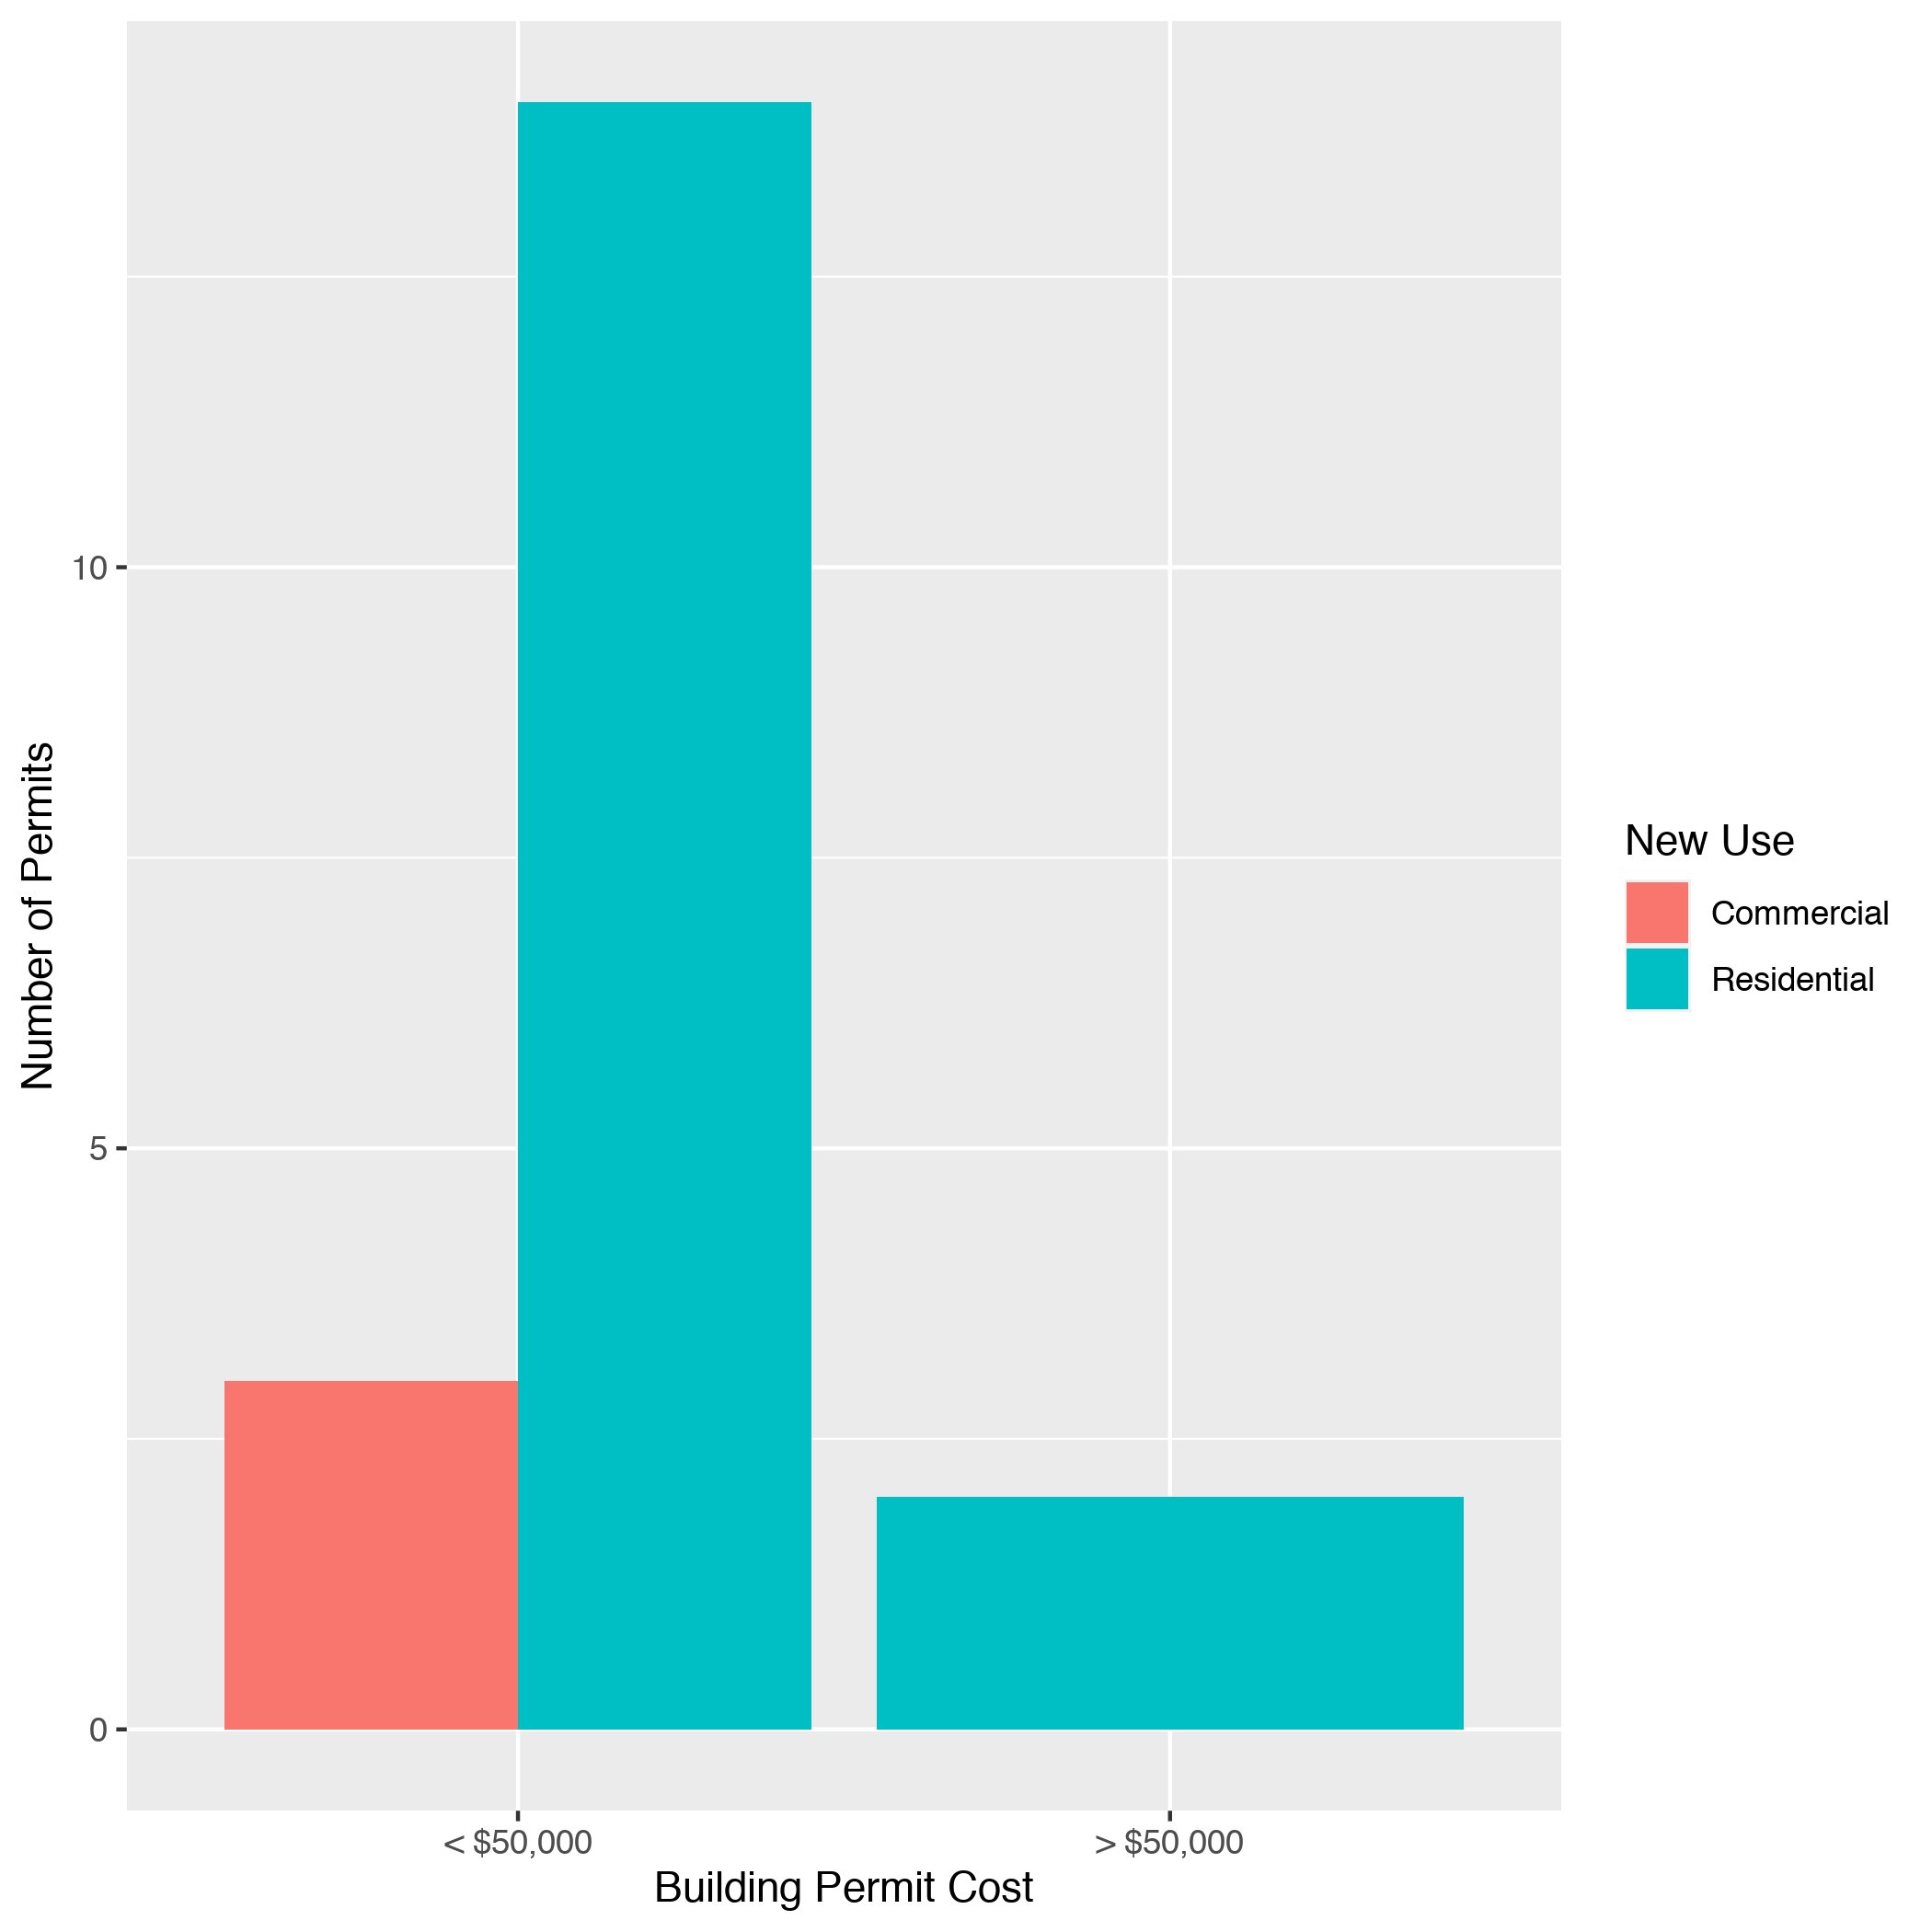
Skinker DeBaliviere High Cost Permits

Slide 27
West End: Summary Notes
8 building permits in West End in February 2020
700.00% change compared to February 2019 (1 total building permits)
$161,081 : Average building permit cost in West End in February 2020
1965.14% change compared to February 2019 ($7,800)

Slide 28
West End: Summary Notes
18 total building permits in West End in 2020
260.00% change compared to this time in 2019 (5 total building permits)
$76,036 : Average building permit cost in West End in 2020
-70.33% change compared to this time in 2019 ($256,240)

Slide 29
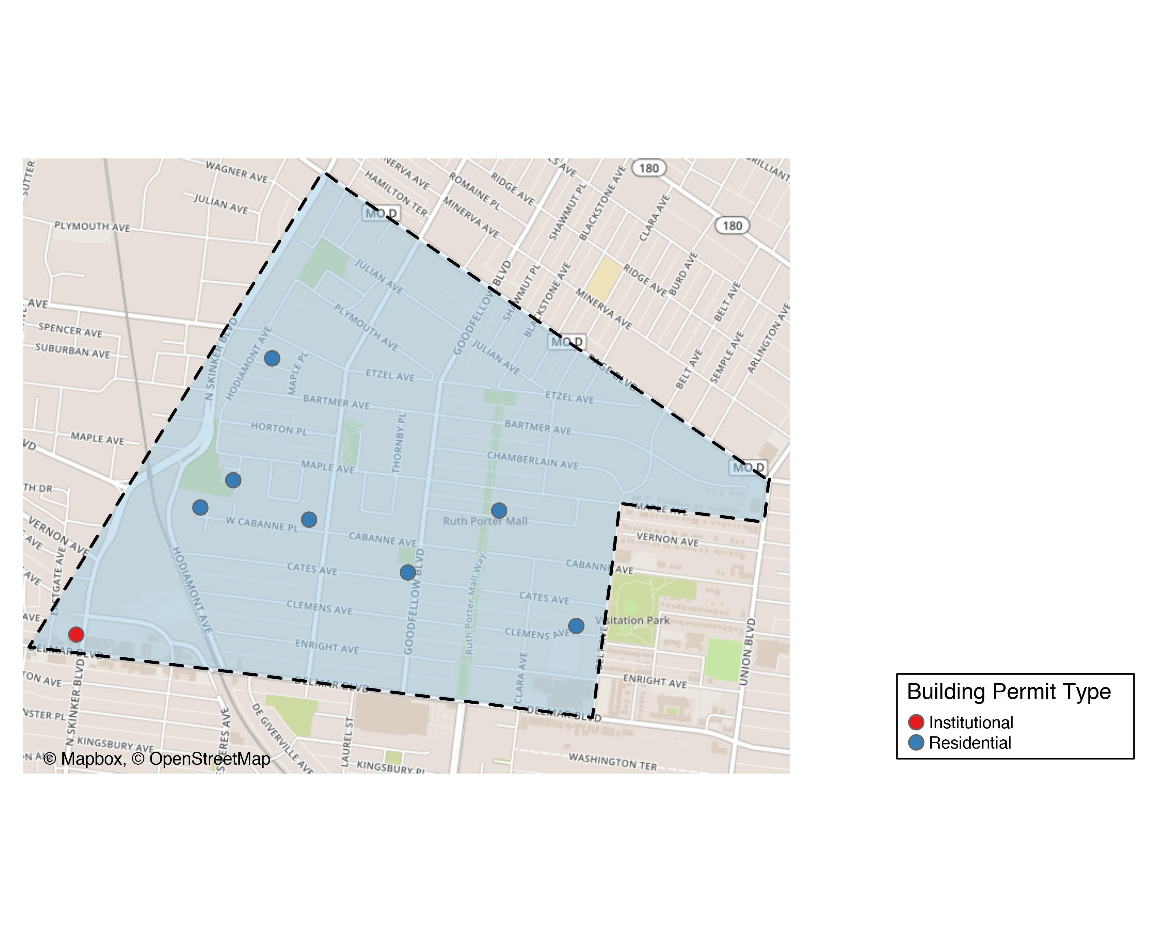
West End

Slide 30
West End
New Use | Average Cost | # of Permits
Institutional | $18,000 | 1
Residential | $181,521 | 7

Slide 31
West End Individual Permit Breakdown
Owner | New Use | Cost | Address
JACOBS, PRESTON ANTONIO | Residential | $2,000 | 5923 WEST CABANNE PL
NEIGHBORHOOD PROPERTIES LLC | Residential | $982,000 | 5815 CATES AV
CORNERSTONE CORPORATION | Residential | $150,000 | 6031 SUBURBAN AV
PACE-DELMAR ASSOCIATES LLC | Institutional | $18,000 | 6211 DELMAR BLVD
KEY MASTERS LLC | Residential | $10,000 | 5647 VERNON AV
COOKSEY, DOROTHY J | Residential | $3,146 | 945 CATALPA ST
SCOTT, TRACY ALICIA | Residential | $110,000 | 6075 WEST CABANNE PL
ALLEN, LILLIE M | Residential | $13,500 | 5531-33 CLEMENS AV

Slide 32
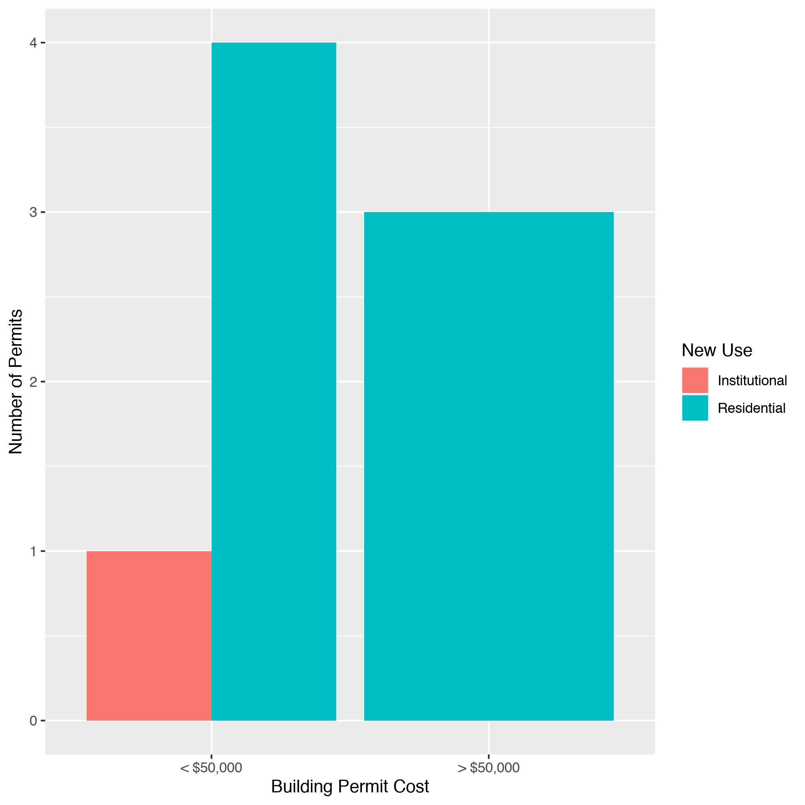
West End High Cost Permits

Slide 33
Visitation Park: Summary Notes
1 building permits in Visitation Park in February 2020
Infinite change compared to February 2019 (0 total building permits)
$14,000 : Average building permit cost in Visitation Park in February 2020
Infinite change compared to February 2019 ($0)

Slide 34
Visitation Park: Summary Notes
1 total building permits in Visitation Park in 2020
Infinite change compared to this time in 2019 (0 total building permits)
$14,000 : Average building permit cost in Visitation Park in 2020
Infinite change compared to this time in 2019 ($0)

Slide 35
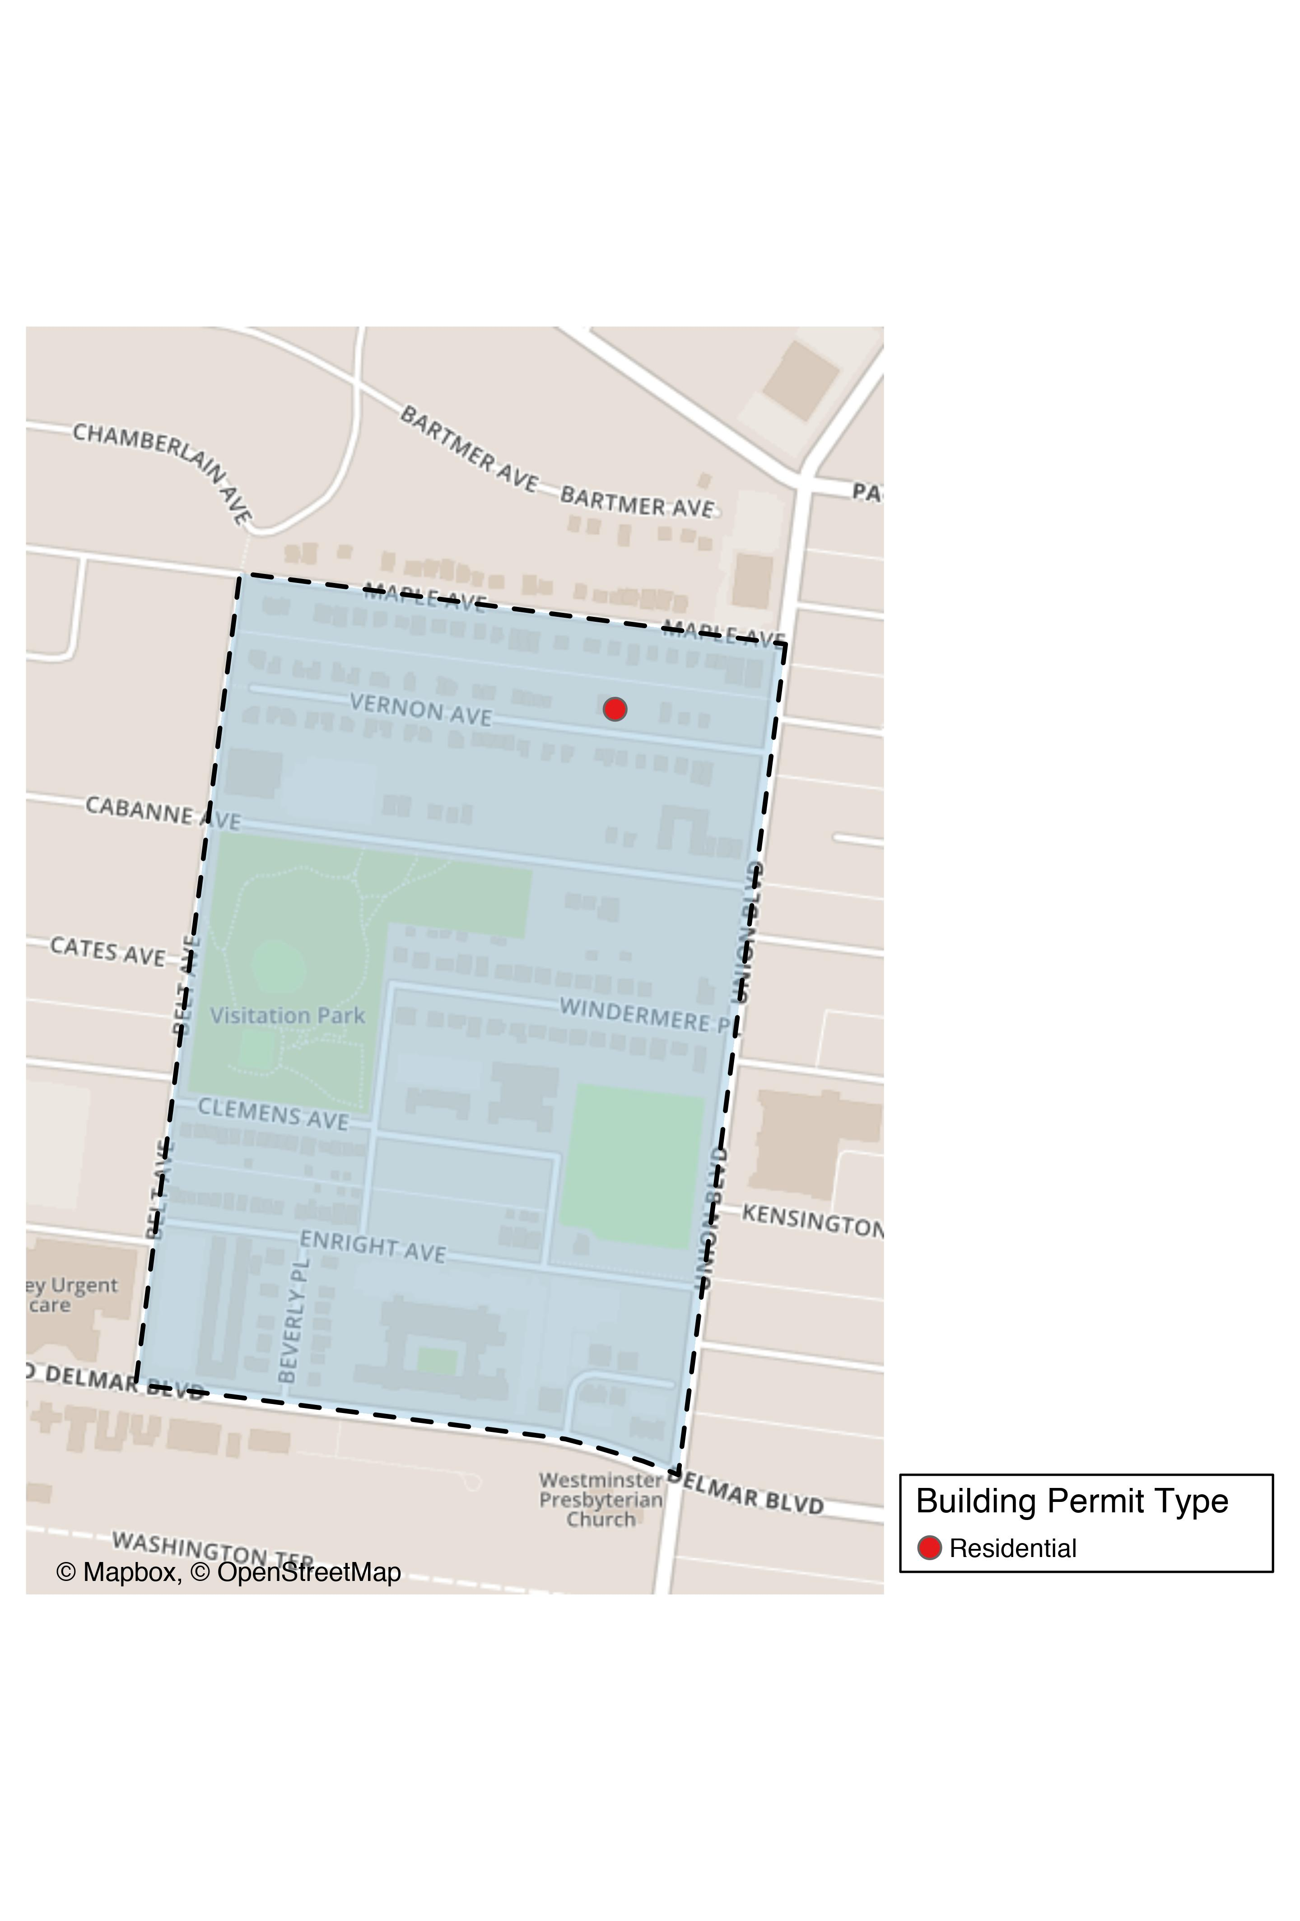
Visitation Park

Slide 36
Visitation Park
New Use | Average Cost | # of Permits
Residential | $14,000 | 1

Slide 37
Visitation Park Individual Permit Breakdown
Owner | New Use | Cost | Address
JOHNSON, KIM M | Residential | $14,000 | 5347 VERNON AV

Slide 38
Visitation Park High Cost Permits

Slide 39
Academy: Summary Notes
3 building permits in Academy in February 2020
50.00% change compared to February 2019 (2 total building permits)
$91,667 : Average building permit cost in Academy in February 2020
-20.29% change compared to February 2019 ($115,000)

Slide 40
Academy: Summary Notes
9 total building permits in Academy in 2020
80.00% change compared to this time in 2019 (5 total building permits)
$87,772 : Average building permit cost in Academy in 2020
-13.99% change compared to this time in 2019 ($102,043)

Slide 41
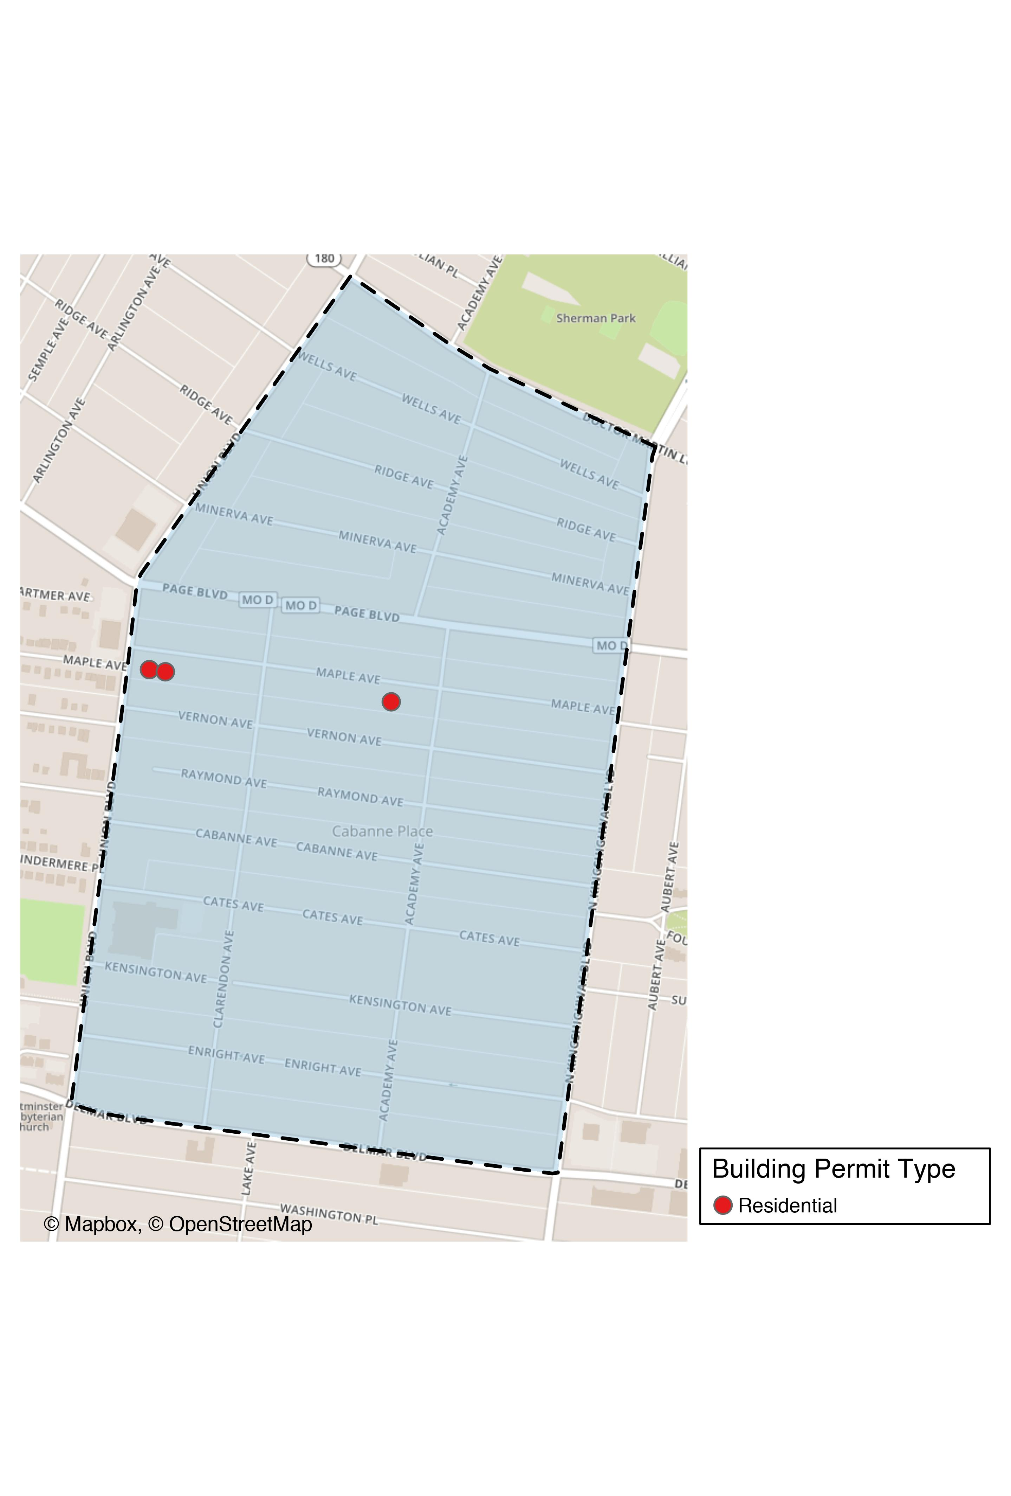
Academy

Slide 42
Academy
New Use | Average Cost | # of Permits
Residential | $91,667 | 3

Slide 43
Academy Individual Permit Breakdown
Owner | New Use | Cost | Address
URBAN UTOPIA MANAGEMENT LLC | Residential | $70,000 | 5124 MAPLE AV
MAPLE LLC | Residential | $200,000 | 5266 MAPLE AV
5258 MAPLE LLC | Residential | $5,000 | 5258 MAPLE AV

Slide 44
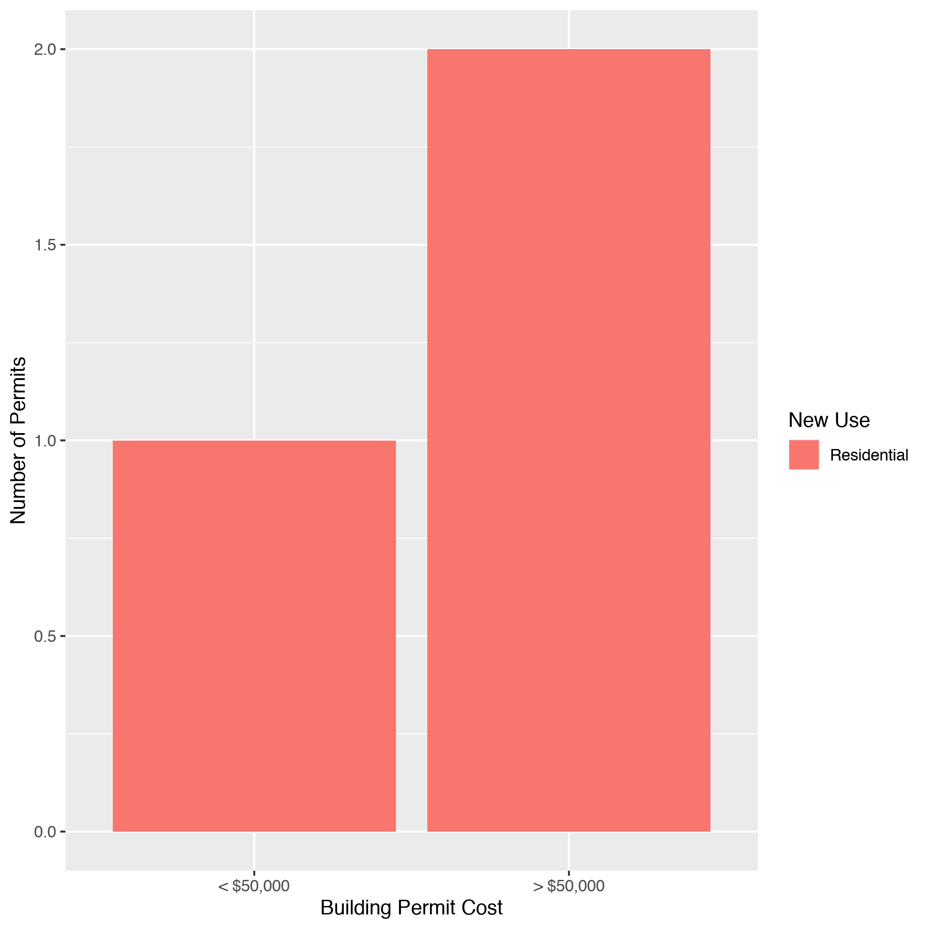
Academy High Cost Permits

Slide 45
Fountain Park: Summary Notes
0 building permits in Fountain Park in February 2020
0.00% change compared to February 2019 (0 total building permits)
$0 : Average building permit cost in Fountain Park in February 2020
0.00% change compared to February 2019 ($0)

Slide 46
Fountain Park: Summary Notes
0 total building permits in Fountain Park 2020
-100.00% change compared to this time in 2019 (1 total building permits)
NaN : Average building permit cost in Fountain Park in 2020
0.00% change compared to this time in 2019 ($500)

Slide 47
Lewis Place: Summary Notes
0 building permits in Lewis Place in February 2020
-100.00% change compared to February 2019 (3 total building permits)
$0 : Average building permit cost in Lewis Place in February 2020
-100.00% change compared to February 2019 ($2,367)

Slide 48
Lewis Place: Summary Notes
1 total building permits in Lewis Place in 2020
-80.00% change compared to this time in 2019 (5 total building permits)
$2,500 : Average building permit cost in Lewis Place in 2020
-52.11% change compared to this time in 2019 ($5,220)

Slide 49
Vandeventer: Summary Notes
1 building permits in Vandeventer in February 2020
-80.00% change compared to February 2019 (5 total building permits)
$8,731 : Average building permit cost in Vandeventer in February 2020
-98.42% change compared to February 2019 ($551,886)

Slide 50
Vandeventer: Summary Notes
3 total building permits in Vandeventer in 2020
-62.50% change compared to this time in 2019 (8 total building permits)
$71,244 : Average building permit cost in Vandeventer in 2020
-79.94% change compared to this time in 2019 ($355,241)

Slide 51
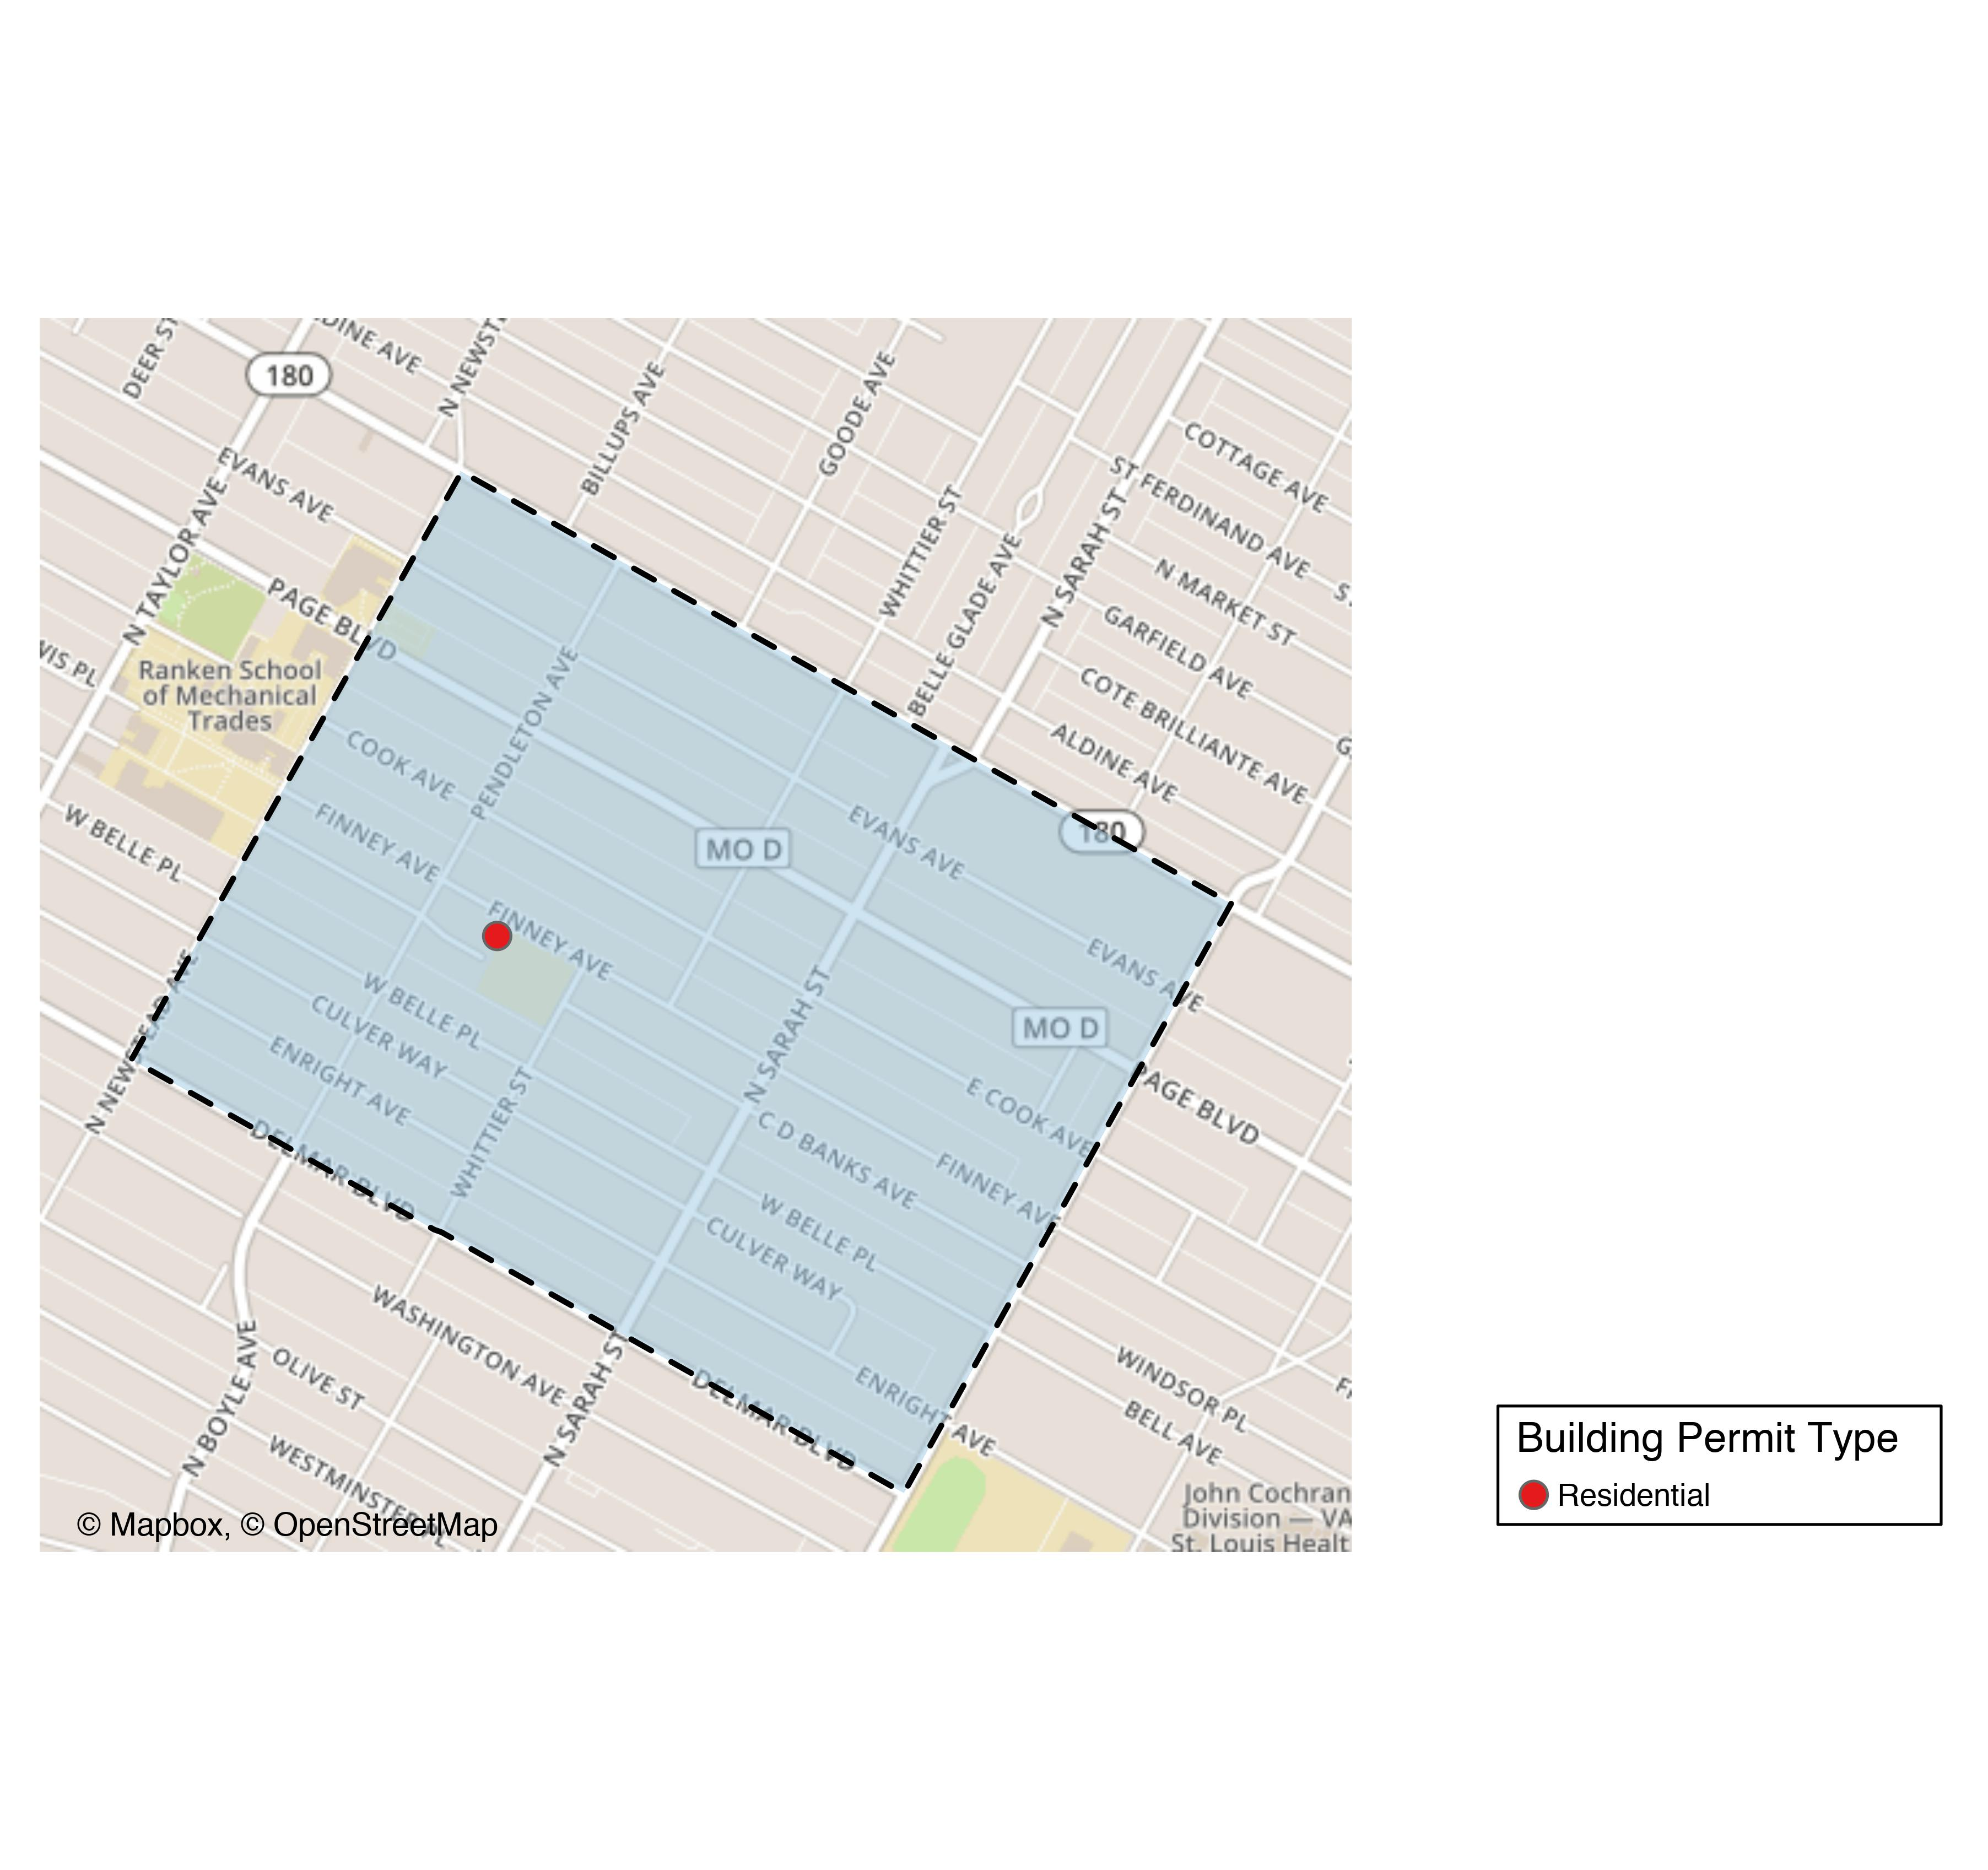
Vandeventer

Slide 52
Vandeventer
New Use | Average Cost | # of Permits
Residential | $8,731 | 1

Slide 53
Vandeventer Individual Permit Breakdown
Owner | New Use | Cost | Address
FINNEY PLACE LP | Residential | $8,731 | 4242 W FINNEY AV

Slide 54
Vandeventer High Cost Permits

