Slide 1
St. Louis Central Corridor West Building Permits
March
2020

Slide 2
Introduction
Data retreived from https://www.stlouis-mo.gov/data/
Building permits with a cost of $0 were dropped
Building permits that were cancelled were dropped

Slide 3
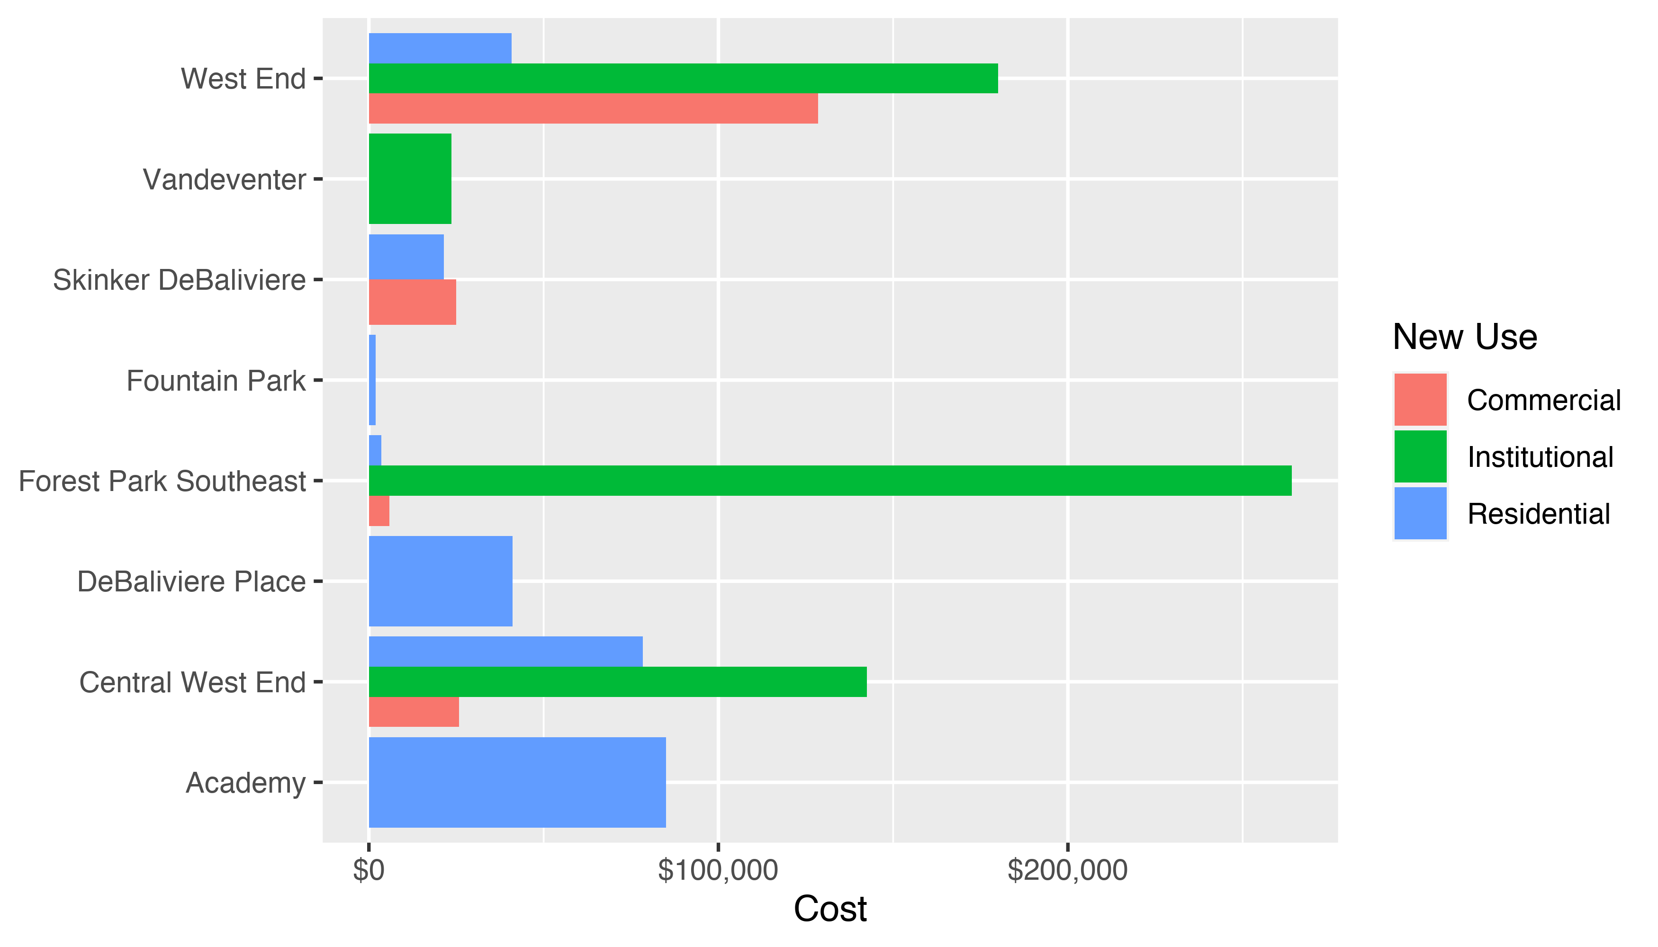
Neighborhood Summary: Average Building Permit Cost

Slide 4
Neighborhood Summary
Neighborhood | Average Cost | # of Permits
Academy | $85,000 | 1
Central West End | $93,112 | 49
DeBaliviere Place | $41,121 | 5
Forest Park Southeast | $41,463 | 7
Fountain Park | $2,000 | 1
Skinker DeBaliviere | $21,799 | 10
Vandeventer | $23,646 | 1
West End | $98,307 | 7

Slide 5
Forest Park Southeast: Summary Notes
7 building permits in Forest Park Southeast in March 2020
-63.16% change compared to March 2019 (19 total building permits)
$41,463 : Average building permit cost in Forest Park Southeast in March 2020
-59.14% change compared to March 2019 ($101,479)

Slide 6
Forest Park Southeast: Summary Notes
25 total building permits in Forest Park Southeast in 2020
-52.83% change compared to this time in 2019 (53 total building permits)
$44,311 : Average building permit cost in Forest Park Southeast in 2020
-76.24% change compared to this time in 2019 ($186,479)

Slide 7
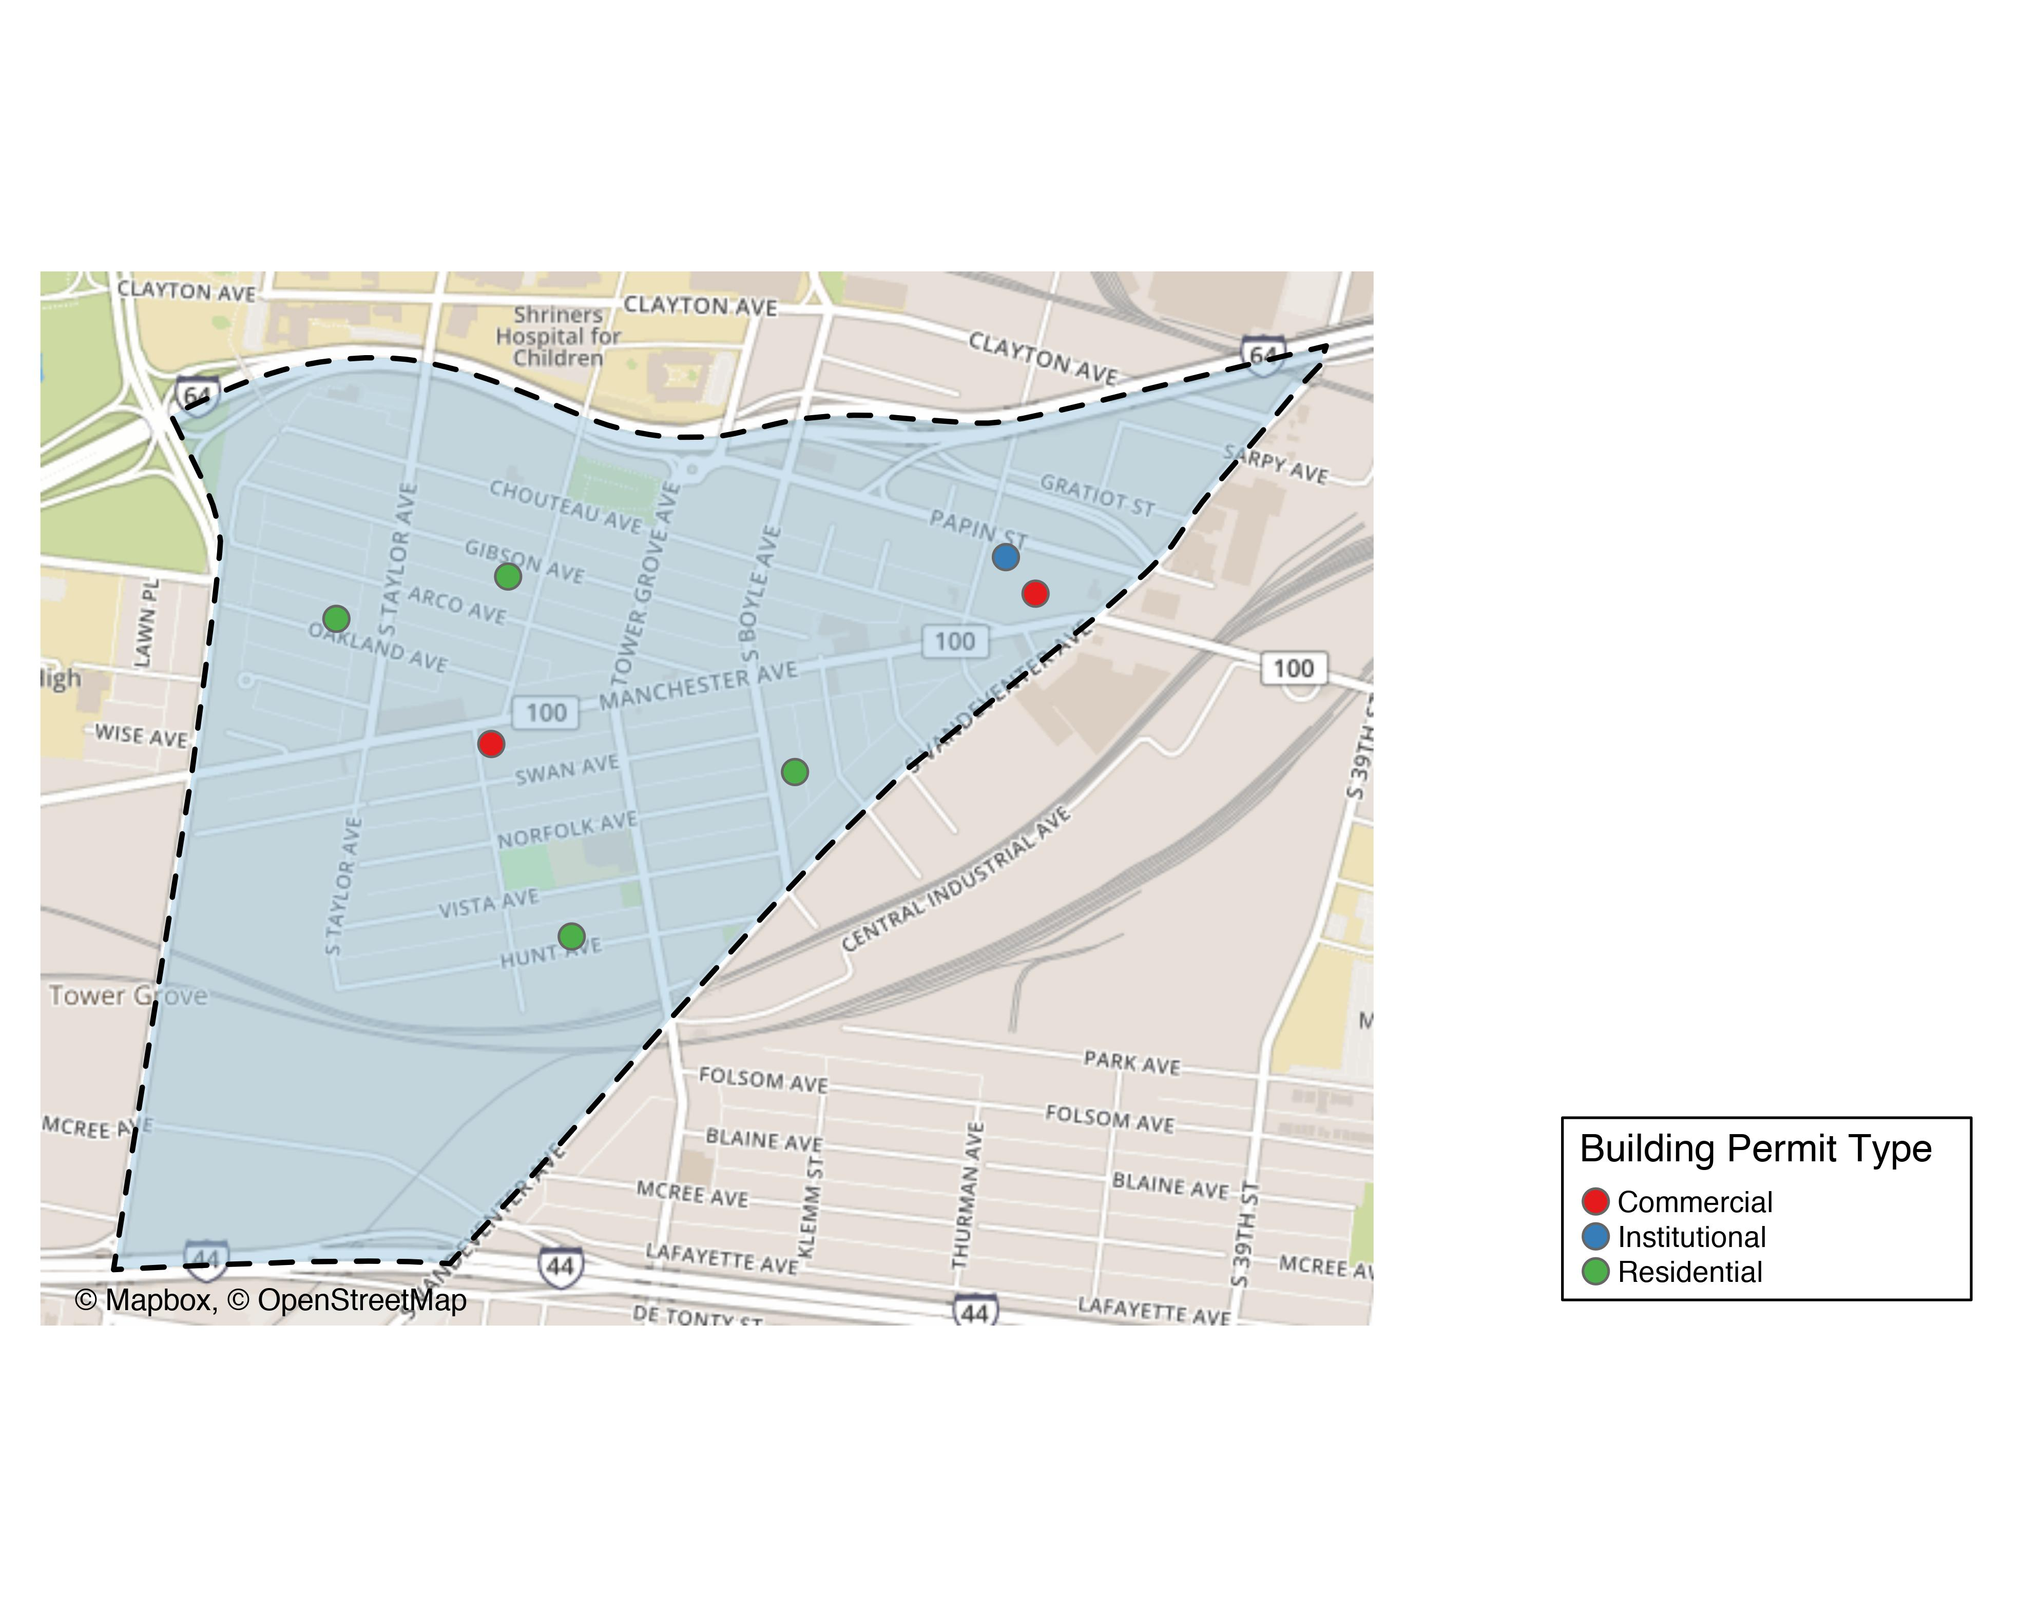
Forest Park Southeast

Slide 8
Forest Park Southeast
New Use | Average Cost | # of Permits
Commercial | $5,900 | 2
Institutional | $264,094 | 1
Residential | $3,588 | 4

Slide 9
Forest Park Southeast Individual Permit Breakdown
Owner | New Use | Cost | address
CAMPBELL, GREGORY H & EDNA M | Residential | $5,500 | 1216 S BOYLE AV
PARK SOUTH PROPERTIES LLC | Commercial | $7,400 | 4370 MANCHESTER AV
GS CHROMA PH I LLC | Commercial | $4,400 | 4071 CHOUTEAU AV
OREILLY, KEVIN DAVID & | Residential | $7,800 | 4529 OAKLAND AV
GS CHROMA PH LLC | Institutional | $264,094 | 900 S SARAH ST
J2 ENVIRONS LLC | Residential | $50 | 4345 HUNT AV
MALLORY, RUBY M & PATRICIA A RUSSELL | Residential | $1,000 | 4418 GIBSON AV

Slide 10
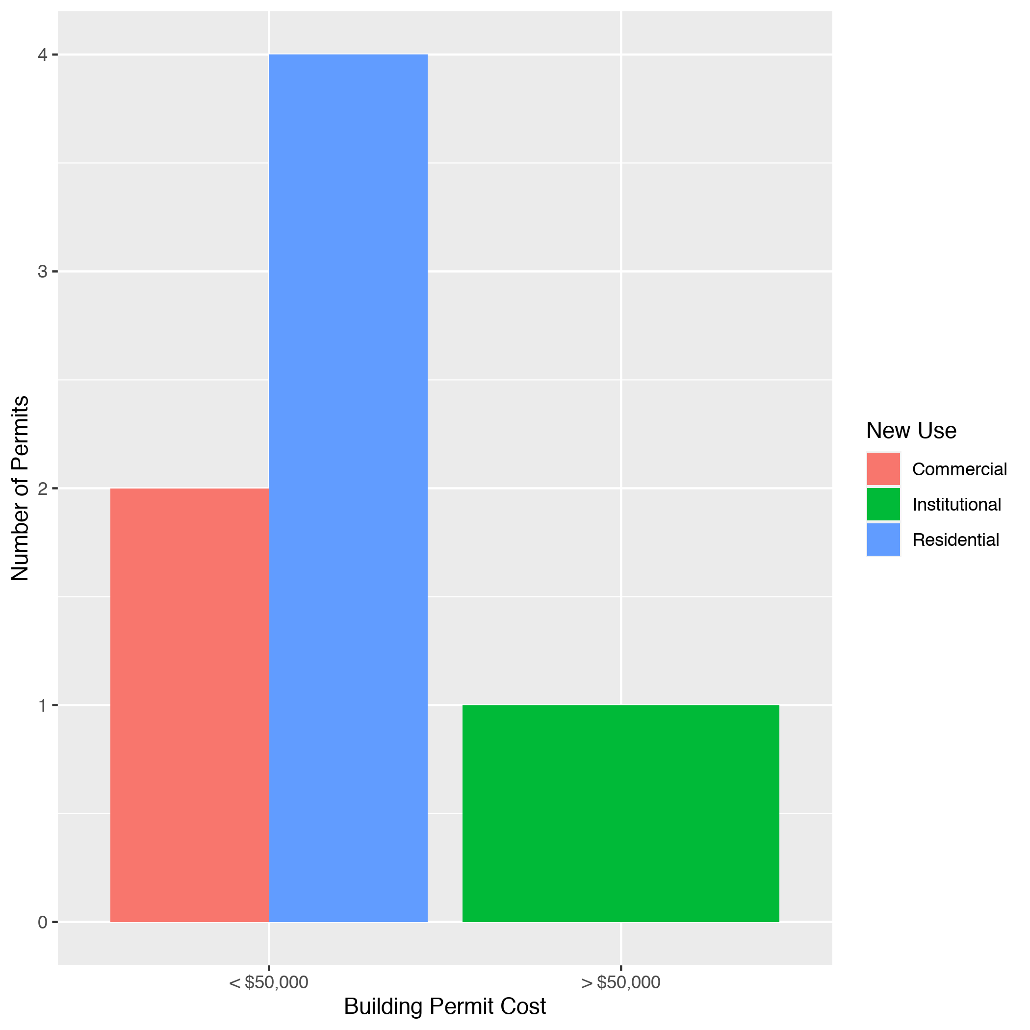
Forest Park Southeast High Cost Permits

Slide 11
Central West End: Summary Notes
49 building permits in Central West End in March 2020
19.51% change compared to March 2019 (41 total building permits)
$93,112 : Average building permit cost in Central West End in March 2020
-61.23% change compared to March 2019 ($240,184)

Slide 12
Central West End: Summary Notes
117 total building permits in Central West End in 2020
-5.65% change compared to this time in 2019 (124 total building permits)
$714,740 : Average building permit cost in Central West End in 2020
273.62% change compared to this time in 2019 ($191,302)

Slide 13
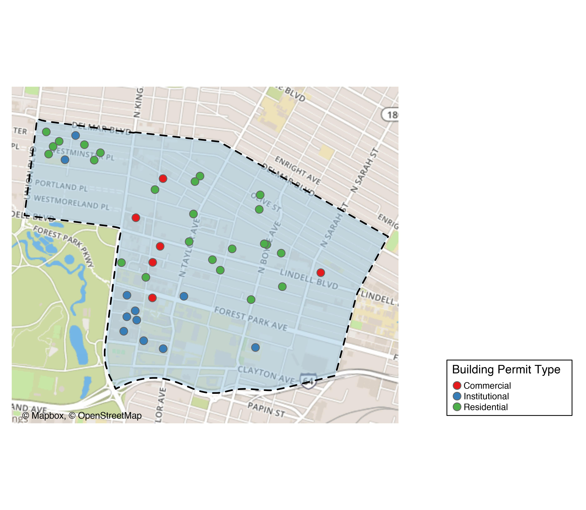
Central West End

Slide 14
Central West End
New Use | Average Cost | # of Permits
Commercial | $25,728 | 7
Institutional | $142,455 | 17
Residential | $78,425 | 25

Slide 15
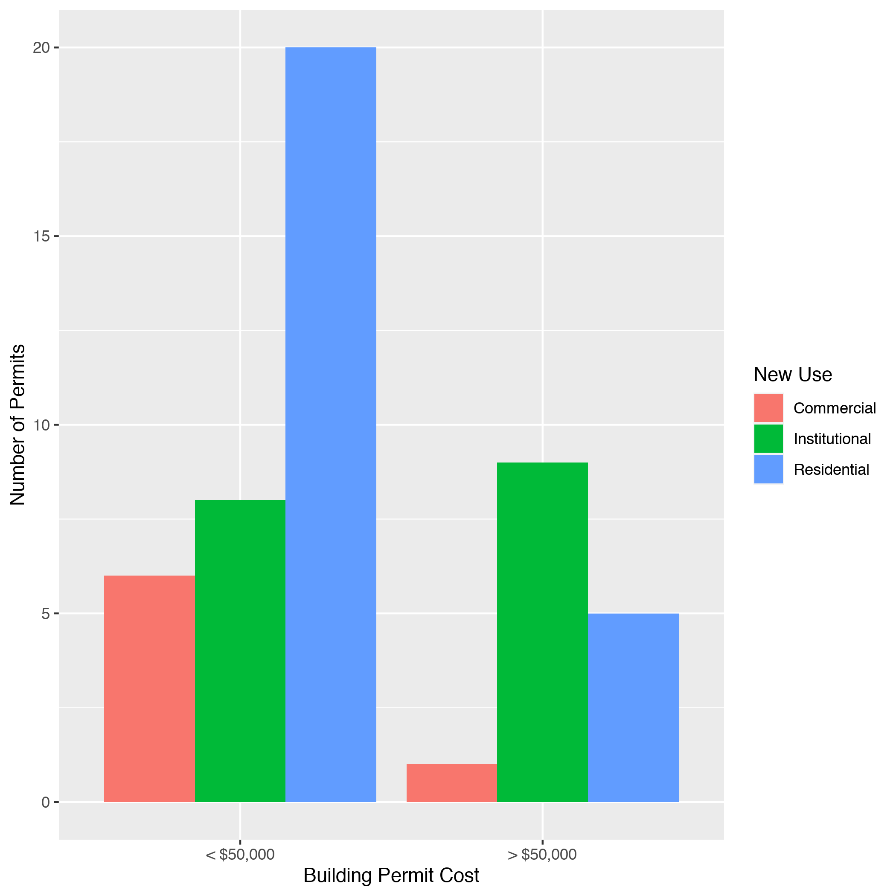
Cental West End High Cost Permits

Slide 16
DeBaliviere Place: Summary Notes
5 building permits in DeBaliviere Place in March 2020
400.00% change compared to March 2019 (1 total building permits)
$41,121 : Average building permit cost in DeBaliviere Place in March 2020
-60.99% change compared to March 2019 ($105,406)

Slide 17
DeBaliviere Place: Summary Notes
10 total building permits in DeBaliviere Place in 2020
-23.08% change compared to this time in 2019 (13 total building permits)
$1,826,761 : Average building permit cost in DeBaliviere Place in 2020
5384.93% change compared to this time in 2019 ($33,305)

Slide 18
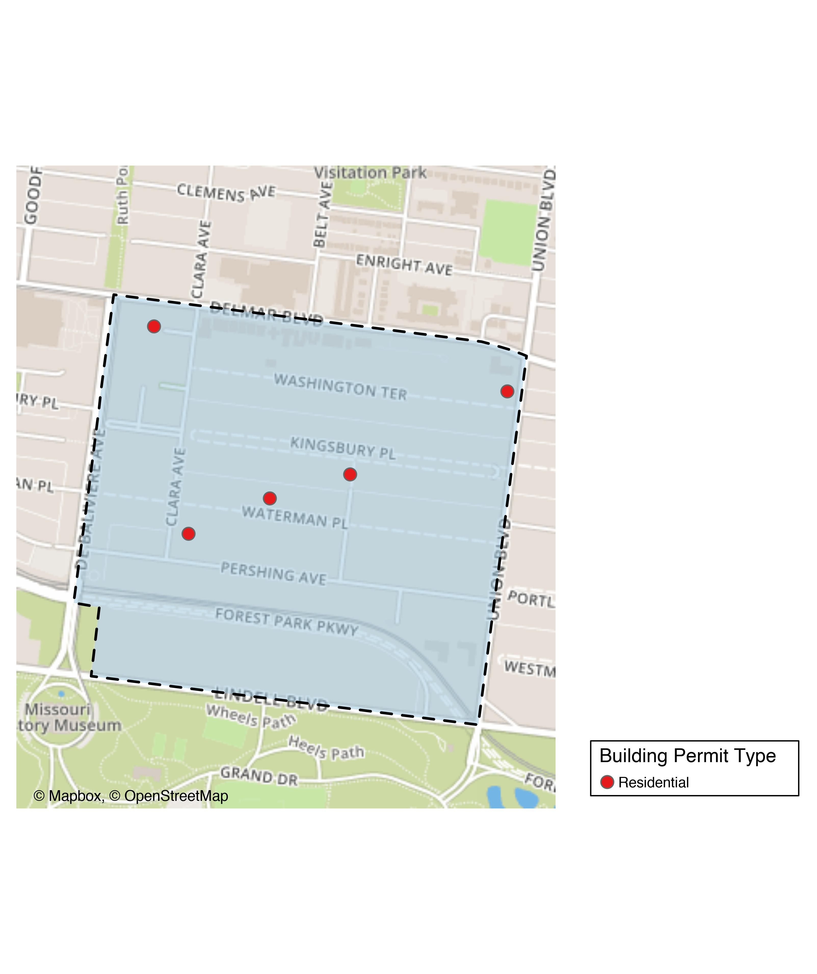
DeBaliviere Place

Slide 19
DeBaliviere Place
New Use | Average Cost | # of Permits
Residential | $41,121 | 5

Slide 20
DeBaliviere Place Individual Permit Breakdown
Owner | New Use | Cost | Address
DEL MONTE APARTMENTS LLC | Residential | $2,500 | 5622 DELMAR BLVD
WATERMAN CONDOMINIUM PLAT 5 | Residential | $8,000 | 5561 WATERMAN BLVD
WOLFF, MICHAEL A & SARAH P | Residential | $120,000 | 24 KINGSBURY PL
BURKE, TIMOTHY ROBERT & | Residential | $53,106 | 1 WASHINGTON TER
CLARA PARK CONDOMINIUMS | Residential | $22,000 | 314 CLARA AV

Slide 21
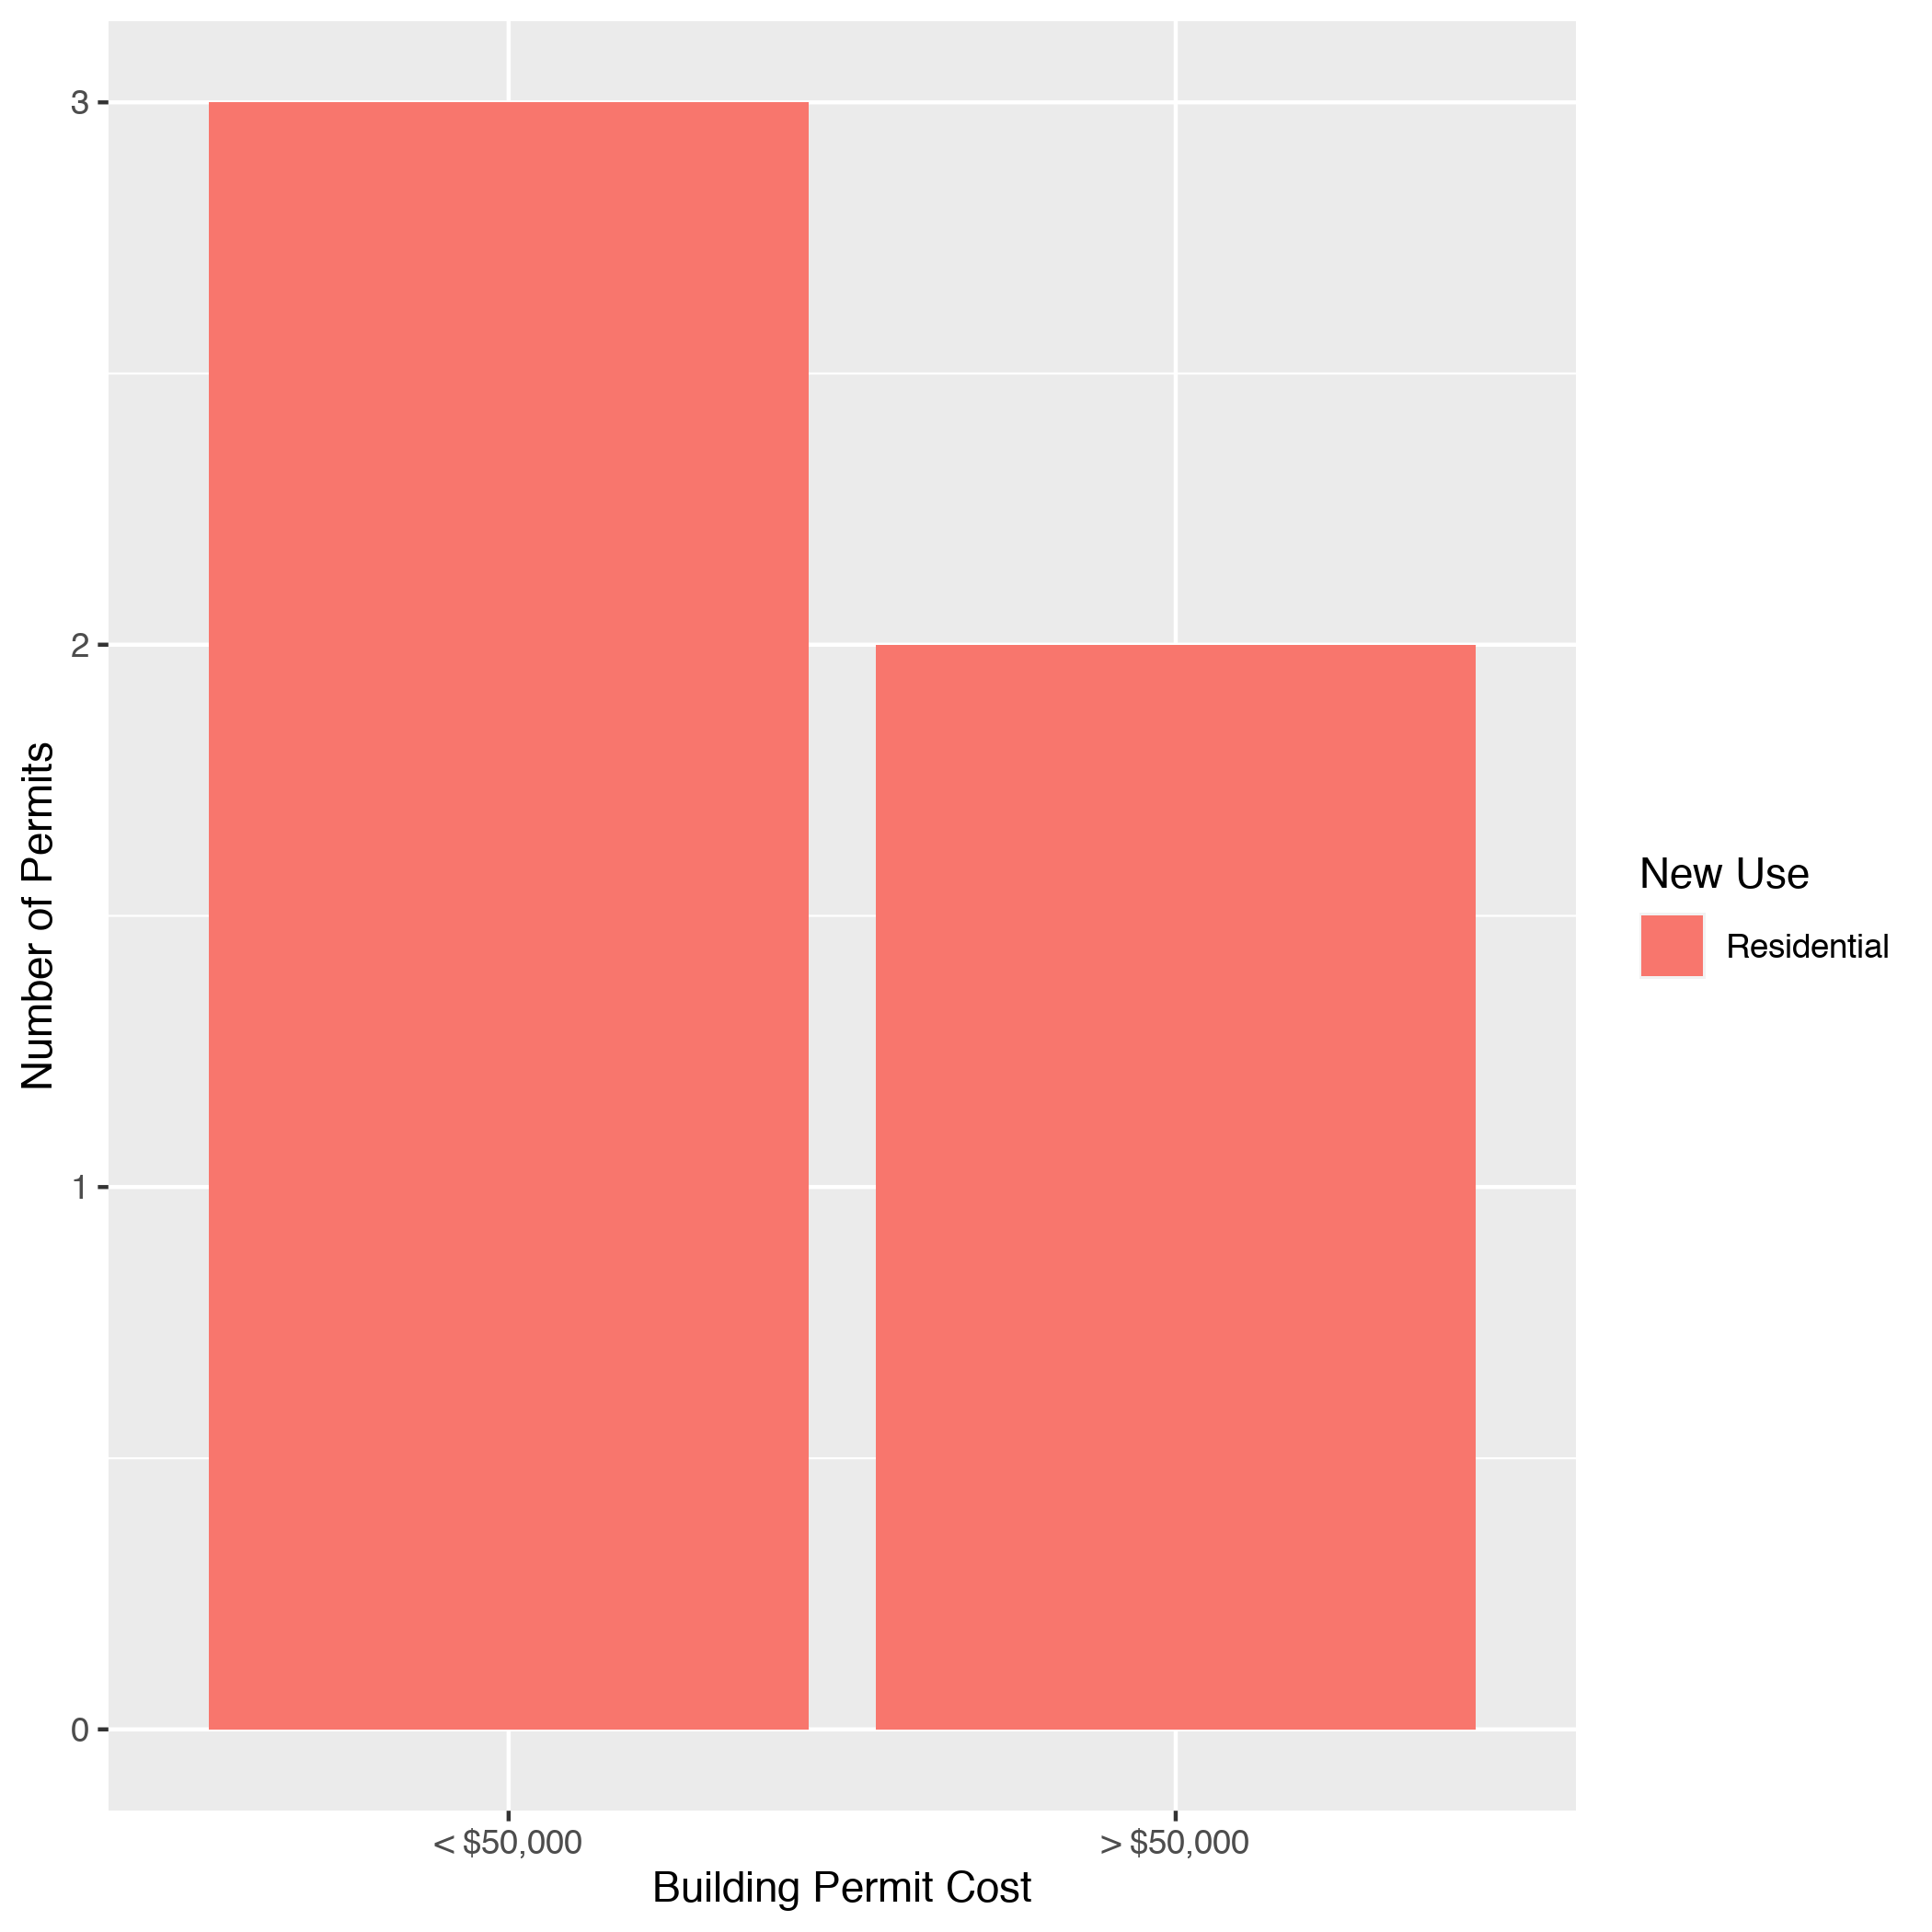
DeBaliviere Place High Cost Permits

Slide 22
Skinker DeBaliviere: Summary Notes
10 building permits in Skinker DeBaliviere in March 2020
400.00% change compared to March 2019 (2 total building permits)
$21,799 : Average building permit cost in Skinker DeBaliviere in March 2020
533.70% change compared to March 2019 ($3,440)

Slide 23
Skinker DeBaliviere: Summary Notes
36 total building permits in Skinker DeBaliviere in 2020
111.76% change compared to this time in 2019 (17 total building permits)
$20,021 : Average building permit cost in Skinker DeBaliviere in 2020
7.33% change compared to this time in 2019 ($18,653)

Slide 24
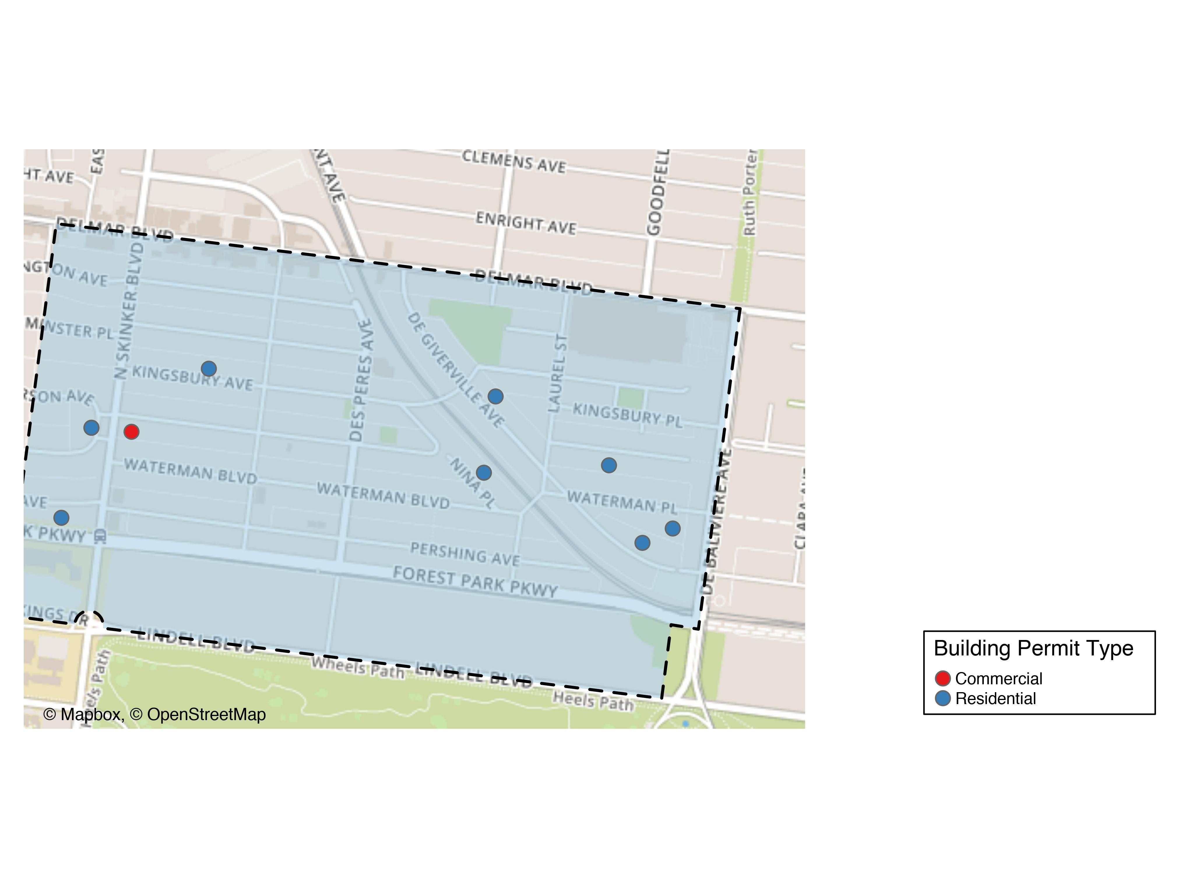
Skinker DeBaliviere

Slide 25
Skinker DeBaliviere
New Use | Average Cost | # of Permits
Commercial | $25,000 | 1
Residential | $21,444 | 9

Slide 26
Skinker DeBaliviere Individual Permit Breakdown
Owner | New Use | Cost | Address
OESCH, ROBERT G & MICHELE D | Residential | $575 | 6143 KINGSBURY AV
BARTON, JONATHAN T & JENNIFER L | Residential | $4,500 | 6200 MCPHERSON AV
RANDALL, JAMES JOSEPH | Residential | $8,450 | 5751 DEGIVERVILLE AV
DENNON, GERALD E | Residential | $6,968 | 5776 MCPHERSON AV
PASTORET, BLAISE & LAYLA LINEHAN | Residential | $10,000 | 5859 DEGIVERVILLE AV
WASHINGTON UNIVERSITY | Commercial | $25,000 | 6188 MCPHERSON AV
MOJAVE PROPERTIES LLP | Residential | $2,500 | 5845 NINA PL
COTHRAN, KILINYAA LOUISE | Residential | $36,000 | 6228 PERSHING AV
KING, BENNIE R | Residential | $15,000 | 5726 WATERMAN BLVD
BARTON, JONATHAN T & JENNIFER L | Residential | $109,000 | 6200 MCPHERSON AV

Slide 27
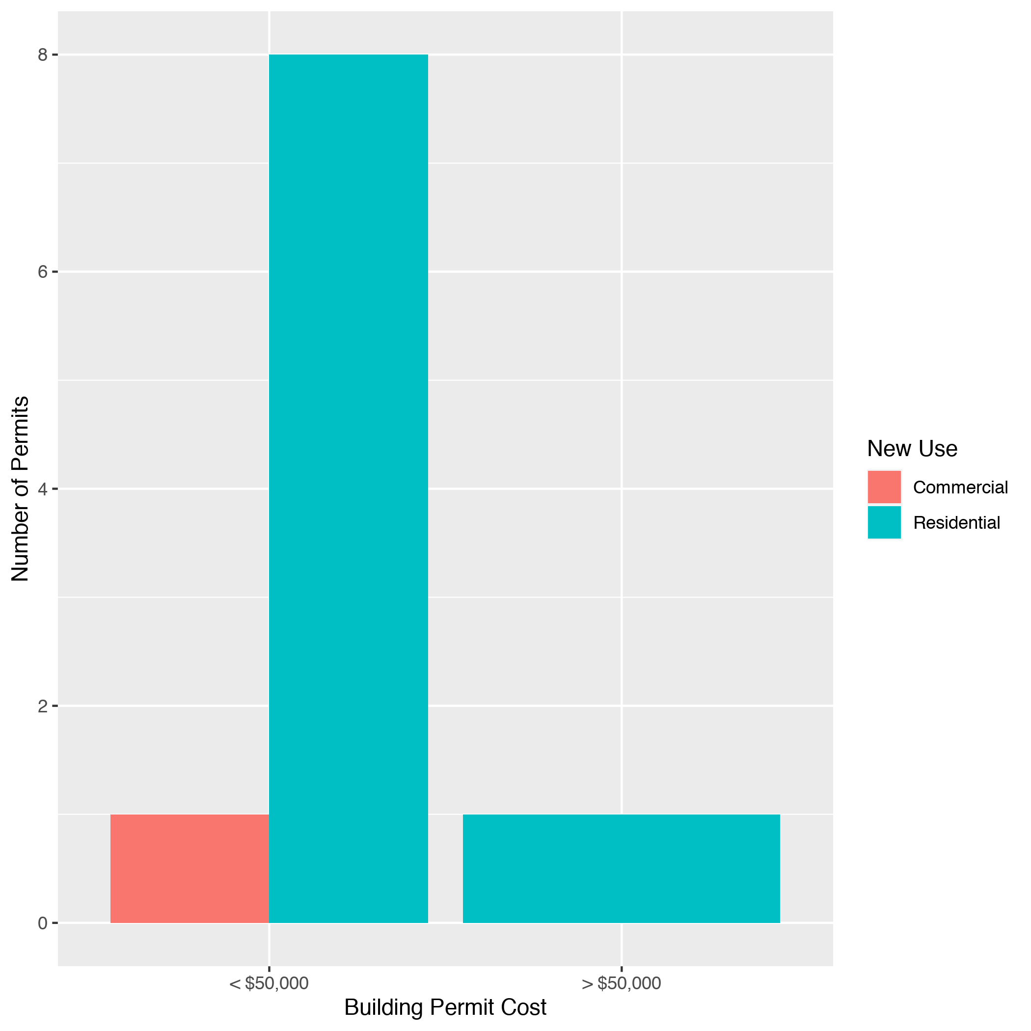
Skinker DeBaliviere High Cost Permits

Slide 28
West End: Summary Notes
7 building permits in West End in March 2020
40.00% change compared to March 2019 (5 total building permits)
$98,307 : Average building permit cost in West End in March 2020
-40.35% change compared to March 2019 ($164,800)

Slide 29
West End: Summary Notes
25 total building permits in West End in 2020
150.00% change compared to this time in 2019 (10 total building permits)
$82,272 : Average building permit cost in West End in 2020
-60.92% change compared to this time in 2019 ($210,520)

Slide 30
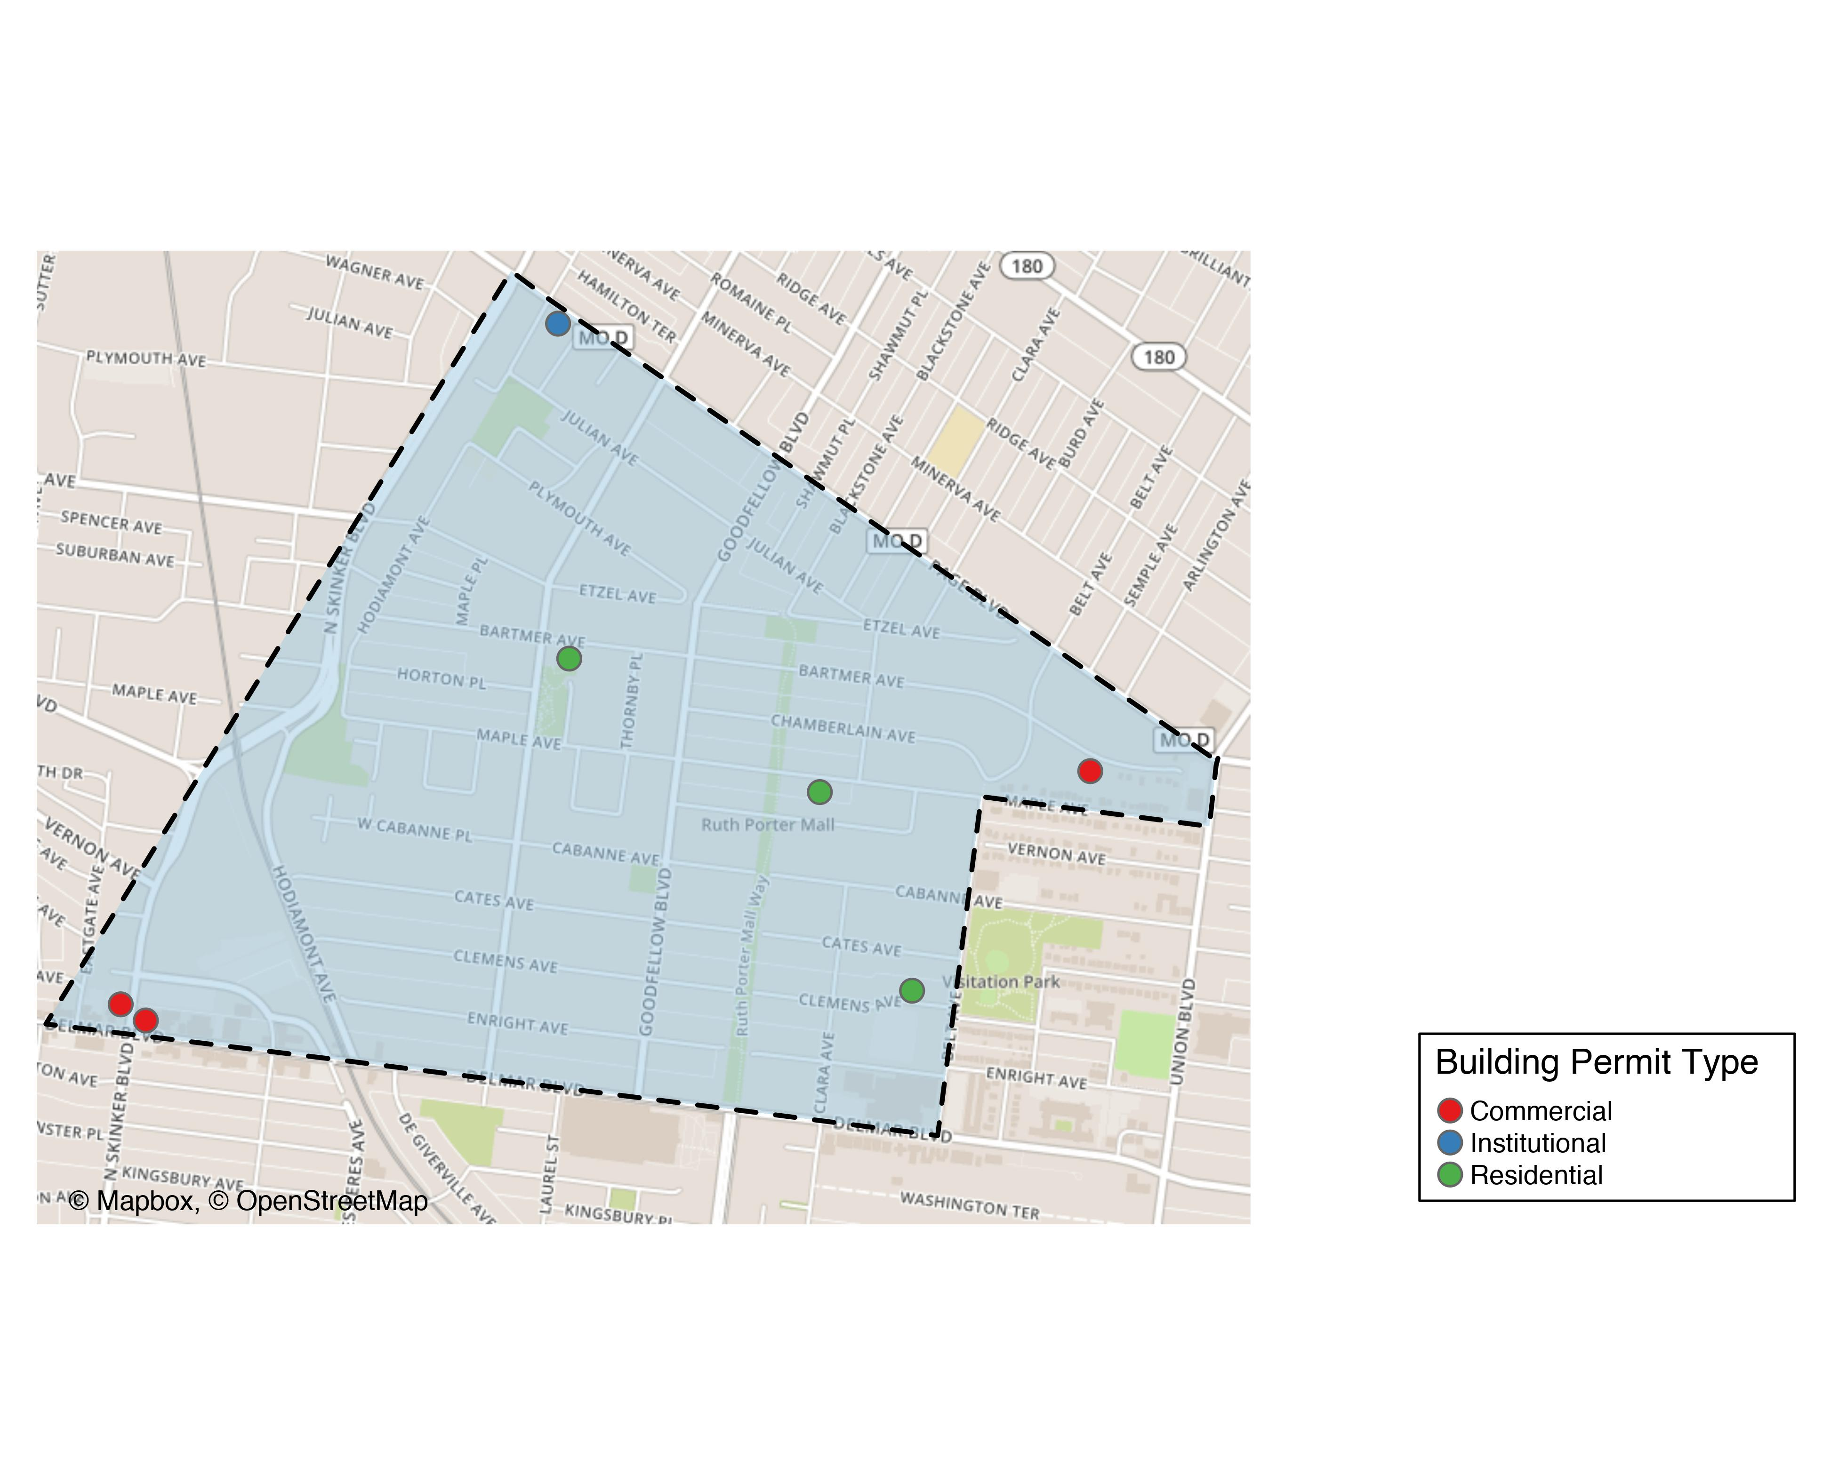
West End

Slide 31
West End
New Use | Average Cost | # of Permits
Commercial | $128,517 | 3
Institutional | $180,000 | 1
Residential | $40,867 | 3

Slide 32
West End Individual Permit Breakdown
Owner | New Use | Cost | Address
YN, TY | Institutional | $180,000 | 5990 PAGE BLVD
CARROLL, DANIEL | Commercial | $1,200 | 5418 BARTMER AV
WASHINGTON UNIVERSITY | Commercial | $375,000 | 6197 DELMAR BLVD
JOHNSON, ERION A SR | Residential | $18,000 | 5886 BARTMER AV
PACE-DELMAR ASSOCIATES LLC | Commercial | $9,350 | 6211 DELMAR BLVD
TAMAYO, SAMUEL | Residential | $100,000 | 5626 MAPLE AV
ALLEN, LILLIE M | Residential | $4,600 | 5531 CLEMENS AV

Slide 33
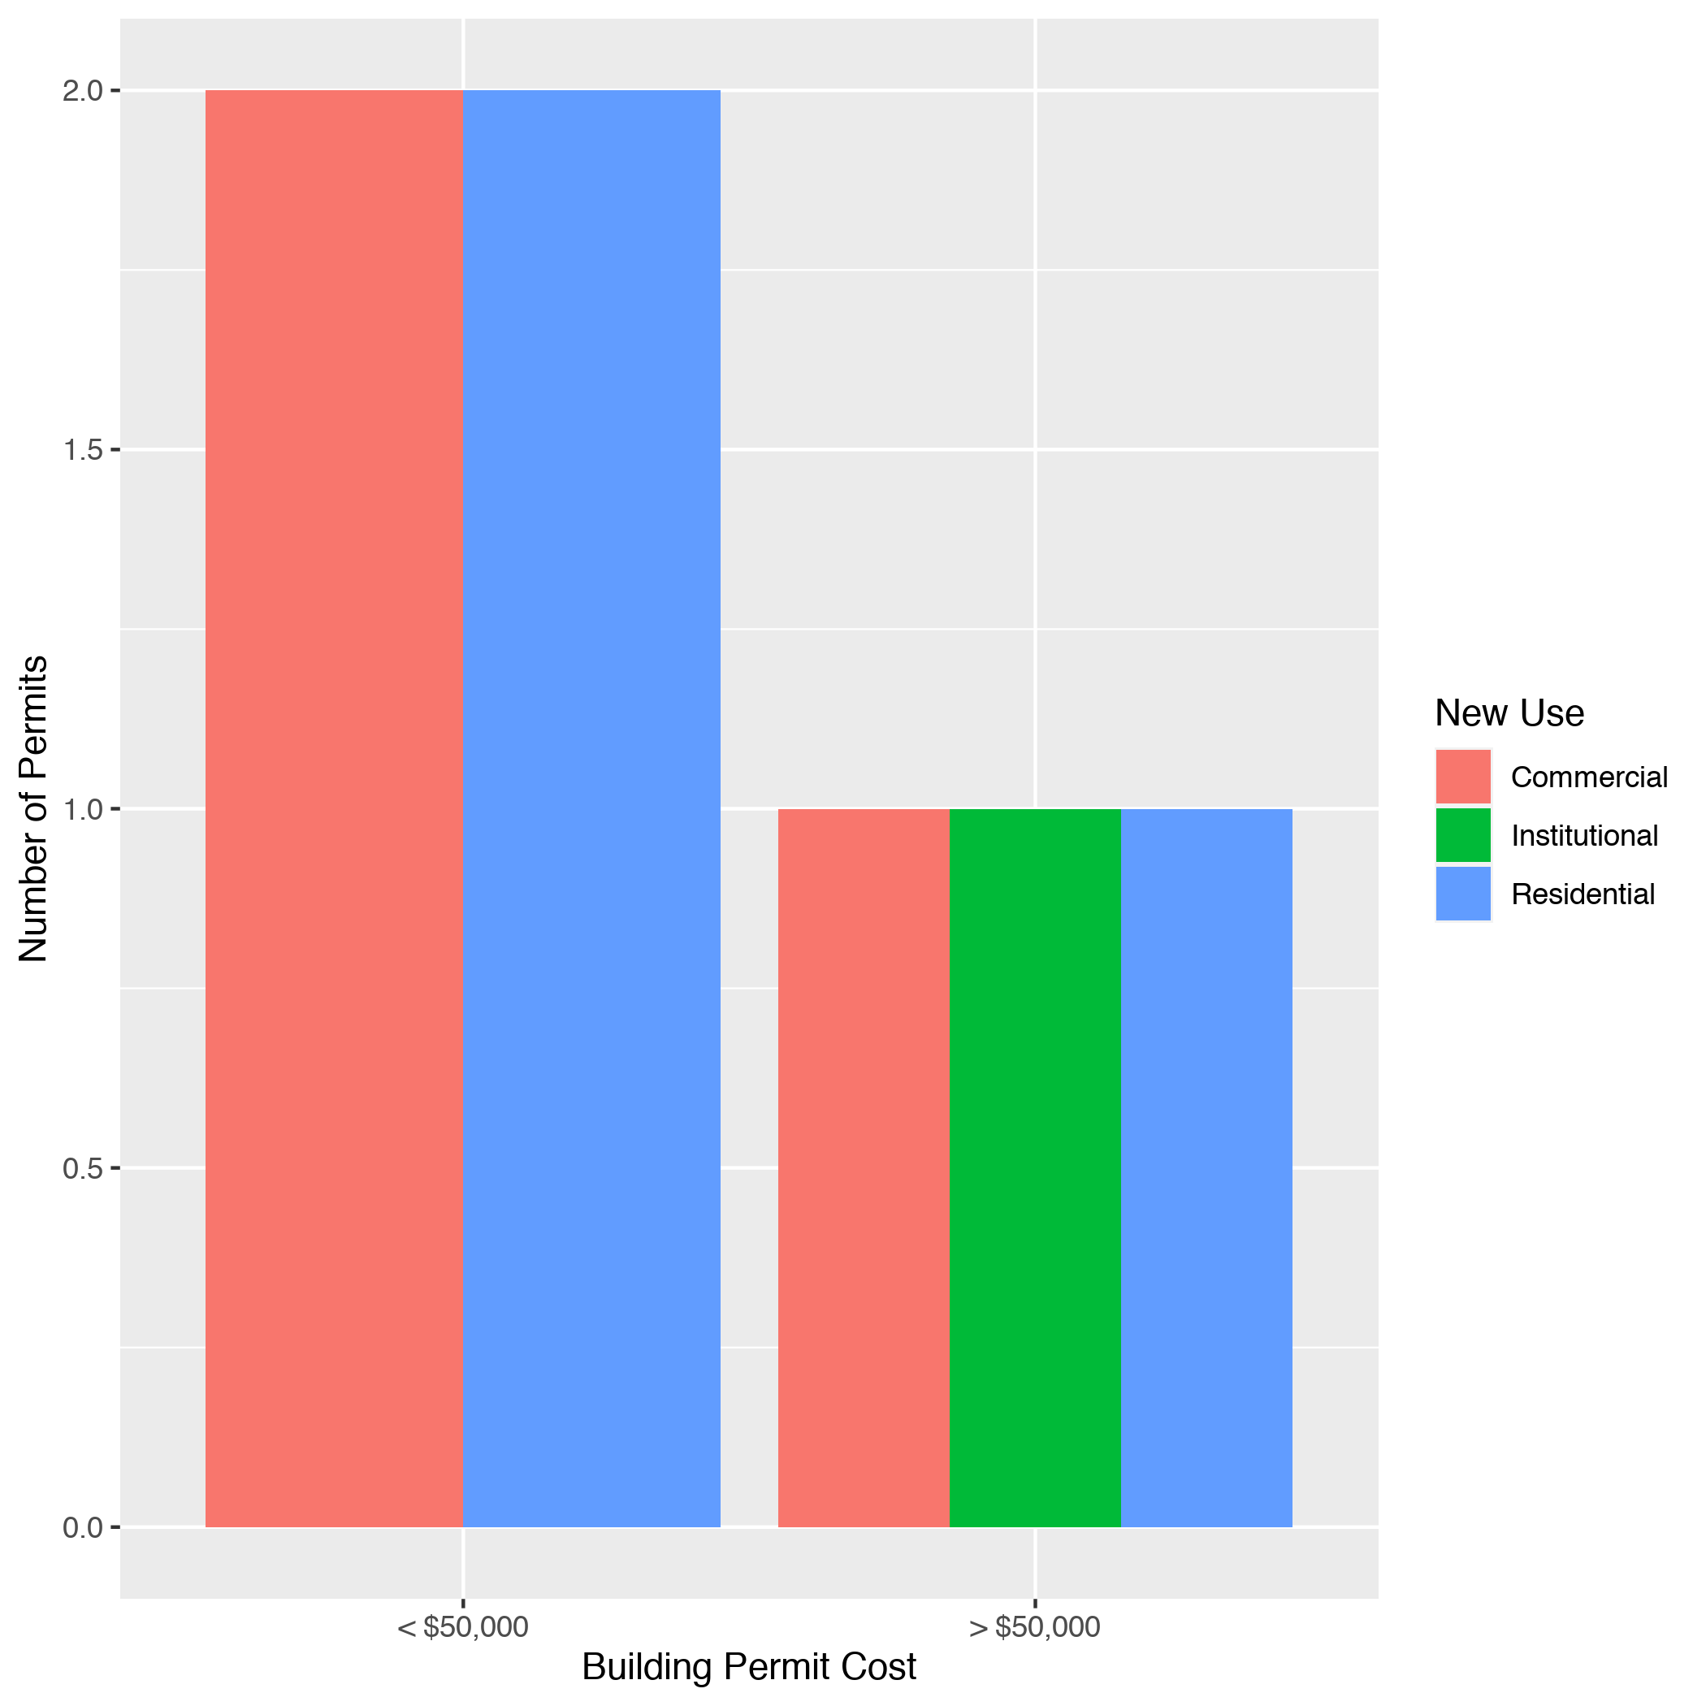
West End High Cost Permits

Slide 34
Visitation Park: Summary Notes
0 building permits in Visitation Park in March 2020
0.00% change compared to March 2019 (0 total building permits)
$0 : Average building permit cost in Visitation Park in March 2020
0.00% change compared to March 2019 ($0)

Slide 35
Visitation Park: Summary Notes
1 total building permits in Visitation Park in 2020
Infinite change compared to this time in 2019 (0 total building permits)
$14,000 : Average building permit cost in Visitation Park in 2020
Infinite change compared to this time in 2019 ($0)

Slide 36
Academy: Summary Notes
1 building permits in Academy in March 2020
-66.67% change compared to March 2019 (3 total building permits)
$85,000 : Average building permit cost in Academy in March 2020
571.23% change compared to March 2019 ($12,663)

Slide 37
Academy: Summary Notes
10 total building permits in Academy in 2020
25.00% change compared to this time in 2019 (8 total building permits)
$87,495 : Average building permit cost in Academy in 2020
27.68% change compared to this time in 2019 ($68,526)

Slide 38
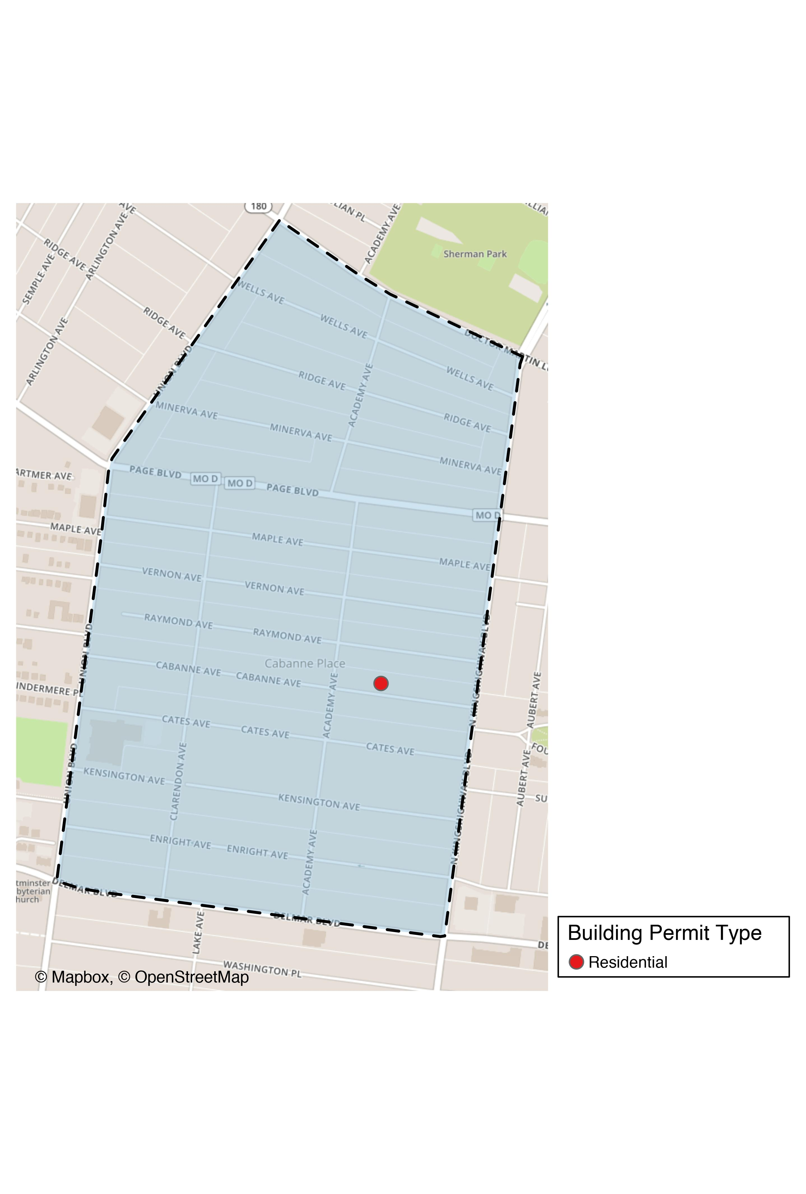
Academy

Slide 39
Academy
New Use | Average Cost | # of Permits
Residential | $85,000 | 1

Slide 40
Academy Individual Permit Breakdown
Owner | New Use | Cost | Address
CUNNINGHAM, ARTESIA | Residential | $85,000 | 5069 CABANNE AV

Slide 41
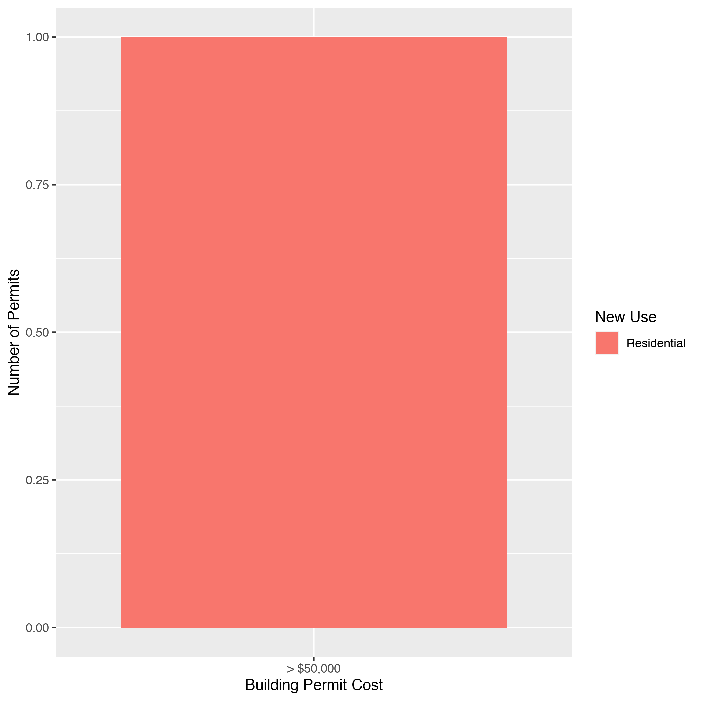
Academy High Cost Permits

Slide 42
Fountain Park: Summary Notes
1 building permits in Fountain Park in March 2020
Infinite change compared to March 2019 (0 total building permits)
$2,000 : Average building permit cost in Fountain Park in March 2020
Infinite change compared to March 2019 ($0)

Slide 43
Fountain Park: Summary Notes
1 total building permits in Fountain Park 2020
0.00% change compared to this time in 2019 (1 total building permits)
$2,000 : Average building permit cost in Fountain Park in 2020
300.00% change compared to this time in 2019 ($500)

Slide 44
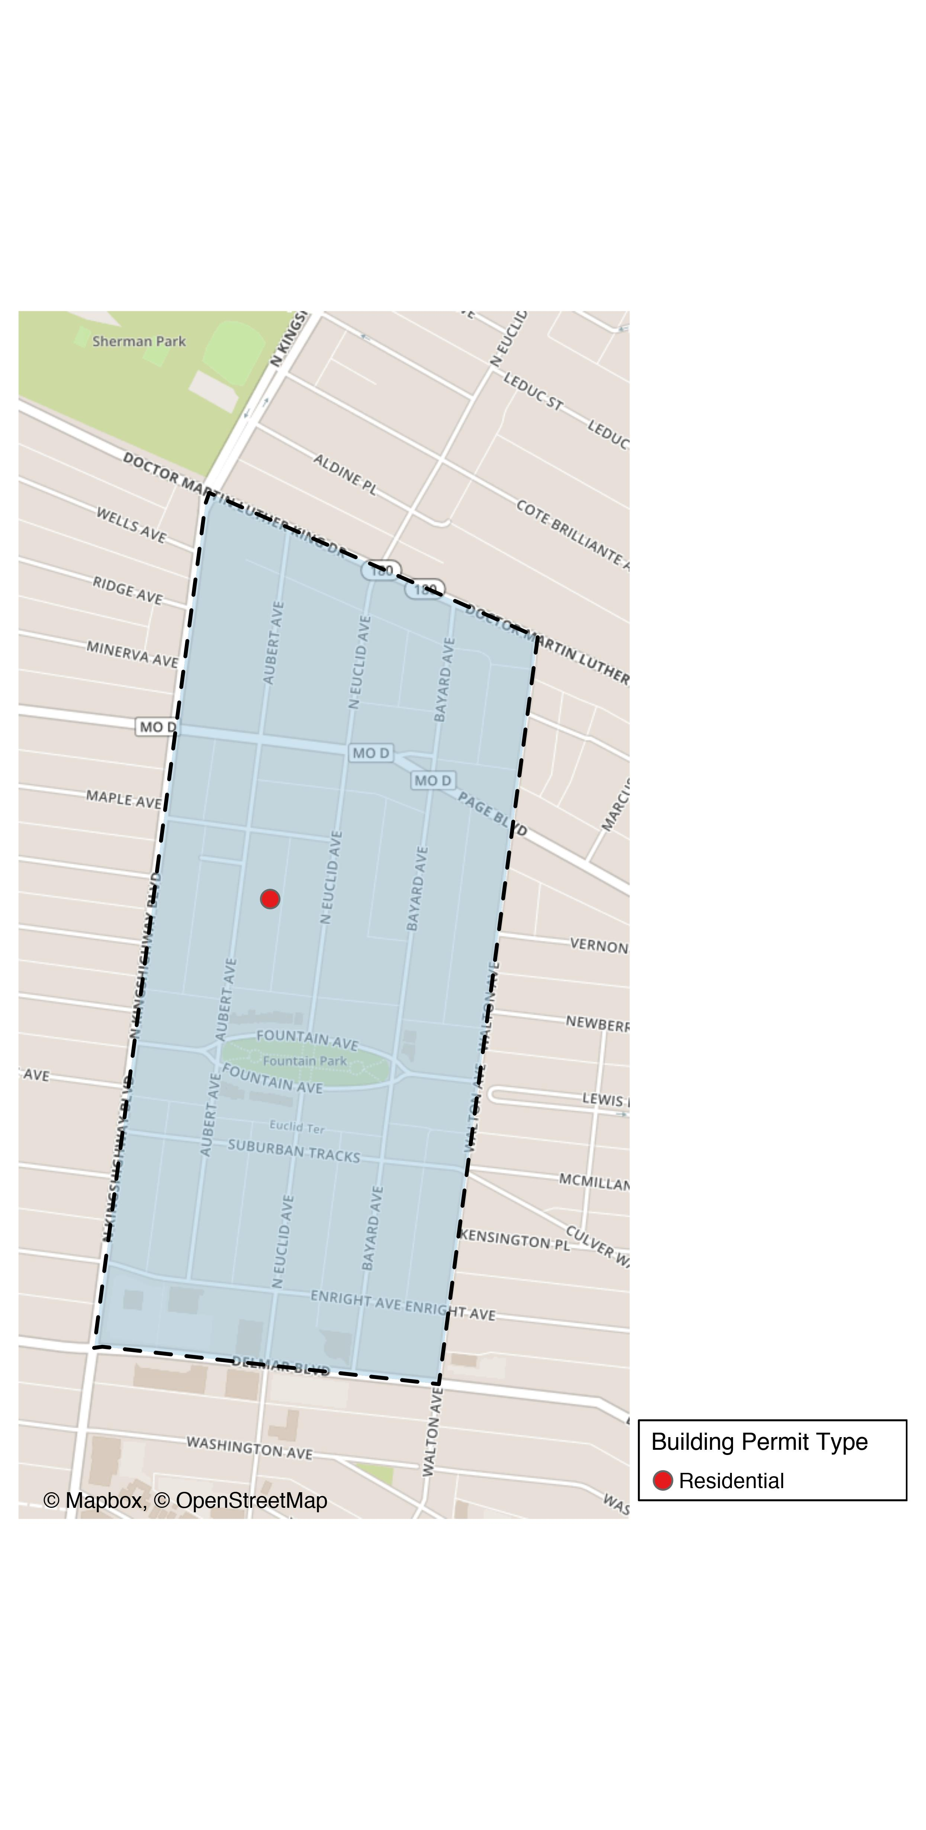
Fountain Park

Slide 45
Fountain Park
New Use | Average Cost | # of Permits
Residential | $2,000 | 1

Slide 46
Fountain Park Individual Permit Breakdown
Owner | New Use | Cost | Address
KOCH, FREDERICK & MARJORIE DEL CARLO | Residential | $2,000 | 1202 AUBERT AV

Slide 47

Fountain Park High Cost Permits

Slide 48
Lewis Place: Summary Notes
0 building permits in Lewis Place in March 2020
0.00% change compared to March 2019 (0 total building permits)
$0 : Average building permit cost in Lewis Place in March 2020
0.00% change compared to March 2019 ($0)

Slide 49
Lewis Place: Summary Notes
1 total building permits in Lewis Place in 2020
-80.00% change compared to this time in 2019 (5 total building permits)
$2,500 : Average building permit cost in Lewis Place in 2020
-52.11% change compared to this time in 2019 ($5,220)

Slide 50
Vandeventer: Summary Notes
1 building permits in Vandeventer in March 2020
0.00% change compared to March 2019 (1 total building permits)
$23,646 : Average building permit cost in Vandeventer in March 2020
-99.14% change compared to March 2019 ($2,746,645)

Slide 51
Vandeventer: Summary Notes
4 total building permits in Vandeventer in 2020
-50.00% change compared to this time in 2019 (8 total building permits)
$59,344 : Average building permit cost in Vandeventer in 2020
-83.29% change compared to this time in 2019 ($355,241)

Slide 52
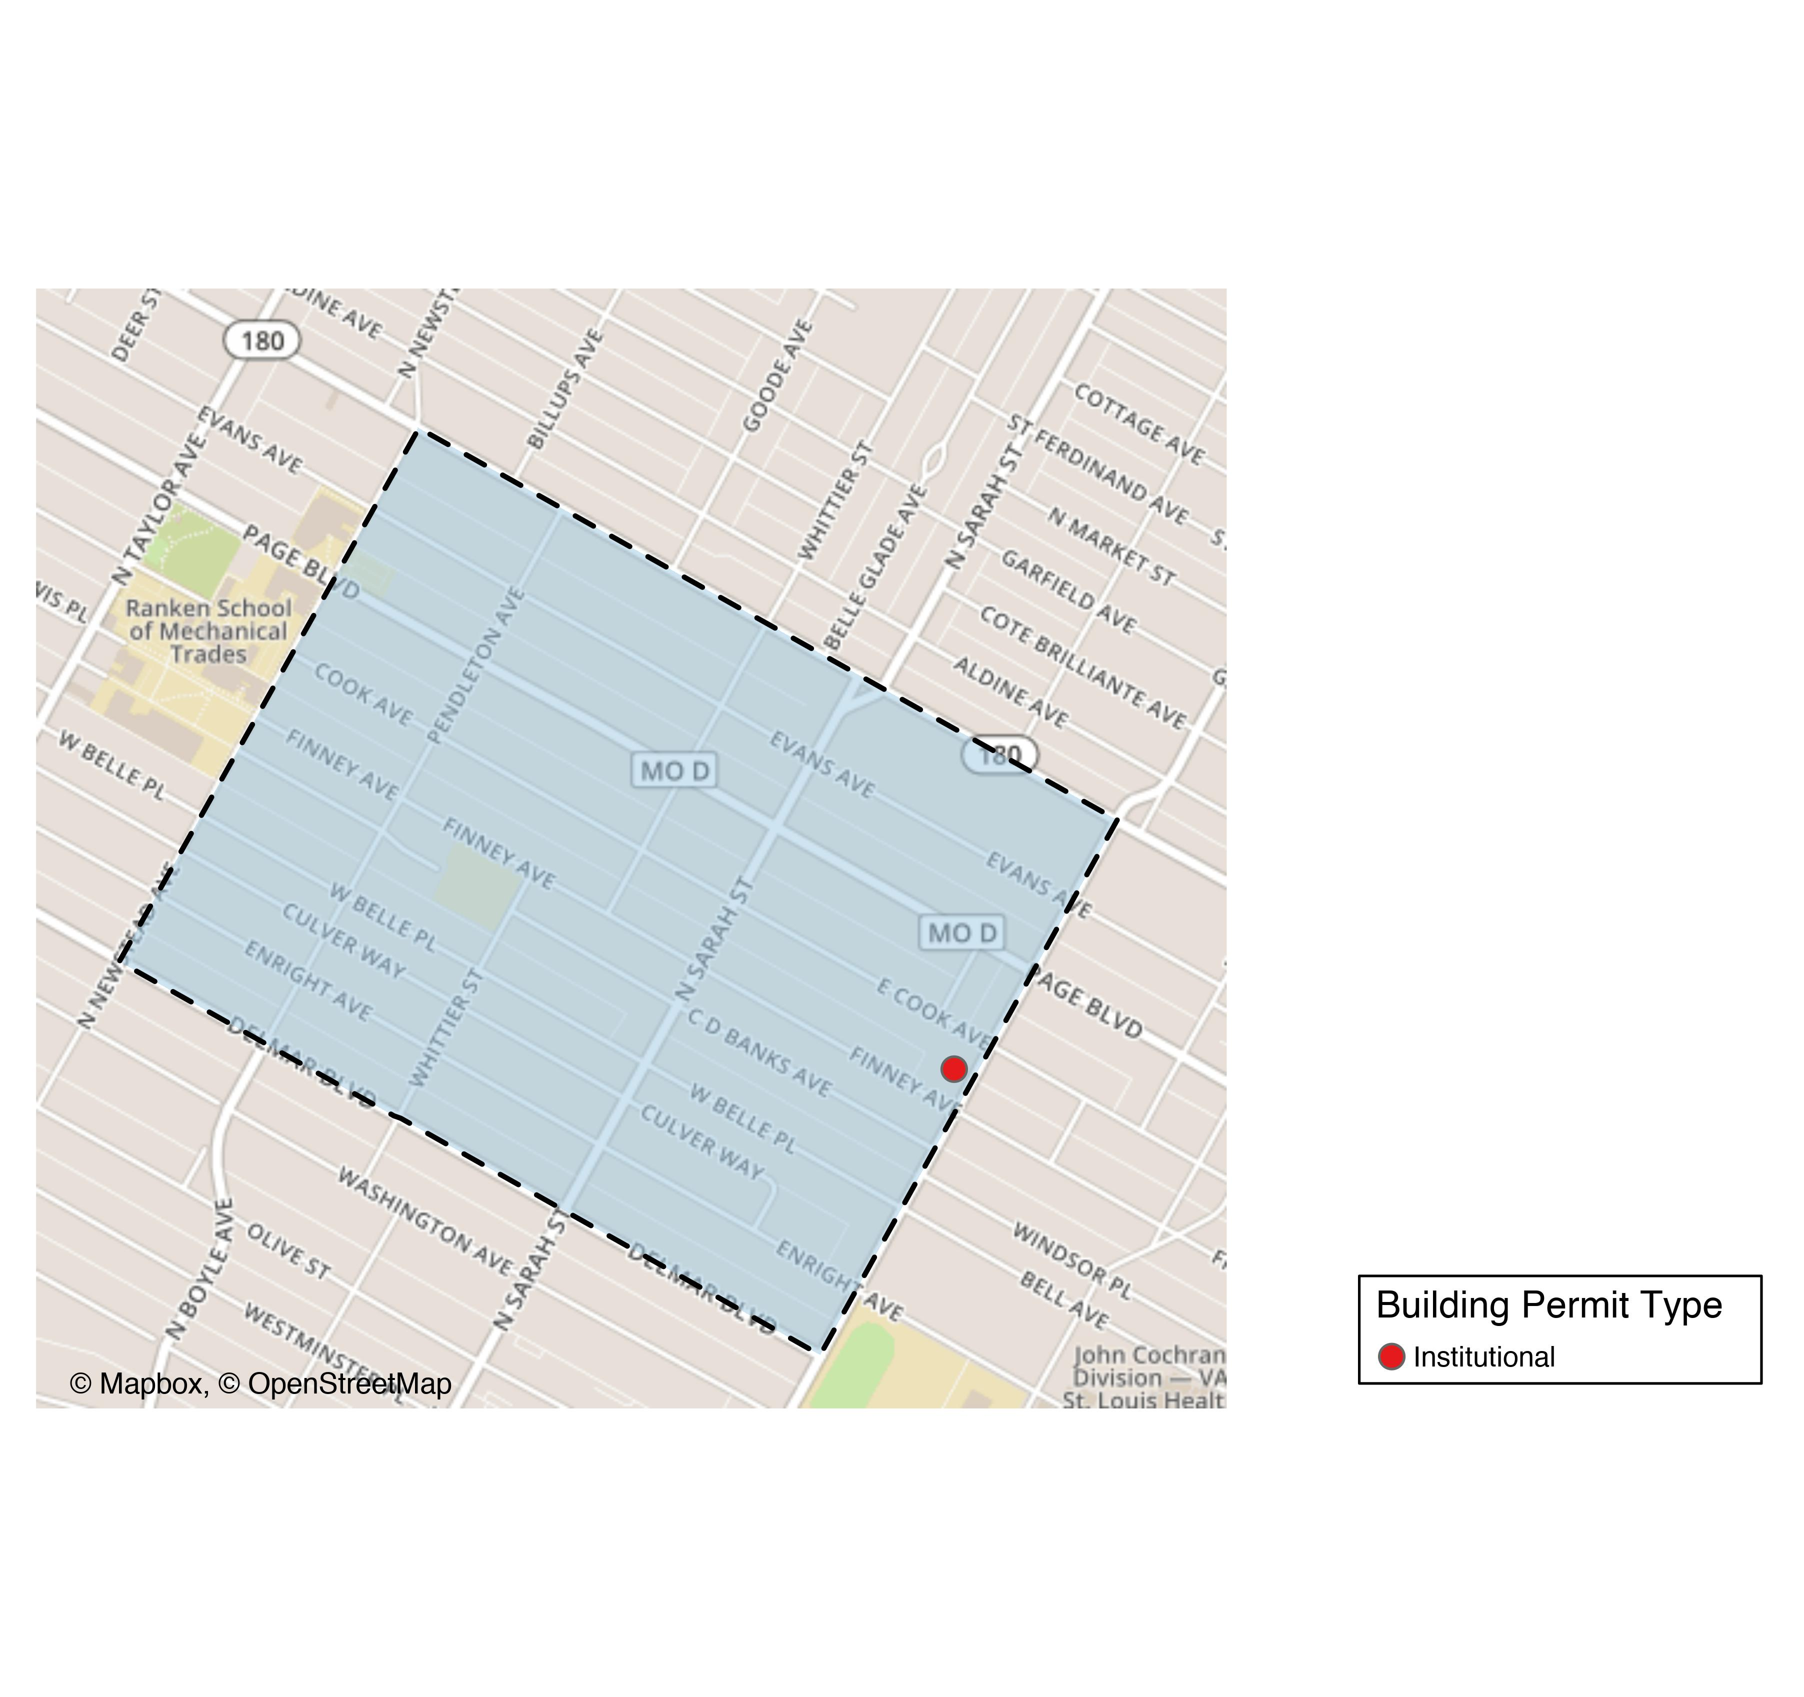
Vandeventer

Slide 53
Vandeventer
New Use | Average Cost | # of Permits
Institutional | $23,646 | 1

Slide 54
Vandeventer Individual Permit Breakdown
Owner | New Use | Cost | Address
GUARDIAN ANGEL SETTLEMENT ASSOC | Institutional | $23,646 | 1127 N VANDEVENTER AV

Slide 55
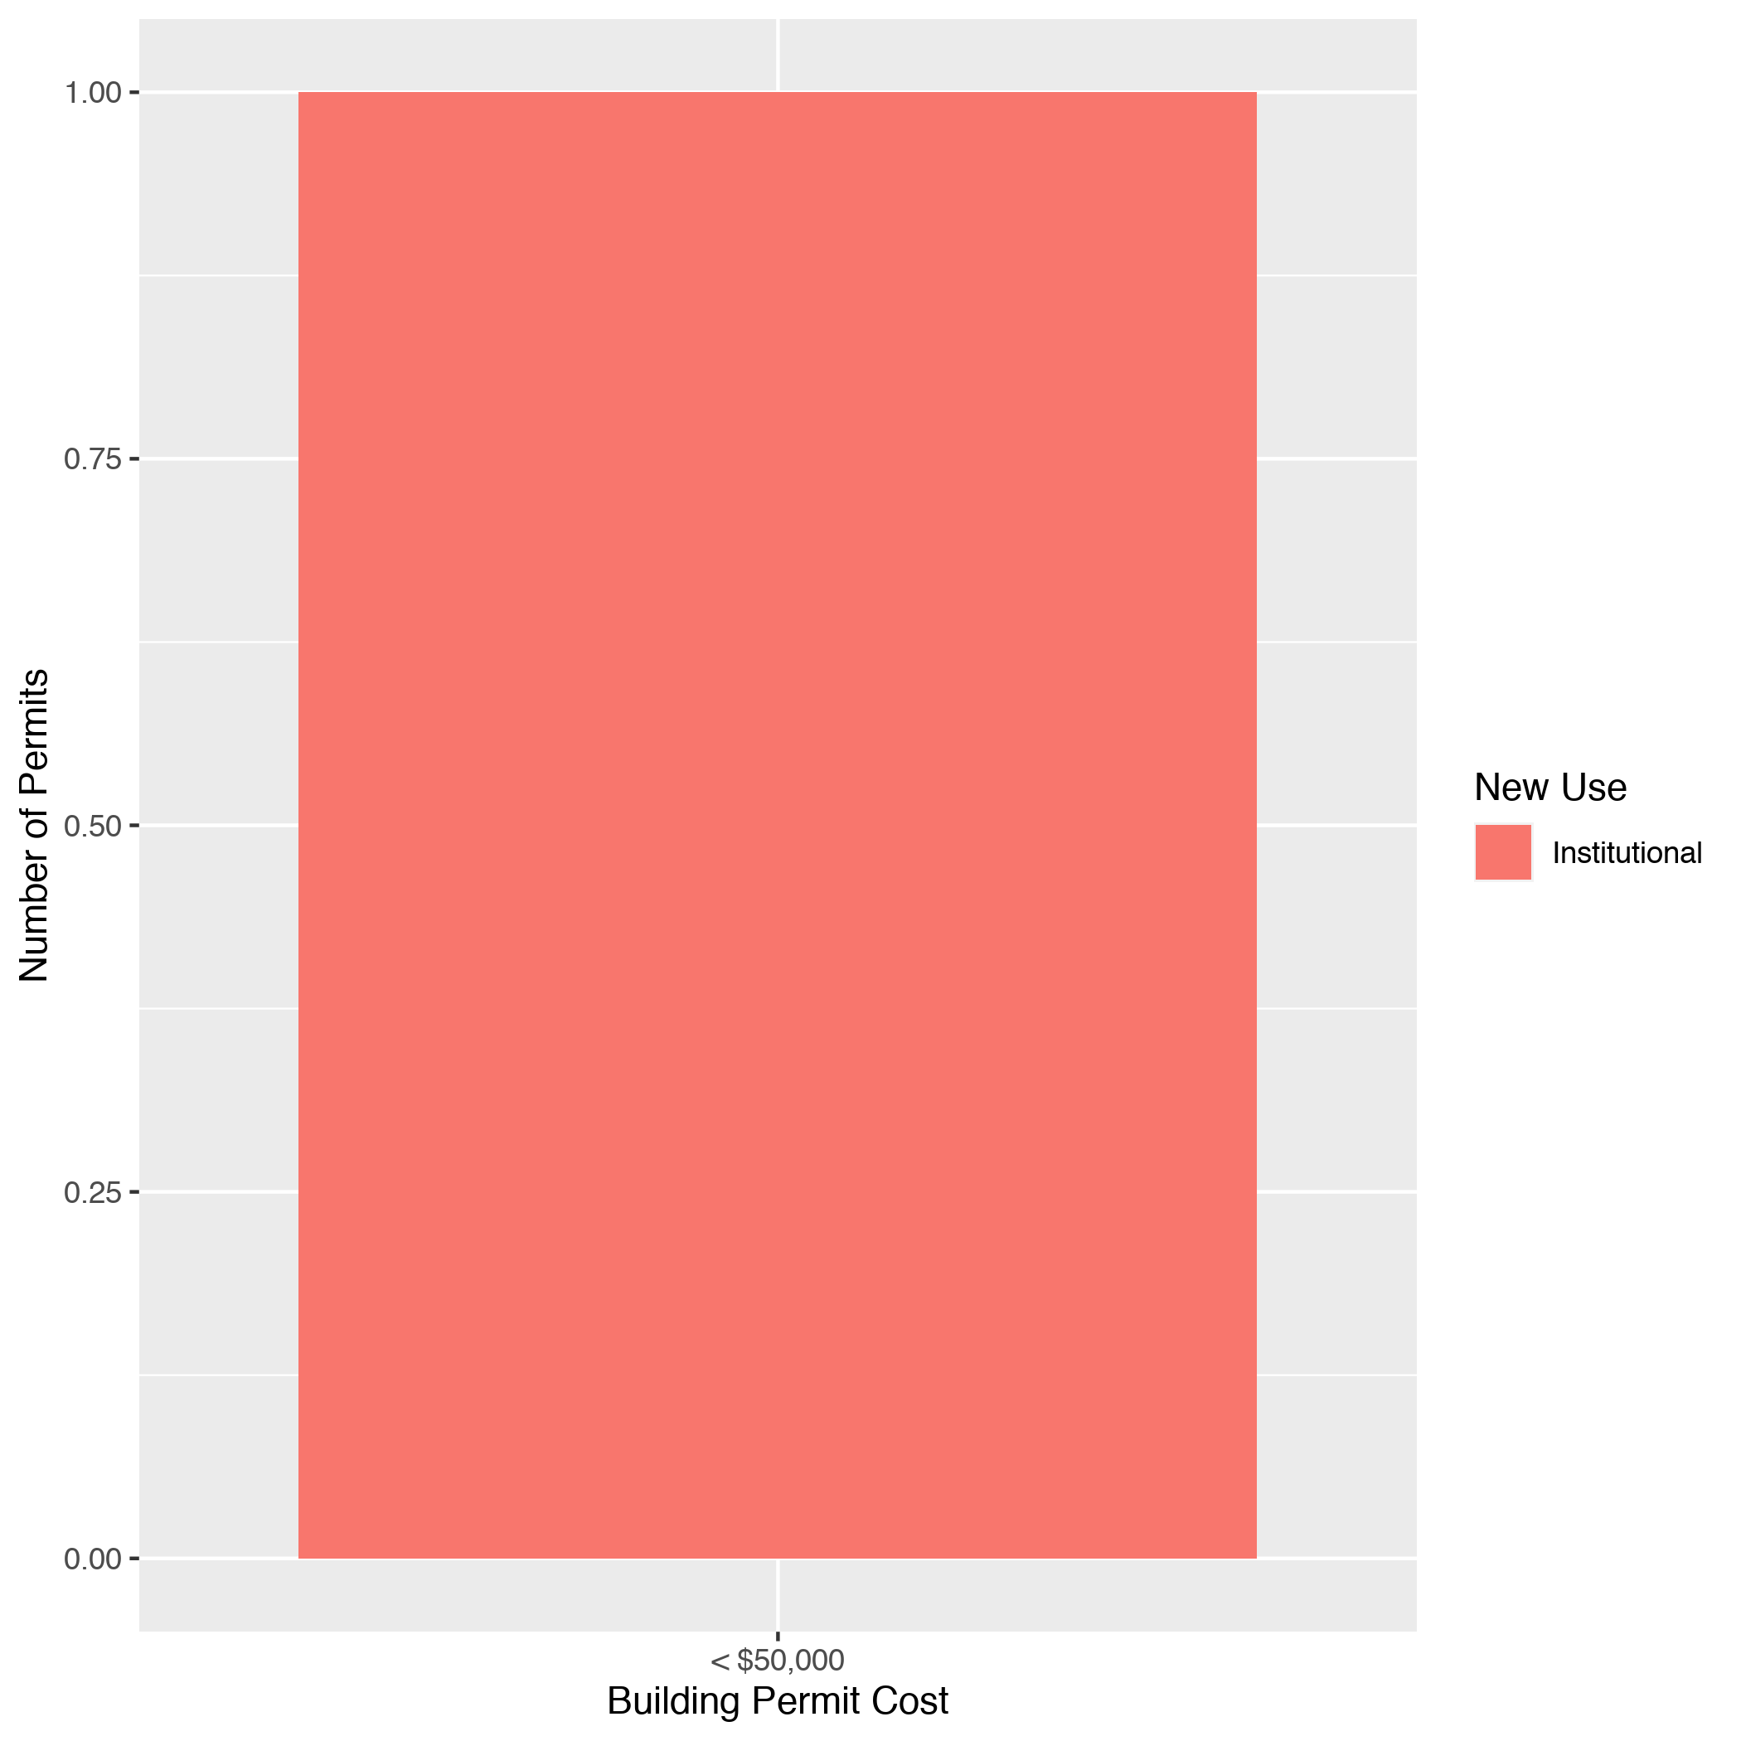
Vandeventer High Cost Permits

