Slide 1
Varnishing your
Django app

Slide 2
Hi.
I’m Jeremy.
Notes:
I’m a senior developer at the Washington Post.

Slide 3
I want to convince you
to use Varnish.
Notes:
And I’m going to start with a story.

Slide 4
Oooh!
A story!

Slide 5
The Post, before Varnish.
Notes:
This story is about the Washington Post in the years before Varnish.

Slide 6

Notes:
Sad Keanu knows there’s good and bad with increased Web traffic. More visitors means your servers are shouldering more load.

Slide 7
Using Django cache framework and memcached.
Notes:
Django encourages the use of object caches though its application-based cache framework. Some caching is better than no caching, but under intense load, you need to move your cache as far up the application stack as possible. Here’s why.

Slide 8
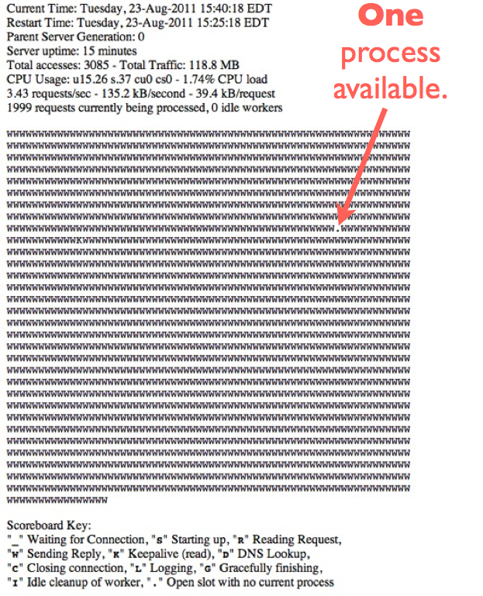
Notes:
Uh-oh. Apache wants to know why we hate it so much.

Slide 9
Yikes.
Notes:
Yeah, that was bad. But what was the big problem?

Slide 10
object caching
v.
proxy caching
Notes:
An object cache stores the results of queries or template fragments or other things. Proxy caches store one thing: Sweet, sweet HTML.

Slide 11
3 problems relying on only object caching.
Notes:
Reliance on object caches only caused us three distinct problems at the Post.

Slide 12
1. Every request travels the whole app stack.
Notes:
Yup. There’s no respite for your app server.

Slide 13

Notes:
Hipster sysadmin wants each page rendered by the application server. If you’re not knitting it together from objects fetched from Memcache, you might as well be buying clothes from Wal-Mart.

Slide 14
Fetch.
Assemble.
Render.
Serve.
Notes:
Your app server has to do all of these things for EVEN a cached request. Kind of insulting, right?

Slide 15
Protect your
application servers!
Notes:
Your app server shouldn’t be working hard when there’s a cache hit.

Slide 16
2. Cache expiration
is hard.

Slide 17
“There are only two hard things in computer science: Cache invalidation and naming things.”
Tim Bray via Phil Karlton
Notes:
And off by one errors.

Slide 18
How many objects are on your home page?
Notes:
Think about it: Expiring objects is hard. Granularity isn’t just a feature; it can also be a bug.

Slide 19
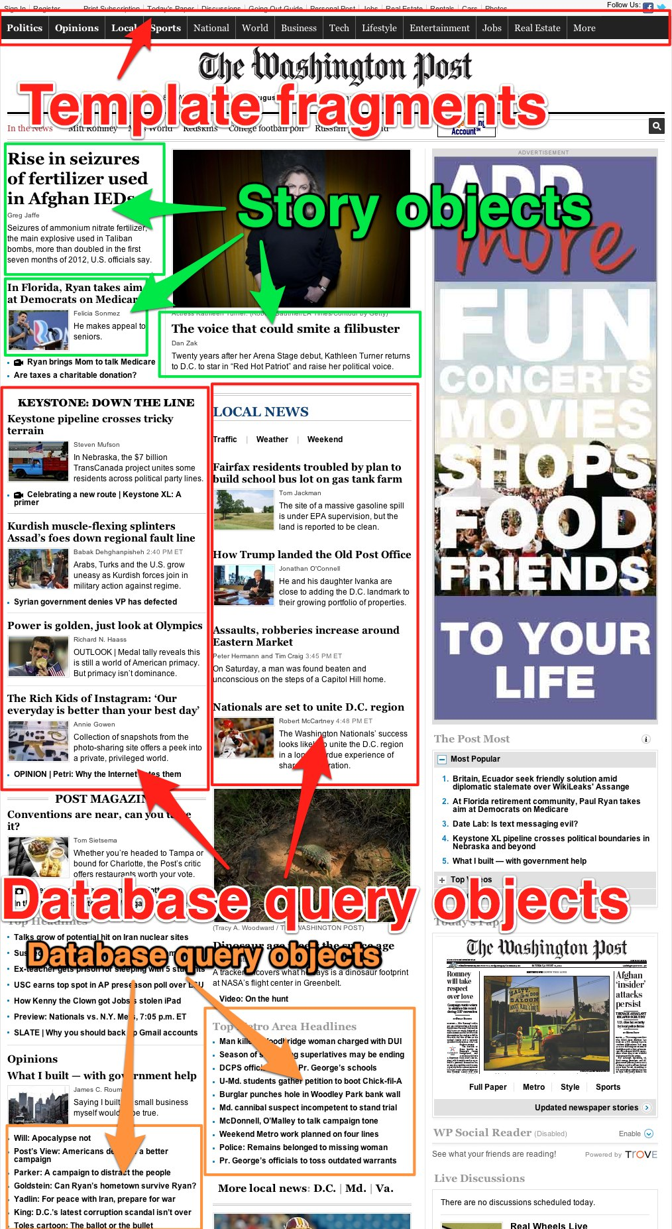

Slide 20
URLs instead of objects.

Slide 21
Cache the results,
not the ingredients.

Slide 22
3. Thundering herd

Slide 23
Apache overwhelmed when cache expires.

Slide 24


Slide 25
django-newcache,
maybe?

Slide 26
Still relies on
application servers.

Slide 27
Back to the story.

Slide 28
Things got better.

Slide 29
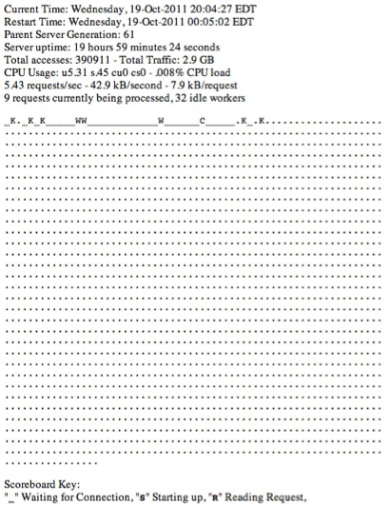

Slide 30
New Hampshire primary: >800 req/s

Slide 31


Slide 32
I can see that
you’re convinced.

Slide 33
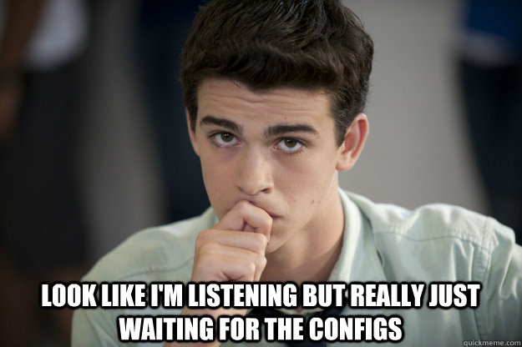

Slide 34
Let’s look at some configuration files!

Slide 35
A simple configuration.

Slide 36
https://gist.github.com/1542949

Slide 37
I am not putting all of that code on the screen.

Slide 38
But here’s the synopsis.

Slide 39
define servers backend
receive request sub vcl_recv
if cache miss sub vcl_miss
if cache hit sub vc_hit
fetching from cache sub vcl_fetch
delivering response sub vcl_deliver

Slide 40
One note for
Django users.

Slide 41
sub vcl_fetch { unset beresp.http.Vary return(deliver);}

Slide 42
Vary headers are the bane of your existence.

Slide 43
Default is path + query.

Slide 44
A more complex configuration.

Slide 45
E.g., ours from New Hampshire Primary.

Slide 46
https://gist.github.com/1542992

Slide 47
A few things to note.

Slide 48
1. Regex-based URL purging.

Slide 49
It’s in vcl_miss.

Slide 50
if (req.request == "PURGE") { ban_url(req.url); error 200 "Miss and banned, sire.";}

Slide 51
Wait.
Error 200?

Slide 52


Slide 53
Yeah.
Skips the rest.
Returns a 200.

Slide 54
curl -X PURGE “http://my.site/ban/these/urls/.*”

Slide 55
2. Priming slow URLs.

Slide 56
2. Priming slow URLs.

Slide 57
It’s in vcl_hit.

Slide 58
if (req.request == "PRIME") { set obj.ttl = 1s; error 200 "USDA PRIME.";}

Slide 59
curl -X PRIME “http://my.site/election/dashboard/”curl -X GET “http://my.site/election/dashboard/”

Slide 60
First: Expire page
after 1 second.

Slide 61
Second: Request
now-expired page.

Slide 62
Serves stale (but cached) page while slow page
loads into cache.

Slide 63
3. jQuery-proof caching.

Slide 64
$.ajax(
  cache: false;
)

Slide 65
&_=[cache defeating int]

Slide 66
It’s in vcl_recv.

Slide 67
Ack! Regex!

Slide 68
set req.url = regsuball(req.url,"[?&]_=[^&]{1,25}","");

Slide 69
Ignores jQuery shenanigans.

Slide 70
There’s more for
the intrepid.

Slide 71
Saint mode.
Grace mode.
Magical internet knight mode.

Slide 72


Slide 73
That’s it!
http://j.mp/django-district-varnish
@jeremybowers
jeremyjbowers@gmail.com

