Slide 1
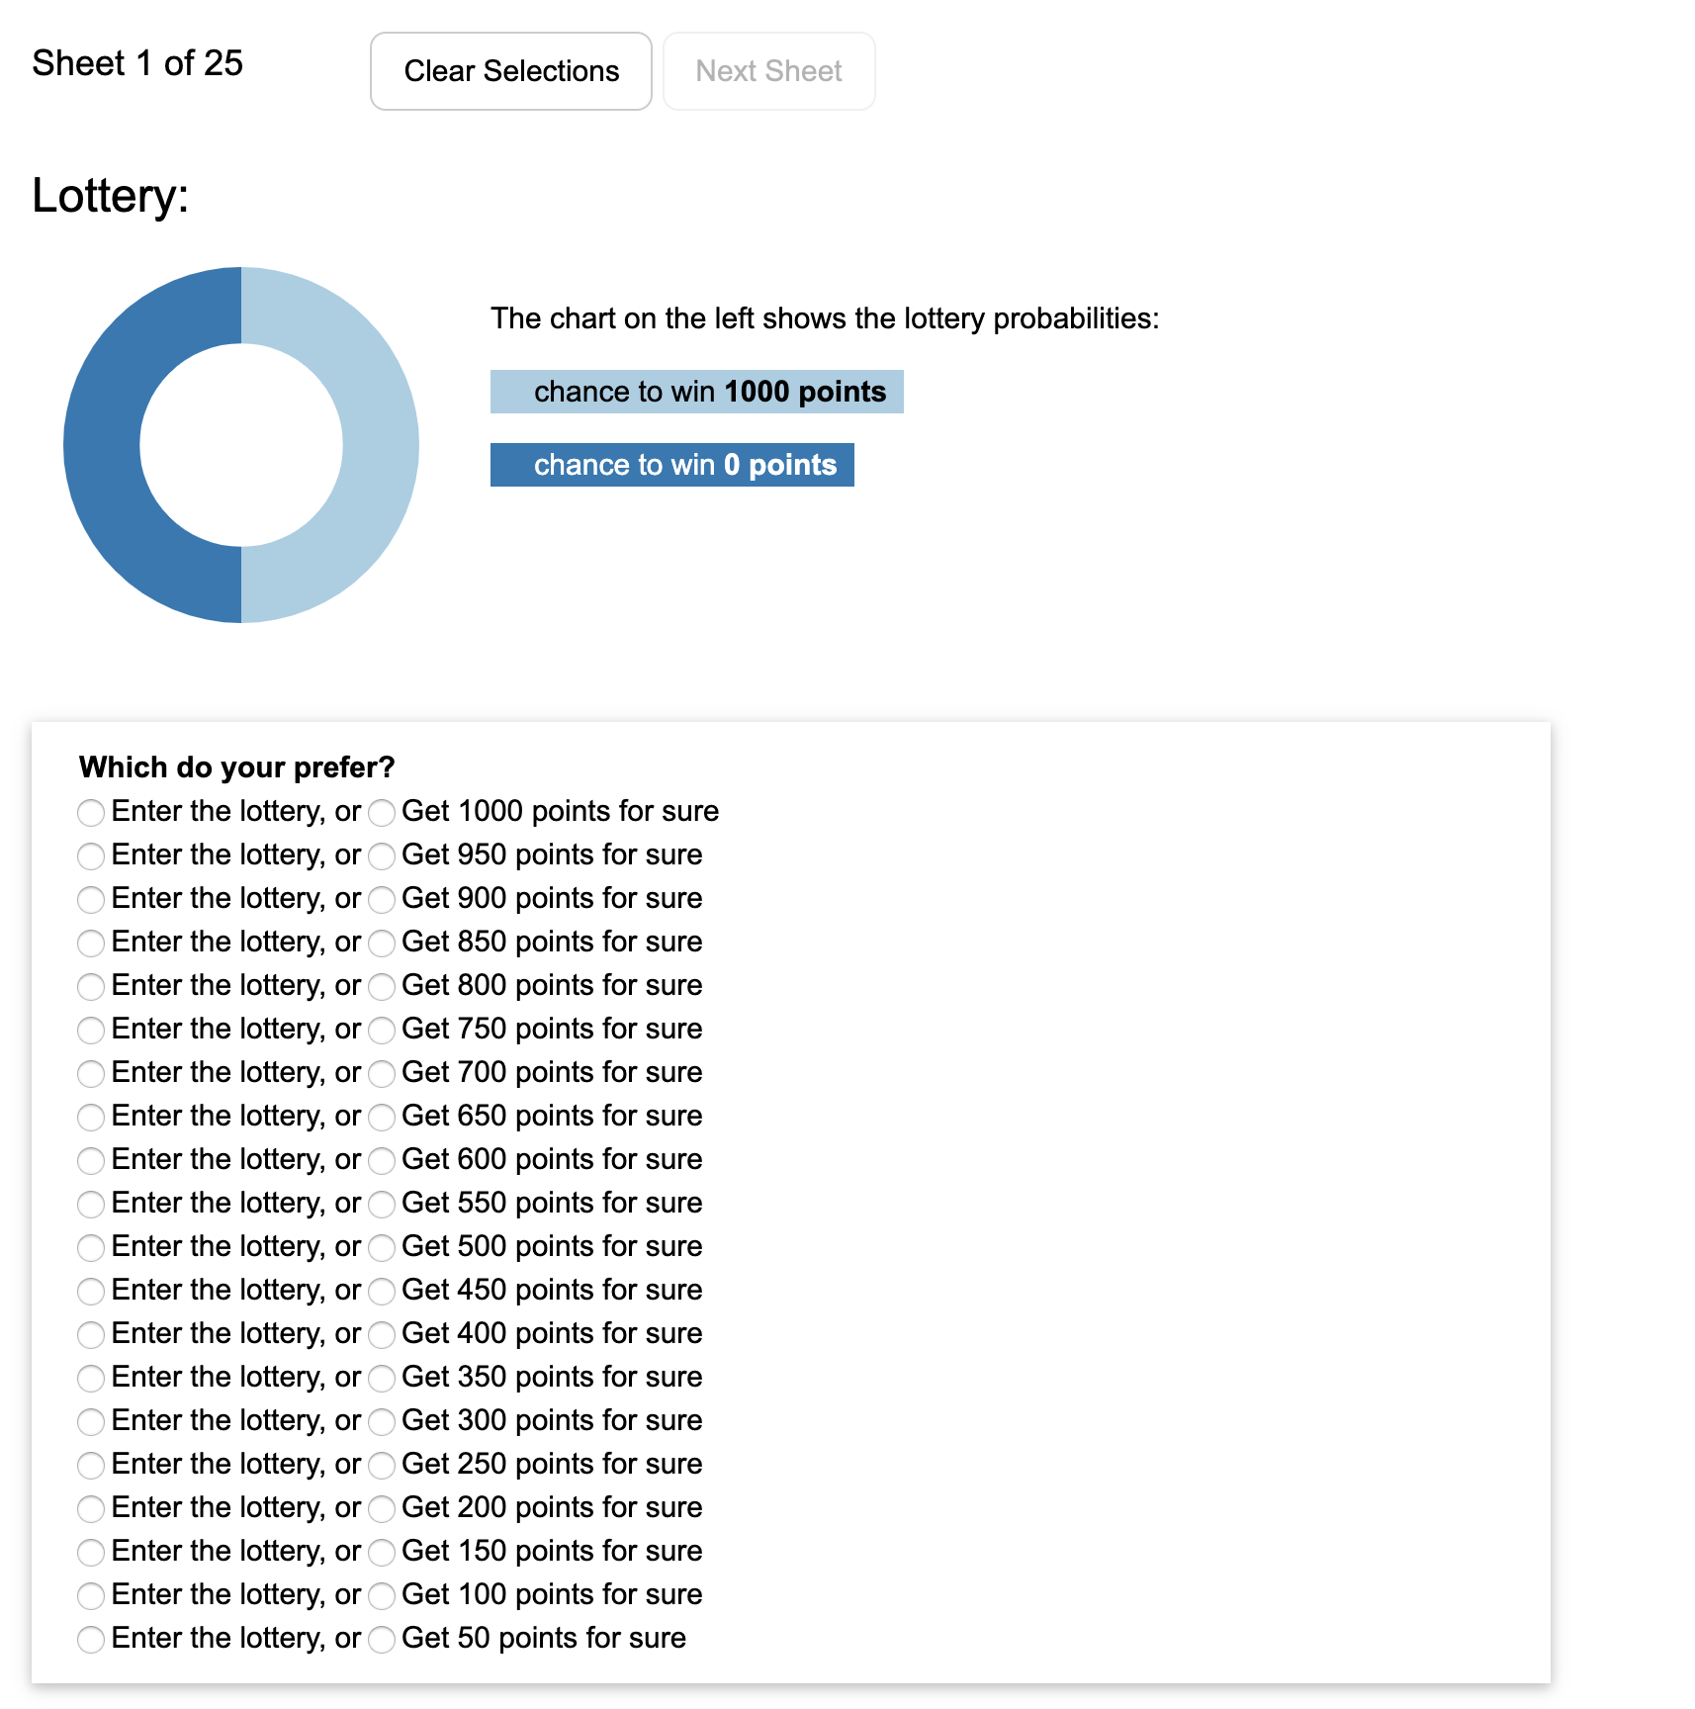

Slide 2
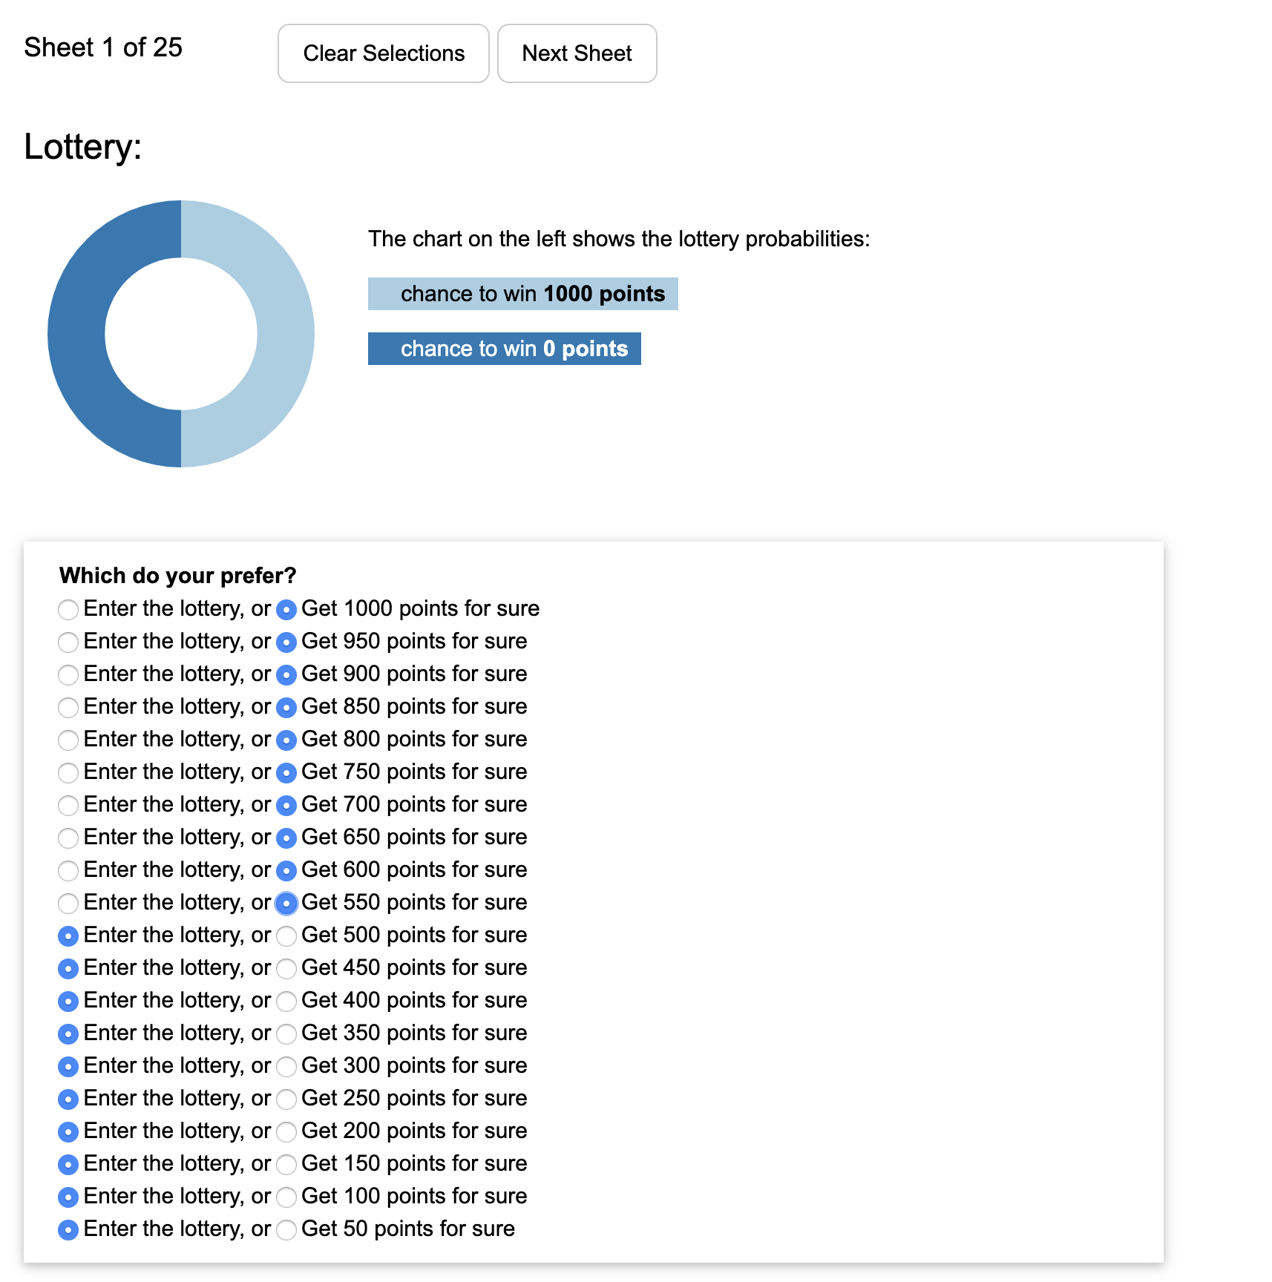
You only need to select one of the options where you switch your decision. We will fill in the rest.

Slide 3
We will simulate the lottery and randomly pick a row.
Your bonus depends on your selection for that row.

Slide 4
You only need to select one of the options where you switch your decision. We will fill in the rest.
We will simulate the lottery and randomly pick a row.
Your bonus depends on your selection for that row.

