Slide 1
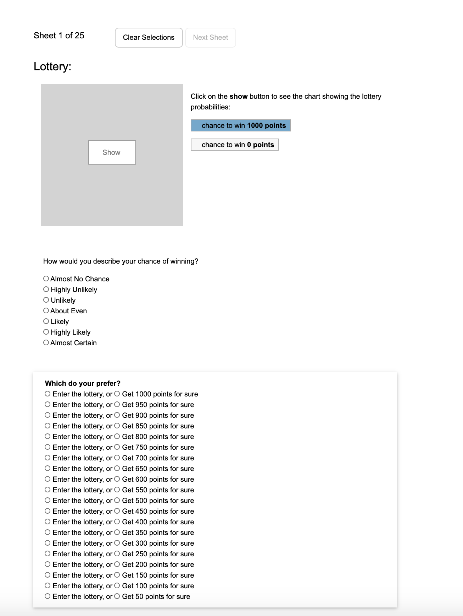


Slide 2
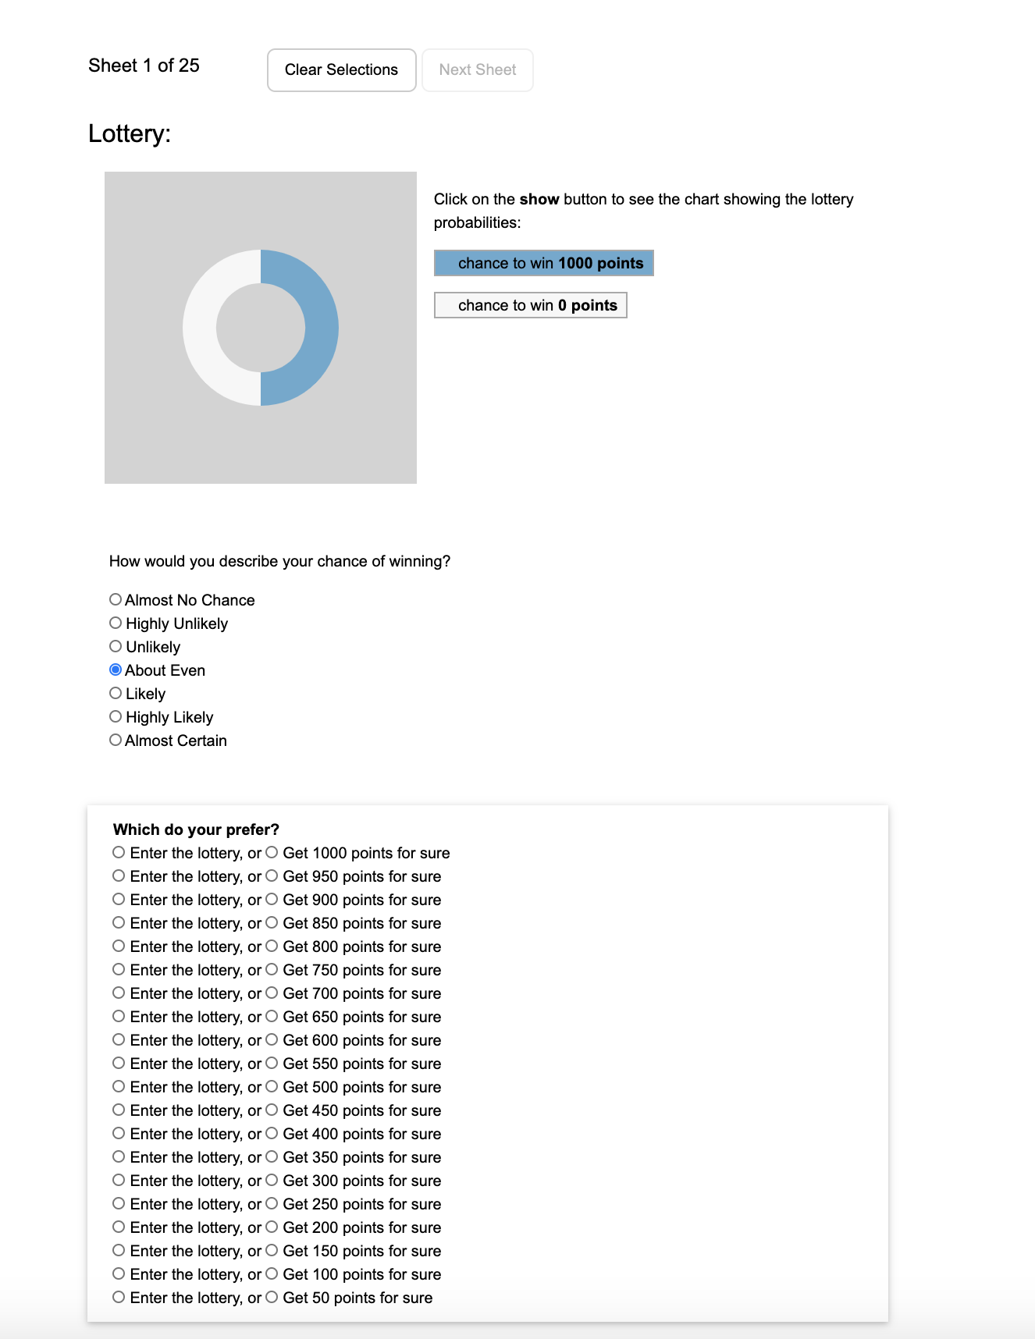
Describe your chance of winning

Slide 3
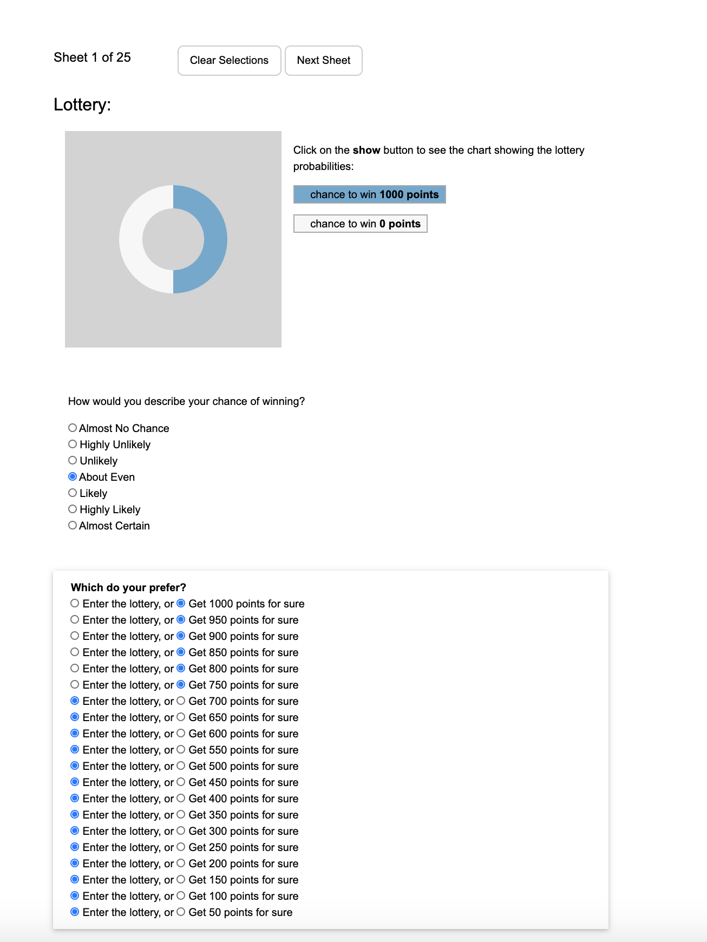
You only need to select one of the options where you switch your decision. We will fill in the rest.

Slide 4
We will simulate the lottery and randomly pick a row.
Your bonus depends on your selection for that row.

Slide 7
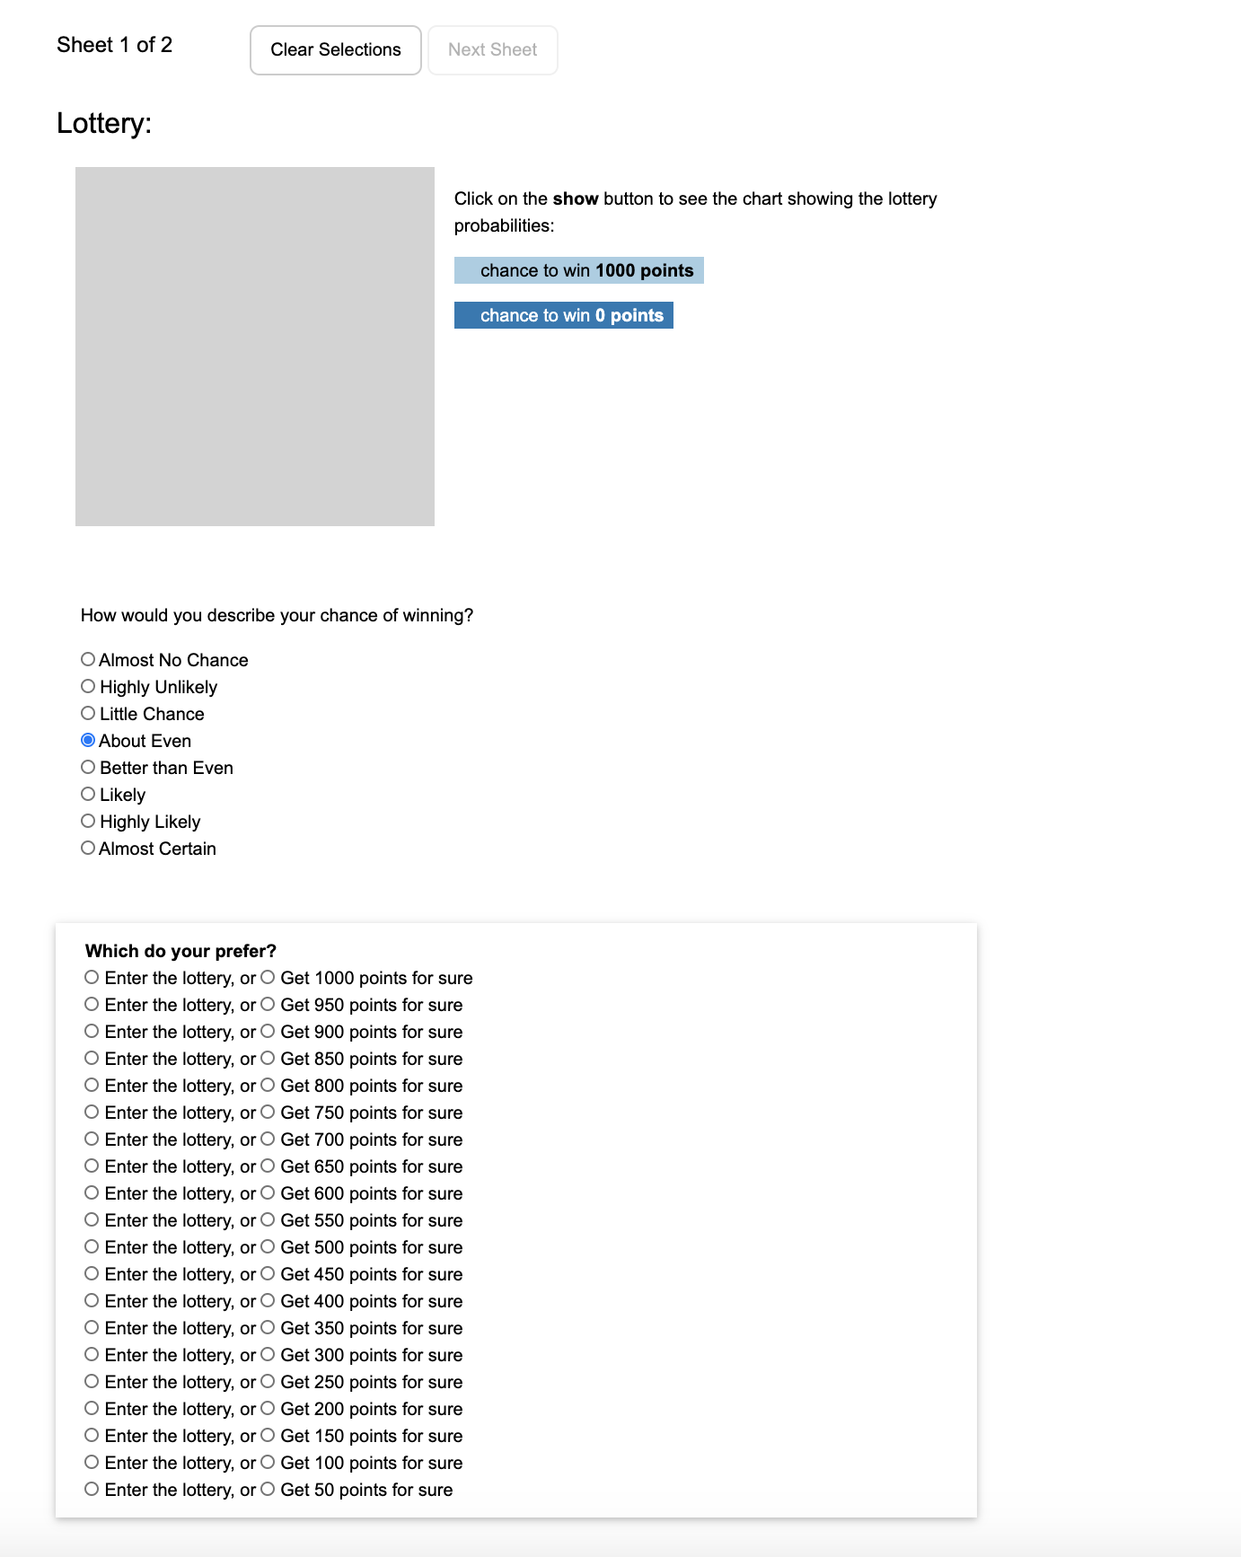
Describe your chance of winning

Slide 8
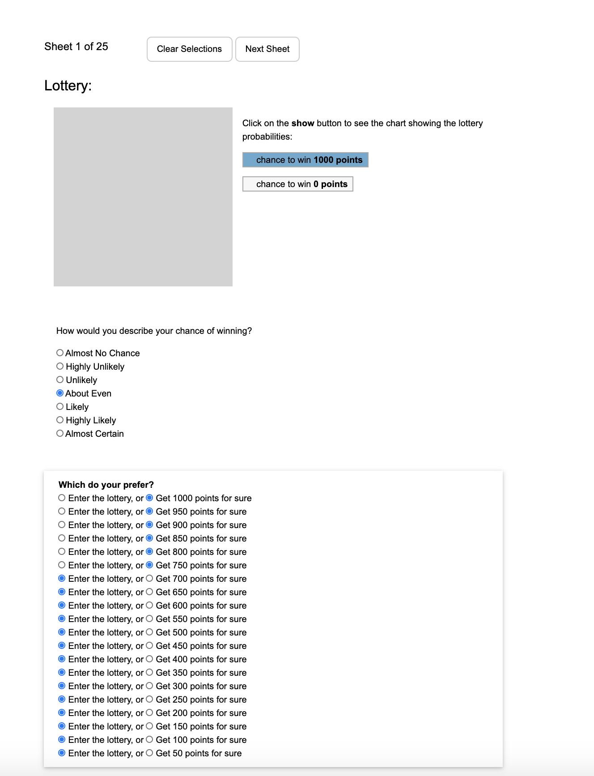
You only need to select one of the options where you switch your decision. We will fill in the rest.

Slide 9
We will simulate the lottery and randomly pick a row.
Your bonus depends on your selection for that row.

Slide 11
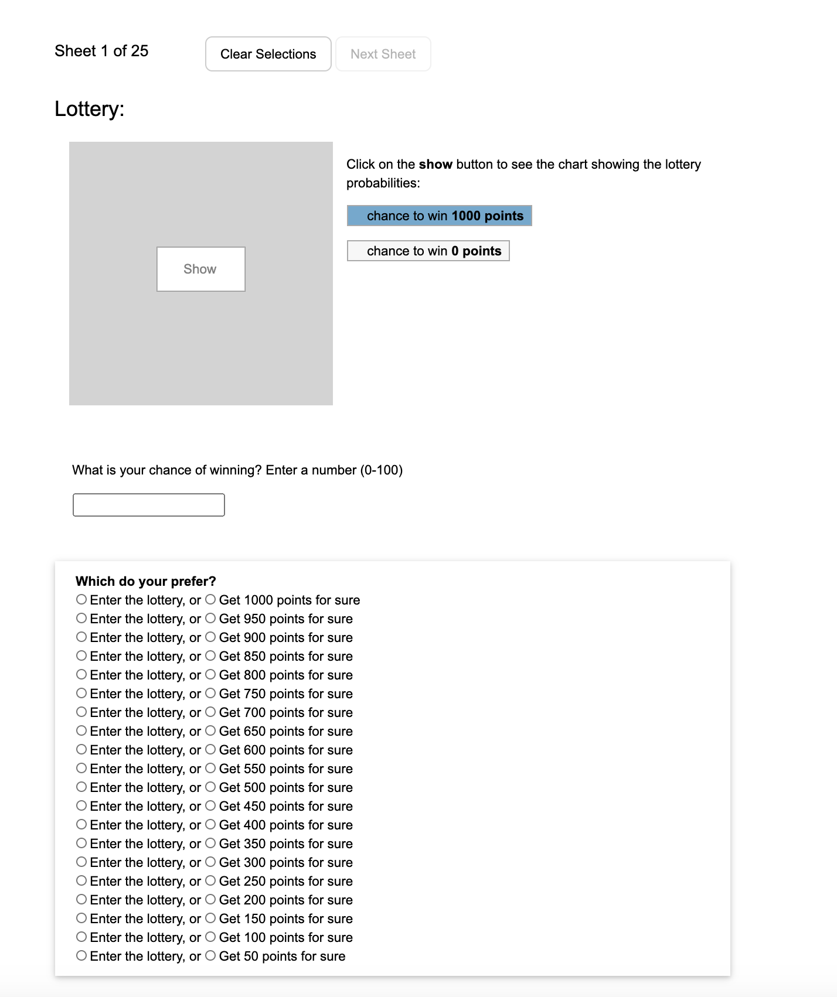

Slide 12
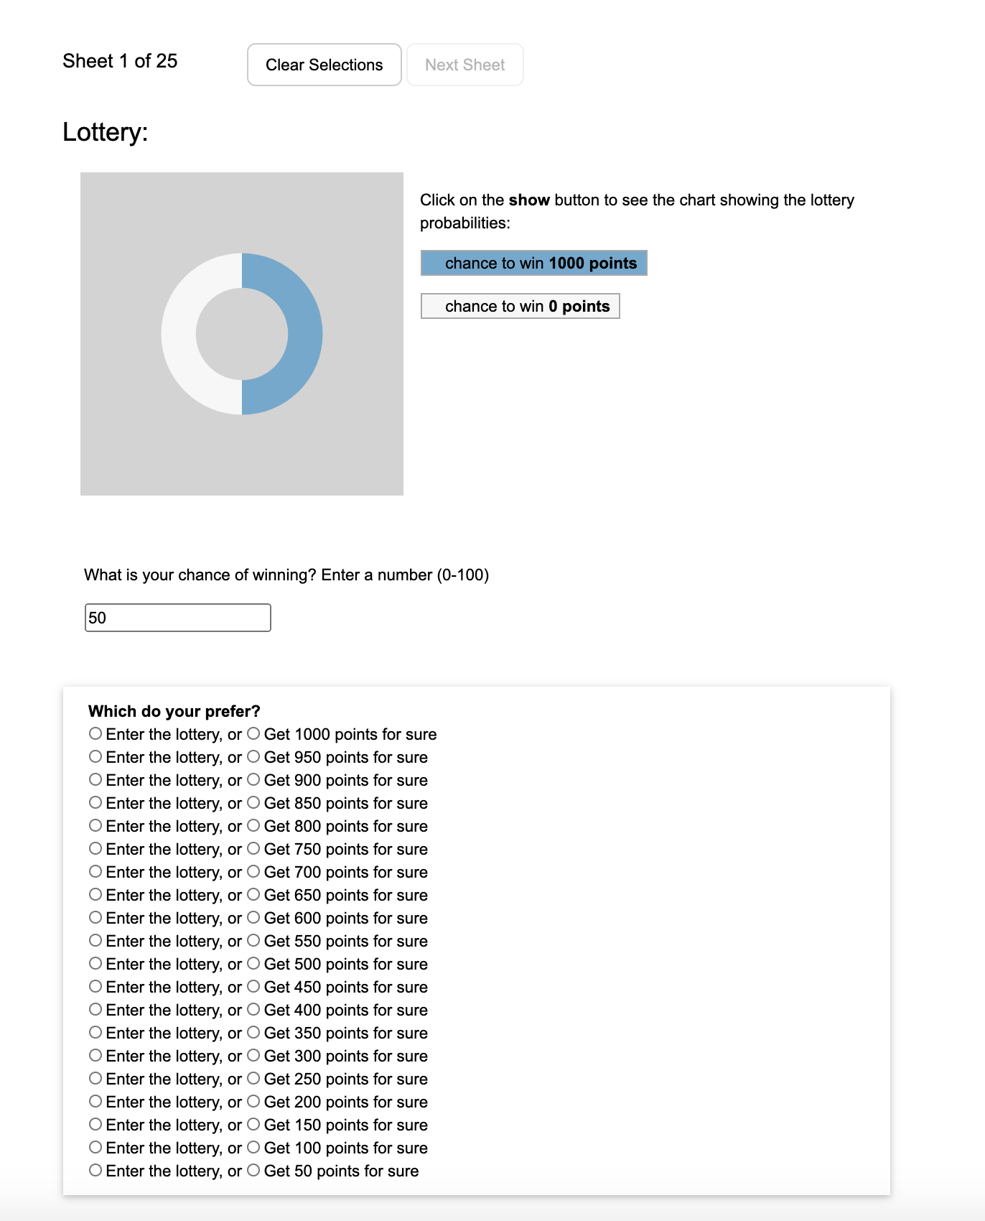
Enter your chance of winning by entering a number from 1 to 100

Slide 13
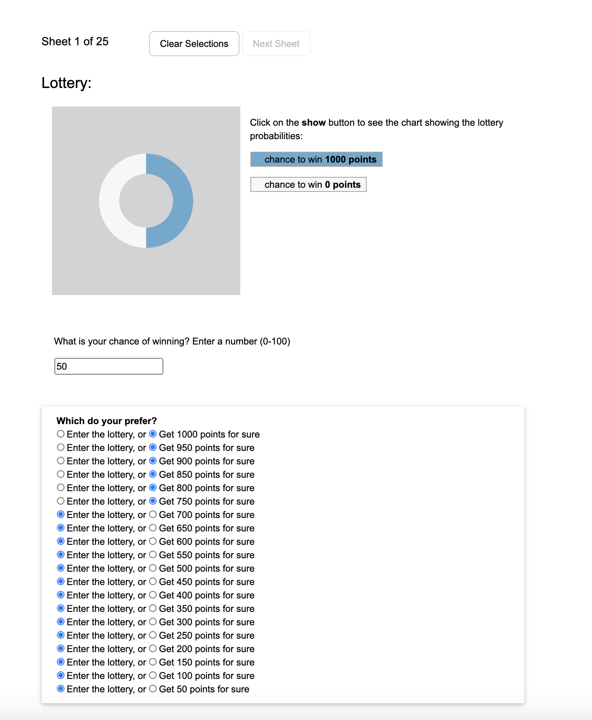
You only need to select one of the options where you switch your decision. We will fill in the rest.

Slide 14
We will simulate the lottery and randomly pick a row.
Your bonus depends on your selection for that row.

Slide 16
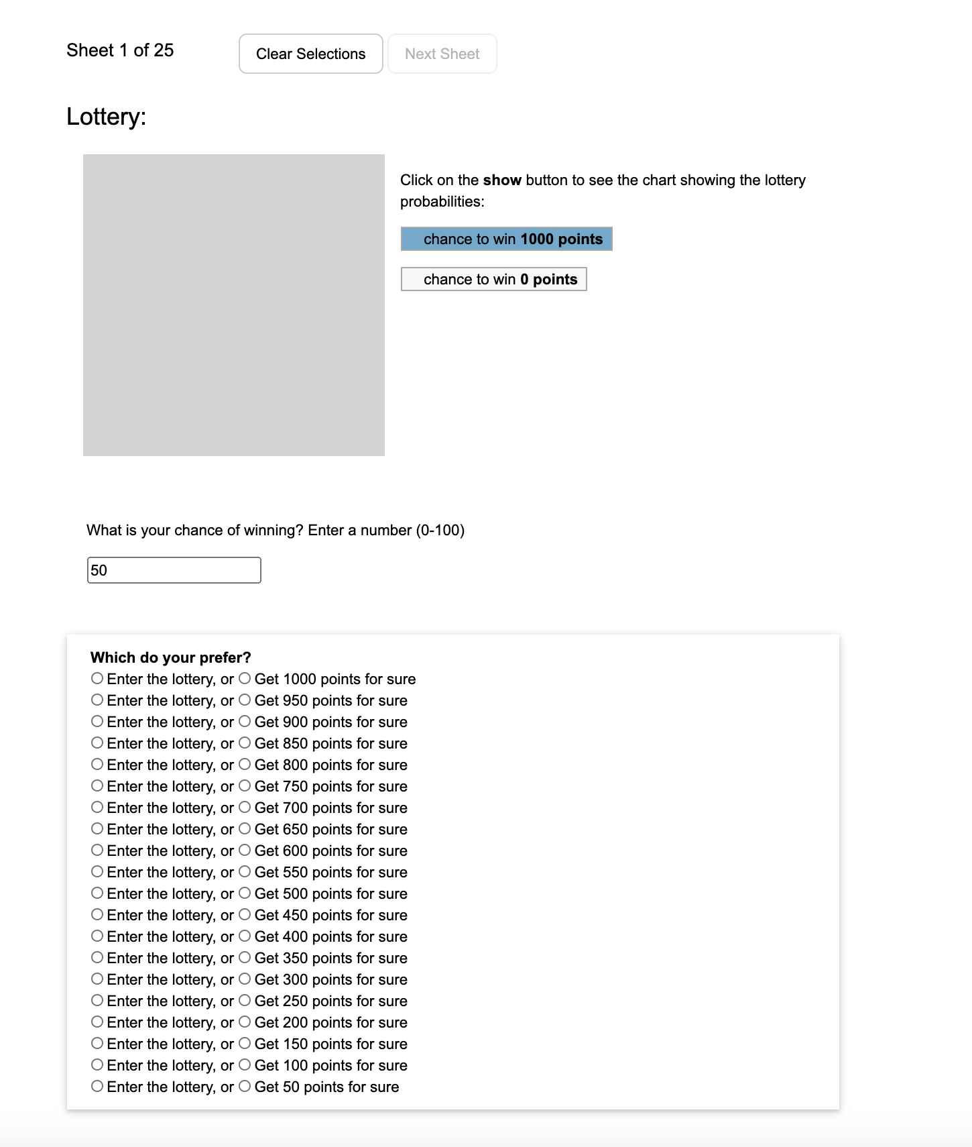
Enter your chance of winning by entering a number from 1 to 100

Slide 17
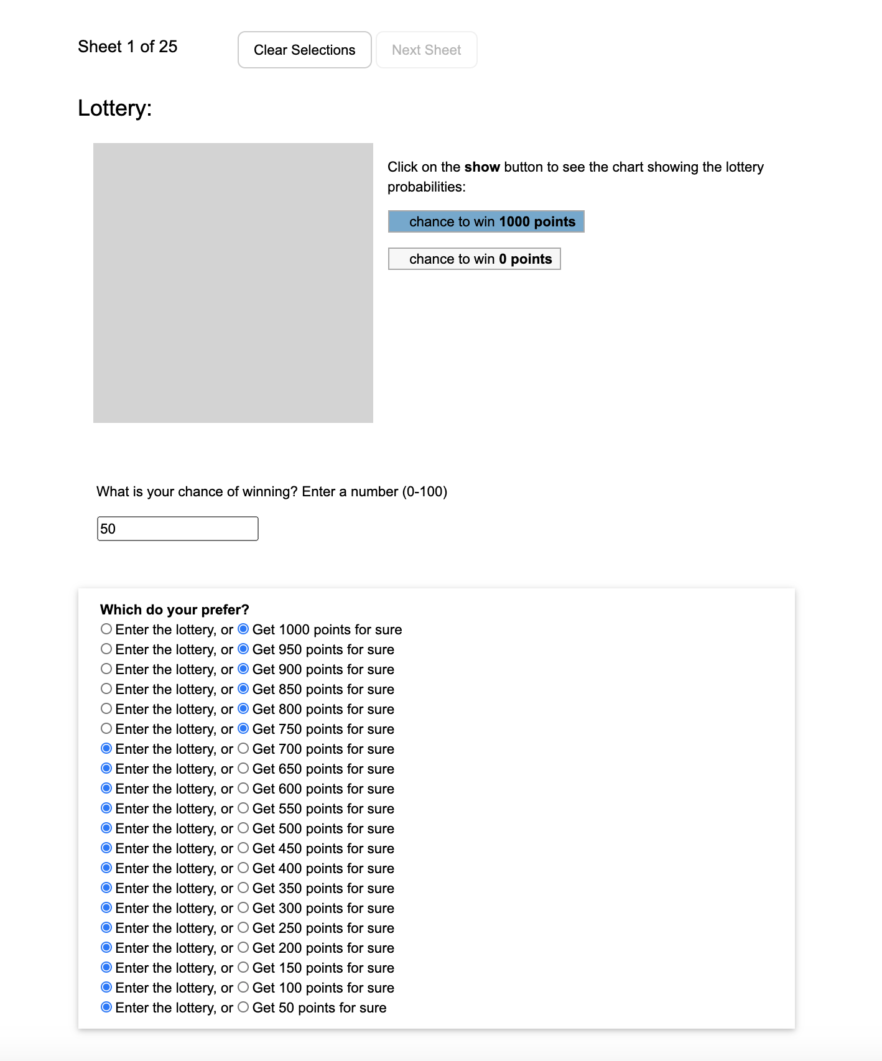
You only need to select one of the options where you switch your decision. We will fill in the rest.

Slide 18
We will simulate the lottery and randomly pick a row.
Your bonus depends on your selection for that row.

Slide 20
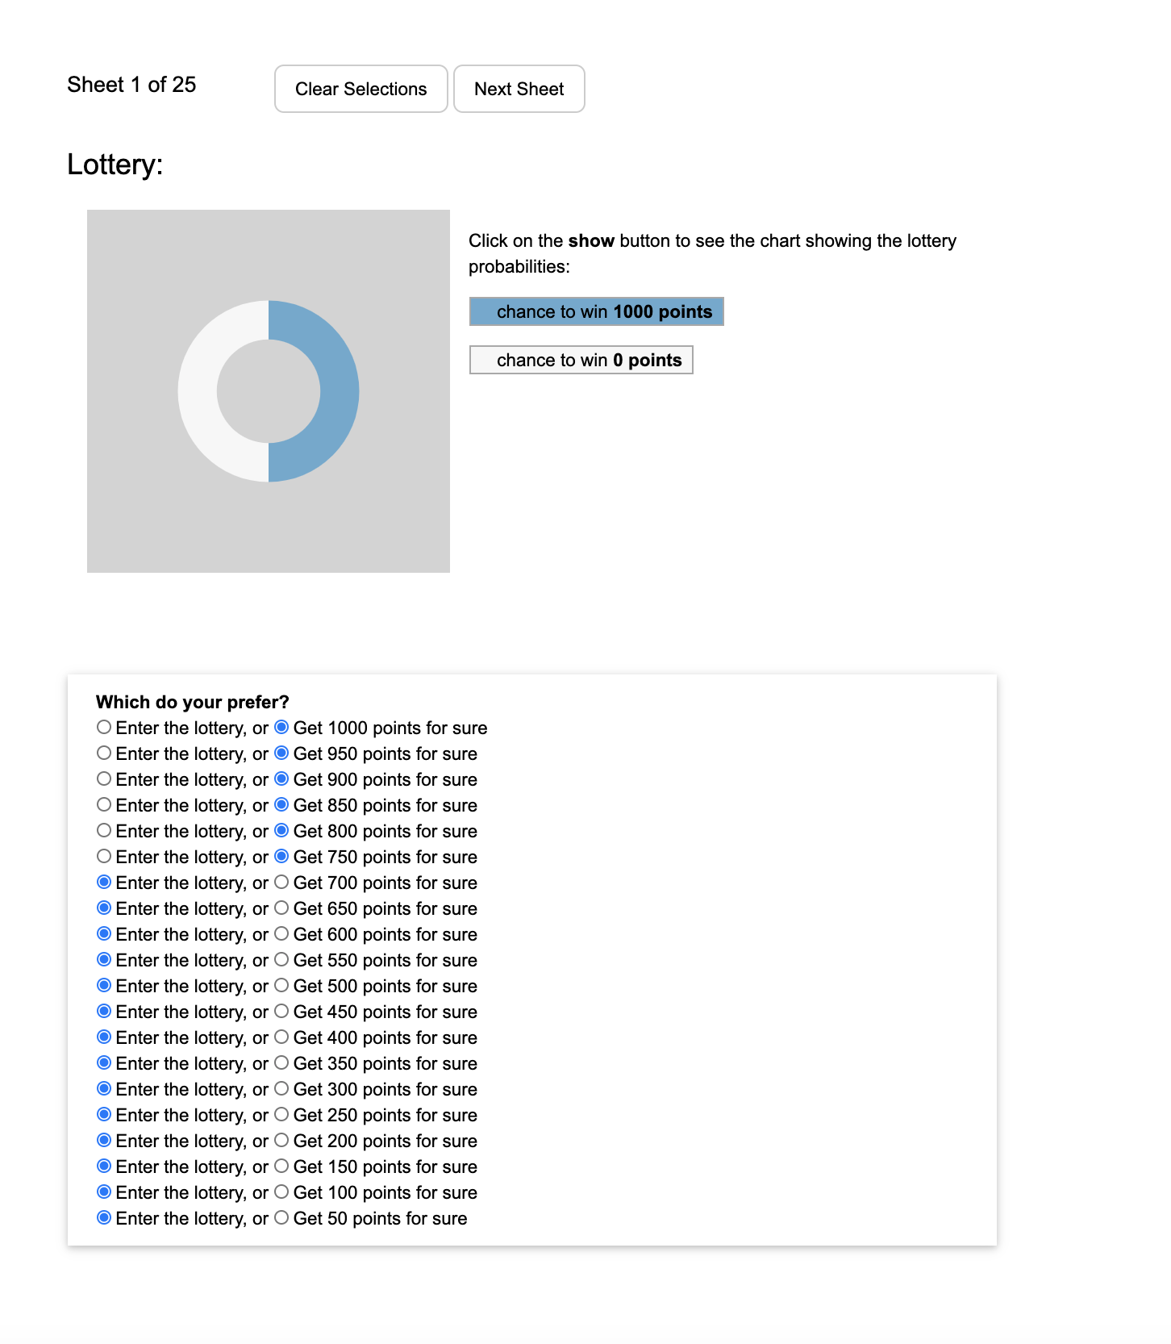
You only need to select one of the options where you switch your decision. We will fill in the rest.

Slide 21
We will simulate the lottery and randomly pick a row.
Your bonus depends on your selection for that row.

Slide 23
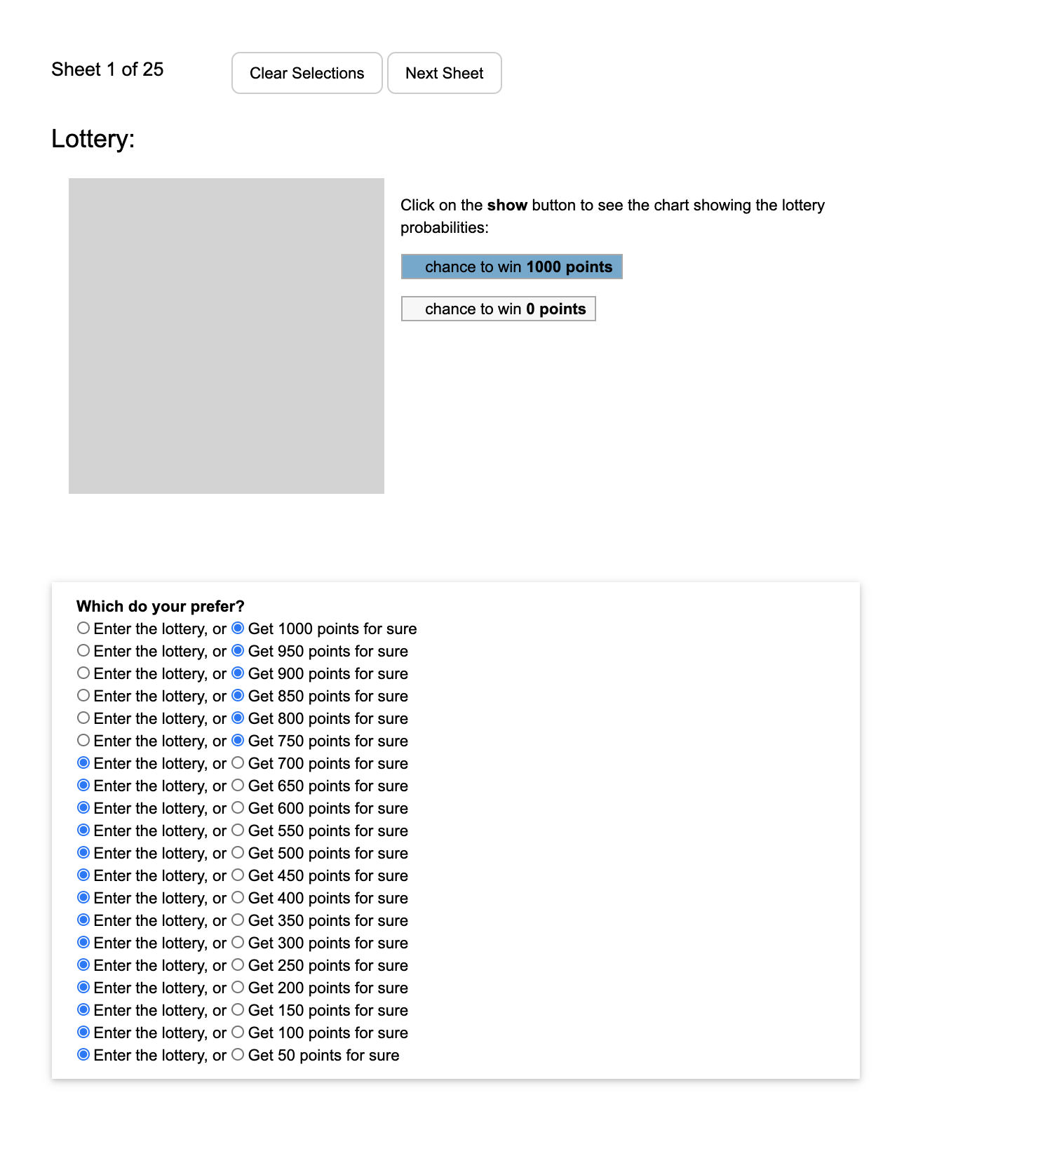
You only need to select one of the options where you switch your decision. We will fill in the rest.

Slide 24
We will simulate the lottery and randomly pick a row.
Your bonus depends on your selection for that row.

Slide 26
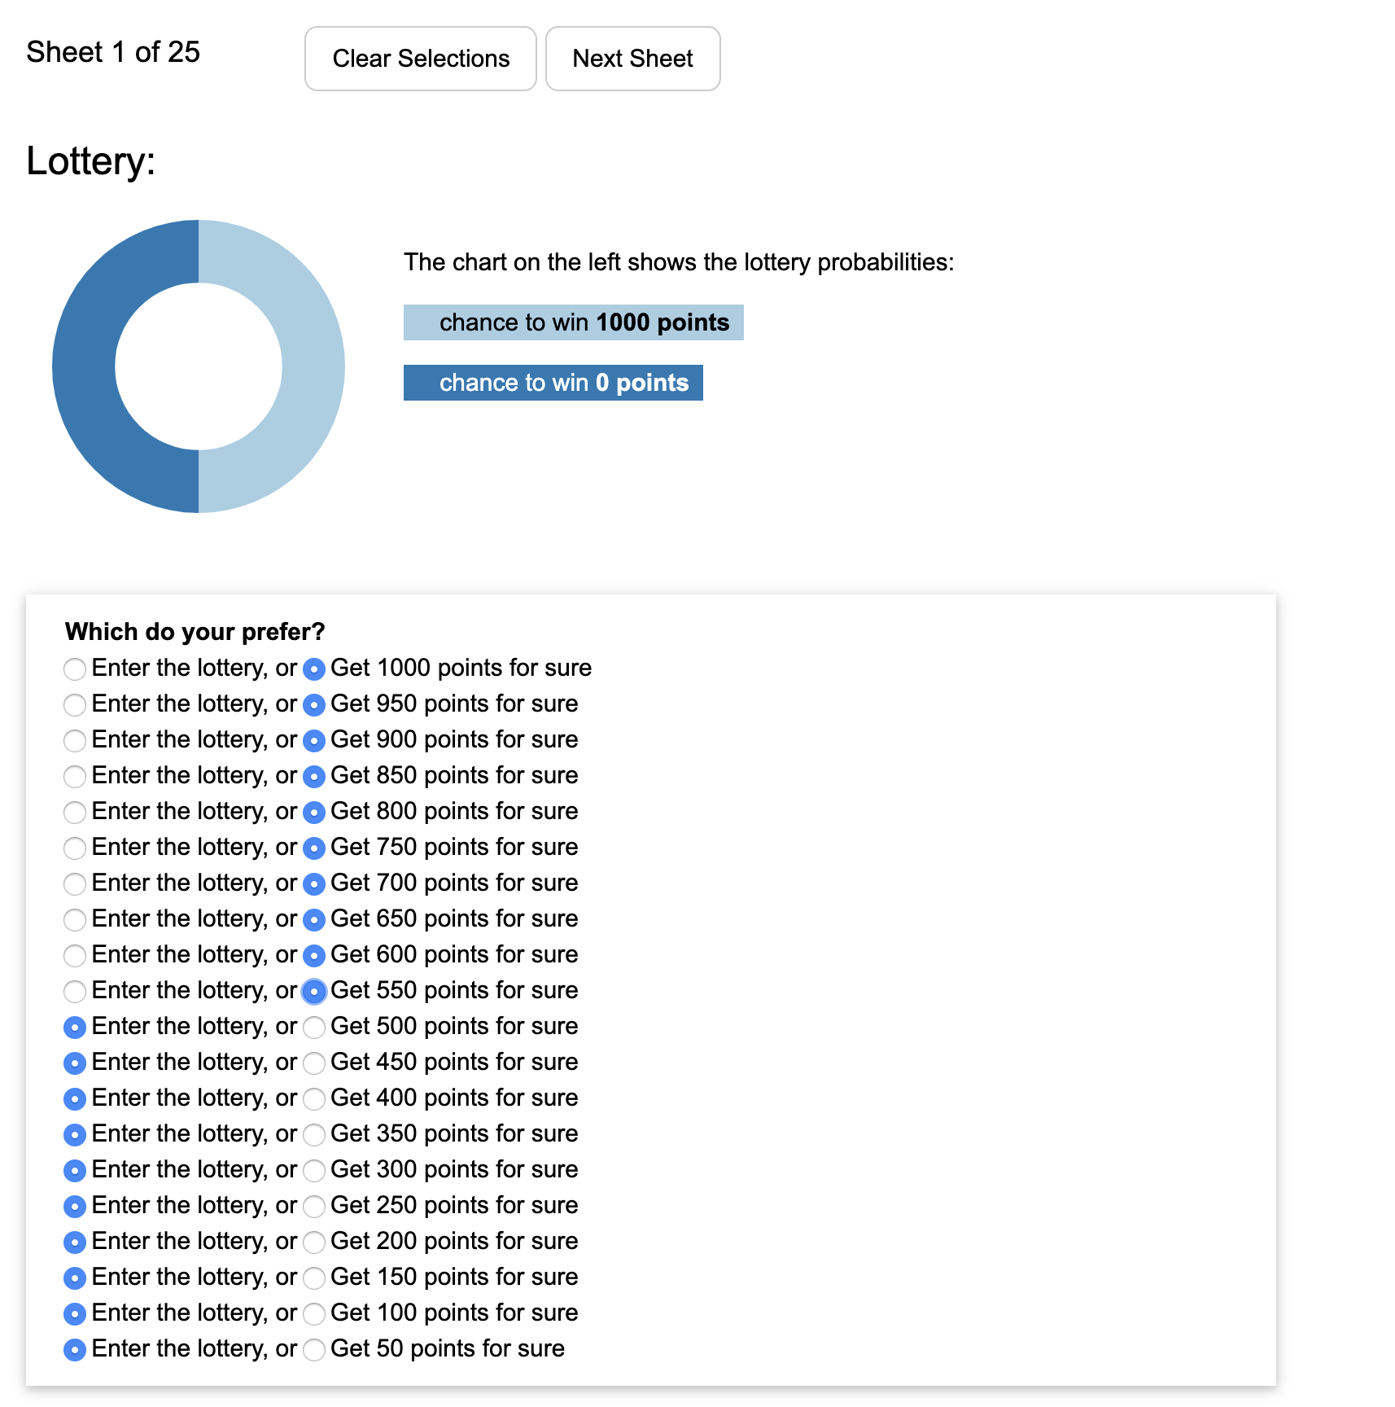
You only need to select one of the options where you switch your decision. We will fill in the rest.
We will simulate the lottery and randomly pick a row.
Your bonus depends on your selection for that row.

