Slide 1
WASTE MANAGEMENT
Submitted by: Ashzabin Wadud

Slide 2
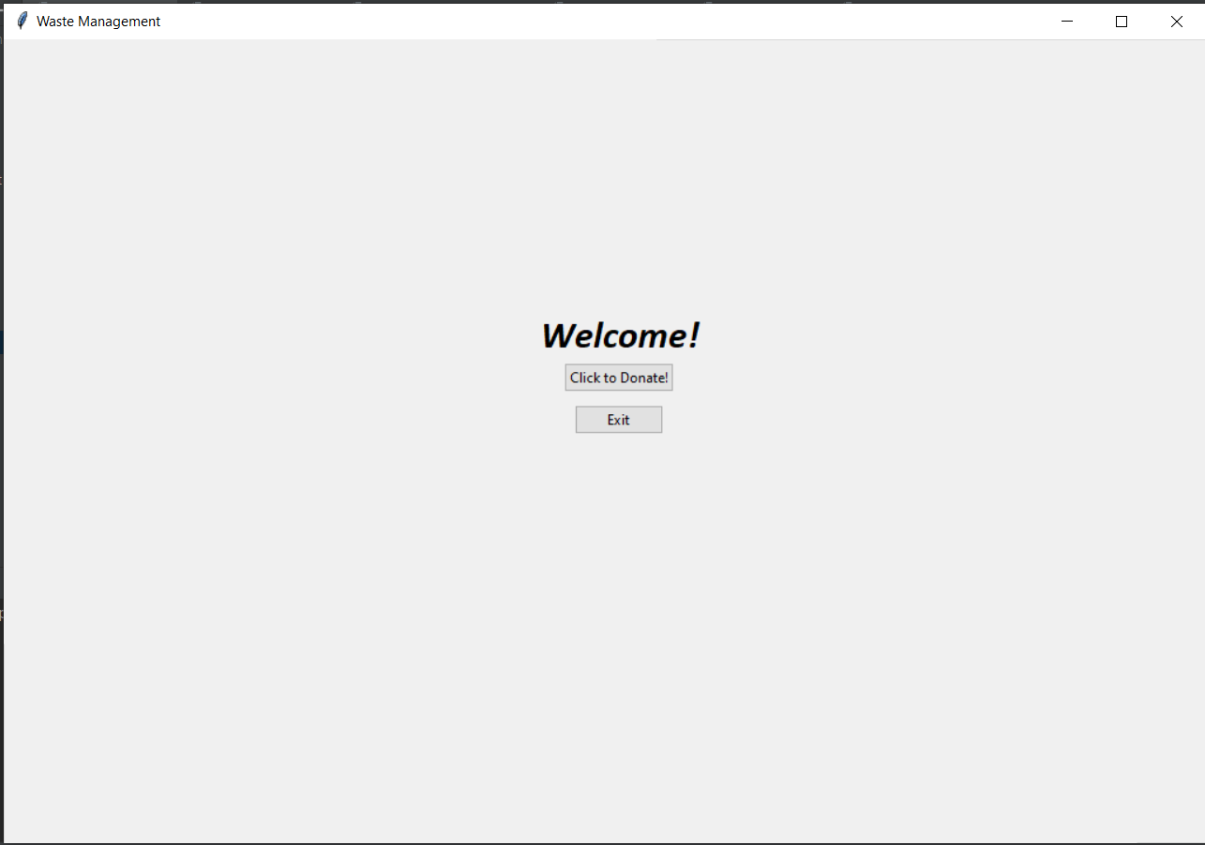

Slide 3
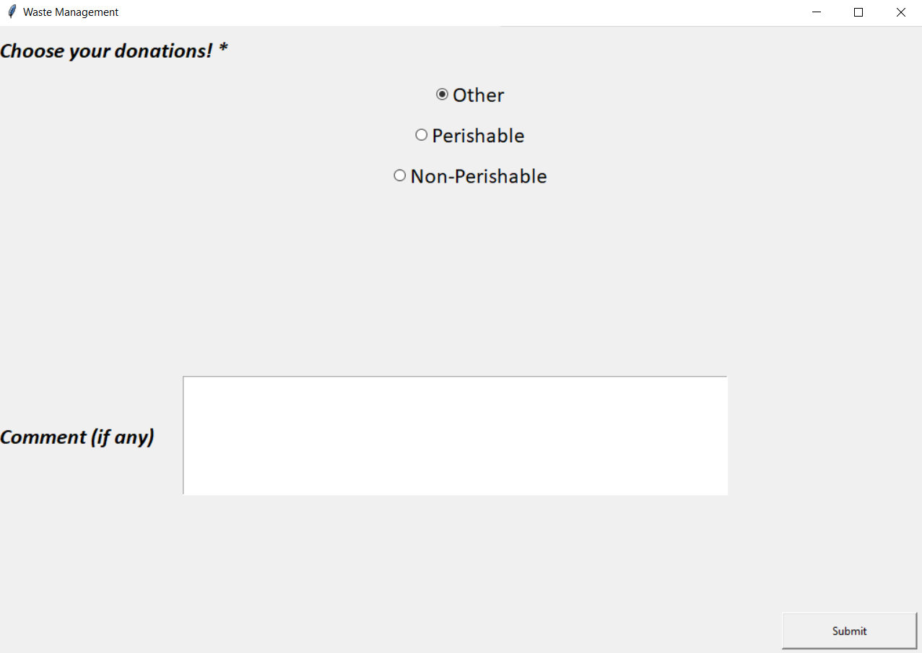

Slide 4
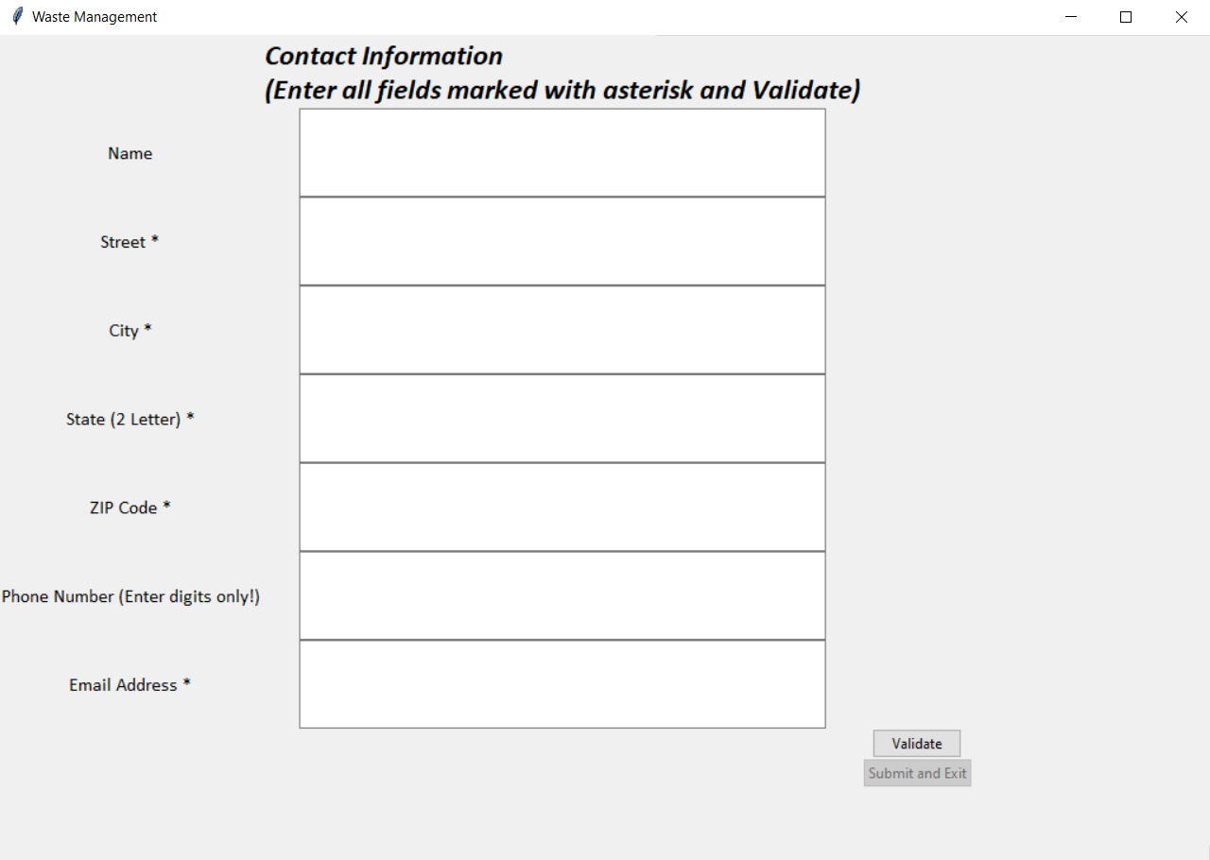

Slide 5
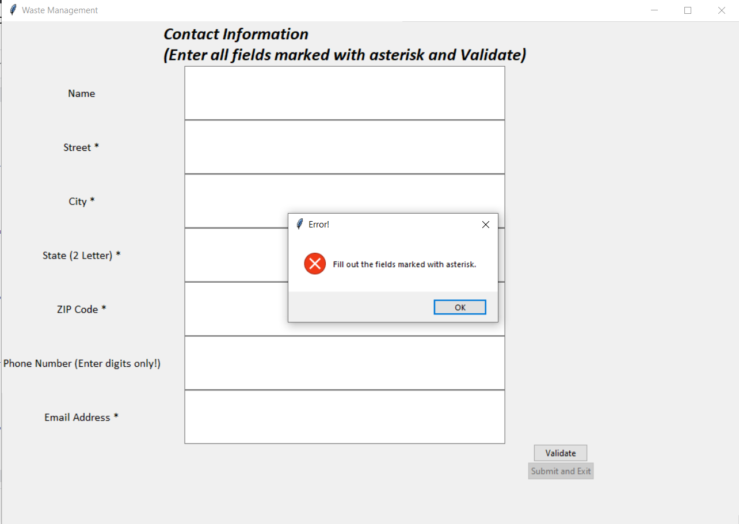

Slide 6
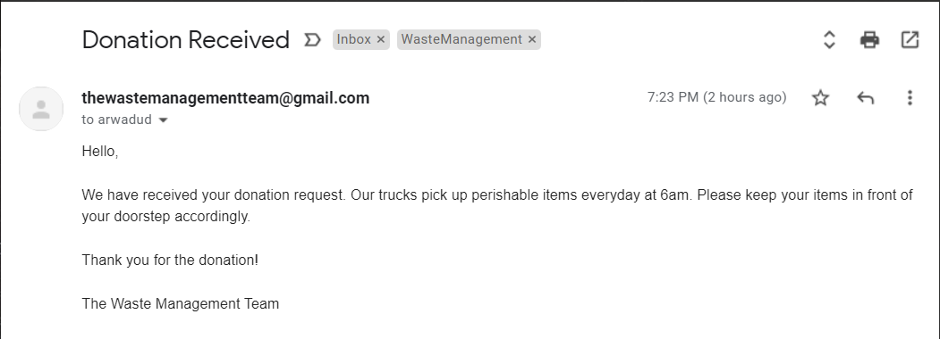

Slide 7
Thank you!

