Slide 1
1-MONTH WEB DEVELOPMENT TRAINING • PRESENTATION #1
Modern Web Foundations & Advanced JavaScript Architecture
A comprehensive technical walkthrough covering Semantic Web Standards, Professional Git Workflows, Asynchronous Event Loop, DOM Event Delegation, and Node.js Core File Management.
🚀 FEATURED LIVE DEMO: DevExplorer PRO v2.0 (GitHub Analytics & Bookmark Manager)
Presenter: Full-Stack Engineering Trainee | Date: August 10, 2026

Slide 2
WEEK 1 OVERVIEW
Technical Curriculum & Milestone Roadmap
DAY 01
Web Design & Git
• HTML5 Semantics
Replaced <div> soup with <main>, <nav>, <header> for SEO & a11y.
• Flexbox & CSS Grid
1D component alignment vs 2D responsive grid matrices.
• Professional Git
Feature-branching (git checkout -b) & Conventional Commits.
DAY 02
Advanced JS & Async
• ES6+ Architecture
Block scope (const/let), destructuring, and spread operator.
• Array Pipelines
.map(), .filter(), and .reduce() 1-pass analytical totals.
• Event Loop Engine
Call Stack execution, Microtask Queue vs Macrotasks.
DAY 03
DOM & Mini-Project
• Event Delegation
Single parent listener handles dynamic items via closest().
• LocalStorage Sync
Client state persistence using JSON serialization.
• DevExplorer PRO
Parallel API fetching via Promise.all() + live analytics.
DAY 04
Node.js & FileSystem
• V8 & Libuv Engine
Server-side JavaScript runtime with direct OS access.
• fs/promises Module
Non-blocking, asynchronous disk read & write operations.
• Path Resolution
Cross-platform path handling via path.join().

Slide 3
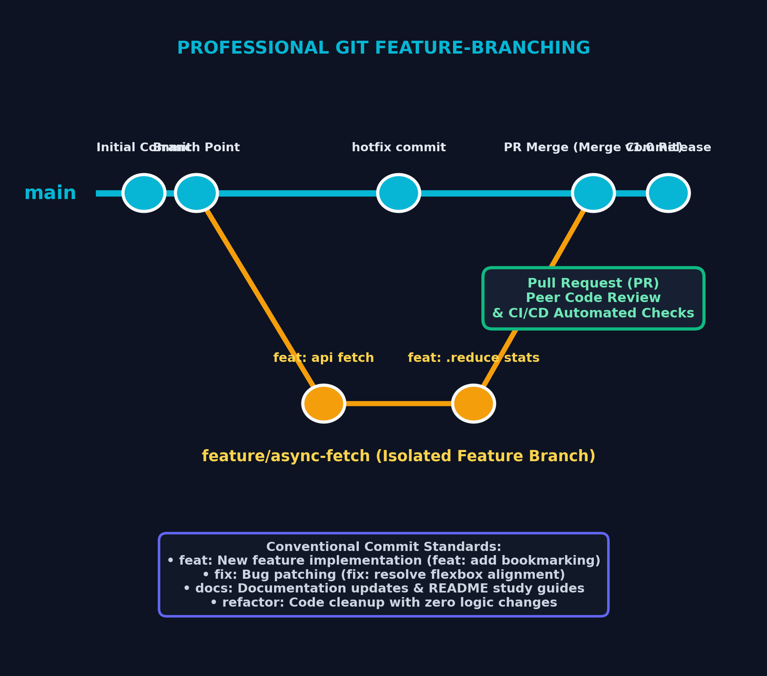
DAY 01 ARCHITECTURE
Modern Web Standards & Team Git Workflows
Core Engineering Principles
✔ Semantic HTML5 Hierarchy
Structure with <header>, <nav>, <main>, <article>, and <footer> to eliminate unindexed div soup, maximizing SEO visibility and accessibility.
✔ CSS Layout Engines (Flexbox vs Grid)
Flexbox for 1D single-axis alignment (navbars, cards) and CSS Grid for 2D auto-responsive dashboard matrices.
✔ Feature-Branching Strategy
Production main branch stays locked and stable. Features are isolated in feature/task-name branches and merged via Pull Requests.
✔ Conventional Commit Standards
Enforces standardized commit tags (feat:, fix:, docs:, refactor:) for clear, automated changelogs.

Slide 4
DAY 02 CORE JS
Advanced JavaScript & Functional Data Pipelines
ES6+ Architecture & Scope
⚡ Block Scope (const / let)
Eliminated var hoisting hazards and scope leakage. Using const by default guarantees immutable variable bindings.
⚡ Destructuring & Spread Operator (...)
Clean object/array unpacking and shallow cloning, forming the foundation for immutable React state updates.
⚡ Nullish Coalescing (??) & Optional Chaining (?.)
Safely navigates deep nested API objects without throwing uncaught runtime errors.
Higher-Order Array Methods
📊 .map() — 1-to-1 UI Transformation
Transforms raw backend API payloads into structured UI presentation elements without mutating source arrays.
📊 .filter() — Boolean Data Selection
Extracts active, non-forked repositories matching user filter criteria.
📊 .reduce() — Single-Pass Analytical Aggregation
Computes total stars, fork count, and primary language in 1 single pass: const totalStars = repos.reduce((sum, r) => sum + r.stargazers_count, 0);

Slide 5
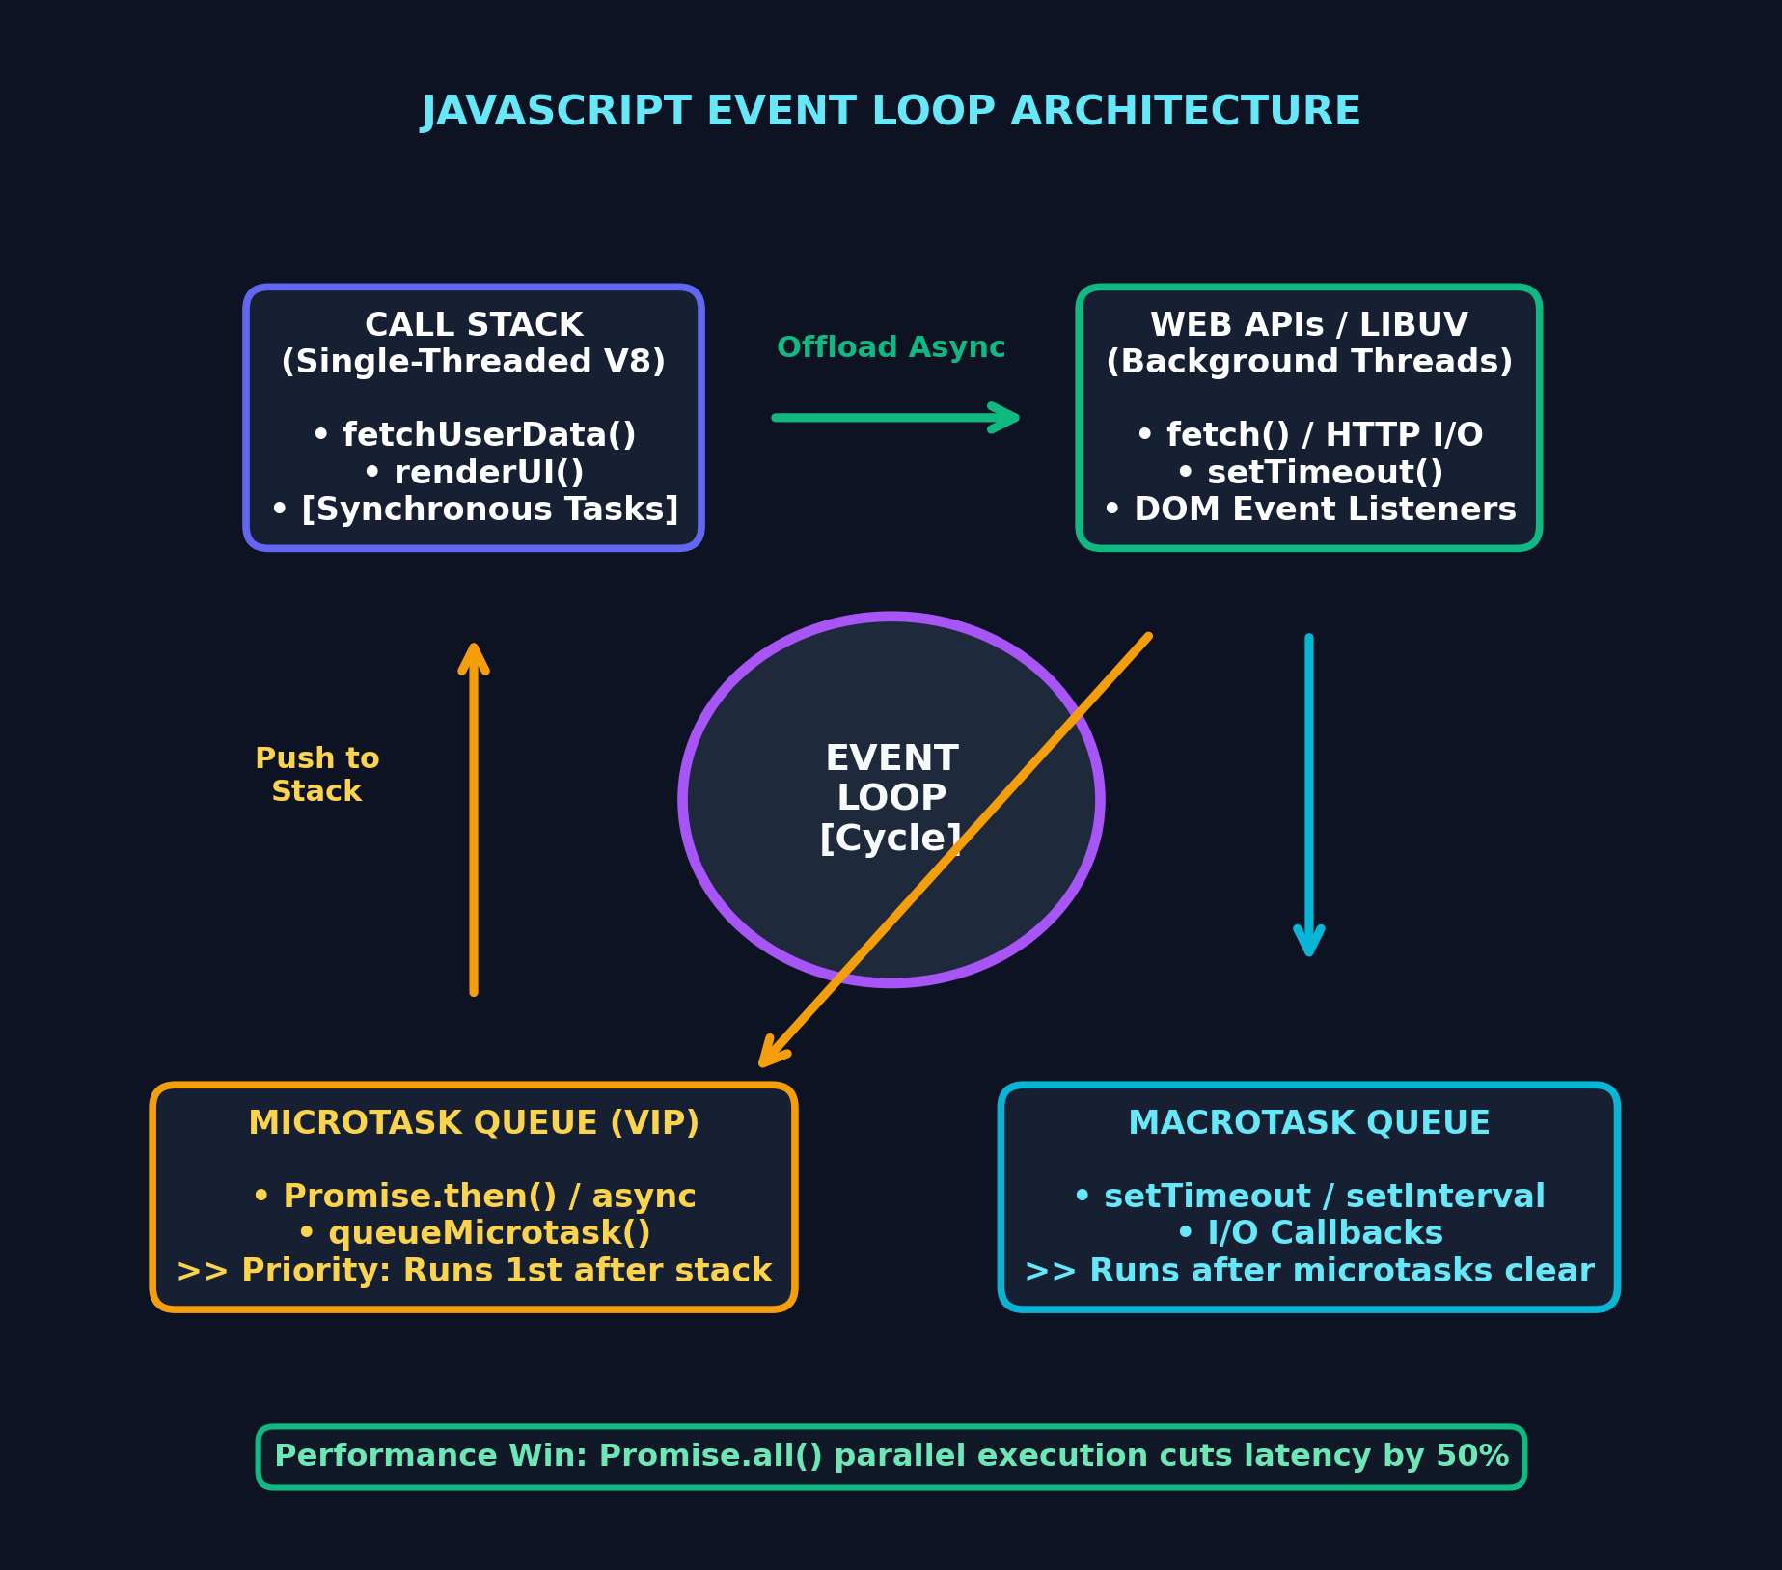
DAY 02 DEEP DIVE
JavaScript Event Loop & Asynchronous Architecture
Concurrency & Execution Queues
🔄 1. Single-Threaded Call Stack
V8 executes synchronous functions line-by-line (LIFO). Long I/O tasks are delegated to Web APIs.
🔄 2. Microtask Queue (VIP Priority)
Promises (.then(), async/await) enter the microtask queue and execute immediately after the Call Stack clears.
🔄 3. Macrotask Queue
Timer callbacks (setTimeout, setInterval) wait until all pending microtasks are completely drained.
🔄 4. Concurrent Promise.all()
Dispatches User Profile and Repositories API requests in parallel, cutting network latency by 50%.

Slide 6
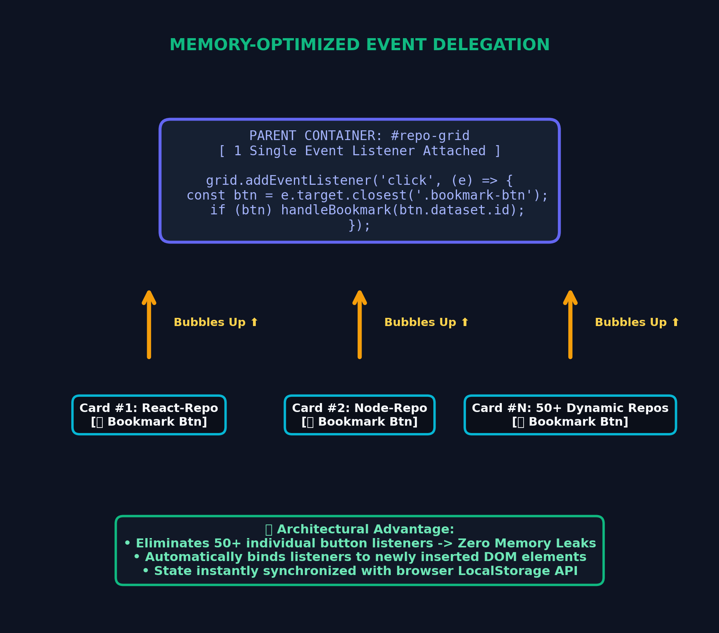
DAY 03 DOM ARCHITECTURE
DOM Event Delegation & State Persistence
Memory Optimization & Storage
🎯 Event Bubbling Mechanism
Browser click events propagate upwards through all DOM parent containers automatically.
🎯 Single Container Listener
Attached 1 single listener to the parent container instead of binding 50+ individual button listeners. Eliminates memory leaks.
🎯 Dynamic Interception via closest()
event.target.closest('.tag-btn') reliably intercepts clicks on nested child icons and text spans.
🎯 LocalStorage State Persistence
Serializes bookmarks with JSON.stringify and restores them on page reload with JSON.parse.

Slide 7
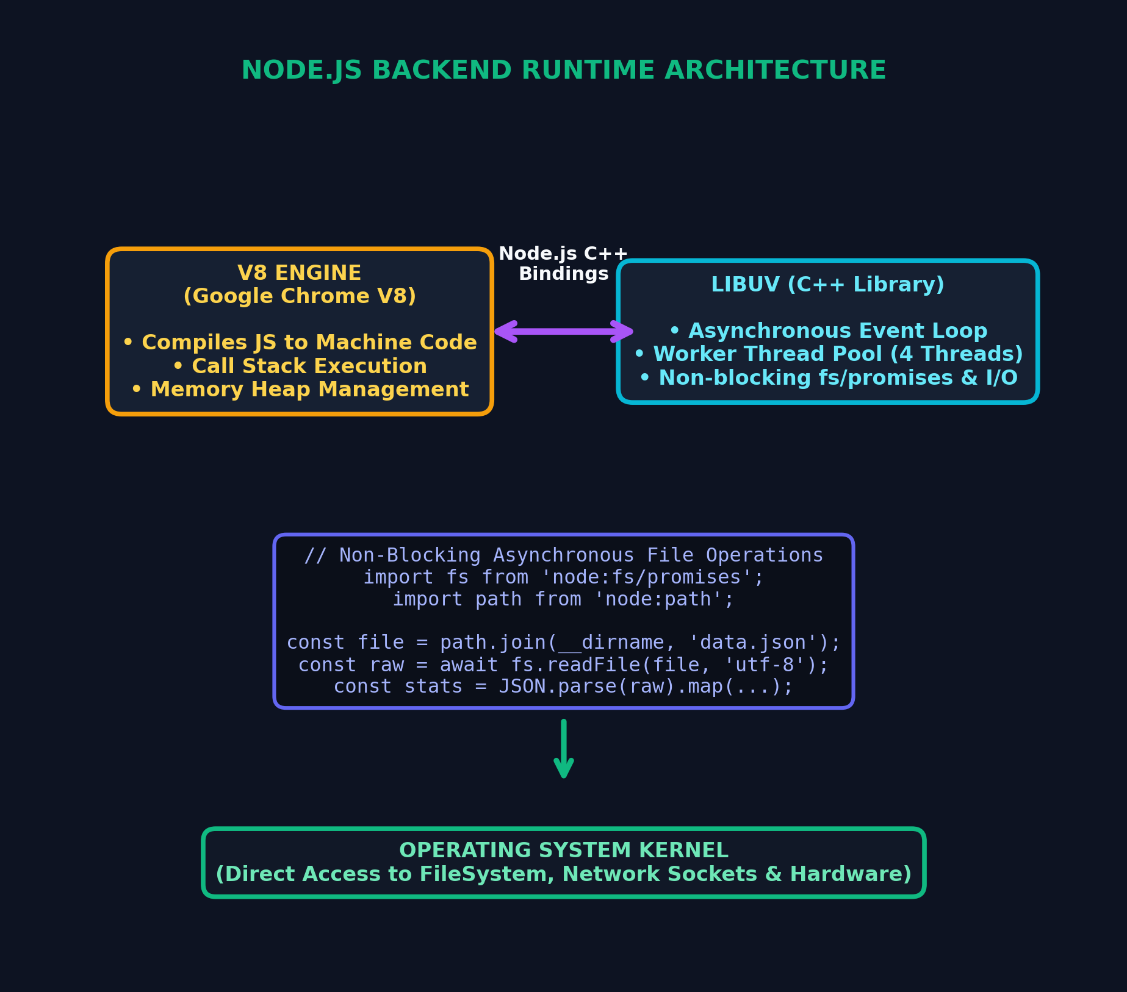
DAY 04 BACKEND ARCHITECTURE
Node.js Core Runtime & Asynchronous FileSystem
Server-Side Execution & fs/promises
🟢 Server V8 + Libuv Architecture
JavaScript executing outside the browser sandbox with multi-threaded C++ Libuv handling non-blocking OS I/O.
🟢 CommonJS Module Standard
Explicit encapsulation and sharing via require() imports and module.exports.
🟢 Non-Blocking fs/promises Module
Asynchronous file I/O (readFile, writeFile, appendFile) maintaining full server responsiveness.
🟢 Safe Cross-Platform Paths
path.join(__dirname, 'file.json') prevents operating system path separator conflicts.

Slide 8
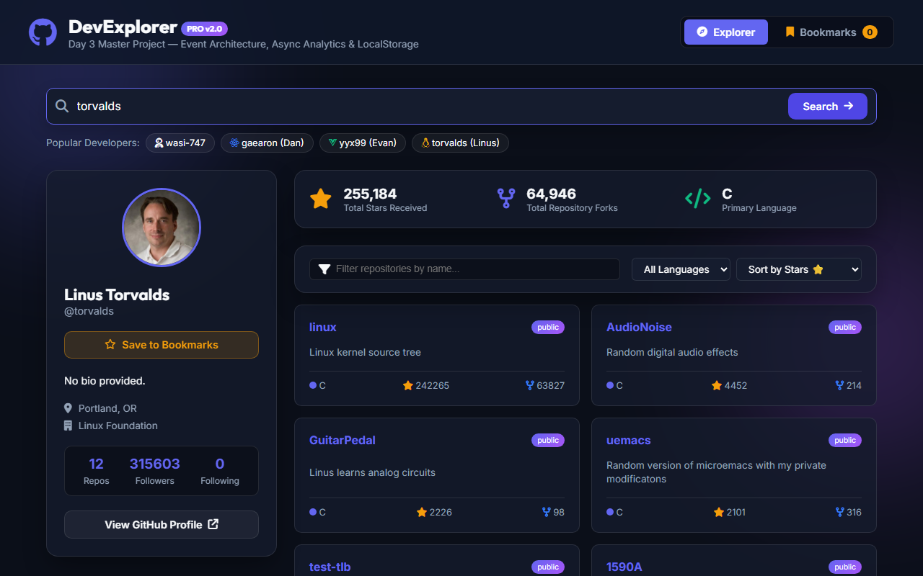
PROJECT SHOWCASE & LIVE DEMO
Live Demonstration: DevExplorer PRO v2.0
Featured Architecture Highlights
🚀 1. Parallel API Fetching
Fetches GitHub User Profile and Repositories concurrently via Promise.all() with shimmer loading states.
🚀 2. Real-Time Analytics Engine
Calculates Total Stars, Fork count, and Top Language using a single-pass .reduce() pipeline.
🚀 3. Event Delegation Tag Cloud
1-click developer exploration (torvalds, gaearon, wasi-747) handled by a single container listener.
🚀 4. LocalStorage State Sync
Persists bookmarked developer profiles client-side across browser sessions.
🚀 5. Resilient Error Handling
Graceful API rate-limit detection, custom 404 cards, and auto-dismissing toast notifications.

Slide 9
LOOKING AHEAD
Summary & Readiness for Week 2 (React Deep Dive)
Week 1 Engineering Mastery
✔ Semantic Web Standards
HTML5 structure, 2D CSS Grid auto-fit matrices, and Tailwind utility tokens.
✔ Production Git Strategy
Locked main branch, atomic conventional commits, and Pull Request reviews.
✔ Asynchronous Architecture
Call Stack, Microtask queue priority, and non-blocking Promise pipelines.
✔ Memory-Optimized DOM & Node
Event delegation, LocalStorage state sync, and asynchronous FileSystem I/O.
Week 2: React Deep Dive Focus
🚀 Declarative UI Mindset
Transitioning from imperative DOM manipulation to Declarative React Component States.
🚀 JSX & Virtual DOM Architecture
Using ES6+ array pipelines (.map()) directly in JSX component trees.
🚀 State Immutability & Hooks
Managing state with useState and useEffect cleanly using spread operators (...state).
🚀 Target Deliverable
Interactive Tic-Tac-Toe App with Undo/Redo & Time-Travel history.

