Slide 1
1-MONTH FULL-STACK TRAINING • WEEK 1 REVIEW & DEMO
Modern Web Foundations & Advanced JavaScript Architecture
Comprehensive Architectural Walkthrough with Exact Code Snippets & Line Numbers: Semantic HTML5, CSS Grid/Flexbox, Event Loop, Event Delegation, LocalStorage & Node.js Core.
🚀 FEATURED LIVE MINI-PROJECT: DevExplorer PRO v2.0 (GitHub Analytics & Bookmark Manager)
Presenter: Full-Stack Engineering Trainee | Date: August 10, 2026

Slide 2
WEEK 1 OVERVIEW
Technical Curriculum & 4-Day Milestone Roadmap
DAY 01
Web Design & Git
• HTML5 Semantics
Replaced <div> soup with <main>, <nav>, <header> for SEO & a11y.
• Flexbox & CSS Grid
1D component alignment vs 2D responsive grid matrices.
• Professional Git
Feature-branching (git checkout -b) & Conventional Commits.
DAY 02
Advanced JS & Async
• ES6+ Architecture
Block scope (const/let), destructuring, and spread operator.
• Array Pipelines
.map(), .filter(), and .reduce() 1-pass analytical totals.
• Event Loop Engine
Call Stack execution, Microtask Queue vs Macrotasks.
DAY 03
DOM & Mini-Project
• Event Delegation
Single parent listener handles dynamic items via closest().
• LocalStorage Sync
Client state persistence using JSON serialization.
• DevExplorer PRO
Parallel API fetching via Promise.all() + live analytics.
DAY 04
Node.js & FileSystem
• V8 & Libuv Engine
Server-side JavaScript runtime with direct OS access.
• fs/promises Module
Non-blocking, asynchronous disk read & write operations.
• Path Resolution
Cross-platform path handling via path.join().

Slide 3
DAY 01 ARCHITECTURE
Day 01: Modern Web Standards & Team Git Workflows
Architectural Decisions & Standards
✔ Semantic HTML5 Hierarchy (index.html: L30-L240)
Utilized <header>, <nav>, <main>, <aside>, <article>, and <footer>. Replaced generic div soup to maximize Google SEO and screen reader accessibility.
✔ 1D Flexbox vs 2D CSS Grid (styles.css)
Flexbox aligns 1D axes (.header-container, .quick-tags) with justify-content: space-between. CSS Grid powers 2D dashboard layouts.
✔ The Golden Responsive Grid Formula
grid-template-columns: repeat(auto-fit, minmax(280px, 1fr)) creates automatic multi-column responsiveness without writing CSS media queries!
✔ Professional Feature-Branching Git Workflow
All changes isolated in feature branches (git checkout -b) with Conventional Commits (feat:, fix:, docs:) before merging via PRs.
📄 Production Snippet: HTML5, CSS Grid & Git
/* 1. CSS GRID: Golden Auto-Responsive Formula */ .repos-grid { display: grid; grid-template-columns: repeat(auto-fit, minmax(280px, 1fr)); gap: 1.5rem; } /* 2. FLEXBOX: 1D Single-Axis Navbar */ .header-container { display: flex; justify-content: space-between; /* Space logo & tabs */ align-items: center; /* Vertical center */ } # 3. Professional Git Team Workflow $ git checkout -b feature/dashboard-ui $ git add index.html styles.css $ git commit -m "feat: build semantic dashboard" $ git push -u origin feature/dashboard-ui

Slide 4
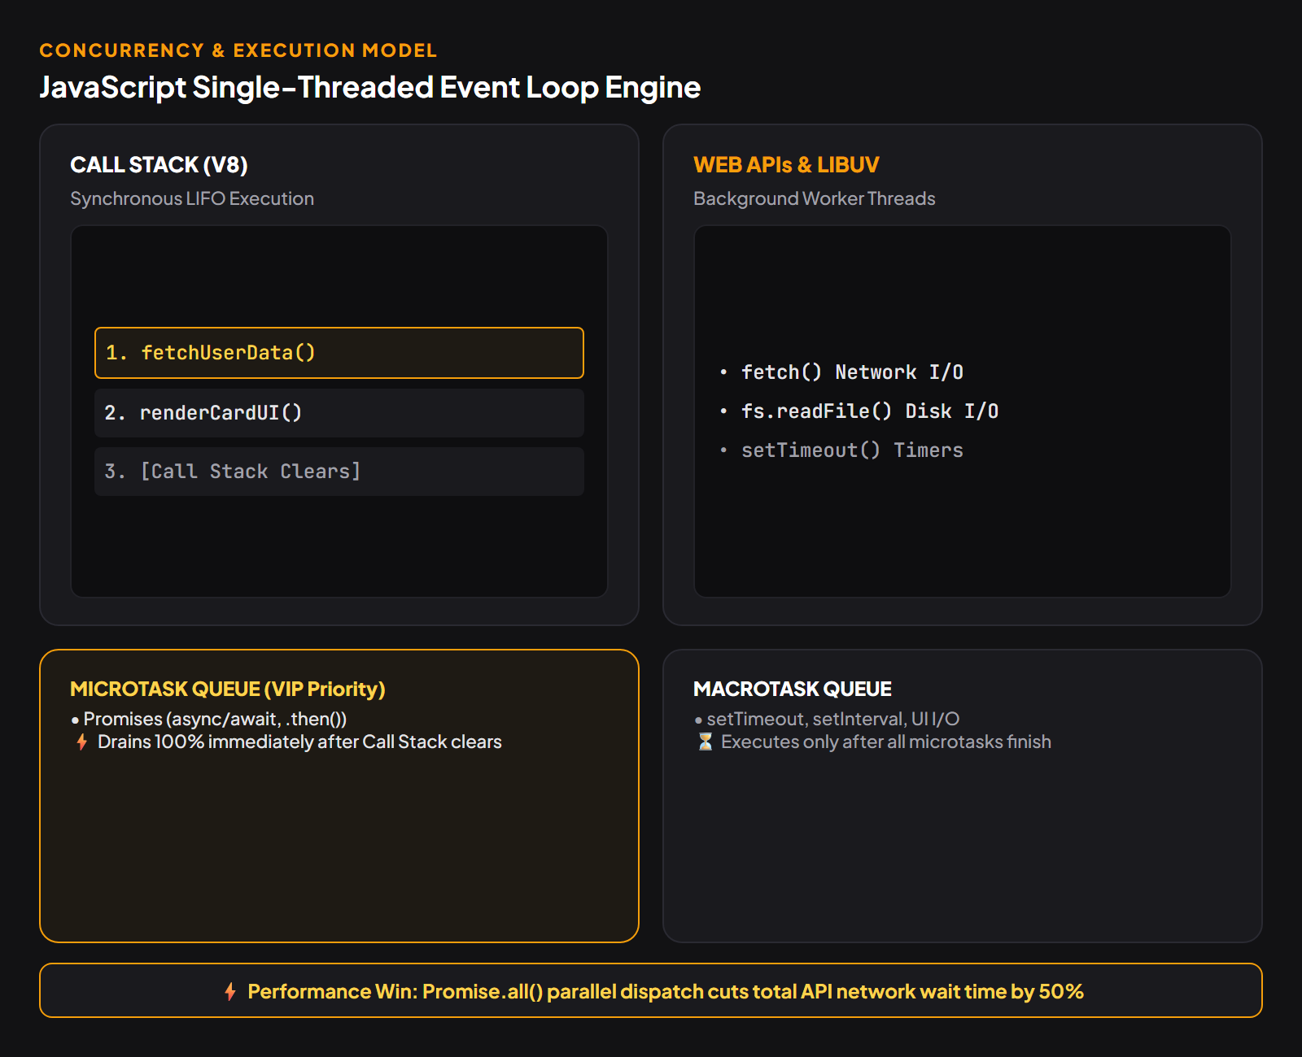
DAY 02 CORE ENGINE
Day 02: Advanced JS Scope & Event Loop Engine
Memory, Scope & Engine Concurrency
⚡ Block Scope & TDZ (const vs let vs var)
const by default prevents identifier rebinding. Eliminated var scope-leakage bugs and hoisting hazards via Temporal Dead Zone (TDZ).
⚡ Single-Threaded Call Stack (LIFO)
V8 executes synchronous JavaScript code sequentially. Blocking operations are offloaded to background Web APIs / Libuv.
⚡ Microtask Queue (VIP Priority)
Promises (.then, async/await) enter the Microtask queue, executing immediately when Call Stack empties before any Macrotask.
⚡ Macrotask Queue (setTimeout)
Timers execute strictly after all microtasks finish. Used in Toast notification auto-dismissal.

Slide 5
APP ARCHITECTURE
Mini-Project: Parallel API Fetching & Caching
Parallel Network Engine & In-Memory Cache
🚀 In-Memory Map Cache (app.js: L23, L166)
ES6 Private Field #searchCache = new Map(). Checks if user was already fetched; re-renders in 0ms without hitting GitHub rate limits.
🚀 Promise.all Concurrent Fetching (app.js: L181)
Dispatches User Profile and Repositories endpoints simultaneously in parallel, cutting network latency by 50% compared to sequential awaits.
🚀 Stream Decoding (app.js: L197)
await userRes.json() decodes the raw incoming HTTP stream into live JavaScript objects.
🚀 Try / Catch Error Boundaries (app.js: L211)
Catches network dropouts and displays friendly UI alerts without crashing the runtime application.
📄 app.js: Lines 166–203 (Parallel Fetch & Cache)
// 1. Check In-Memory Map Cache (0ms Instant Load) if (this.#searchCache.has(cleanUsername)) { const cached = this.#searchCache.get(cleanUsername); this.renderProfileCard(cached.user, true); return; } // 2. Parallel API Dispatch via Promise.all() const [userRes, reposRes] = await Promise.all([ fetch(`https://api.github.com/users/${username}`), fetch(`https://api.github.com/users/${username}/repos?per_page=100`) ]); // 3. Stream Parsing & State Persistence const userData = await userRes.json(); const reposData = reposRes.ok ? await reposRes.json() : []; this.#searchCache.set(cleanUsername, { user: userData, repos: reposData });

Slide 6
DATA PIPELINES
Mini-Project: Single-Pass Analytics Engine
Higher-Order Analytical Aggregation
📊 Total Stars in 1-Pass (app.js: L228)
repos.reduce((acc, repo) => acc + repo.stargazers_count, 0) aggregates total star counts across 100+ repositories in O(N) linear time.
📊 Total Forks Aggregation (app.js: L232)
repos.reduce((acc, repo) => acc + repo.forks_count, 0) accumulates community fork metrics.
📊 Top Language Frequency Map (app.js: L237)
.reduce() constructs a dynamic frequency dictionary: { JavaScript: 15, TypeScript: 8, Python: 3 } to determine developer specialty.
📊 Immutability & Spread (app.js: L259, L273)
const languages = [...new Set(...)]; and let result = [...this.currentRepos] guarantee original API state is never mutated.
📄 app.js: Lines 228–248 (computeAnalytics)
// 1. Total Stars Calculation (.reduce single-pass) const totalStars = repos.reduce((acc, repo) => acc + (repo.stargazers_count || 0), 0 ); this.metricTotalStars.textContent = totalStars.toLocaleString(); // 2. Language Frequency Map Generator (.reduce) const langCounts = repos.reduce((acc, repo) => { if (repo.language) { acc[repo.language] = (acc[repo.language] || 0) + 1; } return acc; }, {}); // Output: { JavaScript: 15, Python: 4 } // 3. Extract Dominant Language let topLang = 'JavaScript', maxCount = 0; for (const [lang, count] of Object.entries(langCounts)) { if (count > maxCount) { maxCount = count; topLang = lang; } }

Slide 7
DOM & STORAGE
Mini-Project: Event Delegation & LocalStorage
Memory Efficiency & Client Persistence
🎯 Single Container Listener (app.js: L102, L141)
Instead of binding 50+ listeners, attached 1 listener to #bookmarks-grid and #quick-tags-container. Prevents memory leaks.
🎯 Event Bubbling & closest() (app.js: L104, L142)
Clicks bubble upwards; e.target.closest('.tag-btn') reliably extracts dataset.user even if user clicked inner icons or spans.
🎯 JSON Serialization Protocol (app.js: L505, L517)
localStorage only stores strings. Used JSON.stringify() to serialize array state, and JSON.parse() on load.
🎯 State Sync (.some & Badges) (app.js: L406)
this.bookmarks.some() syncs Star bookmark toggle button and updates navbar badge counts automatically.
📄 app.js: Lines 102–145, 505–523
// 1. Event Delegation on Parent Grid (app.js: L141) this.bookmarksGrid.addEventListener('click', (e) => { const btnInspect = e.target.closest('.btn-inspect-dev'); const btnRemove = e.target.closest('.btn-remove-bookmark'); if (btnInspect) this.fetchDeveloperProfile(btnInspect.dataset.user); if (btnRemove) this.removeBookmark(btnRemove.dataset.user); }); // 2. LocalStorage Read Protocol (app.js: L505) #loadBookmarksFromStorage() { const data = localStorage.getItem(this.#STORAGE_KEY); return data ? JSON.parse(data) : []; // String -> Array } // 3. LocalStorage Write Protocol (app.js: L517) #saveBookmarksToStorage() { localStorage.setItem(this.#STORAGE_KEY, JSON.stringify(this.bookmarks)); }

Slide 8
DAY 04 BACKEND
Day 04: Node.js V8 Runtime & Asynchronous FileSystem
Server-Side V8 & Non-Blocking FileSystem
🟢 V8 Runtime + Libuv C++ Layer
Chrome V8 translates JS to machine code while multi-threaded Libuv executes background disk I/O without blocking server traffic.
🟢 Non-Blocking fs/promises Module
Replaced synchronous fs.readFileSync with await fs.readFile / fs.writeFile. Keeps main Event Loop 100% responsive.
🟢 Cross-Platform path.join(__dirname, ...)
Normalizes path separators (Windows backslash vs POSIX forward slash) preventing production deployment path crashes.
🟢 Backend Analytics Logging Pipeline
Automated Node.js script reads, aggregates, and persists DevExplorer telemetry snapshots to disk asynchronously.
📄 Node.js: practice-snippets.js (fs/promises)
const fs = require('fs/promises'); const path = require('path'); async function saveAnalyticsLog(analyticsData) { try { // 1. Cross-Platform Safe Path const logPath = path.join(__dirname, 'logs', 'analytics.json'); // 2. Non-Blocking Asynchronous Disk Write await fs.writeFile(logPath, JSON.stringify(analyticsData, null, 2)); console.log('✔ Non-blocking write completed!'); // 3. Asynchronous Non-Blocking Disk Read const raw = await fs.readFile(logPath, 'utf-8'); return JSON.parse(raw); } catch (err) { console.error('Disk I/O Error:', err.message); } }

Slide 9
LIVE DEMO
Live Demonstration Walkthrough & Cheat Sheet
Step 1: Search Trigger (app.js: L94)
Action: Type 'torvalds' or click popular developer tags
Under the Hood: Promise.all concurrent API fetch executes; Network tab shows parallel user & repo responses.
Step 2: Analytics Cards (app.js: L228)
Action: Inspect Total Stars, Forks & Language badges
Under the Hood: .reduce() aggregates 100+ repos into single total numbers in 1 linear pass.
Step 3: Live Filters (app.js: L273)
Action: Type keywords in filter box & select language
Under the Hood: Spread operator maintains immutability while .filter() updates grid without reloading.
Step 4: Bookmark & Storage (app.js: L369)
Action: Click 'Save to Bookmarks' & inspect Tab
Under the Hood: JSON.stringify saves to localStorage; badge count updates; toast animates via setTimeout.
Step 5: Event Delegation (app.js: L141)
Action: Click 'Inspect' or 'Remove' in Bookmarks tab
Under the Hood: 1 single parent listener intercepts clicks via event.target.closest(). Zero memory leaks!
Step 6: Cache Verification (app.js: L166)
Action: Search 'torvalds' again in Explorer tab
Under the Hood: In-Memory Map cache loads profile in 0ms instant speed; 'Cached ⚡' indicator activates.

Slide 10
LOOKING FORWARD
Summary, Key Learnings & Next Steps
Week 1 Core Learnings
✔ Production Web Standards
Adopted Semantic HTML5, 1D Flexbox, and 2D Auto-responsive CSS Grid.
✔ Advanced JS & Event Loop
Learned block scoping, immutability, Microtasks vs Macrotasks, and Promise concurrency.
✔ Event Delegation Architecture
Eliminated memory leaks using single parent container listeners with closest().
✔ Server-Side Node.js Runtime
Understood V8 engine, Libuv thread pool, and non-blocking fs/promises disk I/O.
Week 2: React Deep Dive Roadmap
🚀 Thinking in React & JSX (Day 01)
Component hierarchies, JSX compilation rules, and Props vs State architecture.
🚀 Interactive State & Hooks (Day 02)
useState mechanics, immutable state updates, and building a modular Tic-Tac-Toe game.
🚀 Effects & Custom Hooks (Day 03)
useEffect lifecycle management, dependency arrays, cleanup functions, and custom API hooks.
🚀 Context API & Mini-Project (Day 04)
Global state management without prop-drilling, culminating in a Multi-Theme Task Tracker.

